Slide 1
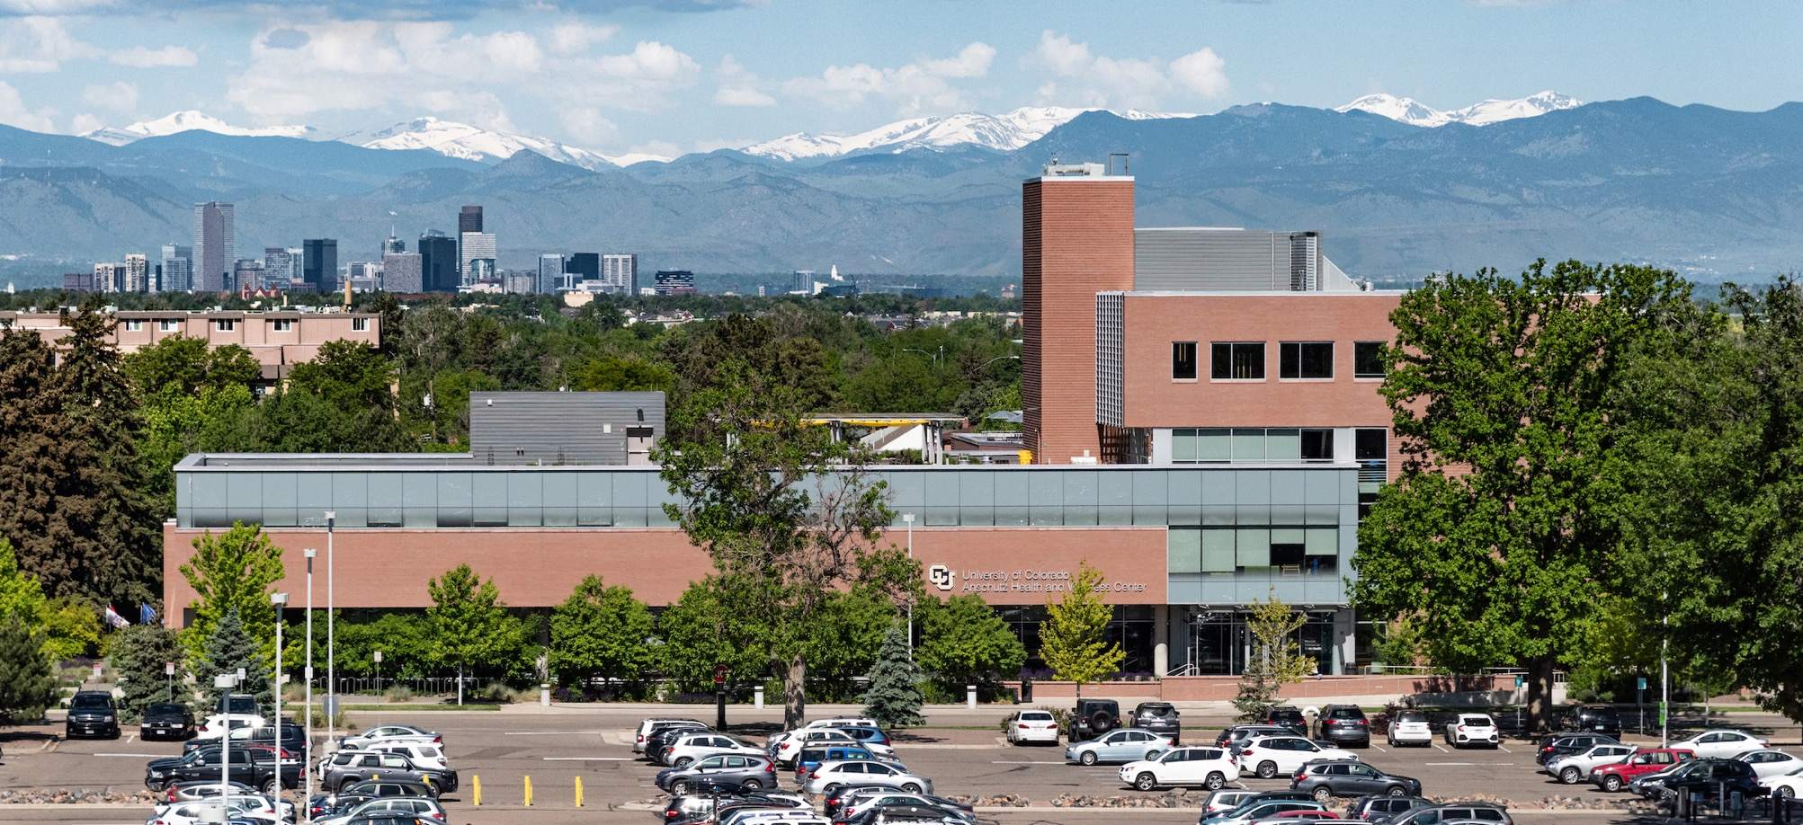
Stress Eating and Resources for PATHWEIGH
May 5th, 2023
Liz Chamberlain, PhD, Licensed Psychologist | CU Weight Management and Wellness Clinic
Assistant Professor, Faculty Wellness Officer | Department of Psychiatry

Slide 2
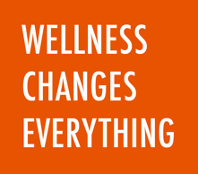
Stress Eating and Resources for PATHWEIGH
Liz Chamberlain PhD | Licensed Psychologist, Assistant Professor
Today we are going to talk about:
Stress Eating Strategies for Patients
AHWC Resources
Outside Resources

Slide 3
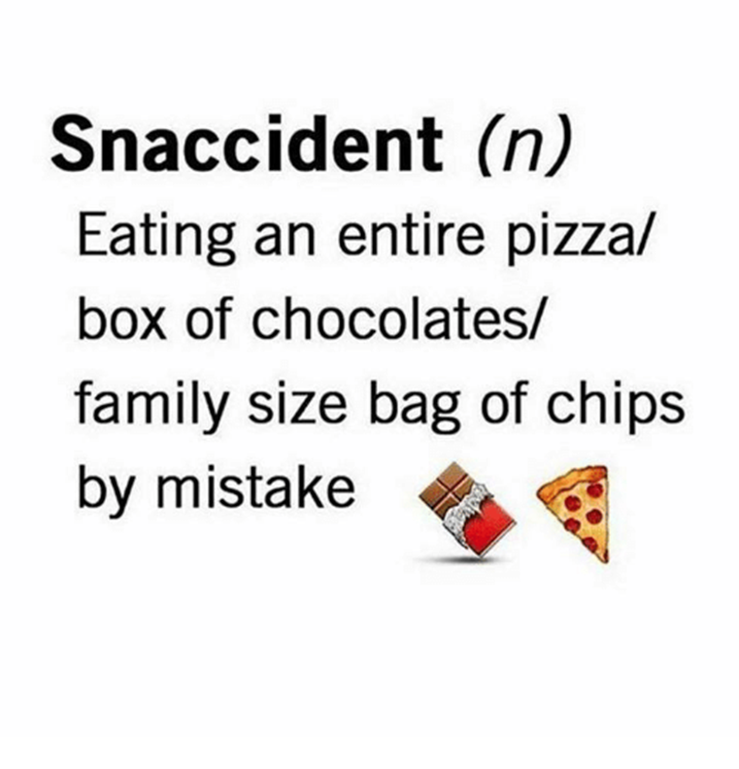
Stress Eating and Resources for PATHWEIGH
Stress Eating Strategies: Why Do I Eat When I’m Stressed?
Normalizes behavior, evokes common humanity – everyone has snaccidents sometimes and everyone reacts to having them
How to use mindfulness strategies to recognize thoughts, feelings, sensations that can trigger food cravings
learning to accept, sit with them rather than get rid of them (temporarily) with food
how we relate to feelings often causes more suffering than the feeling itself
Learning skills (curiosity, being a scientist) to notice and respond rather than react to them
Substitutions to obtain the discovered reward (soothing, connection, engagement, relaxation)

Slide 4
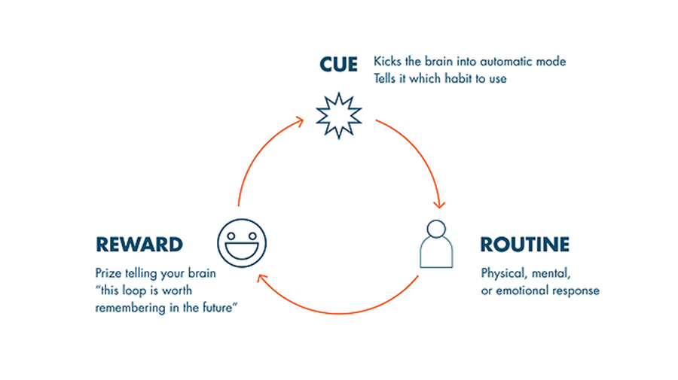
Stress Eating and Resources for PATHWEIGH
Stress Eating Strategies: Identifying Habits and Rewards
Why Is Eating Not Always About Hunger?
Our brains are wired to make associations that help us feel better (in the short term). Brains can be jerks.
Food is highly rewarding and readily available to us, and our brains set up habit loops that drive us to automatic behaviors when a cue presents itself that is linked to a rewarding routine.
If we can get curious about the cues, and the actual reward, we can change the routine.
Judson Brewer MD PhD’s TED Talk
Charles Duhigg’s “How to Break Habits”

Slide 5
Stress Eating and Resources for PATHWEIGH
Stress Eating Strategies: HALT Practice
When you notice a craving say, “HALT!” and then ask yourself, am I…
H – Hungry? When was my last meal/snack?
A - Angry, Agitated, Annoyed, Anxious? Do I need to expend some physical energy, or soothe in some other way? Make a list of activities for yourself to have when this strikes.
L – Lonely (or bored)? Can I reach out to someone to connect, or have a project/hobby?
T – Tired? Do I just need to rest/sleep?

Slide 6
Stress Eating and Resources for PATHWEIGH
How to Encourage Patients to See a Psychologist/BHP
If it is difficult for patients to identify Habit Loops or alternatives to HALT on their own, a psychologist or another behavioral health provider can help.
Stress and difficulty sleeping can contribute to weight gain – a psychologist can help unpack what is contributing to stress and sleep problems, which can help with changing habits.
Psychologists can help patients better understand roadblocks and obstacles to weight management and find new solutions – we help people see what's in their blind spots!
Tips for how a psychologist can help:
https://www.apa.org/topics/obesity/weight-control

Slide 7
Stress Eating and Resources for PATHWEIGH
AHWC Programs and Resources
Programs (Self-Pay)
Weight Loss 4 Life
3 or 6 month subscription
$199 or $299
My New Weigh
20 week medically supervised meal replacement program
Virtual meetings
$999
Stress Eating Workshop
4 week virtual program
$149

Slide 8
Stress Eating and Resources for PATHWEIGH
AHWC Programs and Resources
Individual Appointments (Covered by Insurance)
Providers in Clinic (4 MDs, 2 NPs) will see patients first, often refer to me for behavioral/emotional issues and support with managing stress, exploring habits, changing behaviors
EPIC referrals:
AMB Ref to Weight Management – CU AMC Health and Wellness (Physicians, NP's)
AMB Ref to Psychology – AHWC – Wellness Center (just me – Liz Chamberlain, PhD)
Currently booked into August

Slide 9
Stress Eating and Resources for PATHWEIGH
External Resources
Habits and Cravings
Jud Brewer, MD PhD
www.drjud.com
Holiday Eating/HALT
Liz Chamberlain, PhD
CU Medicine article and video about overeating
Mindful Self Compassion
Kristin Neff, PhD
www.self-compassion.org

Slide 10
Stress Eating and Resources for PATHWEIGH
Liz Chamberlain PhD | Licensed Psychologist, Assistant Professor
Patient Handouts
Stress Eating Workshop Habit Loop Handout 2023.docx
Practical Mindfulness for Stress Resources 2023.docx

Slide 11
Stress Eating and Resources for PATHWEIGH
Liz Chamberlain PhD | Licensed Psychologist, Assistant Professor
Thank You!
Questions?

Slide 12



