Slide 1
Learning Community January 2023
Led by:
Dr. Lauren Tolle, Ph.D
Dr. Seth Kramer, D.O.

Slide 2
Topic: EPIC Updates and how to support your patient’s goals for the New Year
Agenda
Introduction/Welcome
General Updates
EPIC Updates
New Years Resolutions Support
Q/A

Slide 3
Topic: General Updates
General Updates
Cohort Three of PATHWEIGH goes live on March 17th, 2023
A total of 57 UC Health, CU Medicine and HOPD clinics will have the ability to schedule a weight prioritized visit
If you have a clinic that is also in Cohort Three, please reach out to Johnny (Johnny.Williams@CUAnschutz.edu) to get your clinics introduction to PATHWEIGH Meeting Scheduled
If you would like to help support the implementation of weight management in a primary care setting, please reach out to Johnny for more information
If your clinic is in Cohort One (2021 implementation) we are asking to conduct interviews to explore if weight-prioritized visits take more time than non weight-prioritized visits
If your clinic is in Cohort Two (2022 implementation) we are asking for permission to visit your clinic to understand how patients body language changes while in a weight prioritized visit

Slide 4
Topic: EPIC Updates
EPIC Updates
Seth to show EPIC screenshots

Slide 5
Topic: EPIC Updates
EPIC Updates
Seth to show EPIC screenshots

Slide 6
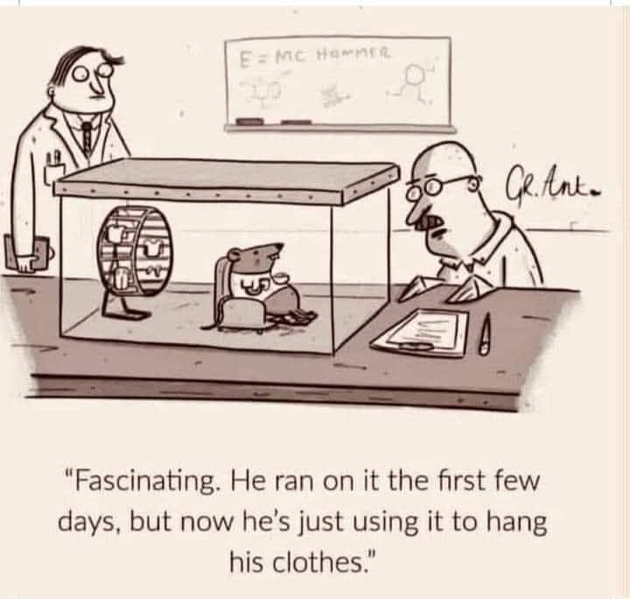
Topic: How to support your patient’s goals for the New Year – or why NY resolutions don't work – and what to encourage instead
New Years Resolutions Support
Lauren

Slide 7
Topic: How to support your patient’s goals for the New Year
Why don't New Year's Resolutions stick?
Too vague
too much too soon
no real "why"

Slide 8
What to do instead – slow and steady wins the race
Eliminate friction
Stacking habits
Temptation bundling
Rinse and repeat

Slide 9
Thank you!
Contact us at
Lauren.Tolle@CUAnschutz.edu (BHP Support )
Erik.Kramer@CUAnschutz.edu ( EPIC Support )
Johnny.Williams@CUAnschutz.edu (Research Support)
PATHWEIGH@CUAnschutz.edu (General Support)

