Slide 1
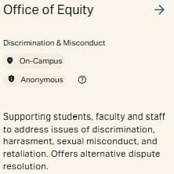
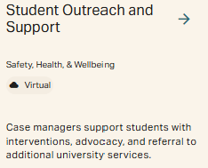
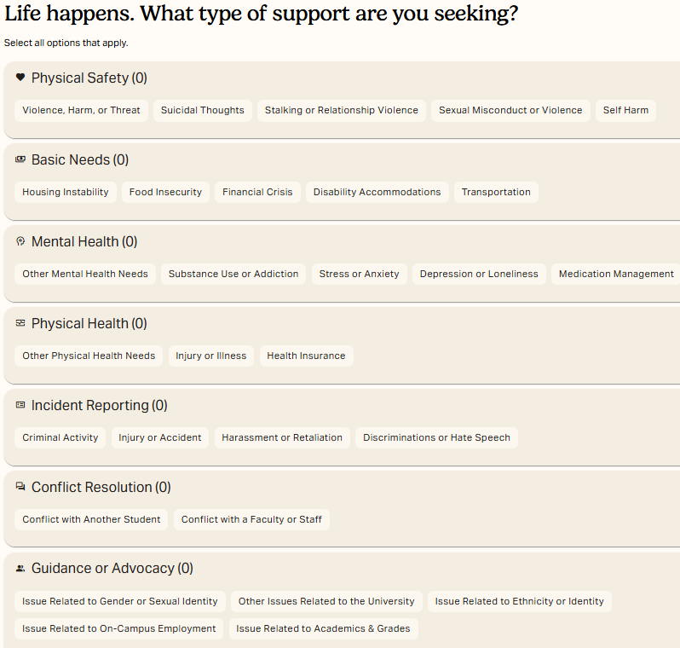
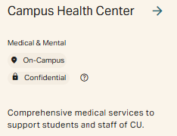
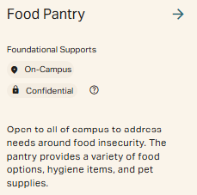
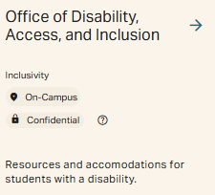
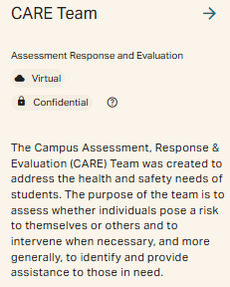
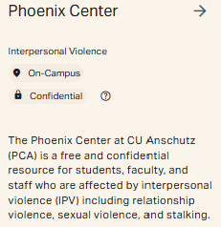
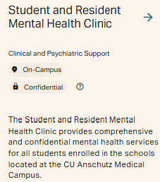
Campus Resources : Help Compass
Help.cuanschutz.edu
Notes:
START here when you have a condition or situation that you’d appreciate support with!
Interactive catch-all website that will suggest various offices/entities on campus that can be utilized for various forms of support. Examples shown on the right here

Slide 2
Campus Resources : Navigating Conflict
1. Ombuds Office
Confidential (only req’d to share information in the case of imminent harm to self or to others)
Independent, Impartial, Informal (no department affiliation)
2. Office of Adaptable Resolution
→ Facilitate dialogue between disagreeing parties, mediate conflict
Preventative services: community building, relationship coaching
3. Student Outreach and Support
Case management framework for proactive and reactive support
Private (not confidential) reporting
Manage Medical Leave of Absence, Fit to Return, and Pregnancy Leave for students
Notes:
We also have specific offices on campus whose role it is to help with navigating conflict
The Ombuds Office acts as a no-barrier, first-stop for students, faculty and staff seeking guidance, information and insight from a trusted advisor
Adaptable Resolution offers private, free, neutral resources to support faculty, staff and students managing conflicts. AR processes empower those directly involved to shape outcomes with professional facilitation, centering the needs of those impacted and addressing justice concerns and power imbalances. These approaches promote trust and relationship-building while considering the broader effects of conflict on the university community. Available to faculty, staff, and students, AR services support navigating complex disputes that may not fall under formal university policies or reach a particular threshold required to take action. Participation is voluntary, and individuals can discontinue the process at any time. AR focuses on constructive outcomes, separate from formal investigations, aiming to rebuild relationships and address the community impacts or harm.

Slide 3
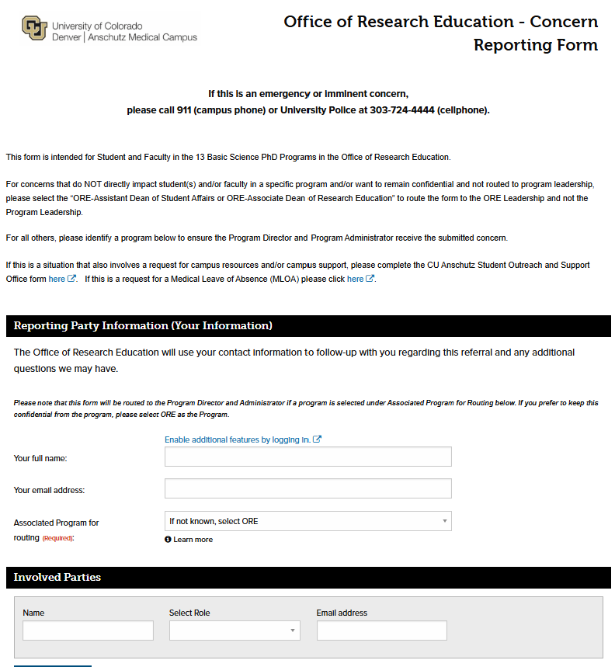
Campus Resources : Reporting
ORE Concern Reporting Form via Maxient
Option to anonymously submit
Option to provide PhD program info for routing to Program Director & Program Admin OR route only to the ORE (Angie and Andy)
Define the nature of your concern: professionalism, academic progression, other/personal, faculty interactions
Explain the issue, provide what has been done to address the issue, provide any suggested follow up (does not need to lead to actions)
Attach photos, video, email or other documents
Student Outreach & Support Referral
For reporting concerns about a fellow student
Option to anonymously submit
Graduate School Ethics Point Reporting
For reporting EHS, Business Integrity, Academic or Research Integrity Concerns
Option to anonymously submit
Notes:
Concern Reporting Form (via Maxient)
What is it?
Maxient is a software program utilized by U.S. higher education institutions to track and record trainee behaviors (i.e. student discipline, academic integrity, care and concern records, Title IX matters, or just an “FYI”).
Why is it useful?
Maxient has centralized reporting and record keeping that will help us connect the dots and prevent students from falling through the cracks by helping us identify students in distress and coordinate the efforts of various departments to provide follow-up.
How will ORE Use Maxient?
We have created an ORE Maxient Form for students, faculty, and staff to share any concern or report any type of issue or concern about oneself or others. Once submitted, the form will be routed to the corresponding Program Director and Program Administrator for follow up. If an individual prefers NOT to notify the program, they may select "ORE" from the Program list and the form will instead be routed to the ORE Assistant Dean for Student Affairs.
Note:: 1 - Maxient reports, per se, are confidential, so they would not be directly taken into account into promotion considerations. However, depending on the follow-up, a faculty's Dept Chair might be contacted. And the promotion process starts within the faculty's dept.

Slide 4
What would be considered reportable?
Workplace Bullying: Repeated and deliberate physical, verbal or written conduct intended to intimidate, degrade, and/or humiliate an individual or group in the workplace. May include:
Negative, abusive interaction that is outside the range of commonly accepted expression of disagreement, disapproval, or critique;
Repetitively shouting, yelling at, or berating;
Persistent or egregious use of abusive, insulting, or offensive language;
Spreading malicious rumors or gossip;
Deliberate exclusion from normal work-related functions
Criticism, complaints, and negative feedback are not considered bullying when they are reasonable and directly address issues of workplace performance and/or conduct.
Anti-Violence Policy
Workplace Bullying Policy
Nondiscrimination Policy
Retaliation Policy
Faculty Professionalism Code of Conduct
Notes:
CU Anschutz has various policies in place surrounding acceptable conduct. We have provided links of some here.
Also on the right is paraphrased information regarding the workplace bullying policy.
Note: in the case of retaliation policy, meaning retaliation for reporting, there is a procedure in place, you complete a form to report

