Slide 1
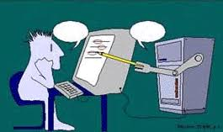
Can faculty development be done with intelligent tutors?
Janet Corral, PhD

Slide 2
Today’s session is a Works In Progress + Active Learning
You have prior knowledge (Adult learning theory)
You can critically appraise, discuss & build on your knowledge (Constructivist learning theory)
People learn best with pauses, discussion, engagement (Active Learning)

Slide 3
Case Study: CU SOM
Attendance at traditional in-person faculty development sessions is declining
Faculty development is still needed
Faculty want to be great educators
Concerns persist (e.g. professionalism)
Lots of educational advances to learn (e.g. active learning)
We live & work in a digital world

Slide 4
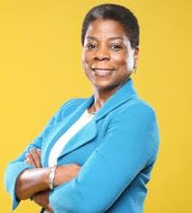
Case Study – Your Turn!
You are a leader on campus.
What would you advocate for with respect for faculty development?

Slide 5
Successive Attempts
Attempt #1: Online Modules
Notes:
36 online modules
These are top 8 most used, mostly b/c learners in the Teaching Certificate Program are required to use the top 3
After this, usage drops to <20 uses a year

Slide 6
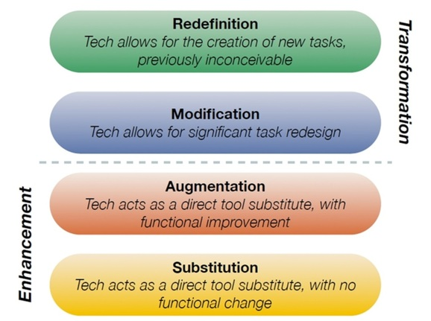
SAMR model
Puentedura (2013)
Notes:
The online modules are direct SUBSTITUTION
Online modules also suffer from being a pull type of technology – i.e. users must choose to come to the modules

Slide 7
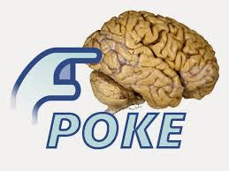
Just-in-Time Approaches
Right before doing an activity =
cognitive prompt
(e.g Nishisaki, 2010)
During an activity = cognitive support
(Collins et al, 1997;
Foale et al, 2005)
Notes:
Effect of Just-in-time Simulation Training on Tracheal Intubation Procedure Safety in the Pediatric Intensive Care Unit
Akira Nishisaki, M.D.; Aaron J. Donoghue, M.D., M.S.C.E.; Shawn Colborn, R.R.T.; Christine Watson, R.N.; Andrew Meyer, M.D.; et al
2010
Foale CM, Kaleri AY, Sargsyan AE, Hamilton DR, Melton S, Martin D, Dulchavsky SA. Diagnostic instrumentation aboard ISS: just-in-time training for non-physician crewmembers. Aviat Space Environ Med 2005; 76:594–598.
Collins J.A., Greer J.E., Kumar V.S., McCalla G.I., Meagher P., Tkatch R. (1997) Inspectable User Models for Just-In-Time Workplace Training. In: Jameson A., Paris C., Tasso C. (eds) User Modeling. International Centre for Mechanical Sciences (Courses and Lectures), vol 383. Springer, Vienna

Slide 8
SAMR model
Puentedura (2013)
Notes:
Because we’re looking at a cognitive prompt, we are looking at AUGMENTATION

Slide 9
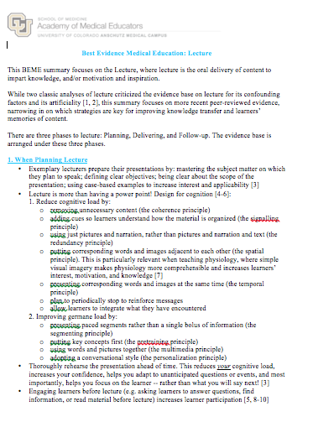
Successive Attempts
Attempt #2: Best Evidence Medical Education (1 pg)
6 faculty users
2 committee meetings
No further uptake

Slide 10
Successive Attempts
Attempt #3: Short Webinars (30 mins)
5 offerings
Time: 12:15-12:45
Active engagement format with dialogue
Avg Rating: 4.9/5.0
Notes:
Rate limiting factor: not everyone can teach this format – requires significant faculty development

Slide 11
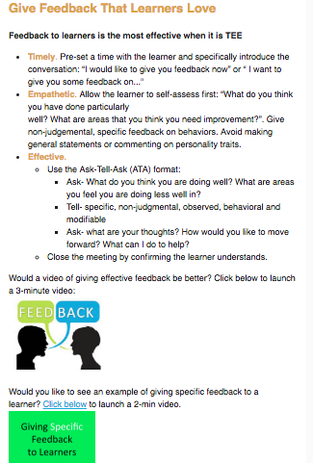
Successive Attempts
Attempt #4: Email - Short Evidence-Based Tips
Evidence-based tips
Video: demo of steps
Video: demo w/ learner

Slide 12
Just-in-Time Coaching
Day 1
Day 2
Day 3
Day 4
Email Tip 1
Email Tip 2
Email Tip 3
Email Tip 4
Notes:
Everyone gets the same tips, regardless of teaching ability, student ratings

Slide 13
Successive Attempts
Attempt #4: Email Short Evidence-Based Tips
UME Area | Duration | # of Sendouts | # of Sub-Topics | Average Opening Rate | Range
Family Med & Int Med Clerkship | 12 months | 12 | 5 | 31.5% | 10-59%
Pathology Small Groups | 4 months | 6 | 6 | 30.8% | 15.4-53.8%
Colorado Springs Branch | 12 months | 1 | 1 | 35.8% | n/a
Int Med Clerkship | 6 months | 6 | 5 | 42.2% | 20-80%

Slide 14
Successive Attempts
Attempt #4: Email Short Evidence-Based Tips
UME Area | Duration | # of Sendout Cycles | # of Sub-Topics | Average Opening Rate | Range
Family Med & Int Med Clerkship | 12 months | 12 | 5 | 31.5% | 10-59%
Pathology Small Groups | 4 months | 6 | 6 | 30.8% | 15.4-53.8%
Colorado Springs Branch | 12 months | 1 | 1 | 35.8% | n/a
Int Med Clerkship | 12 months | 18 | 5 | 42.2% | 20-80%
Notes:
The idea of this project has spread also to Pediatrics, OB/GYN, and Peds Residency

Slide 15
Case Study – Your Turn!
What data from Attempts #1-4 would you use to guide your decision on how to proceed with faculty development?
Notes:
Taken from: https://media-exp2.licdn.com/media-proxy/ext?w=800&h=800&hash=sC2iQ6zDwjGv0wk7pYdOpdEKORc%3D&ora=1%2CaFBCTXdkRmpGL2lvQUFBPQ%2CxAVta5g-0R6nlh8Tw1It6a2FowGz60oISIfYC2G8G2f1spyfNT-tdoDSfrKhsgUbeykBhlI_IfnwEXO5H8LUdtusJ4E51N-hUdK_SFYJRxZlg0d769ceEFx3kdKpF-qtMWsc8e1-TwyJC73iVV8vLQll8fq4GKH6GWxUi3WUbO71GJVgTOdX8dhS5Wt6sNXKDNgv77h7z0ttnGuS04vXZWwuuZe8I0GwEgM3MlfuIdAUlIWs8RnFllqKjX_iiKu-JvmFB_YdnXWXwMvsOwSzkltskFMF9C841ZtcE337n8QU03I

Slide 16
Intelligent Tutors
Computer-assisted learning
Expert systems
Artificial intelligence
Yazdani, 1987; Nwana, 1990; Shute, 1990; Corbet & Koedinger, 1997
Notes:
Corbett, A. T., Koedinger, K. R., & Anderson, J. R. (1997). Intelligent tutoring systems. Handbook of human-computer interaction, 5, 849-874.
Yazdani, M. (1986). Intelligent tutoring systems: An overview. Expert systems, 3(3), 154-163.
Nwana, H. S. (1990). Intelligent tutoring systems: an overview. Artificial Intelligence Review, 4(4), 251-277.
Shute, V. (1990). Rose garden promises of intelligent tutoring systems: blossom or thorn? Paper presented at the Space Operations, Applications and Research (SOAR) Symposium.

Slide 17
Intelligent Tutors (ITS) – A brief history
Ideal ITS:
What student knows + pedagogical strategy = expert tutor
Machine learning: what worked, and when it worked, and improve over time

Slide 18
Intelligent Tutors (ITS) – A brief history
Examples:
Research ITS
Support student’s thinking process (VanLehn et al., 2005; Anderson et al., 1995)
Talk with students in NLP (Nye, Graesser, & Hu, 2014)
Recognize and respond to differences in student emotion (D’Mello et al., 2010; Arroyo et al., 2014)
Simulated students that enable human students to learn by teaching (Leelawong & Biswas, 2008; Matsuda et al., 2010)
ITS At-Scale
SQL- Tutor (Mitrovic & Ohlsson, 1999)
ALEKS (Craig et al., 2013)
Cognitive Tutor (Pane et al., 2014)
ASSISTments (Koedinger, McLaughlin, & Heffernan, 2010)
Notes:
Research ITS usually have many of the ideasl – but are not used at scale
Those at scale are achieving outcomes (like improved learner performance), but without more thoughtful pedagogies, tips, subtelties of education

Slide 19
“Stupid tutoring systems, intelligent humans”
Ryan S Baker, 2016

Slide 20
Intelligent tutor personalizes development
Day 1
Day 2
Day 3
Day 4
Email Tip 1
Email Tip 1_{x}
Email Tip 1_{x2}
Email Tip 1_{x3}
Text feedback
Text feedback
Text feedback
Text feedback
Learner feedback
Learner feedback
Learner feedback
Learner feedback

Slide 21
Is it that ‘simple’?
Faculty have different incoming skills
Faculty have different coaching needs
Clinical schedules differ
Learners are on different schedules than faculty
Ideally, faculty improve towards mastery

Slide 22
Multiple variables
Day 1
Day 2
Day 3
Day 4
Email Tip 1
Email Tip 1_{x}
Email Tip 1_{2x}
Email Tip 1_{3x}
Day 1
Day 2
Day 3
Email Tip 1
Email Tip 2_{x}
Email Tip 2_{2x}
Day 3
Day 4
Day 5
Email Tip 1_{2x}
Email Tip 1_{3x}
Email Tip 1_{4x}
Notes:
Everyone gets the same tips, regardless of teaching ability, student ratings

Slide 23
Is it that ‘simple’?
Incoming Data & Content
Student ratings of faculty
Faculty schedule
Learner schedule
Content messages by topic
Content messages by expertise
Data Collected
Message opening (yes/no)
Message opening (time)
Faculty ratings of content (text) Faculty self-assessment of performance (text)
Student ratings of faculty (text)

Slide 24
Is it working? (Pilot data)
Day 1
Day 2
Day 3
Day 4
Email Tip 1
Email Tip 2
Email Tip 3
Email Tip 4
80% avg opening rate
76% avg opening rate
48% avg opening rate
21% avg opening rate
Notes:
This is hwere you show pilot results. Ask for help/

Slide 25
Is it working? (Pilot Data)
Day 1
Day 2
Day 3
Day 4
Email Tip 1
Email Tip 1_{x}
Email Tip 1_{2x}
Email Tip 1_{3x}
✔
✔
✔
✔
Day 1
Day 2
Day 3
Email Tip 1
Email Tip 2_{x}
Email Tip 2_{2x}
x
x
x
Day 3
Day 4
Day 5
Email Tip 1_{2x}
Email Tip 1_{3x}
Email Tip 1_{4x}
✔
✔
x
Notes:
Everyone gets the same tips, regardless of teaching ability, student ratings

Slide 26
Systems Considerations
Email goes to Junk
Schedule is complicated & often unclear
Not all cell numbers provided
Leadership support & encourage faculty

Slide 27
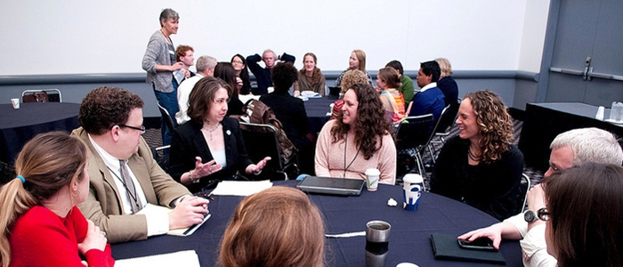
Case Study – Your Turn!
How would you facilitate faculty development at CU SOM with an intelligent tutor?

Slide 28
Take Home Messages
Busy faculty are increasingly not attending traditional faculty development sessions
Iterative digital coaching pilot was successful
Intelligent tutors + machine learning might coach…and learn…to keep coaching towards expertise

Slide 29
Thank You!
Janet Corral
Janet.corral@ucdenver.edu

