Slide 1
Practice Transformation Support to Implement New Evidence-based Interventions and Advanced Primary Care Models
Perry Dickinson, MD
Practice Innovation Program
Department of Family Medicine
University of Colorado School of Medicine

Slide 2
General Outline
Introduction to the Practice Innovation Program and the Colorado Health Extension System and the type of research we do
Results from EvidenceNOW Southwest as an example of our projects

Slide 3
Primary Care / Health Extension
Affordable Care Act authorized formation of a Primary Care Extension Program
Based on the Cooperative Extension Program of the Department of Agriculture
Goals:
Speed the transformation of primary care, adoption of new models of advanced primary care
Integrate primary care with public health
Improve translation of research into practice
No appropriation provided, although AHRQ has supported testing the model through IMPaCT project and the subsequent EvidenceNOW program

Slide 4
Practice Innovation Program
Formed in 2005 around a group of inter-related projects within the University of Colorado, Department of Family Medicine
Mission- To support the transformation of the health care system and the advancement of comprehensive primary care to accomplish the Quadruple Aim
Unvoiced mission – To help primary care practices to survive, adapt to change, and hopefully flourish

Slide 5
Multiple, Inter-related Activities
Research to answer key questions regarding primary care transformation and implementation of primary care innovations:
How to support practices in improving care or implementing new models of care
Diabetes – ongoing theme, plus new Primary Care Diabetes Lab
Behavioral health integration
Substance use disorders
Prevention – cancer, cardiovascular disease
Patient self-management support

Slide 6
Activities
Implementation of evidence-based interventions and new models of care through practice facilitation, clinical HIT support, learning communities, and other services;
Training the workforce necessary for the provision of team-based comprehensive care;
Evaluating practice transformation projects to identify and disseminate best practices and key questions;
Using data to inform health policy

Slide 7
Colorado Health Extension System (CHES)
Public – private cooperative effort beginning around 2009
Convened and staffed by the Practice Innovation Program at CU
Includes over 20 practice transformation support organizations, Colorado AHEC, Colorado Department of Health Care Policy and Financing, Colorado Department of Public Health and Environment, Governor’s Office, health systems, public health associations, other groups

Slide 8
Practice Facilitator Role
External (generally) person who meets regularly with a practice improvement team – traditionally in person, increasingly virtual
Implement an ongoing change and quality improvement process
Implement new evidence-based interventions and models of care
Keep the team on task
Identify and solve problems
Great source for data regarding implementation process
For large projects, fielded through partner organizations across Colorado

Slide 9
Clinical HIT Advisors (CHITAs)
Support practice data capacity, including clinical quality measure reporting
Identify potential improvements in practice data systems
Assist with developing and managing workflow for data collection, reporting, and analysis
Link practices with technical assistance
Deployment of CHITAs varies depending on project and practice needs
Centralized support for practice facilitators and practices, or
Practice-level support

Slide 10
Regional Health Connector
Housed locally with an organization that serves convening role in each of the 21 Colorado health statistic regions
Builds ongoing supportive relationships with practices, public health, community agencies and others working on health and health care
Connects practices, public health agencies, other health care providers, and community resources
Collaborates with community partners to:
Identify and assist with community health priorities
Address social determinants of health, health equity

Slide 11
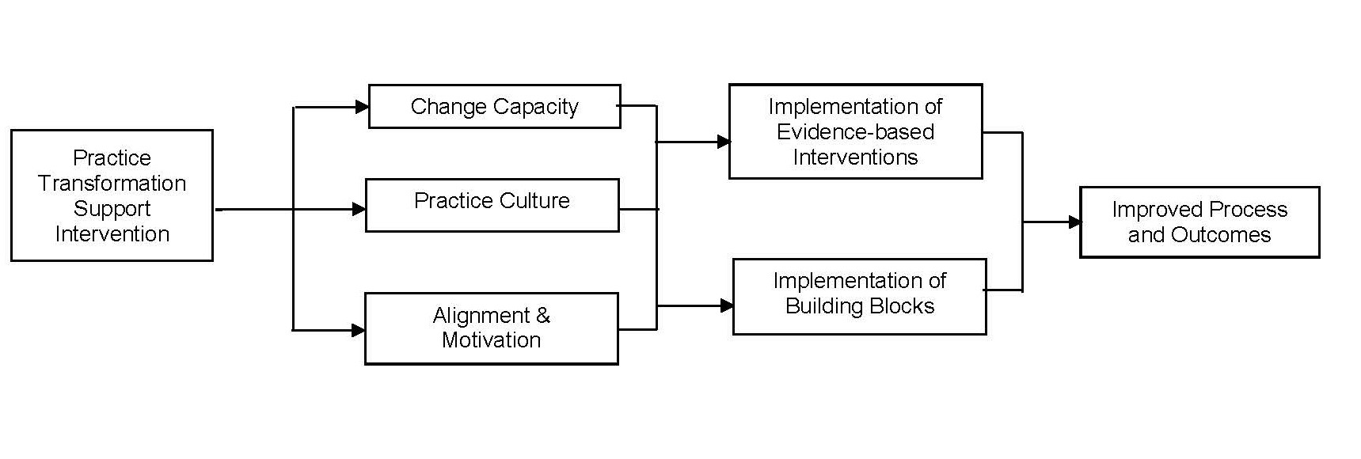
Practice Transformation Conceptual Framework

Slide 12
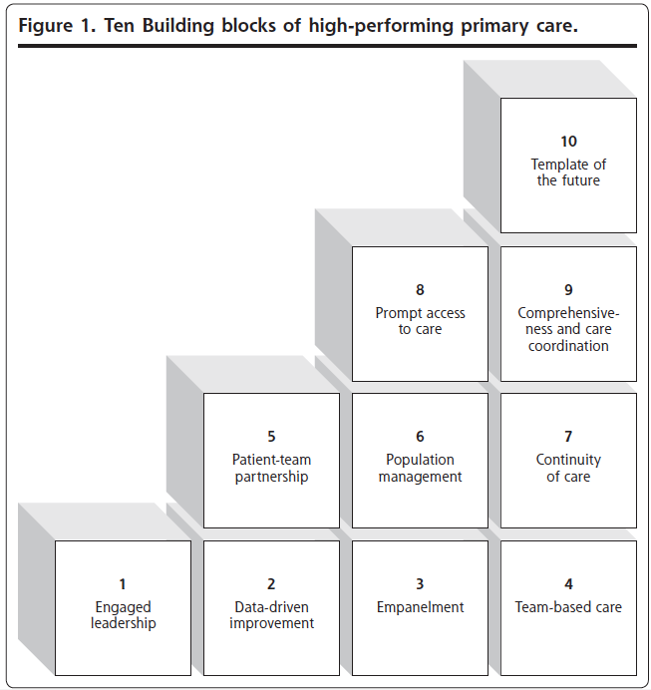

Slide 13
Methods
Most of what we do would be considered to be pragmatic trials
Lessons learned from large implementation projects have produced questions and initial data for more formal trials
Use a combination of methods pulled from implementation science, evaluation, quality improvement
Most involve a mix of qualitative and quantitative approaches
Cluster randomization using practice or patient characteristics as balancing criteria (covariate constrained randomization)
Commonly look at the impact of potential mediators and moderators, including contextual effects, practice characteristics

Slide 14
Practice Innovation Program Funding
Our relationships with most practices is largely built around the long term support that is at the core of what we provide
We have largely strung together funding from one project focused on a specific condition to another because that is what is available
We select projects carefully based on needs and interests of practices
Overall funding – over $100 million since program started
Very wide variety of funders – AHRQ, NIDDK, NIMH, CMMI, CDC, SAMHSA, multiple foundations……..

Slide 15
Results Across Multiple Projects
Consistent improvement in clinical quality measures – although patient outcome measures are slower to change than process measures
Improved practice capacity for change
Improved practice culture – although slower to change
Qualitatively – practices are more adaptable to change
Continuing to learn how to better support practices in this work

Slide 16
Challenges
Projects of this type take a lot of “boots on the ground”
It takes time to build the necessary relationships and infrastructure
Need for large numbers of practices for studies
Major data issues
It takes time for practices to change (and for measures to reflect the changes)
The infrastructure is difficult to maintain – benefits accrue broadly, so hard to get anyone to pay for this work

Slide 17
Lessons Learned
This type of program is all about building trusting relationships with practices, practice systems, other organizations
No recreational data gathering – focus on core questions, center around data useful for both implementation and evaluation
Have to balance fidelity with practice-level flexibility. Learn from adaptations in implementation.
Value of practice facilitator field notes in understanding implementation
Value of practice facilitators in assisting with data gathering
Importance of data infrastructure

Slide 18
Collaboration Opportunities
Some of our implementation projects can provide great pilot data and publications for future proposals
Our team has outstanding experience and expertise in on-the-ground implementation in primary care practices
We have relationships with a lot of practices of various types across Colorado

