Slide 1
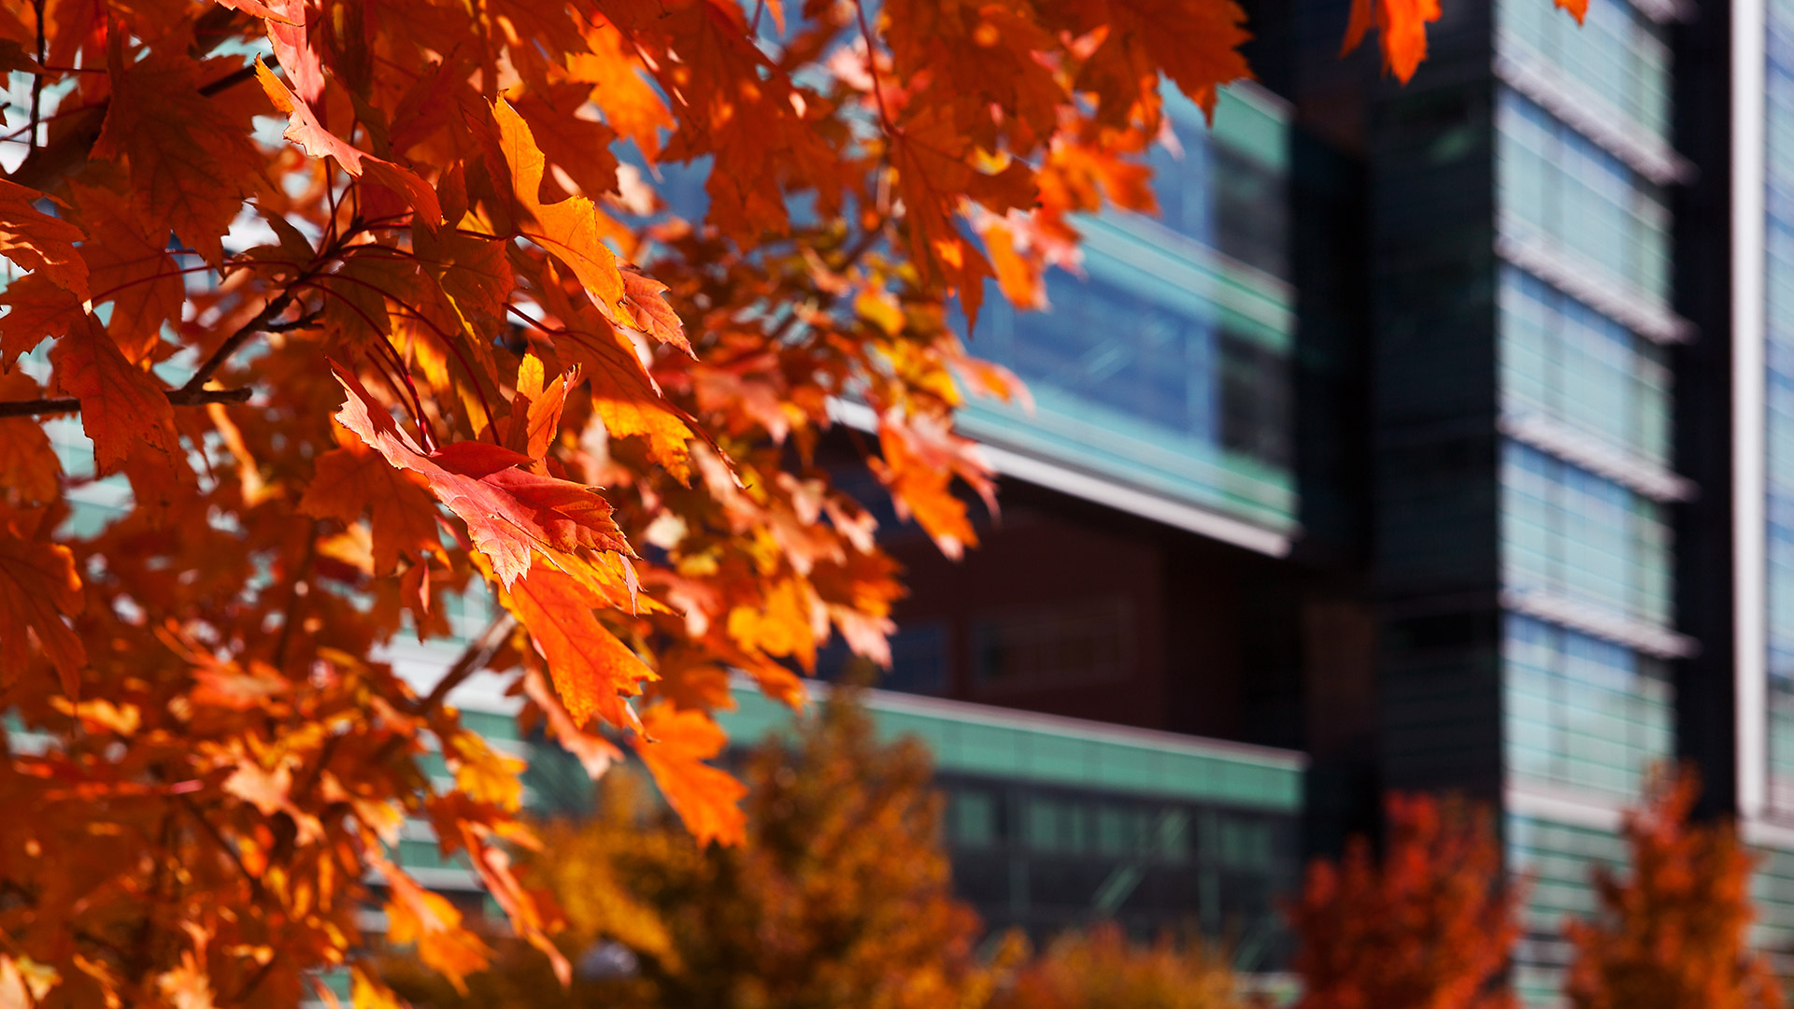

DISSEMINATION & IMPLEMENTATION SCIENCE
GRADUATE CERTIFICATE
https://medschool.cuanschutz.edu/accords/DICert
Notes:
[AMY]
The ACCORDS D&I certificate is a collaborative program with the Clinical Science Graduate Program of the CCTSI and University of Colorado | AMC. The Clinical Science serves as the academic home for the certificate program and courses completed can be applied to their masters and doctoral degrees.
LAYOUT NOTES:
Do not replace, change or add to the logo
Add school or unit information in text form to the right of the logo. DO NOT add additional school or unit logos
Changing the background: right-click on background image and select “Change picture” to replace
Background images should be 1920 x 1080 pixels in size to ensure a perfect fit
Adjust transparency of dark box accordingly, to ensure logo and text is legible over image background

Slide 2
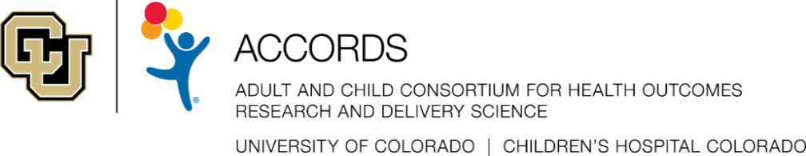

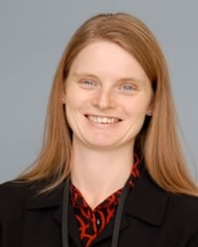
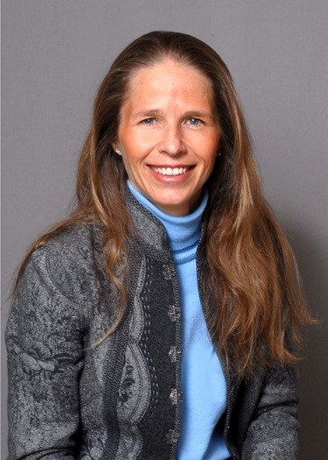
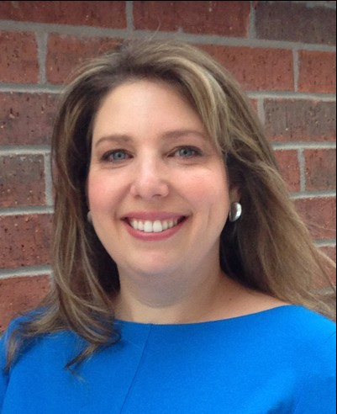
D&I Certificate Directors & Sponsors
Clinical Sciences Graduate Program
Amy Huebschmann, MD, MS, FACP
Director, D&I Certificate
Borsika Rabin, PhD, MPH, PharmD
Co-Director, D&I Certificate
Lisa Cicutto, PhD, ACNP( cert), RN
Director, Clinical Sciences Graduate School Program
Galit Mankin, MSW
Administrative Lead, CLSC
https://medschool.cuanschutz.edu/accords/DICert
Notes:
Amy
The ACCORDS D&I certificate is a collaborative program with the Clinical Sciences Graduate Program of the CCTSI and University of Colorado | AMC. The Clinical Science Graduate Program serves as the academic home for the certificate program and courses completed could also be applied to their Masters and Doctoral degrees.

Slide 3
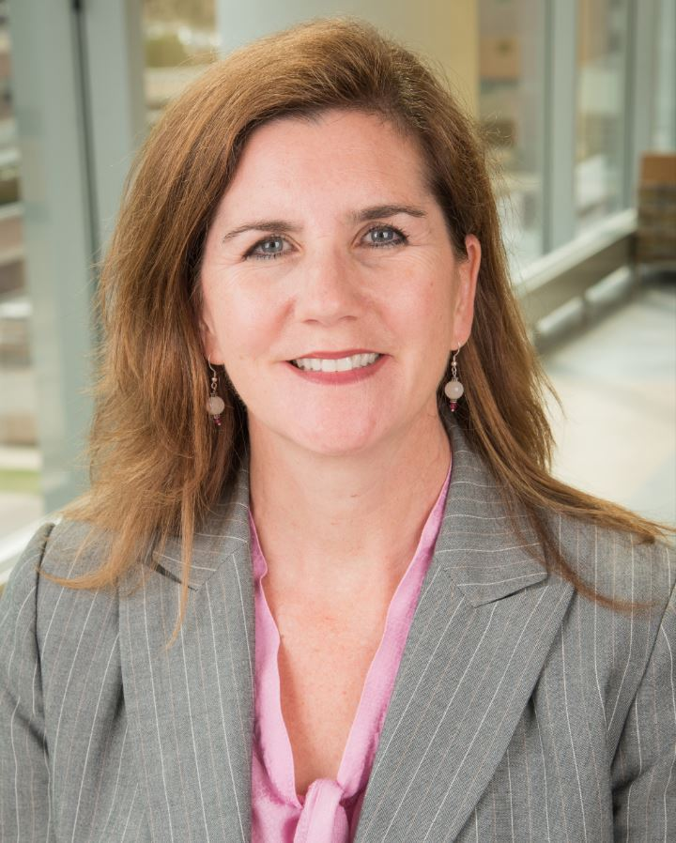
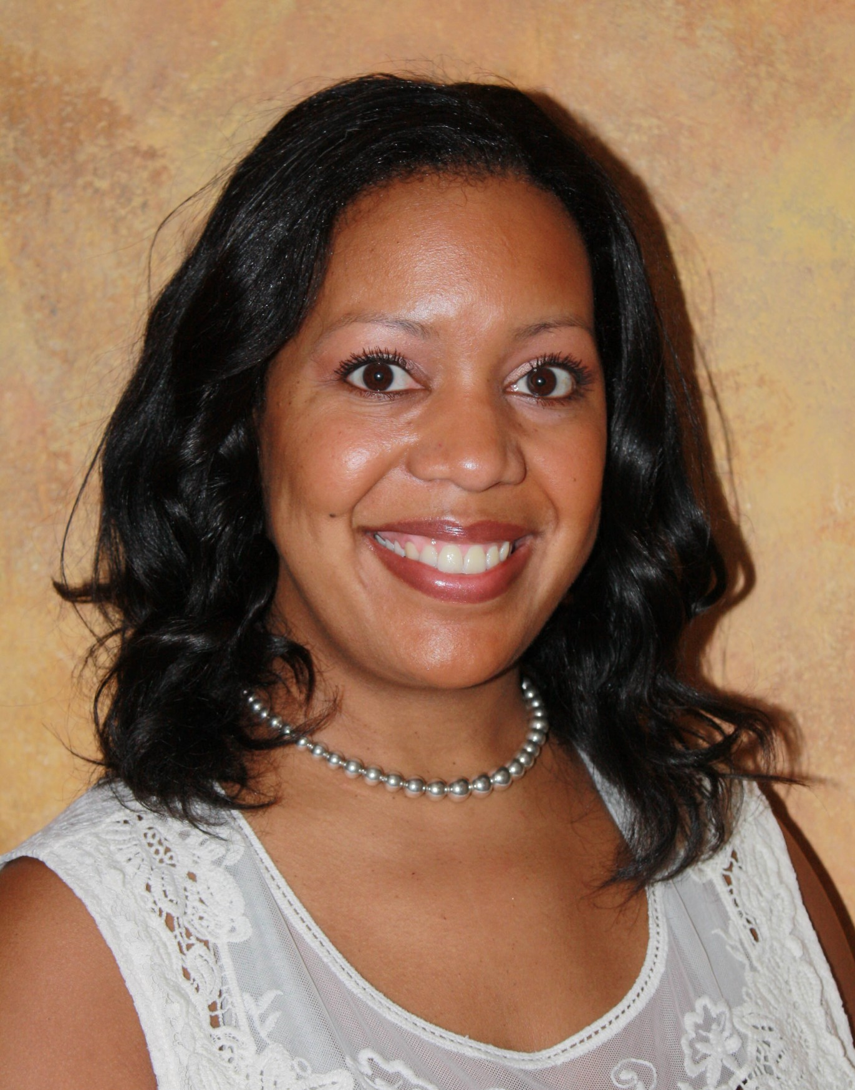
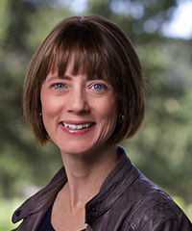
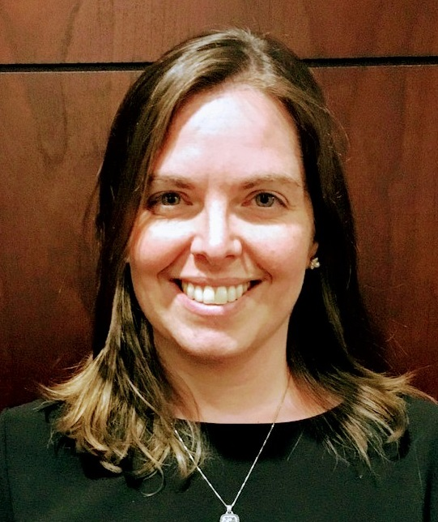
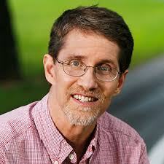
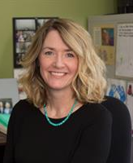

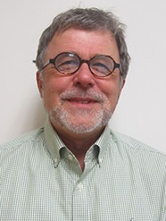




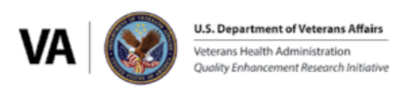
D&I Certificate faculty
Jodi Holtrop, PhD, MCHES
Brooke Dorsey Holliman, PhD
Elaine Morrato, DrPH
Bethany Kwan, PhD
Ross Brownson, PhD
Christina Studts, PhD, MSPH, LCSW
Russ Glasgow, PhD
Amy Huebschmann, MD, MSc
Borsika Rabin, PhD, MPH, PharmD
Notes:
[AMY]
All of us bring tremendous experience nationally and internationally – card-carrying implementation scientists - some highlights include our Implementation Science Centers for Cancer prevention and Control (ISC3), our affiliation with VA QUERI program – part of the national CTSA D&I CLIQ network. More details about the faculty can be found on our website.
Faculty include: Russ Glasgow developer of RE-AIM, Director of ACCORDS D&I program, PI of one of only 6 center grants awarded by NIH nationally for Implementation Science Centers for Cancer prevention and Control (ISC3), and PI for our NHLBI D&I K12 training grant along with Ed Havranek. Mix of research in clinical, community and international forums. Jodi Holtrop - D&I senior advisor role with AHRQ and co-director of ACCORDS D&I
Elaine Morrato – former interim Dean of CSPH and founding Dean of Loyala University School of Public Health, past Director of ICorps program with CCTSI
Bethany is lead of D&I for CCTSI and co-director of DICE for D2V
Ross Brownson is Director of the St. Louis Prevention Research Center, co-Director of Washington University’s ISC3, co-edited the gold standard D&I textbook – “D&I Research in Health”, past director of the Mentored Training for Dissemination and Implementation Research in Cancer (MT-DIRC), and many other D&I roles.
Amy - in addition to directing this Certificate program, senior faculty mentor for NHLBI-funded D&I K12 directed by Russ, co-lead of Network/Outreach center for NCI-funded ISC3
Borsika Rabin role is co-Director @ UCSD D&I center, VA Triple Aim QUERI Co-lead of D&I Science, and Implementation Scientist @ the Center of Excellence Stress and Mental Health
Add in Elaine Morrato, Amy Huebschmann (smaller), Ross Brownson, Tina Studts?

Slide 4
PRESENTATION OVERVIEW
What, Why, Who, Where, When, How?
What is dissemination & implementation (D&I) science?
Who should pursue the D&I science certificate?
Why pursue the D&I science graduate certificate?
Where are certificate courses held?
How do I apply?
When should I apply?
Notes:
Amy -> verbal transition to Borsika for next slide

Slide 5
WHAT IS DISSEMINATION & IMPLEMENTATION (D&I) SCIENCE?
WHAT
Definitions
➧Dissemination research: scientific study of targeted distribution of information and intervention materials to a specific public health or clinical practice audience. (How best to package, communicate about, and deliver evidence-based interventions?)
➧Implementation Research: scientific study of the use of strategies to adopt and integrate evidence-based health interventions into clinical and community settings to improve individual outcomes and benefit population health. (How best to support the uptake, integration, and sustained use of evidence-based interventions?)
PAR-19-274 – Dissemination and Implementation Research in Health
Notes:
[Borsika]

Slide 6
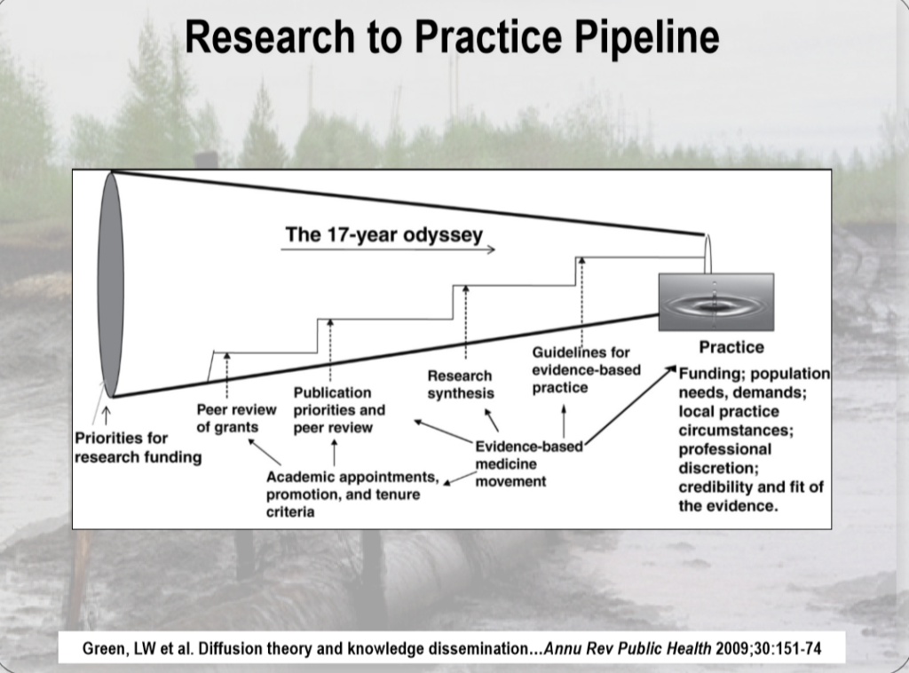
WHAT IS DISSEMINATION & IMPLEMENTATION (D&I) SCIENCE?
WHAT
With Traditional D&I Approach
14%, 17 years
But there is hope. . .
With Active D&I Approach
May be able to achieve up to 80%, 3 years
Balas & Boren, 2000; Green, 2008, Fixsen, Blasé, Timbers & Wolf, 2001, Saldana & Chamberlain, 2012
Notes:
Borsika
Research to address the “leaky pipeline” problem: 17-year odyssey for 14% of evidence to enter practice
Challenges include:
Sustainability of programs
Stakeholder demand/priority for programs
Whose responsibility to disseminate?

Slide 7
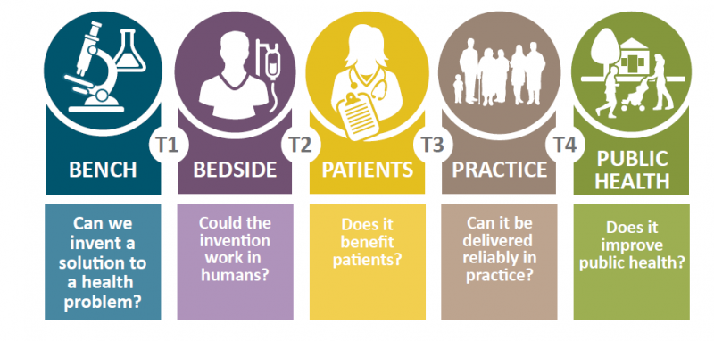
WHAT IS DISSEMINATION & IMPLEMENTATION (D&I) SCIENCE?
WHAT
*PAR-19-274 – Dissemination and Implementation Research in Health
Notes:
Borsika

Slide 8
WHAT IS THE RATIONALE FOR OUR D&I GRADUATE CERTIFICATE?
WHAT
Rationale
Addresses a local and national need for rigorous training in D&I Science in health services and public health research
Leverages our outstanding D&I faculty and resources on our campus, and our connections with other national D&I leaders as guest lecturers
Notes:
Borsika

Slide 9
WHAT IS THE EDUCATIONAL PHILOSOPHY?
WHAT
Educational Philosophy
Tailor materials and assignments to each student’s current D&I experience level, professional background, and future goals
Personal attention is important to ensure individual attainment of D&I competencies
  Small class sizes: 10-15 people maximum
Balance theoretical and applied learning
  Provide opportunities for students to apply the course theoretical/didactic content to advance a specific research goal in a clinical or public health setting
Notes:
Borsika

Slide 10
WHAT ARE THE D&I COMPETENCIES?
WHAT
Selected D&I Competencies* addressed
Develop a rationale for why/how to select a D&I model
Design pragmatic interventions and evaluations
Select appropriate process/outcome measures
Balance the need for adaptations with fidelity
Use of mixed methods for evaluation of D&I studies
Engage key stakeholders throughout the process
*Padek et al., Impl. Sci., 2015; Tabak et al., Am J Prev Med, 2017
Notes:
Borsika

Slide 11
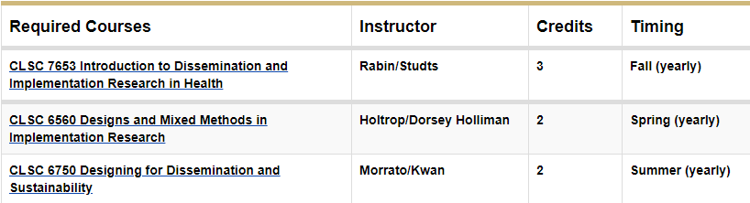
WHAT ARE THE COURSES?
WHAT
Total of 12 credit hours completed within a 3-year period
Required Courses (7 credit hours)
Notes:
Borsika –
All courses are fully online
Combination of synchronous and asynchronous learning experiences
For synchronous learning we use Zoom – for asynchronous learning we use our Canvas platform to post independent learning tasks and discussion boards

Slide 12
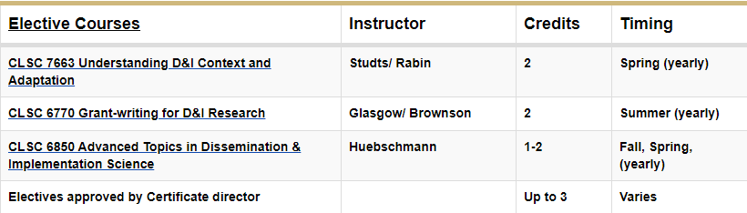
WHAT ARE THE COURSES?
WHAT
Elective Courses (5 credit hours)
Notes:
Borsika

Slide 13
WHAT ARE THE COURSES?
WHAT
“Introduction to Dissemination and Implementation Research in Health” (CLSC 7653 – Drs. Rabin and Studts)
  Overview of key D&I models, methods, and measures
  Supports students to develop D&I grant or Quality Improvement (QI) project proposal over the semester
  Ideas that students develop in this initial course may be further developed in additional later courses (see next slide)
Notes:
Borsika – talk about intro course (last one)

Slide 14
WHAT ARE THE COURSES?
WHAT
“Designs and Mixed Methods” (CLSC 6560 – Drs. Holtrop and Dorsey Holliman)
  In-depth examination of study designs
  Qualitative, quantitative, and mixed-methods approaches
  Complete a D&I methods section for a research proposal
Notes:
[Amy]

Slide 15
WHAT ARE THE COURSES?
WHAT
“Designing for Dissemination” (CLSC 6750 – Drs. Morrato and Kwan)
  Learn about design-thinking processes and diagnosing situational context
  Conduct key informant interviews with stakeholders
  Evaluation based on final oral presentation and written report
Notes:
Amy

Slide 16
WHAT ARE THE COURSES?
WHAT
“Understanding D&I Context and Adaptation” (CLSC 7663 – Drs. Studts and Rabin)
  Learn to assess, guide, and balance adaptations with fidelity
  Develop understanding and skills for assessing multi-level and contextual issues in D&I research
  Recognize the role of D&I science in advancing health equity
Notes:
Amy

Slide 17
WHAT ARE THE COURSES?
WHAT
“Grant-writing for D&I” (CLSC 6770 – Drs. Glasgow and Brownson)
  Led by Drs. Glasgow/Brownson with numerous other national D&I researchers participating
  Webinar presentations on D&I grant segments
  Students draft/revise grant sections to get feedback
  Leads up to a mock study section final exam
Notes:
Amy

Slide 18
WHAT ARE THE COURSES?
WHAT
“Advanced research topics in D&I Science” (CLSC 6850 – Dr. Huebschmann)
  Journal club discussions – presenting critiques of recent D&I publications followed by group discussion with our ACCORDS D&I team (includes Drs. Rabin, Glasgow, Holtrop, Kwan, and others)
  Research presentations – deliver an oral research presentation to a small group of D&I Certificate faculty
  Provide peer critiques
Notes:
Amy – deeply engage with D&I literature is a key piece and peer critiques for oral presentations

Slide 19
WHAT DO STUDENTS THINK OF THE COURSES?
WHAT
Testimony
“I am taking this class because I have discovered that creating predictive models is the easy part. Implementing them and understanding where they can provide value is the real challenge."
  Douglas Barnaby, MD, MSc – Assistant Professor of Emergency Medicine, Northwell Health, Hofstra University School of Medicine, Feinstein Institute for Medical Research
"Thank you for a fantastic class and for continuing to share resources! I really appreciate how well-structured your class is. You strike just the right balance between sharing new content, allowing time for discussion and reflection, applying D&I concepts to individual projects, and bringing in experts at different career stages."
  Meredith Fort, PhD - Research Assistant Professor and NHLBI IMPACT K12 scholar, University of Colorado School of Public Health
Notes:
Amy
Additional anonymous critiques of Holtrop course:
The main assignments were great; asked critical questions that required deep thought and thus learning - thank you! The workbook was a perfect choice for the course and something I intend to use ongoing.
Exceeded expectations. Jodi was absolutely excellent - she obviously knows this content area inside and out, but her ability to communicate these concepts was top notch.
Overall, I learned a lot in this course and it definitely helped me move forward a project I'm interested in.

Slide 20
WHO SHOULD PURSUE THE D&I SCIENCE CERTIFICATE?
WHO
Target Audience
Researchers interested in conducting T3-T4 translational research with a focus on the dissemination and implementation of evidence-based programs
Professionals in health services, community health, and public health research
Notes:
Amy

Slide 21
WHY PURSUE THE D&I SCIENCE GRADUATE CERTIFICATE?
WHY
Rationale for individuals in different career stages
K-awardees: Robust coursework for a D&I training goal on a career development award
Mid-career faculty: Become a “home-grown” local faculty expert for D&I research methods in your institution
PhD/DrPH students: potential area of minor concentration research methods
Exploring areas for a PhD: test out the field of D&I science before committing to research in this area
Notes:
Amy

Slide 22
WHERE ARE CERTIFICATE COURSES HELD?
WHERE
Format
All courses are fully available online (Zoom© videoconference platform) – our current students participate remotely from locations across the USA
Academic Home
Collaboration with Clinical Science Graduate Program, part of the Colorado Clinical and Sciences Institute (CCTSI)
Courses can be applied to graduate degrees (MSCS, PhD)
Notes:
Amy

Slide 23
HOW DO I APPLY?
HOW
Admission Requirements
Degree: BA/BS minimum
GPA: A minimum of 3.00 recommended
Complete application forms
Upload CV or resume
Upload transcripts from highest degree completed:
  Applicants from USA may upload unofficial transcript
  International applicants must provide official transcript – may also need to complete TOEFL*
  MD applicants must also upload Bachelor’s degree transcripts
Answer two brief questions about your interests in D&I training (≤200 words per question)
*See website below for details on international applicant requirements for TOEFL scores – certain countries are exempt including Canada (other than Quebec – applicants from Quebec may be exempted in certain circumstances): http://www.ucdenver.edu/academics/internationalprograms/oia/admissions/apply/application/graduate/Pages/default.aspx
Notes:
Amy – there are some different requirements for MD applicants and international applicants – may address further in Q&A.
Note: (TOEFL – “toe-’full”)

Slide 24
HOW DO I APPLY?
HOW
Complete the proper Application form for your background on our website - see next slide for details on WHICH form is right for you…
SLATE form (University of Colorado (CU) Graduate School Application)
https://application.admissions.ucdenver.edu/apply/
Formstack form (Internal form for CERTAIN existing CU Graduate students)
https://ucdenverdata.formstack.com/forms/d_i_certificate_program
Website with FAQs on Application process
https://medschool.cuanschutz.edu/accords/cores-and-programs/dissemination-implementation-science-program/dissemination-implementation-science-graduate-certificate-program/admissions
Notes:
Amy – subset of current CU graduate students but not others will use Formstack – all others use SLATE.

Slide 25
WHICH APPLICATION DO I FILL OUT?
 | University of Colorado Graduate School Application (“SLATE”) | Internal Application (Formstack)
Factors that determine the type of application to fill out | Not a current Graduate Student at any institution Current Graduate Student, but NOT at the University of Colorado (CU) Currently taking courses at CU, but not in enrolled in a degree-seeking program (i.e., non-degree student) Current CU Medical Student at Anschutz Medical Campus (AMC) Current CU Graduate Student at Boulder or Colorado Springs campus | Current University of Colorado (CU) Graduate Student at: Anschutz Medical Campus (AMC) OR Downtown Denver Campus (DC)
Link to application | https://application.admissions.ucdenver.edu/apply/ Choose: University of Colorado Denver Graduate Non-Degree Admissions In the Academic Interests part, mark the “Certificate” option Select the “Dissemination and Implementation Certificate” | https://ucdenverdata.formstack.com/forms/d_i_certificate_program
Application materials | Official or Unofficial Transcripts from highest completed degree International applicants must provide official transcripts – please see previous page for additional guidance; MD applicants should also provide Bachelor’s degree transcript) CV/Resume Program Specific Questions $50-75 fee | Official or Unofficial Transcripts from highest completed degree (International applicants must provide official transcripts; MD applicants should also include Bachelor’s degree transcript) CV/Resume Program Specific Questions
Questions | Galit.Mankin@cuanschutz.edu | Galit.Mankin@cuanschutz.edu
Notes:
Amy

Slide 26
HOW MUCH DOES IT COST?
HOW
Information on Tuition Costs
  MS Clinical Sciences Program: 2020-2021
    Resident = $494/credit hour
    Non-resident = $1,204/credit hour
Reminder: 12 credit hours total to complete the Certificate, may be completed over 2-3 years.
University of Colorado faculty members may use Tuition Assistance for courses if they are an eligible employee.
Notes:
Amy

Slide 27
WHEN TO APPLY?
WHEN
Cohort starting classes in Summer or Fall 2021
Application available now on our website
Due date: March 1, 2021
Timing to matriculate (start courses):
  June 2021 (Summer semester)
  August 2021 (Fall semester)
Notes:
Amy

Slide 28
ACKNOWLEDGEMENTS
It takes a village! Thank you!
Primary sponsor: ACCORDS
ACCORDS Director/Administration
  Alison Kempe
  JD Ainsworth
  Katie Klossner
ACCORDS D&I Certificate Faculty and program administrator – Elise Robertson
Secondary sponsor: CCTSI
CCTSI Clinical Sciences Graduate Program
  Lisa Cicutto
  Galit Mankin
University of Colorado Graduate School
  Kristine Sikora
  Alaina Leverenz
Notes:
Amy

Slide 29
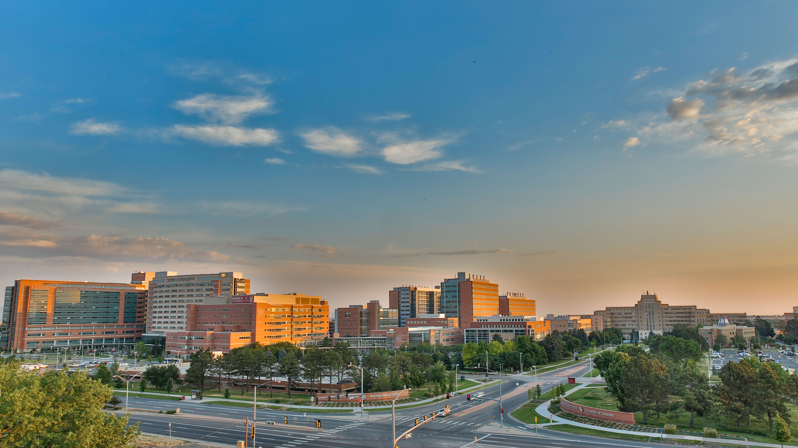
General Program questions: Dr. Amy Huebschmann
Amy.Huebschmann@cuanschutz.edu
Application-specific questions: Galit.Mankin@cuanschutz.edu
Join our mailing list! https://bit.ly/2TQh6ny
CONTACT US
Notes:
LAYOUT NOTES:
Do not replace, change or add to the logo
Add school or unit information in text form to the right of the logo. DO NOT add additional school or unit logos
Changing the background: right-click on background image and select “Change picture” to replace
Background images should be 1920 x 1080 pixels in size to ensure a perfect fit
Adjust transparency of dark box accordingly, to ensure logo and text is legible over image background

Slide 30
QUESTIONS?
https://medschool.cuanschutz.edu/accords/DICert
Notes:
LAYOUT NOTES:
Do not replace, change or add to the logo
Add school or unit information in text form to the right of the logo. DO NOT add additional school or unit logos
Changing the background: right-click on background image and select “Change picture” to replace
Background images should be 1920 x 1080 pixels in size to ensure a perfect fit
Adjust transparency of dark box accordingly, to ensure logo and text is legible over image background

