Slide 1



The iPRISM Webtool:
An Interactive, Visual Webtool to Guide the Pragmatic and Iterative Use of PRISM
Katy Trinkley, PharmD, PhD
Associate Professor
Department of Family Medicine
ACCORDS D&I Science Program
University of Colorado
Anschutz Medical Campus
Acknowledgments: Russ Glasgow, Bryan Ford, Borsika Rabin, and many others
Notes:
https://medschool.cuanschutz.edu/accords/cores-and-programs/education-program/colorado-pragmatic-research-in-health-conference/2023-conference/submit-an-abstract

Slide 2
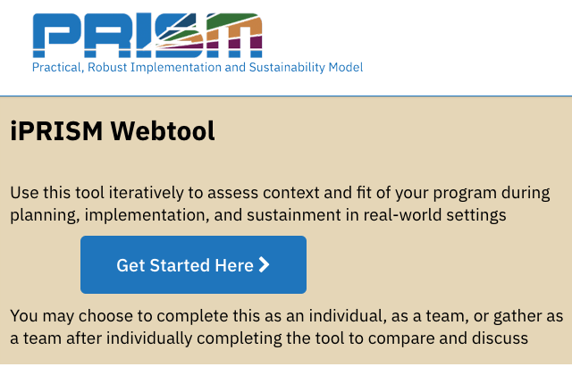
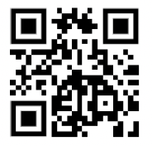
Goals for this presentation
Overview of PRISM
Describe the iPRISM webtool
  Purpose
  How it was developed
  Function
  Future directions
www.prismtool.org

Slide 3
Potential Discussion Points
How might you use the iPRISM webtool?
What do you see as challenges to using the iPRISM webtool?
Pros/cons of using the iPRISM webtool vs current method of using TMFs?

Slide 4
What is PRISM?
Practical, Robust Implementation and Sustainability Model
Contextually expanded RE-AIM
Can be used as:
  Determinant framework
  Process framework
  Outcome framework
Feldstein AC¹, Glasgow RE. A practical, robust implementation and sustainability model (PRISM) for integrating research findings into practice. Jt Comm J Qual Patient Saf. 2008 Apr;34(4):228-43.

Slide 5
PRISM
Feldstein AC¹, Glasgow RE. A practical, robust implementation and sustainability model (PRISM) for integrating research findings into practice. Jt Comm J Qual Patient Saf. 2008 Apr;34(4):228-43.

Slide 6
PRISM CONTEXTUAL DOMAINS
Feldstein AC¹, Glasgow RE. A practical, robust implementation and sustainability model (PRISM) for integrating research findings into practice. Jt Comm J Qual Patient Saf. 2008 Apr;34(4):228-43.

Slide 7
Feldstein AC¹, Glasgow RE. A practical, robust implementation and sustainability model (PRISM) for integrating research findings into practice. Jt Comm J Qual Patient Saf. 2008 Apr;34(4):228-43.
RE-AIM
OUTCOMES
Notes:
Which as you know can be used for evaluation, but also to forecast or anticipate how a program is doing to inform course corrections earlier during planning or implementation phases of a program

Slide 8
Purpose - iPRISM webtool
Simplify implementation science - using PRISM
  For diverse researchers and implementation teams
  Support rapid learning health systems
Guide and prompt users to iteratively
  Assess context
  Align project with context
  Assess progress on key outcomes
  Develop feasible and impactful strategies/adaptations
  Create action plans
Systematic, consistent approach
www.prismtool.org
Trinkley et al. Acad Med. 2022;97:1447
Maw et al. Implement Sci Commun. 2022;3:89
Notes:
With PRISM in mind, the purpose of the iPRISM webtool is….we know it is hard for those that are not as immersed in IS to figure out how to apply it….

Slide 9


User-centered methods
Iterative partner engagement
  >20 individuals and teams
  English and Spanish speakers
  Diverse settings, users and programs
  With and without implementation science expertise
Used prototypes of varying fidelity
Refined
  Purpose, interface, flow
  Assessment questions – Makes PRISM actionable
Maguire M. Int J Hum Comput Stuf. 2001;55:587

Slide 10
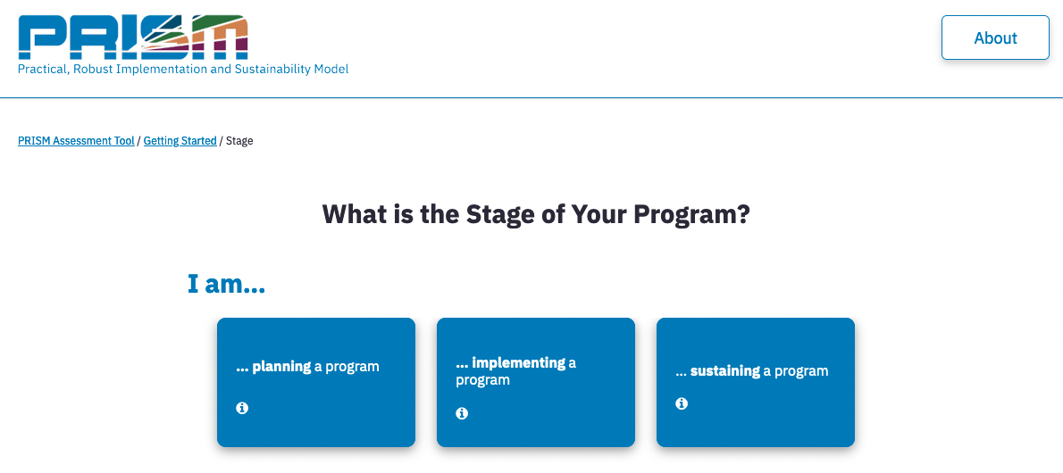
Notes:
And these assessment questions are tailored to the stage of implementation. Before a user answers the questions, they are asked which stage they are in, which then prompts the correct quesitons

Slide 11
21 assessment questions
Operationalize PRISM’s context domains and outcomes
  6 PRISM questions
  15 RE-AIM questions
Prioritize equity
  Representation of perspectives
  Representativeness of outcomes
www.prismtool.org
Rabin et al. Implement Sci. 2022;17:62
Notes:
And irrespective of the stage, there are 21 questions total

Slide 12
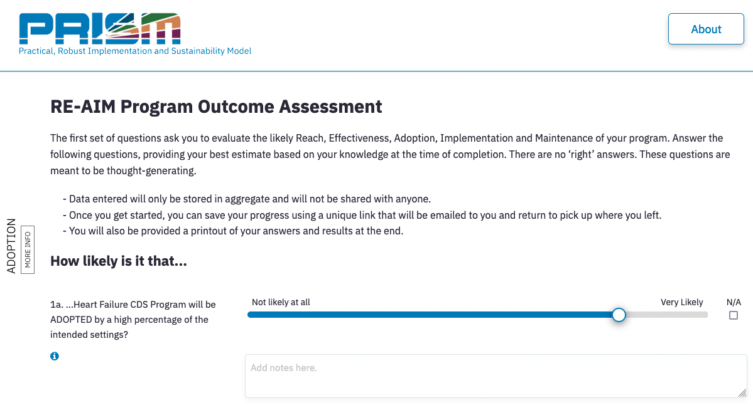
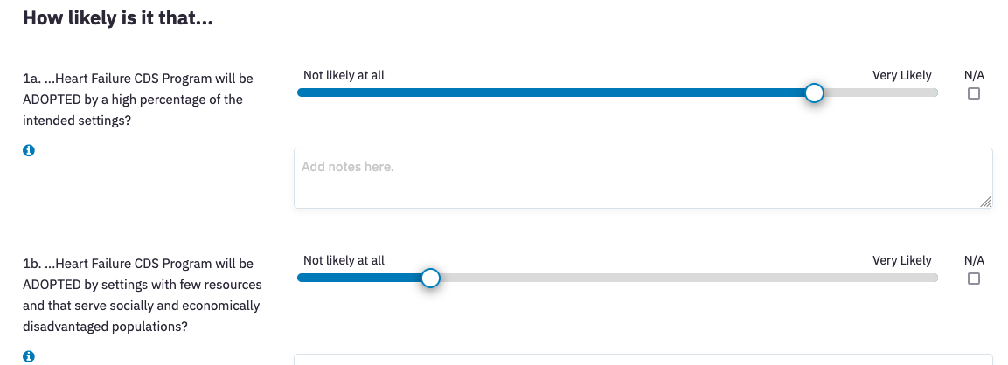
Notes:
Here is an example of 2 RE-AIM questions

Slide 13
Notes:
I want to point out that the webtool is pretty dynamic and one really basic example of this is that it autopopulates based on the name of your program. This is one small feature that helps simplify the process for users by removing jargon of program, policy or intervnetion

Slide 14
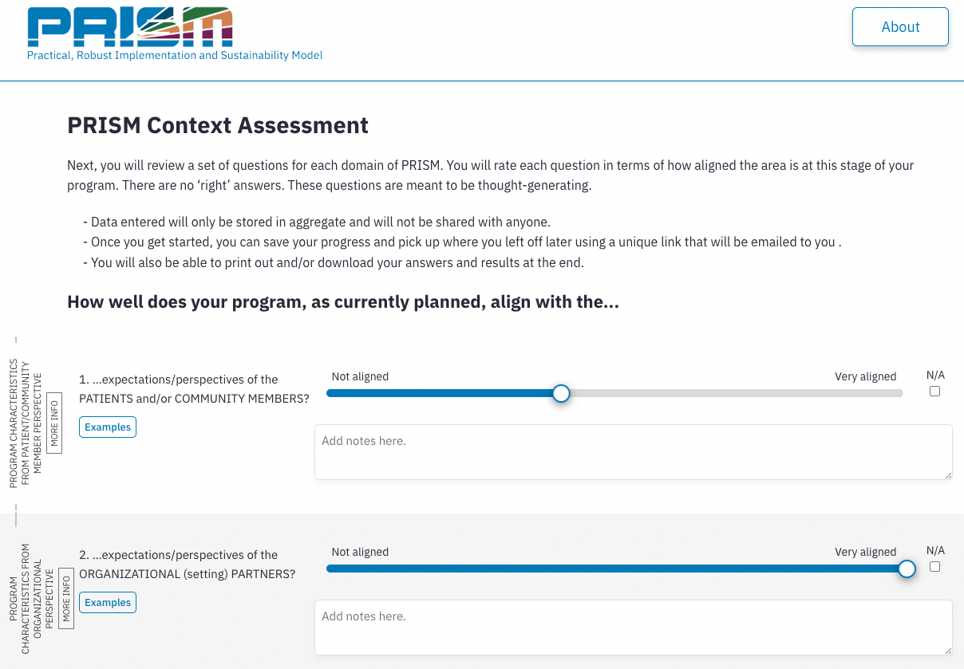

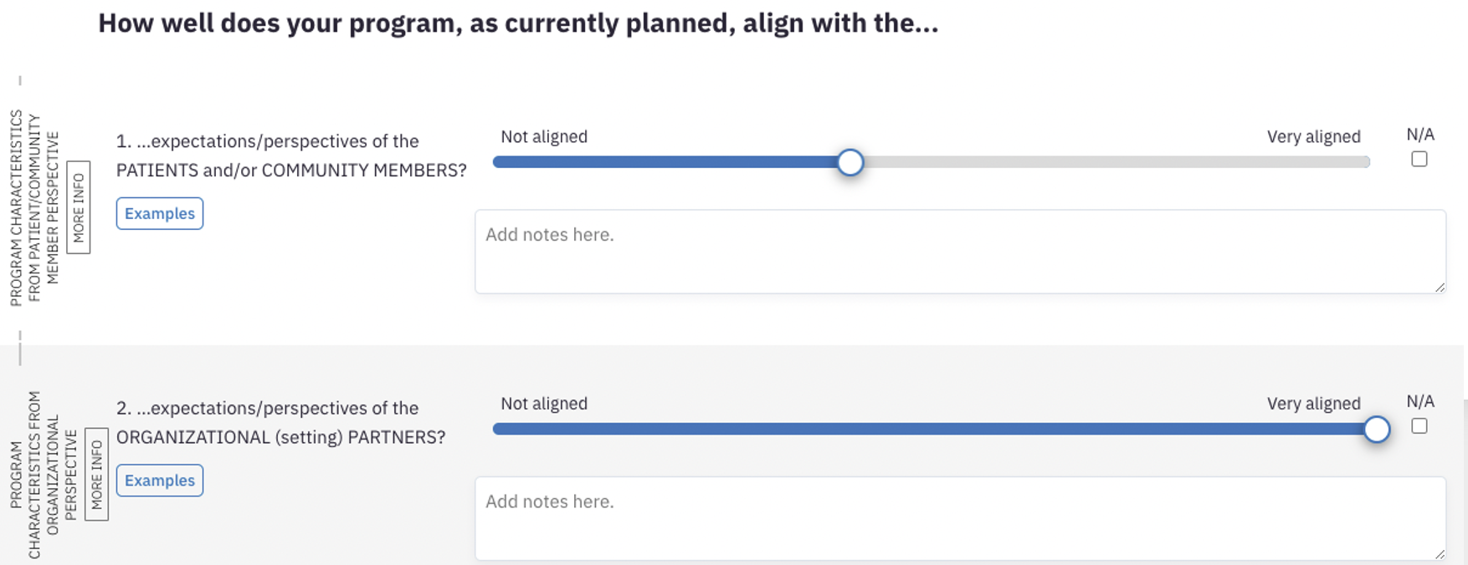

Slide 15
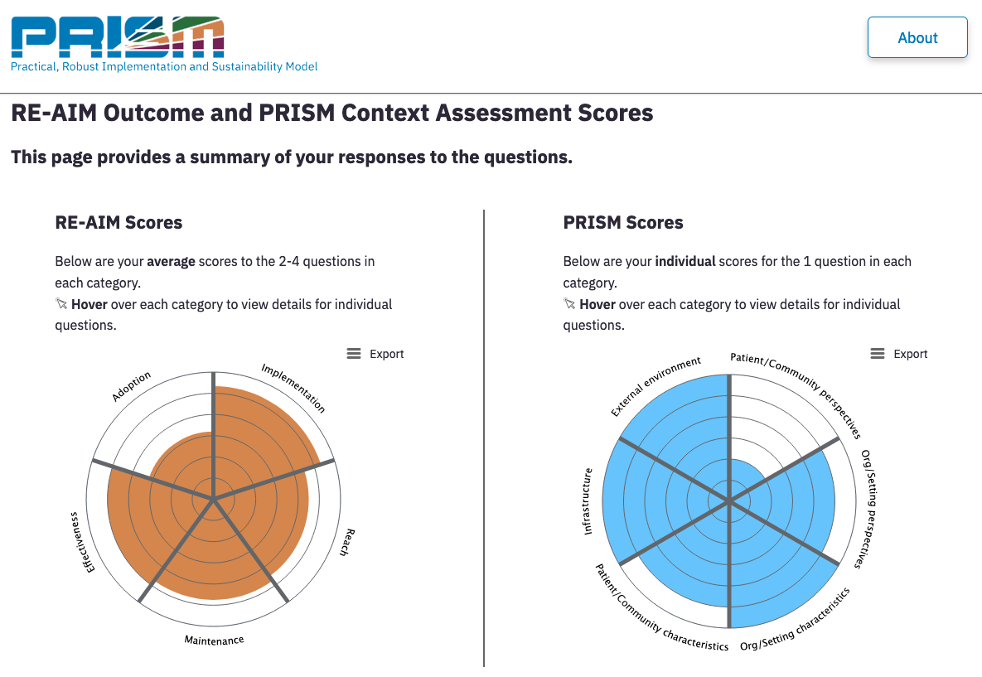
Graphical display of responses
*For individuals

Slide 16
Graphical display of responses
Quickly identify areas to improve misalignment and impact

Slide 17

Graphical display of responses

Slide 18

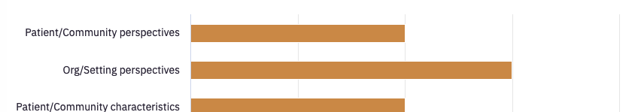
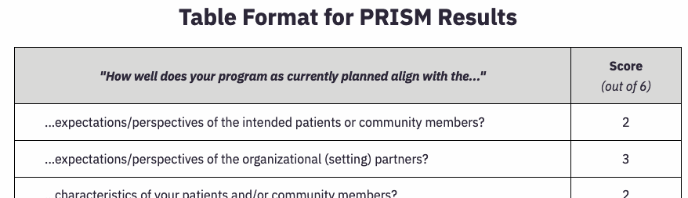
Alternative views

Slide 19

Implementation strategies/adaptations
Identify
Rate
Prioritize

Slide 20



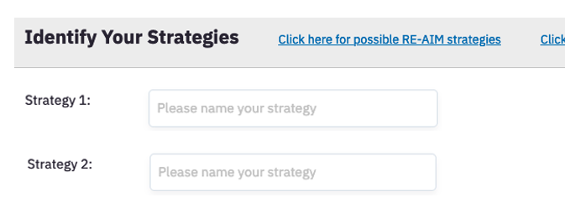
Notes:
There is an option to click to see examples as well

Slide 21
Audit and feedback
Integrate within clinician workflow

Slide 22
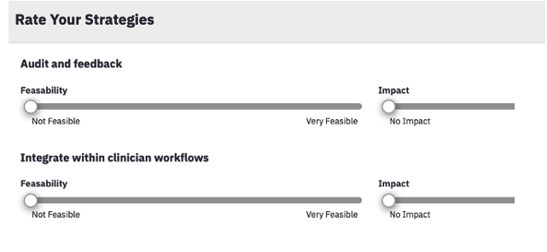
*Equitable/representativeness of impact

Slide 23
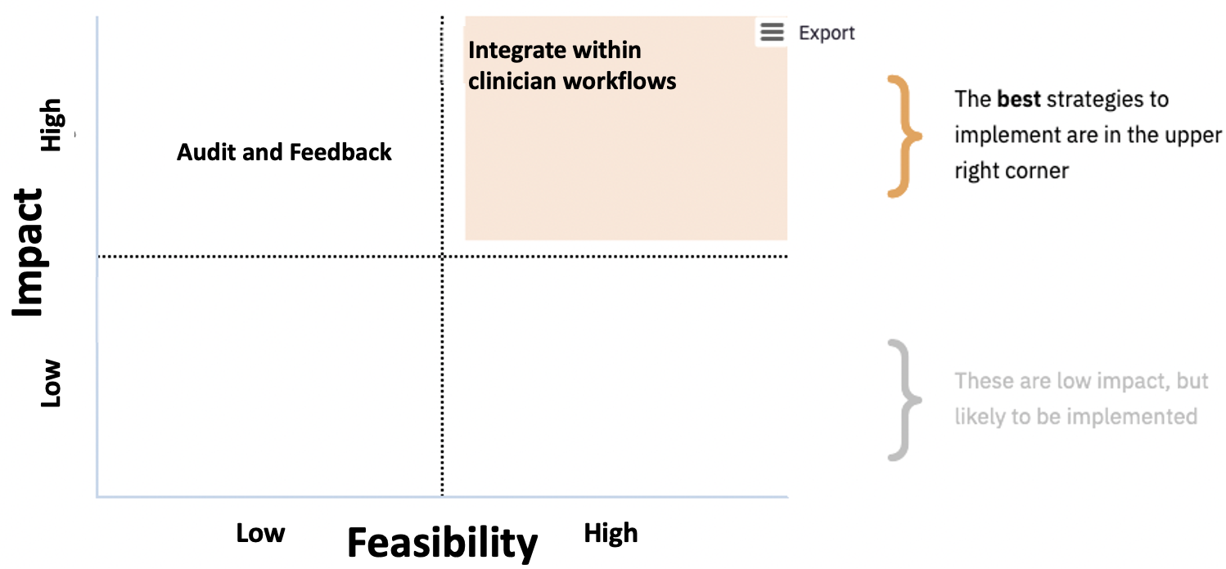
Prioritize strategies

Slide 24

Other features
Action plan template
Embedded education - tailored to different audiences/expertise
  Video
  Examples
  Links out
  Info buttons
  Quick start guides
Ability to export results
  Individuals
  Teams

Slide 25



Team use
Team members complete asynchronously
  Using team code
Automated report summarizes responses
  Means and distribution of responses
Meet to discuss results
  Develop action plans

Slide 26
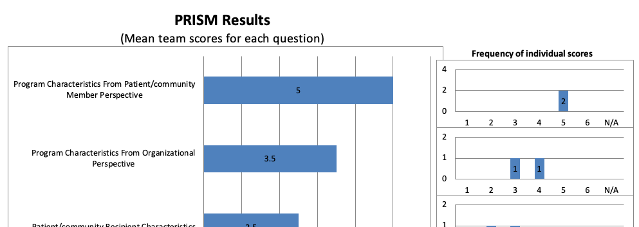
Team summary view

Slide 27
Intended uses
Across settings, types of users and projects
  Healthcare and community issues
  English and Spanish speakers
Each phase of implementation
Iteratively
Planning
Implementation
Sustainment
Notes:
And consistent approach

Slide 28

Future directions
Refine and update
-User testing
-Additional ‘bells and whistles’
Evaluate use and impact
-Diverse settings
-Different conditions, varying facilitation
Notes:
User testing with the website – previous versions were with other forms of prototypes

Slide 29





Acknowledgements
Co-leads: Russ Glasgow, Borsika Rabin
Bryan Ford, Meredith Fort, many others
Supported by:
  NHLBI (K12/K23)

Slide 30


THANK YOU
Join us virtually or in person for -
The Colorado Pragmatic Research in Health (COPRH) Conference
Notes:
https://medschool.cuanschutz.edu/accords/cores-and-programs/education-program/colorado-pragmatic-research-in-health-conference/2023-conference/submit-an-abstract

Slide 31
Thank you and Discussion
How might you use the iPRISM webtool?
What do you see as challenges to using the iPRISM webtool?
Pros/cons of using the iPRISM webtool vs current method of using TMFs?

