Slide 1


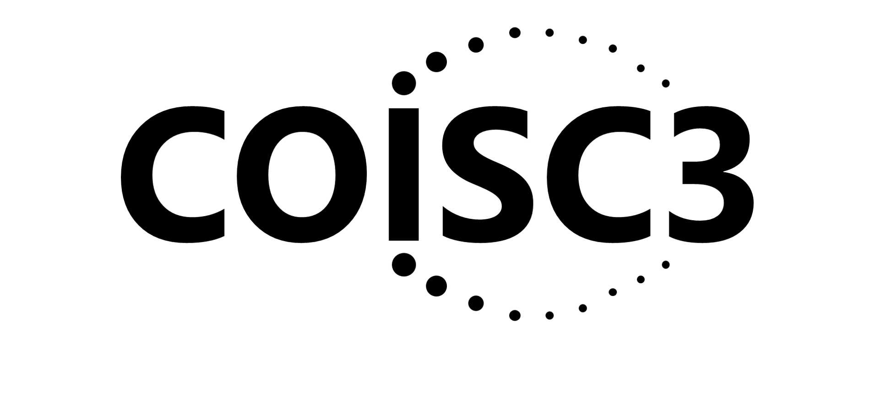
The Need For and Key Issues In the Application of Implementation Science in Pharmacy Research and Practice
Russell E. Glasgow, PhD
Director, ACCORDS Dissemination And Implementation Science Program
University of Colorado, Anschutz Medical Campus
https://bit.ly/2BnJzuk
Acknowledgments:
Borsika Rabin, Katy Trinkley, and the great researchers cited throughout this talk

Slide 2
Learning Objectives
At the end of the session, participants will be able to:
Identify the value of and key concepts and methods in implementation science relevant to pharmacy research and practice
Identify and describe multi-level contextual factors (e.g., community, policy, organizational, pharmacy team) that support effective implementation
Describe the process and importance of ‘designing for dissemination, equity and sustainment’
*This accredited CE activity will discuss non-clinical content

Slide 3



Presentation Outline
BRIEFLY review key issues from Jan. 26 – Drs. Blanchard and Bacci
More in depth: What Can Implementation Science Do for You?
  Use implementation logic models and frameworks to plan projects
  Understand and fit to local context
  Evaluate and produce equitable impact across outcomes
  Evaluate and guide adaptations
  Help make programs and results more sustainable
Future Directions
  Designing for Dissemination, Equity and Sustainability
  Pharmacogenetics and Learning Health Systems

Slide 4
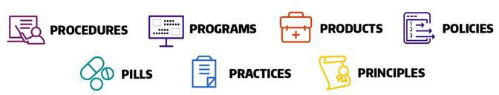
Implementation Science is:
The study of methods to promote the adoption and integration of evidence-based practices,
interventions and policies into routine health care and public health settings
to improve population health
Sources: https://cancercontrol.cancer.gov/is/about; UW Imp Sci Resource Hub, 2022
Adapted from presentation by Dr. Rinad Beidas

Slide 5
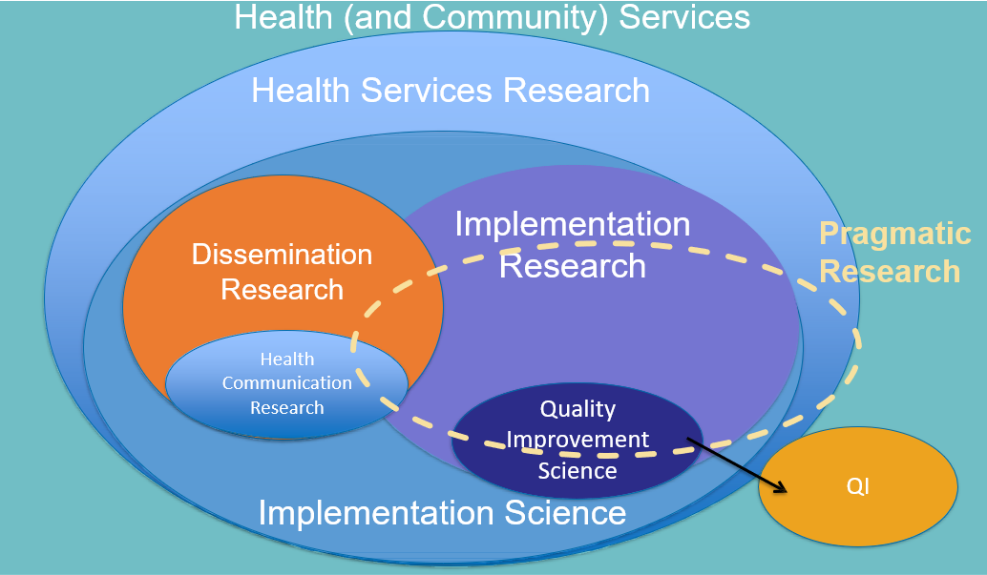
A Big Tent of Terms (and ovals)
Pragmatic Research
Adapted from Mitchell S, Chambers, D. https://doi.org/10.1200/JOP. 2017.024729.
Notes:
You might not like how I tweaked this slide for CCOR, so I am calling it out in case you disagree and my edits are just wrong ☺ – I removed the dashed oval and changed the outside circle header from “Health Services Research” to “Health Services Pragmatic Research”…

Slide 6

What Can Implementation Science Do for You?
Select and Use Conceptual Theories, Models, and Frameworks
Understand (and Address) Context
Assess (and Guide) Adaptations
Assess and Address health Equity and Disparities
Map and Understand the Sequence of Implementation Actions
Select and Use Implementation Strategies
Where We Are Headed?
  Designing for Sustainability, Dissemination, and Equity
  Pharmacogenetics and Learning Health Systems
Pragmatic Research
Notes:
You might not like how I tweaked this slide for CCOR, so I am calling it out in case you disagree and my edits are just wrong ☺ – I removed the dashed oval and changed the outside circle header from “Health Services Research” to “Health Services Pragmatic Research”…

Slide 7




1.
Many IS Frameworks
2.
Understanding Context
3.
Assessing and
Guiding Adaptations
4.
Addressing
Health Equity
Notes:
Could probably delete this one…

Slide 8
D&I Models & Frameworks are available!
Outlined in Tabak, et al., proliferation of models: 61 reviewed, now more than 150!!
Many Similarities:
Context is critical
Focus on external validity
Begin with community and clinical partners—take their perspective(s)
Find balance between fidelity to EB program and adaptation to local setting
Unlikely you need to create a new model
Tabak RG, et al. Bridging research and practice. Am J Prev Med. Sep 2012;43(3):337-350
Strifler et al. Scoping review on D&I TMFs. J Clin Epidemiol. 2018;100:92–102.
1

Slide 9
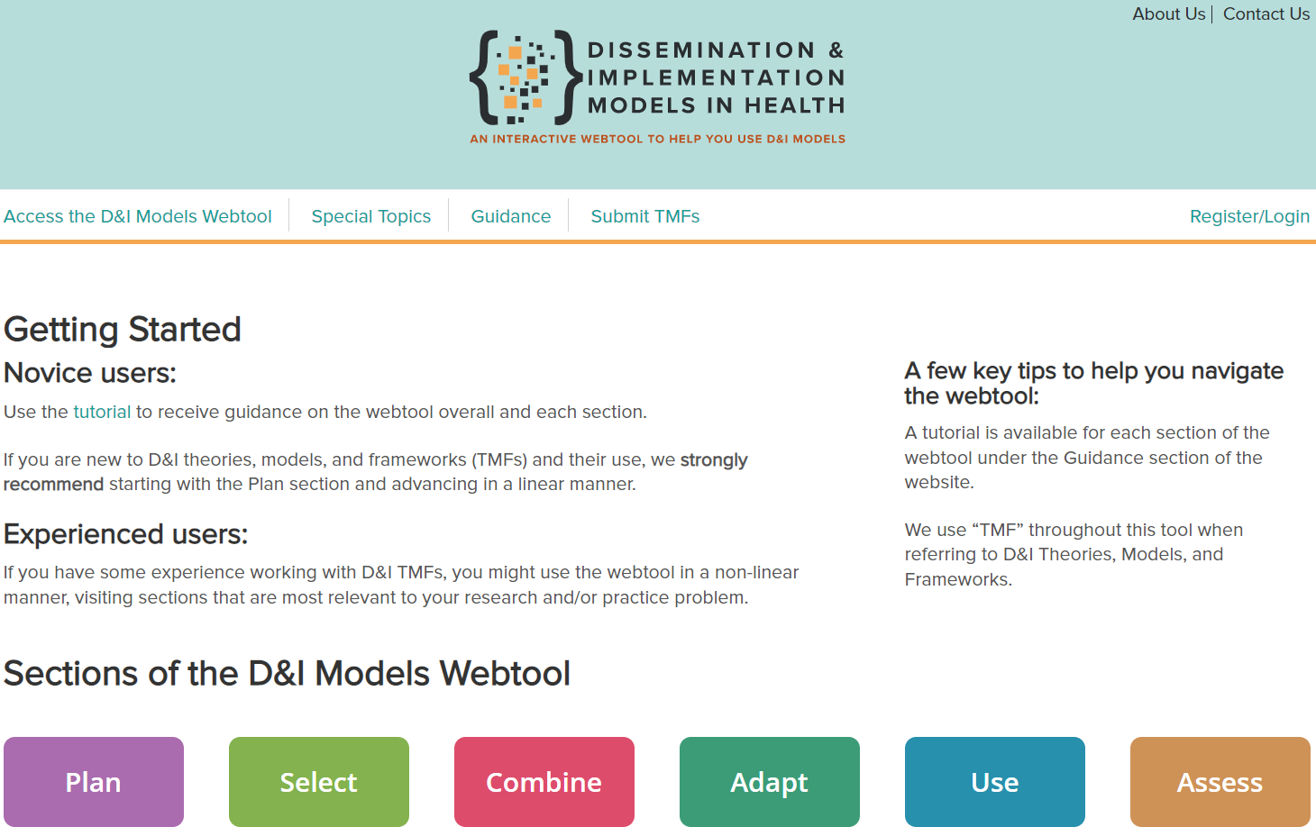
https://dissemination-implementation.org
Pragmatic Research
1

Slide 10
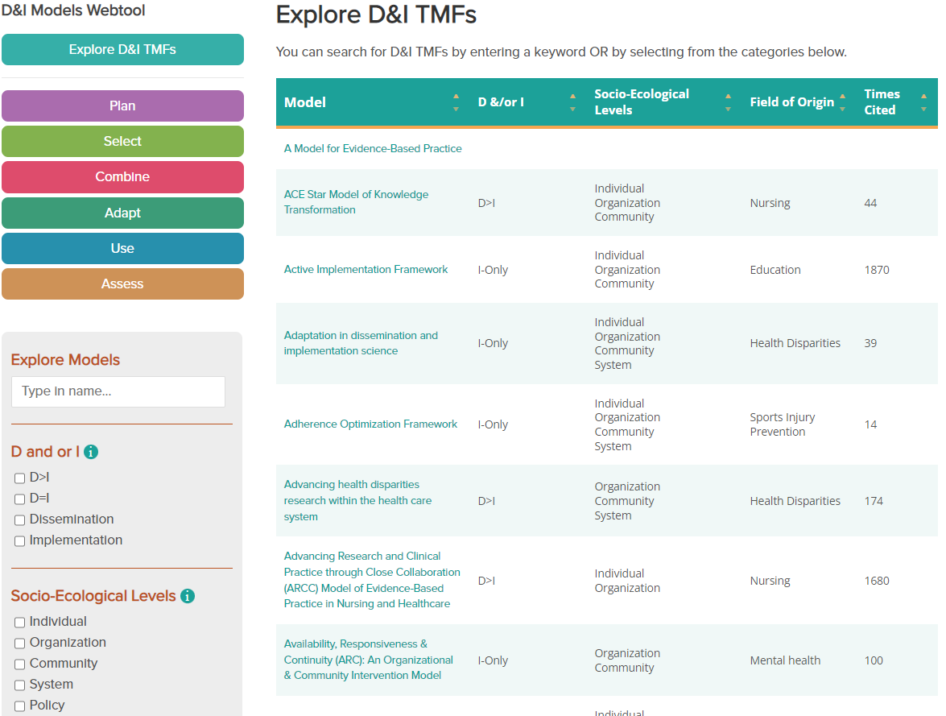
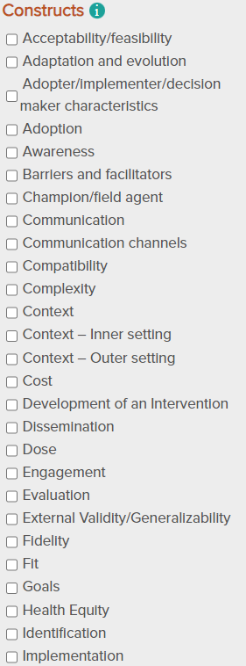
https://dissemination-implementation.org
Pragmatic Research
1
Notes:
“Selecting a Model by constructs” (and a tailored logic model)
Call out health equity- good
Stress how the algorithm works to return modes that have the largest number of ‘matches’ with the constructs that entered……. Might also note that creating a logic model- fillable PDF during planning tab is often helpeful both for proposal/team to think though, and in selecting a TMF

Slide 11
Relating interventions & strategies to outcomes
Implementation Logic Models
Intervention
Strategies
Implementation
Strategies
Outcomes
Implementation Outcomes | Service Outcomes | Client Outcomes
Feasibility | Efficiency | Satisfaction
Fidelity | Safety | Function
Penetration | Effectiveness | Symptomatology
Acceptability | Equity
Sustainability | Timeliness
Uptake | Patient-centeredness
Costs
Evidence-Based Practice
(“the thing”)
Systems | Environment Organizational Group/Learning Supervision
Individual Providers/Consumers
(‘the how”)
Adapted from Proctor, EK. Et. al., Adm Policy Ment Health. 2009 Jan; 36(1)
For Implementation Research Logic Model, see Smith JD, Raffety, Li. 2020 Implementation Science 15
1

Slide 12
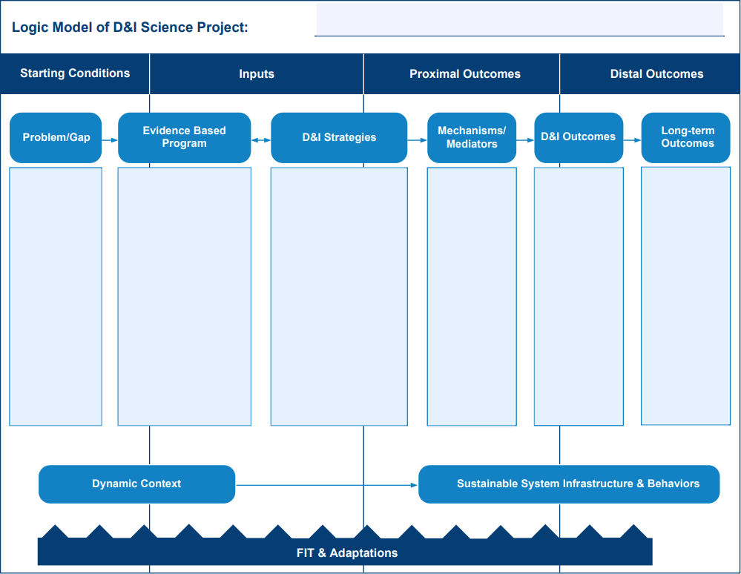
Start with a Logic Model:
Use this to select your conceptual framework
https://dissemination-implementation.org/content/plan.aspx
1

Slide 13

REFLECTION AND WORKSHEET:
Create an implementation logic model for your project.
What implementation strategies will be used to impact what implementation outcomes?

Slide 14
Context Issues from an IS Perspective
People exist in the context of culture and places in which they work, live, study and play
Context is multi-level and dynamic - not just places, but also history and relationships (trust, etc.) (Take Home Message)
Studying and understanding context is challenging:
  So many factors…which are most important for which issues, for which settings, for which populations
  Need for brief, validated pragmatic measures
Bayliss et al. Understanding context. Ann Fam Med (2014) 12: 260-269
Chambers, D et al. The dynamic sustainability framework. Implement Sci. (2013) 8:117
2

Slide 15
More on Context
Context Defined: from CICI perspective = “the set of characteristics and circumstances that consist of active and unique factors within which the implementation is embedded”.
Context is more than Setting: also relationships, history, workflow, etc.
Methods Issues in Studying Context- most often surveys or qualitative interviews; challenges are that context changes, sometimes rapidly.
  Need for more multi- and mixed methods, for including implementation partners and recipients, community members in analyses
Need to Adapt to and Align interventions and implementation strategies with Context- (Take Home Message)
Pfadenhauer LM, et al. The Context and Implementation of Complex Interventions (CICI) framework. Imp Sci. 2017;12(1):21.
Mielke J et al. BMC Medical Research Methodology 2022. 22:320
2

Slide 16
Context through the Lens of the Practical Robust Implementation and Sustainability Model (PRISM)
PRISM is the Contextually expanded RE-AIM
  Includes RE-AIM
  REPEAT AFTER ME: “PRISM INCLUDES RE-AIM” ☺
Determinants framework
Process framework
Outcomes framework
Feldstein AC, Glasgow RE. Jt Comm J Qual Patient Saf. 2008 Apr;34(4):228-43
Rabin, B. et al. (2022). Implementation Science 17:62 https://doi.org/10.1186/s13012-022-01234-3
2

Slide 17
PRISM CONTEXTUAL DOMAINS
RE-AIM
OUTCOMES
Feldstein AC, Glasgow RE. Jt Comm J Qual Patient Saf. 2008 Apr;34(4):228-43.
2

Slide 18
PRISM Domain | Examples
Organizational Perspective of Program Characteristics | Strength of evidence Usability, adaptability, burden, cost Addresses a need or priority
Patient/Community Perspective of Program Characteristics | Aligned with values and preferences Accessibility, usability, adaptability, cost Addresses a need or priority
Organizational Recipient Characteristics | Culture Leadership and management support and communication Staffing and incentives Data availability
Patient/Community Recipient Characteristics | Demographics, comorbidities Social determinants of health Knowledge, beliefs, competing priorities
External environment | Reimbursement, performance metrics Guidelines, regulations and policy Community resources
Implementation and sustainability infrastructure** | Feasibility, resource availability Automation, integration within standard workflows Training and support
Adapted from: Feldstein AC, Glasgow RE. A practical, robust implementation and sustainability model (PRISM) for integrating research findings into practice 2008 Jt. Comm. Qual Safety Apr;34(4):228-43.
2
Notes:
For your reference – complete list of examples in the original paper

Slide 19
PRISM context and RE-AIM outcomes: Key points
PRISM includes RE-AIM- they are not different frameworks
  PRISM context factors with RE-AIM implementation outcomes
PRISM/RE-AIM are multilevel
Context is dynamic- and should be assessed iteratively; as should RE-AIM outcomes
Usually need to align 1) your EBI 2) implementation strategies, and 3) context- sometimes need to change context
Chambers, D.A., Glasgow, R.E. & Stange, K.C. The dynamic sustainability framework. Implementation Sci 8, 117 (2013).
Glasgow RE, et al. Iterative RE-AIM to guide adaptations. Frontiers in Health Services, 2. https://doi.org/10.3389/frhs.2022.959565
2

Slide 20

REFLECTION AND WORKSHEET:
What Contextual Factors are Most Relevant for your Projects?
What PRISM domains seem most relevant?
Recipient characteristics (patient and staff)
Recipient perspectives (patient and staff)
External environmental (policy, regulatory, reimbursement)
Implementation and Sustainability Infrastructure

Slide 21
How Can RE-AIM/PRISM (and other Implementation Science Frameworks) Help Address Health Equity?
Understand Context and Guide Tailoring and Adaptation to Context and Population
Broaden Focus on All Steps and Outcomes Necessary for Population and Equity Impact
Focus Attention on Issues of Representation and Representativeness
Address Systems Issues and Unintended Consequences
3

Slide 22
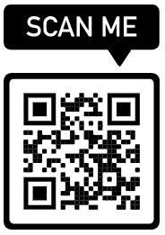
An Example from Recent History (or insert your own program)
Implementing An Evidence-Based Program; Pharmacy Intervention (or COVID-19 Vaccine) Story
Even if 100% effective...is only so good as how and whether:
It is adopted widely, including in low resource settings
Local delivery staff choose to deliver it
It can be implemented consistently with quality
It reaches intended recipients, including those at highest risk
It can be maintained or sustained
If we assume 70% success for each step…. Population Impact = 17%
https://re-aim.org
Glasgow RE, Vogt TM, Boles SM. Am J Public Health. 1999;89(9):1322.
Glasgow RE, et al. Frontiers Public Health 2019 7:64. doi: 10.3389/fpubh.2019.00064
3

Slide 23
RE-AIM Outcomes – Health Equity Implications
RE-AIM Issue | Disparity | Overall Impact
Effectiveness | 0 (equal) | 100% benefit
Reach | 30% | 70% benefit
Adoption | 30% | 49% benefit
Implementation | 30% | 34% benefit
Maintenance | 30% | 24% benefit
https://re-aim.org
3
Notes:
This slide uses hypothetical data to illustrate the importance of broad thinking about outcomes. The importance of focusing on all five dimensions of RE-AIM – effectiveness is not the only important factor, especially in disparities. Note if one only focused on effectiveness, one would likely conclude there were no health disparities associated with this program or policy

Slide 24
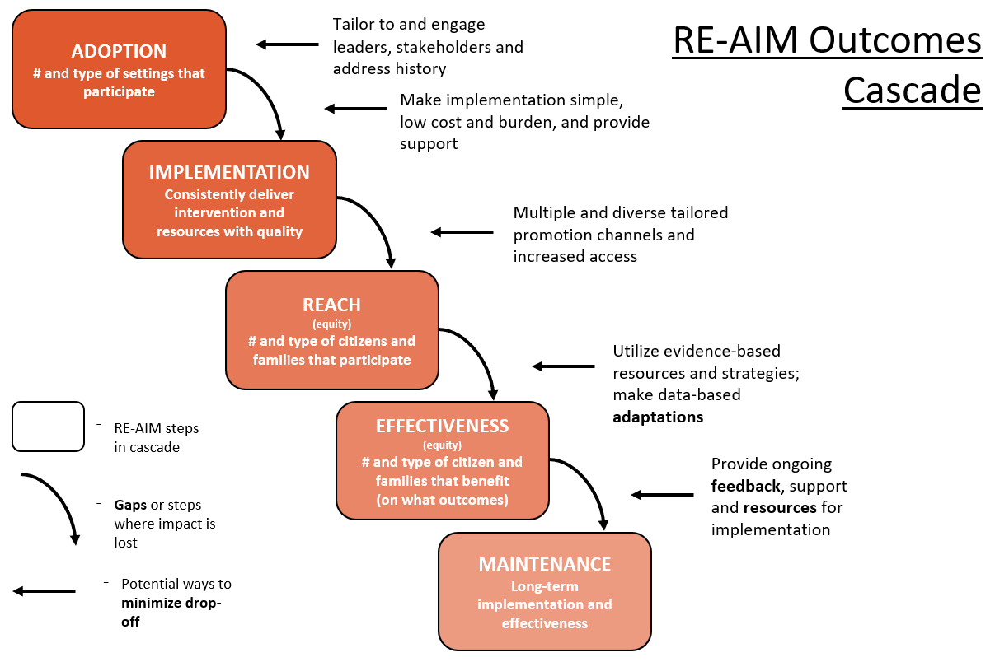
3

Slide 25
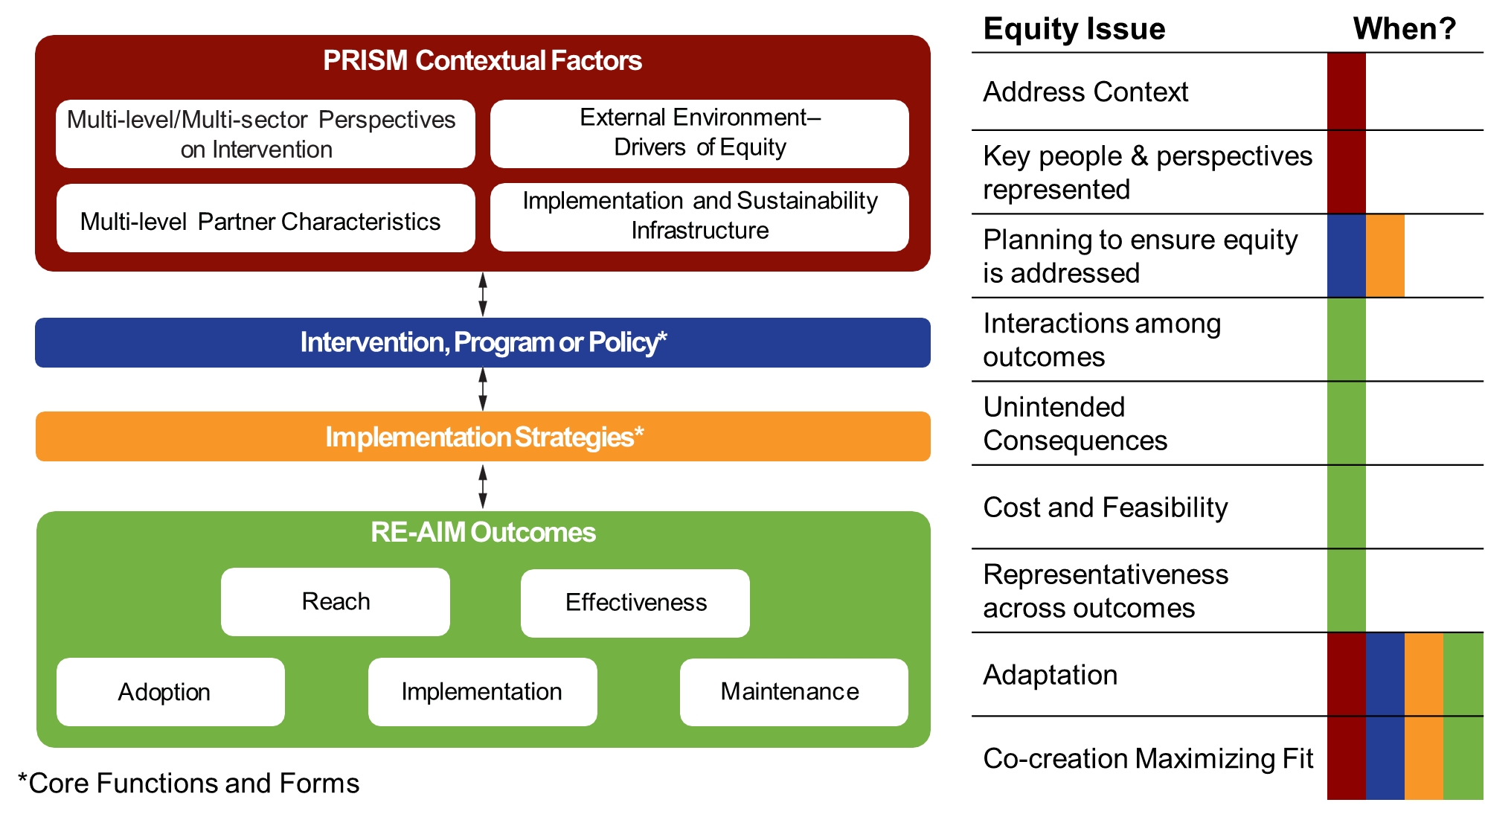
How PRISM (and RE-AIM Outcomes) Address Equity Issues
3

Slide 26
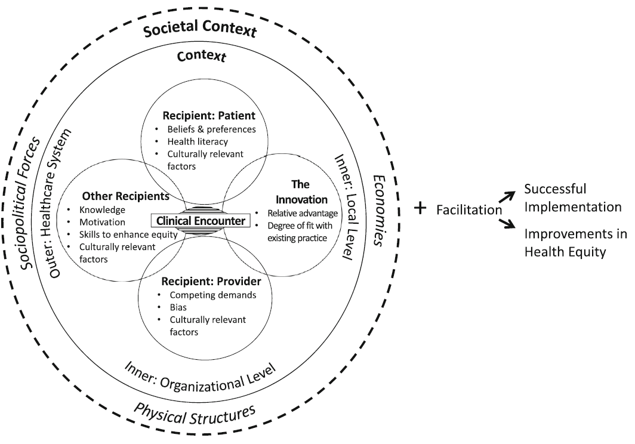
Health Equity Implementation Framework
Woodward et. al. Imp Sci Comm (2021) 2:61. https://doi.org/10.1186/s43058-021-00146-5
3

Slide 27

REFLECTIION AND WORKSHEET:
How Can Implementation Science (or PRISM) help you address health equity issues in your setting and projects?
Where in the ‘RE-AIM Cascade’ do you see the greatest drop off or equity issues?
How can you best engage clinical and community partners to get their ongoing input?
Consider issues of Representation and Representativeness

Slide 28
ADAPTATION can be good or bad, it just happens…
Adaptation is inherent – perhaps crucial – to the implementation process
Thinking about local adaptations, cultural adaptation, and other efforts to improve fit as flaws in implementation fidelity is at best a missed opportunity, and at worst, a recipe for implementation failure
Baumann, A. A., Cabassa, L. J., & Stirman, S. W. (2018). Adaptation in D&I science. In Brownson R et al (Eds): D&I research in health: translating science to practice, 2, 286-300.
Baumann, A.,... & Ward, C. L. (2018). Strengthening a culture of prevention in low-and middle-income countries: Prevention Science, 1-11.
4

Slide 29
Types of Adaptations – Cultural; Resources; AND Local: ALL WITH AND DRIVEN BY Community and Clinical Partners
Type of Adaptation | Timing of Adaptation (point in the project)
 | Planning | During | Sustainment- Dissemination
To the Intervention
To Implementation Strategies
To the Context
Key PRISM and RE-AIM issues related to assessing adaptations include:
  Purpose of an adaption (increase reach, adoption, implementation, etc.)
  Impact of the adaptation on RE-AIM outcomes
4

Slide 30
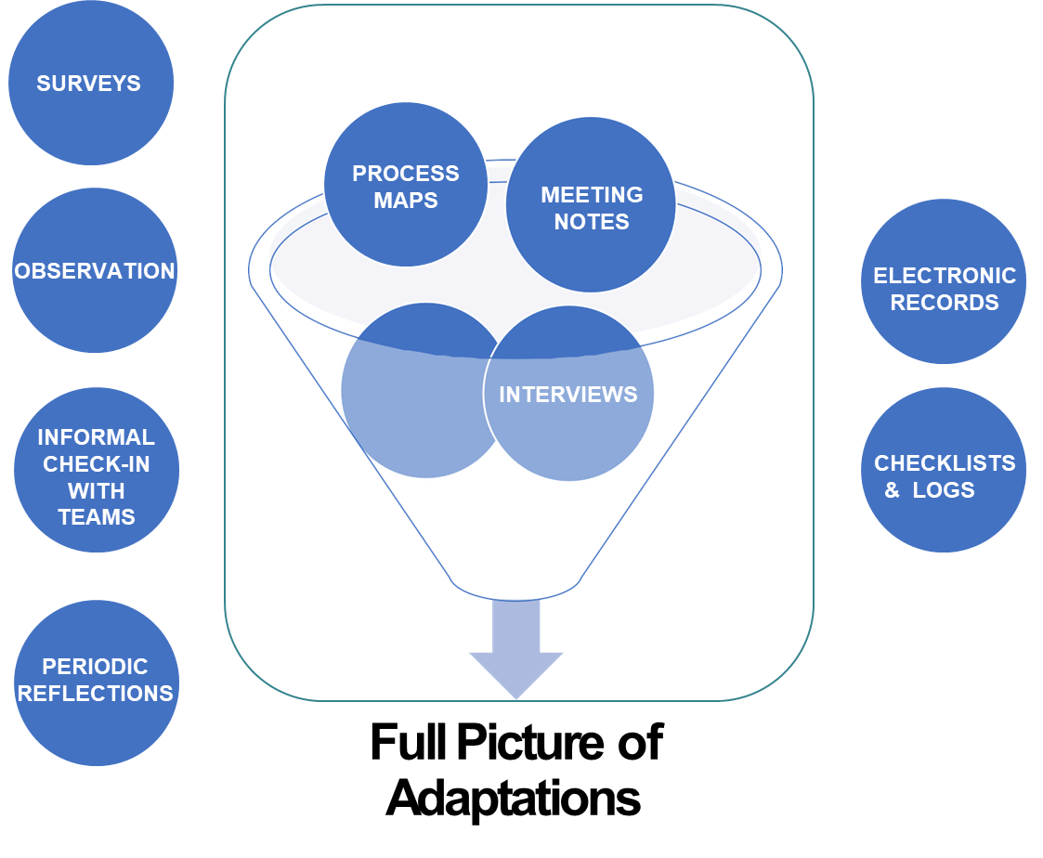
Assessing Adaptations: Multiple Methods are Key
4

Slide 31
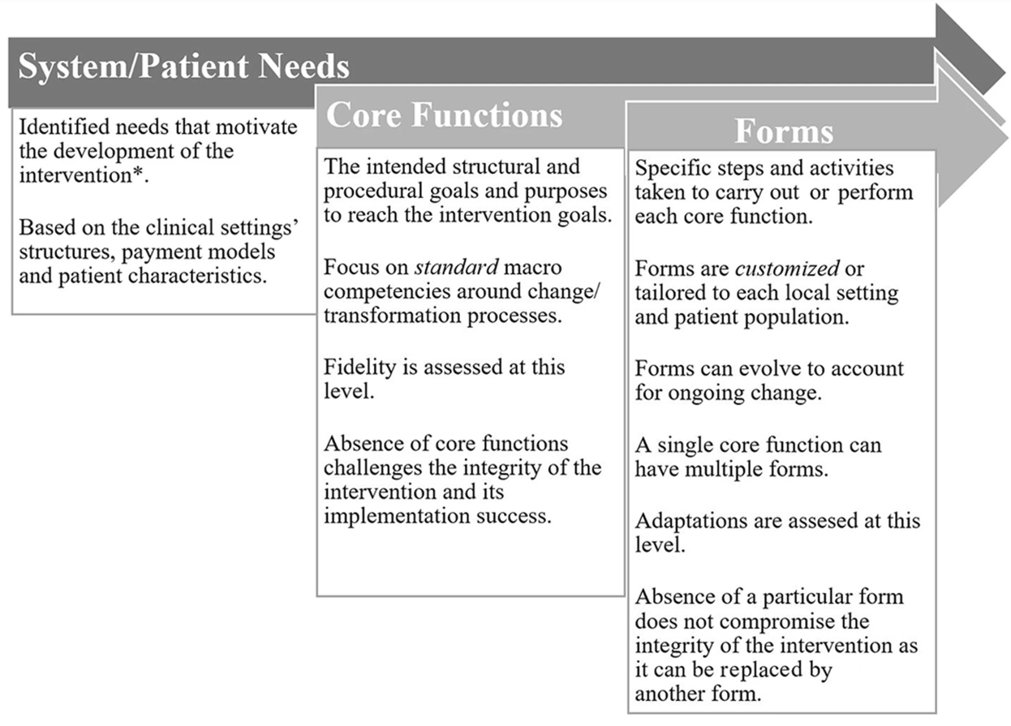
Functions vs. Forms: A different paradigm to conceptualize interventions and guide adaptations
Core Functions = the intervention or strategy’s basic purpose
Forms = specific strategies or activities that may be customized to local contexts that are needed to carry out the core functions
Ideally, an intervention’s or strategy’s core functions and forms align with system and patient needs to ensure the integrity of the intervention and implementation success
Jolles et al. (2019)Journal of General Internal Medicine 34: 1032-8.
“Core functions and forms of complex health interventions: a patient-centered medical home”
4

Slide 32
Key Science Questions- New and Old
Traditional Science and evidence question (necessary but not sufficient):
“What intervention produces the largest average effect in tightly controlled trials on the primary (clinical) outcome?
Pragmatic Implementation Science question: (contextual)
“What program/policy functions are most effective for producing what outcomes for which populations/recipients when implemented by what type of persons using what strategies under what conditions, using how many resources and how/why do these results occur?”
4

Slide 33
Summary and Future Opportunities:
What Can Implementation Science Do for You?
Select and Use Conceptual Theories, Models, and Frameworks
Understand (and Address) Context
Assess (and Guide) Adaptations
Assess and Address Health Equity and Disparities
Map and Understand the Sequence of Implementation Actions
Select and Use Implementation Strategies
Where We Are Headed?
  Designing for Sustainability, Dissemination, and Equity
  Pharmacogenetics and Learning Health Systems
Pragmatic Research

Slide 34

The Future (one version): “D4DES”

Slide 35
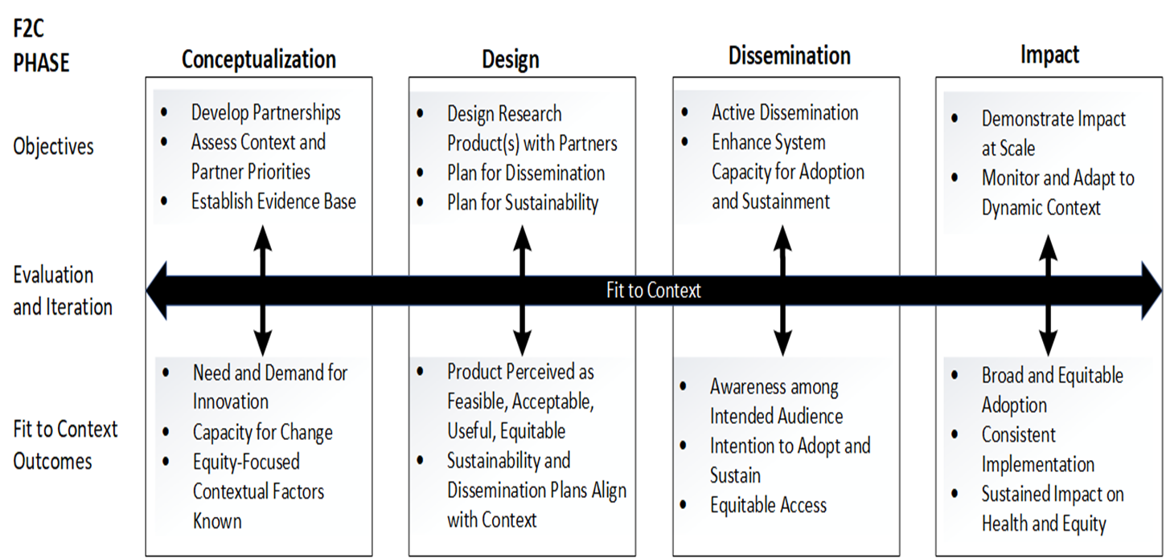
The Fit to Context (F2C) Framework for Designing for Dissemination, Equity & Sustainability
Kwan BM, Luke DA, Adsul P, Koorts H, Morrato EH, Glasgow RE. Designing for Dissemination and Sustainability: Principles, Methods, and Frameworks for Ensuring Fit to Context. In: Dissemination and Implementation Brownson, Colditz, & Proctor. (2018). Research in Health: Translating Science to Practice, 3rd ed.
5
Notes:
The F2C Framework was designed to address three major roadblocks to impact in CTS – a poor fit between the products of research and the context and setting for intended use, lack of capacity to adopt and sustain the products of research in real-world settings, and inattention to the need to plan for active dissemination to target audiences.

Slide 36
COISC3 = Colorado Implementation Science Center in Cancer Control
https://coisc3.org
5

Slide 37
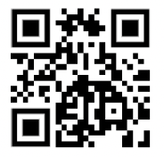
iPRISM webtool: Purpose
Simplify implementation science - using PRISM
  For diverse researchers and implementation teams
  Support rapid learning health systems
  In English and Spanish
Guide and prompt users to iteratively
  Assess context
  Align project with context
  Assess progress on key outcomes
  Develop feasible and impactful strategies/adaptations
  Create action plans
https://prismtool.org
Trinkley et al. Acad Med. 2022;97:1447; Trinkley et al, in press
Maw et al. Implement Sci Commun. 2022;3:89
5

Slide 38
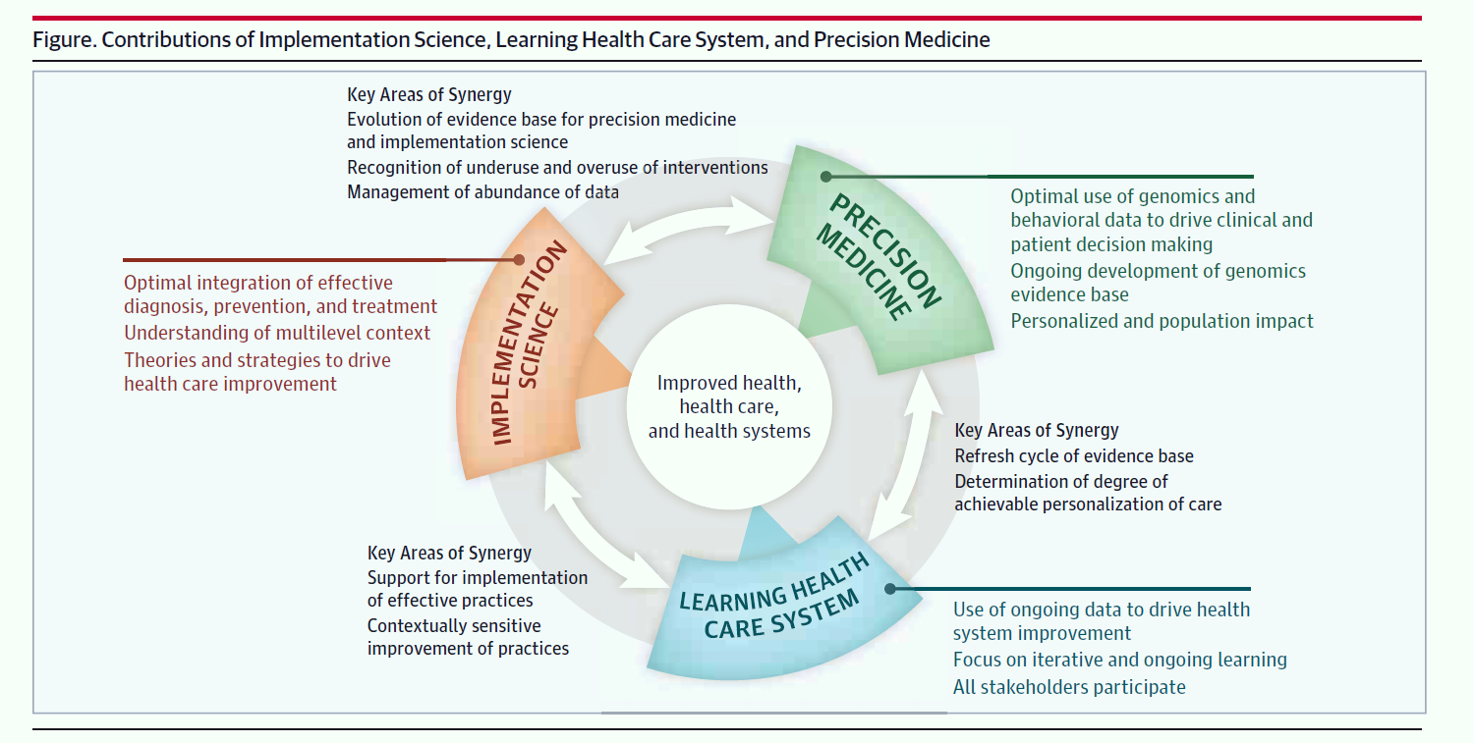
Convergence of Precision Health (pharmacogenetics), Implementation Science, Learning Health Care Systems and Communities
Chambers DA, Feero WG, Khoury MJ. JAMA. 2016, 315: 1941-1942
Trinkley KE, et al Contribute to the Advancement of Learning Health Systems. Acad Med. 2022 10 01; 97(10):1447-1458. PMID: 35796045.
5

Slide 39
RE-AIM Pharmacogenetics (or Precision Health- PH): Questions to Ask and Design to Address
Determine and Enhance:
What percent and types of patients are Reached (equity)?
For whom among them is the PH intervention Effective, in improving what outcomes, with what unanticipated consequences (is health equity improved or decreased)?
In what percent and types of settings is this intervention Adopted?
How consistently are different PH solutions Implemented at what cost to whom?
And how well are the PH intervention components and their effects Maintained at both setting and individual levels?
……. AND- at EACH LEVEL- who benefits and who does not?
    Kuo GM, Trinkley, K, Rabin B. Implementation science studies. (2022). JACCP doi: 10.1102/jac5.1673
    Gaglio B, Glasgow RE. Evaluation approaches…In: Brownson R, Colditz G, Proctor E, (Eds). Dissemination and implementation research in health. New York: Oxford University Press; 2018. 317-334.
5

Slide 40
Everything I Know
(about Implementation Science)
Implementation Science is about:
Multi-level, contextual issues, and external validity
Relevant, pragmatic models, research methods and measures
Real world implementation and adaptation (T3 and T4)
Designing for dissemination, sustainability and equity
(Normal science (T1– T2) is necessary but not sufficient)
5

Slide 41

IF AN INTERVENTION WORKS
AND NOBODY CAN USE IT…
DOES IT STILL MAKE AN IMPACT?

Slide 42
Thank you
Russell E. Glasgow, PhD
russell.glasgow@cuanschutz.edu
Twitter: @RussGlasgow

Slide 43

Brief explainer videos
FAQ’s and examples
Guidance on application
Searchable list of 700+ article abstracts
Calculators, checklists, tools
Recommended slides
Webinars, upcoming events, blogs
Additional Resources at www.re-aim.org
Glasgow et al (2019). RE-AIM Planning and Evaluation Framework: 20-Year Review. Front Public Health, 7, 64. doi:10.3389
Holtrop et al. (2021) Understanding and applying the RE-AIM framework J Clinical Translat Sci, page 1 of 10. doi: 10.1017/cts.2021.789
Special issue Front PH- 13 articles https://www.frontiersin.org/research-topics/10170/
Notes:
Many additional resources are available at re-aim.org. At re-aim.org you can find:
FAQ’s,
Guidance on applying RE-AIM, including quantitative and qualitative approaches.
A searchable list of 600+ RE-AIM article abstracts, plus a list of over 40 key publications.
Various tools including calculators and checklists.
Links to webinars, upcoming events, and blogs.

Slide 44
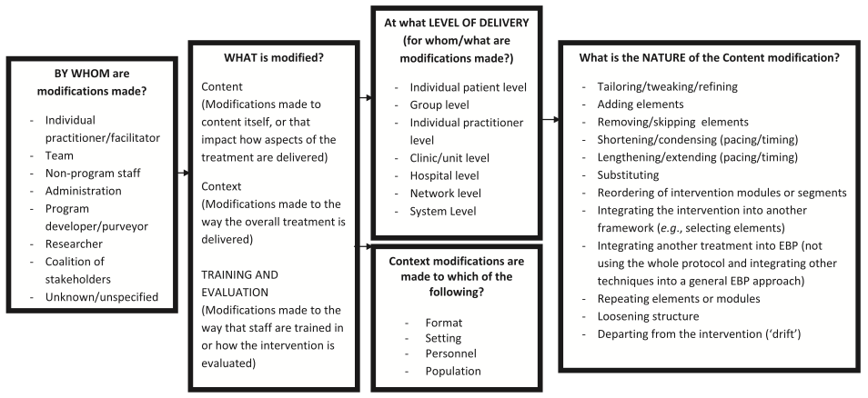
Adapting the FRAME-IS framework using the RE-AIM model and clinical experience
        Hall et. al. Translational Behavioral Medicine, 2017, DOI 10.1007/s13142-017-0511-3
        Stirman et. al.
WHY – What is the purpose of the adaptation?
Increase reach, participation, access
Increase effectiveness
Increase adoption by more clinics/settings or make intervention more aligned with organizational goals
Increase implementation/ability of staff to deliver intervention successfully
Increase maintenance – to make intervention more likely to be institutionalized
IMPACT – What are (subjective) short term results of the adaptation?
Are they positive, negative, no real impact?
Did the changes impact:
  Reach/participation/access
  Effectiveness
  Adoption
  Implementation/ability of staff to deliver intervention successfully
  Maintenance
4
Notes:
To conceptualize adaptations we used a modified version of the Stirman et al Adaptation Framework influenced by:
the RE-AIM model – IN RED; AND
and clinical experience SPECIFIC TO PRIMARY CARE TRANSFORMATION*
Stirman SW et al. Development of a framework and coding system for modifications and adaptations of evidence-based interventions. Implementation Science 2013, 8:65.
Hall et al. Understanding adaptations to patient-centered medical home activities: The PCMH adaptations model
Translational Behavioral Medicine, 2017, DOI 10.1007/s13142-017-0511-3

Slide 45
Pragmatic Use of RE-AIM – What is Feasible?
RE-AIM Dimension | Key Pragmatic Priorities to Consider and Answer
Reach (Individual Level) | WHO is (was) intended to benefit and who actually participates or is exposed to the ‘program’ or policy?
Effectiveness (Individual Level) | WHAT is (was) the most important benefit you are trying to achieve and what is (was) the likelihood of negative outcomes?
Adoption (Setting Levels) | WHERE is (was) the program or policy applied WHO applied it?
Implementation (Setting Levels) | HOW consistently is (was) the program or policy delivered? HOW will (was) it be adapted? HOW much will (did) it cost? WHY will (did) the results come about?
Maintenance (Individual and Setting Levels) | WHEN will (was) the program become operational; how long will (was) it be sustained (setting level); and how long are the results sustained (individual level)?
Glasgow RE & Estabrooks, P. Preventing Chronic Disease, 2018; 15: E02
Notes:
Program, policy, product. Intervention, innovation, assessment

Slide 46
Some Remedies and Key Terms
Implementation science is the study of methods to promote the integration of research findings and evidence into healthcare policy and practice.
Dissemination research is the scientific study of targeted distribution of information and intervention materials to a specific public health or clinical practice audience. The intent is to understand how best to spread and sustain knowledge and the associated evidence-based interventions.
Implementation research is the scientific study of the use of strategies to adopt and integrate evidence-based health interventions into clinical and community settings to improve patient outcomes and benefit population health.
Pragmatic research is the use of real-world tests in real-world populations and situations.
Brownson, Colditz & Proctor. Dissemination and Implementation Research in Health 2018

Slide 48

THANK YOU

