Slide 1
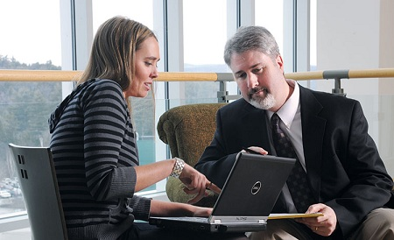
Student Projects for the Clinic

Slide 2
Objectives
Describe how a student project can provide value to the clinic
Describe the process and players involved
Provide examples of student projects to stimulate brainstorming ideas that would be pertinent at the clinical site and add value to the student experience

Slide 3
Value to the Student and the Clinic
Can start &/or finish those projects the staff hasn’t had time to complete
Provides the student with opportunities to:
demonstrate initiative and accountability
understand the role of a PT as a team member
understand the role of a PT in quality improvement/quality control
develop an understanding of administrative/managerial areas
Allows the student to share their knowledge with the staff & develop presentation skills in some instances

Slide 4
Who are the players in the process?
Student
Site Project Liaison
Suggested to be different from CI to offload their work & time involvement
Can function for multiple students at site simultaneously
Allows student to work with additional staff members

Slide 5
Responsibilities
Project Liaison
Provides & discusses project options
Offers guidance and resources as needed
Provides timeline
Clearly communicates what the project outcome should be
Student
Completes project
Communicates with Project Liaison & seeks resources as needed

Slide 6
Project Selection
Consider the timeline for completion (# of weeks to complete)
Set weekly, attainable project goals/checkpoints
Clinically relevant to the student’s patient population
Consider all aspects of PT practice (patient care, documentation, reimbursement, skill or equipment competency, community outreach or marketing, PTA/tech supervision, standards of care, student management, clinical research, etc)

Slide 7
The Idea List
Have a standing document in the department
Anyone can add an idea to the list
Review it at staff meetings for appropriateness
Allow the student to choose from list or present/develop his or her own idea based on observations of the unit and how it functions

Slide 8
Inservices
Traditional way of students contributing to clinic
Appropriate for EBP knowledge dissemination, literature search strategies, etc.
Only one of many options for student projects

Slide 9
Topic Areas
Coding/Billing procedures
Policies & Procedures
Staff recruitment/retention
Patient satisfaction assessment
Job descriptions
Facility accreditation
Budgeting/finance
Risk management
Supervision/delegation of support staff
Quality improvement/control
Medicare compliance
Marketing
Documentation reviews
Inventory tracking
Program development
Productivity assessment
Outcomes assessment
Student orientation & experiences
Forms

Slide 10
Project Examples
Development of a customer service satisfaction survey
Start a journal club
Apps & technology uses in the clinic (HEP with digital photos, eg)
Program development &/or promotional materials
HEP form development
Quick reference forms for equipment
Psychometric properties of common tests & measures
Implementation of outcomes measures in the clinical setting
CSIF form completion
Form or content development
Skill competencies
Equipment competencies
Prognostic indicators in various practice settings
Inservices (topics such as: APTA shift to ICF model language, EBP on areas of practice, etc)
Skills fairs for other disciplines (transfer & gait training for CNAs/RNs)
Development of patient education materials

Slide 11
The Win-Win
Project must be interesting & relevant to the student so that you get his/her best effort
It must fit a clear need in the clinic (Utility)
Project Liaison must be available for weekly consultation & provide objective feedback to the student throughout the project

