Slide 1
Pulmonary Grand Rounds
Shelly Forbes and Alicia Rizzo
Pulmonary and Critical Care Fellows
University of Colorado
April 9th, 2020

Slide 2
Clinical Presentation

Slide 3
Additional History

Slide 4
Physical Exam

Slide 5
Laboratory Data
134 102 18
4.6 24 0.91
13.4
111
7.8 427
39.6
Protein 7.6
Albumin 4.1
Tbili 0.4
AST 17
ALT 16
Alk Phos 106
PMN 72%
Lymph 13%
Mono/macro 10%
Eosinophil 4%
Basophil 0%

Slide 6
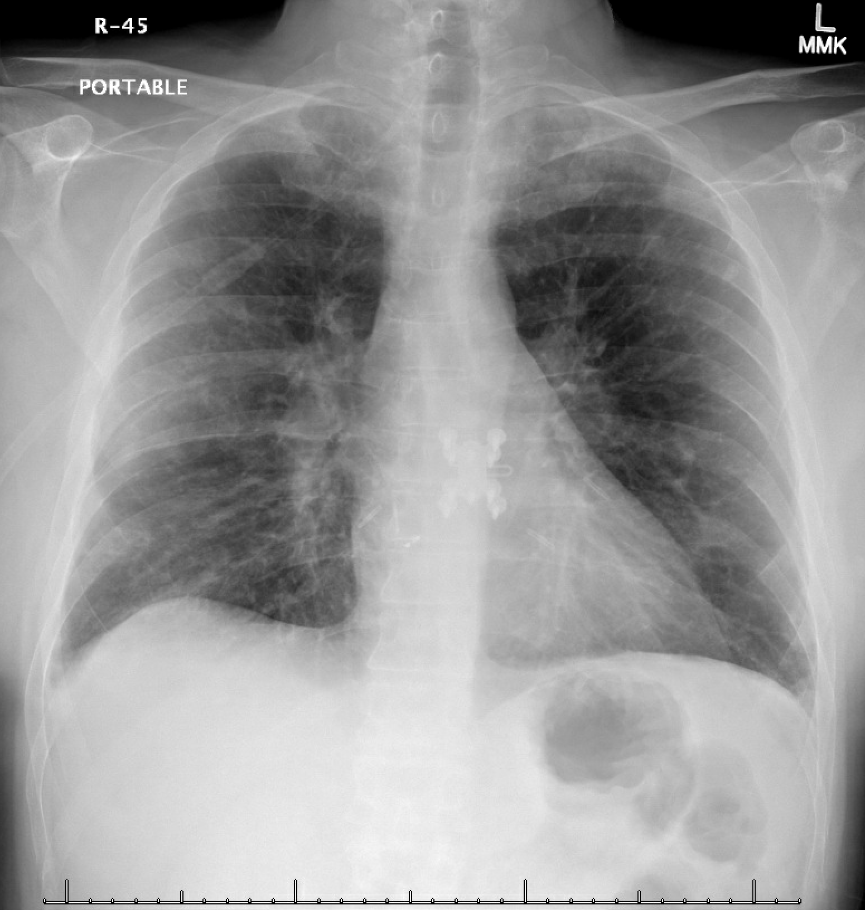

Slide 7
Infectious Studies
RVP negative
Strep/Legionella UAg negative
Sputum Cx negative
Blood Cultures negative

Slide 8
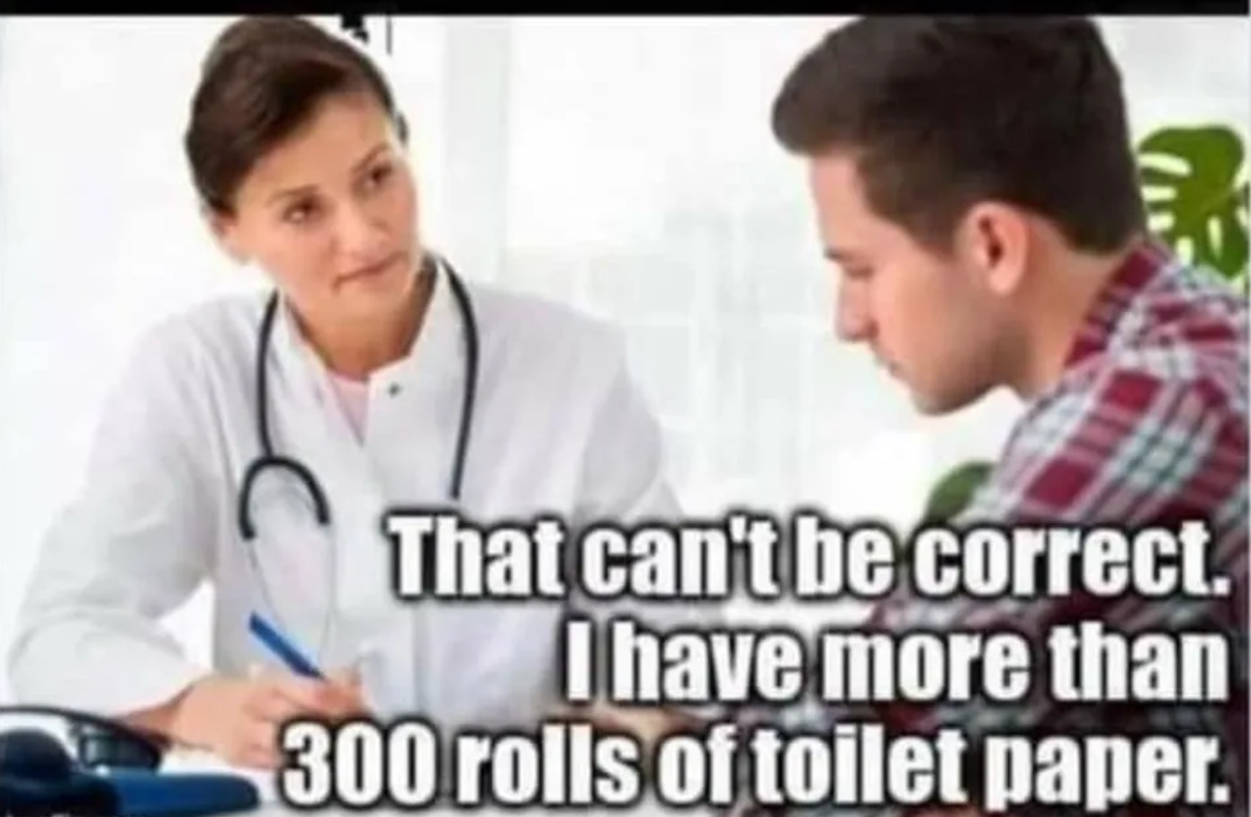

Slide 9
COVID-19 ARDS

Slide 10
Management of COVID-19 ARDS
In comparison with the management of ARDS in the pre-COVID-19 era how should we be changing our practices to consider:
Health-care provider safety?
Patient safety?
Ventilator shortages?
Medication shortages?
Topics for Discussion: care team structure, oxygen delivery methods, ventilator management, and sedation practices
Notes:
Specifically hoping that discussants could touch on various oxygen delivery methods, ventilator management, sedation practices

Slide 11
Targeted Pharmacotherapies for COVID-19

Slide 12
START OF SLIDES REVIEWING CLINICAL TRIALS

Slide 13
References

