Slide 1
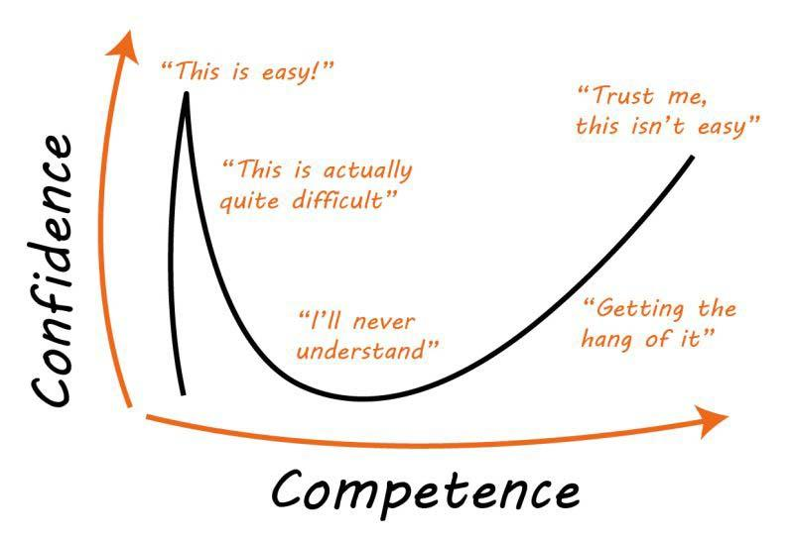
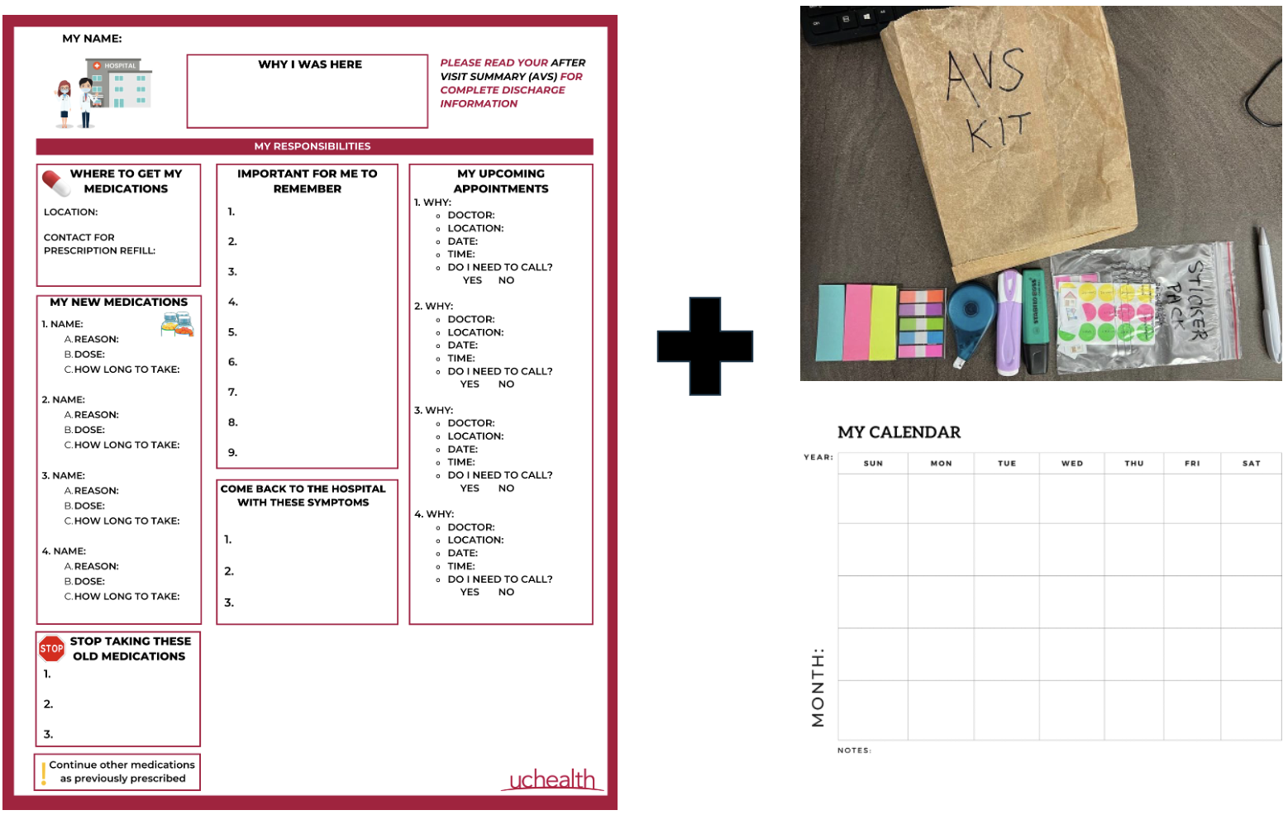
TAKING CHARGE OF DISCHARGE: A PATIENT-CENTERED APPROACH
Kimia Ziafat, BSc, MSc, MD Student¹; Michelle Yan, BKin, MD Student²; Yassine Lamzadrhi, MD Student³; Emmanuel Cruz, BS, MEng, MD Student⁴; Tyler Anstett, DO⁴; Samuel Porter, MD⁴; Michelle Knees, DO⁴
University of British Columbia, Faculty of Medicine
Washington State University Elson S. Floyd College od Medicine
Cheikh Anta Diop University, Faculty of Medicine
University of Colorado, School of Medicine
Background
Design Thinking Iterations & Feedback
Conclusions & Reflections
HCAHPS is a post-discharge survey which aims to capture a patient’s experience during and after hospitalization and influencing Medicaid and Medicare reimbursements (1).
Discharge communication is critical for patient safety and overall health outcomes (2,3).
We examined low scores from the “Understanding Your Care” category within HCAHPS at our institution and aimed to understand why by asking patients and relevant parties involved in discharge from hospital medicine services at The University of Colorado Hospital.
Utilizing design thinking, solution prototypes were created for testing on the wards, based on interview findings.
Iteration #1
Methods
Using Design thinking, we produced low-cost prototypes and rich feedback on workflow and patient-centered solutions with the potential to increase patient engagement and empower active involvement during the discharge process.
We addressed two HCAHPS questions:
When I left the hospital, I had a good understanding of the things I was responsible for in managing my health.
When I left the hospital, I clearly understood the purpose for taking each of my medications.
Interviews Conducted
17 Patients
10 Solution Tests
9 Discharges
7 Attending Physicians
4 Discharge Nurses
Throughout our interviews, patients consistently reported high confidence and readiness for discharge. However, when asked to confirm care plans, responses were basic, patients had incorrect understanding, or reported: “I will know when I get home and look this all over”.
Thus, we gathered that patients typically do not have a clear understanding of their health responsibilities at time of discharge.
Feedback
+ Logical order, simple, one-page summary
- Test like
+ Variety of organized sections, color, logical order
- Strict flow, too many graphics
+ Identify most important points, use in combination with storyboard & calendar
PATIENT FEEDBACK
Abundance of information
The design and structure of the AVS
Don't understand the content: language barriers; cognitive disorders...
Time limitations:
So little time to go through all the AVS and think of questions
"It would be more helpful if we were educated about the AVS instructions earlier during our stay."
Mismatch between patient reported confidence (high), and knowledge in managing own health (low)
NURSE FEEDBACK
Communication:
Chart Update
Confusion about the indications of some medications
Lack of the patient's focus
Pressure:
Workload
Timing: discharge patients to admit new ones
Next Steps
Complete prototyping and testing of the solution, particularly with diverse groups of patients and staff involved in patient care.
Perform a one-month pilot on a few select units to check for improvement in patient experience data, using pre-post patient testing for knowledge acquisition and satisfaction, and assess changes to discharge time, following solution implementation.
If pilot adds significant value to staff, roll out the solution as a division, continue to incentivize adoption, and draft a hospital-wide solution.
Assess feasibility and longevity of solution implementation on the units.
Iteration #2
Feedback
+ This solution forces patients to know what they don’t know
+ The AVS Kit is being used
actively on the floor
- The design is not strong
enough to incentivize patients
References
Increasing patient interaction and engagement during the discharge process could help increase knowledge retention and confidence among patients
Hospital Consumer Assessment of Healthcare Providers and Systems. Survey Instruments. HCAHPS Online. August 3rd, 2023. Accessed November 6th, 2023. https://www.hcahpsonline.org/en/survey-instruments/
Howard-Anderson J, Busuttil A, Lonowski S, Vangala S, Afsar-Manesh N. From discharge to readmission: Understanding the process from the patient perspective. J Hosp Med. 2016;11(6):407-412. doi:10.1002/jhm.2560
Krook, M., Iwarzon, M., & Siouta, E. (2020). The Discharge Process-From a Patient's Perspective. SAGE open nursing, 6, 2377960819900707. https://doi.org/10.1177/2377960819900707
DeSai, C., Janowiak, K., Secheli, B., Phelps, E., McDonald, S., Reed, G., & Blomkalns, A. (2021). Empowering patients: simplifying discharge instructions. BMJ Open Quality, 10(3), e001419. https://doi.org/10.1136%2Fbmjoq-2021-001419
KEY INSIGHT:

