Slide 1
Tracheal Intubation in the Pediatric Emergency Department: Initial Findings from the VIPER Collaborative
Sage Myers, MD MSCE
on behalf of VIPER Collaborative

Slide 2
VIPER: Videography In Pediatric Emergency Resuscitation (VIPER)
Resuscitation events relatively uncommon
Detailed study requires multiple centers
Valid data collection difficult
Collaborative of 3 sites
Children’s Hospital of Philadelphia
Children’s National Medical Center
Cincinnati Children’s Hospital and Medical Center
Notes:
Mention likely extension to other sites
Summarize methods/database/video and continuously measured VS?

Slide 3
Background: Tracheal Intubation
Essential but uncommon for individual providers in a PED
Self-report/chart review: unreliable for data on success/adverse events*
Video review allows accurate and comprehensive data collection
*Kerrey et al 2012, Rinderknecht et al 2017
Notes:
Mention that we combine video with direct collection of VS data from the monitor

Slide 4
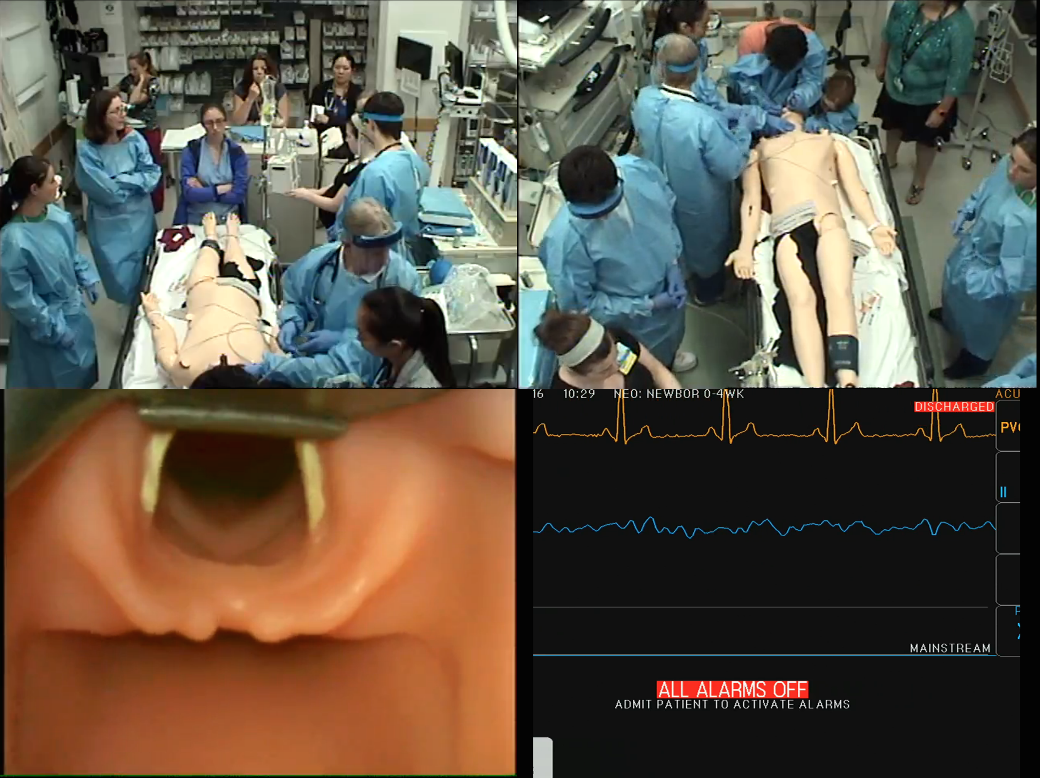
Methods: Tracheal Intubation
Outcomes
Technical
Attempt success/number
Occurrence and duration/depth of hypoxemia
Adjunctive maneuvers
Duration of pre-oxygenation
Duration of laryngoscopy
Time to tube insertion
Time to ETCO2 detection
Notes:
Mention that numerous data for TI were abstracted from the registry, including technical aspects of the procedure and outcomes. Because we used video, we were able to parse each procedure into its various components, including pre-ox, laryngoscopy, tube insertion, and confirmation. Typically, the relative duration of each is difficult/impossible to determine from the chart/self-report.

Slide 5
Results
140 patients with complete data
216 attempts
By center:
CHOP:
CNMC:
CCHMC:

Slide 6
Results: Attempt Success
Technical aspects
First attempt success | 89 (64%)
Notes:
Maybe make the time ones into bar graph
I think that the people will most want to know:
First attempt success/total attempts
Duration of attempts
Desats
Times
Adjunctive maneuvers
I suggest presenting

Slide 7
Results: Hypoxemia
Outcomes
Desaturation (among those not in cardiac arrest) | 42 (24%)
Median duration of hypoxemia | 165 sec | +/- 300 sec
Notes:
desat <90%

Slide 8
Results: Technical
Technical aspects
Mean duration preoxygenation first attempt | 727 sec | +/- 667 sec
Mean duration preoxygenation subsequent attempts | 154 sec | +/-184 sec
Mean duration of laryngoscopy | 42 sec | +/- 27 sec
Mean time to tube insertion | 23 sec | +/- 16 sec
Mean time to ETCO2 detection for successful attempts | 71 sec | +/- 102 sec
Notes:
Maybe make the time ones into bar graph
I think that the people will most want to know:
First attempt success/total attempts
Duration of attempts
Desats
Times
Adjunctive maneuvers
I suggest presenting

Slide 9
Results
Adjunctive Maneuvers | n | %
Cricoid pressure | 59 | 27%
External laryngeal maipulation | 9 | 4%
Apneic oxygenation | 8 | 8%
Retraction of right corner of mouth | 16 | 9%

Slide 10
Limitations
Uneven enrollment
?

Slide 11
Future Directions
GBR

Slide 12
Conclusions
First attempt failure, prolonged attempts and adverse events relatively common
Adjunctive maneuvers to improve success and prevent hypoxemia relatively rare
Video-based data registry allows accurate and comprehensive assessment of TI performance across multiple sites

Slide 13
VIPER Collaborative
CHOP
Aaron Donoghue, MD MSCE
Sage Myers
CNMC
Karen O’Connell, MD
Allison Mak
Alexis Sandler
CCHMC
Benjamin Kerrey, MD
Mary Frey
Stephanie Boyd, pHD
Notes:
? Should divide by location and put local logos- I am fine either way

