Slide 1
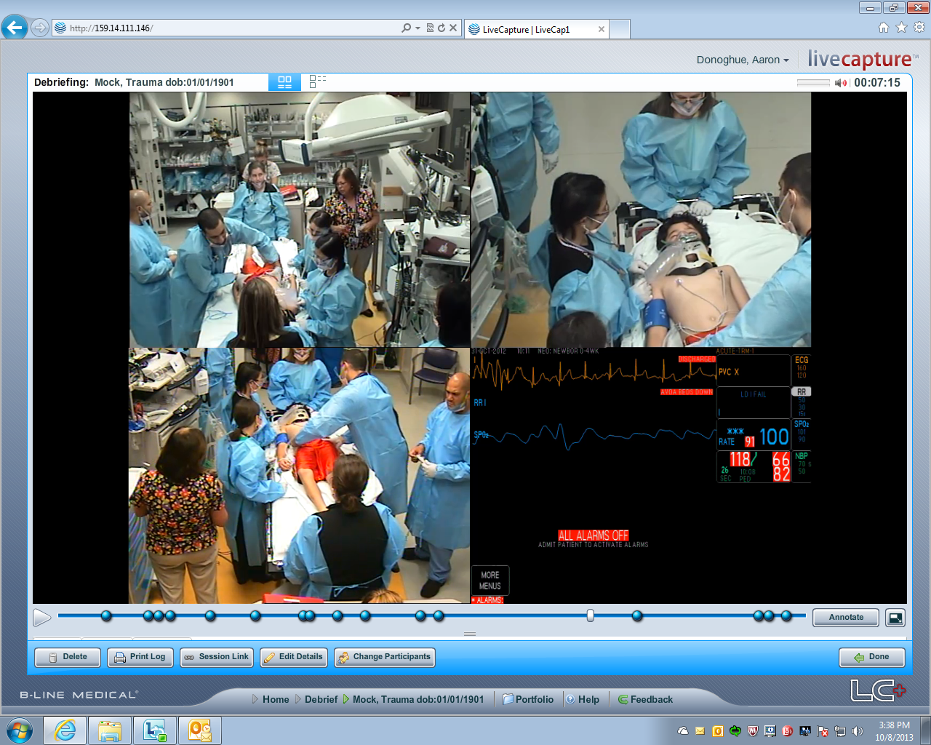
88
The Videography In Pediatric Emergency Resuscitation (VIPER) Collaborative:
Simulation to Assess Feasibility and Reliability of a Video-based Resuscitation Registry
Ben T. Kerrey¹, Karen J. O'Connell², Sage R. Myers³, Allison L. Mak³, Aaron J. Donoghue^{3,4}
1 Division of Emergency Medicine and the Center for Simulation and Research, Cincinnati Children's Hospital Medical Center, Cincinnati, OH, 2 Division of Emergency Medicine, Children's National Medical Center, Washington, D.C., 3 Division of Emergency Medicine and 4Critical Care Medicine, Children’s Hospital of Philadelphia, PA, USA
TAKE HOME: A video-based data registry developed through simulated resuscitations in a pediatric ED is generally feasible and reliable.
Methods
Results
Next Steps
Prospective, observational study
Simulated pediatric resuscitations in a PED
Existing resident education curriculum
Three VIPER PEDs: resuscitation equipped with digital cameras/microphones
VIPER registry drafted by expert consensus and refined via iterative process
Data fields: our studies/AHA guidelines
4 main domains for data field:
Monitors and vitals
Primary survey
Basic interventions
Tracheal intubation
3 investigators independently reviewed simulations of pediatric resuscitation
Analysis
Feasibility: indeterminate fields (%)
Reliability: weighted Cohen’s kappa and intra-class correlation coefficients
3 simulations reviewed
Feasibility (178 data fields)
4% indeterminate (67 of 1,602 fields among 3 simulations and 3 reviewers)
Reliability (Table) measures high
except primary survey
Refine 1◦ survey fields
Add CPR and teamwork
Validate for actual pts
Add centers
GOAL: create opportunities to conduct robust research on rare pediatric resuscitation events and evaluate needed interventions to improve care and outcomes for a vulnerable population
Background
Studies of resuscitative care in an emergency department (ED) are limited by single center nature (limited power and generalizability) and standard methods of data collection (chart review, self-report). We developed a multicenter, video-based collaborative (VIPER) to facilitate high quality clinical research and quality improvement initiatives
5
Table
Dichotomous Fields | k
All | 0.83
Monitors and vital signs | 0.93
Primary Survey | 0.48
Basic Interventions | 0.84
Tracheal Intubation | 0.96
Continuous fields | ICC
All | 0.99ª
ª 95% CI = (0.98, 1.0); ICC = intra-class coefficient
Objective
To determine the feasibility and reliability of the VIPER registry using multi-rater video review of in situ simulations
Acknowledgements
The authors thank the Zoll Foundation and their respective Divisions of PEM for their support of this research

