Slide 1
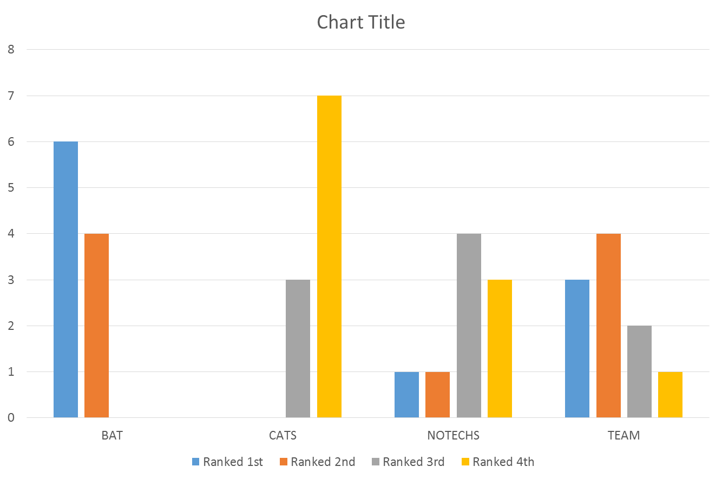
88
Measuring Teamwork during Simulated Pediatric Resuscitations: An Assessment of Existing Tools
A Report from the Videography In Pediatric Emergency Resuscitation (VIPER) Collaborative
Karen J. O‘Connell¹, Benjamin T. Kerrey², Sage R. Myers³, Jennifer Lapin⁴, Judy Shea⁴, Paul Mullan⁵, Xian Zhao¹, Grace Good³, Lauren E. Zinns³, Marleny Franco³,
Desiree Seeyave¹, Eva M. Delgado³, Andrea Rinderknecht², Kristen Crandall¹, Payal Gala³, Aaron J. Donoghue^{6,3}
¹Division of Emergency Medicine, Children's National Medical Center, Washington, DC; ²Division of Emergency Medicine, Cincinnati Children’s Hospital Medical Center, Cincinnati, OH; ³Division of Emergency Medicine, Children’s Hospital of Philadelphia, PA, ⁴University of Pennsylvania, Philadelphia, PA; ⁵Division of Emergency Medicine, Children’s Hospital of the King’s Daughters, Norfolk, VA; ⁶Division of Critical Care Medicine, Children’s Hospital of Philadelphia, PA, United States
Background
Methods
Results
Medical resuscitation teams are ad hoc, inter-disciplinary and deploy for potentially critically ill patients
Effective team performance relies on both technical and nontechnical skills
Nontechnical skills focus on key principles of crisis resource management (CRM):
Leadership
Followership
Communication
Human and material resource utilization
Situational awareness
Multiple published instruments exist for quantifying CRM performance in clinical environments
Our research collaborative plans to study CRM performance measured by video review of actual pediatric resuscitations
Prospective, observational study of video recorded, simulated pediatric resuscitations
8 scenarios total: 4 cases run in pairs, with a pre- and post-debriefing session
10 independent clinician raters scored a random sample of 4 out of 8 sessions
Four published tools used to evaluate team performance (randomly assigned to raters, 3 tools per case reviewed) (see below)
Raters were asked to rank tools in order of preferences following completion of reviews
Analysis:
Generalizability study to evaluate variance components from Raters, Scenarios, and Items
Decision study to assess changes in coefficients under different conditions
Rater preference among tools (descriptive)
 | Percentage of observed variance
 | BAT | CATS | NOTECH | TEAM
Rater | 0.00 | 0.04 | 0.00 | 0.02
Scenario | 0.56 | 0.14 | 0.40 | 0.37
Item | 0.00 | 0.15 | 0.03 | 0.01
R x S | 0.00 | 0.05 | 0.27 | 0.14
R x I | 0.14 | 0.16 | 0.06 | 0.06
S x I | 0.06 | 0.11 | 0.02 | 0.04
S x I x R | 0.24 | 0.36 | 0.22 | 0.36
G coefficient | 0.90 | 0.15 | 1.0 | 0.78
Rater preference among tools: #1 BAT, #2 TEAM, #3 NOTECHS, #4 CATS
Scores were higher during post-debriefing scenarios for all cases and all tools
All 4 instruments had low variability ascribable to Rater (see Table); the BAT and NOTECHS showed the lowest Rater variance components
D-study results: increasing the number of Raters or Scenarios would have no effect
BAT was ranked as most preferred by 6/10 raters
Next Steps
Study team members from the VIPER Collaborative will use the BAT to score CRM performance in actual pediatric resuscitations
Interrater agreement will be prospectively analyzed during the first year of data collection with the anticipation that reliability will be high enough not to require multiple raters
Objectives
BAT: Behavioral Assessment Tool 5 point scale 10 items | CATS: Communication and Teamwork Skills 3 point scale 18 items, 4 domains
NOTECHS: Nontechnical Skills Scale for Trauma 5 point scale 5 items | TEAM: Team Emergency Assessment Measure 5 point scale 11 items, 4 domains
To evaluate the psychometrics of four published CRM assessment tools during simulated pediatric resuscitations
To survey expert clinicians as to which tool is most preferred
To select one tool to be used prospectively during video review of actual pediatric resuscitations in a three-center research collaborative (VIPER)
Conclusions
References
All 4 tools exhibited favorable psychometrics
Based on psychometric analysis and expert opinion, the Behavioral Assessment Tool will be used for CRM analysis in the VIPER Collaborative
1. Steinemann S, et al,. Assessing teamwork in the trauma bay: introduction of a modified "NOTECHS" scale for trauma. Am J Surgery 2012
2. Cooper S, et al., Rating medical emergency teamwork performance: Development of the Team Emergency Assessment Measure (TEAM). Resuscitation 2010
3. Frankel A, et al., Using the Communication and Teamwork Skills (CATS) Assessment to measure health care team performance. The Joint Commission J of Qual and Patient Safety 2007
4. LeFlore JL, et al., Alternative educational models for interdisciplinary student teams. Simul Healthc 2009
5
The authors thank and acknowledge the Zoll Foundation for their support of this research.

