Slide 1
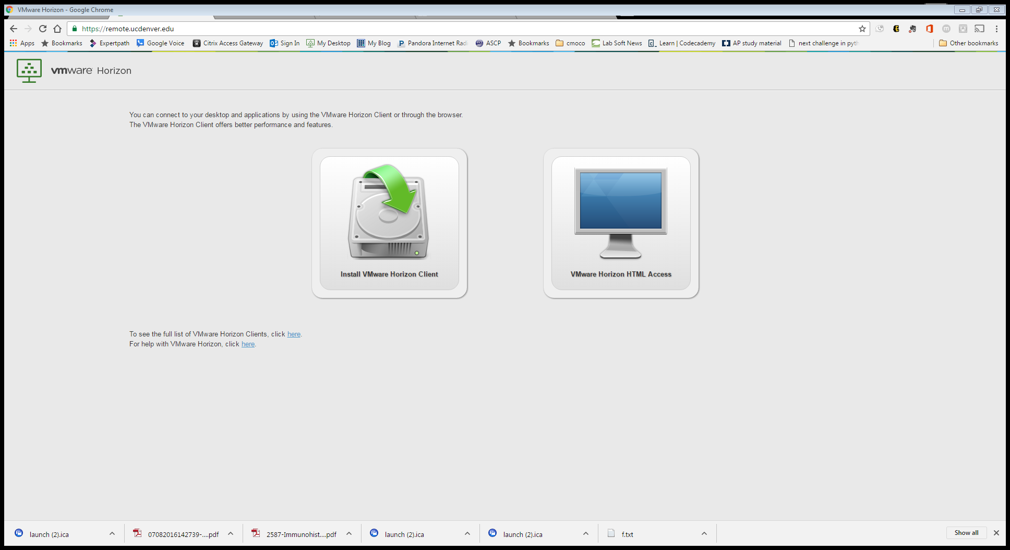
Remote.ucdenver.edu → click Vmware Horizon HTML access

Slide 2
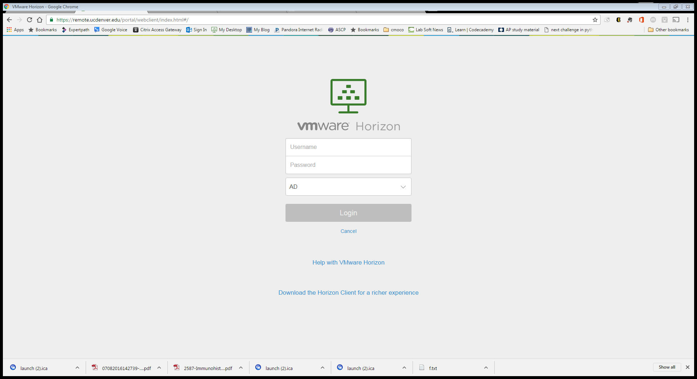
Fill out login, change AD → University

Slide 3
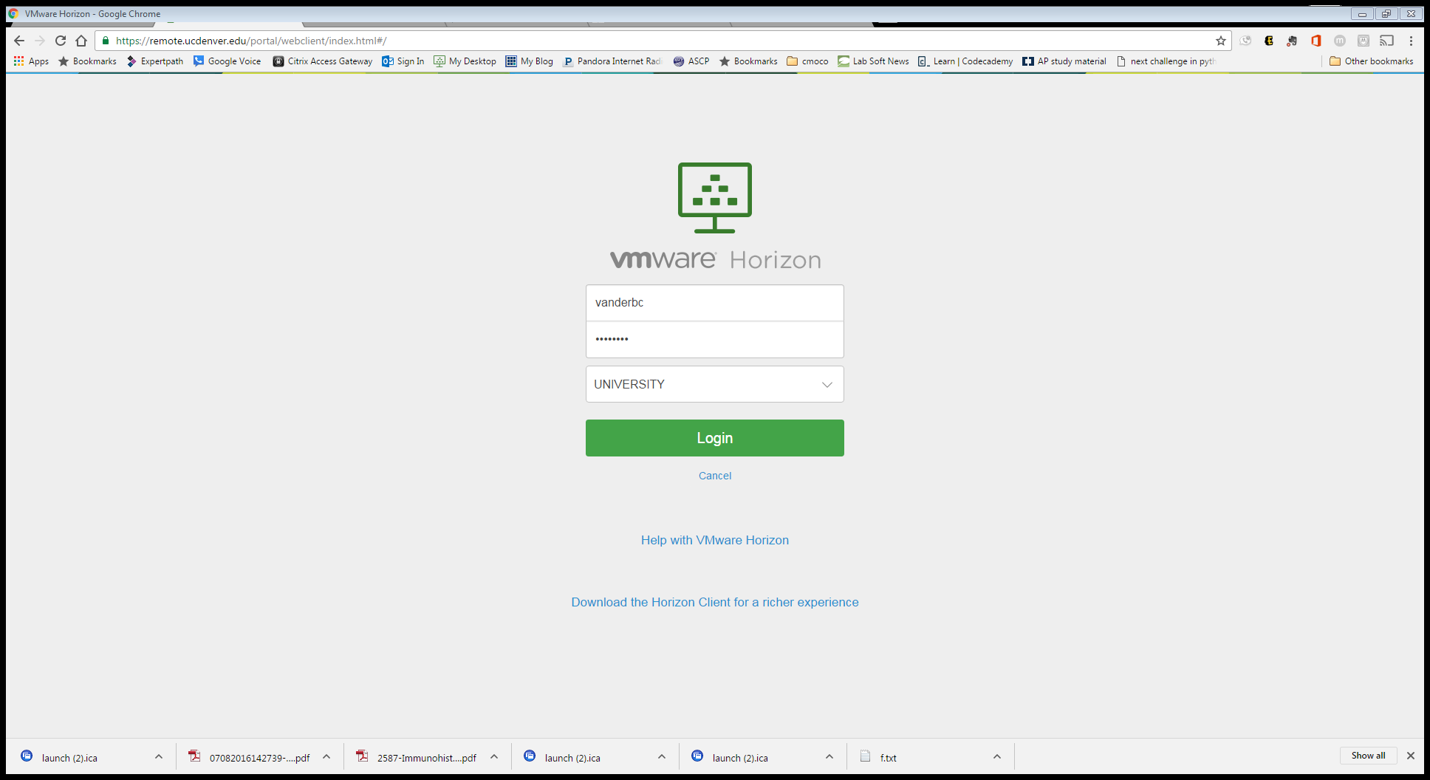
login

Slide 4
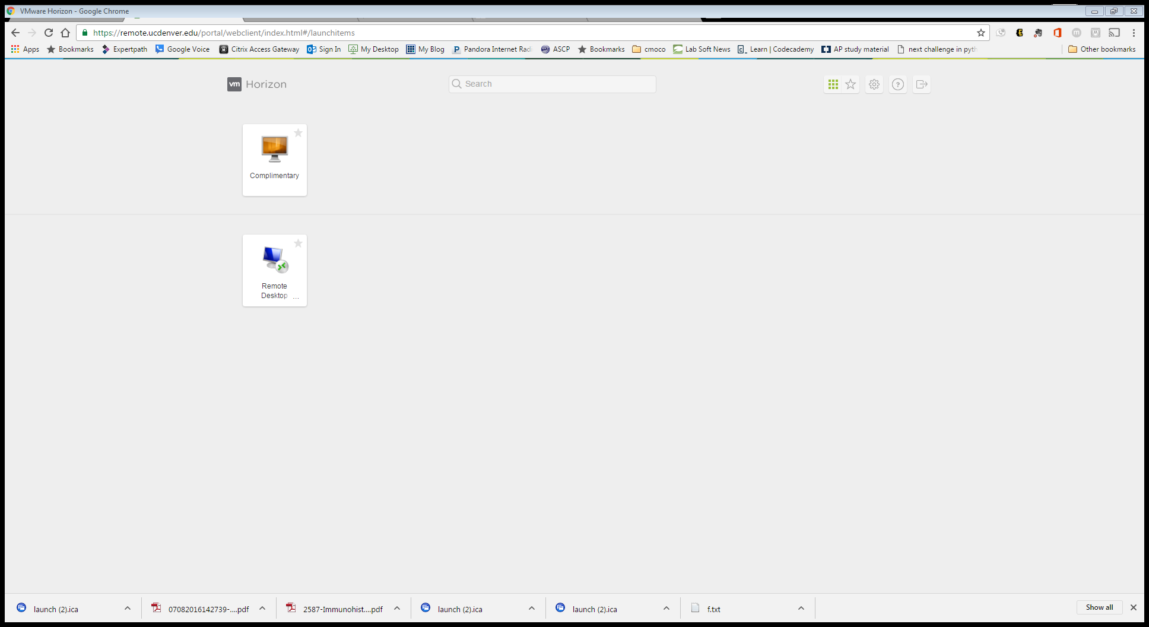
Click complementary

Slide 5
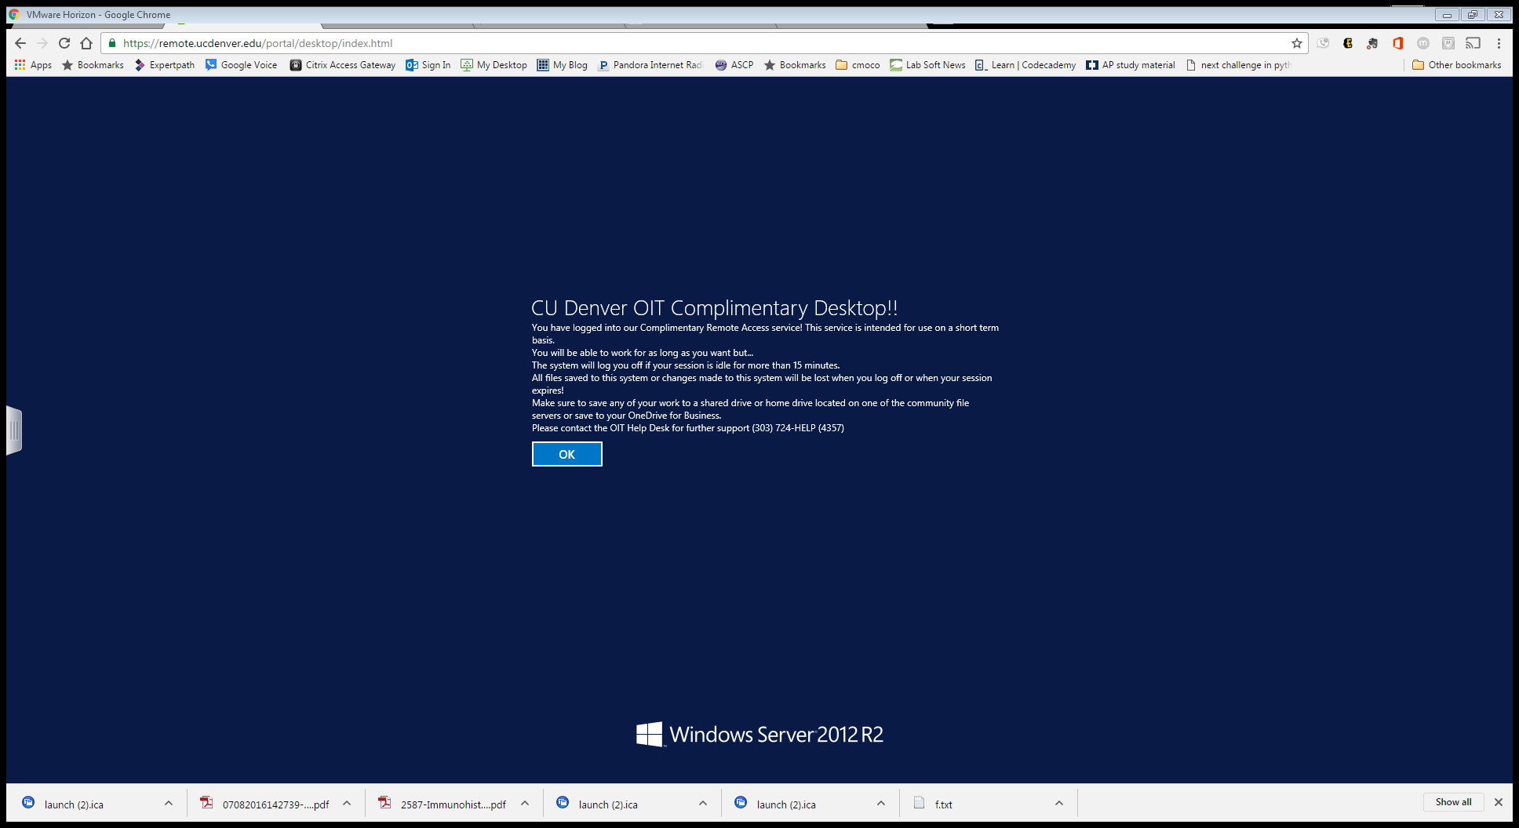
Click ok

Slide 6
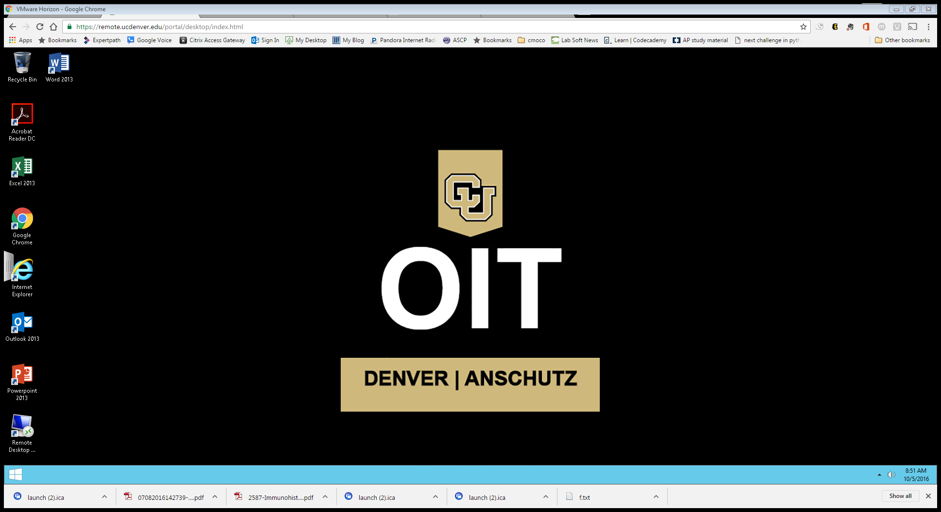
Remote desktop

Slide 7
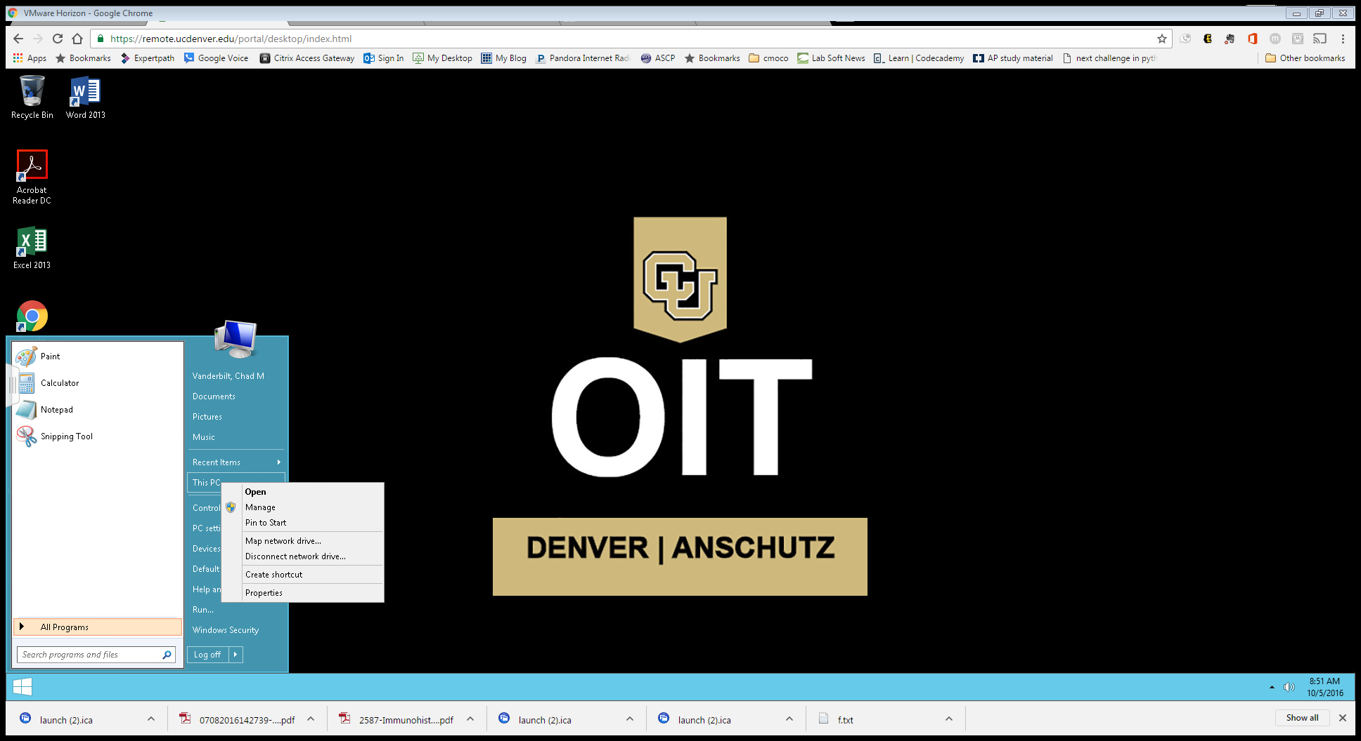
Click the windows icoon in corner and go to ‘This PC’

Slide 8
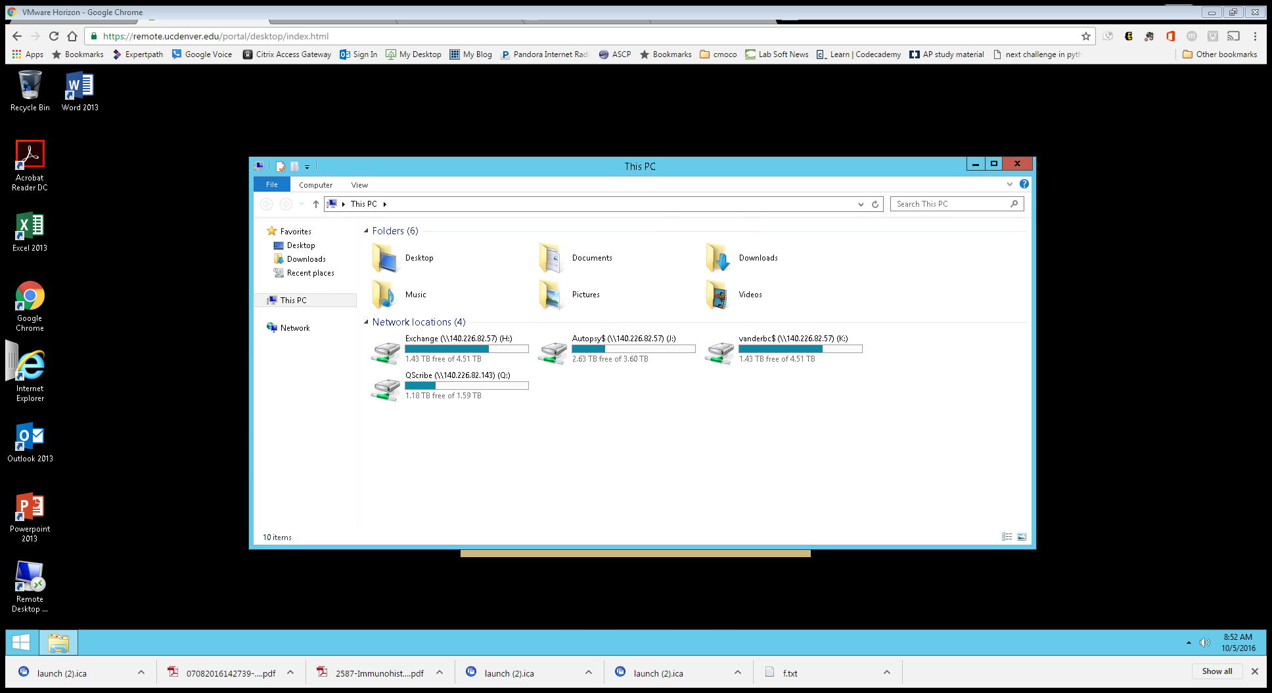
This will display Drives, go to exchange like normal

