Slide 1
Reflections on Four Decades of Scientific Partnerships
J. Mark Petrash, Ph.D.
Professor and Vice Chair for Research
Department of Ophthalmology
Notes:
I want to thank Dr Mandava for having the department organize today’s events around my retirement.
And Bethany for organizing the logistics and Rachel for the communications pieces.
It is such an honor to be recognized in this way, and to have Phil, Kun-Che, Dan, and Vasilis interrupt their schedules to come today and share their stories.
I wanted to use my time today to reflect back on the projects and people that have been at the center of my research life for the past 40 years.

Slide 2
Amazing Support Along My Journey
Satish Srivastava, PhD; Professor, University of Texas, Galveston
John Chen, PhD; Professor, New York University
Robert Church, PhD; Research Director, Emory Eye Clinic, Atlanta
Henry Kaplan, MD; Chair of Ophthalmology and Visual Sciences, Washington University, St Louis, MO
Michael Kass, MD; Chair of Ophthalmology and Visual Sciences, Washington University, St Louis, MO
Naresh Mandava, MD; Chair of Ophthalmology, Univ of Colorado
Joanne Angle, Iris Rush; Executive Directors, ARVO
My family!
Notes:
After undergraduate study at the University of Texas at Austin, I enrolled in the Graduate School of Biomedical Sciences at the UT Medical Branch in Galveston, TX in the Human Biological Chemistry & Genetics PhD program. There I had the good fortune of joining the laboratory of Satish Srivastava, where I began my studies on inborn errors of metabolism and genetic disease.
From there, I went to NYU for a postdoctoral fellowship with John Chen. Dr. Chen was famous for early studies of RNA transcription for coding of lens crystallins, the major proteins in lens. At that time, which was 1981, the technology for cDNA cloning was just beginning to develop, and I wanted more than anything to identify genes that could be involved in cataract formation.
I was awarded an NIH postdoctoral fellowship, which funded my work at NYU for 3 years to study the gene structure for aldose reductase, an enzyme linked to the pathogenesis of diabetic cataracts and retinopathy.
While at NYU in my last year of PDF support, I presented my work at ARVO. One visitor to my poster was Bob Church, who had just been hired as Research Director to develop an eye research group for the new Emory Eye Clinic in Atlanta. Bob essentially hired me on the spot at ARVO, and paved the way for me to start my research career at Emory. At Emory, I got my first individual NEI grant, a new investigator award, that provided enough money for a postdoc and some supplies.
Things went well at Emory where we published several small papers on lens crystallin gene families in my first three years. In 1987, Henry Kaplan, then at Emory, was recruited as chair of ophthalmology at Washington University in St Louis. Hank asked me to join him there to start a molecular biology unit in the department. Needless to say, this was an amazing opportunity, which led us to move to St Louis and work with Dr Kaplan to build an amazing research faculty. After 10 years, Kaplan left Wash U and was succeeded by Michael Kass, a glaucoma leader and co-PI, along with Mae Gordon, of the OHTS trial. Dr Kass was also supportive of basic research, but did not share my enthusiasm to develop an ocular stem cell research program.
At that time, Dr Mandava had just been appointed chair of ophthalmology at CU and convened a group of scientists on campus to plan for recruitment of a research leader. Vasilis Vasiliou, an acquaintance from my research area, was part of that group, and suggested my name as a possibility.
Dr. Mandava and I quickly realized we shared many dreams about what could be created for eye research in Denver. To make this happen, right away I went to my family to convince them we were moving to Colorado. And I went to Phil Ruzycki to convince him he needed to come with me to help transition by lab from St Louis to Denver. In both cases, I succeeded.
I want to mention two other people whose work has enriched my scientific career. Joanne Angle, the late executive director of ARVO, recognized my commitment to eye research and to the next generation of scientists. She helped me make connections through ARVO to other scientific leaders in vision research, and to become engaged in leadership of ARVO on the Board of Trustees. She was instrumental in helping me establish a Research Directors Council as part of the Association for University Professors of Ophthalmology (AUPO). Iris Rush, who succeeded her as Executive Director, continued that wonderful support and has been a tremendous partner in our efforts to develop programs to support vision research and vision scientists, young and old, worldwide.
And most important of all, I thank my family for supporting my work all these years and being willing to put up with me when the stress of grant writing and deadlines made me somewhat less pleasant to be around.

Slide 3

Career Research Aim: Prevent Diabetic Blindness
Elucidate genetic origins of metabolic imbalances in diabetic target tissues
Develop therapeutic strategies
Innovate
Test and refine
Notes:
The over-arching goal of my research career was to find ways to prevent diabetic blindness.
My foundational thinking is that metabolic imbalances result from the action of enzymes and signaling proteins, and we can use genetics and an ever-expanding DNA toolbox to get at understanding how these disease effectors work.
We have used this basic approach in our studies of glucose metabolism and metabolic imbalances in diabetic target tissues.

Slide 4
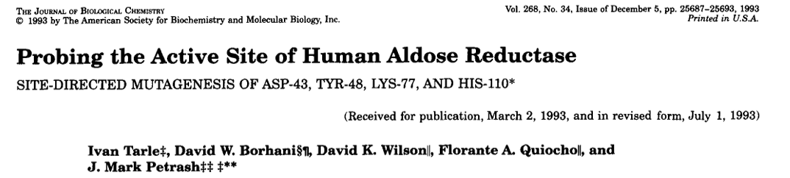
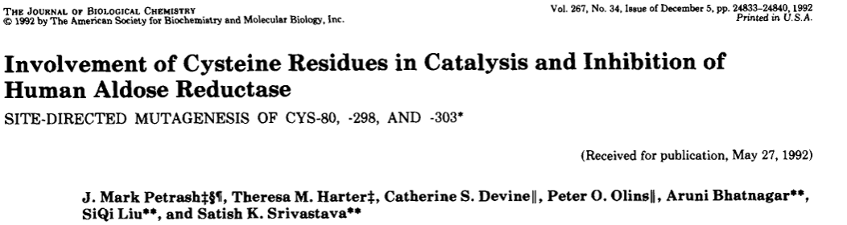
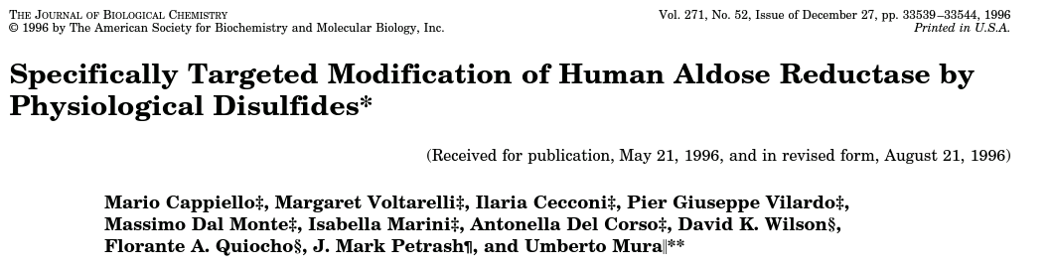
Aldose Reductase: Catalytic Mechanism and Regulation
AR
SDH
Glucose
Sorbitol
Fructose
NADPH
NADP
NAD
NADH
ROS
GSSG
2 GSH
GR
Notes:
Our main focus in diabetic eye disease has been on glucose metabolism through the polyol pathway. Chronically elevated blood sugars activate a pathway catalyzed by Aldose Reductase, an aldo-keto reductase, which converts it to sorbitol, using NADPH to reduce the aldehyde to an alcohol. The pathway is completed by sorbitol dehydrogenase, which oxidizes sorbitol to fructose, using stoichiometric amounts of NAD. Activation of this pathway has many deleterious effects, including build up of sorbitol, which can induce osmotic stress in cells. Also, production of fructose which itself is toxic to cells and results in ATP depletion. NADPH can also be depleted in cells, which incudes oxidative stress due to inadequate regeneration of reduced glutathione, an essential antioxidant in cells and the most abundant antioxidant in lens and red blood cells.
Given the key role of AR in this pathway, there was intense interest to understand how the enzyme works and how it is regulated. To answer these questions, we cloned the gene for AR and developed methods to overexpress it in E coli shake flask cultures. This led to a series of papers in the JBC where we used site directed mutagenesis, guided by structural information from crystallography, to develop an understanding the catalytic mechanism and regulatory domains on the enzyme. Many collaborators contributed to this work, including my grad student Ivan Tarle (went on to oculoplastic surgery career) and the laboratories of Satish Srivastava (UTMB), Flo Quiocho (Baylor), and Umberto Mura (University of Pisa).

Slide 5
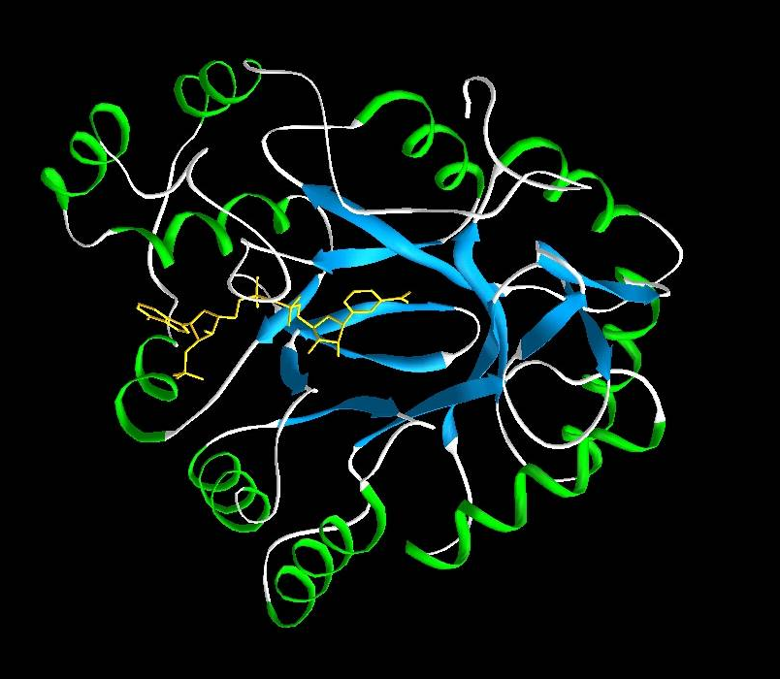
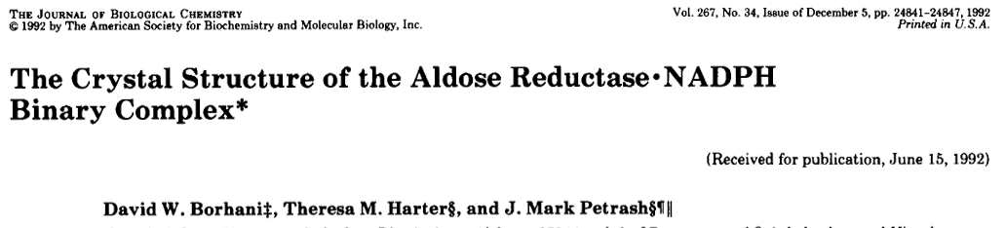
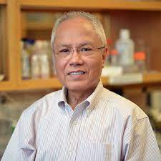
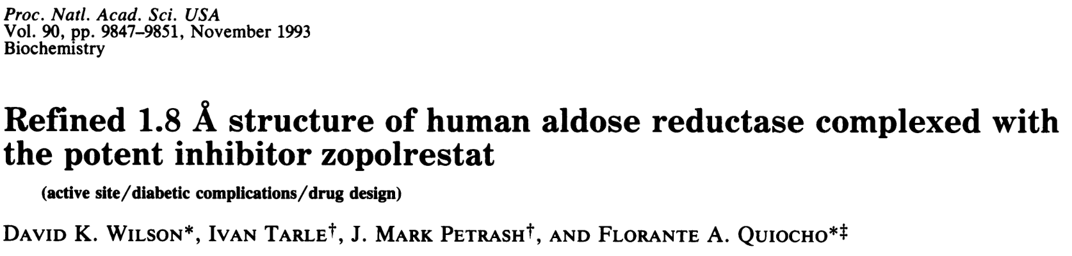
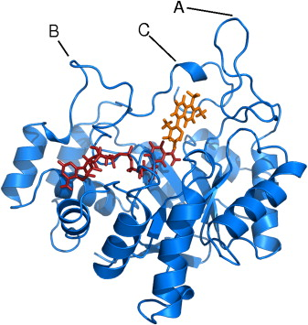
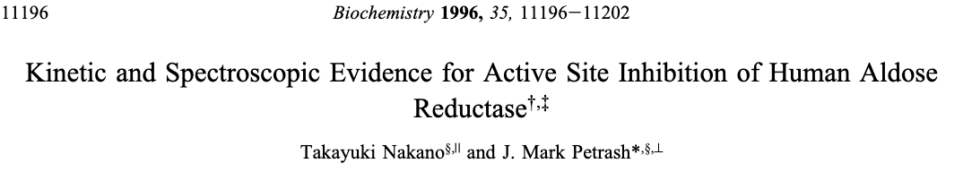
Insights from Crystallography
Florante Quiocho, PhD
Notes:
Our mutagenesis work would have been much more difficult and less productive had it not been for a structural model based on x-ray crystallography. For this work, we collaborated first with David Borhani at University of Alabama, Birmingham and then with Florante Quiocho and his then grad student David Wilson at Baylor College of Medicine in Houston. This was an amazing collaboration that led to structural models for the enzyme active site, cofactor binding mechanism, and showed for the first time that AR inhibitors then in clinical trials bound at the enzyme’s active site. My postdoctoral fellow, Yuki Nakano, did a fabulous job validating the structural model based on a static structure with enzyme kinetic studies published in Biochemistry.

Slide 6
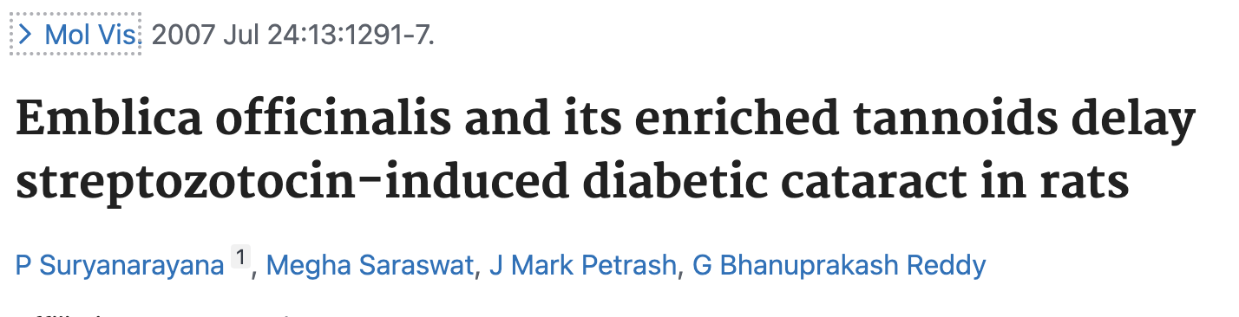
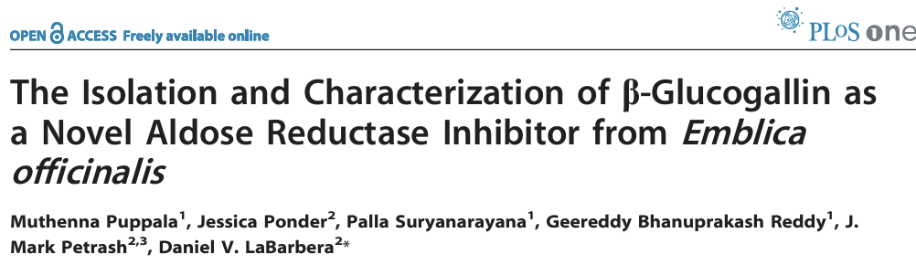
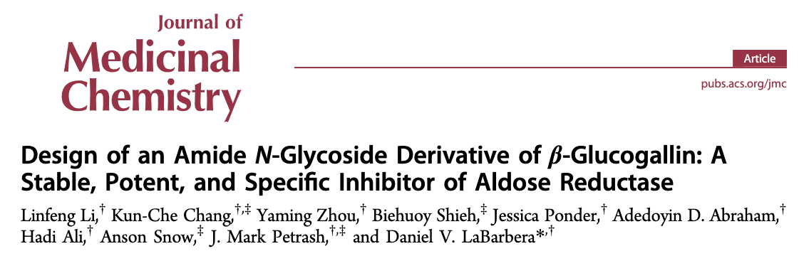
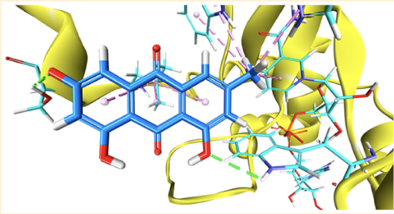
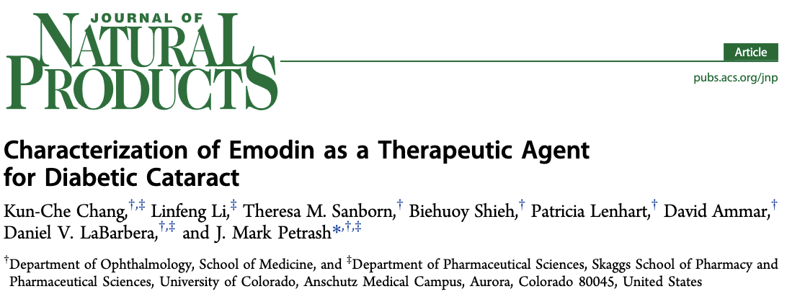
Natural Product Cataract Inhibitors
Notes:
I had the good fortune to make a collaboration with Bhanu Reddy from the National Nutrition Institute in Hyderabad, India. Bhanu’s lab were interested in studying natural products that were considered helpful against some chronic diseases such as diabetes. We collaborated on a study of Indian gooseberry, or Emblica Officinalis, and demonstrated that gooseberry extracts delayed the onset and progression of cataracts in diabetic rats. Two of Bhanu’s postdoctoral fellows then came to my lab just as I arrived to CU: Palla Suryanarayana and Muthenna Puppala. Working with Dan Labarbera’s lab, our teams identified β-glucogallin as a potent inhibitor of the polyol pathway, and indeed was a good aldose reductase inhibitor. Dan’s postdoc, Linfeng Li, went on to design a derivative of b-glucogallin which would be more stable in the eye. This was an amazing study, as it led to the identification of a natural product inhibitor of AR that bound perfectly into the enzyme’s active site. About that time, Kun-Che Chang in my lab initiated a study of goji berry extracts due to the use of goji berries in Chinese traditional medicines. Working with Dan’s lab, Kun-Che showed that emodin, a major anthraquinone in goji berry extract, showed good inhibitory activity against AR, and was selective for AR over other structurally-similar enzymes of the aldo-keto reductase enzyme superfamily. They were able to show that emodin suppressed sorbitol production in the diabetic lens and partially blocked lens vacuole formation and opacification in a mouse model.

Slide 7
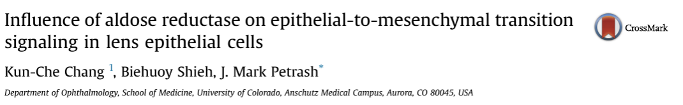
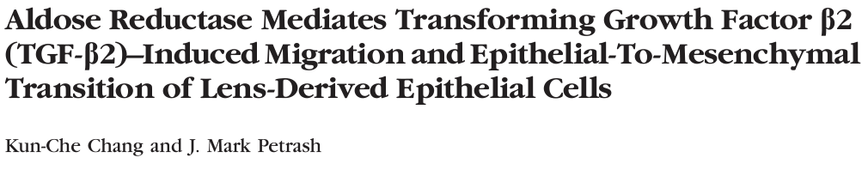
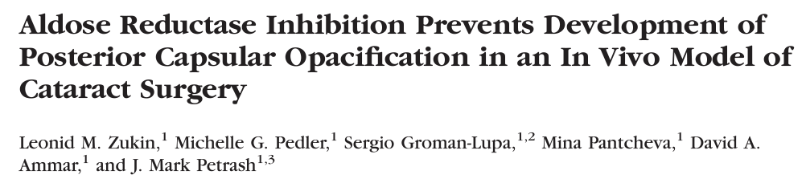
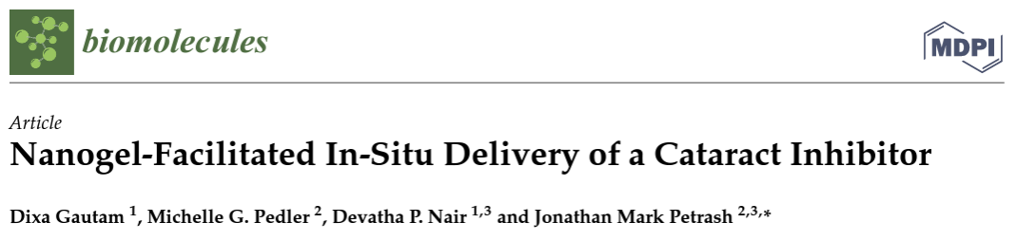
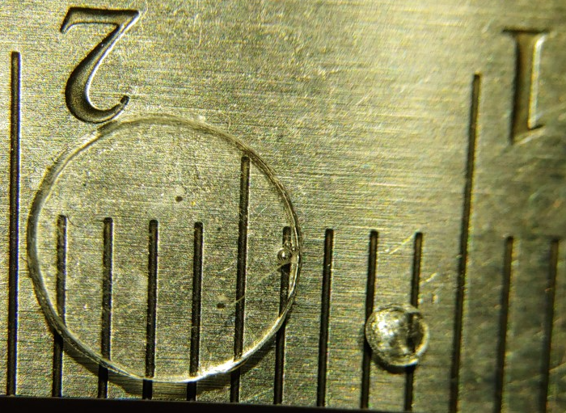
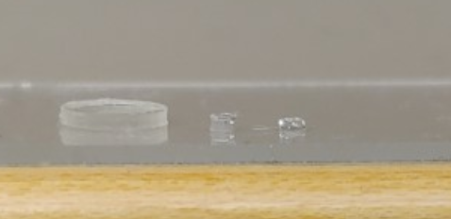
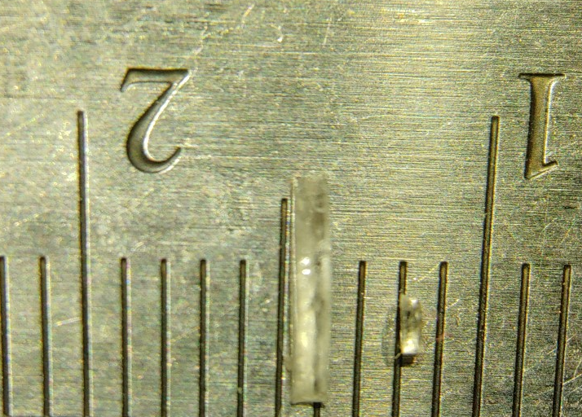
Posterior Capsule Opacification
Notes:
Posterior capsule opacification is one of the most common complications of cataract surgery, and it involves epithelial-to-mesenchymal transition of lens epithelial cells left behind after lens extraction. Kun-Che Chang, then a PhD student in my lab, worked with Leo Zukin, then a medical student, to demonstrate a role for AR in the EMT process, showing that AR inhibitors, or ablation of the AR gene, protects against PCO in a mouse model. They published their work in a series of beautiful papers in IOVS. Dixa Gautam, a masters student in bioengineering, followed this by developing a nanogel-based formulation to release AR inhibitors from a mouse-lens sized IOL, prepared under the guidance of Devatha Nair, PhD, a professor at CU.

Slide 8
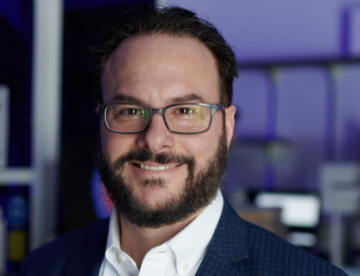
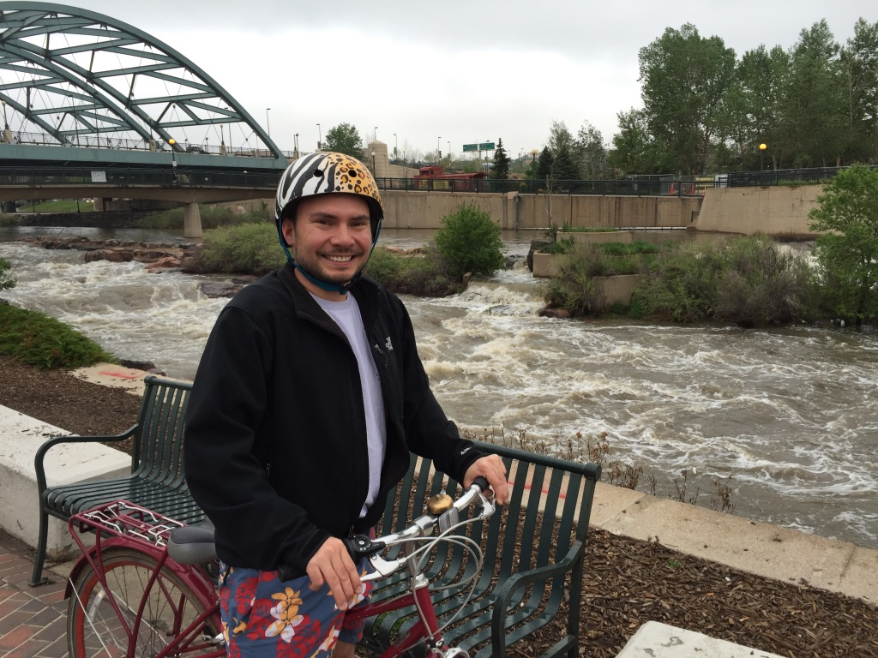
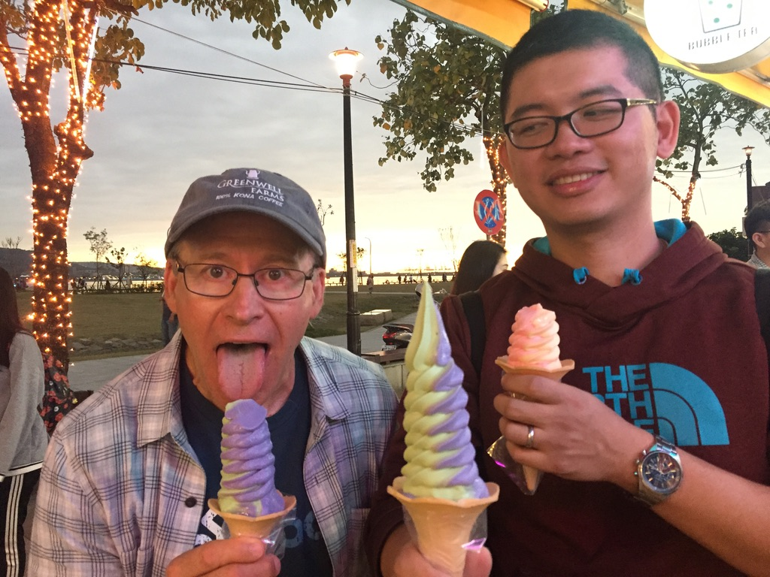
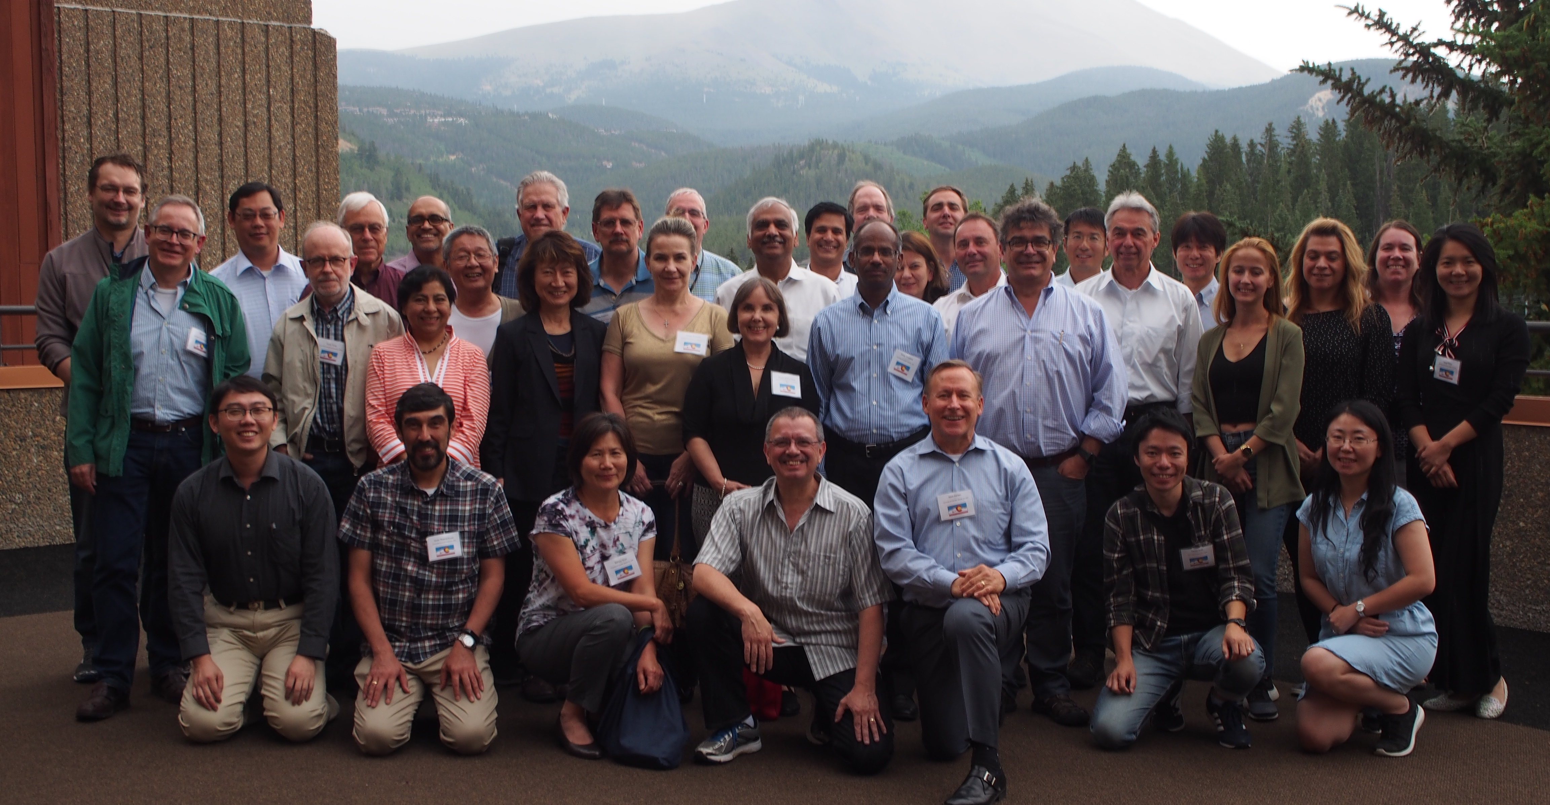
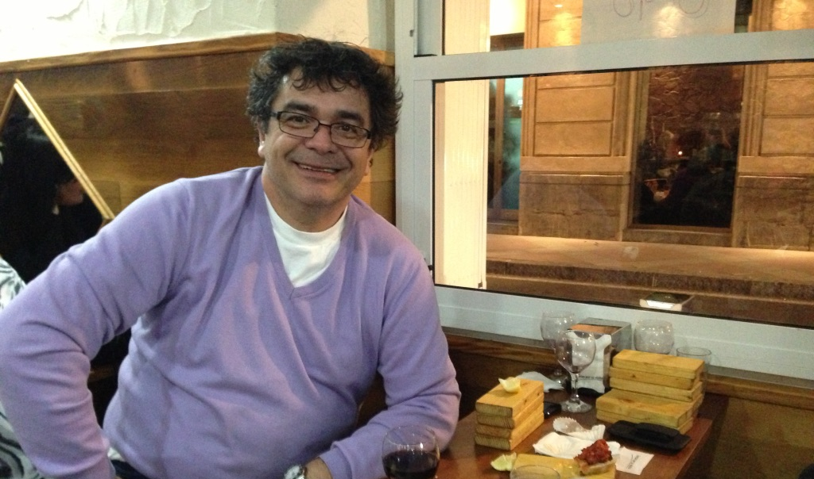
The Magic is Collaboration
Notes:
In looking back over my research career, I can say that my most rewarding work came about through collaboration. I had the honor to work with these four outstanding scientists and individuals, who brought their love for research and commitment to high standards of integrity to our collaborations. Each, in their own way, elevated my work and facilitated my success in science. I also want to acknowledge the importance of networking in science. I include a picture from the 2018 conference of Carbonyl Metabolism Dr Vasiliou and I hosted in Breckenridge. This international group of scientists met every other year for over 30 years, discussing and debating ideas often late into the night. Some of my best ideas and publications came about after meeting with this group over the years. It was at a meeting of this group in 1992 in Dublin, Ireland that I met the young Dr. Vasilis Vasiliou who had just accepted his position in the School of Pharmacy at University of Colorado, and from that point onwards he has been a trusted friend and collaborator. Also shown are Dan Labarbera, PhD, Philip Ruzycki, PhD, Kun-Che Chang, PhD, and Vasilis Vasiliou, PhD.

Slide 9

Ophthalmology research faculty at CU
2008
David Ammar
Mark Petrash
2024
  Miguel Flores-Bellver
  Joseph Brzezinski
  Valeria Canto-Soler
  Lynn Hassman
  Ram Nagaraj
  Mi-Hyun Nam
  Mark Petrash
  Natalia Vergara
  Jayashree Kalpathy-Cramer
  Tianjing Li
  Alison Suhsun Liu
  Anne Lynch
  Steve McNamara
  Jennifer Patnaik
  Riaz Qureshi
  Praveer Singh
Notes:
I take tremendous pride in the research faculty we have assembled in the Department of Ophthalmology.
When I came in 2008, there were 2 of us in research: me and David Ammar.
And over the next 16 year, the research faculty grew to 16, thanks to the tremendous support and vision of Dr Mandava. Our basic research strengths are in the areas of eye development, drug discovery, cataract and lens disorders, and in the development of stem cell-based therapies for degenerative eye diseases. We have amazing faculty expertise in ocular epidemiology and systematic review of clinical trials and outcomes research, artificial intelligence, and machine learning. Our areas of greatest strength in research are at the cutting edge of scientific technology development worldwide.

Slide 10

Community Impact of Ophthalmology Research Faculty
Anschutz Accelerator Initiative: 2 Awards
Gates Grubstake Awards: 4 Awards
Gates Institute charter members
SPARK|REACH
Vice Chancellor’s Advisory Committee
Faculty Promotions Committee
Strategic Infrastructure for Research Committee (SIRC)
Faculty Wellness Committee
Research track for medical students
Vision course for medical students
Graduate Faculty multiple programs
Faculty advisors to MS/ PhD students and summer Interns, co-director GSIP
Faculty to NIH Training Grants
Service to refugee community (Project Worthmore)
NIH grant reviewers and advisory panelists
ARVO officers and elected committee members
Notes:
What also gives me tremendous pride is the impact our ophthalmology research faculty have on the community of science at the Anschutz Medical Campus (University of Colorado) and in service to the national and international research community.
I believe CU Anschutz is a better place because of our faculty, and the sacrifices they make to make this a better place to do research, to teach, and due to your service to your colleagues, the department is a better place to work and thrive in our careers.
I am so thankful to have had the opportunity to lead in this effort and to help shape our environment for research.

Slide 11

Thank You

