Slide 2
Evolving Crisis Standards of Care to Meet New Challenges
Anuj Mehta, MD MS
Assistant Professor of Medicine
University of Colorado Department of Medicine Grand Rounds
November 30, 2022

Slide 3
Disclosures
I have no financial or intellectual disclosures or conflicts of interest
I receiving funding from the NIH for unrelated research.

Slide 4
Official Roles
Lead for Colorado Crisis Standards of Care committees
Member National Academy of Medicine working group on evolving Crisis Standards of Care
Chair Governor’s Medical Advisory Group on COVID-19 Vaccine Allocation
Chair Medical Advisory Panel for the Mountain Plains Regional Health Disaster Response System

Slide 5


Slide 6
Objectives
Review classic conceptualizations of Crisis Standards of Care
Highlight inequities that can be intrinsic to Crisis Standards of Care and discuss potential mitigation strategies
Discuss new and emerging areas of Crisis Standards of Care
  Staffing
  Hospital capacity
  Pediatrics
  Politics

Slide 7
Objective 1:
Review classic conceptualizations of Crisis Standards of Care

Slide 8
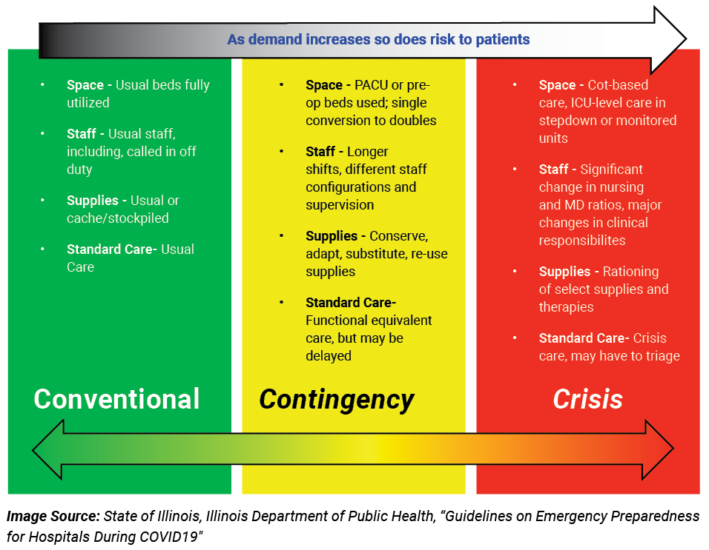
The Continuum of Care
Source: National Academy of Medicine

Slide 9
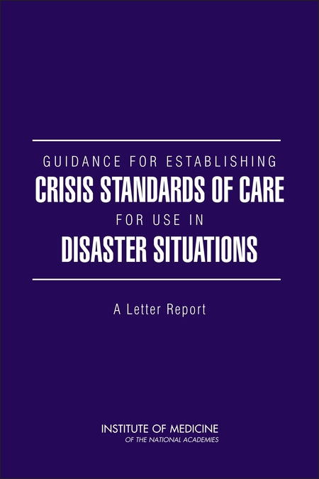
What is Crisis Standards of Care
“a substantial change in usual healthcare operations and the level of care it is possible to deliver, which is made necessary by a pervasive (e.g., pandemic influenza) or catastrophic (e.g., earthquake, hurricane) event”
Triage – allocating treatment to one patient over another actual patient or another potential patient
IOM. 2009. (https://nap.nationalacademies.org/catalog/12749/guidance-for-establishing-crisis-standards-of-care-for-use-in-disaster-situations)

Slide 10

Classic conceptualizations of ‘triage’
Col. Blake: It’s at least 8 hours work.
Hawkeye: His liver’s gone.
Col. Blake: There’s a dozen kids outside that can be saved. He’ll take two surgeons and who knows how many units of blood. And what’s worse, he’ll never make it.
Hawkeye: And meanwhile, we may lose some of the others.
Col. Blake: Pierce, I have a lot of trouble with this kind of decision.
Hawkeye: Henry, he never should’ve been brought in here in the first place.
(Season 3, Episode 6)

Slide 11
Classic conceptualizations of triage during the pandemic
78F, widowed, hypoxic and AKI, metastatic breast CA
36M, single, 1 organ failure, type 1 DM
78F, widowed, hypoxic and AKI, metastatic breast CA
V
V
36M, single, 1 organ failure, type 1 DM
V
48F, married, RN, hypoxic, AKI, low BP, no comorbidities
48F, married, RN, hypoxic, AKI, low BP, no comorbidities
V
26F, single mother, hypoxic, morbid obesity, uncontrolled DM
26F, single mother, hypoxic, morbid obesity, uncontrolled DM

Slide 12
What triage is really like in a pandemic
26F, single mother, hypoxic, morbid obesity, uncontrolled DM,
78F, widowed, hypoxic and AKI, metastatic breast CA
48F, married, RN, hypoxic, AKI, low BP, no comorbidities
36M, single, 1 organ failure, type 1 DM
Time
??
V
V

Slide 13
What triage is really like in a pandemic
26F, single mother, hypoxic, morbid obesity, uncontrolled DM,
78F, widowed, hypoxic and AKI, metastatic breast CA
48F, married, RN, hypoxic, AKI, low BP, no comorbidities
36M, single, 1 organ failure, type 1 DM
Time
V
V
First come first serve?

Slide 14
What triage is really like in a pandemic
26F, single mother, hypoxic, morbid obesity, uncontrolled DM,
78F, widowed, hypoxic and AKI, metastatic breast CA
48F, married, RN, hypoxic, AKI, low BP, no comorbidities
36M, single, 1 organ failure, type 1 DM
Time
V
V
Under 65?

Slide 15
What triage is really like in a pandemic
26F, single mother, hypoxic, morbid obesity, uncontrolled DM,
78F, widowed, hypoxic and AKI, metastatic breast CA
48F, married, RN, hypoxic, AKI, low BP, no comorbidities
36M, single, 1 organ failure, type 1 DM
Time
V
V
Under 40?

Slide 16
What triage is really like in a pandemic
26F, single mother, hypoxic, morbid obesity, uncontrolled DM,
78F, widowed, hypoxic and AKI, metastatic breast CA
48F, married, RN, hypoxic, AKI, low BP, no comorbidities
36M, single, 1 organ failure, type 1 DM
Time
V
V
Most likely to survive?
Prioritize health care workers?

Slide 17
Purpose of Crisis Standards of Care
Provide ethical framework by which care can be allocated
Provide objective processes to allocate care
Remove the burden from bedside team/provider
Provide expanded liability coverage for health care workers

Slide 18
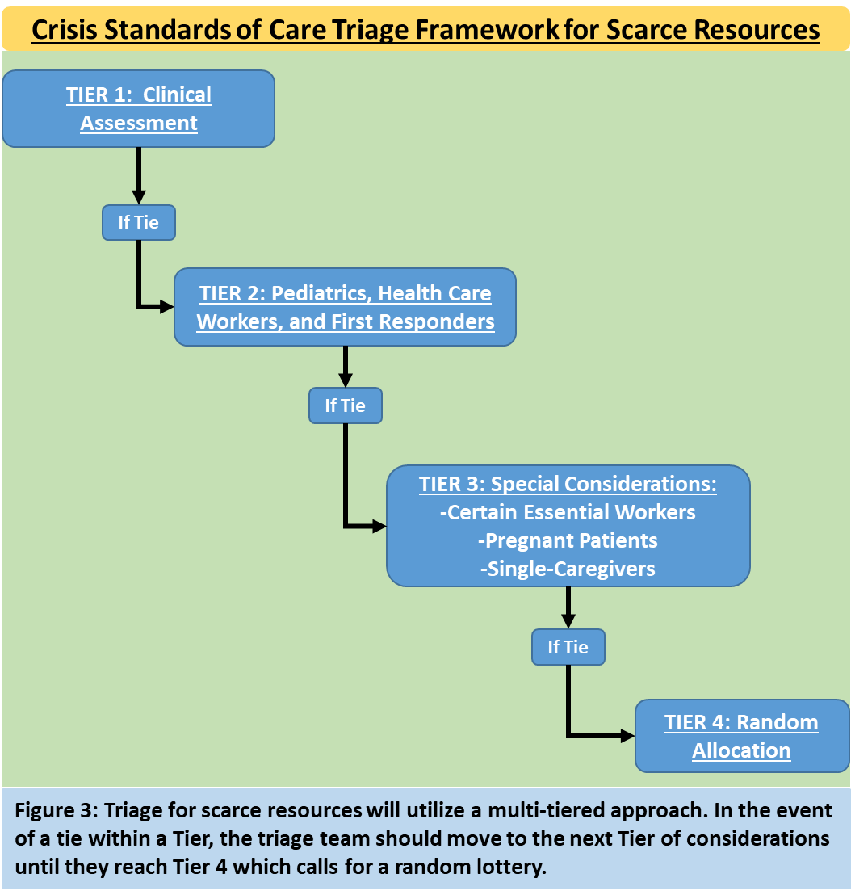
Colorado’s CSC Plan
Severity of Acute and Chronic Illness
Make prioritization decisions based on likelihood of receiving benefit
Prioritize those most likely to survive if they receive the resource
Deprioritize those unlikely to survive even if they receive the resource
Additional considerations when clinical factors are insufficient to separate patients
Reciprocity &
Multiplier Effect
Multiplier Effect
Lottery

Slide 19
Tier 1: CSC Triage Score
TABLE 1
Purpose | Specification | Point System^{A}
 |  | 0 | 1 | 2 | 3 | 4
Measure of Acute Illness | Adjusted SOFA score^{B} | X | 1-5 | 6-9 | 10-12 | >12
Measure of chronic illness | Modified Charlson Comorbidity Index Score^{C} | 0 | 1-2 | 3-5 | 6-7 | >8

Slide 20
Objective 2:
Highlight inequities that can be intrinsic to Crisis Standards of Care and discuss potential mitigation strategies

Slide 21
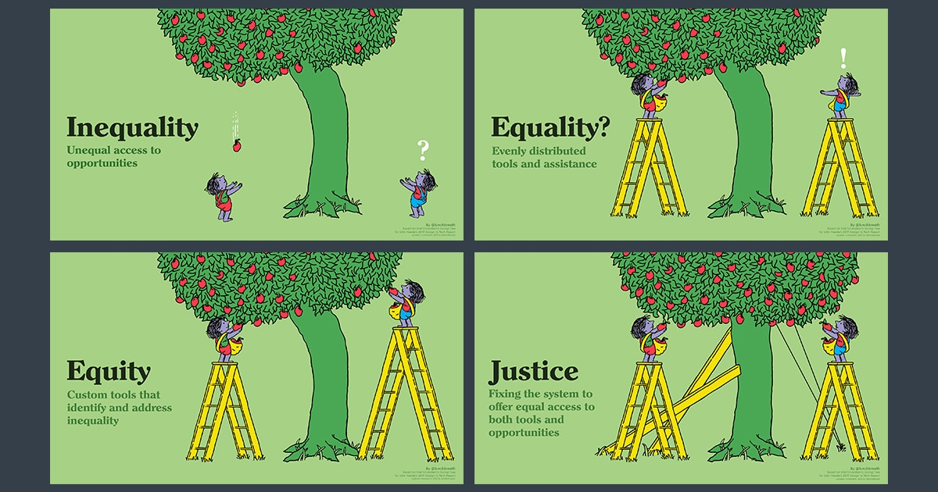
Inequities are pervasive in health care

Slide 22
Focus on two areas relevant to CSC
Structural inequities
Factual fallacies

Slide 23
Tier 1: CSC Triage Score
TABLE 1
Purpose | Specification | Point System^{A}
 |  | 0 | 1 | 2 | 3 | 4
Measure of Acute Illness | Adjusted SOFA score^{B} | X | 1-5 | 6-9 | 10-12 | >12
Measure of chronic illness | Modified Charlson Comorbidity Index Score^{C} | 0 | 1-2 | 3-5 | 6-7 | >8

Slide 24
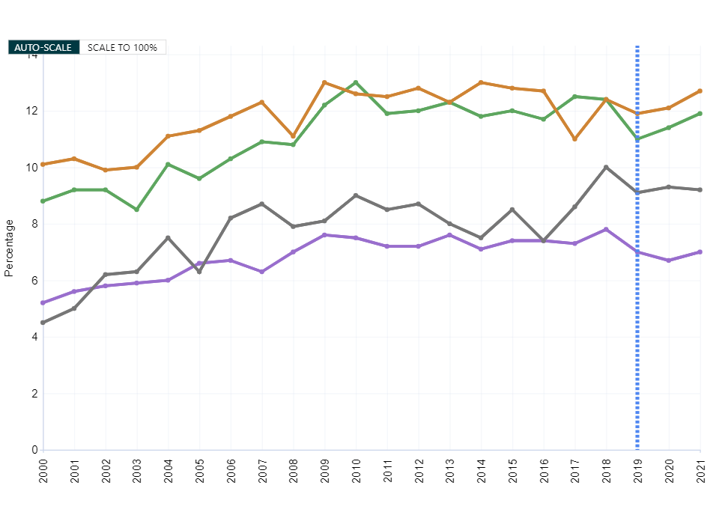
Diagnosed Diabetes, Race-Ethnicity, Adults Aged 18+ Years, Age-Adjusted Percentage, National
Percentage ( Race-Ethnicity )
Hispanic
Non-Hispanic White
Non-Hispanic Black
Non-Hispanic Asian
Source:
USDSS
Major changes to the survey methods in 2019
Horizontal dotted line indicates "No Data", "Suppressed Data" or both.
Disclaimer: This is a user-generated report. The findings and conclusions are those of the user and do not necessarily represent the views of the CDC.
National Center for Chronic Disease Prevention and Health Promotion
Division of Diabetes Translation

Slide 25
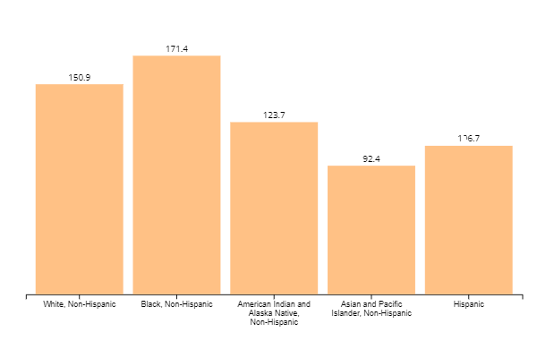
Rate of Cancer Deaths By Race and Ethnicity, Both Sexes
All Types of Cancer, United States, 2019
Rate per 100,000 people
Source - U.S. Cancer Statistics Working Group. U.S. Cancer Statistics Data Visualizations Tool, based on 2021 submission data (1999-2019): U.S. Department of Health and Human Services, Centers for Disease Control and Prevention and National Cancer Institute; https://www.cdc.gov/cancer/dataviz, released in November 2022.

Slide 26
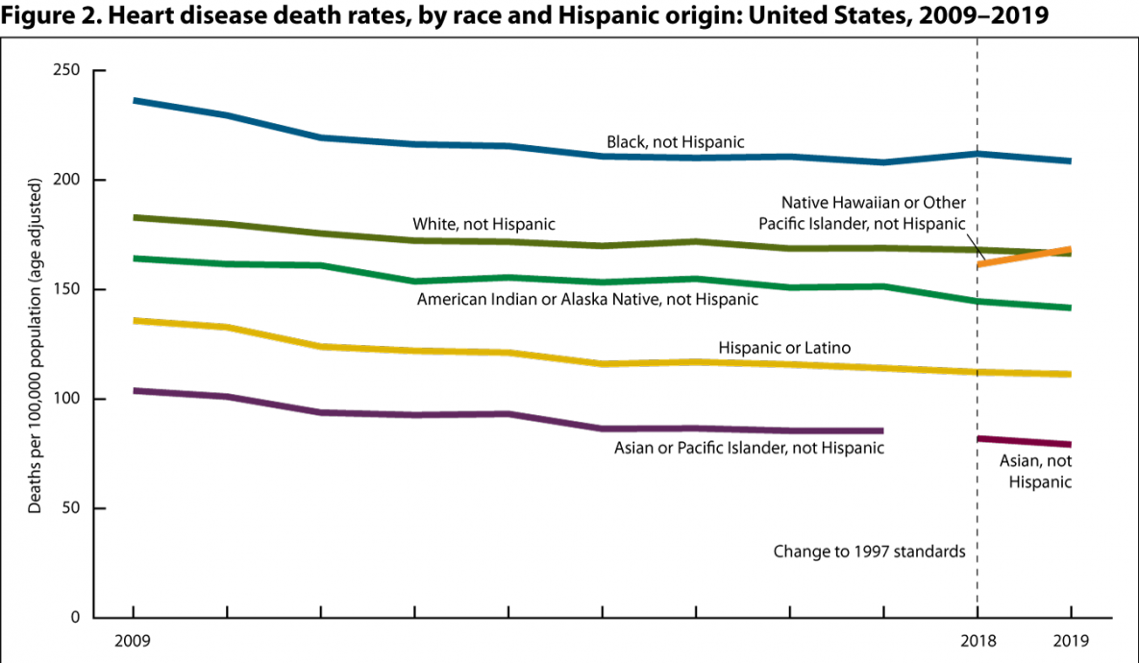
Source: https://www.cdc.gov/nchs/hus/topics/heart-disease-deaths.htm

Slide 27
Potential drivers of disparities
Decreased access to healthy food options
Decreased access to safe spaces for exercise
Tailored marketing for tobacco and sugar products
Decreased access to primary care
Insurance inequities

Slide 28
Do plans that account for comorbid illness achieve equality but not equity?

Slide 29
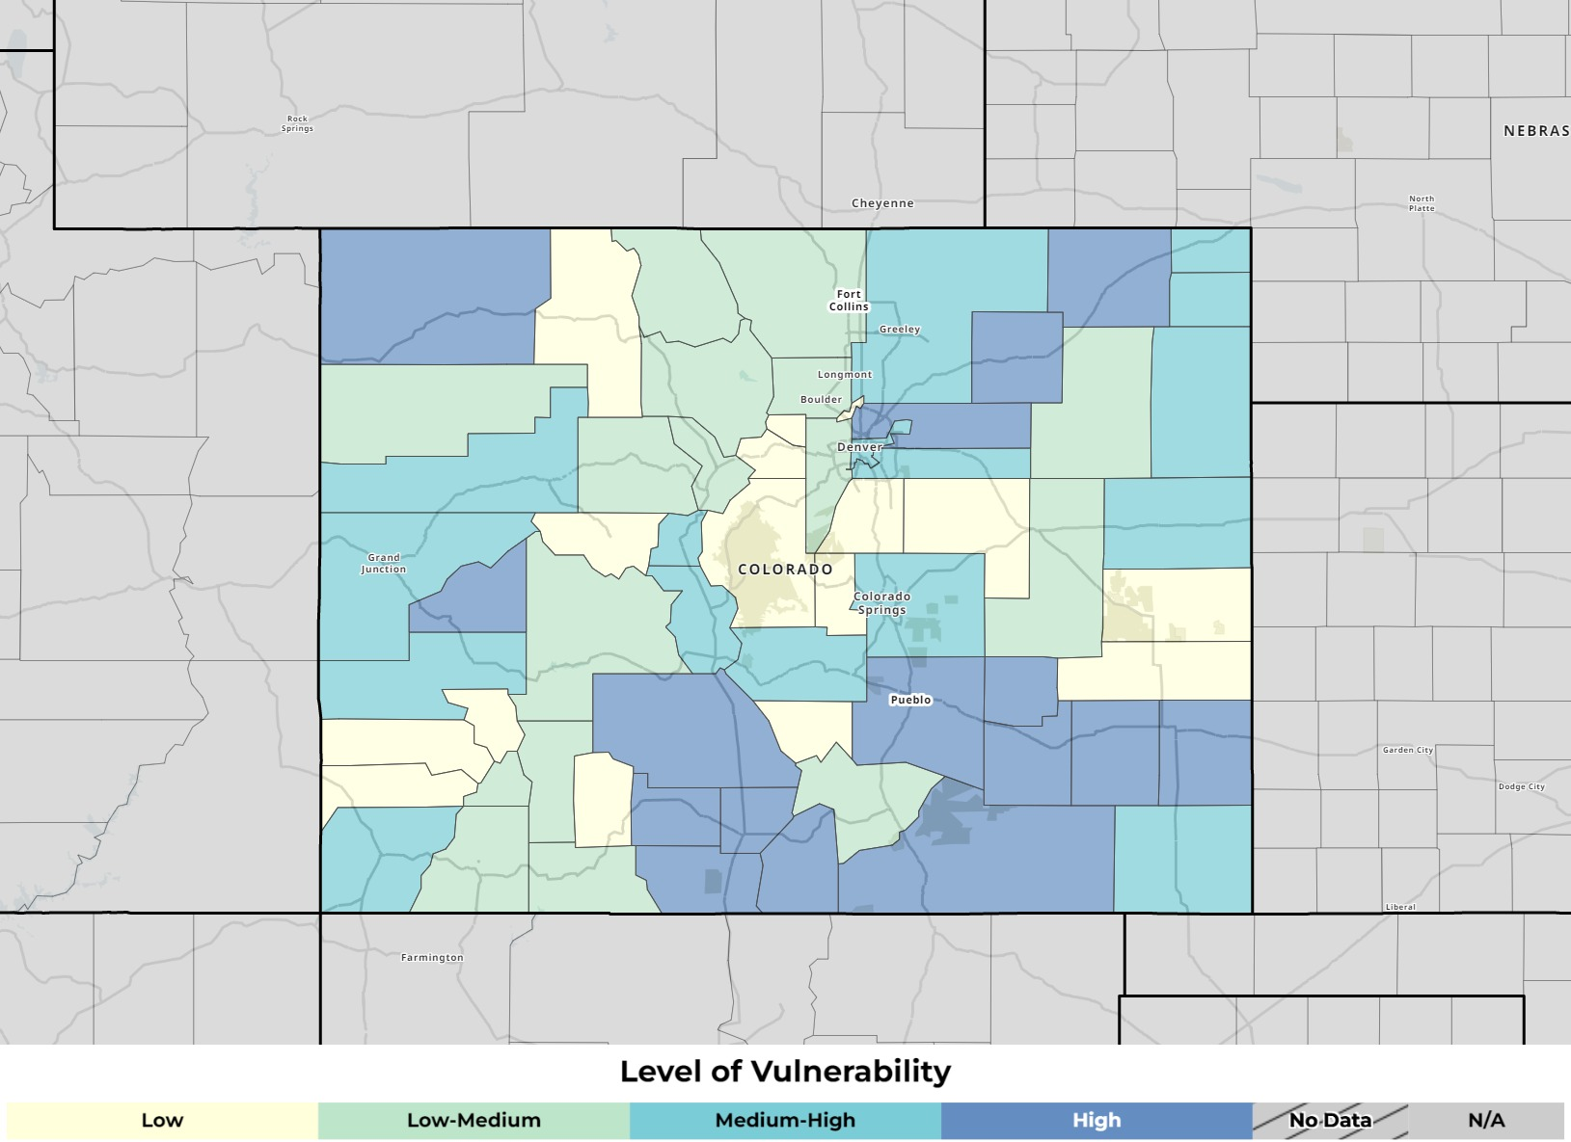
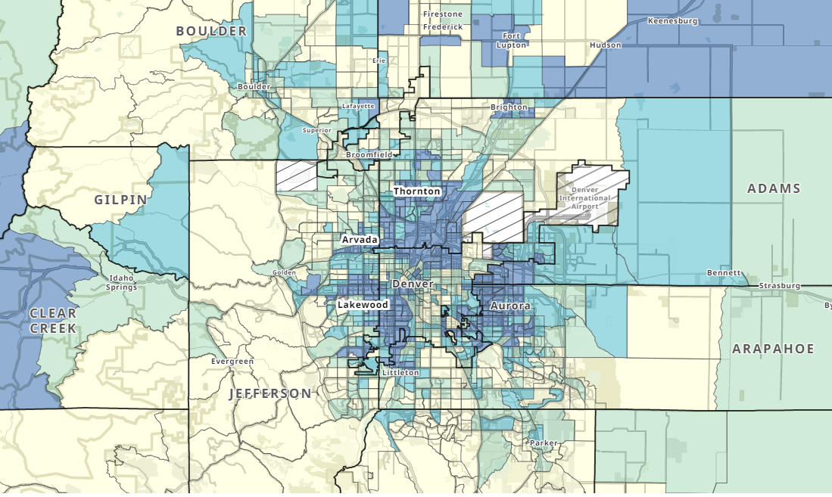
Potential Solutions: SVI Adjustment
SVI – score based on 16 social determinants of health based on US census tract, higher score = greater social vulnerability
Source: https://www.atsdr.cdc.gov/placeandhealth/svi/index.html

Slide 30
Potential drawbacks
Living in an area does not guarantee that you specifically experienced vulnerability
Some census tracts cover large heterogeneous populations
Adjustment results in allocation that may ensure more equitable allocation of ventilators but does not change the risk of death

Slide 31
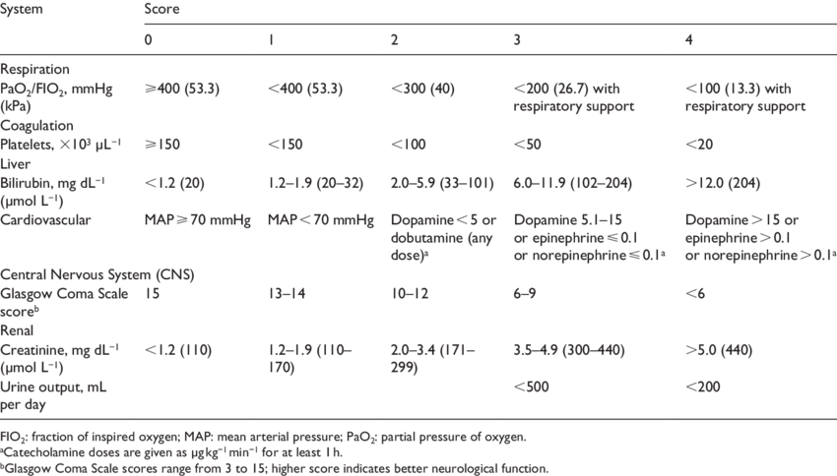
Factual fallacies with SOFA
Some studies indicate that Black patients experience lower mortality compared to other patients with similar Sequential Organ Failure Assessment scores -> less likely to receive critical care resources
Source: Miller et al. JAMA Network Open. 2021. Manchanda et al. NEJM. 2020

Slide 32
Potential Solution: Adjusted SOFA
Eliminate lowest abnormal levels of creatinine
 | POINTS
Variables | 0 | 1 | 2 | 3 | 4
Respiratory P_{a}O₂/FiO₂, mmHg OR S_{p}O₂/FiO₂ª | >400 >400 | <400 <400 | <300 <315 | <200^{B} <235 | <100^{b} <150
Coagulation Platelets x 10³/µL | >150 | <150 | <100 | <50 | <20
Liver Bilirubin, mg/dL | <1.2 | 1.2-1.9 | 2.0-5.9 | 6.0-11.9 | >12.0
Cardiovascular Hypotension^{c} | No Hypotension | MAP<70 mm Hg | Norepinephrine <0.03 Dopamine< 5 OR Dobutamine any dose | Norepinephrine <0.1 OR Epinephrine<0.1 OR Dopamine >5 | Dopamine >15 OR Epinephrine >0.1 OR Norepinephrine >0.1
Central Nervous System Glasgow Coma Scale^{d} | 15 | 13-14 | 10-12 | 6-9 | <6
Renal Creatinine, mg/dL OR UOP (mL/day) | <2.0 | ---^{e} | 2.0-3.4 | 3.5-4.9 OR UOP<500 | >5 OR UOP <200

Slide 33
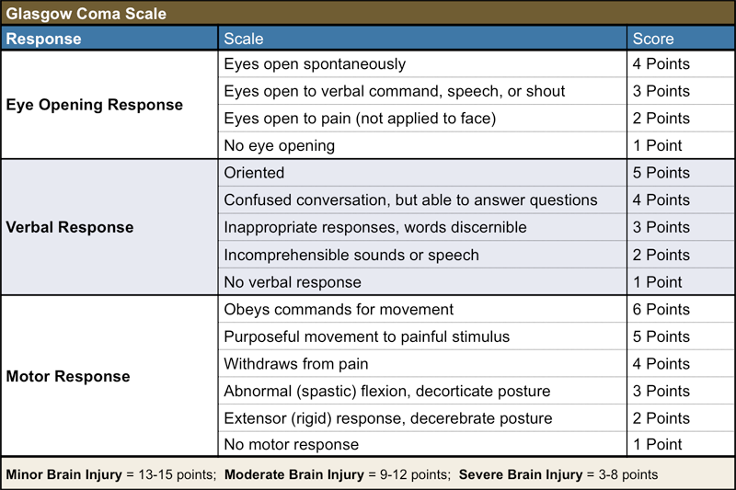
Patients living with disabilities: GCS
Clarified that Glasgow Coma Scale scoring should be based on change from baseline and not to penalize those with baseline disabilities.

Slide 34
Objective 3:
Discuss new and emerging areas of Crisis Standards of Care

Slide 35
Staffing
Excessive patient volume leads to burnout and worse outcomes for patients

Slide 36
Colorado CSC for Health Care Staffing
Establishes staffing as a fixed resource no different than beds
Describes various examples of expanded scope of practice
Broadens liability protections afforded to HCW working under CSC for Staffing
Establishes that prolonged strain can degrade contingency into crisis
Describes various creative staffing approaches and potential triggers

Slide 37
What does CSC for Health Care Staffing not do?
Does not create more health care workers
Does not create mandatory caps for crisis
Does not create automatic triggers

Slide 38
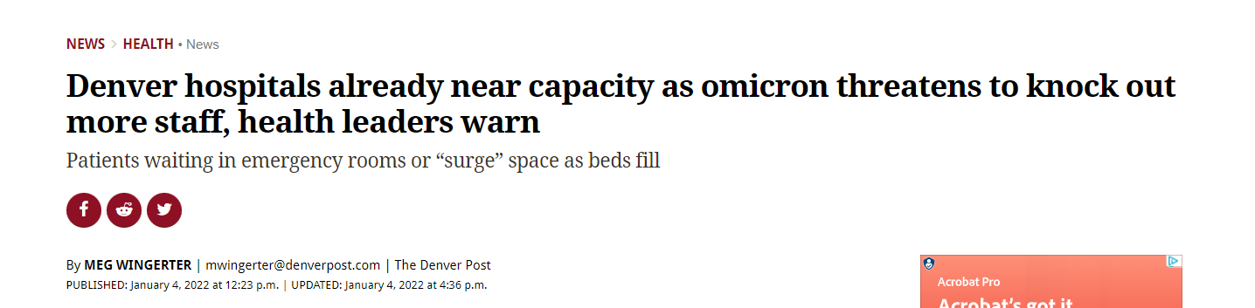
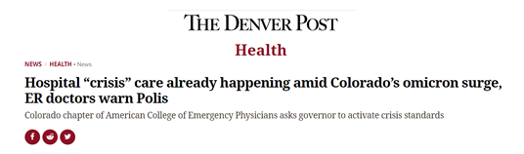
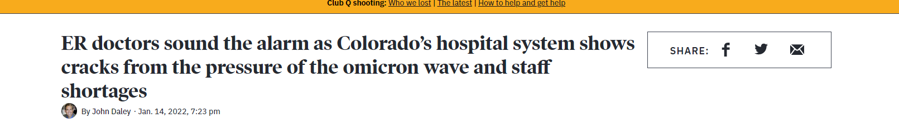
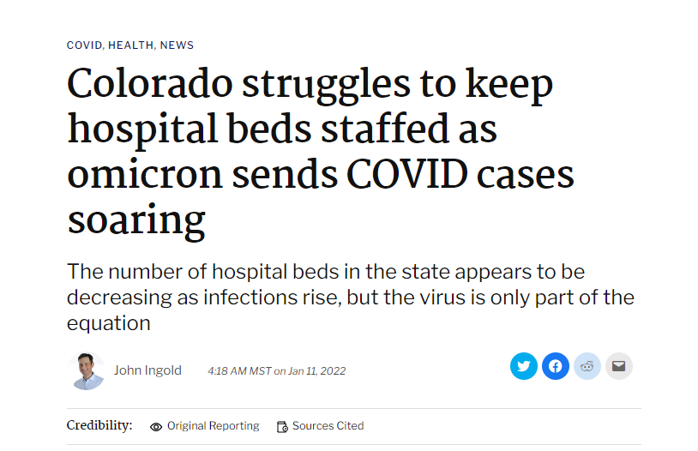
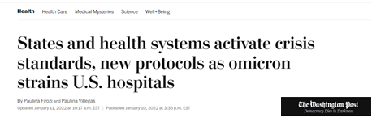
Hospital Capacity as the Strained Resource

Slide 39
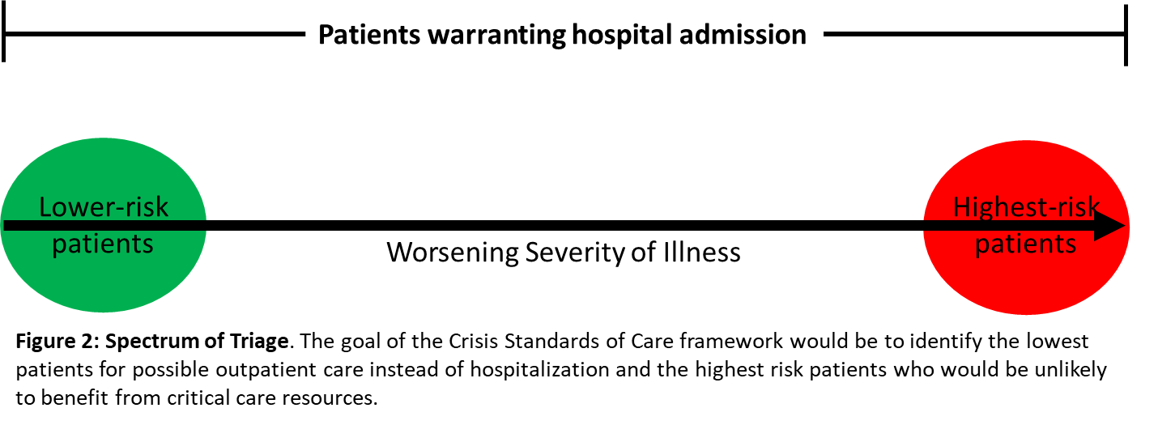
A Broad Ethical Framework for CSC for Hospitals
How likely is a patient to survive without the resource being considered?
How likely is a patient to not need readmission or re-evaluation without the resource considered?
Does the patient have a low likelihood of survival even if they do receive the resource being considered?
Does a patient have realistic access to an alternate care pathway if they are triaged to it (e.g., outpatient care including follow-up, equipment/supplies, and medications)?

Slide 40
Decompressing Hospital Systems: Shifting Risk Tolerance
Inpatient
Hospitals
Capacity
Emergency Departments
Treatment
Completion
Inflow
Outflow
Discharges
Outpatient Care:
Access/Appointments
Prescriptions
DME (e.g., oxygen)
Housing

Slide 41
Decompressing Hospital Systems: Shifting Risk Tolerance
Risk of Decompensation Scores
HEART & TIMI for ACS
CURB-65 for Pneumonia
PSI for PE
BAP for COPD
Risk of Readmission Scores
HOSPITAL
LACE
NEWS-2
EPIC-based score
Inpatient
Hospitals
Capacity
Emergency Departments
Treatment
Completion
Inflow
Outflow
Discharges
Outpatient Care:
Access/Appointments
Prescriptions
DME (e.g., oxygen)
Housing

Slide 42
Equity Impact
Prioritizes older individuals
Prioritizes individuals with more comorbidities
Prioritizes vulnerable populations (e.g. patients without health insurance or patients experiencing homelessness)

Slide 43
Pediatrics
Expand capacity in children’s hospitals
Expand pediatric capacity on pediatric units in mixed hospitals
Shift adult HCWs onto pediatric wards to expand staffing
Shift pediatric patients onto adult units with care provided by adult HCWs

Slide 44
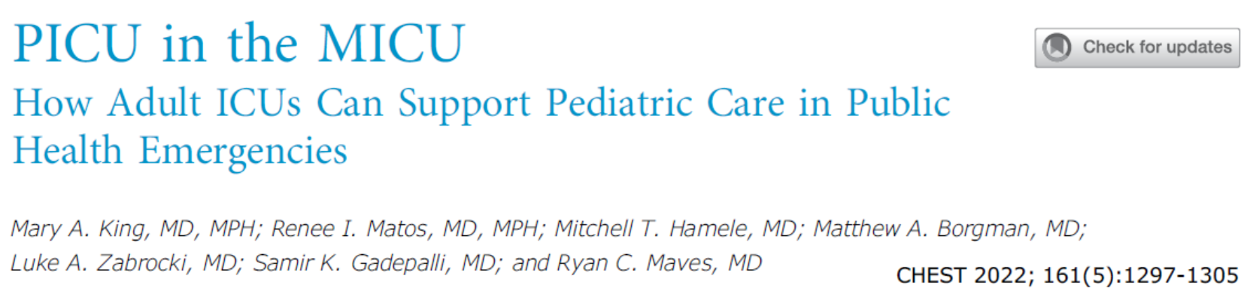

Slide 45
Children are not Small Adults BUT Adolescents May Be Close Enough
Weight-based dosing can typically be abandoned in crisis when weight >40 kg and age > 12
Most supplies (ET tubes, CVCs, IVs) are based on patient size, not age
ACLS is recommended after puberty
Many adolescent conditions can be managed similarly to adults
  Asthma
  ARDS
  Diabetes
  Sepsis
  Intoxication

Slide 46
Politics
Crisis Standards of Care
Politics
Implementation
Planning

Slide 47
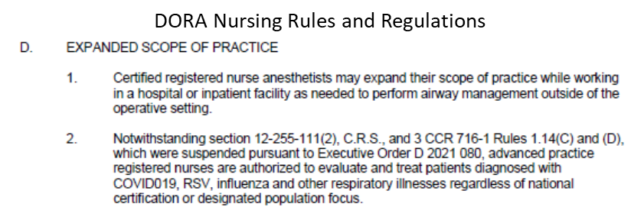
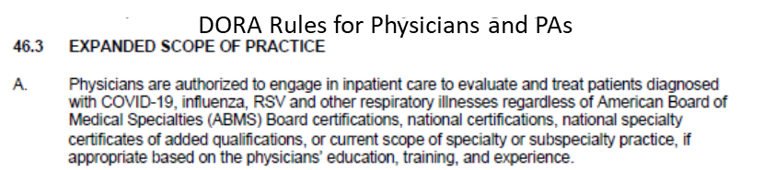
Intersection of CSC and Politics
Alternative Approaches – Executive Orders, Public Health Orders, and Public Health Emergencies

Slide 48
Intersection of CSC and Politics
Alternative Approaches – Executive Orders, Public Health Orders, and Public Health Emergencies
Limitation in Triage Approaches
  Office of Civil Rights
  Americans with Disabilities Act
Political Cost of CSC Activation

Slide 49
Thank You anuj.mehta@cuanschutz.edu

Slide 50

Scan to request CME/MOC credit for 11/30 Grand Rounds

Slide 53
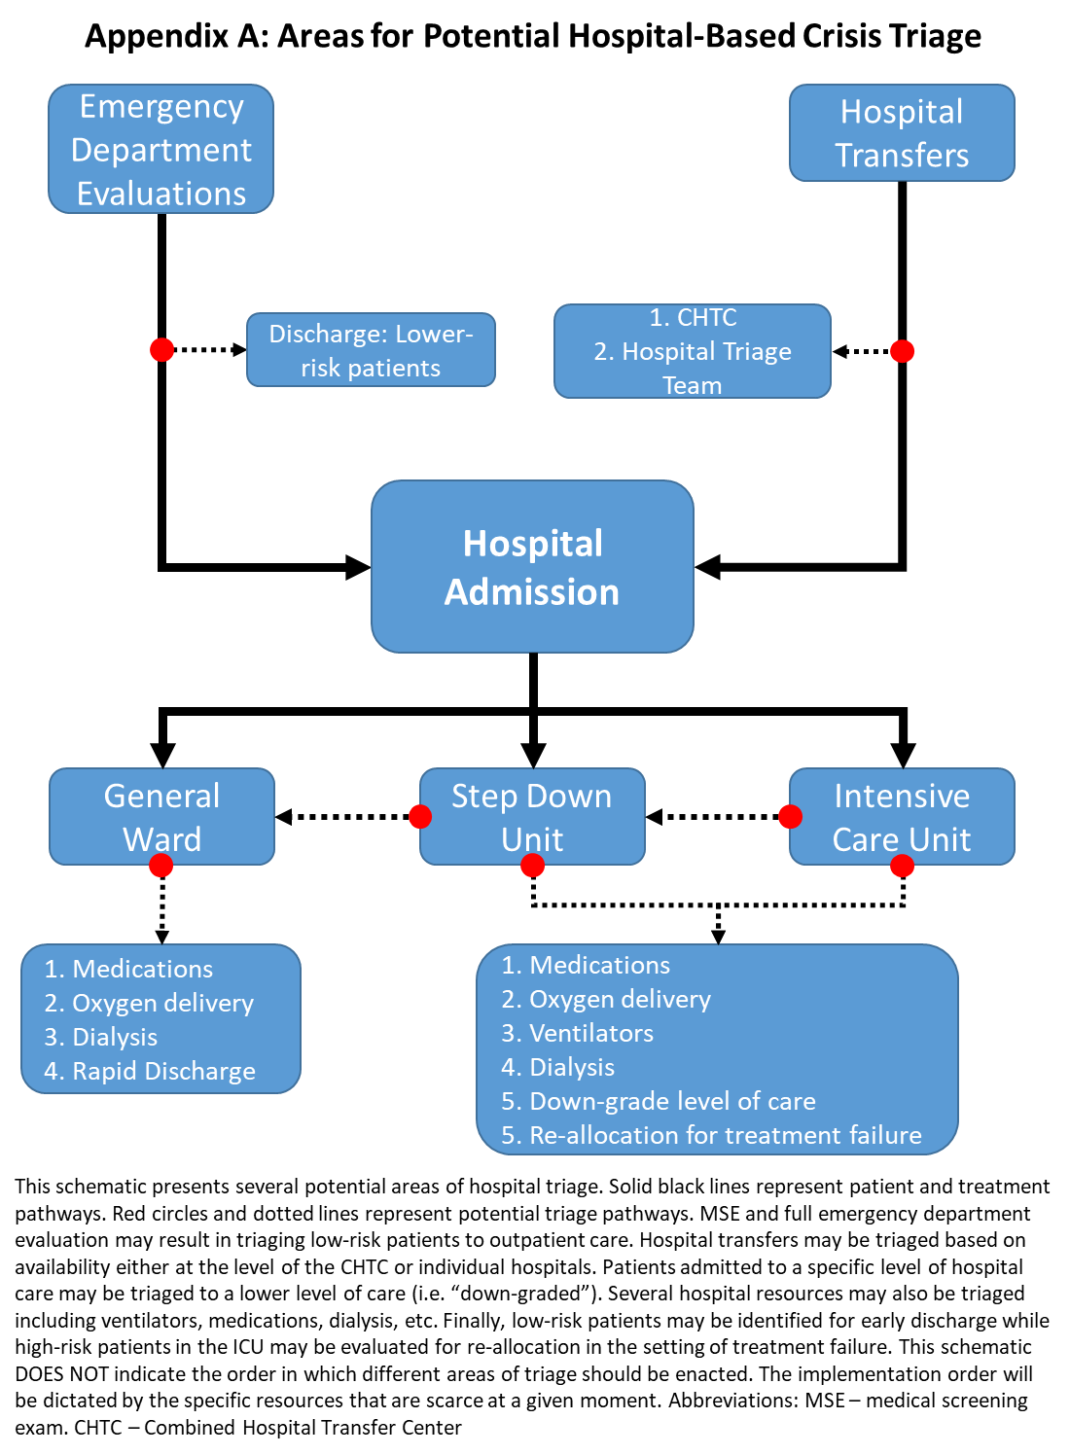

Slide 54
The mCCI was validated for its predictive capability for hospital mortality using the California Patient Discharge Database (PDD) from 2020. The PDD contains administrative data for 100% of discharges from nonfederal hospitals in the State of California. Using 2,866,340 observations (including 166,535 hospitalizations for COVID-19), the mCCI had strong predictive abilities with an area-under-curve (AUC) = 0.752. Removing age reduced the AUC to 0.695, indicating that not including age reduced the predictive ability of the mCCI (i.e. made worse predictions). Within the PDD, only broad definitions of mCCI comorbidities could be determined. It is possible to identify patients with chronic heart failure or chronic pulmonary disease. However, it is not possible to determine which patients who carry a diagnosis of chronic heart failure have NYHA Class III or IV symptoms or an LV<45%. Similarly, while it is possible to identify patients with chronic lung disease, it was not possible to determine which patients used supplemental oxygen or had an FEV1<40%. Therefore, the validation of the mCCI using an administrative database allowed for assessment of a large sample size but included a large number of patients who likely had lower predicted mortality. The strict definitions for each comorbidity proposed above increase the association with predicted mortality. Therefore, with full clinical information and the strict comorbidity definitions, the mCCI will likely have even strong predictive capabilities for hospital mortality.

