Slide 1
Compositional Data Analysis using Kernels
in Mass Cytometry Data

Slide 2
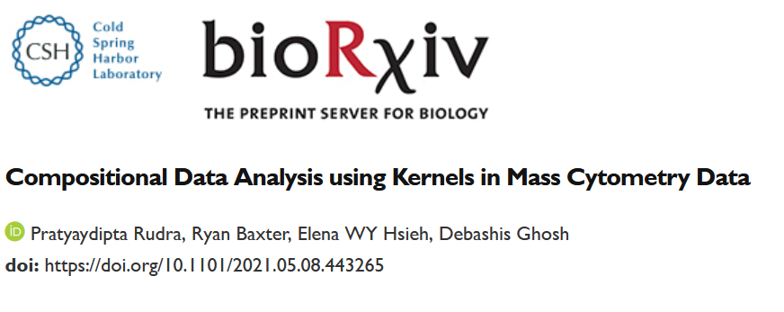
Acknowledgements
Debashis Ghosh
University of Colorado, Anschutz Medical Campus
Elena Hsieh
University of Colorado, Anschutz Medical Campus
Ryan Baxter
University of Colorado, Anschutz Medical Campus

Slide 3

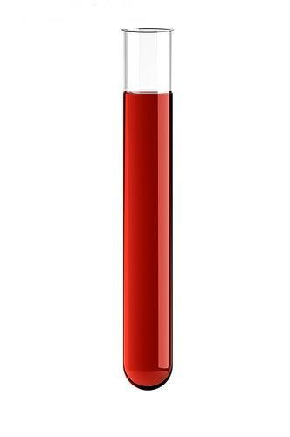


Motivating study – mass cytometry (CyTOF)
Healthy controls
systemic lupus erythematosus (SLE) patients
Blood sample
Over
4-5 time points
(study 2)
No stimulation
Stimulation 2 (T6R)
Stimulation 1 (T6)
38 antibodies: 22 surface markers and 16 cytokines
Cell types can be determined based on the intensity levels of the cell markers
Data on cytokine levels for each cell type
Several thousand cells
CyTOF is run for each condition, and data are produced
38 antibodies

Slide 4
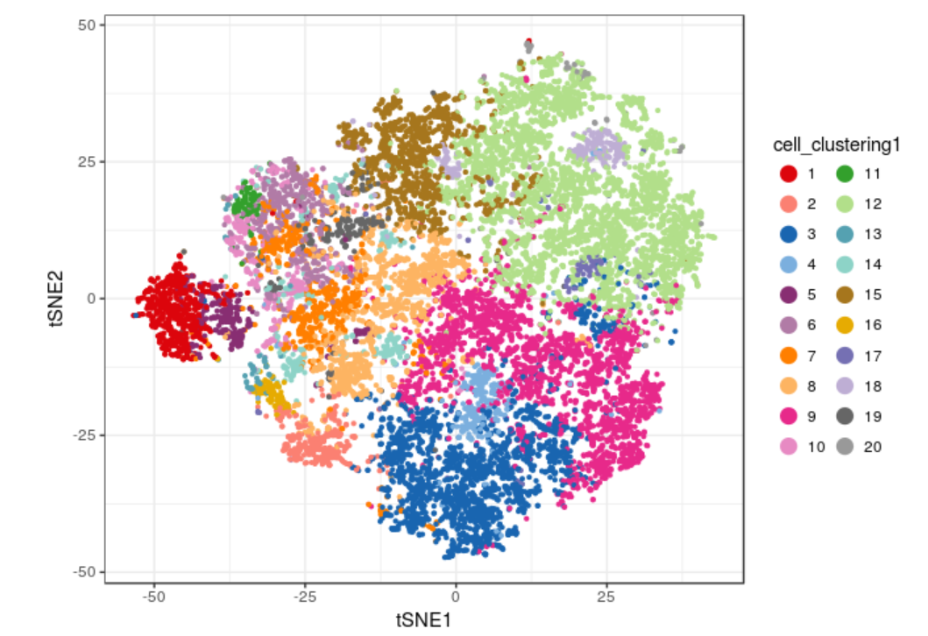
Steps of statistical analysis
Clustering the data into cell populations.
Testing abundance of cell populations across groups (or finding associations with other continuous variables).
Testing differential expression of functional markers, e.g. cytokines.
We propose a new Kernel-based approach CODAK to conduct this test
Figure source: Nowicka et al, F1000 Research (2017)

Slide 5
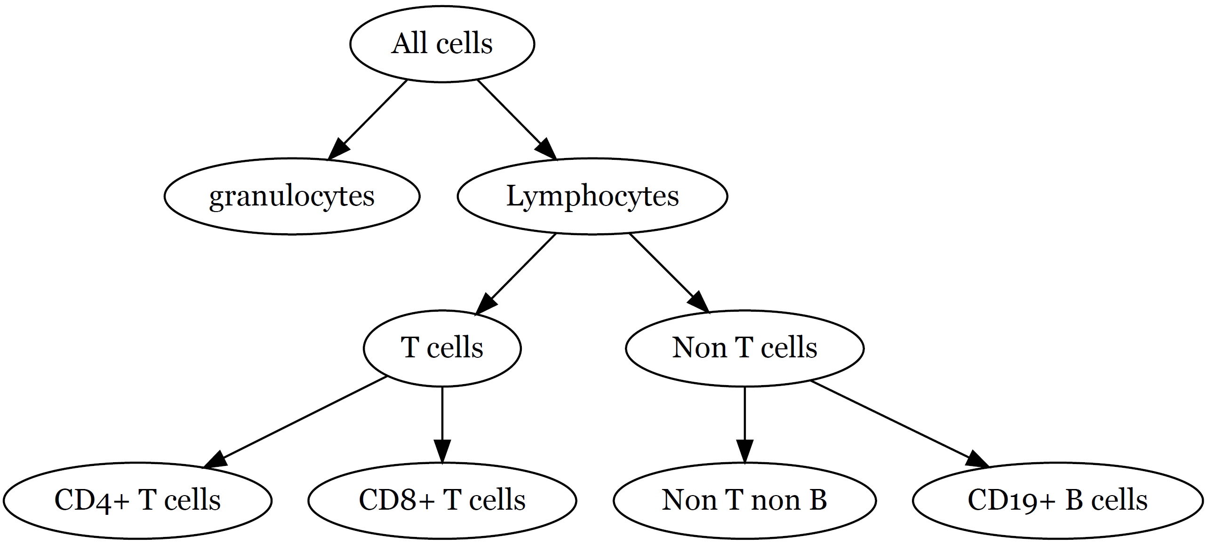
Hierarchical tree structure of the cell types

Slide 6
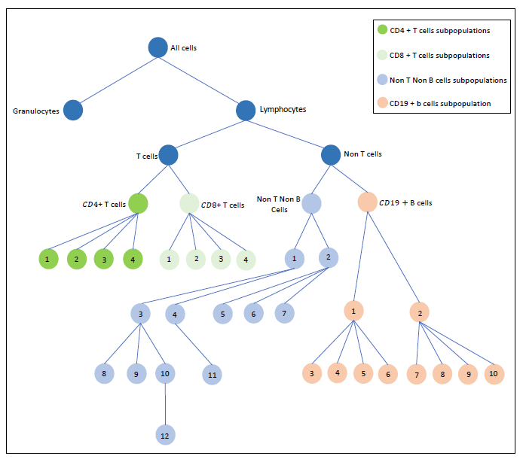
Hierarchical tree structure of the cell types

Slide 7
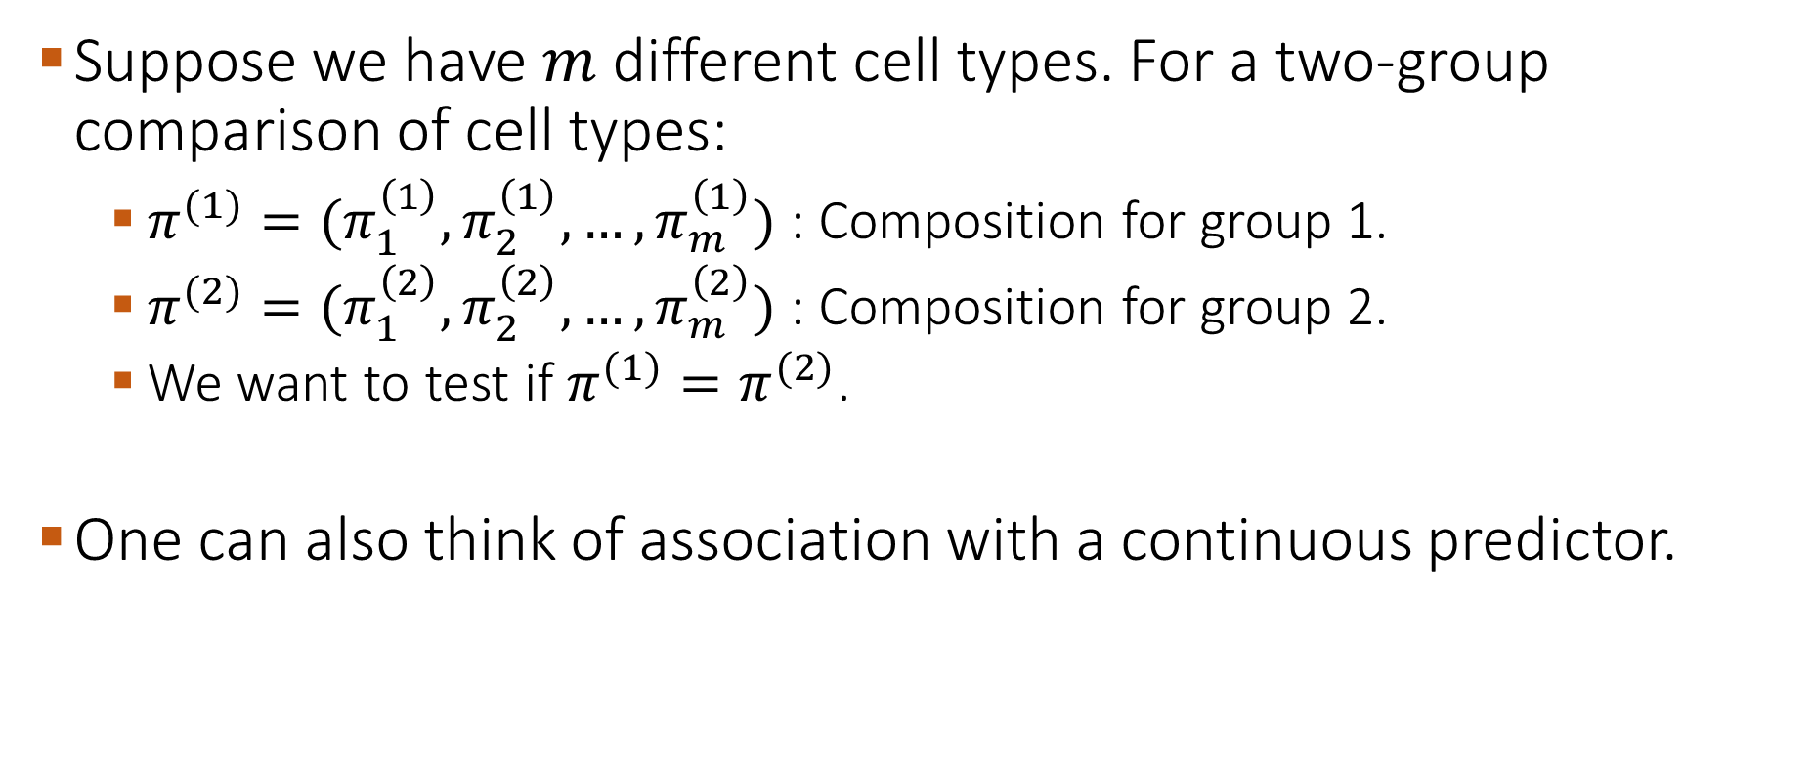
Testing abundance of the cell populations
Suppose we have $m$ different cell types. For a two-group comparison of cell types:
  $π^{(1)}=(π_{1}^{\left(1\right)}, π_{2}^{\left(1\right)},…,π_{m}^{\left(1\right)})$ : Composition for group 1.
  $π^{(2)}=(π_{1}^{\left(2\right)}, π_{2}^{\left(2\right)},…,π_{m}^{\left(2\right)})$ : Composition for group 2.
  We want to test if $π^{(1)}=π^{(2)}$.
One can also think of association with a continuous predictor.

Slide 8
Unique features of the data
Single cell data: Very large number of cells per individual. But usually not many individual samples.
Data are high-dimensional in the sense that there are more than 40 parameters being measured for every cell.
Also, when testing composition, there can be a large number of cell type categories.
Overdispersion.
Several thousand cells
40 antibodies

Slide 9
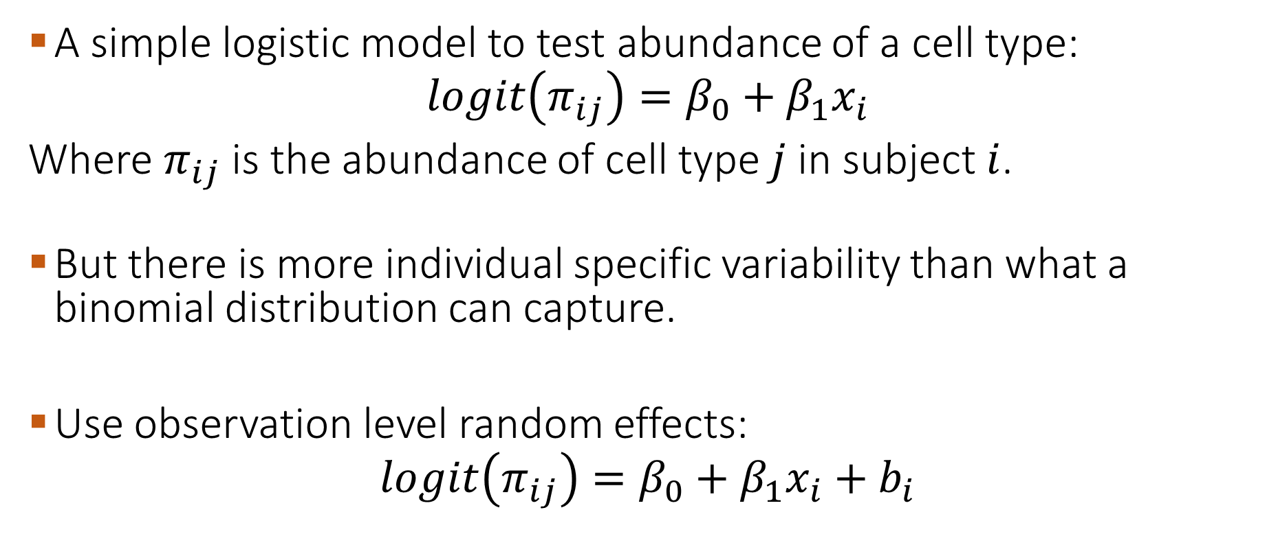
Overdispersion
A simple logistic model to test abundance of a cell type:
$$logit\left(π_{ij}\right)=β_{0}+β_{1}x_{i}$$
Where $π_{ij}$ is the abundance of cell type $j$ in subject $i$.
But there is more individual specific variability than what a binomial distribution can capture.
Use observation level random effects:
$$logit\left(π_{ij}\right)=β_{0}+β_{1}x_{i}+b_{i}$$

Slide 10
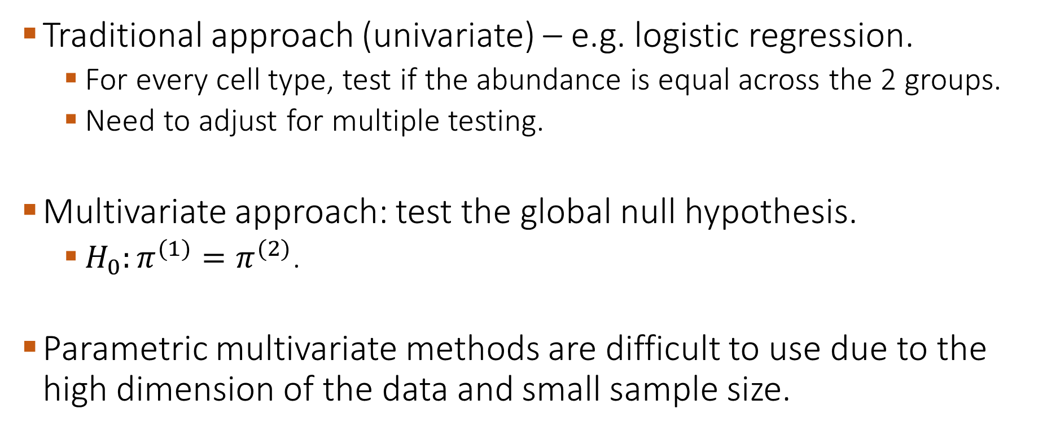
Univariate vs multivariate approaches to test the global null hypothesis
Traditional approach (univariate) – e.g. logistic regression.
  For every cell type, test if the abundance is equal across the 2 groups.
  Need to adjust for multiple testing.
Multivariate approach: test the global null hypothesis.
  $H_{0}:π^{(1)}=π^{(2)}$.
Parametric multivariate methods are difficult to use due to the high dimension of the data and small sample size.

Slide 11
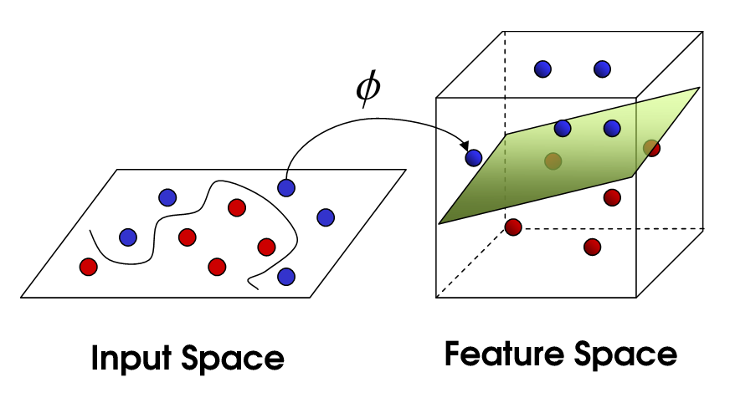

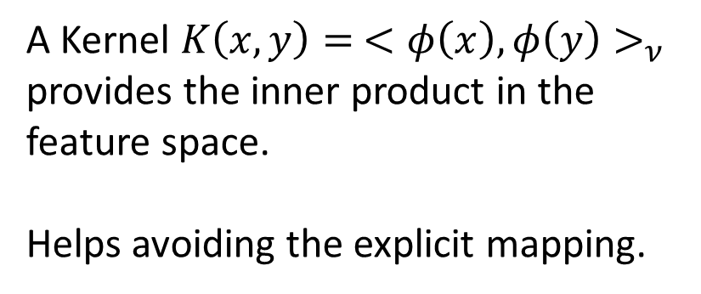
Kernel-based Methods
Several statistical methods use the concept of Reproducing Kernel Hilbert Space (RKHS) to quantify and test association.
Example: ‘Kernel trick’ avoids the explicit mapping to get a linear boundary for classification problems.
$$φ:χ→ν$$
A Kernel $K\left(x,y\right)= <φ\left(x\right),φ\left(y\right)>_{ν}$ provides the inner product in the feature space.
Helps avoiding the explicit mapping.
$$x,y∈χ$$
$$φ(x),φ(y)∈ν$$

Slide 12
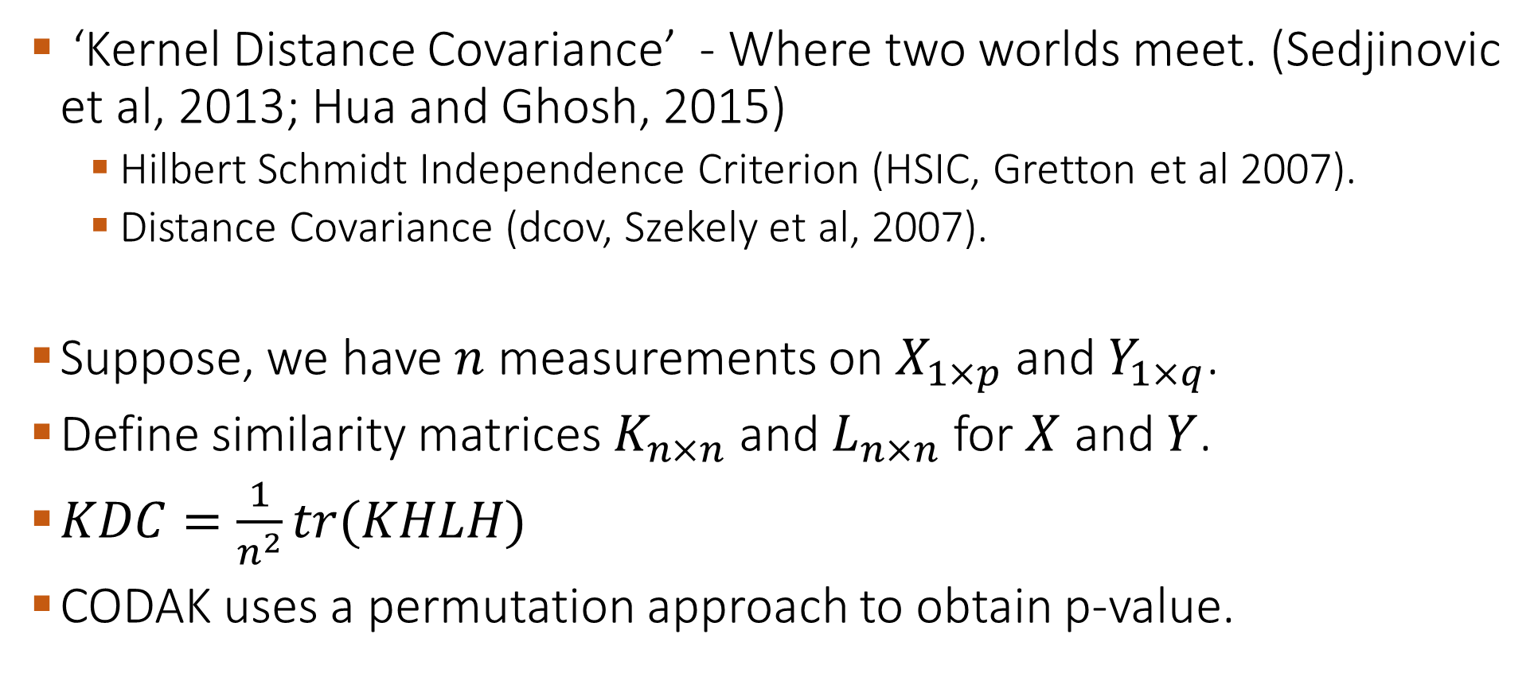
Kernel distance covariance for test of association
‘Kernel Distance Covariance’ - Where two worlds meet. (Sedjinovic et al, 2013; Hua and Ghosh, 2015)
  Hilbert Schmidt Independence Criterion (HSIC, Gretton et al 2007).
  Distance Covariance (dcov, Szekely et al, 2007).
Suppose, we have $n$ measurements on $X_{1×p}$ and $Y_{1×q}$.
Define similarity matrices $K_{n×n}$ and $L_{n×n}$ for $X$ and $Y$.
$KDC=\frac{1}{n^{2}}tr(KHLH)$
CODAK uses a permutation approach to obtain p-value.

Slide 13
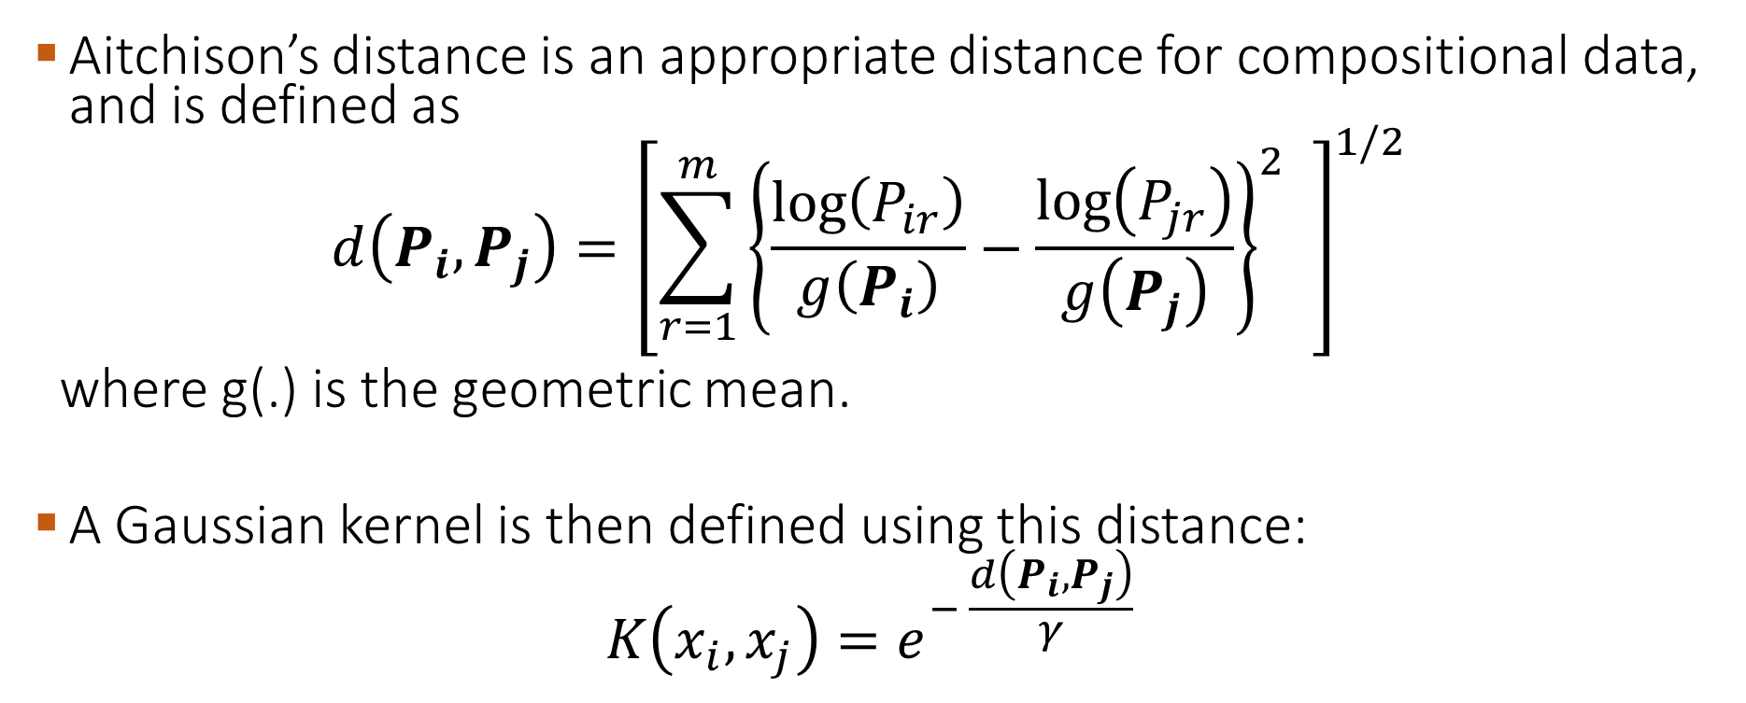
Kernel Distance Covariance (KDC) test for comparing cell type abundance
Aitchison’s distance is an appropriate distance for compositional data, and is defined as
$$d\left(P_{i}, P_{j}\right)={\left[\sum_{r=1}^{m}{{\left\{\frac{\log\left(P_{ir}\right)}{g\left(P_{i}\right)}−\frac{\log\left(P_{jr}\right)}{g\left(P_{j}\right)}\right\}}^{2}} \right]}^{1/2}$$
where g(.) is the geometric mean.
A Gaussian kernel is then defined using this distance:
$$K\left(x_{i},x_{j}\right)=e^{− \frac{d\left(P_{i}, P_{j}\right)}{γ} }$$
Rudra et al, Biorxiv 2021. doi: https://doi.org/10.1101/2021.05.08.443265

Slide 14
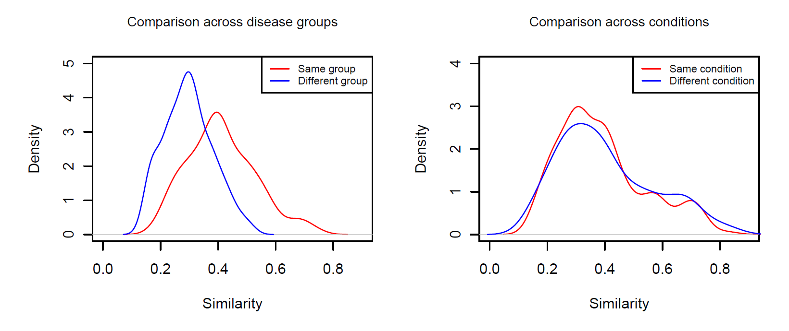
Application on SLE data – study 1

Slide 15
Simulation study
We simulate data using a multinomial logit model.
Different types of “true difference” in the compositional profiles are used.
The parameters are motivated by the real data (study 1).
  10-20 individuals per group.
  10-20 cell types.
Overdispersion: Observation level random effects (OLRE).
Other methods: GLMM (Nowicka et al 2017), diffcyt (Weber et al, 2019).

Slide 16
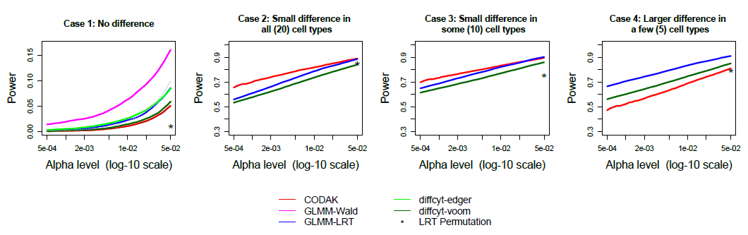
Comparison of size and power

Slide 17
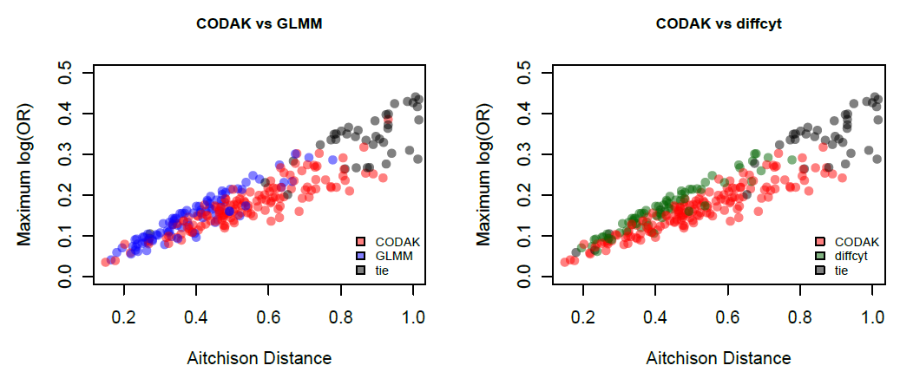
Some more insights

Slide 18
Adjusting for covariates
Approach 1: Transform the compositional data using the so called additive log ratio (alr) or centered log ratio (clr) transformation, residualize for the covariates and then bring it back to the compositional space again.
Approach 2: If the covariate is categorical, we can use a stratified kernel approach (Zhan et al, 2015).
  Similarity = 0 when observations come from different strata.

Slide 19
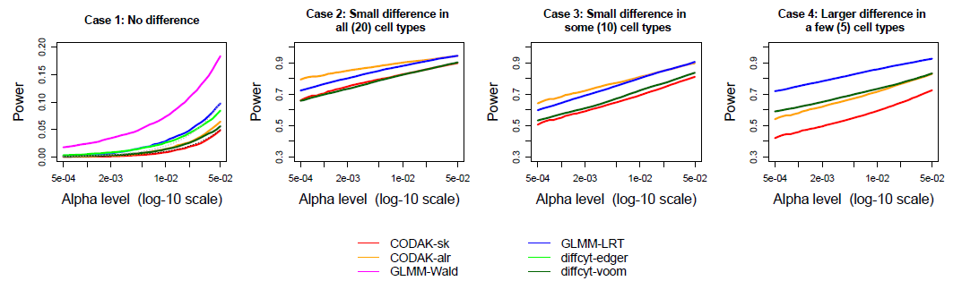
Adjusting for covariates
Notes:
Correlated data

Slide 20
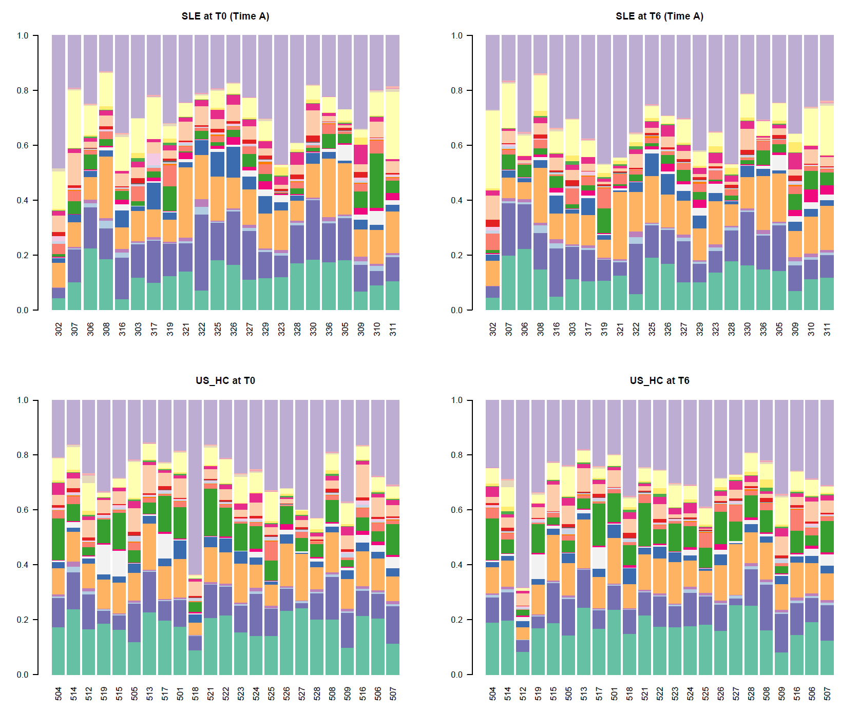
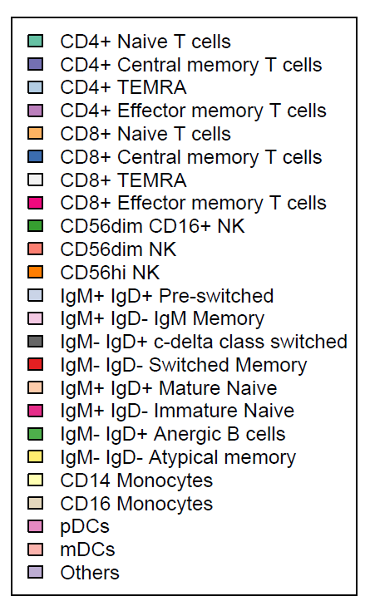
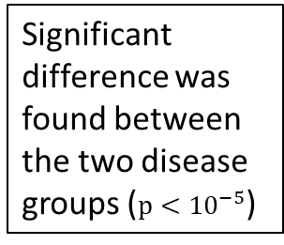
Compositional profiles from the SLE – study 2
Significant difference was found between the two disease groups ($p<{10}^{−5}$)

Slide 21
Application of CODAK for longitudinal data
Disease score (SLEDAI)
  Every individual was followed over time and the disease activity was measured using SLEDAI score.
  Other clinical covariates were measured.
  SLEDAI was found to be not significantly associated with cell type abundance (p-value > 0.3).
  SLEDAI is more likely to be associated with functional markers (ongoing analysis).

Slide 22
Extra slides

Slide 23
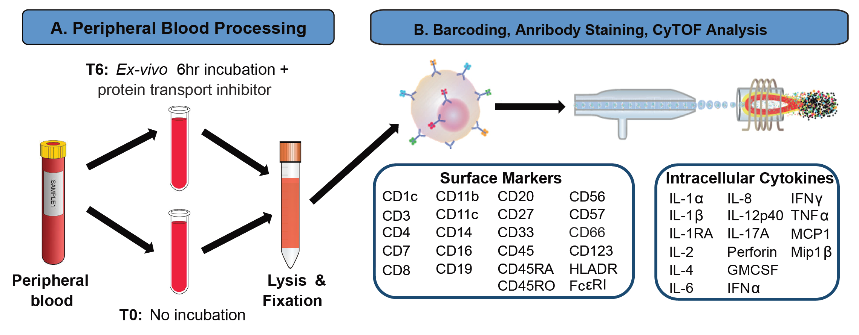
Experimental details

Slide 24
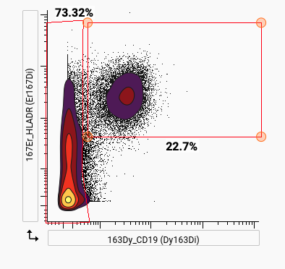
Manual Gating Example

Slide 25
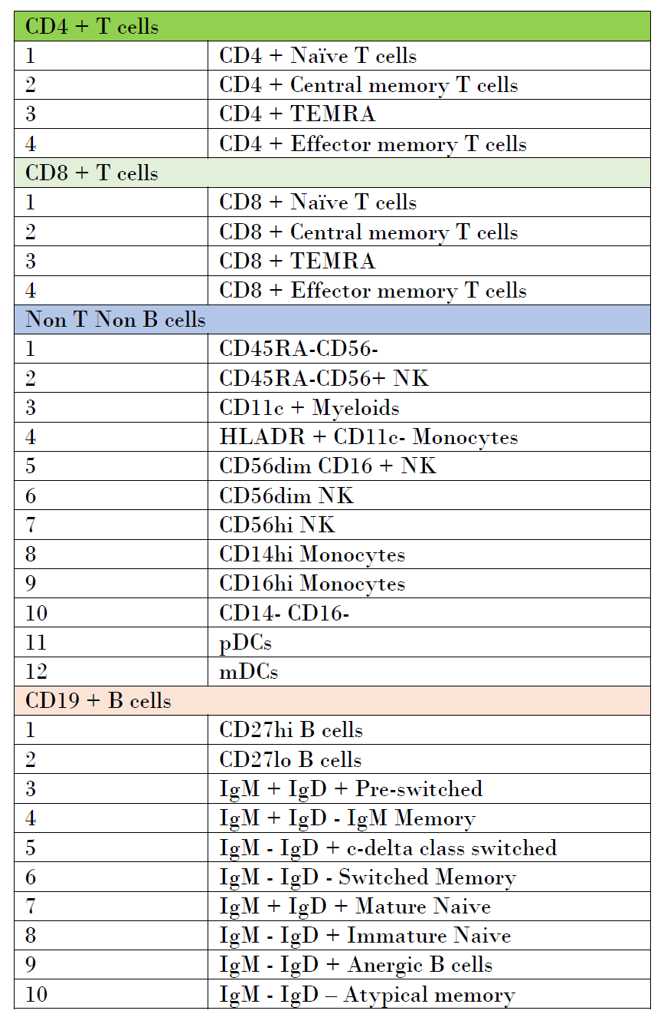
List of cell subpopulations in study 2

Slide 26
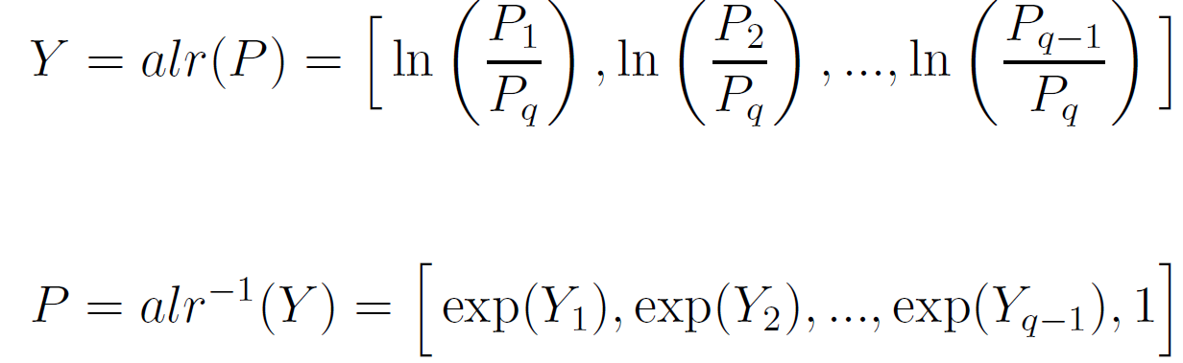
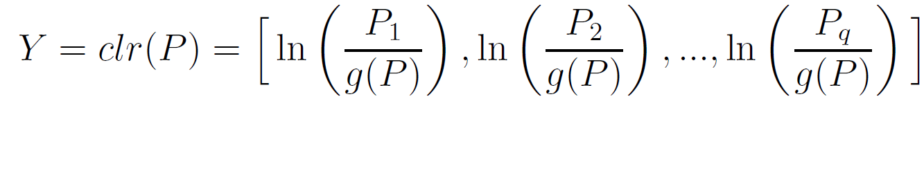
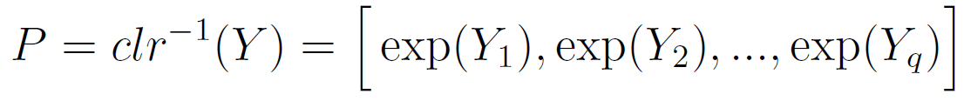
alr and clr transformations

Slide 27
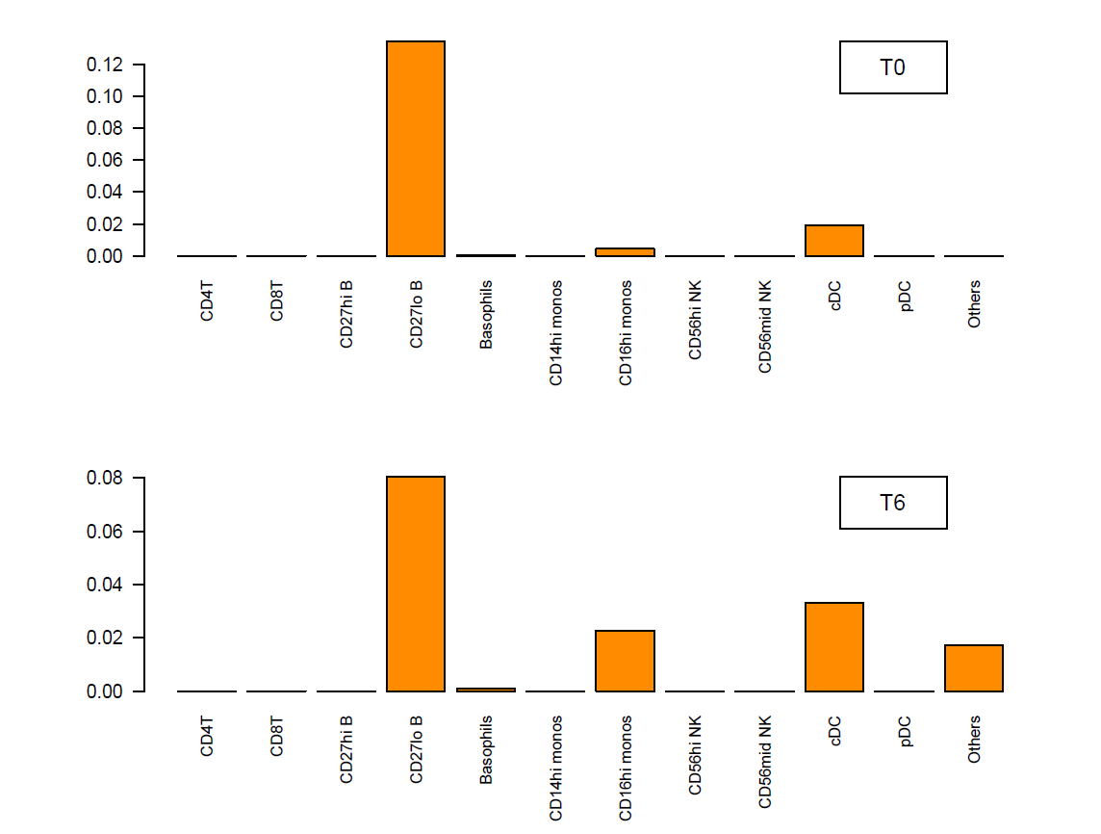
Follow up - Leave one out approach

Slide 28
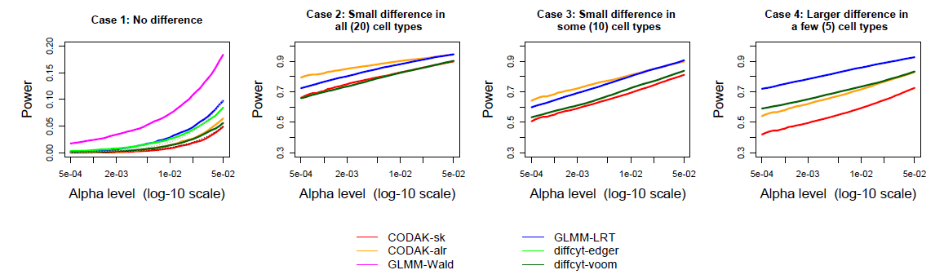
Robustness against violation independence

