Slide 1
NCI Drug Development Resources: Stepping Stones, NExT and Consultation Service Sharad K. Verma, PhD Morgan O’Hayre, PhD John Giraldes, MS National Cancer Institute
2024 Molecular & Cellular Oncology (MCO) Retreat
University of Colorado Cancer Center

Slide 2
NCI Experimental Therapeutics (NExT) Program
A peer-reviewed program to support the discovery and development of promising agents for cancer therapeutics towards/through the clinic.
Resources available encompass the end-to-end process: early discovery, candidate selection, IND enabling (cGMP, GLP PK/Tox, filing), FIH, Phase I/II
NExT does NOT award grants to the applicants, but rather supports their projects via NCI contracts to advance approved projects in a milestone-driven manner. Clinical trials may be supported through NCI-funded clinical trial networks.

Slide 3
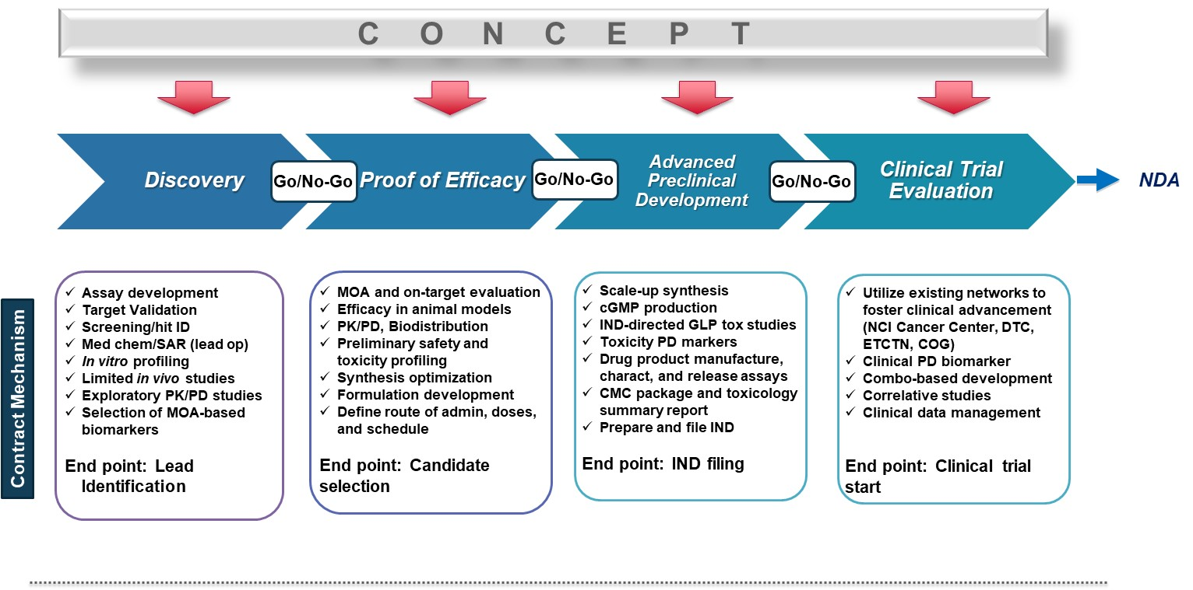
Flexible entry points into the NExT pipeline
Notes:
Flexible entry points for therapeutic agents are a hallmark of the NExT Program, whereby investigators with a concept but little resources or funding to put an idea through could apply for these resources at the various stages. Through NCI and government contractual mechanisms, the NCI is able to provide critical resources in a milestone driven process to PIs in the community to advance their projects through the stage gates.

Slide 4
NExT Agents for Therapeutic Intervention
Agents with a direct Therapeutic Intervention in Cancers are considered.

Slide 5
NExT Program Metrics
Since its inception in late 2009, NExT has received over 1000 applications over 46 application cycles
Approx 5-10% acceptance rate each cycle

Slide 6
NExT - FAQs
Results/products are returned to the applicant PIs and used to support further development by the applicants or in partnership with NCI.
Applicants retain ownership of their existing IP– new IP may be shared
All are eligible to apply:
Researchers in academia, government, industry
Nationally or internationally
Submission deadlines three times per year: Mar 15, July 15, Nov 15
Only 2 submissions allowed (initial and a re-submission)
Approximately 5-10% acceptance rate each cycle
For more information, website: https://next.cancer.gov
For questions, email NCINExTInfo@mail.nih.gov

