Slide 1
Kimber Simmons, MD MS
Assistant Professor of Pediatrics, Pediatric Endocrinology

Slide 2
ASK the Experts Goals Families
Connect families and individuals with our national network of trained local experts and research partners in type 1 diabetes and celiac disease for
Screening
Monitoring
Early interventions available through clinic or research trials

Slide 3
ASK the Experts Goals Healthcare Providers (HCPs)
Empower HCPs to manage patients screened for T1D or in early stages of T1D
Training (via zoom)
Resources (downloadable via web)
Connections with our team for support (phone, e-mail, member site)

Slide 4
Website Home Page

Slide 5
Website Home Page

Slide 6
Families

Slide 7
T1D Information for Families

Slide 8
Families and Individuals Connect with Us through Web, E-mail or Phone

Slide 9
Families Work-Flow
Referral to Experts
HCP, screening program, web search, social media, JDRF screening clinic, industry
Contact Experts
web form, e-mail, phone
Phone Call
Clarify reason for contact, complete consent/intake form/enrollment
Antibody Status Negative
recommend re-screen based on symptoms and family/medical hx
Antibody Status Unknown
recommend screening
Antibody Positive
rule out symptomatic T1D, recommend random blood glucose, HbA1c and repeat antibody test

Slide 10
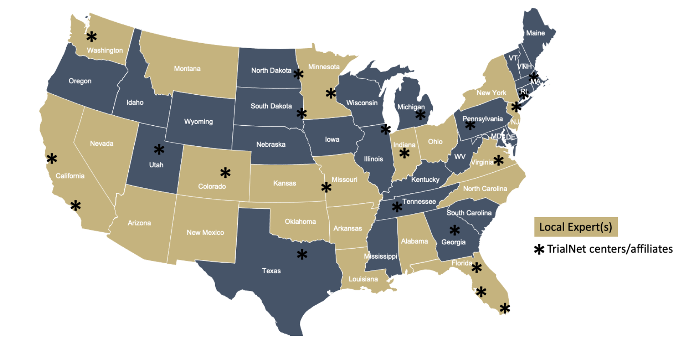
Connect Families Confirmed Positive for T1D Associated Autoantibodies to “Local Expert”
Local expert has confirmed expertise in early T1D education and metabolic monitoring
If local expert does not exist, we work to identify and train an expert in that area

Slide 11
Experts Participants
Experts engages people of all ages with the majority (88%) <18 years of age
Over represents non-Hispanic white individuals - we are working with providers in racially and ethnically diverse areas to increase diversity of participants
Half of participants have a family history of T1D

Slide 12
Healthcare Providers

Slide 13
Website Home Page

Slide 14
”Cliff Note” Resources

Slide 15
Healthcare Provider Workflow

Slide 16
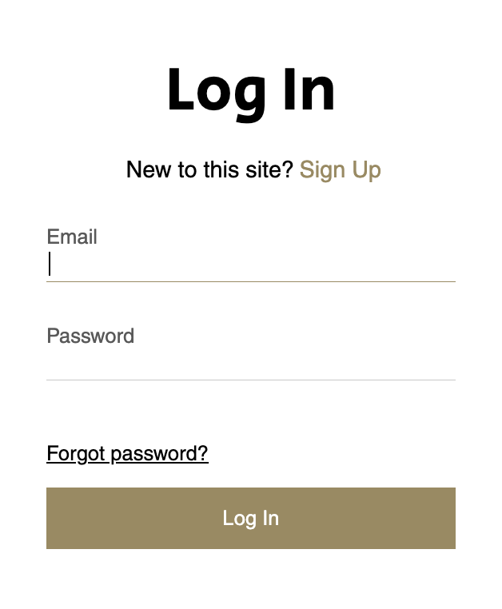
Join for Member Resources

Slide 17
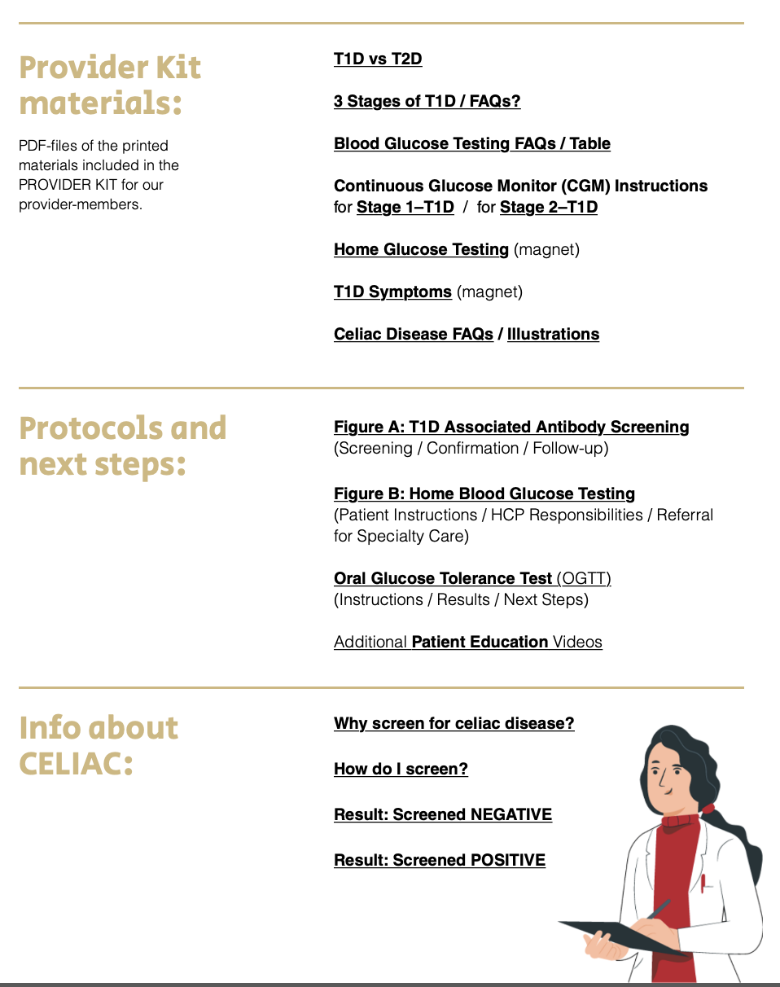
Member Resource Page

Slide 18
Experts Supports Local Experts
LOCAL
MONITORING
REMOTE
MONITORING
HYBRID
Enroll in ASK follow-up research study
Offer trainings
Access to web-based, downloadable resources
Access to CGM as needed
Glucometer with remote data capabilities as needed
Support via member log-in on website or e-mail

Slide 19
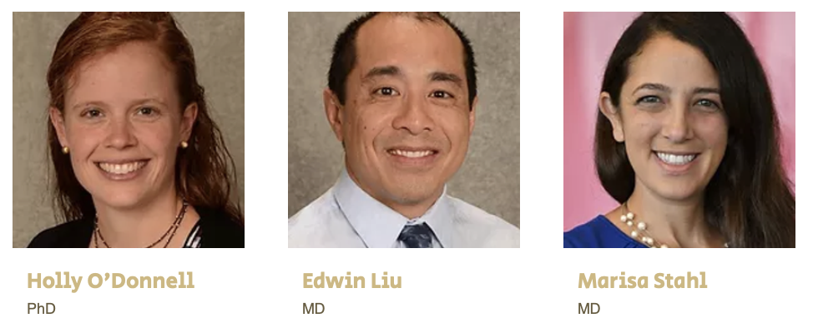
Thank You!
Ask the Experts Team
Support
Collaborators
“Expert” Healthcare Providers, Families and Individuals
Contact: Kimberly.Bautista@cuanschutz.edu
Screening/Monitoring Programs:
ASK, CASCADE, PLEDGE, TrialNet

