Slide 1

Integration of Screening and Monitoring with routine care and EHR in
the Sanford PLEDGE Study
Kurt J. Griffin PhD, MD
5th Childhood Diabetes Prevention Symposium
11 November 2022
In Partnership with

Slide 2




PLEDGE Overview of Procedures
Entry before 6th birthday
OR once 9-16 y.
Genetic Risk Score (GRS2)
Once at study entry
(blood spot; can be with Newborn Screening)
Birth
2 years
5 years
9 -16 years
Parental Worry Screening
T1D AutoAb
Celiac Testing

Slide 3


Innovation and Infrastructure
Invitation
Completed Consent
Self-eligibility
Routine Care
Lab Collection
Consent
(MyChart)
Invitation
(MyChart)
Lab Results
Epic / MyChart
+
Existing Infrastructure
– Collection
– Processing
– Shipping (PNRI)
– Results
Research Staff will:
– Contact Family & Explain
– Retest
– If persistent:
– Monitoring Protocol for T1D
– Clinical referral to peds GI for celiac
Integration into routine care
Leverage existing processes and infrastructure
Automation of invitation, enrollment, and messaging

Slide 4
Expansion and Enrollment
Pilot site August 2020
Now Open at every primary care clinic in Sioux Falls and Fargo
126 Clinics Open across Sanford footprint
Number Enrolled
8 November 2022

Slide 5
Screening Results
Celiac Disease:
Positive Screens 42
Repeat Testing Pending 4
Persistent positives 18
Previously known CD 4
New referrals to GI 14
T1D:
Positive Screens 61
Repeat Testing Pending 5
Persistent positives 18
Single Antibody 14
2 Antibodies 2
4 Antibodies 2
New-Onset Stage 3 1
Other Clinical Care 1
DKA at Diagnosis 0
8 November 2022

Slide 6
Alert for Clinicians
How help providers recognize a child at risk for T1D when they present with relevant symptoms?
  Initial approach: include in Epic Problem List
    Custom Problem list entry:
      e.g. “Pre-symptomatic Type 1 Diabetes (Stage 1)”
    Not an option in our implementation of Epic:
      must be tied to ICD-10 code.
      Eventual update of ICD-10 to include these diagnoses?
    Compliance recommended R76.0: “Abnormal Antibody Level”
      “You can add details in the problem overview”
    Critical information hidden in a place that requires active clicking to find

Slide 7
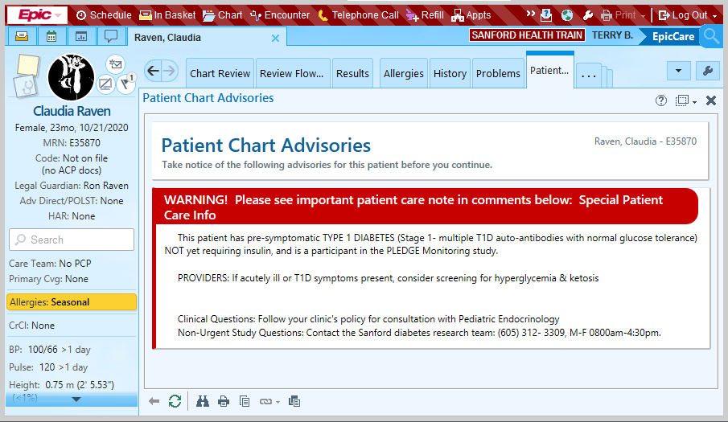
Alert for Clinicians
How help providers recognize a child at risk for T1D when they present with relevant symptoms?
  “Patient Chart Advisory”
    Appears on opening chart
    Reminder to consider T1D
    Provides guidance
    Does not slow work
Interface © 2022 Epic Systems Corporation

Slide 8
Updates to Testing
More older subjects, some younger had ZnT8 Ab on confirmatory testing
Adding ZnT8 assay to screening panel
Some positive screens (PNRI) had negative results on confirmatory testing (BDC)
Is this inter-assay variability? Or is this Biology?
Confirmatory draws now have aliquots run on both assays
Monitoring Protocol Updates:
• Remote OGTT
• CGM for Stage 1/2
• Home monitoring
– Urine Ketones
– Blood Glucose
• Patient handbook under development with Patient Education Team
1 November 2022

Slide 9
What’s working Well?
Automatic invitations to participate
Self-enrollment
Order Entry
Logistics of lab collection, processing, and results
Collection of blood spot with newborn screens
Communicating with families about Positive antibody results and subsequent monitoring.
Identifying at-risk patients to clinicians at time of visit

Slide 10

Leveraging The System
IT Development
Clinic & Lab Infrastructure
Capture and measure costs and savings
Active engagement from leadership and health plan
Measure for those not enrolled in PLEDGE

Slide 11

Thank you!
The Sanford Project Team
Ann Mays
Magdalena Skon
Vanessa Williams
Connie Hoffman
Amber Figg
Danae Fritza
Sanford IT Team
Sandi Froke
Nancy Konopasek
Many others
Funding
Leona M. and Harry B.
Helmsley Charitable Trust
T. Denny Sanford
Todd and Linda Broin
Sanford Health
All the families who volunteer for studies
Subinvestigators
Luis Casas
Stephanie Hanson
Sharon Hunt
Candice Nelson
Jennifer Schriever
Brenda Thurlow
Lab Assays
Bill Hagopian
Richard Oram
Advice and Examples
Marian Rewers

