Slide 1

5th Childhood Diabetes Prevention Symposium
General Population Screening for T1D
REPORT FROM SWEDEN:
The TRIAD Study
Daniel Agardh, MD, PhD
On behalf of the DiaUnion Study Group

Slide 2



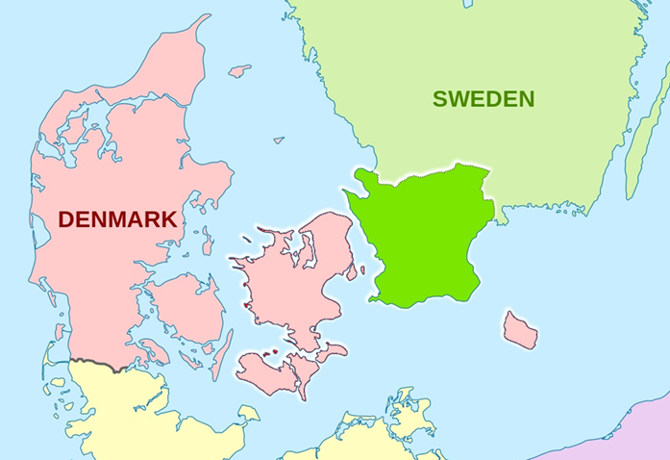
DiaUnion Est.2020
The goal is to establish an early detection program for T1D and other autoimmune diseases in the Öresund Area.
DiaUnion’s first focus: Building the missing neutral infrastructure for early detection fo T1D, CD and AIT (TRIAD).
The long-term goal is preventing and curing T1D as well as other autoimmune diseases
DiaUnion’s next focus: Creating an internationally competitive center of excellence for diabetes research, attractive for both academia and industry.
Notes:
Flemming item 1
Maria item 2
Flemming item 3
Maria thanks
The DiaUnion collaboration has made it possible to create an early detection program for T1D and other autoimmune diseases in Medicon Valley that none of the participating institutions would have been able to create on their own.
This brings us closer to the goal of preventing and curing T1D as well as other autoimmune diseases, while at the same time creating a internationally competitive center of excellence for diabetes research, attractive for both academia and industry.
For both Steno Diabetes Center Copenhagen and Lund University this is a success story that has made us stronger together.

Slide 3

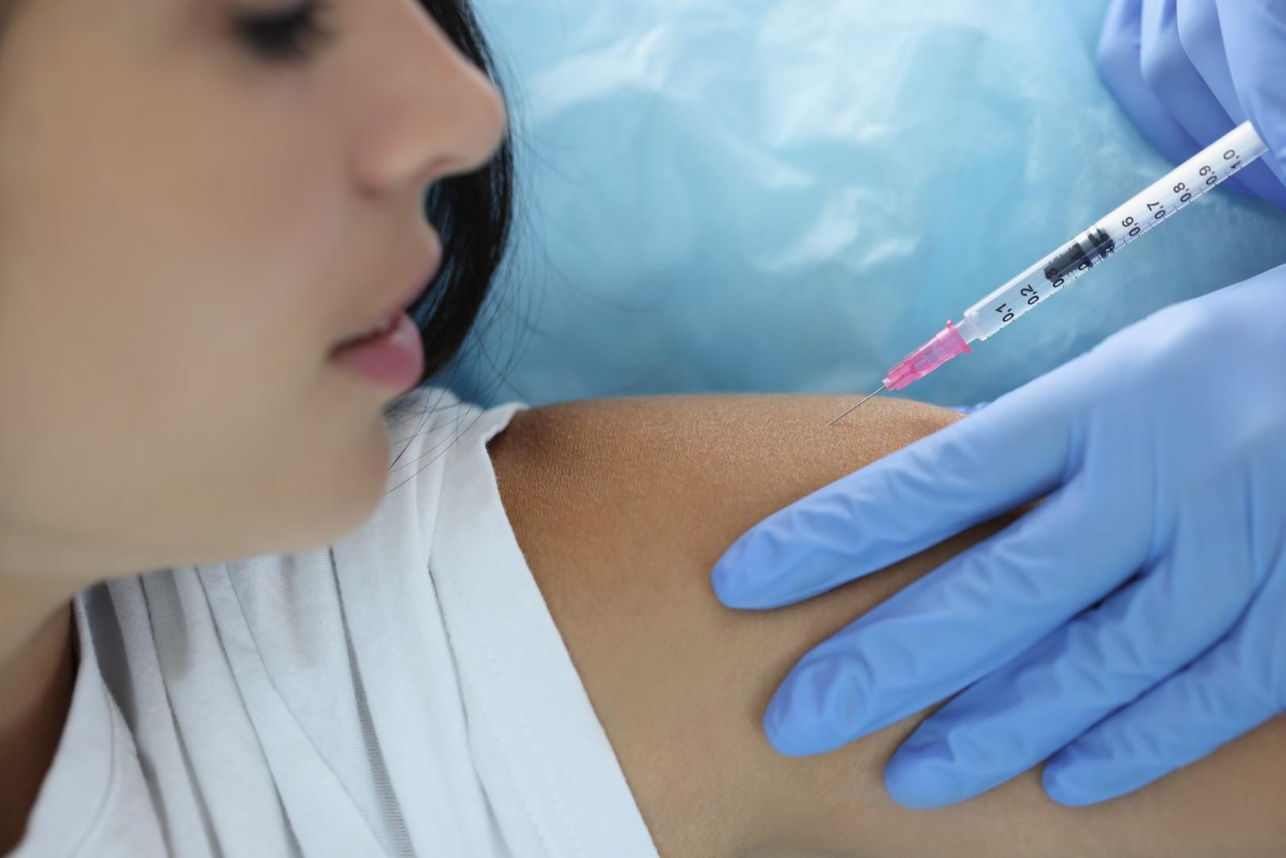
Clinical Trials of Preventive Therapies
Offer individuals at risk participation in clinical trials of novel therapeutic concepts (in collaboration with the pharmaceutical industry)
Extend research in beta cell biology, immunity and biomarkers to accelerate the development of novel preventive and interventive therapies
Document the societal benefit of a large-scale detection program for T1D, CD and AIT with a view of implementing the DiaUnion program as a public health service
Notes:
Flemming explains about the next steps of DiaUnion
Once the DiaUnion public screening program has been established, the aim is to offer people identified at risk for any of the three diseases participation in clinical trials of novel therapeutic concepts. This will be done in collaboration with the pharmaceutical industry.
In parallel, DiaUnion will extend research in beta cell biology, immunity and biomarkers to accelerate the development of novel preventive and interventive therapies for the three diseases.
The long-term goal is to document the societal benefit of a large-scale detection program for T1D, CD and AIT with a view to implementing the DiaUnion program as a public health service.

Slide 4

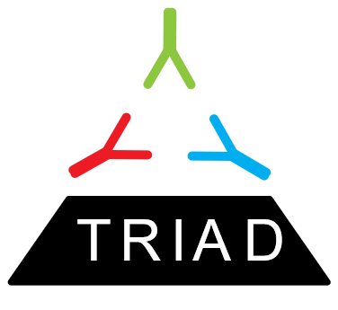
Screening for type 1 diabetes, celiac disease and autoimmune thyroiditis in a general pediatric population
THE TRIAD STUDY
Maria Scherman¹, Alexander Lind¹, Åke Lernmark¹, Flemming Pociot², Daniel Agardh¹
¹Lund University, Sweden, ²Steno Diabetes Center, Denmark

Slide 5
RATIONALE FOR SCREENING
Early detection of children with disease to prevent acute and long-term complications
Identification of healthy individuals at increased risk of disease in the future for inclusion in prevention and intervention studies

Slide 6

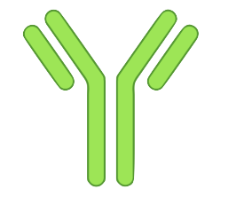

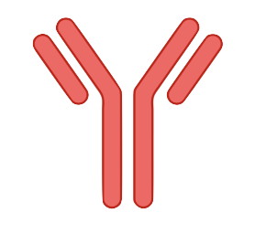
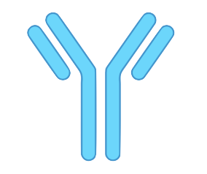
SCREENING OF THREE DISEASES
IAA
GADA
IA-2A
TYPE 1 DIABETES
(T1D)
Znt8A
Step 1. Radiobinding assays (RBA) method for screening of autoantibodies
Step 2. Antibody Detection by Agglutination PCR (ADAP) method for evaluation
IgA-tTG
CELIAC
DISEASE
(CD)
AUTOIMMUNE THYROIDITIS
(AIT)
TPOA
IgG-tTG
TGA

Slide 7
AIMS
To explore the prevalence of autoantibodies for T1D, CD and AIT in a general pediatric population
To test the feasibility of home capillary blood sampling for future large-scale screening

Slide 8

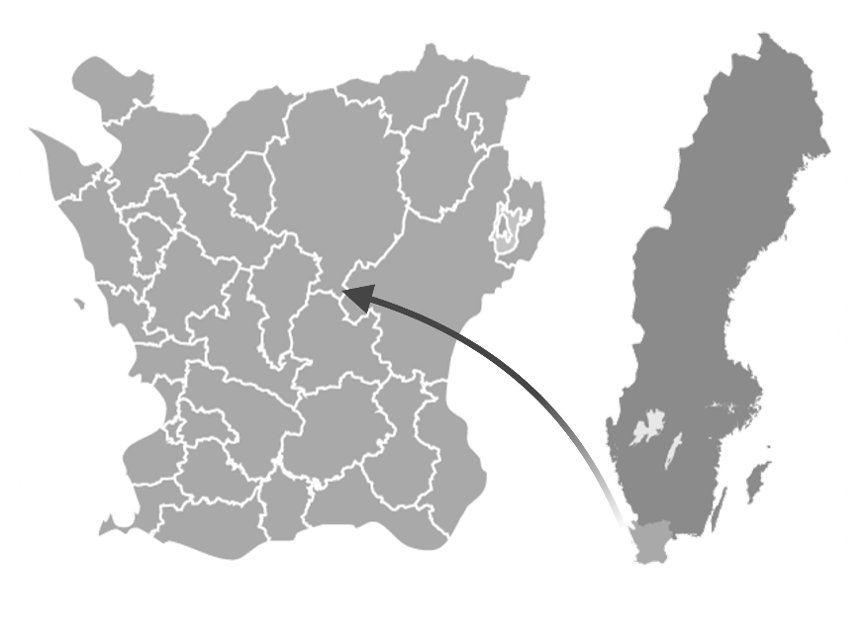
Obtain 2000 samples from invited 20,000 children
GOAL OF SCREENING
General pediatric population
Ages 6-9 years (born 2013/2014)
Ages 13-16 years (born 2006/2007)
Capillary blood sampling at home
Check Aab+ children in a confirmatory sample
Persistently Aab+ are referred to pediatrician
TRIAD screened children living in Skåne located in southern parts of Sweden

Slide 9
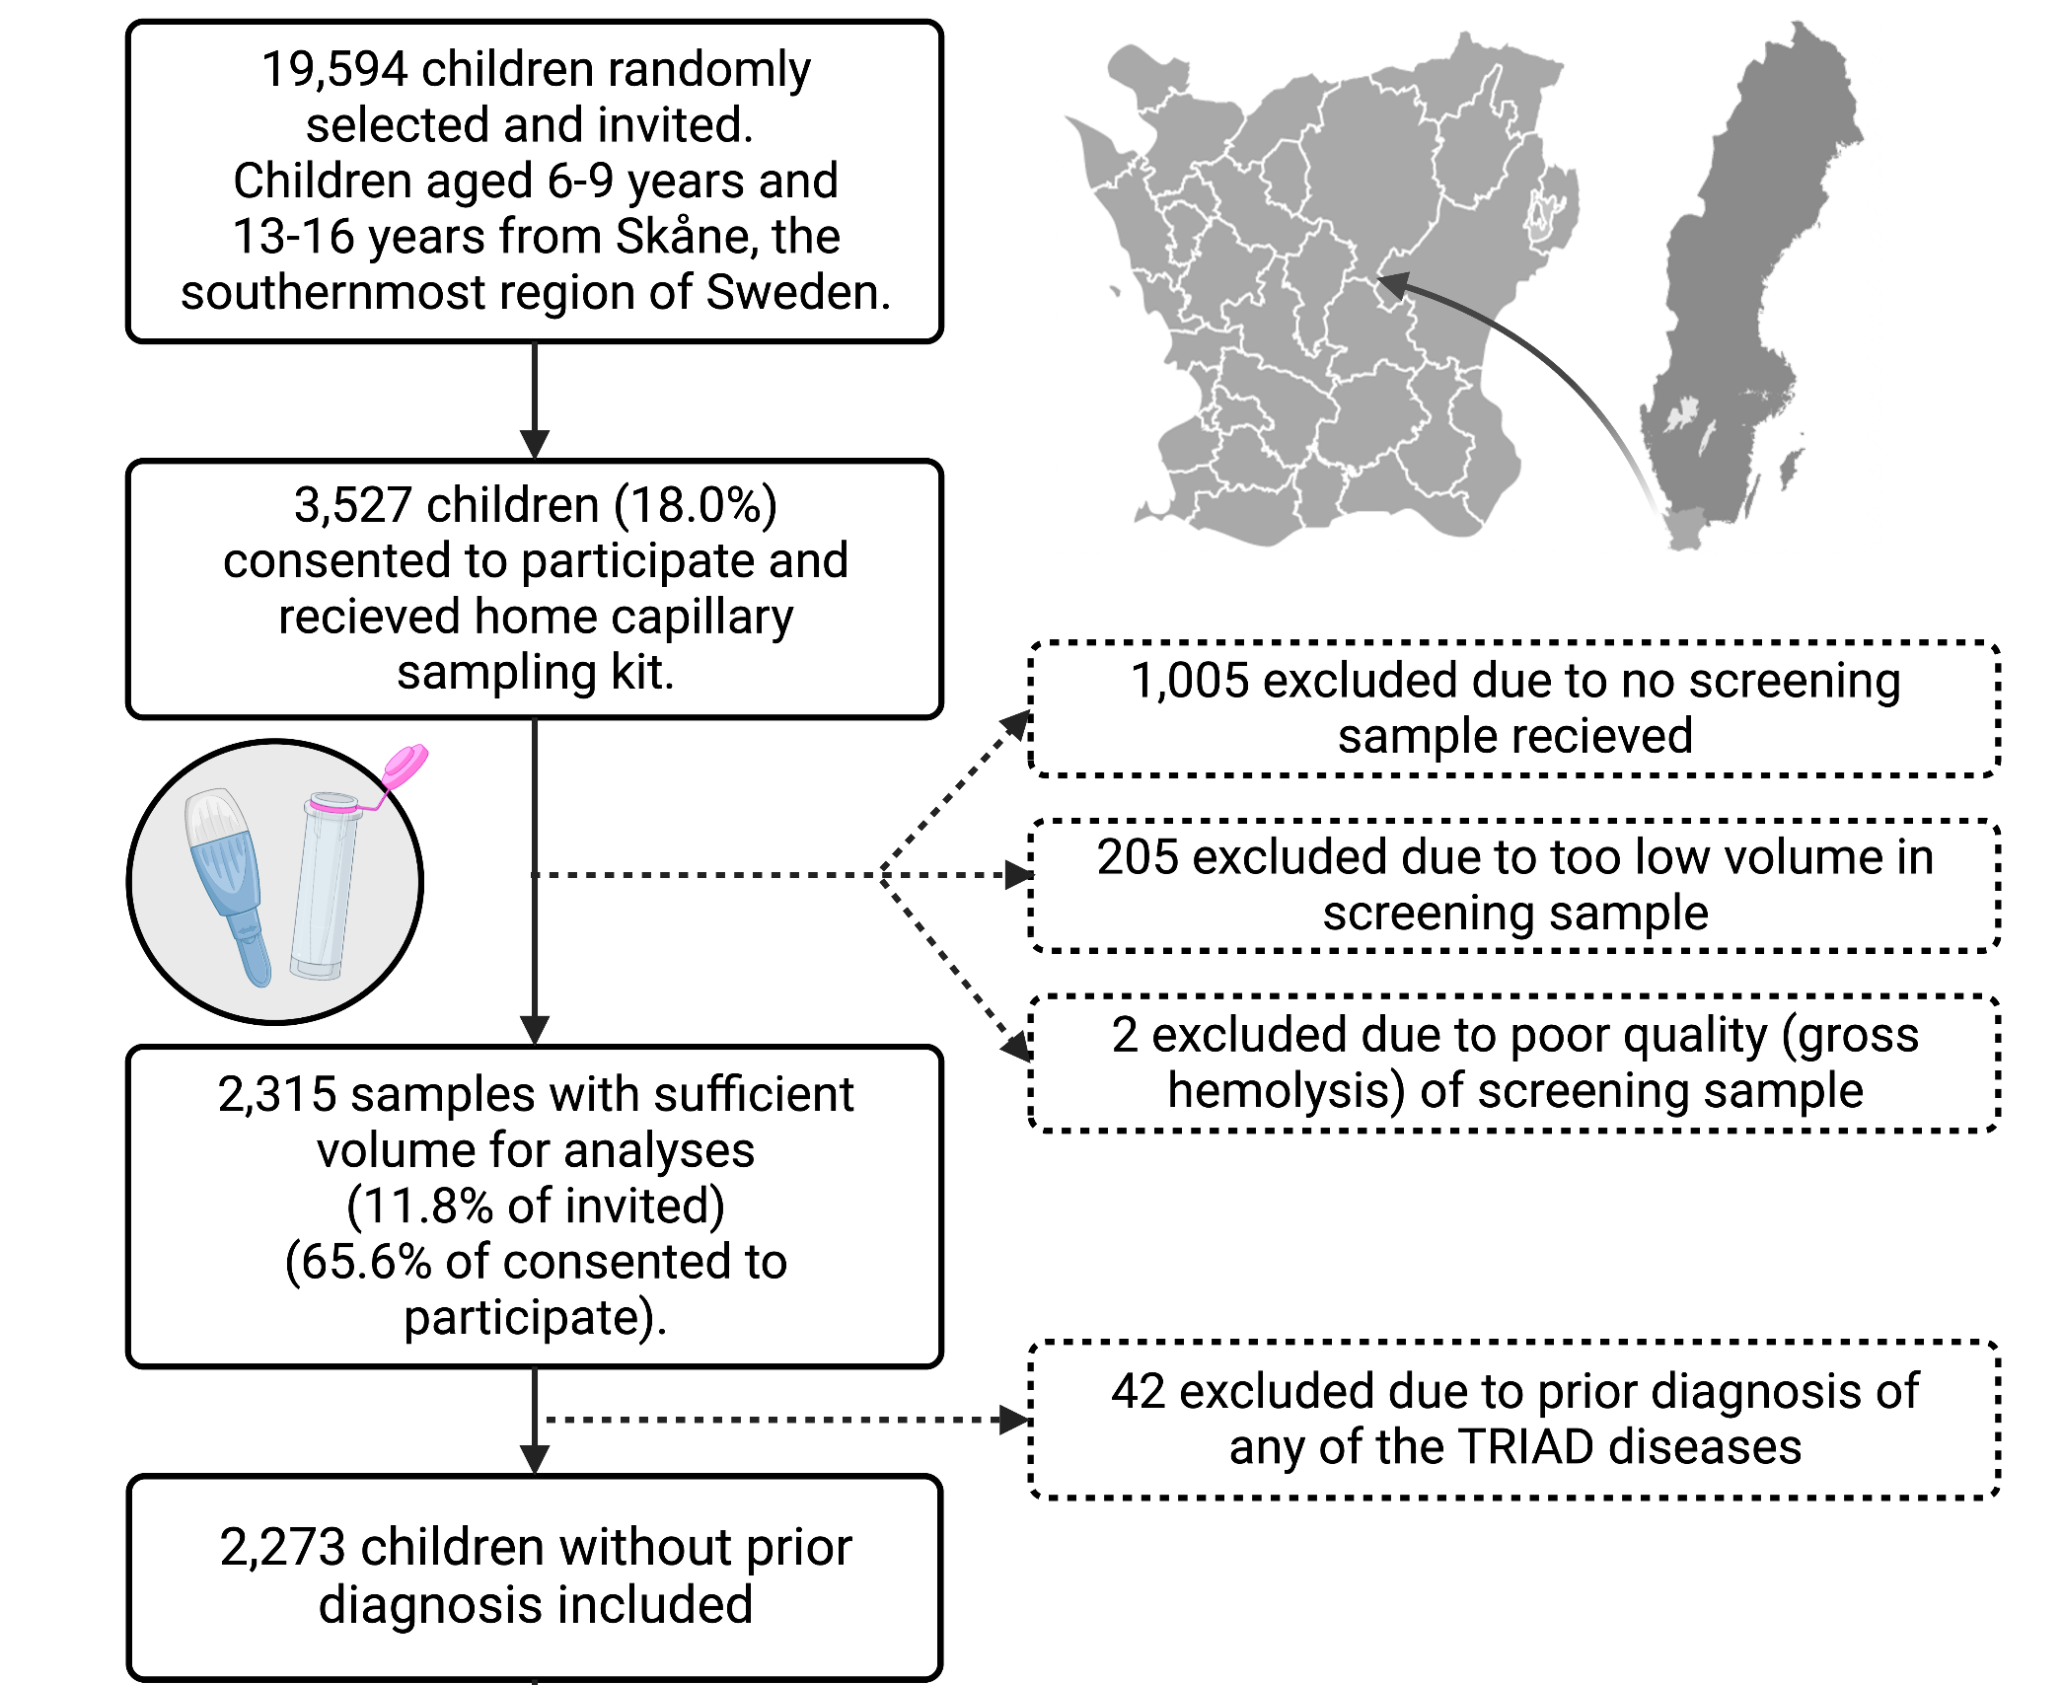
STUDY POPULATION

Slide 10

RESULTS

Slide 11
PREVALENCE
Aab+ individuals in 2,273 screening samples, n=240 (10.6%)

Slide 12
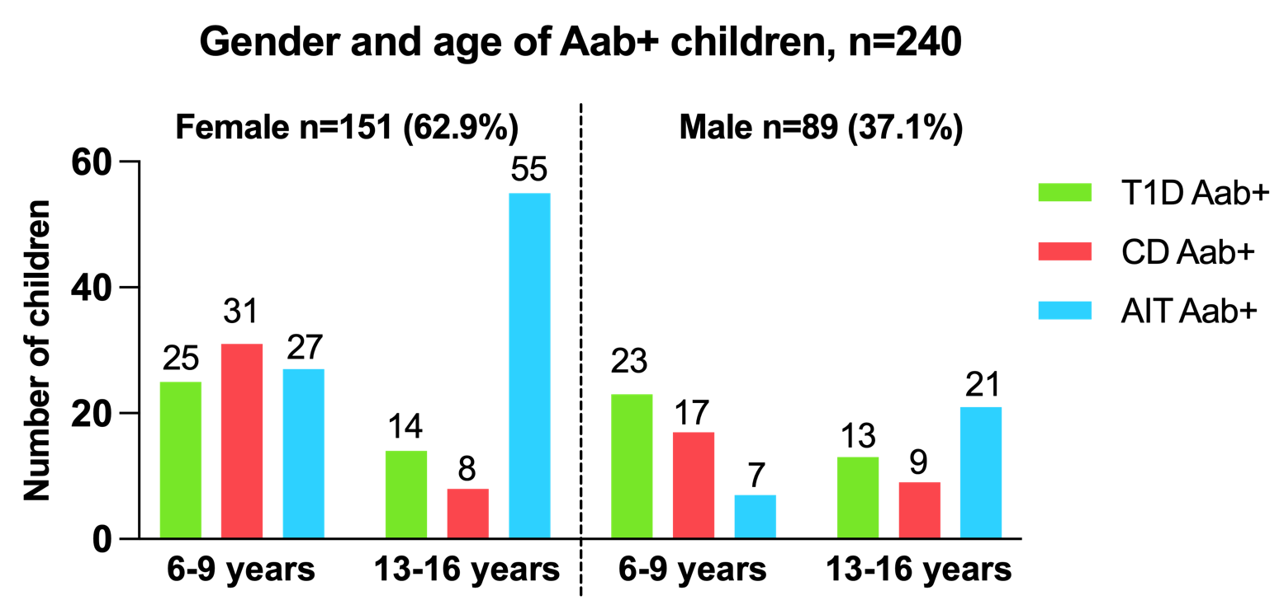
AGE & GENDER DISTRIBUTIONS

Slide 13
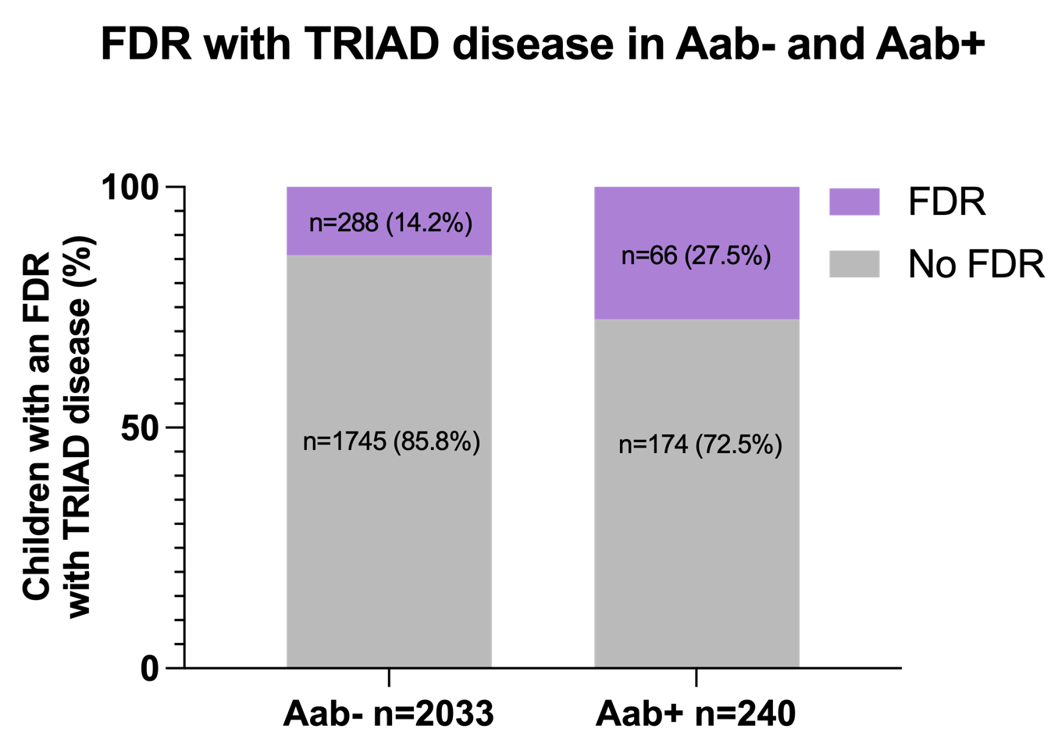
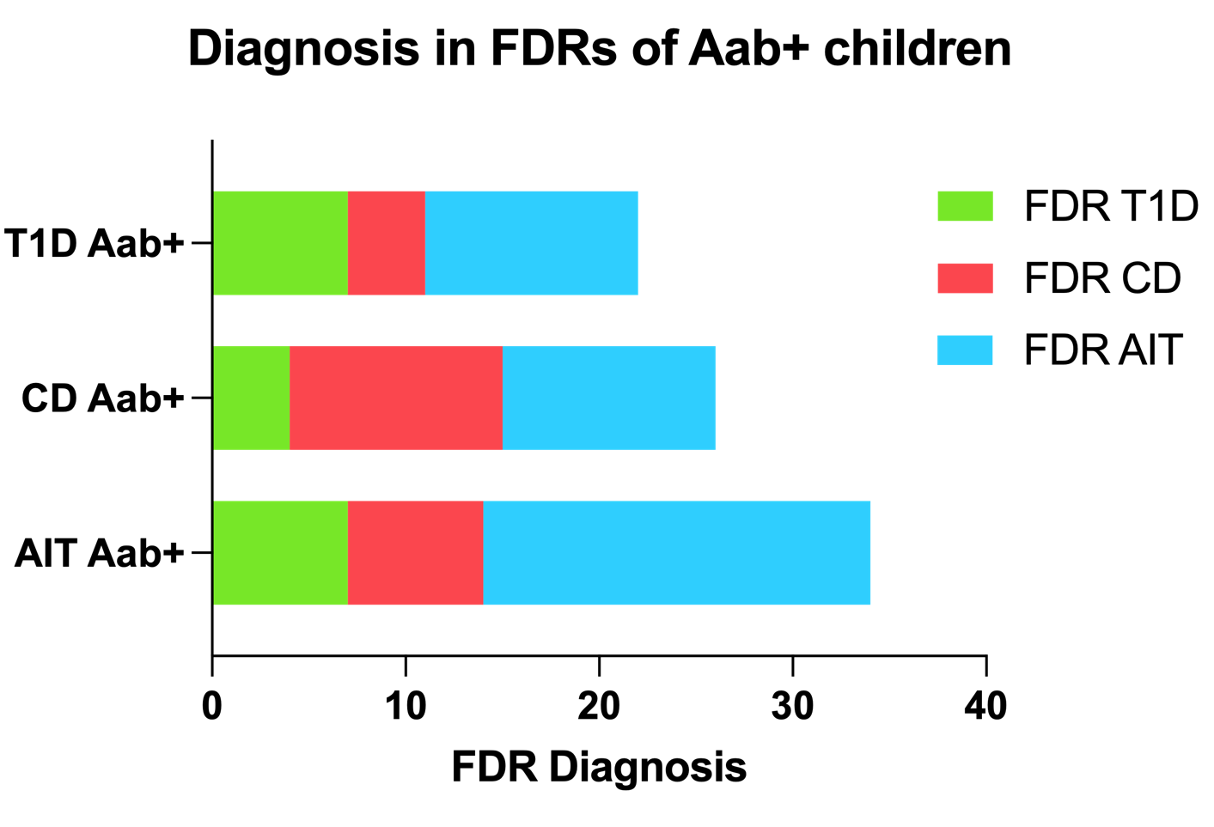
FIRST-DEGREE RELATIVE STATUS

Slide 14
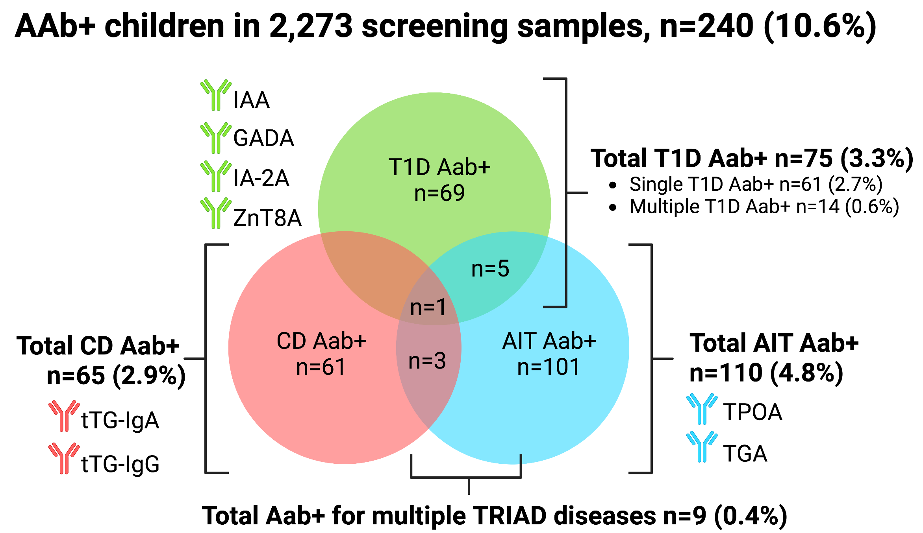
OVERLAP

Slide 15
CLINICAL DIAGNOSIS AFTER SCREENING
Distribution (%) of screening detected Aab+ children (n=207) by diagnosis
Notes:
15 under investigation:
6 waiting endoscopy
5 waiting ultrasound thyroid gland
2 waiting thyroid tests
1 waiting HbA1c
1 waiting additional tTG

Slide 16
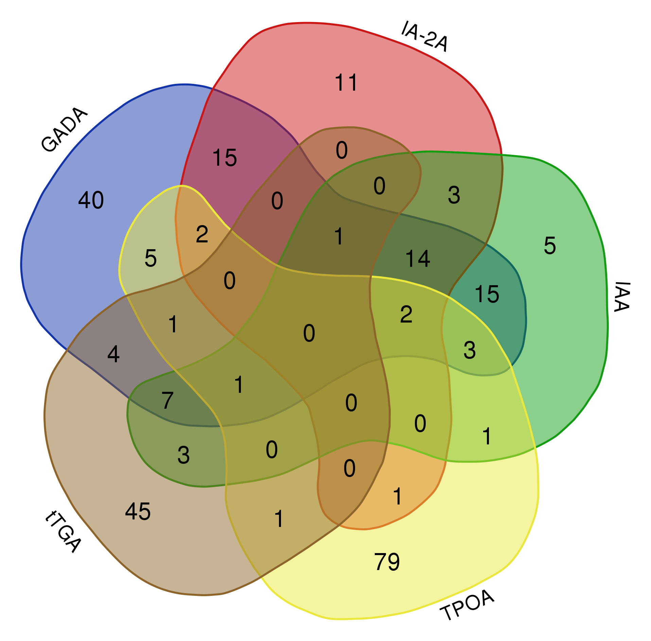


SCREENING OF DANISH FDRs OF T1D CHILDREN
Aab+ individuals in 1349 FDRs to children with T1D, n=259
AAB | Number of positive DK | Number of positive SWE
GADA | 110/1349 (8.2%) | 37/2273 (1.6%)
IA-2A | 49/1349 (3.6%) | 17/2273 (0.75%)
IAA | 55/1349 (4.1%) | 45/2273 (2.0%)
TPOA | 97/1349 (7.1%) | 116/2273 (5.1%)
tTGA | 63/1349 (4.7%) | 89/2273 (3.9%)
Overall number of positives | 259/1349 (19.2%) | 257/2273 (11.3%)
Notes:
Flemming gives a graphical overview of aab screening results of both S and DK samples

Slide 17
CONCLUSIONS
Previously unknown autoimmunity for T1D, CD and/or AIT is common in Swedish children, particularly among girls and children having a FDR with any of the diseases.
Home capillary blood sampling is a feasible and safe procedure to obtain blood samples in children.
Overall high prevalence of autoimmunity in Danish FDRs of children with T1D.

Slide 18
NEXT STEPS
IAA
GADA
IA-2A
TYPE 1 DIABETES
(T1D)
ZNT8A
Step 1. Antibody Detection by Agglutination PCR (ADAP) method for screening
Step 2. Radiobinding assays (RBA) method for confirmation of autoantibody positives
IgA-tTG
CELIAC
DISEASE
(CD)
AUTOIMMUNE THYROIDITIS
(AIT)
TPOA
IgG-tTG
TGA

Slide 19
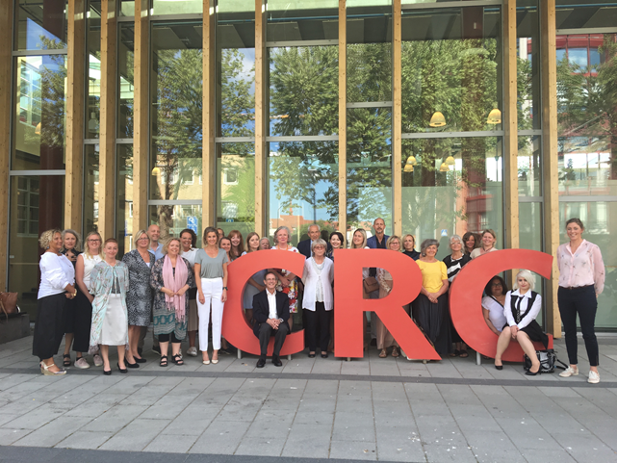
THANK YOU!
Alexander Lind
Maria Scherman
Samia Hamdan
Zeliha Mestan
Neele Bergemann
Anita Ramelius
Rasmus Bennet
Johan Svensson
Markus Lundgren
Finn Kristensen
Flemming Pociot
Åke Lernmark
Jason Tsai & team
Enable Biosciences
Celiac disease & Diabetes Unit

