Slide 1

The Early Start Study: TESS
^{5th} Childhood Diabetes Prevention Symposium
Brigitte I. Frohnert MD PhD
November 11, 2022

Slide 2
Outline
  Background and goals
  TESS protocol
  Baseline data from TESS participants
  Intermediate data from TESS participants
  Presymptomatic T1D and EMR communication

Slide 3
Rationale for TESS
(Trial of Early Initiation of CGM-Guided Insulin Therapy in Stage 2 T1D)
Currently no guidelines for management of stage 2 T1D
OGTT and HbA1c present challenges for monitoring
Continuous Glucose Monitor (CGM) opportunities:
  Therapeutic decisions
  Teaching patients and families from real-world data

Slide 4
Goals
Minimize dysglycemia:
    Maintain HbA1c <7.0%.
    Peak HbA1c during study
    CGM values at 6 and 12 months after enrollment
Avoid adverse outcomes:
    ER visits, hospitalizations, DKA and severe hypoglycemia

Slide 5
Goals
Optimize education:
    Early education before symptomatic/ on insulin
    CGM-guided learning
Experience:
    Patient/caregiver satisfaction
    Quality of life

Slide 6
TESS Design and Study Population
  Randomized controlled trial
    Intensive follow-up of stage 2 T1D participants utilizing continuous CGM technology and early education of families to guide early insulin therapy
  Target 36 participants (31 enrolled to date)
  Randomized 2:1 (intervention:control)
  6 months intervention/6 months follow-up
  Intervention: CGM-guided education and initiation of insulin

Slide 7
TESS Protocol
Intervention (6 months):
  Unblinded CGM-guided education
  Monthly evaluation of CGM data
  CGM-guided insulin start (verification by glucometer)
Control
  Monitoring by intermittent finger stick glucose
  Standard review of symptoms

Slide 8
Outcomes
Glycemic measures
  CGM data collection every 3 months
  OGTT at 0, 6, 12 months
Collection of markers of beta-cell function
Knowledge
Quality of life
Cost analysis

Slide 9
Enrollment Criteria
ADA Criteria for Stage 2 T1D
OGTT (plasma glucose)
Fasting | 100-125 mg/dL
2 hour glucose | 140-199 mg/dL
A1c
At visit | 5.7-6.4%
Increase from last visit | >10%
Age 2 to 20 years
Islet autoimmunity with high risk of progression:
  Multiple IA positive (>50% 5-year risk)
  Single high-affinity IA (>30% 5-year risk)
Dysglycemia:
  ADA criteria
  CGM-based criteria
  Home glucose testing data
Additional TESS Criteria for Stage 2 T1D
OGTT (plasma glucose)
30, 60 or 90 min glucose | >200 mg/dL
CGM (worn for > 5 days)
Average sensor glucose | >120 mg/dL
% time above 140 mg/dl | ≥15%
Peaks ≥200 mg/dl | on ≥2 days
Home glucometer:
Fasting BG | >110 mg/dL on ≥2 days
2-hour post meal BG | >150 mg/dL on ≥2 days
Single random BG | > 200 mg/dL

Slide 10
Qualifying Dysglyemia in TESS Participants
HGT: Home glucose testing

Slide 11
Participant eligibility
Eligibility Criteria for Dysglycemia | Control (N=11) | Intervention (N=19) | P-value
Eligibility visit (weeks before baseline) | 14.1 ± 11.2 | 14.0 ± 13.5 | 0.98
HbA1c (5.7-6.4%) | 18% (2) | 32% (6) | 0.67
CGM | 64% (7) | 63% (12) | 0.98
OGTT | 40% (4) | 13% (2) | 0.18
Home glucose testing | 20% (2) | 22% (5) | 1
Multiple abnormal measures | 36% (4) | 26% (5) | 0.56

Slide 12
TESS Baseline Demographic Data
Baseline Characteristics | Controls (N=11) | Intervention (N=19) | P-value
Age (years) | 14.6 ± 3.6 | 10.1± 3.7 | 0.01
Female, % (n) | 64% (7) | 53% (10) | 0.56
1st degree relative w/ T1D | 36% (4) | 42% (8) | 0.76
BMI Z-score | 0.3 ± 1.4 | 0.2 ± 1.4 | 0.77
TG antibody positive, % (n) | 18% (2) | 21% (4) | 0.90

Slide 13
TESS Baseline Glycemic Data
Baseline Characteristics | Controls (N=11) | Intervention (N=19) | P-value
HbA1c at baseline (%) | 5.2 ± 0.3 | 5.4 ± 0.4 | 0.14
CGM at baseline
%Time >140 mg/dL | 10.0 ± 13.0 | 11.5 ± 8.7 | 0.74
average SG (mg/dL) | 112 ± 14 | 114 ± 9 | 0.65
OGTT at baseline
Fasting glucose (mg/dL) | 89 ± 11 | 85 ± 10 | 0.36
Peak 30,60,90 glucose (mg/dL) | 186 ± 35 | 183± 59 | 0.91
2h glucose (mg/dL) | 116 ± 26 | 151 ± 57 | 0.06

Slide 14
TESS Education and Insulin Start

Slide 15
Early-stage T1D education
MD/NP:
  Pathophysiology of T1D
  CGM-guided education (diet/exercise)
  Trends with illness
  (Insulin plan)
RD: Dietary education:
  Carbs and healthy diet
  Exercise
CDE: Practical education:
  Use of CGM, troubleshooting
  Symptoms of highs and lows
  Checking ketones/Illness
  (Glucagon)
SW: Emotional/Family impacts
  Family strengths
  Depression/anxiety
  Coping and grief

Slide 17
PRELIMINARY dATA

Slide 18
T1D Diagnosis
Baseline Characteristics | Controls (N=11) | Intervention (N=19) | P-value
Diagnosed, % (n) | 18% (2) | 32% (6) | 0.67*
Age (years) | 14.8 ± 5.4 | 10.4± 4.6 | 0.30
HbA1c at diagnosis (%) | 5.5 ± 0.4 | 5.6 ± 0.4 | 0.60
Time after enrollment (months) | 7.5 ± 10.6 | 3.5 ± 3.7 | 0.41
*Fisher’s exact test

Slide 19
P=0.049
6
15
3
10
2
4

Slide 20



EMR Communication

Slide 21
Development of new problem list entries
  Collaboration with Children’s Colorado Epic team
  Intelligent Medical Objects (IMO)
    health informatics serving:
      EHR and Point of Care Solutions
      Clinical Research Organizations
      Health Information Exchanges (HIEs)
      Health Data and Analytic Vendors
  American Health Information Management Association (AHIMA)
    Global nonprofit association of health information professionals

Slide 22
Stage-related Problems and Risk summary
Persistent single high-affinity islet autoantibody
  (R76.8 abnormal immunological findings)
Stage 1 presymptomatic normoglycemic type 1 prediabetes
  (R73.03 - prediabetes)
Stage 2 presymptomatic dysglycemic type 1 prediabetes
  (R73.03 - prediabetes)
NAME has presymptomatic type 1 diabetes mellitus (and has shown dysglycemia on previous measures). HE/SHE is at risk for progression to clinical diabetes and diabetic ketoacidosis.

Slide 23

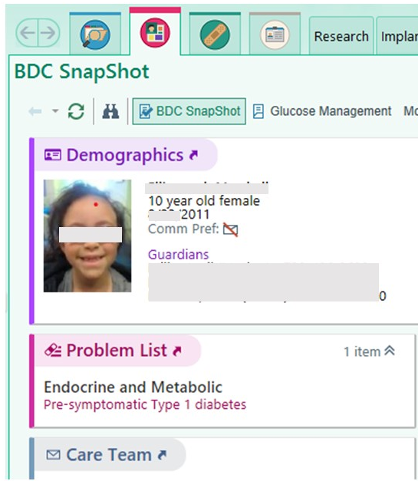

Currently visible in patient chart
Research memo with consent for ASK
Lab order placed as “Research Only Order”
Results viewable to all – with flag for abnormal and text narrative of risk.
Problem list with linked overview containing details and recommendations
Notes:
More recently, we have added presymptomatic T1D to the problem list, as can be seen here, including current stage. When one clicks on this entry, the detailed information covered in the memo will pop up.

Slide 24
Clinical decision support: Best Practice Advisory (BPA)
Goal: address potential care gaps:
  Recognize presymptomatic T1D and associated risks
  Assessment for acute care visits
Solution: presymptomatic T1D problem list codes will trigger BPA:
    Assessment of risk
    Recommendations
    Associated order set to be used at provider discretion

Slide 25
Advice and order set
Consider HbA1c, blood and/or urine glucose and ketones during illness.
Please page Barbara Davis Center physician with questions or if labs show ketosis, HbA1c ≥ 6.5, or glucose >200 mg/dL.
Optional order set (pick list)
  HbA1c
  POC blood glucose
  Dipstick urinalysis: for glucose and ketones

Slide 26
Future Directions
Current mapping to ICD-10 codes is somewhat problematic
  Definition of “Prediabetes” is based on evolution of type 2 diabetes
  Type 1 diabetes “stage 2” definition is similar but distinct.
  This will likely continue to evolve (CGM data or other biomarkers)
Anticipate increased screening as potential for intervention increases (Teplizumab)
IMO working on request to Centers for Medicare & Medicaid Services (CMS) for developing T1D-specific ICD-10 codes.

Slide 27




Acknowledgements
Sponsors
BDC
  Cristy Geno Rasmussen
  Judy Baxter
  Flor Sepulveda
  Kim Bautista
  Brigitte Frohnert
  Liping Yu
  Andrea Steck
  Kim Bautista
  Kathy Waugh
  Tricia Gesualdo
  Kimber Simmons
  Danny Felipe- Morales
Brett McQueen
Fran Dong
David Roth
Rick Bacher
Jill Norris
Jeffrey Krischer
5-ECR-2017-388-A-N
G-1911-03463
Patten-Davis Foundation
Partners
  Edwin Liu, Marisa Stahl
  Erin Sandene
  Kevin Carney, Suzy Jaeger
  Amy Lewis, Chrisann Karr
  Willy Boucharel, Stephanie Beling
  Sondra Valdez, Chris Martin
  Arleta Rewers, Alison Brent
  Michael Narkewicz
Dan Feiten
Tracy Brekken
Martha Middlemist
Rebekah Phillips
Kathy Love-Osborne
Holly Frost

Slide 29
Decision Points for Early Initiation of Insulin
Is there an ongoing pattern of elevated glucose?
What is typical pattern?
  Peak with largest meal?
  Elevation across the day or with multiple meals?
What is overnight trajectory?
  Would Long-acting insulin cause early morning lows?

