Slide 1
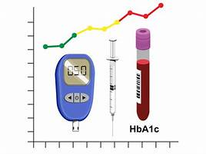
The value of HbA1c and OGTT in predicting progression to clinical type 1 diabetes
Kendra Vehik, PhD, MPH
University of South Florida
Barbara Davis center symposium – November 11, 2022
General population screening for T1d

Slide 2
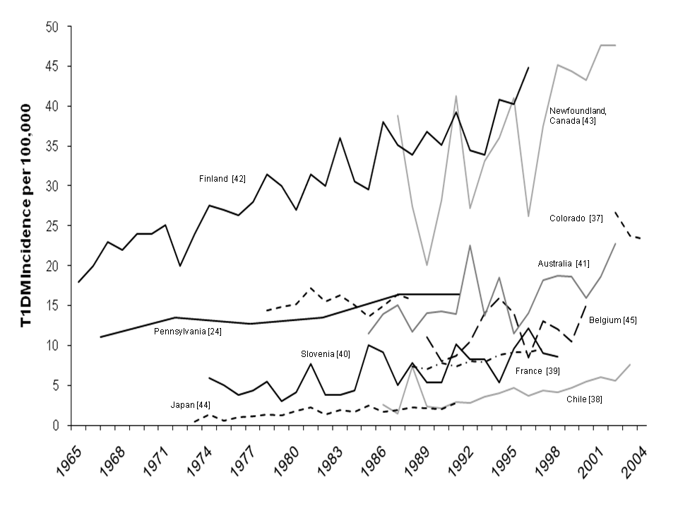
Worldwide Epidemic of Type 1 Diabetes
Incidence doubling every 20 years
In the very young, incidence doubling every 10 years
Vehik K et al. DMRR 2011

Slide 3
Burden of Type 1 Diabetes in the U.S.
Diabetes Rising
Morbidity and Mortality
Economic Burden
Prevalence ~1 in 300 or approximately 1.8 million
Shortened life expectancy
Annual healthcare costs average $18,500 per T1D
Acute complications of hypoglycemia and DKA
Annual incidence of 20,000+ with most rapid increase in children < 5 yrs
Hospital charge for DKA admission averages over $26,600
Long-term complications of heart attack, stroke, kidney disease, neuropathy, and retinopathy
Prevalence expected to reach 5 million by 2050
Annual medical costs and lost income totals $14.4B
Schatz CHEMED 2022

Slide 4
Why it is important to actively monitor for type 1 diabetes?
EARLY DIAGNOSIS
Make early diagnosis to decrease morbidity/mortality
Better understanding of natural history of pre-diabetes
PREVENTION
Gain insight into etiology/immunopathogenesis
Identify individuals for prevention trials
Schatz CHEMED 2022

Slide 5
Impact of Early Surveillance: Newborn Screening Impact on DKA
STUDY
< 2 years old
< 5 years old
1 – 3%
% DKA
p-value
% DKA
p-value
TEDDY
16.1%
13.1%
Sweden Registry
39.5%
0.02
16.9%
0.45
SEARCH
50.0%
<0.0001
36.4%
<0.0001
Finland Registry
44.8%
<0.0001
18.7%
<0.11
Germany Registry
54%
<0.0001
32.2%
<0.0001
TEDDY study demonstrates reduced DKA rates in young children
Larsson HE et al. Diabetes Care 34, 2347-52 2011

Slide 6
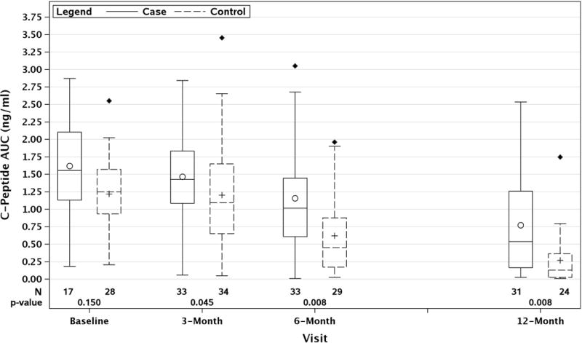
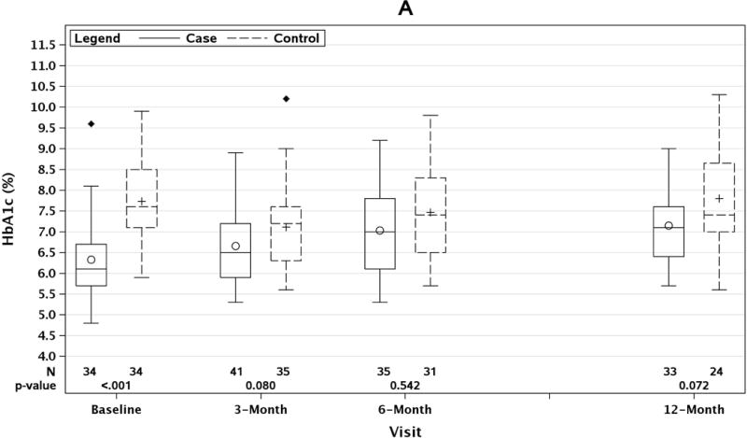
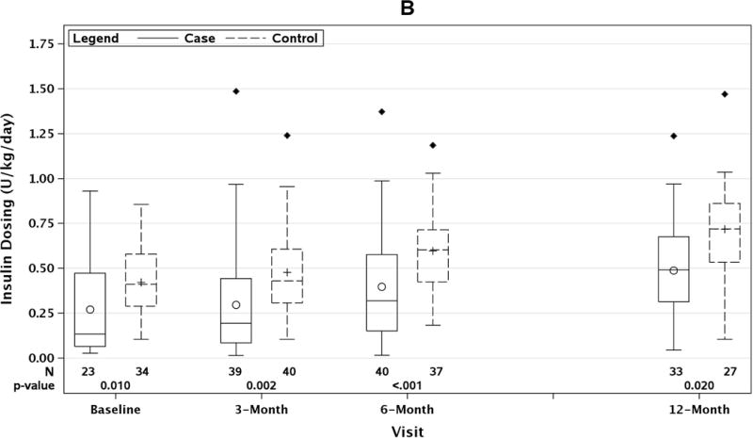
Improved Outcomes from Close Monitoring
Better C-peptide, HbA1c and decreased insulin dose in TEDDY cases compared to community controls in first year post-diagnosis.
Steck et al. Ped Diabetes 2017;18(8):794-802

Slide 7
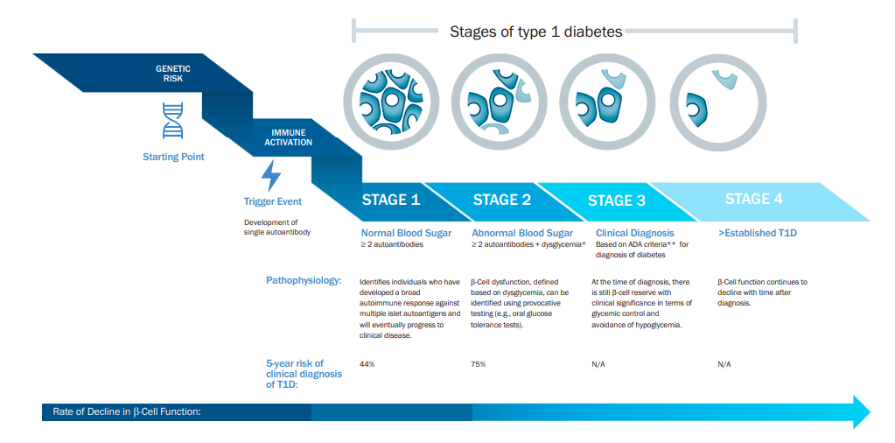
Who most benefits from active surveillance
Relatives of those who have type 1 diabetes
Autoantibody positive
Genetic risk for type 1 diabetes
Sims EK et al. Diabetes 2022;71:610-623

Slide 8
HbA1c and OGTT are ADA diagnostic criteria and used in managing Stage 4 diabetes
Stage 2 (autoimmunity with dysglycemia; pre-symptomatic)
OGTT FPG 100-125 mg/dL (5.6–6.9 mmol/L)
OGTT 2-HPG 140 – 199 mg/dl (7.8 – 11.0 mmol/l)
HbA1c 5.7-6.4% (39-47 mmol/mol) or >10% ↑ HbA1c
Stage 3 (autoimmunity, dysglycemia with symptoms)
OGTT FPG >126 mg/dl (>7.0 mmol/l);
OGTT 2-hPG > 200 mg/dL (>11.1 mmol/l), or
HbA1c > 6.5% (>48 mmol/mol)
American Diabetes Assoc. Diabetes Care 2020 Jan;43(Suppl.1):S14-31

Slide 9
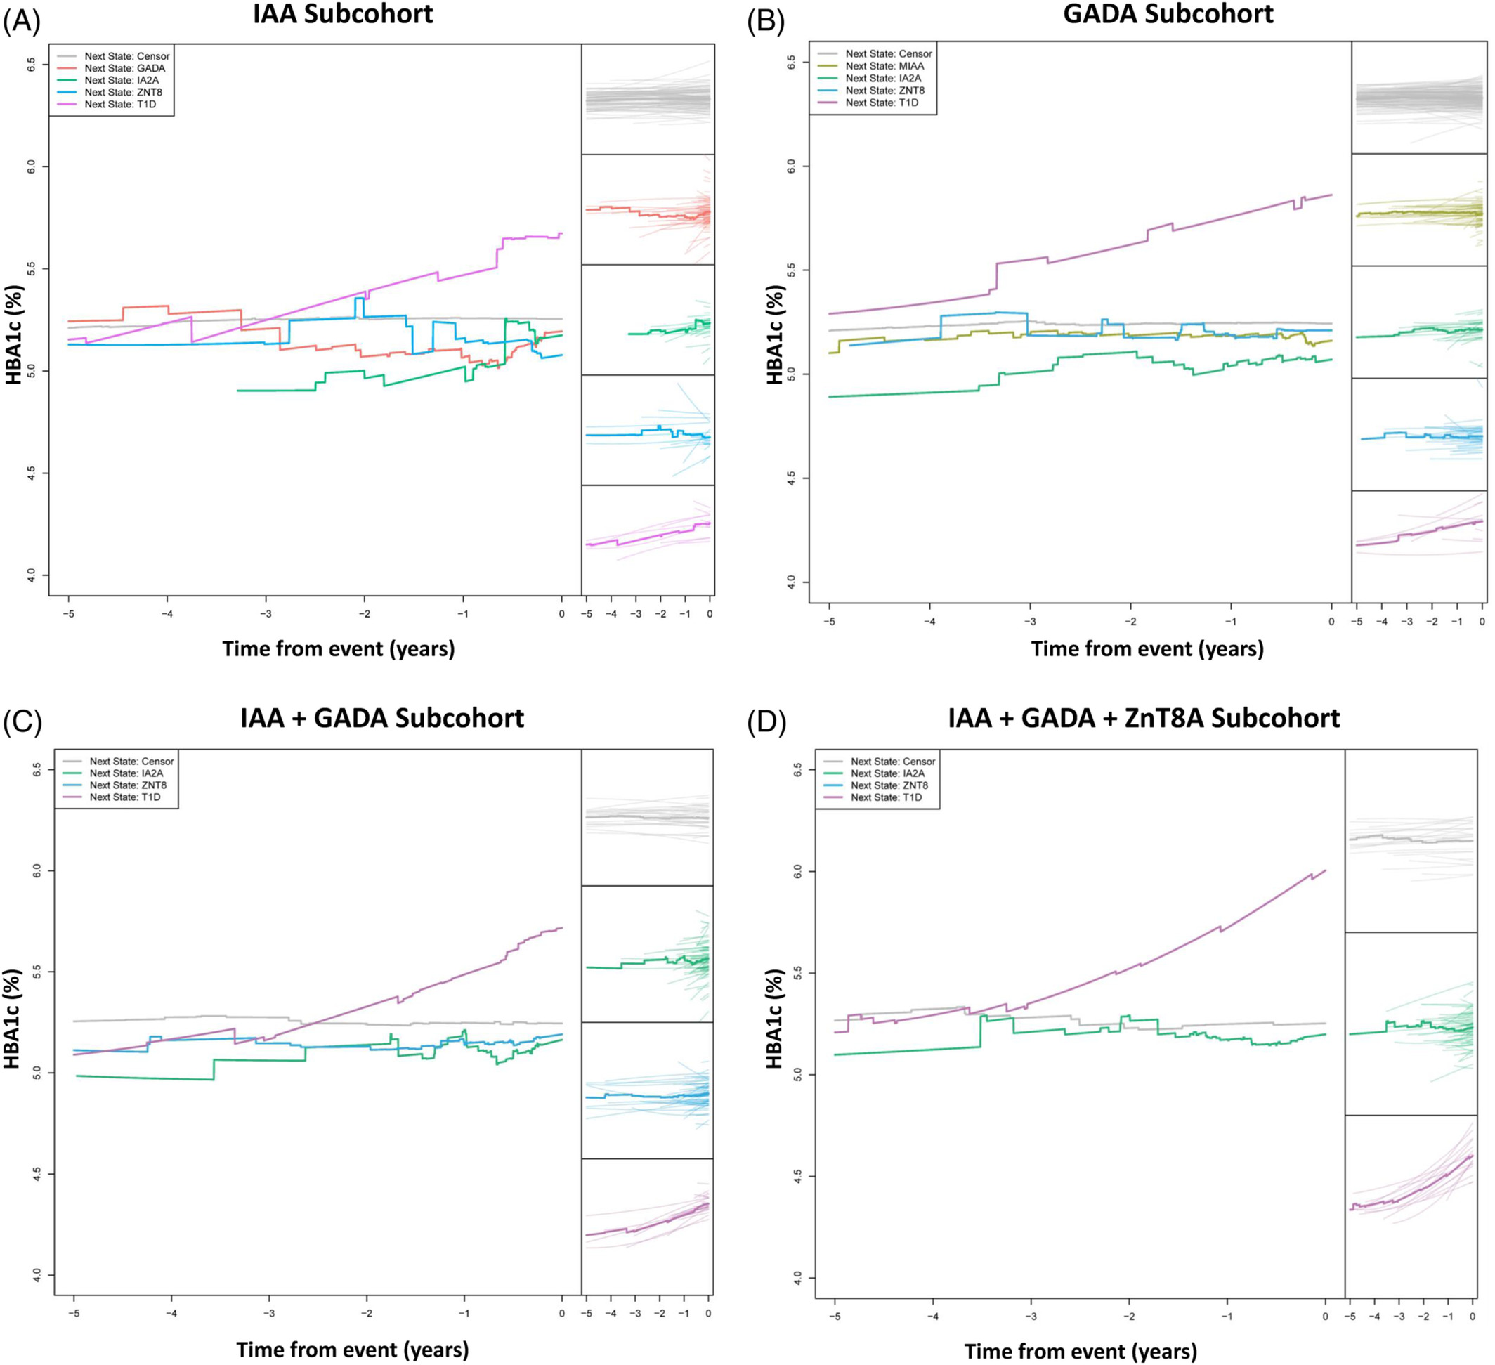
Recent evidence that ∆HbA1c as a predictor for developing multiple islet autoantibodies
HbA1c ↑ more rapidly overtime as number of autoantibodies ↑ from 1 to 3 (p<0.001).
Salami F et al. Pediatr Diabetes 2022

Slide 10
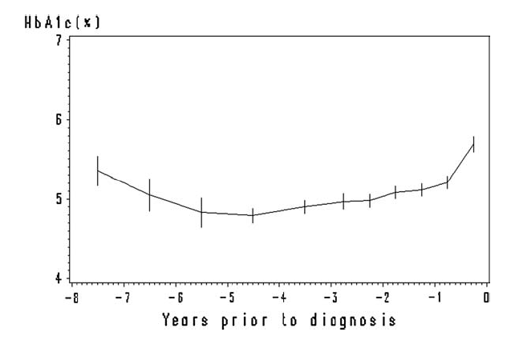
Normal but increasing HbA1c predicts progression to T1D – Diabetes Autoimmunity Study in the Young (DAISY)
Mean pre-diagnostic HbA1c was 5.1% [SD = 0.4%]
0.4%-point ↑ in HbA1c corresponded to a 5-fold ↑ in T1D risk
Modest increases starting as early as 5 years prior to diagnosis, followed by a sharp ↑ 6-months prior to diagnosis.
Stene LC et al. Pediatric Diabetes 2006;7:247-253

Slide 11
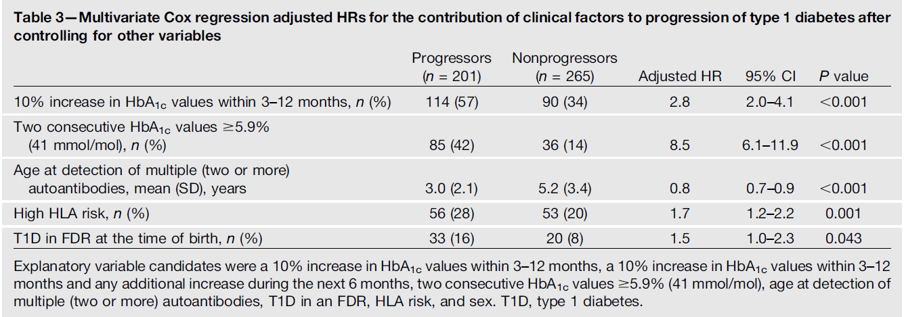
ΔHbA1c predicts time to T1D in children with multiple autoantibodies – Diabetes Prediction and Prevention (DIPP) study
10% increase in HbA1c level in samples 3-12 months apart increased ↑ risk of progression to T1D by 2.8-fold.
Two consecutive HbA1c > 5.9% ↑ risk of progression by 8.5-fold.
Helminen O et al. Diabetes 2015;64:1719-1727

Slide 12
OGTT 2-hPG useful metric in predicting time to T1D diagnosis in high-risk children
progressors
OGTT-derived 2 h plasma glucose (p<0.001) started to ↑ 1.5 years before diagnosis.
Non-progressors
Helminen O et al. Diabetologia 2015;58:1787-1796

Slide 13
Extending previous work in HbA1c and OGTT in the TEDDY and TrialNet Studies
Key questions:
Identify optimal thresholds for Δ%HbA1c and OGTT 2-hPG for prediction of Stage 3 type 1 diabetes in children and adolescents
Identify specific diabetes-related risk factors that associate with a change in HbA1c and OGTT 2-hPG
Evaluate if a change in HbA1c is associated with progression to Stage 3 in children
Determine if a rapid change in HbA1c and OGTT 2-hPG alters the estimated risk of T1D
Assess Δ%HbA1c and OGTT 2-hPG as prognostics of T1D.

Slide 14
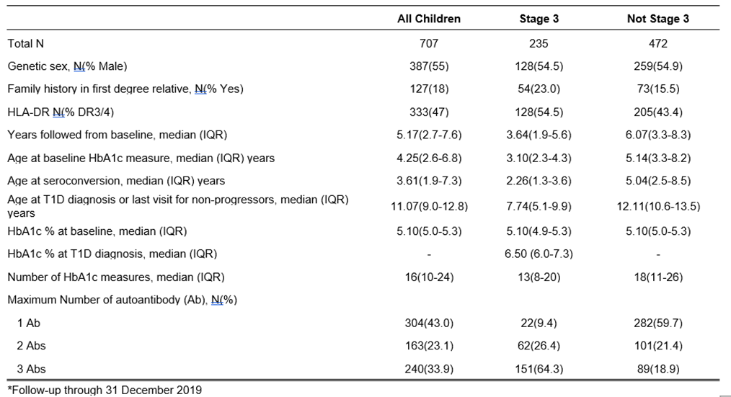
TEDDY Study Population

Slide 15
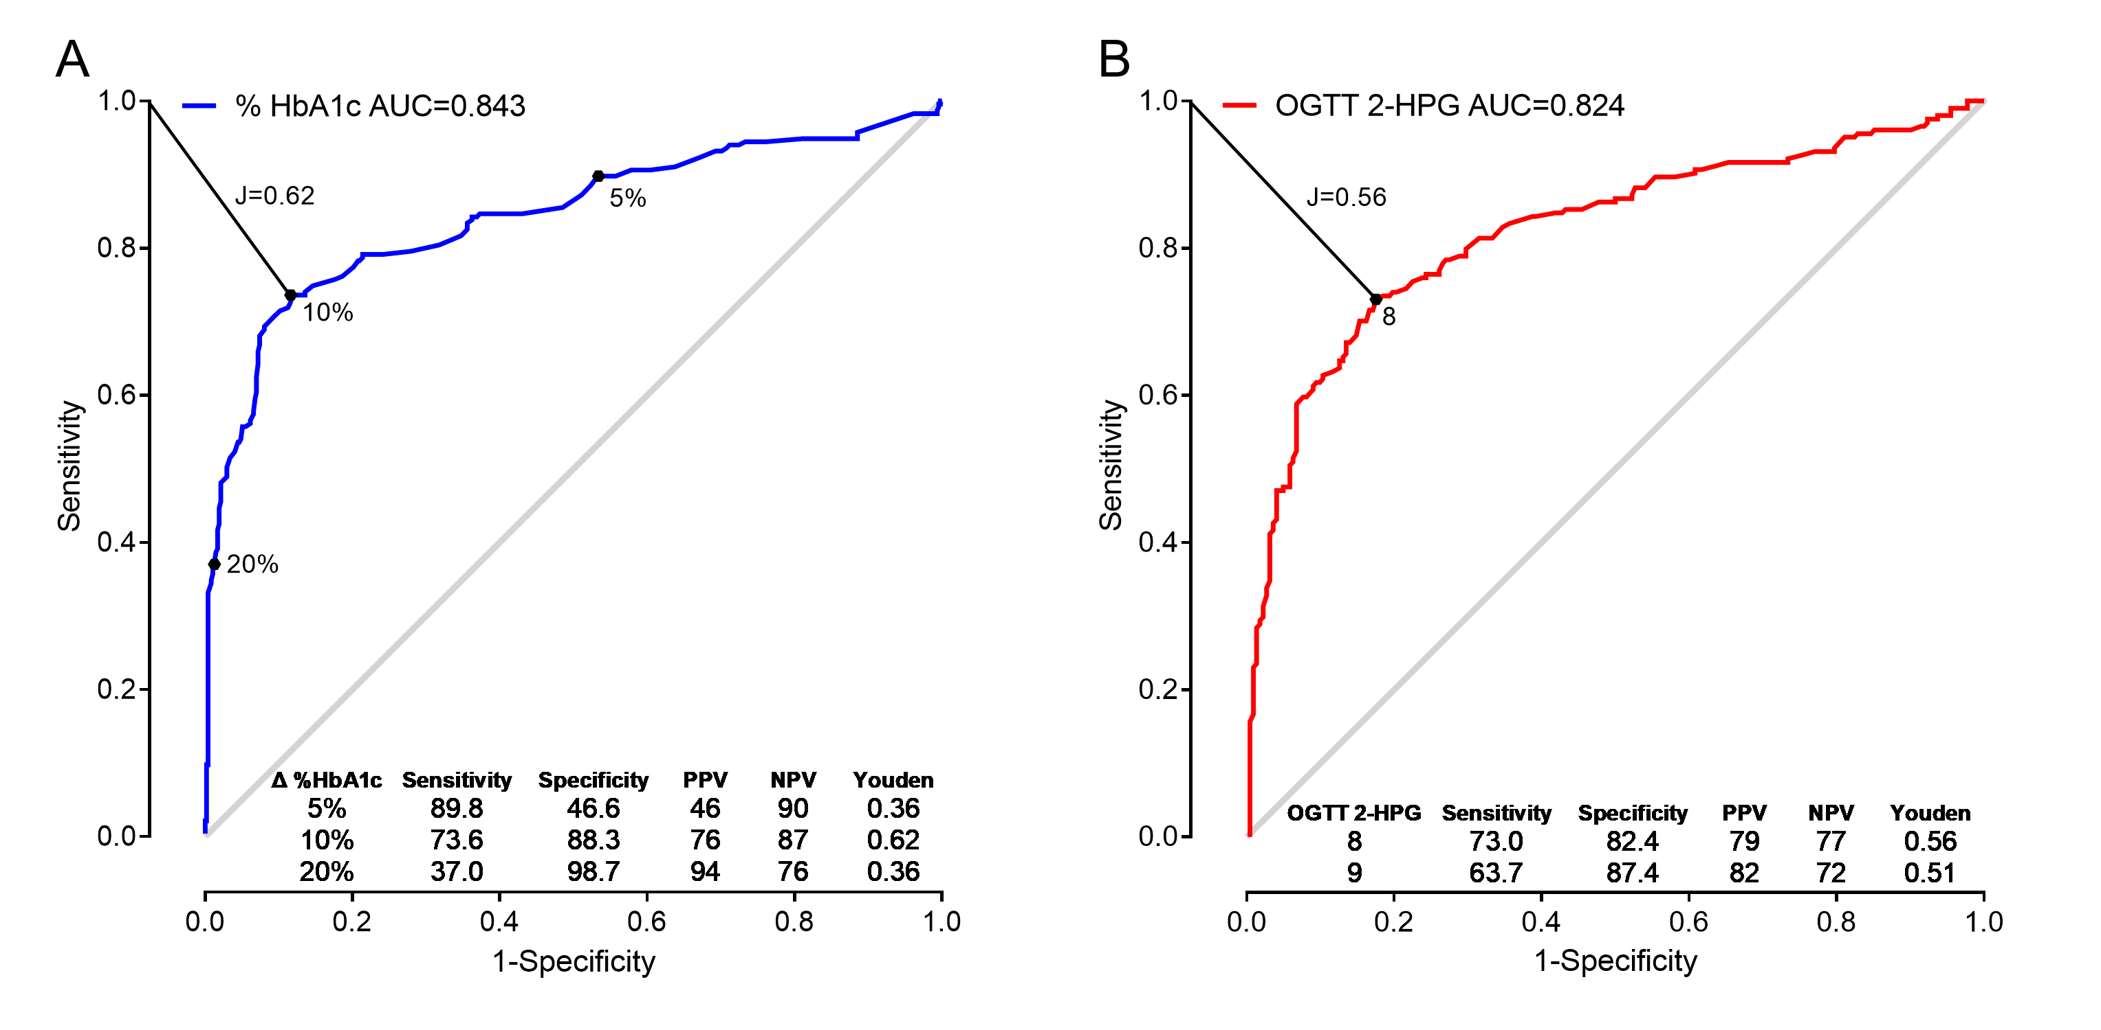
Identifying optimal HbA1c and OGTT thresholds in TEDDY children (n=707)
Vehik K et al. Diabetes Care 2022;45(10):2342-2349

Slide 16
Risk factors associated with a Δ % HbA1c
Risk of % change in HbA1c ↑ with every additional Ab
Older age at time of HbA1c measure ↓ risk of % change in HbA1c
Lower baseline HbA1c ↑ risk of a % change in HbA1c
Faster rate of change between repeated HbA1c ↑ risk of a % in HbA1c
Vehik K et al. Diabetes Care 2022;45(10):2342-2349

Slide 17
Risk factors associated with a 2-hPG >8mmol/l in TEDDY
Risk of a 2-hPG >8mmol/l ↑ with every additional Ab
Higher baseline OGTT 2-hPG ↑ risk of a 2-hPG >8mmol/l
Vehik K et al. Diabetes Care 2022;45(10):2342-2349

Slide 18
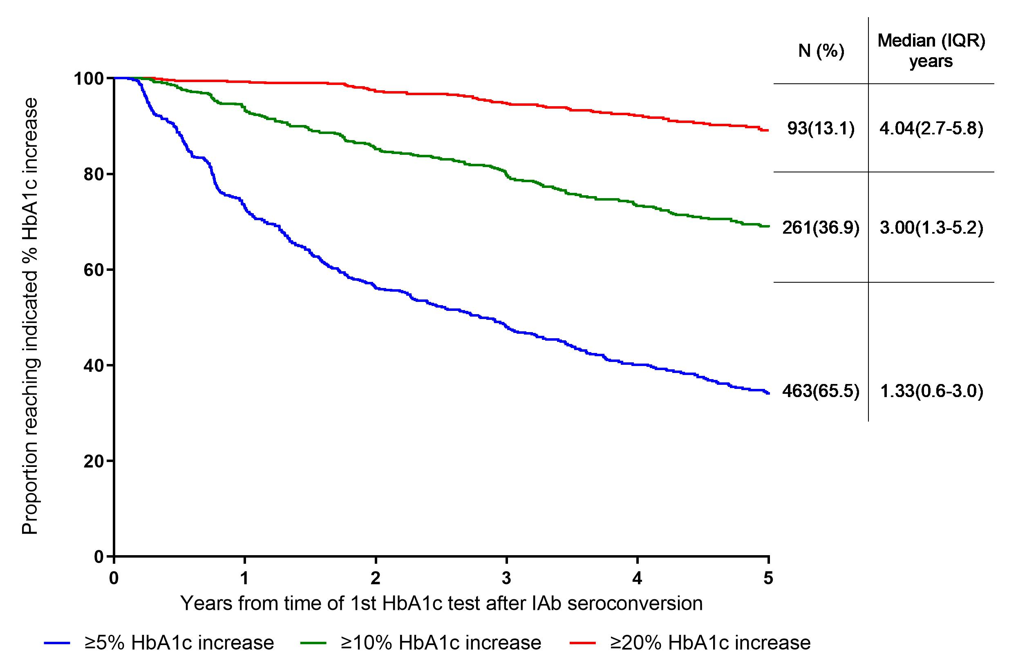
Proportion of TEDDY children reaching indicated % HbA1c increase criterion by years since baseline HbA1c test
Vehik K et al. Diabetes Care 2022;45(10):2342-2349

Slide 19
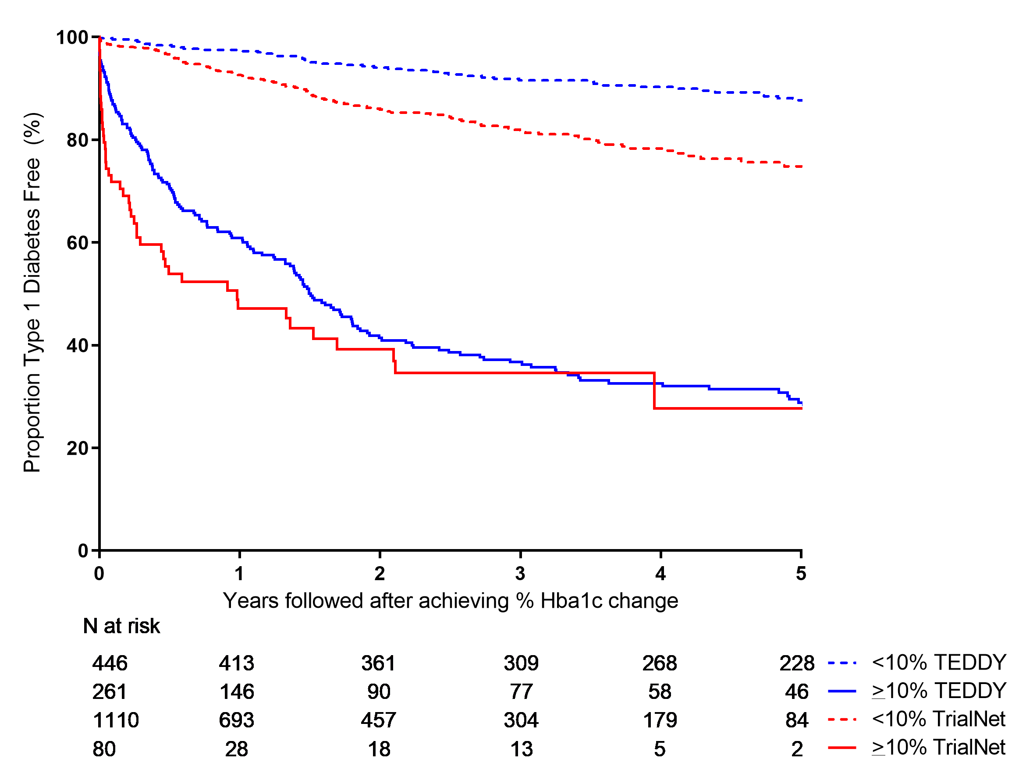
Δ% HbA1c predicts T1D in children and adolescents
>10% change in HbA1c from baseline significantly ↑ the risk of progression to type 1 diabetes in TEDDY and TrialNet children, independent of other known risk factors
TEDDY: >10% relative change ↑ risk 12-fold
TrialNet: >10% relative change ↑ risk 5-fold
Periodic HbA1c surveillance in children with autoantibodies is a good metric to estimate timing of T1D onset, especially within 2 years.
Vehik K et al. Diabetes Care 2022;45(10):2342-2349

Slide 20
Rapid change in % HbA1c does alter risk of T1D in TEDDY
The maximum rate of change between HbA1c measures leading up to and including the visit at which the 10% threshold was met was associated with an increased risk of clinical T1D
TEDDY: HR=1.34, 95%CI 1.2-1.5, p<0.0001
TrialNet: HR=1.24, 95%CI 1.2-1.3, p<0.0001
The median (IQR) years from the time the child had a HbA1c >10% increase and progressed was 0.70 (0.2-1.7) in TEDDY and 0.16 (0.02-0.50) in TrialNet
In TEDDY, an older age at meeting the % HbA1c increase was associated with a lower risk of progressing within two years.

Slide 21
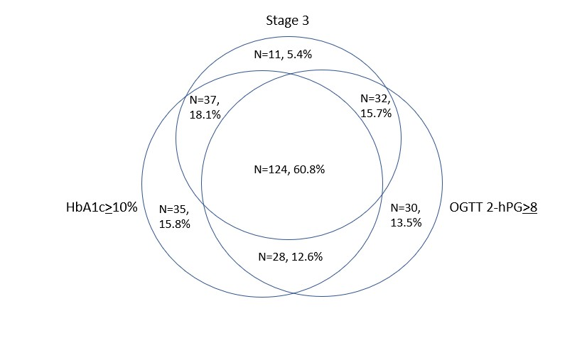
Overall, 79% of the TEDDY children who had a >10% HbA1c increase and 77% of those who had an OGTT 2-hPG>8mmol/L developed Stage 3 diabetes
Vehik K et al. Diabetes Care 2022;45(10):2342-2349

Slide 22
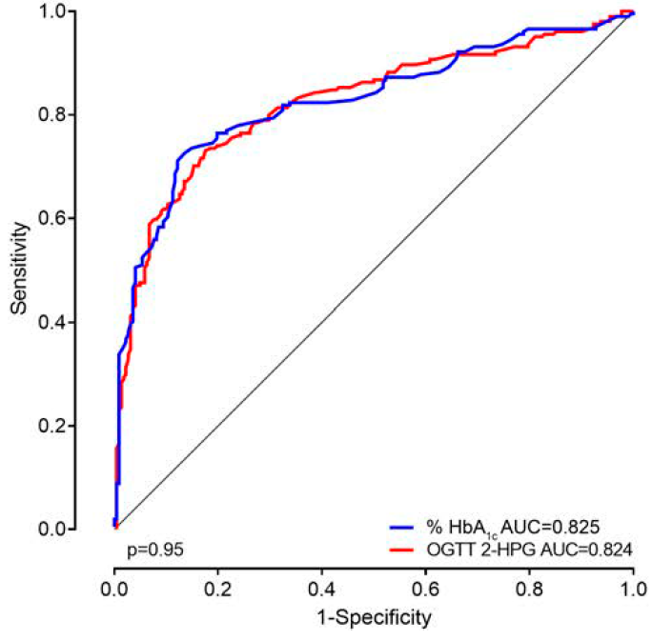
Δ % HbA1c is as good a prognostic measure in a pediatric population with multiple Abs as a single OGTT 2-hPG for T1D in TEDDY children
Vehik K et al. Diabetes Care 2022;45(10):2342-2349

Slide 23
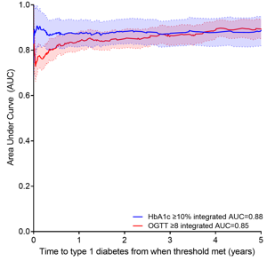
Δ % HbA1c and OGTT 2-hPG composite scores stable prognostic up to 5 years for T1D in TEDDY children
A Δ %HbA1c composite performs similarly to an OGTT composite scores
HbA1c score included:
Age and HbA1c level at baseline
# of autoantibodies
Max rate of change in HbA1c
OGTT score included:
OGTT level at baseline
Age when threshold met
Family history of T1D
Genetic sex
Vehik K et al. Diabetes Care 2022;45(10):2342-2349

Slide 24
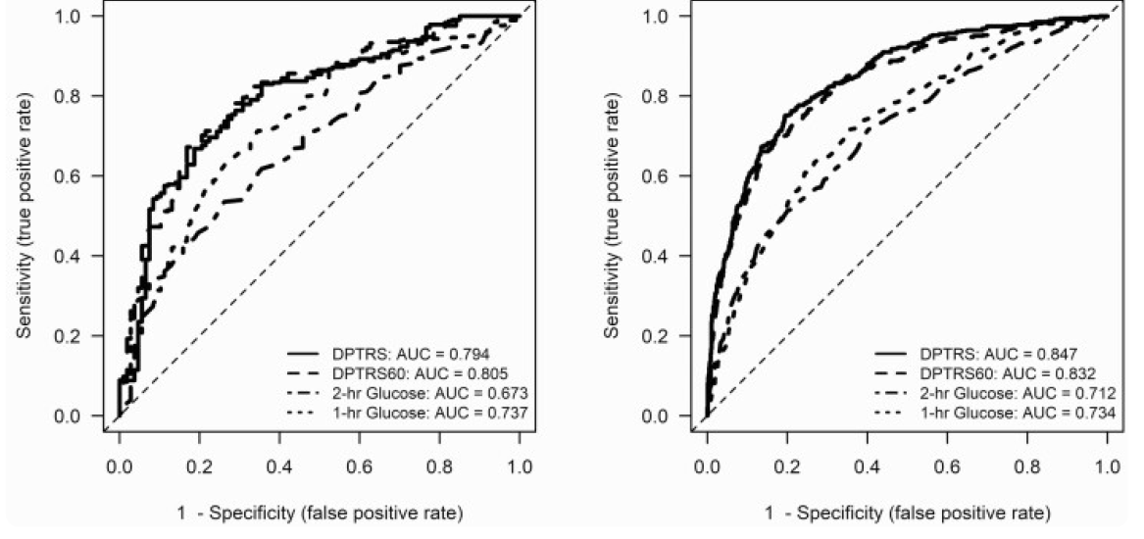
OGTT at 1-hPG – prognostic metric
DPT-1
TNPTP
OGTT 1-hPG as good a predictor of progression to T1D as 2-hPG in large study of children and adult relatives of people with T1D.
Simmons K et al. JCEM 2020;105(11):e4094-e4101

Slide 25
Strengths and Challenges with HbA1c and OGTT
HbA1c
Identifies chronic elevation in blood glucose
Absolute levels sensitive to variability; relative levels more robust
Low cost and non-fasting draw
Non-invasive, low volume collection in clinic or home sampling
OGTT
More info on pathology of uncontrolled post-prandial blood glucose
Provides info about glucose, insulin and C-peptide
Time consuming, costly, fasting required – 1-hPG option
Poorly accepted by children and families
Δ%HbA1c good prognostic within 2 years of onset
Δ%HbA1c good prognostic within 2 years of onset
OGTT 2-hPG good prognostic within 1.5 years of onset

Slide 26
Monitoring with HbA1c and OGTT fits into multi-tiered surveillance
Genetic screening at birth
Subsequent islet autoantibody cross-sectional screening
Ongoing islet autoantibody and HbA1c surveillance with parental education in those + islet autoantibod(ies)
Heightened glycemic surveillance (e.g., CGM or OGTT) and/or referral to immunotherapy trials in those that met the HbA1c or OGTT threshold
Vehik K et al. Diabetes Care 2022;45(10):2342-2349

Slide 27
Acknowledgements
Participants and Patients
William Hagopian
Jeff Krischer
Des Schatz
Marian Rewers
Ake Lernmark
Suzanne Johnson
Anette Ziegler
Jorma Toppari

