Slide 1
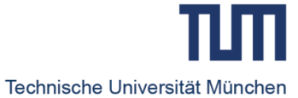
Fr1da and EDENT1FI
Peter Achenbach
Institute of Diabetes Research, Helmholtz Munich, Germany
Forschergruppe Diabetes, Technische Universität München, Klinikum rechts der Isar

Slide 2
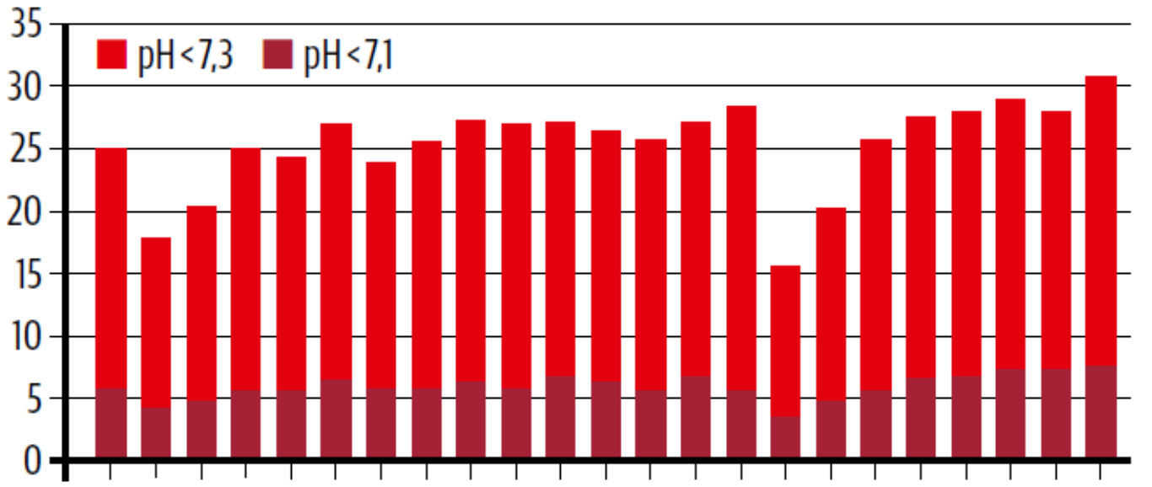
Proportion of diabetic ketoacidosis (DKA) in children and adolescents at T1D manifestation in Germany
44.7%
pH <7.3
pH <7.1
(%)
1995 2005 2017
Year of manifestation
2020
DPV Register
Holl et al. (2019), update of Karges et al. (2011) Klin Pädiatr
Kamrath et al.,
JAMA 2020

Slide 3

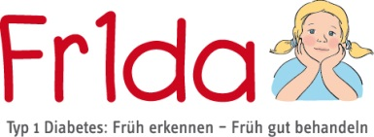
Type 1 diabetes stages
Prevention
ADA Professional Practice Committee (2022) Diabetes Care
Insel et al. (2015) Diabetes Care
Identifying people at risk
Immune intervention
Genetic predisposition
Identifying people with disease
Immune activation
Stage 1
Stage 2
Stage 3
Long-standing diabetes
Early-stage T1D
> 50 susceptibility genes
≥ 2 islet autoantibodies
Normoglycemia
islet autoantibodies
Dysglycemia
WHO diagnosis
Hyperglycemia
Symptoms

Slide 4

Public Health Screening for Early Stages of
Type 1 Diabetes in Bavaria, Germany
Since 2015
Rationale
prevent diabetic ketoacidosis on a population level, reducing family burden and health care cost
identify children who benefit from immune-based therapies to prevent insulin dependence on a broad population-based level
Raab et al. (2016) BMJ Open; Ziegler et al. (2020) JAMA

Slide 5
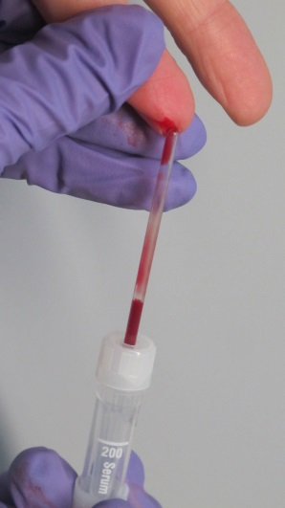
Approach:
Capillary Blood, Age 2-5 years, and since 2019, Age 2-10 years
3 Screen – ELISA RSR
3 islet autoantibodies in one test: GADA, IA-2A, ZnT8A
> 98th centile
IAA, GADA, IA-2A, ZnT8A by RBA
≥ 2 islet Abs+ > 99th centile
2nd venous blood draw requested
Confirmed ≥ 2 islet Abs+ by RBA > 99th centile
Early (presymptomatic) stage type 1 diabetes
Raab et al. (2016) BMJ Open
Amoroso et al. (2016) Clin Chim Acta
Ziegler et al. (2016) Diabetes Technol Ther
Metabolic staging by OGTT, HbA1c, PLS
and education, counseling, monitoring

Slide 6


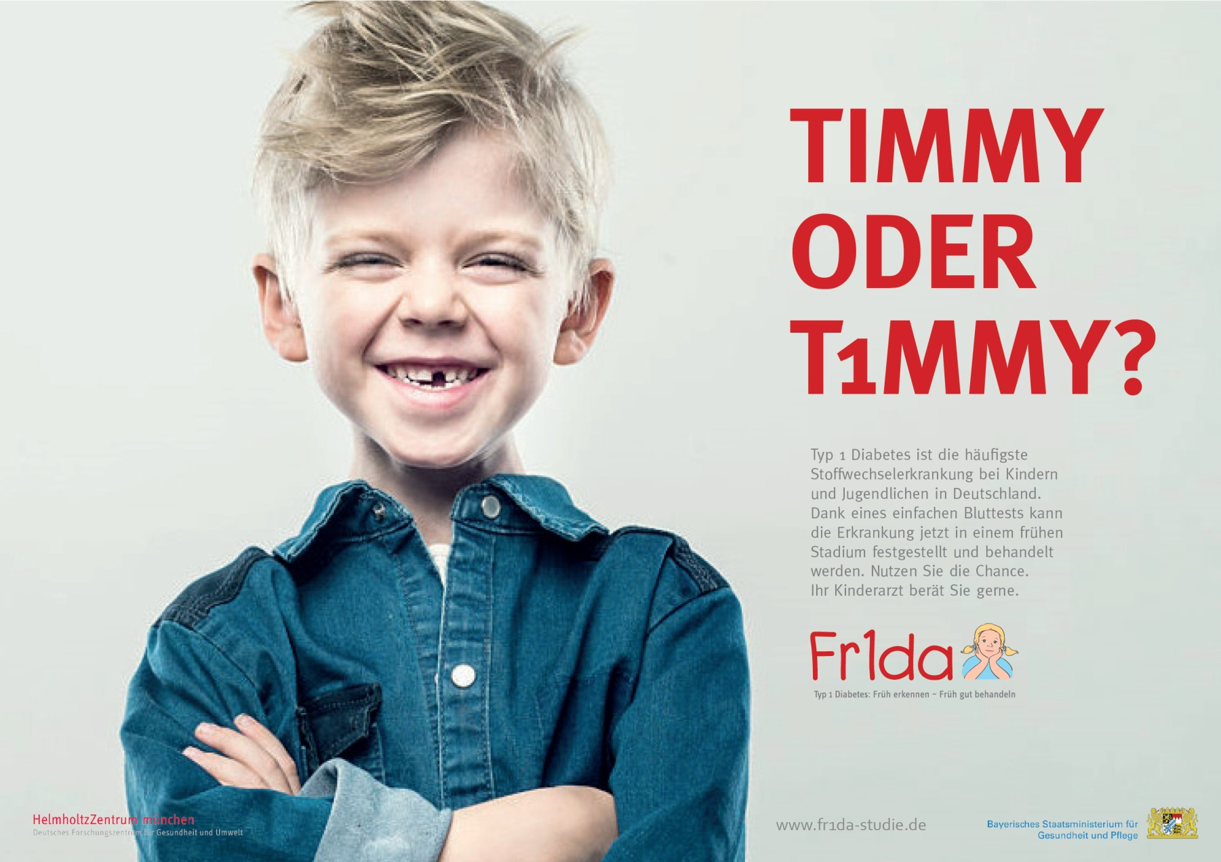
Thank you to 682 primary care physicians
Renate Abt, MD, Wendelstein; Aderbauer/Leonhardt/Riedl, MD, Weiden; Ina Albrich, Dorfen; Stephan Arenz, MD, Pfaffenhofen; Bernd Aulinger, MD, Burglengenfeld; Glenn Averbeck, MD, Pfaffenhofen; Annette Bachmann-Hoschka, MD, Teisendorf; Andrea Bachmeyr, MD, München; Baier/Baier, MD, Schwabach; Elmar Barthel, MD, Gemünden; Marina Bascone-Fricke, MD, Aidenbach; Batz/Hubmann, MD, Zirndorf; Rolf Bauer, MD, Roth; Yvonna Bauer, MD, Augsburg; Gunhild Bauer-Niedermaier, MD, Zirndorf; Larissa Baumgärtner, Heilsbronn; Michael Bäzner, MD, Sonthofen; Beck/Baier/Mussar, MD, Donauwörth; Axel Becker, MD, Haar; Ulrich Müller, MD, München; Herbert
Beer/Schirmer, MD, Marktredwitz; Lutz Bellingrath, MD, Bamberg; Reiner
Benckendorff, MD, Augsburg; Gertraud Bergen, MD, Haßfurt; Monika Berger,
MD, Haimhausen; Annerose Bergner, MD, München; Beste/Hosemann, MD,
Dachau; Reinhard Beuthan, MD, Dingolfing; Katrin Biebach, MD, München;
Dominique Bienert, MD, München; Matthias Bierler, MD, Amberg;
Biermann-Franke/Trinczek, MD, Erlangen; Klaus Binder, MD, Nürnberg;
Brigitte Birk, MD, Peißenberg; Maria-Magdalena Blauditschek, MD, Würzburg;
Jörg Blume, Schweinfurt; Blümel-Eiber/Rösch, MD, Nürnberg; Andreas Blüml,
Trostberg; Sabine Böhm-Vogt, MD, Ottobrunn; Karola Börzsönyi, MD,
Freising; Stephan Böse-O’Reilly, MD, München; Malte Bräutigam, MD,
Eichstätt; Walter Breiner, Marktoberdorf; Ulrike Brendel, MD, Parsberg;
Michael Brijnen von Oldershausen, MD, München; Christian Brückmann, MD,
Brannenburg; Halina Eva Buchalik, Lauf an der Pegnitz; Franz Bundscherer,
MD, Geretsried; Anna Bürcky, MD, Ochsenfurt; Barbara Capelle, MD,
Unterhaching; Mona Castrop, MD, Regensburg; Alina Cocos, MD, Markt
Schwaben; Cordes/Gebhard, MD, Nürnberg; Christoph Daffner, MD, Nürnberg;
Arcan Demircioglu, MD, München; Jost Dieckerhoff, MD, Rosenheim; Karolin
Diergarten, MD, Germering; Elmar Dietmair, MD, Bobingen; Lutz Dietrich, MD,
Hof; Maximilian Dietrich, MD, Aichach; Brigitte Dietz, MD, Taufkirchen;
Christian Döbig, MD, Erlangen; Sylvia Döpfer, MD, München; Jürgen Dörrer,
Freyung; Ragnar Dörrfuss, MD, Nürnberg; Monika Drexel, MD, Rehau; Elke
Düll-Schiller, MD, Neumarkt; Stefan Eber, MD, München; Christoph Ebert,
MD, Ebersberg; Thomas Ebert, Veitsbronn/Siegelsdorf; Christina Eder, MD,
Bayreuth; Claudia Eichwald, MD, Ingolstadt; Annette Eiden, MD, Gauting;
Claus Engelhardt, MD, Nürnberg; Anja Engelmann, MD, Dinkelscherben;
Georg Engl, MD, München; Uta Enzensberger, MD, Mering; Patricia Erlinger,
MD, Postbauer-Heng; Uwe Ermer, MD, Neuburg/Donau; Kirsten Exl,
München; Florian Fackler, MD, Erlangen; Edgar Fath, MD, München; Peter
Feiereisen, MD, München; Daniela Felsl, MD, Wolnzach; Fendel/Wieland, MD,
München; Maria Fischer, MD, Lappersdorf; Cordula Fischer-Trüstedt, MD,
München; Katrin Franke-Augustin, MD, Bayreuth; Harald Frantzmann, MD,
Memmingen; Rudolf Franz, MD, München; Claudia Frey, MD, Augsburg;
Müller, MD, Kempten; Müller/ Wilken/Schürmann, MD, Naila; Müller/Wilken/ Susanne Gandenberger, MD, München; Antonia Gavazzeni, MD, München;
Christian Geißendörfer, MD, Selb; Edeltraud Gerber, MD, Kolbermoor; Martin
Gerlich, MD, Dinkelsbühl; Elke Gerlitz, MD, Herzogenaurach; Julia Gerstl, MD,
Hauzenberg; Jürgen Geuder, MD, Freilassing; Johannes Gilles, Gunzenhausen;
Rainer Gillessen, MD, Ottobrunn; Cornelia Gläßel, MD, Fürth; Judith
Glöckner-Pagel, MD, Regensburg; Hermann Gloning, MD, München; Birgit
Goldschmitt-Wuttge, MD, München; Martin Götz, MD, Elisabethzell; Wolfgang Graser, MD, Nürnberg; Marion Grau-vom-Scheidt, MD, Nürnberg; Martin
Griebel, MD, Poing; Angelika Gruber-Müller, MD, Ingolstadt; Dietrich Grunert,
MD, Kempten; Christian Haas, MD, München; Richard Haaser, MD, Feucht;
Caroline Haberl, MD, Starnberg; Ulrich Hagen, MD, Friedberg; Verner
Hallmen, MD, München; Emma Halwas, MD, Geisenfeld; Ingrid Hartmann,
MD, Lichtenfels; Conny Hartmann, MD, Bad Wörishofen; Christian Hartnik,
Bad Staffelstein; Ulrike Haun, MD, Vilshofen; Gabi Haus, MD, München;
Rudolf Havla, MD, Hof; Wolfgang Heck, MD, Vöhringen; Heck-Buchhorn/ Willnow, MD, Kösching; Ralph Heidingsfelder, Ansbach; Anette Hein, MD,
Gerbrunn; Markus Helmreich, MD, Schweinfurt; Tanja Hemmers, MD,
Augsburg; Anna Hencz, MD, Germering; Holger Hertzberg, MD, Schwabach;
Sigrid Hesse, MD, Straubing; Daniela Heuschmann, MD, Regensburg;
Cornelia Hoegen, MD, Herrsching; Reinhard Hoffmann, MD, Landshut; Steffen
Hoffmann-Baldus, MD, Haar; Gerhard Hofmann, MD, Würzburg; Meike
Hofmann, Mitterteich; Sabina Hohn, Nürnberg; Gabriele Hopf, MD, Ingolstadt;
Jörg Horcher, MD, Straubing; Birgit Hortig-Nevelö, MD, Regenstauf; Annette
Hovestadt, MD, München; Irene Hummel, Bamberg; Peter Hußlein, MD,
Grassau; Wolfgang Hüttner, MD, Coburg; Anna Iarrapino-Demmel, MD,
München; Birgit Indlekofer, MD, Tutzing; Annelie Intemann, MD, München;
Margarete Jäger, MD, München; Peter Jakob, MD, Erlangen; Christine Janello,
MD, Neubiberg; Jarosch/Schleupner, MD, Würzburg; Stefan Jobst, MD,
Bayreuth; Janina Joiko, MD, München; Guido Judex, Regensburg; Ronny
Jung, MD, Roth; Andreas Kalmutzki, Schwabach; Lampros Kampouridis, MD,
Baldham; Michael Kandler, MD, Nürnberg; Susanne Kastl, MD, Bayreuth;
Walther Kaufmann, Nürnberg; Bernhard Keck, MD, Augsburg; Peter Kellner,
MD, Vilsbiburg; Lars Kellner, MD, Gräfelfing; Ghassan Khazim, MD,
Hammelburg; Conelia Kiani, MD, Bayreuth; Gunhild Kilian-Kornell, MD,
Starnberg; Annegret Klein, MD, Oberaudorf; Wolfgang Klein, MD, Augsburg;
Kristina Klemp, MD, Burgkunstadt; Margreth Knebel, MD, München; Norbert
Knieß, MD, Ingolstadt; Kober/Spannagel, MD, Gmund; Cornelia Komm, MD,
Waldkraiburg; Nikos Konstantopoulos, MD, München; Cosima Köring, MD,
Altötting; Renate Kramer, MD, München; Guido Krandick, MD, Deisenhofen;
Barbara Krappatsch, MD, Viechtach; Krebs/Güler, MD, Neuendettelsau; Berndt
Kreisberger, MD, Ismaning; Gerlinde Kreß-Rohrbach, MD, Stegaurach;
Josef Kriesmair, MD, München; Andreas Kronwitter, MD, München; Matthias
Krueger, MD, Klingenberg; Kubryk/Döring, MD, Aschheim; Thomas
Kuchenbauer, MD, München; Ursula Kuhnle-Krahl, MD, Gauting; Stephan
Küntzer, MD, Kitzingen; Wolfgang Künzer, MD, Regensburg; Beate Kusser,
MD, München; Werner Küstermann, MD, Veitshöchheim; Wolfgang Küver,
MD, München; Franz Lachner, MD, Ruhpolding; Wolfgang Landendörfer, MD,
Nürnberg; Christina Lang, MD, Nürnberg; Martin Lang, MD, Schwabmünchen;
Martin Lang, MD, Augsburg; Lang/Zötl, MD, Bad Tölz; Otto Laub, Rosenheim;
Peter Lautenbach, Herzogenaurach; Gerhard Legat, MD, Amberg; Karl-Heinz
Leppik, MD, Erlangen; Katrin Leuchtenberger, MD, Kelheim; Karin Leykauf,
Bayreuth; Hans Lichtenstern, MD, Pocking; Werner Lick, MD, Würzburg;
Gabriele Lieb, MD, Würzburg; Bärbel Liebezeit, MD, Mühldorf am Inn; Armin
Liebscher, MD, Eckental; Susanne Linder, MD, Grafrath; Ruth Lindner-Gajek,
MD, München; Lipinski/ Mende/Kirtscher, MD, Lindenberg; Harald Lodes,
MD, Neumarkt; Markus Loeff, MD, Landsberg am Lech; Andreas Lorenz,
Krumbach; Martin Löw, Memmingen; Anna Elisabeth Lüdtke, MD, Neu-Ulm;
Renata Lysy, MD, Möhrendorf; Eva Maas-Doyle, MD, Erlangen-Tennenlohe;
Michaela Maier, MD, Pfaffenhofen; Soyoun Maisch, MD, München; Stefanie
Marr, Ingolstadt; Martin/Schilder, MD, Schrobenhausen; Stephan Martini, MD,
München; Monika Maurus, MD, Memmingen; Barbara Meiler, Grafrath; Bettina
Meinel, MD, Regensburg; Udo Meißner, MD, Bamberg; Steffi Menzel,
München; Jürgen Messner, MD, Lohr; Roland Metzner, MD, Würzburg; Petra
Sibyl Meyer, MD, Augsburg; Oliver Michael, Murnau; Rupert Moser,
Schwandorf; Kathrin Mothes, MD, Schwandorf; Miriam Mrach, München;
Sabine Mühlbauer, MD, München; Schürmann, MD, Hof; Patrick Muzzolini, MD, Kulmbach; Sabine Nagel, MD, Neustadt/Do.; Dieter Nagel, MD, Freyung; Karsten Naumann, Erlangen; Nicole Nellen-Hellmuth, MD, Würzburg; Klaus Neumann, MD, Höhenkirchen-Siegertsbrunn; Christiane Neumeir, MD, Königsbrunn;
Hans-Peter Niedermeier, MD, Erding; Jochen Noss, MD, München; Andreas
Nowack, MD, Siegsdorf; Thomas Nowotny, MD, Stephanskirchen; Stefan Oberle, MD, Höchstadt; Osang/Pudenz, MD, München; Nicola Pape-Feußner, MD, Berg; Parhofer/Wiß, MD, Dachau; Michael Pätzold, Marktoberdorf;
Christian Pauli, MD, Olching; Michaela Pausenberger, MD, Lauf a.d. Pegnitz;
Angela Pfeffer, MD, Regen; Bergit Pfleger, Neuendettelsau; Stefan Platzer,
MD, Osterhofen; Hermann Pöhlmann, Bayreuth; Polster/Kainzinger, MD,
Dingolfing; Pontz/Wimmer, MD, Passau; Manfred Praun, MD, Gilching; Preis/
Preis, MD, Bischberg; Preissler/Tomas/Theil, MD, Gersthofen; Verena Printz,
MD, Fürstenfeldbruck; Prinz/Sedlacek, MD, Burgau; Barbara Przyklenk, MD,
München; Georg Puchner, MD, Regensburg; Marco Ramella Pezza, MD,
Meitingen; Rampf/Lautner, MD, Freising; Jürgen Ratay, MD, Freising; Thomas
Rath, MD, Landsberg am Lech; Karla Rauschning-Sikora, MD, Mainaschaff; Christiane Razeghi, MD, Miesbach; Anja Regenfus, MD, Nürnberg; Brigitte
Reichstein, MD, Ingolstadt; Reitz/Pawlak, MD, Rosenheim; Christian Renner,
MD, Deggendorf; Renz/Lauterbach, MD, Weiden; Tobias Reploh, MD, Bad
Tölz; Reschke/Exner, MD, Kaufbeuren; Michael Richter, MD, München;
Mustafa Rihawi, MD, Kronach; Ringert-Esmaeili/Müller-Bühl, MD, Alzenau;
Carsten Rinker, MD, München; Ingrid Rohland, MD, Erding; Herbert Rohr,
MD, Fürstenfeldbruck; Alexander Roithmaier, MD, München; Rosenthal/
Lütkemeyer, MD, Unterschleißheim; Anne Katrin Rothe, MD, München; Irene
Rühlemann, MD, München; Ramon Rümler, MD, Dachau; Monika Sachse,
Neumarkt/Opf.; Uwe Sack, MD, Würzburg; Sirin Salik, Nürnberg; Schaaff/
Höpner, MD, Eckental-Eschenau; Hans-G. Schatz, MD, Bayreuth; Hans-Ulrich
Schatz, MD, München; Carolus Schenke, MD, Neustadt a.d. Aisch; Barbara
Scherer, MD, München; Scheuerer/Eidenschink, MD, München; Ute Schindler,
MD, Kelheim; Lydia Schlak, Sulzbach-Rosenberg; Andreas Schlossbauer, Bad
Kissingen; Schmid-Seibold/Leipold, MD, Regensburg; Volker Schmidt, MD,
Kempten; Stefan Schmidt, Rosenheim; Dorothea Schmidt-Colberg, MD,
Erlangen; Stephan Schneider, Schweinfurt; Klaus Schnell, MD, Coburg;
Scholz/Scholz-Kühn, MD, Deggendorf; Monika Schömig-Spingler, MD,
Würzburg; Volker Schönecker, Kaufering; Martin Schöniger, MD, Weilheim;
Philipp Schoof, München; Franziskus Schuhböck, MD, Kirchheim; Christine
Schweikl, MD, Eggenfelden; Rosemarie Schwertner, MD, Germering; Christian
Seidel, MD, Ingolstadt; Josef Seidl, MD, Füssen; Monika Seidt, MD, München;
Seiler/Pletl-Maar, MD, Erlangen; Horst Seithe, MD, Nürnberg; Marko Senjor,
MD, Wasserburg am Inn; Manfred Singer, MD, Forchheim; Wilfried Späth,
Weißenhorn; Michael Sperlich, MD, Ampfing; Spieß/Robert, MD, Neuburg;
Spooren/Usadel, MD, Senden; Sprich/Sannig, MD, Biessenhofen; Johannes
Stadler, Gerolzhofen; Wilhelm Stechl, MD, Raubling; Wolfgang Steck, MD,
Immenstadt; Constanze Steinborn, MD, Sauerlach; Bernd Steinkirchner, MD,
Neufahrn; Stefan Stellwag, MD, München; Frank Steppberger, Oberasbach;
Anke Steuerer, MD, Augsburg; Stöckhert/Meyer, MD, Fürth; Christoph
Stöhr-Sökefeld, MD, Neubiberg; Annette Stratmann, MD, Holzkirchen; Dominik Stricker, MD, Lappersdorf; Annette Strobel, MD, Erlangen; Michael
Strobelt, MD, Bruckmühl; Gesine Strohbach, Nürnberg; Thomas Sturm, MD,
Fürstenfeldbruck; Raphael Sturm, MD, Affing; Sturm/Mayr, MD, Memmingen;
Vita Teichler, MD, München; Günter Theurer, MD, Traunstein; Uta Tielker, MD,
Eichenau; Achim Timnik, MD, Neusäß; Michael Torbahn, MD, Nürnberg;
Regina Trammer, MD, Planegg; German Tretter, MD, Altenstdt/WN; Burkhard
Trusen, MD, Bamberg; Roland Ulmer, MD, Lauf; Stephan Unkelbach, MD,
Volkach; Reiner Valentin, MD, Grafing; Michael Veh-Hölzlein, Fürth;
Veh-Hölzlein/Richter, MD, Fürth; Oliver Viethen, MD, Traunstein; Michael
Vogel, MD, München; Victor von Arnim, MD, Roding; Eleonore von der
Schulenburg, MD, München; Patrik von Schoenaich, MD, Neusäss; Olaf
Vorbeck, Moosburg; Christoph Wachenfeld-Wahl, MD, Augsburg; Roland
Wagner, MD, Nittendorf; Edgar Waldmann, MD, Bamberg; Karin Waldmann,
Memmelsdorf; Annette Weber-Pöhlmann, MD, Selb; Claudia Wegener, MD,
München; Josef Weidinger, MD, Nabburg; Johannes Weigel, MD, Augsburg;
Weigel/Chittka/Kordowich, MD, Karlstadt; Christine Weigmann-Popp, MD,
Bamberg; Benedikt Weiß, MD, Bad Kötzting; Mathias Wendeborn, MD,
München; Wiesheu/Buckl/Paul/Popp, MD, Landshut; Wiessner-Straßer/
Eisenhut, MD, München; Hermann Wittrock, Mering; Daniela Wohlmann, MD,
Garmisch-Partenkirchen; Alexander Zeiss, MD, München; Roland Zeller,
Aschaffenburg; Stefan Zeller, MD, Kempten; Ziemer/Ziemer, MD, Nürnberg; Ulrich Zimmer, MD, Rothenburg ob der Tauber; Mathias Zimmer, Coburg;
Lothar Zimmermann, MD, Aichach; Thomas Zimmermann, MD, Burgebrach;
Thomas Zimmermann, MD, Hirschaid; Andreas Zurmühl, MD, Penzberg;
Kristin Zwenzner, MD, Neudrossenfeld; Affiliated Diabetes Centres—
Engelsberger, MD, Katharina Warncke, MD, Kinderklinik Schwabing, Desiree
Dunstheimer, MD, Klinikum Augsburg; Horst Seithe, MD, Klinikum Nürnberg
Süd; Eva-Maria Gerstl, MD, Klinikum Dritter Orden Passau; Herbert Müller,
MD, Klinikum Kempten; Reinhard Koch, MD, Leopoldina Krankenhaus
Schweinfurt; Christian Ockert, MD, RoMed Klinikum Rosenheim; Stefanie
Tretter, MD, Klinikum Weiden; Ursula Kuhnle-Krahl, MD, Gauting; Nicole
Nellen-Hellmuth, MD, Würzburg; Uwe Ermer, MD, Kliniken St. Elisabeth
Neuburg/Donau; Susanne Bechtold-Dalla Pozza, MD, Haunersches
Kinderspital München; Antonia Gavazzeni, MD, München; Silke Christina
Schmidt, MD, Klinikum Dritter Orden München; Marina Sindichakis, MD,
Klinikum Traunstein; and Sonja Braig, MD, Klinikum Bayreuth.

Slide 7
Prevalence of presymptomatic T1D and stages
Participants
n = 185,670
Presymptomatic type 1 diabetes
n = 533 (0.3%)
Stage 3 before confirmation sample
n = 27
Education and metabolic staging by OGTT
n = 400
Staging pending or refused
n = 106
Stage 1
Normoglycemia
n = 344 (86%)
Stage 2
Dysglycemia
n = 40 (10%)
Stage 3
Hyperglycemia
n = 16 (4%)
Update November 2, 2023
Ziegler et al. (2020) JAMA

Slide 8

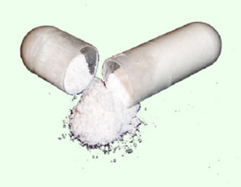
Fr1da-Insulin-Intervention-Study
To determine the immune efficacy and treatment efficacy of daily high dose oral insulin in children aged 2 to 12 years with Stage 1 T1D
Enrolment completed; 220 participants enrolled

Slide 9


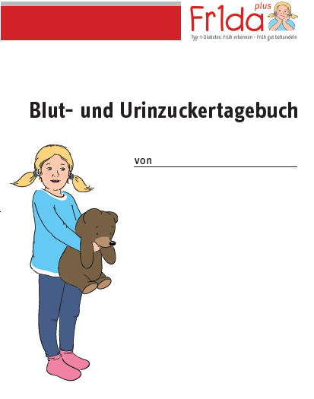

Education and counseling are very important
Training materials for early-stage T1D
Diary and instructions for self-monitoring
Invitation to the training
Guidebook for early-stage T1D
PIXI book
about T1D

Slide 10
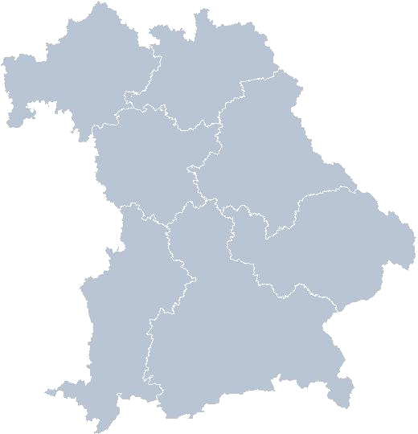
Local care for early-stage T1D
18 pediatric diabetes centers
Bavaria
Schweinfurt
OGTT, HbA1c
Education
PHQ-9 Questionnaire on psychological stress
Follow-up visits according to monitoring plan
Würzburg
Bayreuth
Erlangen
Weiden
Nürnberg
Deggendorf
Passau
Neuburg
Augsburg (2)
Munich (4)
Traunstein
Rosenheim
Kempten

Slide 11
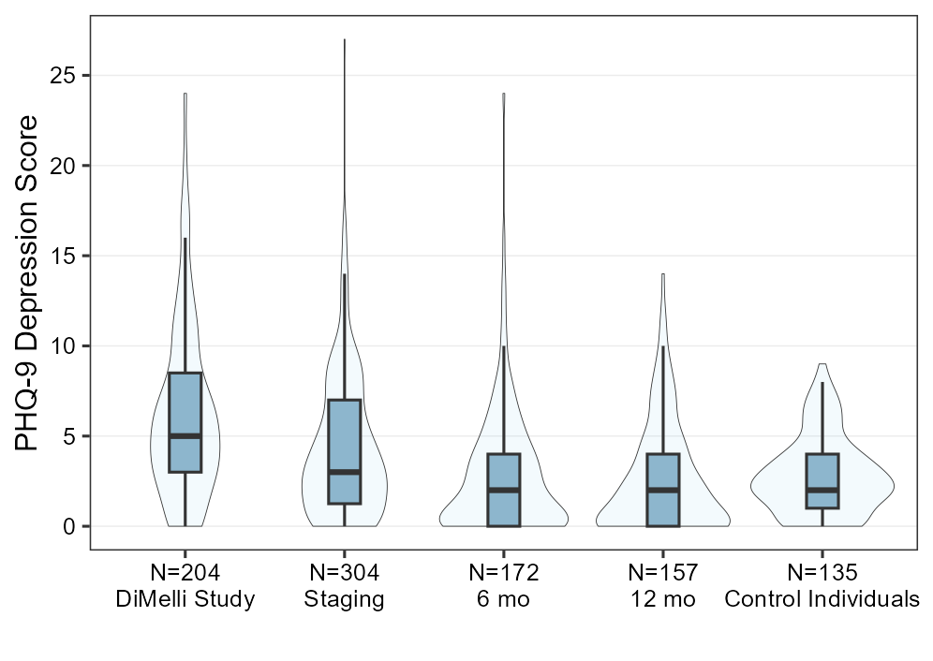
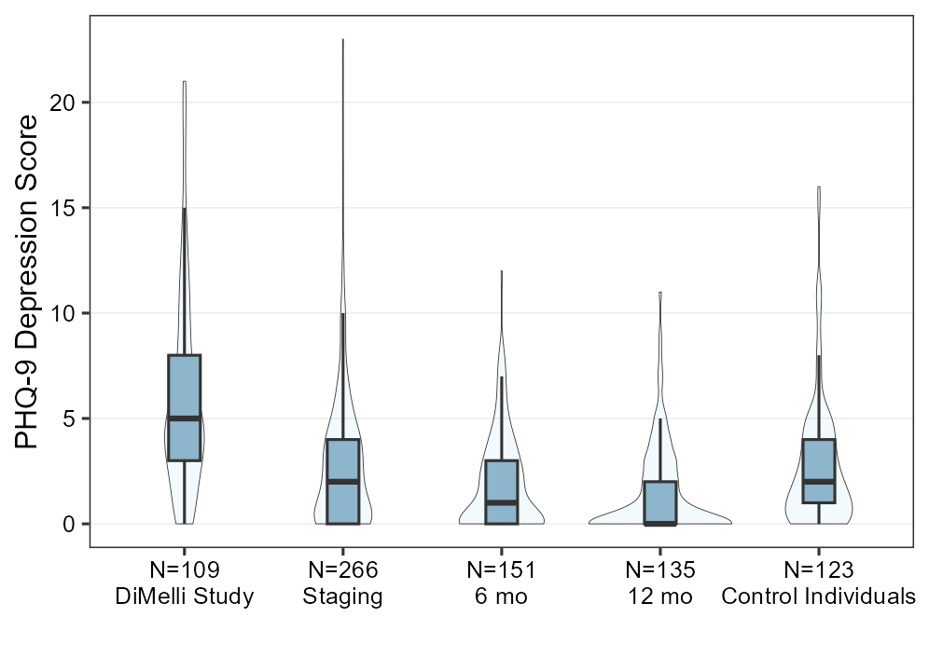
Well-being: Parents less burdened than with 'classic diagnosis'.
WHO Questionnaire PHQ-9
Ziegler et al. (2020) JAMA
Mother
Median PHQ-9-Score
Father
Median PHQ-9-Score
P=0,004
P<0,0001
P<0,0001
5
2
1
0
2
5
3
2
2
2

Slide 12
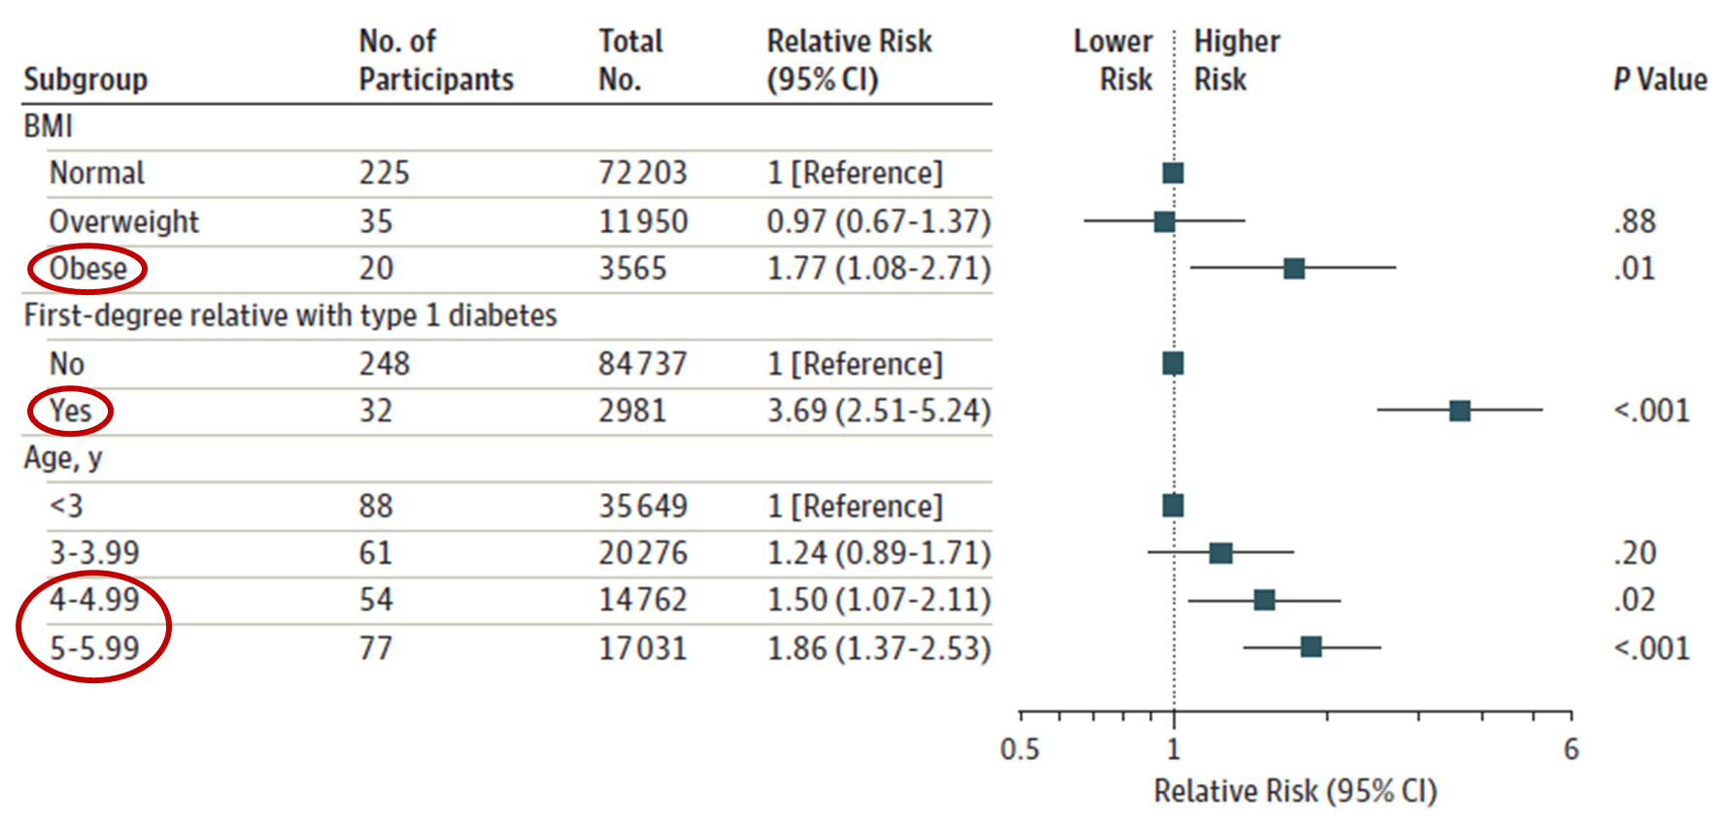
What is associated with relative risk for early-stage T1D?
Ziegler et al. (2020) JAMA

Slide 13
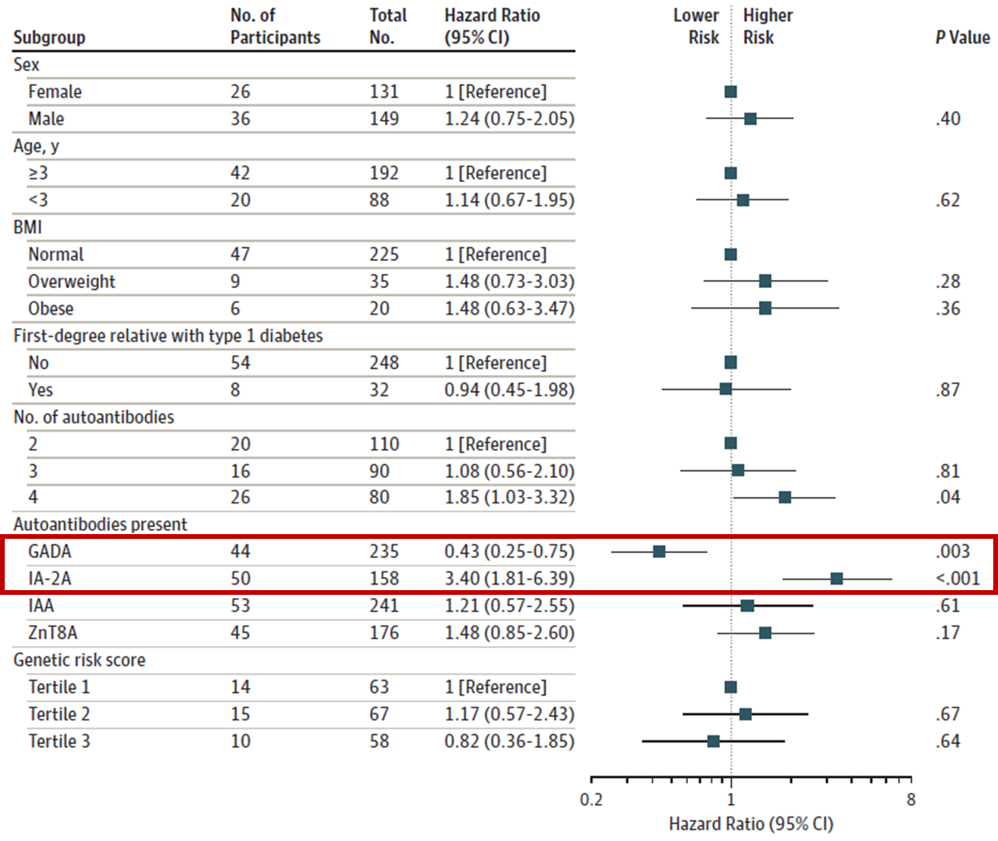
What is associated with
risk of progression
from Stage 1 or Stage 2
to Stage 3 T1D ?
Ziegler et al. (2020) JAMA

Slide 14
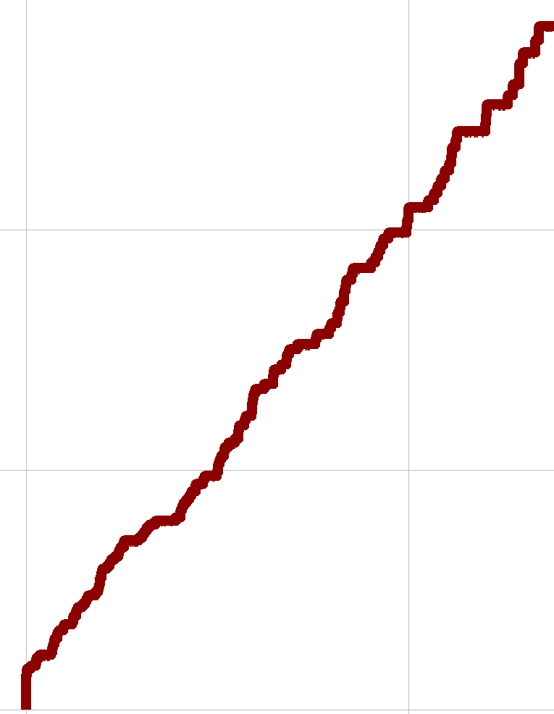
Progression from early-stage T1D (stage 1 or stage 2)
to clinical T1D (stage 3)
100
BABYDIAB, DIPP, DAISY
80
Similar progression rate in
Fr1da children with early-stage T1D compared to
international birth cohort with increased genetic risk
60
Probability of Stage 3 T1D (%)
40
20
0
0
5
10
15
20
Follow-up (years)
Ziegler, Rewers, Simell et al, JAMA 2013; Ziegler et al, JAMA 2020; Weiss et al, Diabetologia 2022

Slide 15
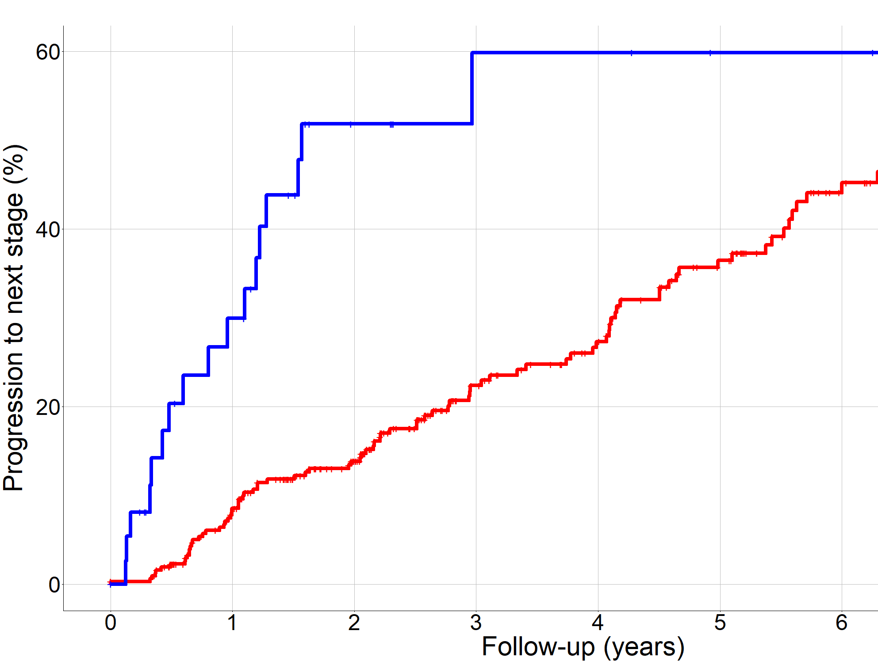
Stratification of progression rate by stage
Stage 2
Half of the children have reached the next stage
in 2 years for Stage 2
in 6 years für Stage 1
Stage 1
Weiss et al., Diabetologia 2022

Slide 16
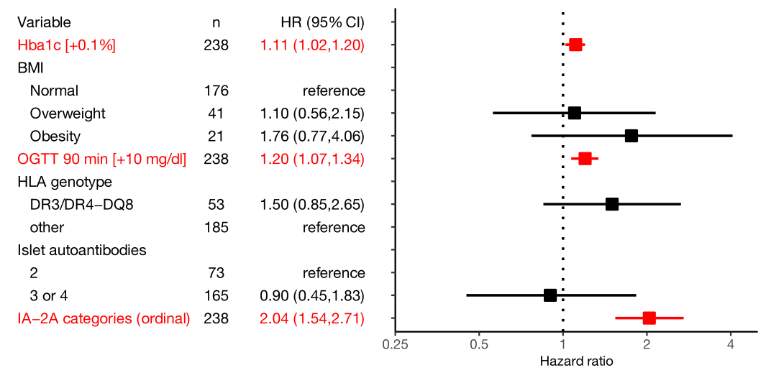
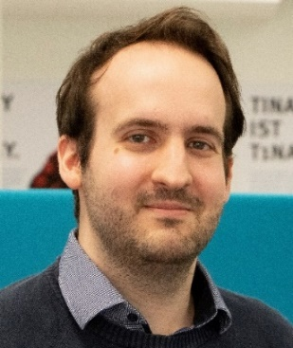
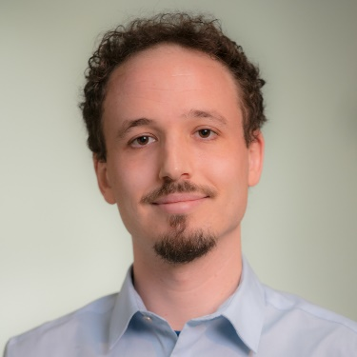
Which factors contributes to disease progression?
- stage 1 to stage 3, multivariable -
Andreas Weiss
Jose Zapardiel Gonzalo
Weiss A et al, Diabetologia 2022
Progression Likelihood Score: exp[(HbA_{1c}[%] − 5.233) ×
1.125 + (OGTT₉₀[mg/dl] − 107.6) × 0.0195 + (IA-2A_{cat} − 1.27) × 0.662)]

Slide 17
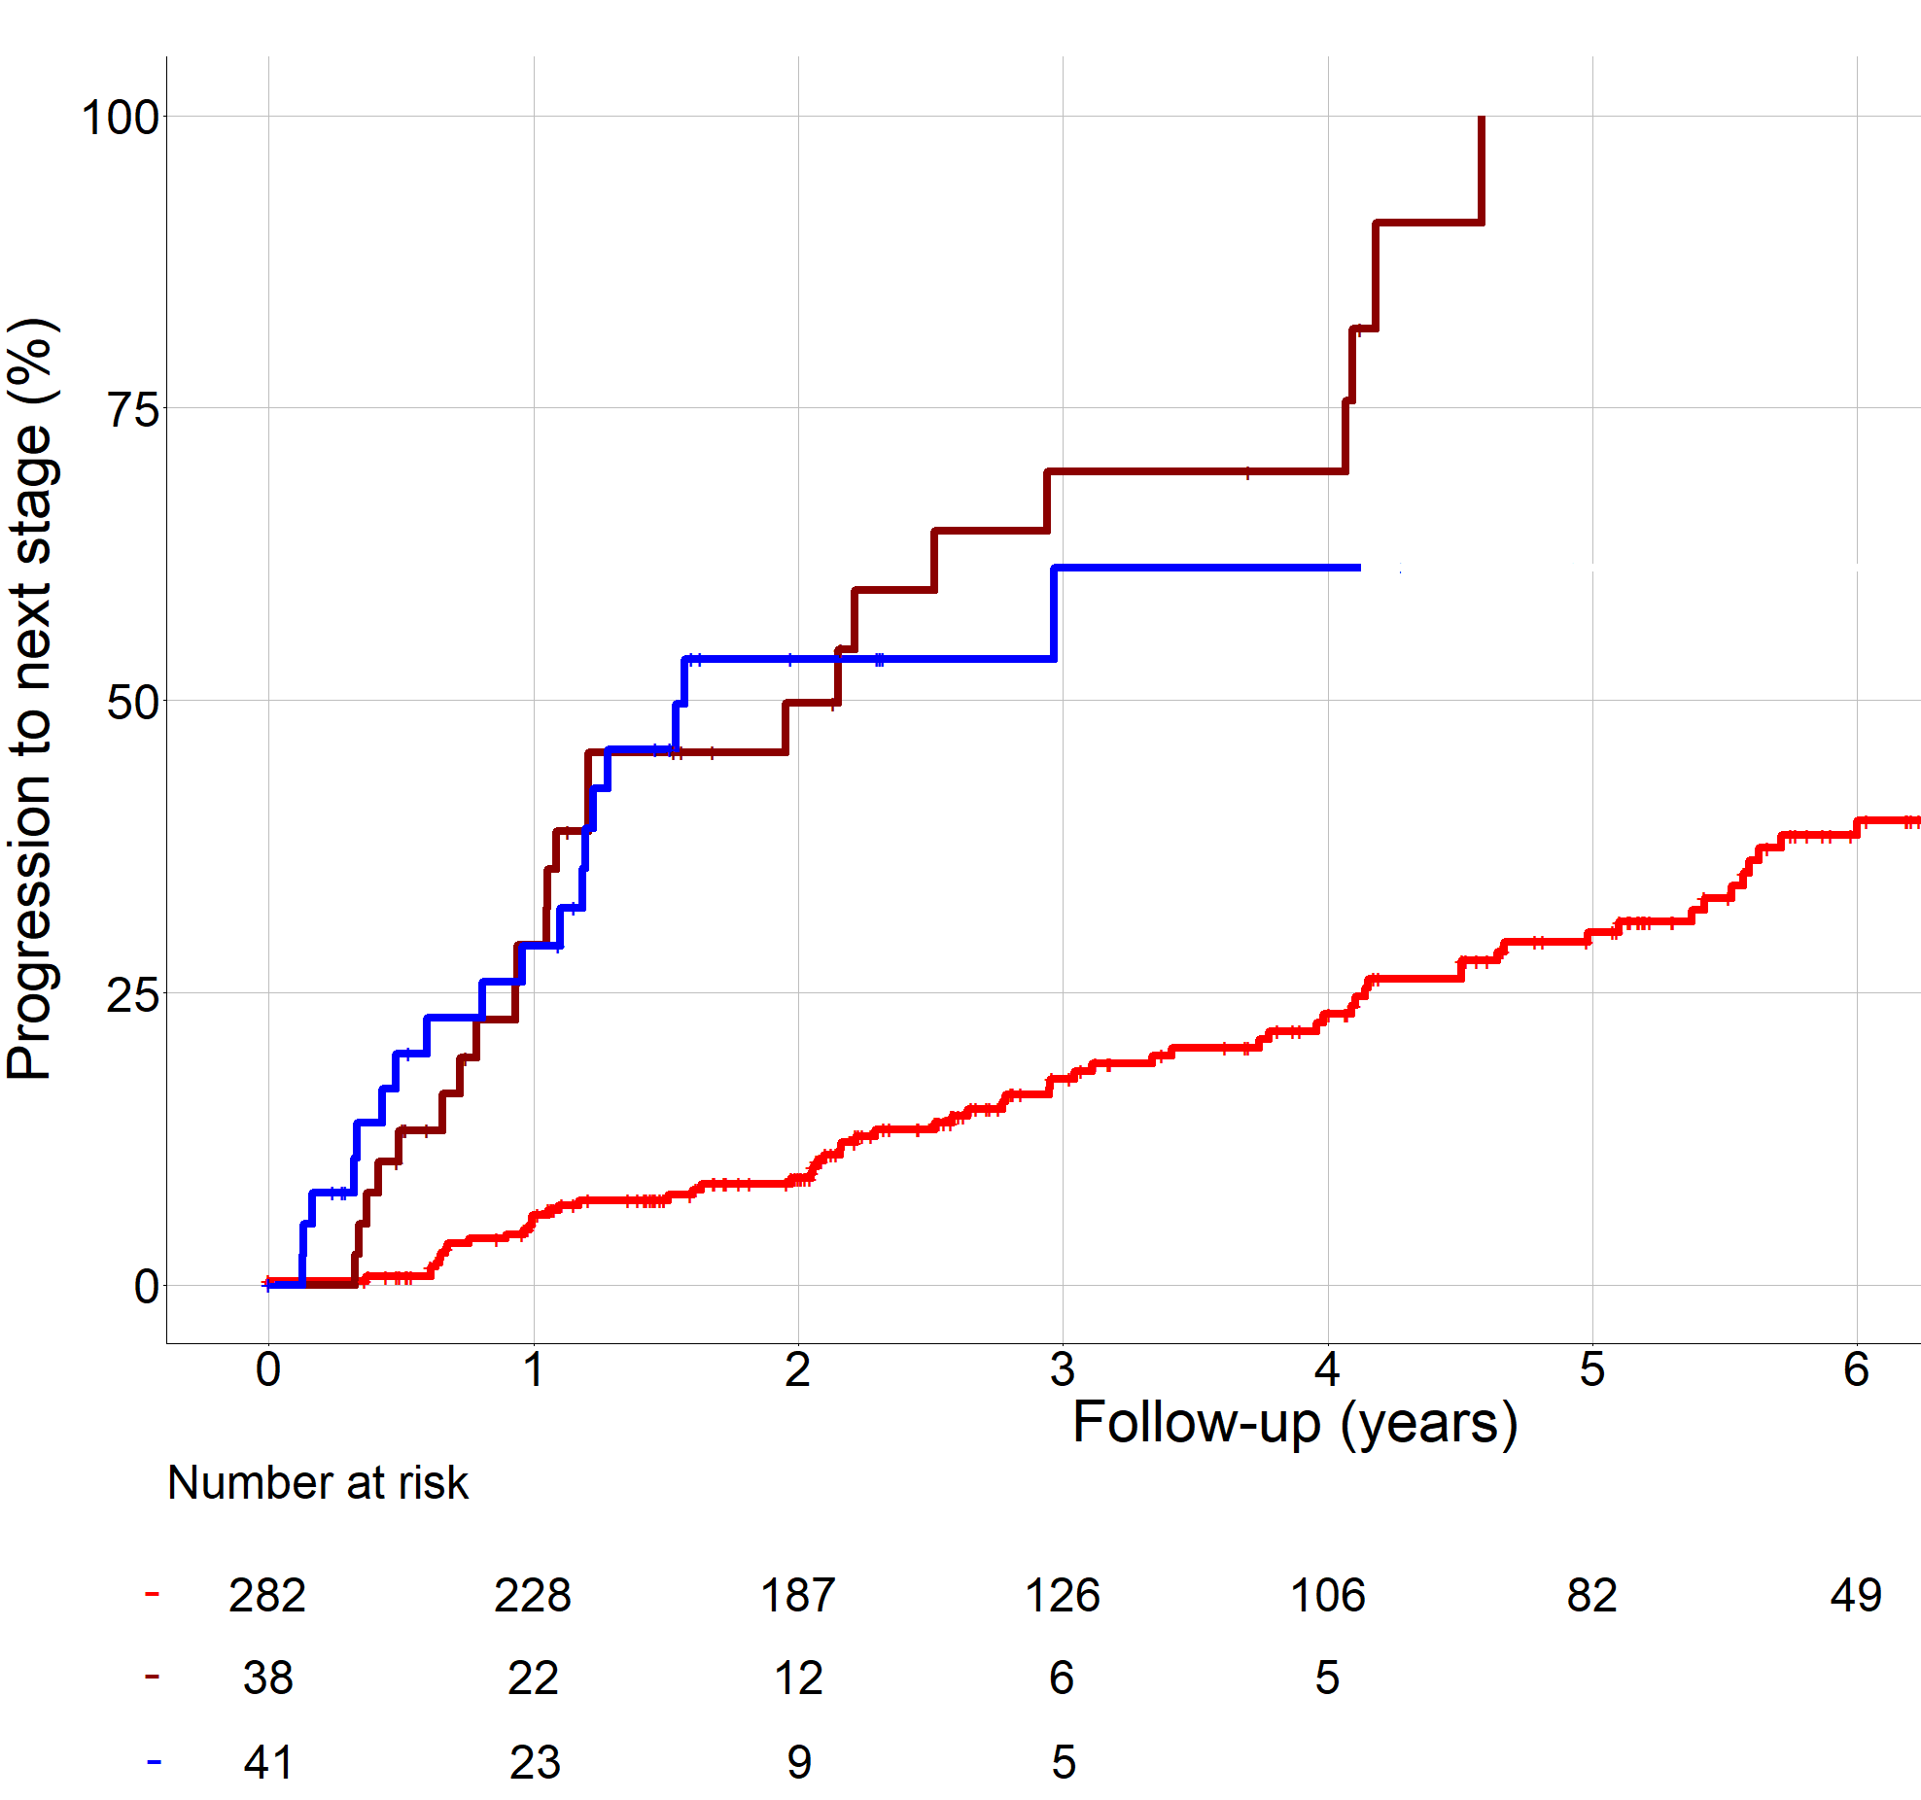
Stratification by Progression Likelihood Score (PLS)
Stage 1b
Stage 2
Stage 1a
Stratification can be used
to provide individual advice
on how often monitoring
should take place
Weiss et al., Diabetologia 2022

Slide 18
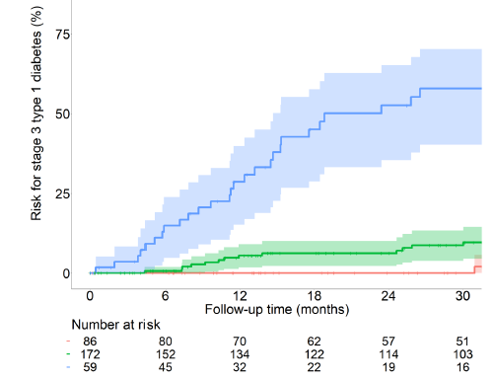
Staging plus PLS can identify very high risk and
majority of progressors within 2 years
Stage 1b and 2
25 (74%) cases within 2 years
9 cases within 2 years
Stage 1 PLS 30th – 90th centile
Stage 1 PLS <30th centile

Slide 19
Staging, Teaching, Monitoring, Psychological Support
Normoglycemia (stage 1)
Dysglycemia
PLS < 0.5 (<30th)
(0% 2yrs-progression)
PLS 0.5-4 (30-90th),
or no score done
(4-8% 2yrs-progression)
Stage 1b; PLS >4 (>90th)
(~ 50% 2yrs-progression)
Yearly:
Glucose, HbA1c, IA2A
After 2 years: OGTT
At home*:
glucose in case of symptoms, infections, fever, poor general condition
6-monthly:
glucose, HbA1c
After 1 year: OGTT, IA2A
At home*:
glucose every 2 month 2h after biggest meal + in case of symptoms, infections, fever, poor general condition
See dysglycemia
Dysglycemia
*urine glucose measurements recommended, if blood glucose monitoring is not possible at home

Slide 20
Staging, Teaching, Monitoring, Psychological Support
Dysgycemia (stage 2, ADA or TrialNet) or Stage 1b
Every 3 months:
glucose, HbA1c
Every 6 months:
OGTT
At home*:
glucose every 1-2 weeks 2h after big/evening meal + in case of symptoms, infections, fever, poor general condition
Hyperglycemia
*urine glucose measurements recommended, if blood glucose monitoring is not possible at home

Slide 21
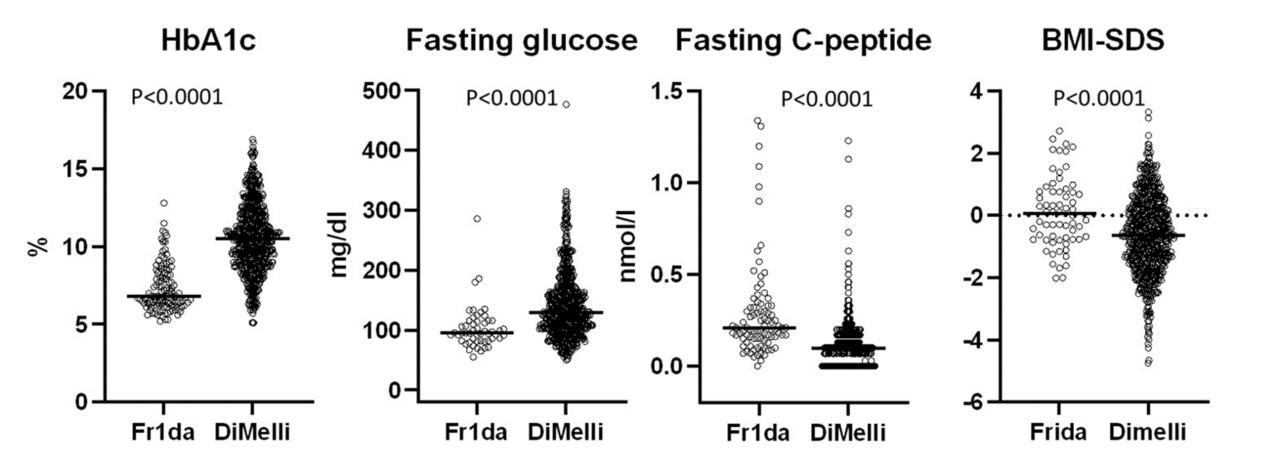
At clinical diagnosis (stage 3):
Drastically reduced ketoacidosis rate: 2.5%,
and more residual beta cell function
Hummel S et al., Diabetologia, September 2023
New onset register cohort in children in Bavaria, Germany

Slide 22
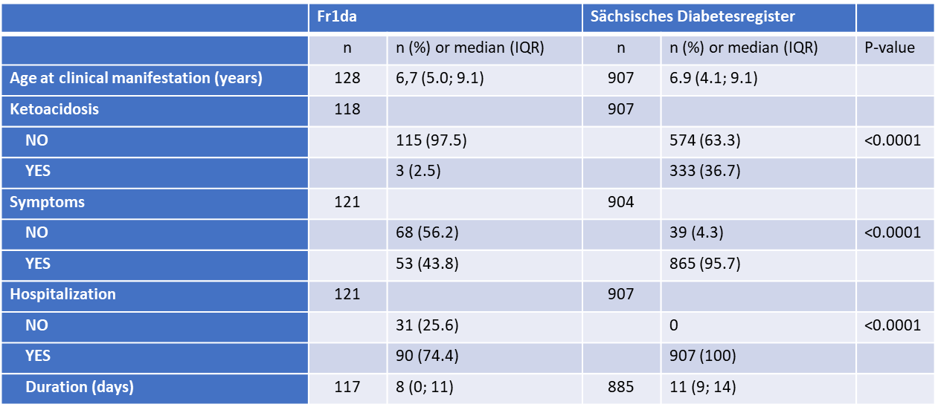
Schneider J, Gemulla G, Kiess W, Berner R, Hommel A.
Presymptomatic type 1 diabetes and disease severity at onset.
Diabetologia, September 2023

Slide 23
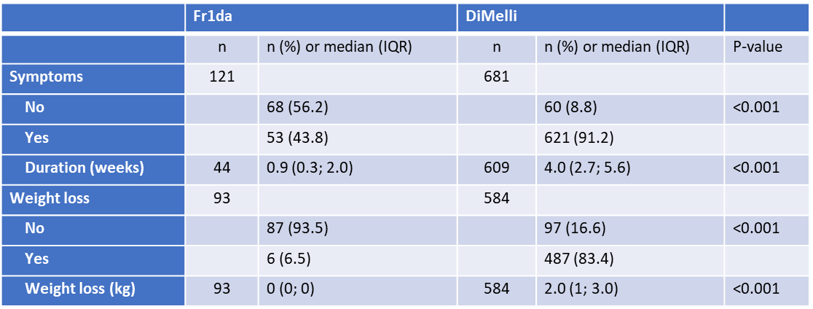
Hummel S, Friedl N, Winkler C, Ziegler AG, Achenbach P; Fr1da Study Group.
Presymptomatic type 1 diabetes and disease severity at onset. Reply to Schneider J, et al [letter]. Diabetologia, September 2023

Slide 24
Advantages of screening for islet autoantibodies
Drastic reduction in the rate of diabetic ketoacidosis
Better preserved residual beta cell function at clinical manifestation
Less psychological stress at clinical diagnosis, better quality of life
Smooth transition to insulin therapy at the right time
Access to preventive therapies (e.g. teplizumab)

Slide 25
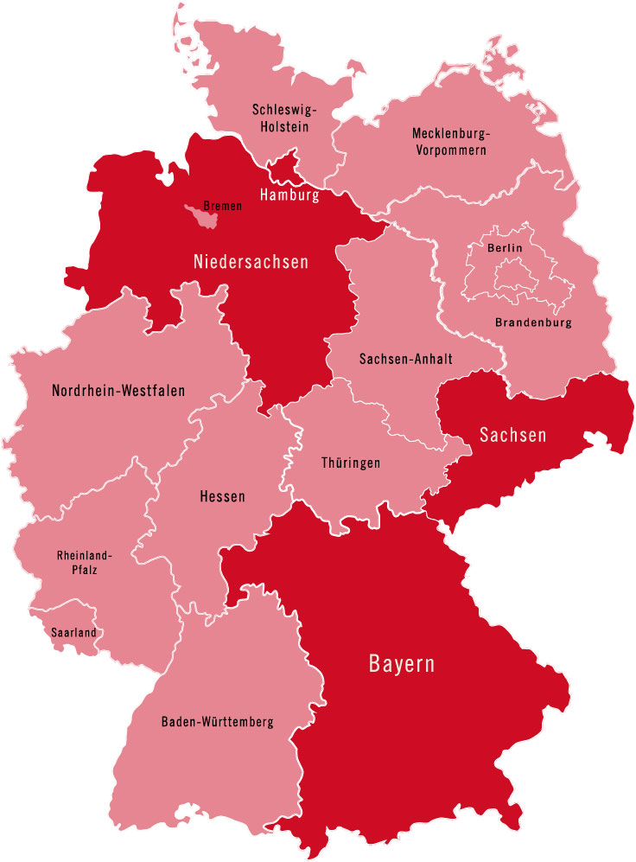
Fr1da-Plex: Scaling up
to other regions
Screening for presymptomatic T1D
in four German federal states:
Bavaria
Lower Saxony
Hamburg
Saxony

Slide 26

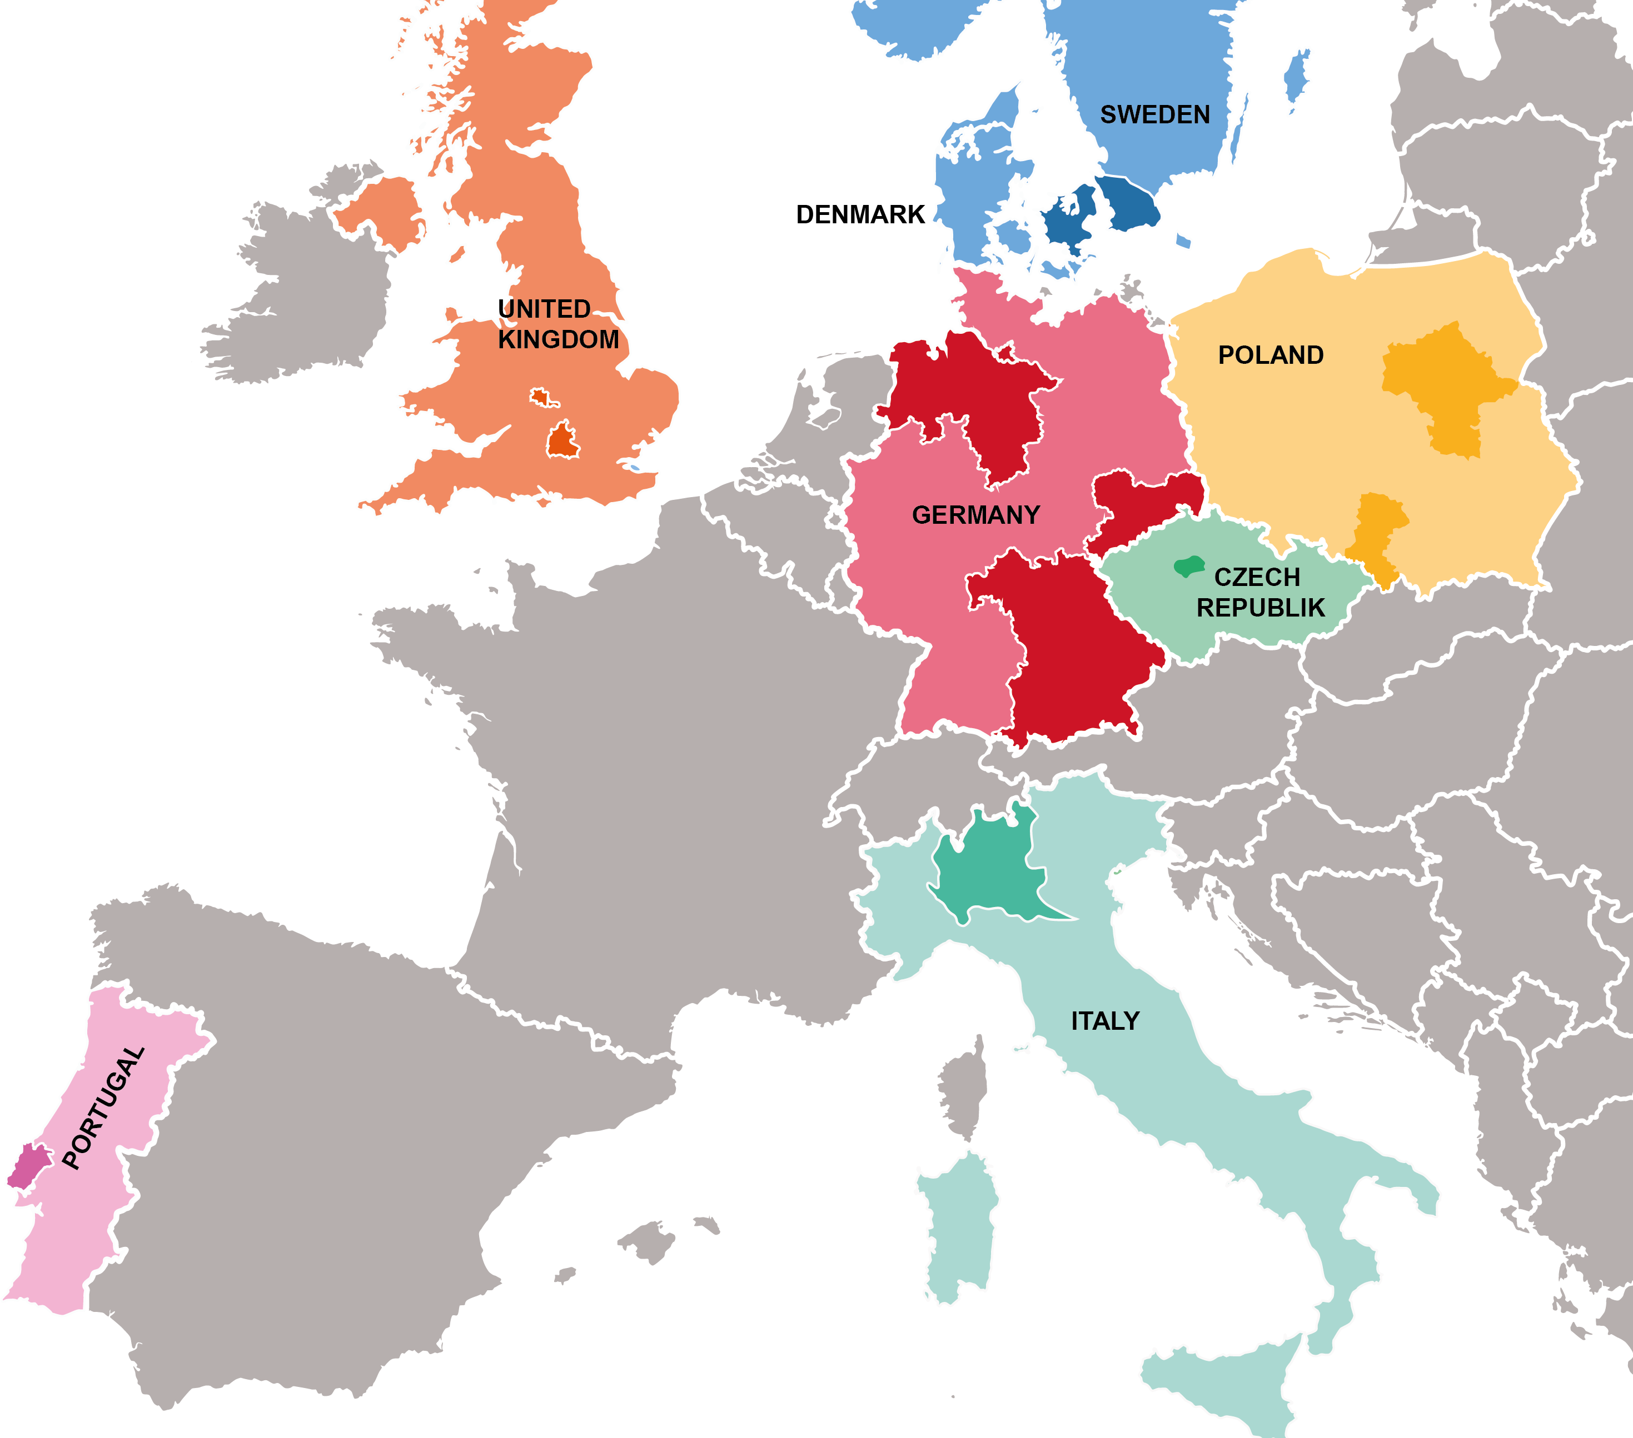




GERMANY
DENMARK & SWEDEN
UNITED KINGDOM
New initiatives:
ITALY, POLAND, PORTUGAL
& CZECH REPUBLIC

Slide 27

Press release EDENT1FI
Brussels, November 1, 2023
In a groundbreaking collaborative effort, academic researchers, industry leaders, and charities have joined forces to combat Type 1 Diabetes (T1D) …
EDENT1FI is a global consortium comprised of 28 partners spanning 12 countries. These partners have come together with a shared mission: to identify T1D at its pre-clinical stage in children in the general population. The project is funded through the Horizon Europe program and is set to run over five years.

Slide 28
Funding
The project operates within the framework of the Innovative Health Initiative – Joint Undertaking (IHI-JU) and boasts a total budget of approximately €23.5 million.
The majority (€22 million) originates through funding from the European Commission (Horizon Europe), from The Leona M. and Harry B. Helmsley Charitable Trust, from the Juvenile Diabetes Research Foundation International (JDRF) and from in-kind contributions (EFPIA, MedTech and JDRF).
Additional funding of €1.5 million is provided to associated UK partners through the UKRI (UK Research and Innovation) Guarantee Fund.

Slide 29
Coordination Team
The EDENT1FI consortium has been initiated by
Prof. Chantal Mathieu, of KU Leuven in Belgium.
Prof. Mark Peakman, representing Sanofi.
Prof. Anette Ziegler, Director of the Institute of Diabetes Research at Helmholtz Munich, Germany
Dr. Jeannette Söderberg, Director European Research for JDRF International
contact: info@edent1fi.eu or www.edent1fi.eu

Slide 30
The EDENT1FI key objectives include:
Creating a roadmap for general population screening for early-stage T1D in 200,000 children across Europe.
Assessing the psychosocial, medical, and economic impact of such screening in diverse European health systems and populations, including underserved families.
Refining the use of T1D biomarkers to improve risk stratification, staging, and personalized monitoring.
Enabling the development of innovative, adapted therapeutic strategies to effectively prevent and manage T1D.
Informing and educating the public, healthcare professionals, and regulatory authorities about new paradigms in T1D diagnosis and care.

Slide 31
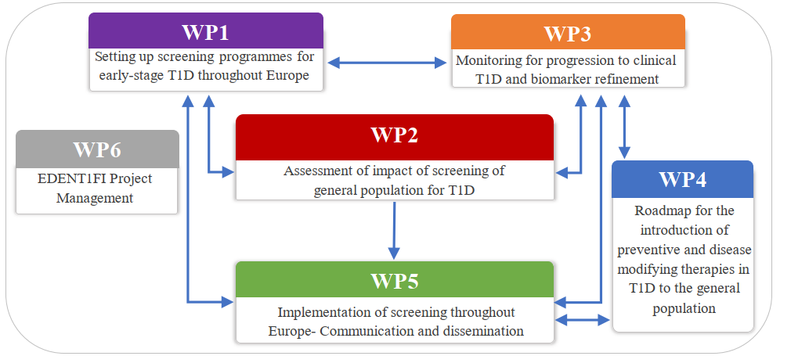
Work packages

Slide 32


Slide 33





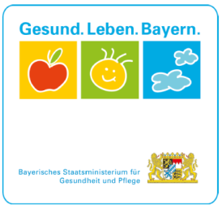



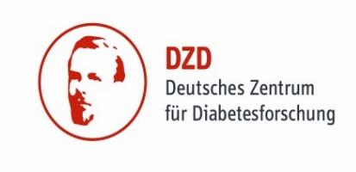
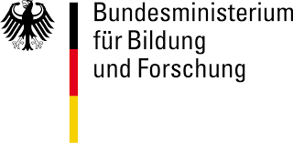



MANY THANKS to all study teams,
study participants and families,
supporters and sponsors!
Insulin crystals

Slide 34


Slide 35
Cost of screening for presymptomatic type 1 diabetes
 |  | Total costs as observed in Fr1da study
Costs (€) |  | Mean (95% CI)
Cost per child screened |  | € 28.17 (19.96; 39.63)
Cost per case diagnosed |  | € 9,117 (6,460; 12,827)
 |  | Total costs as estimated for standard care in Germany
Costs (€) |  | Mean (95% CI)
Cost per child screened |  | € 21.73 (16.76; 28.19)
Cost per case diagnosed |  | € 7,035 (5,426; 9,124)
Karl et al. (2022) Diabetes Care

