Slide 1
TTTS and technology: breaking down educational barriers
Hisham Nsier
Allison Dempsey, PhD
Pediatric Mental Health Institute, Children’s Hospital Colorado

Slide 2
TTTS? What’s that?
Twin-to-Twin Transfusion Syndrome
Occurs in 15% of monochorionic, diamniotic twin pregnancies (Lopriore et. al., 2007)
Shared placenta, separate amniotic sacs
Uneven blood flow between babies due to connection of twin blood vessels (anastomosis)

Slide 3
TTTS diagnoses are stressful
Without treatment, risk of fetal death is > 80% (McIntosh et. al., 2014)
Parents and physicians both perceive a fetal anomaly diagnosis as a very stressful event and are usually not prepared for it (Luz et. al., 2017)
Women with fetal anomalies tend to report higher psychological distress, depression, and anxiety (Kaasen et. al., 2017)

Slide 4
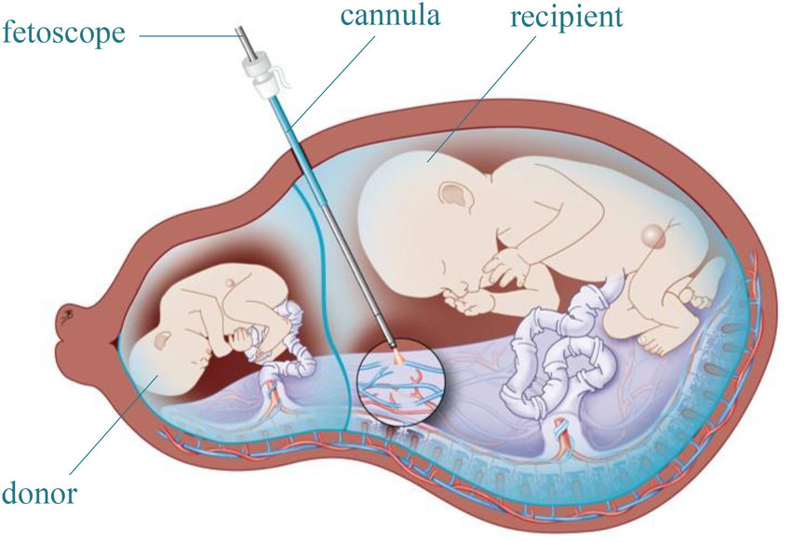
How is TTTS Treated?
Preferred treatment: selective fetoscopic laser photocoagulation (SFLP)
Small camera used to locate abnormal placental blood vessels
Laser energy used to seal the anastomoses
Fetal survival after SFLP treatment ranges from 76-87% (McIntosh et. al., 2014)

Slide 5
Rationale
The information presented to families during consultations is complex and often hard to understand.
Physicians commonly struggle communicating scientific information to patients in a way that makes sense.
Understanding medical information and terminology is very important for making decisions regarding pregnancy and overall health.
De Wikkelkinderen (The Swaddled Children), 1617, Unknown Artist

Slide 6
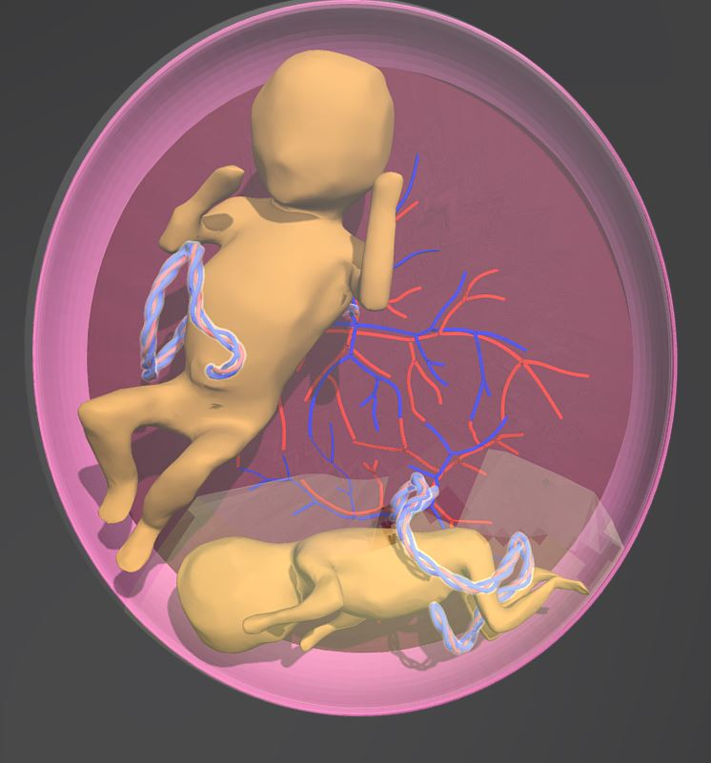
Parental education
Research Question: Does educating parents about TTTS with a physician-approved 3-D model increase their retention of information?
Independent Variable | Dependent Variable
Group 1: education without model | Change in score on TTTS- knowledge quiz
Group 2: education with model
http://tinyurl.com/3DTTTSModel

Slide 7
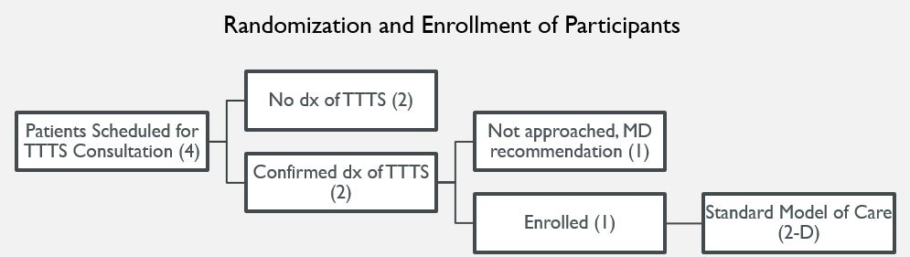
Study demographics

Slide 8
Study methods
Administration of the “Short Assessment of Health Literacy” (SAHL) test
Contains 18 questions that test the ability to understand common medical terms
Administration of a “knowledge quiz” before AND after the doctor consultation (graded by 2 independent scorers)
“What is TTTS?”
“Why is TTTS bad for both twins?”
“What does laser treatment do?”
Pre-post score differences will be assessed
Using Cohen’s kappa, the inter-rater reliability of the knowledge quiz will be assessed

Slide 9
Study protocol
Determination of eligibility
Consent
SAHL, Pre-Knowledge Quiz
Meeting with MFM, surgeon
Education without 3-D Model
Education with 3-D Model
Post-Knowledge Quiz
Post-Knowledge Quiz
Pre-Intervention
Post-Intervention
Intervention

Slide 10
discussion
Pilot study in early stages: not enough data collected to determine pre-post differences or inter-rater reliability
Study Importance:
previous studies have examined the efficacy of 3-D models in medical settings, BUT:
they used physical 3-D printed models
they used 3-D virtual models to visualize the cardiovascular system
this is the first study of its kind to apply virtual models to OG/GYN and perinatology!
Limitations:
low number of women referred to CFCC for treatment due to relative rarity of TTTS

Slide 11
Acknowledgements
Dr. Dempsey, Christine Castillo, Hilary Hoffman, Ailen Gutierrez
Dr. Douglas Novins, Chair of PMHI
Dr. Dominic Martinez, Dir. Office of Inclusion and Outreach, CCTSI
Mrs. Emmaly Perks, Dr. Merlin Ariefdjohan, PURPLE Administrators

Slide 12
Questions?

Slide 13
Patients Scheduled for TTTS Consultation (n = 4)
No dx of TTTS (n = 2)
Confirmed dx of TTTS
(n = 2)
Not approached, MD recommendation (n = 1)
Enrolled (n = 1)
Standard Model of Care (2-D)
Figure 3. Flow of Participants

Slide 14
Pre
Enrollment/Randomization
Health Literacy Test (SAHL) + Pre-Knowledge Quiz
Intervention
Education with 3-D model
Education without 3-D model
Post
Post-Knowledge Quiz

