Slide 1
A Novel Cognitive Target for the Treatment of Co-occurring Irritability and Anxiety in Youth
14 August, 2017
Analyse DeSousa^{1,2}, Simona Haller PhD³, Ellen Leibenluft MD³, Melissa Brotman PhD³, Matt Jones PhD⁴, Joel Stoddard MD^{1,2}
1Pediatric Mental Health Institute, Children’s Hospital Colorado; 2School of Medicine, University of Colorado (Anschutz); 3Emotion and Development, NIMH; 4Institute of Cognitive Science, University of Colorado (Boulder)
Notes:
[Today I am going to talk to you about a new target for the development of treatment of youth who are both irritable and anxious.]

Slide 2
Irritability
Debilitating symptom that spans mental disorders
BP, anxiety, DMDD, etc
Few evidence based treatments
One promising target for treatment development is the Hostile Interpretation Bias
Notes:
[Disruptive mood DYSREGULATION disorder]
[Irritability predictive of later negative outcomes- adult suicide, anxiety, and depression]
[irritability as a public health concern, so there is national interest in developing treatments]
[HIB mildly associated with irritability (.4)]

Slide 3
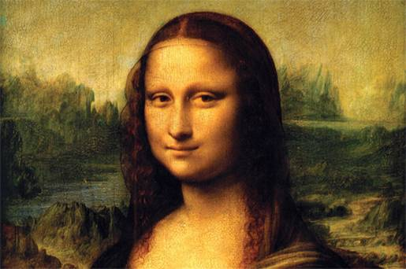
Hostile Interpretation Bias (HIB)
Tendency to judge ambiguous social information as being threatening
HIB persists in irritable youth, even when they receive feedback that social information is benign¹
1. Stoddard, J., et al. (2016).
Notes:
[kiddos who suffer from irritability…chip on their shoulder…might judge that the Mona Lisa is smirking at them, and interpret that to be threatening]

Slide 4
Hostile Interpretation Bias (HIB)
Tendency to judge ambiguous social information as being threatening
HIB persists in irritable youth, even when they receive feedback that social information is benign¹
Two hypothesis may explain why HIB persists:
-Irritable youth may not detect subtle social cues
-Irritable youth may be slow to learn benign associations
1. Stoddard, J., et al. (2016).
Notes:
…subtle social cues [they need to learn benign associations]
…learn benign associations [making it harder for them to update their hostile associations to be more benign]
[in the present study we perform an analysis using a novel computational model to explore the relationship between irritability and both of these theories]
[I am going to revisit these two hypothesis in a moment, but first…]

Slide 5
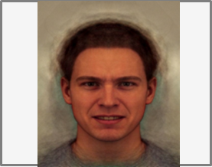
Fixation (1500-2500 ms)
Face (200 ms)
Mask (20 ms)
Remained until ‘happy’ or ‘angry’ response made
Notes:
[This is the task used to measure the hostile interpretation bias]

Slide 6
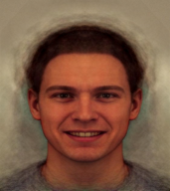
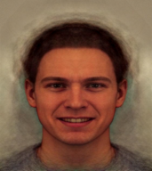
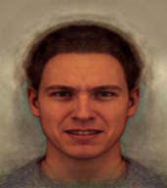
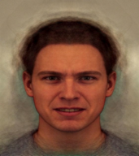
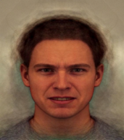
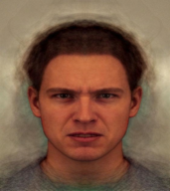
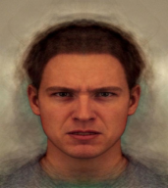
Interpretation Bias Training
Training Blocks
Assess
…
…
Train x 6
Time
Happy judgments
X
Angry judgments
Assess
Baseline balance point
Feedback threshold
Notes:
[in training, participants learn to switch their judgements of two ambiguous faces that they had previously judged as angry, to happy; in this was, it encourages the irritable youth to make benign associations]
-emphasize training

Slide 7
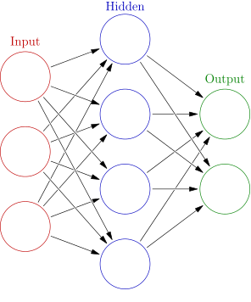
Computational Learning Model
ΔV=ε (λ−V)
Face Stimuli
Judgement
H
A
Notes:
[How do we measure…a difficulty detecting subtle cues, or a slow learning rate? …Used an established computational learning model. The model takes the data from the IBT, and uses this well validated learning equation to generate 3 parameters]

Slide 8
Computational Learning Model
ΔV=ε (λ−V)
Parameter | Measures
σ | Generalization
ε | Learning Rate
Θ | Reliability
Face Stimuli
Judgement
H
A
Notes:
[sigma- …participants ability to distinguish between morphs that are similar to each other on the spectrum. Higher generalization indicates “over-generalization”…participant has difficulty distinguishing between similar (neighbor) morphs]
[epsilon- …adaptation to feedback]
ε = learning rate
Λ = prediction error
V = last trial’s “angry” value

Slide 9
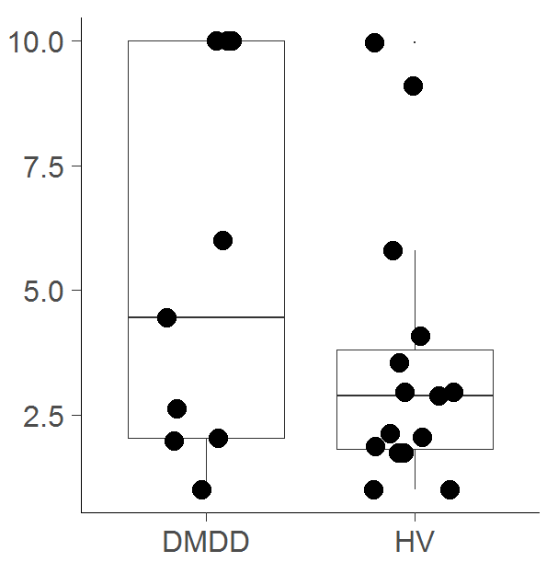
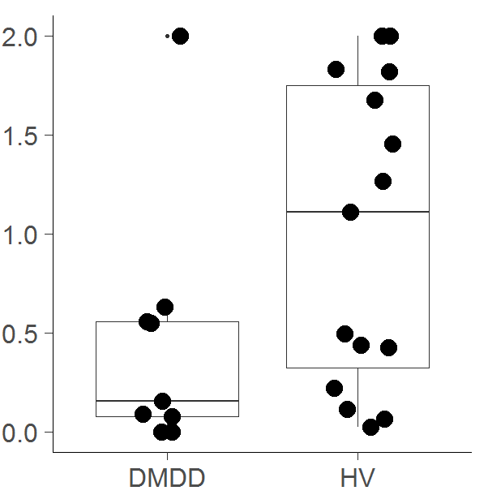
Remember: Prior work suggested two hypothesis
may not detect subtle social cues
may be slow to learn benign associations
Generalization
Learning Rate
Group
Group
n=9 DMDD; n=15 HV
Notes:
Highlight differences between DMDD and HV
-generalization=trouble detecting cues they need to learn benign associations
-learning rate=slow to learn associations making it harder for them to update their hostile associations to be more benign

Slide 10
Study Population
48 youth (8-21 yo); %F=41.67
8 youth were excluded for accuracy <75%
Characteristics | M (SD)
Age | 14.1 (3.0)
IQ | 115.3 (11.4)
ARI (Irritability) | 1.4 (1.8)
SCARED (Anxiety) | 12.7 (11.3)
CDI (Depression) | 15.1 (10.0)
CONNERS (ADHD) | 54.5 (15.0)
Notes:
[we recruited 48 youth who presented for research at the national institute of mental health treatment and development branch. Our sample was transdiagnostic, and, as you can see from the table, all participants varied among major dimensions of affective psychopathology]

Slide 11
Data Analysis
Mixed effects model:
ARI + SCARED =
(may not detect subtle social cues)
σ
ε
(may be slow to learn benign associations)
Adjusting for age, gender, and IQ
Subject as random factor
Notes:
[our model tested the effects of irritability (ARI) and anxiety (SCARED) on the generalization and learning rate; while controlling for age, gender, and IQ)]
[additional post hoc analysis ensured that the findings were not accounted for by CONNERS and/or CDI]

Slide 12
Results
Generalization (σ):
We found no significant associations between σ and any of the clinical variables (p values>0.08)
Learning Rate (ε):
Significant interactive effect of ARI by SCARED across ε, β(SE)=0.01(0.005), t(27)=2.11, p=0.04
All other associations with ε were non-significant (p values>0.18)

Slide 13
Results
Generalization (σ):
We found no significant associations between σ and any of the clinical variables (p values>0.08)
Learning Rate (ε):
Significant interactive effect of ARI by SCARED across ε, β(SE)=0.01(0.005), t(27)=2.11, p=0.04
All other associations with ε were non-significant (p values>0.18)

Slide 14
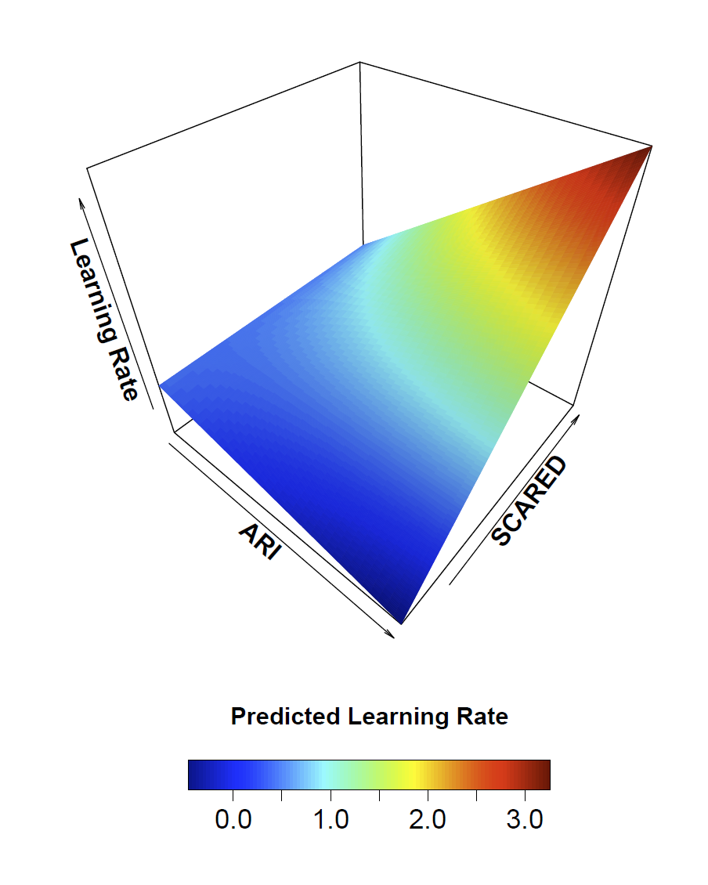
Irritability by Anxiety on Learning Rate
Notes:
[The significant interactive effect of ARI and SCARED (p=0.04), suggests that individuals with higher anxiety and irritability have higher learning rates]
Graph of predicted values by mixed effects model at center age, female gender, and center IQ.
Learning rate maximum is 3

Slide 15
Key Findings
Irritable youth may not detect subtle social cues
Irritable youth may be slow to learn benign associations
The significant effect we found was opposite our expectations
Post hoc analysis:
Quick to learn angry associations
Instead of slow to learn benign associations
Notes:
Post hoc: […capability to model two learning rates: one for hostile and one for benign associations, independently of each other. The hostile association rate would look just like the 3D graph you showed, while the benign rate would be a flat plane.]

Slide 16
Key Findings
Irritable youth may not detect subtle social cues
Irritable youth may be slow to learn benign associations
The significant effect we found was opposite our expectations
Post hoc analysis:
Quick to learn angry associations
Instead of slow to learn benign associations
Limitations
Low level irritability in sample
Depression and ADHD may be confounds
Notes:
[Because our study is limited, we did not find our two hypothesis supported by the data. However, this doesn’t necessarily mean that these two hypothesis are not true, but rather our data suggest that we consider a new hypothesis, and a new direction for research]

Slide 17
Future Directions
Irritability and anxiety should be considered together in further development
Investigate the rapid reinforcement of hostile judgements as a potential training target
Notes:
[Consider that HIB is maintained in irritable and anxious youth because they are quick to learn hostile judgments NOT impaired in learning benign judgments]

Slide 18
References
1. Stoddard, J., Sharif-Askary, B., Harkins, E.A., Frank, H.R., Brotman, M.A., Penton-Voak, I.S., Maoz, K., Bar-Haim, Y., Munafo, M., Pine, D.S., Liebenluft, E. (2016). An open pilot study of training hostile interpretation bias to treat disruptive mood disorder. Journal of Child and Adolescent Psychopharmacology, 26, 49-57. doi: 10.1089/cap.2015.0100
Notes:
[In case you’d like to read more, here is the citation I used to inform on this project.]

Slide 19
Acknowledgment
All participants and their families
Our lab team: | Our Collaborators: | PMHI Summer Research Program:
Joel Stoddard, MD Anne Penner, MD Robert Evans | Simona Haller, PhD Ellen Leibenluft, MD Melissa Brotman, PhD Matt Jones, PhD | Merlin Ariefdjohan, PhD, MPH Emmaly Owens, MA Marisa Deguzman
Funding
NIMH Intramural Research Program
Department of Psychiatry, School of Medicine, University of Colorado
Dr. Dominique Martinez, CCTSI, Office of Diversity and Inclusion, University of Colorado
Dr. Douglas Novins and Dr. Jennifer Hagman, PMHI, Department of Psychiatry, School of Medicine, University of Colorado

Slide 21
Clinical Diagnosis | N (%)
DMDD | 6 (12.5%)
ADHD | 15 (31.3%)
Anxiety | 5 (10.4%)
Relatives of BD | 6 (12.5%)
BD | 2 (4.2%)
HV | 14 (12.2%)

