Slide 1


Silent Struggles: Examining Trauma & Adversity in the Context of Adolescent Depression
Katelyn Lamberton
Amanda Millar, Shengh Xiong, Dr. Jessica Kenny, Dr. Ayelet Talmi

Slide 2
What is trauma?
“Scary” events
Abuse
Death
Notes:
“Trauma is defined as events (including physical injury or threats social and emotional well-being) that create difficult-to-manage levels of psychological and physiological stress.

Slide 3




Background
Crucial for identification
Primary Care Providers (PCPs)
60.3%
PHQ-9A
Notes:
Nationally, 60.3% of youth with major depression do not receive needed mental health treatment.
The PHQ-9A (Patient Health Questionnaire 9-item modified for Adolescents) is a screener that the American Academy of Pediatrics (AAP) recommends to screen adolescents for depression.
Studies suggest that trauma and adversity may impact depression in adolescents, making it crucial to identify these factors in integrated primary care settings (Kenny et. al., 2021; Campbell et. al., 2024).
However, trauma and adversity may not be sufficiently assessed by Primary Care Providers (PCPs) to properly understand the impact of these important areas of psychosocial functioning in a child’s life (Campbell et. al., 2024).

Slide 4
Methods
Clinic
Data
Measures
Sample
Analysis
Project CLIMB (Consultation Liaison in Mental Health and Behavior)
January 2017-August 2018 Electronic Health Record Data
PHQ-9A
Psychosocial Screener
Trauma and Adversity Code
277 adolescents with documented elevated PHQ-9A (score >10 or item #9 positive).
Qualitative analysis;
Descriptive statistics, Chi-square
2,107 adolescents aged11-18
Notes:
Project CLIMB (Consultation Liaison in Mental Health and Behavior) provides integrated behavioral health services to children and families seen in an urban residency training pediatric primary care clinic.
2,107 adolescents aged 11-18 completed PHQ-9A.
Traditional content analysis was employed to code interventions by PCPs and CLIMB for elevated PHQ-9A scores, as well as themes of trauma and adversity found in patient charts where they were present. The qualitative codes were then converted into quantitative results.
Qualitative data: Traditional content analysis was employed to code interventions by PCPs and CLIMB for elevated PHQ-9A scores, as well as themes of trauma and adversity found in patient charts where they were present. The qualitative codes were then converted into quantitative results
Chi-square tests were utilized to evaluate the relationship between actions/recommendations made by PCPs and CLIMB when trauma or adversity was present and not present.

Slide 5



Objectives
Aim 1
Examine the prevalence of reports of trauma and/or adversity in a sample with elevated PHQ-9A scores.
Aim 2
Explore actions taken by the behavioral health team after trauma and/or adversity was disclosed.
Aim 3
Identify strategies for primary care settings to respond to adolescent reports of trauma and/or adversity.
Notes:
Examine the prevalence of reports of trauma and/or adversity in a sample with elevated PHQ-9A scores.
Explore actions taken by behavioral health team after trauma and/or adversity was disclosed.
Identify strategies for primary care settings to respond to adolescent reports of trauma and/or adversity.
Hypothesis: In a sample of adolescents with elevated PHQ-9A scores, patients are likely to have indicators of trauma and/or adversity in their medical record.

Slide 6
Results and Conclusions

Slide 7
Table 1. Demographics and Sample Characteristics
Sample | N = 277
Age of Child (M, SD) | 13.19 (1.68)
Gender Male Female | 133 (40.8%) 164 (59.2%)
Ethnicity Latino Non-Latino Not-reported/unknown | 155 (56.0%) 117 (42.2%) 5 (1.8%)
Race American Indian/Pacific Islander Asian Black/African American White More than one race Other/Unknown | 1 (0.4%) 5 (1.8%) 55 (19.9%) 79 (28.5%) 32 (11.6%) 105 (37.9%)
Primary Language English Spanish Other | 193 (67.9%) 79 (28.5%) 5 (1.8%)
Insurance Public Private/Other | 246 (88.8%) 31 (11.2%)
PHQ-9A PHQ-9A Score (M, SD) Q9 Positive | 12.09 (4.38) 140 (50.5%)
Adversity Screen Resource Needs Behavioral Health Needs | 37 (13.4%) 37 (13.4%) 7 (2.5%)
Trauma Indicated PCP Documented CLIMB Documented Both Documented | 78 (28.2%) 12 (4.3) 62 (22.4%) 4 (1.4%)
Aim 1:
Examine the prevalence of reports of trauma and/or adversity in a sample with elevated PHQ-9A scores.
Notes:
Average score of 12 = moderate depression.
Expand more on what the adversity and trauma stats mean

Slide 8
(10)
(9)
(5)
N = 24
N = 78
Example: “Patient indicated that he sometimes thinks that he would be better off dead…and indicated that he has these thoughts about once/week because his mother yells at him and is unpredictable. He noted…that if the stressors were better, he would not have these thoughts.” (Trauma: verbal abuse).
N = 44
Notes:
Out of all the types of trauma mentioned in the charts, “scary” events were the most common. Specifically, bullying was the most frequently mentioned “scary” event.
Out of all the types of abuse, sexual abuse was the most frequently mentioned.
Example: “Patient indicated that he sometimes thinks that he would be better off dead…and indicated that he has these thoughts about once/week because his mother yells at him and is unpredictable. He noted…that if the stressors were better, he would not have these thoughts.” (Trauma: verbal abuse).

Slide 9
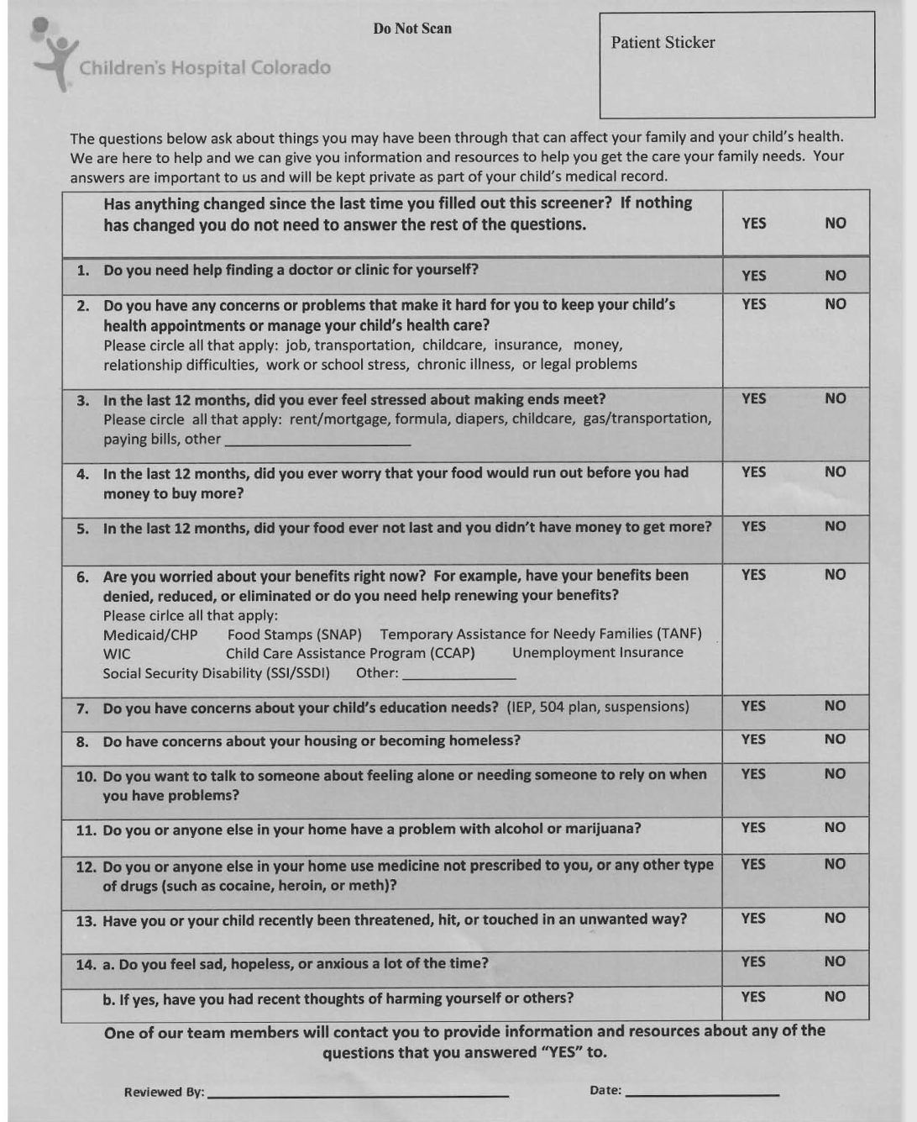
Psychosocial Screener
Table 2. Themes of Adversity Found in Patient Charts
Trouble keeping up with child's healthcare needs | 5 (6.9%)
Financial Stress | 14 (19.4%)
Food Insecurity | 11 (15.3%)
Need Benefits Connection | 9 (12.5%)
Child's Education | 7 (9.7%)
Housing Insecurity | 5 (6.9%)
Fears of Child Safety | 1 (1.4%)
Sad, hopeless, or anxious | 3 (4.2%)
Adversity mentioned, type not specified | 10 (13.9%)
Adversity coded but not documented in patient chart | 6 (8.3%)
False Positive | 1 (1.4%)
Notes:
The most common forms of adversity in the patient charts was financial stress and food insecurity.

Slide 10
Aim 2:
Explore actions taken by behavioral health team after trauma and/or adversity was disclosed.
*p < 0.05
**p < .001
Notes:
PCP notes and CLIMB notes were reviewed
When trauma or adversity were present, PCP and CLIMB recommendations aligned with expected clinical actions.
When trauma or adversity were present, PCPs were more likely to refer patients to CLIMB and less likely to counsel patients without consulting CLIMB.
When trauma or adversity were present, CLIMB was more likely to conduct a risk assessment and refer patients to an outside mental health resource.
When trauma or adversity were present, CLIMB was more likely to discuss instances of bullying.

Slide 11
Conclusions
In a sample of adolescents with an elevated depression screener:
Trauma was documented in 78 (28.2%) patient charts. Out of all the types of trauma mentioned in the charts, “scary” events were the most common. Specifically, bullying was the most frequently mentioned “scary” event.
Adversity was documented in 37 (13.4%) patient charts. The most common forms of adversity in the patient charts were financial stress and food insecurity.
When trauma or adversity were present, PCPs were more likely to refer patients to CLIMB and less likely to counsel patients without consulting CLIMB.
When trauma or adversity were present, CLIMB was more likely to conduct a risk assessment and refer patients to an outside mental health resource.
Notes:
In a sample of adolescents with an elevated depression screener:
Trauma was documented in 78 (28.2%) patient charts. Out of all the types of trauma mentioned in the charts, “scary” events were the most common. Specifically, bullying was the most frequently mentioned “scary” event.
Adversity was documented in 37 (13.4%) patient charts. The most common forms of adversity in the patient charts were financial stress and food insecurity.
When trauma or adversity were present, PCP and CLIMB recommendations aligned with expected clinical actions.
When trauma or adversity were present, PCPs were more likely to refer patients to CLIMB and less likely to counsel patients without consulting CLIMB.
When trauma or adversity were present, CLIMB was more likely to conduct a risk assessment and refer patients to an outside mental health resource.
When trauma or adversity were present, CLIMB was more likely to discuss instances of bullying.

Slide 12
Future Directions
Aim 3:
Identify strategies for primary care settings to respond to adolescent reports of trauma and/or adversity.
Documentation
Improving the accuracy of PCP documentation when trauma is reported or when patients screen positively for adversity is important.
Notes:
Future Implications
Improving the accuracy of PCP documentation when trauma is reported or when patients screen positively for adversity is important.

Slide 13
Table 2. Themes of Adversity Found in Patient Charts
Trouble keeping up with child's healthcare needs | 5 (6.9%)
Financial Stress | 14 (19.4%)
Food insecurity | 11 (15.3%)
Need Benefits Connection | 9 (12.5%)
Child's Education | 7 (9.7%)
Housing insecurity | 5 (6.9%)
Fears of child safety | 1 (1.4%)
Sad, hopeless, or anxious | 3 (4.2%)
Adversity mentioned, type not specified | 10 (13.9%)
Adversity coded but not documented in patient chart | 6 (8.3%)
False positive | 1 (1.4%)
Notes:
Despite this documentation in the patient charts, there were mentions of trauma or adversity. Similarly, the psychosocial screener was filled out but missed in documentation.
Correction of dot phrases is important when Medical Doctors write “denies any history of trauma,” “no trauma present,” or “the Psychosocial Screener was not completed.”

Slide 14
Future Directions
Aim 3:
Identify strategies for primary care settings to respond to adolescent reports of trauma and/or adversity.
Define Trauma
Next Steps
In patient visits when assessing for past trauma, explaining what “trauma” means is crucial for accurate patient-provider communication.
Adding data from a newly coded 2022 dataset would help improve understanding of the relationship between adolescent depression and trauma or adversity.
Documentation
Importance of Screening
Improving the accuracy of PCP documentation when trauma is reported or when patients screen positively for adversity is important.
Due to clinical significance and importance of trauma informed care, providers should ensure that trauma screening is completed.
Notes:
Future Implications
In patient visits when assessing for past trauma, explaining what “trauma” means is crucial for accurate patient-provider communication.
Due to clinical significance and importance of trauma informed care, providers should ensure that trauma screening is completed either informally (conversation) or formally (screener).
Adding data from a newly coded 2022 dataset would help improve understanding of the relationship between adolescent depression and trauma or adversity.

Slide 15
Thank You
Dr. Ayelet Talmi, Dr. Jessica Kenny, Amanda Millar, Shengh Xiong
CLIMB Team
Shanna Trott, Yunliang (Lily) Luo, Directors of the PURPLE Program
Dr. K. Ron-Li Liaw, Chair of PMHI, Dr. Neill Epperson, Chair of Department of Psychiatry, Dr. Dominic Martinez, Dir. Office of Inclusion and Outreach, CCTSI, Dr. Merlin Ariefdjohan, PURPLE Program Founder and Faculty Advisor
Notes:
Thank you

Slide 16
Acknowledgements
This poster is supported by the Health Resources & Services Administration (HRSA) of the U.S. Department of Health & Human Services (HHS). The contents are those of the author and do not necessarily represent the official views of, nor an endorsement, by HRSA, HHS, or the U.S. Government. For more information, please visit www.HRSA.gov.
This research was approved by the Colorado Multiple Institution Review Board and generously funded with State and philanthropic dollars.
The authors are grateful to the families, staff, and providers in the Child Health Clinic and the CLIMB team for ongoing contributions and support.

Slide 17
References
Brown, J. D., King, M. A., & Wissow, L. S. (2017). The central role of relationships with trauma-informed integrated care for children and Youth. Academic Pediatrics, 17(7), 94–101. https://doi.org/10.1016/j.acap.2017.01.013.
Campbell, K. A., Byrne, K. A., Thorn, B. L., Abdulahad, L. S., Davis, R. N., Giles, L. L., & Keeshin, B. R. (2024). Screening for symptoms of childhood traumatic stress in the Primary Care Pediatric Clinic. BMC Pediatrics, 24(1). https://doi.org/10.1186/s12887-024-04669-3.
Costello, L. H., Suh, C., Burnett, B., Kelsay, K., Bunik, M., & Talmi, A. (2019). Addressing adolescent depression in primary care: Building capacity through psychologist and pediatrician partnership. Journal of Clinical Psychology in Medical Settings, 28(1), 53–66. https://doi.org/10.1007/s10880-019-09680-w.
Davis, M., Jones, J. D., Gallop, R., So, A., Dysart, G., & Young, J. F. (2023). Adolescent depression symptom trajectories detected via Universal Screening in Pediatric Primary Care. Research on Child and Adolescent Psychopathology, 52(2), 183–194. https://doi.org/10.1007/s10802-023-01116-2
Darnell, D., Flaster, A., Hendricks, K., Kerbrat, A., & Comtois, K. A. (2019). Adolescent clinical populations and associations between trauma and behavioral and emotional problems. Psychological trauma: theory, research, practice and policy, 11(3), 266–273. https://doi.org/10.1037/tra0000371
Duffee, J., Szilagyi, M., Forkey, H., & Kelly, E. T. (2021). Trauma-informed care in Child Health Systems. Pediatrics, 148(2). https://doi.org/10.1542/peds.2021-052579
Green, B. L., Saunders, P. A., Power, E., Dass-Brailsford, P., Schelbert, K. B., Giller, E., Wissow, L., Hurtado de Mendoza, A., & Mete, M. (2015). Trauma-informed medical care: Patient response to a primary care provider communication training. Journal of Loss and Trauma, 21(2), 147–159. https://doi.org/10.1080/15325024.2015.1084854
Jackson, A. L., Frederico, M., Cleak, H., & Perry, B. D. (2022). Childhood neglect and its implications for physical health, neurobiology and development—A scoping review of the literature. Developmental Child Welfare, 4(2), 114–135. https://doi.org/10.1177/25161032221088042.
Kenny, J., Costello, L., Kelsay, K., Bunik, M., Xiong, S., Chiaravalloti, L., Millar, A., & Talmi, A. (2021). All hands on deck: Addressing adolescent depression in pediatric primary care. Journal of Pediatric Psychology, 46(8), 903–911. https://doi.org/10.1093/jpepsy/jsab033.
Kirouac, S., & McBride, D. L. (2009). The impact of childhood trauma on brain development: A literature review and supporting handouts. Distributed by ERIC Clearinghouse.
Long, Y., Dickey, L., Pegg, S., Argiros, A., Venanzi, L., Dao, A., & Kujawa, A. (2024). Interpersonal trauma effects on adolescent depression: The moderating role of neurophysiological responses to positive interpersonal images. Research on Child and Adolescent Psychopathology, 52(2), 195–206. https://doi-org.du.idm.oclc.org/10.1007/s10802-023-01118-0
McLaughlin, K. A., Koenen, K. C., Hill, E. D., Petukhova, M., Sampson, N. A., Zaslavsky, A. M., & Kessler, R. C. (2013). Trauma exposure and posttraumatic stress disorder in a national sample of adolescents. Journal of the American Academy of Child & Adolescent Psychiatry, 52(8), 815–830. https://doi.org/10.1016/j.jaac.2013.05.011.
Reinert, M, Fritze, D. & Nguyen, T. (2021). “The State of Mental Health in America 2022” Mental Health America, Alexandria VA.

Slide 18

Questions?

