Slide 1
Childhood Trauma and Disordered Eating: What’s the Connection?
Selihom Yosief
Mentor: Phoutdavone “Noy” Phimphasone-Brady, Ph.D
Oral Presentation, PURPLE Symposium

Slide 2
TABLE OF CONTENTS
01
03
02
04
Overview & Background
My Research
BEET Diabetes Study
Reflections

Slide 3
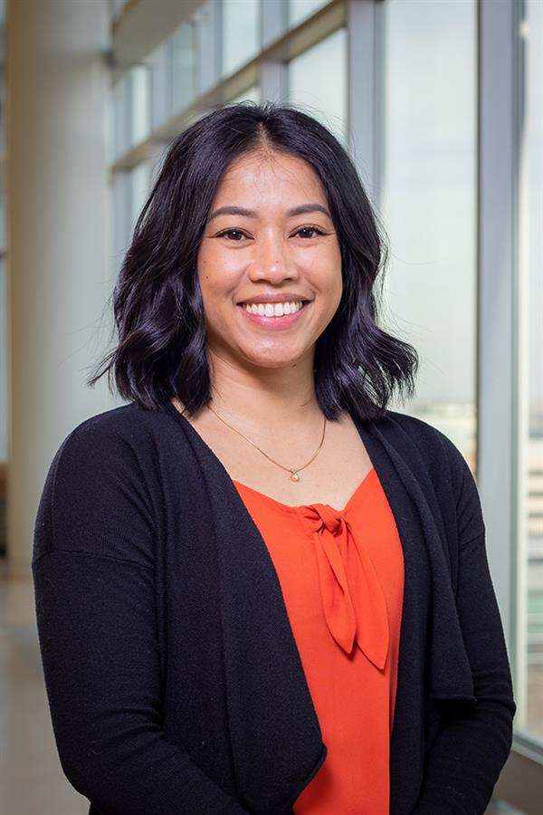
OVERVIEW
Working with Dr. Phoutdavone “Noy” Phimphasone-Brady PhD
Clinical health psychologist
Specific training in women’s physical and mental health
Focuses on PCOS, type II diabetes and weight management
Implementation science researcher

Slide 4
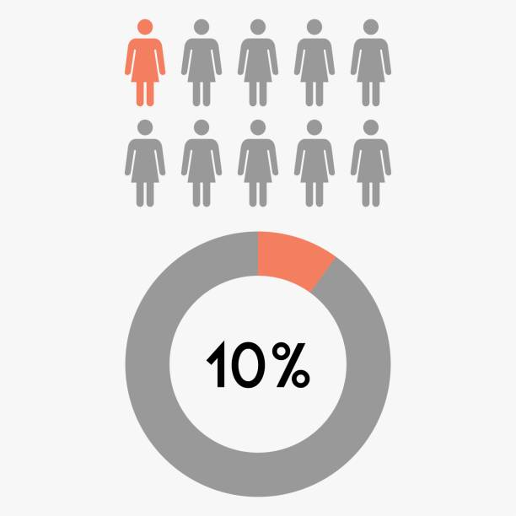
Background
More than 37 million Americans (1 in 10) are living with Type II Diabetes Mellitus
Besides provider-sanctioned ways of managing diabetes (exercise, diet, medicine), people with T2DM can engage in disordered eating behaviors (DEB)
DEB: induced vomiting, dietary restraint, compensatory behaviors

Slide 5
02
BEET (Balanced and Empowered EaTing)
Diabetes Study
Mixed Methods Intervention study looking at disordered eating behaviors in those with Type II Diabetes Mellitus
How to tackle them using Cognitive Behavioral Therapy
Hypothesis: Treating DEB should be a necessary and necessary component for successful diabetes management
Notes:
Supported by the NIH-funded Building Interdisciplinary Research Career’s in Women’s Health (BIRCWH) K12 Program
Treating the symptoms of ed, but people do not need to meet diagnostic criteria for ed to qualify (trying to treat subclinical population)
Insert slide on intervention + treatment

Slide 6
AIMS IN BEET STUDY
PROVIDER PERSPECTIVE
PATIENT FEEDBACK
Looking at the knowledge and skill sets of providers to see what barriers to treating DEB in those with T2DM exist
Having patients provide feedback on intervention and their satisfaction
05
04
03
02
REFINEMENT
01
Refining the intervention according to feedback and data analysis, improving CBT
EXPERIMENTATION
Conducting a pilot trial to look at how effective CBT is in treating DEB in diabetes
RELATIONSHIP
Looking at the relationship between DEB and diabetes, as well as variations caused by gender

Slide 7
METHODS IN BEET STUDY
SAMPLE
~ 50 patients
~ 20 providers
18-65 years, inclusive
Type 2 diabetes diagnosis
Screening for DE score >/= 2
DURATION
METHODOLOGY
1 Month
6 Months
All interviews recorded
Mixed methods analysis, meaning quantitative and qualitative data is integrated
** Not a therapy session
Treating symptoms of ED, but trying to treat subclinical population
Notes:
List primary outcomes in next slide
Each aim has different outcome (can do that in slide 6)
Recreate schedule of events in slide

Slide 8
Intervention
14 pre-intervention surveys (including ACEs, DEPS-r, EDDS)
6 sessions over 9 weeks
Cognitive Behavioral Therapy (CBT) Techniques
1. Getting Started
2. Establish regular pattern of eating and activity
3. Alternatives to Disordered Eating
4. Problem Solving
5. Dieting and Related forms of Avoidance
6. Maintenance & Relapse Prevention
Supported by the NIH-funded Building Interdisciplinary Research Career’s in Women’s Health (BIRCWH) K12 Program

Slide 9
03
My Research
Research Question: To what extent should childhood trauma and disordered eating behaviors be looked at together in people with Type II Diabetes?

Slide 10
Why?
The relationship between childhood trauma and disordered eating behaviors is not often looked at with people who are living with T2DM.
Notes:
Understanding potential effects of adverse childhood experiences, such as likelihood of DEB, can provide a level of understanding for those with eating disorder psychopathology.
Those who engage in DEB can realize the negative psychological and physical impacts of DEB on their bodies

Slide 11
Methodology
Case Study
Operational Definitions
I am looking at two BEET study participants, Participant E and Participant S, and their ACE scores, DEPS-r scores, EDDS responses.
ACEs – Adverse Childhood Experience Questionnaire. 10 questions, score of 2+ is considered “high ACE”
DEPS-r – Diabetes Eating Problems Survey. 16 questions, score of 20+ indicates a level of disordered eating warranting further attention.
EDDS – Eating Disorder Diagnostic Scale. 22 questions.

Slide 12
Case Descriptions
Participant E
58 year old Black female, 47.9 BMI, HbA1c level 7.0
First diagnosed in 2008
Has attended educational diabetes classes, has received behavioral health counseling but has not seen a diabetes-specific counselor
Living with asthma, hyperlipidemia, hypertension, and obstructive sleep apnea
DEPS-r Score: 33
Participant S
46 year old white female, 42 BMI, HbA1c level 7.3
First diagnosed in 2018
Has not received any education about diabetes, has not received any behavioral health counseling
Living with hypertension and polycystic ovarian syndrome (PCOS)
DEPS-r Score: 34
Ace score of 6
Answered YES to question 10 of EDDS

Slide 13
Results
Both Participant E and Participant S have ACE scores of 6, classifying them as “high ACE.”
When a report was pulled of those with the highest DEPS-r scores, it was revealed that Participant S had a score of 34, the second highest in the study, and Participant E had a score of 33, the third highest.
In the EDDS surveys, both participants answered YES to question 10, asking if they eat large amounts of food even when they are not hungry. Participant E answered question 16 by saying she had fasted (skipped meals) about 10 times per month.

Slide 14
Graphed Results
Participant E
Participant S

Slide 15
”I've been struggling a little bit with depression. You know, of course, I have a little depression around the diabetes, but again, other things in life, not just diabetes… I don't have the energy or the motivation to get up and walk, even though I want to”
Pre-Intervention Interview testimony

Slide 16
“It's not necessarily the diabetes, but it affects my diabetes. Other things. The life things. Because it causes me to emotionally eat. Emotionally eating"
Pre-Intervention Interview testimony

Slide 17
04
Reflections
Conclusions
Limitations
What I learned

Slide 18
Conclusion & Observation
We can infer that a connection exists between adverse childhood experiences and a later experience of eating disorder psychopathology in those with diabetes
There seem to be other confounding factors, such as depression, that could be interesting to explore in tangent with DEB.
Further studies should be conducted examining this connection on a broader level (more participants, more variables).

Slide 19
Limitations
Case Study did not include any male participants
Case Study did not include Spanish-speaking participants
Notes:
Lack of knowledge ab men w T2DM and DEB, also could’ve compared experiences based on gender
Talk ab participant who also had ACE score of 6, DEPS-r of 29 Talk about R1, who has same ACE score of 6, deps-r score of 29, also binge eats and skips even more meals than participant E, skips 13.
Mainly about inclusion and could’ve been exposed to more information or greater awareness of differences and variations

Slide 20
Reflecting on my Experience
Gained a lot of awareness concerning research and its avenues
Worked with a wonderful team
Familiarity with RedCap, reaching out to participants, observing intervention sessions
Mentorship
Opportunities for learning

Slide 21
Acknowledgements
Phoutdavone “Noy” Phimphasone-Brady, PhD - PI
Paul Dormond-Brooks, Research Coordinator
Perla Rodriguez, Research Assistant
Devin Rodriguez, Research Assistant
Zachary Giano, PhD, Biostatistician
Dr. Ron-Li Liaw, Chair of PMHI
Dr. Neill Epperson, Chair of Department of Psychiatry
Dr. Dominic Martinez, Dir. Office of Inclusion and Outreach, CCTSI
Emmaly Perks, Director PURPLE Program
Yunliang (Lily) Luo, Assistant Director PURPLE Program
Shanna Trott, PURPLE Program Coordinator
Dr. Lindsey Rogers
Dr. Neill Epperson’s lab group

Slide 22
THANKS!
Please keep this slide for attribution

