Slide 1
Associations of Parental Self-efficacy and Parenting Practices in a Clinical Sample
By Naomi Tubbs and Jacob Holzman, PhD

Slide 2
Background
Parental self-efficacy and parenting practices are associated with child behavioral concerns
Parental self-efficacy can be described as an individual's beliefs in their own capabilities as a parent
Past research has shown that increased parental self-efficacy is associated with more positive parenting and less inconsistent discipline
This increase in effective parenting has been shown to be linked to decreased child behavioral concerns

Slide 3
The Current study
Hypotheses
The current study aimed to identify how parental self-efficacy and effective parenting styles can affect child behavioral concerns in a clinical sample
Less research has been done examining these factors in a treatment seeking sample
Results from this study will help identify the factors that should be targeted in clinical interventions concerning child behavioral concerns
1. Parental self-efficacy will be positively associated with effective parenting practices. Specifically, increased self-efficacy will be linked to increased positive parenting and decreased inconsistent discipline.
2. Child behavioral concerns will be inversely associated with effective parenting practices. Specifically, increased behavioral concerns will be linked to decreased positive parenting and increased inconsistent discipline.
3. Parental self-efficacy will be inversely associated with child behavioral concerns. In that, parents with higher self-efficacy will have children with fewer behavioral concerns.

Slide 4
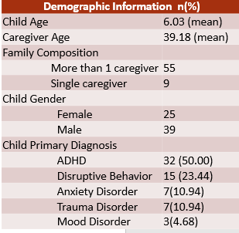
Methods
Following IRB approval, charts of 64 children whose caregivers participated in a brief parenting group were reviewed.
Prior to treatment, caregivers completed several surveys assessing:
Child behavioral concerns were investigated both in terms of the frequency and how problematic the behavioral concerns are.
Child’s behavioral concerns: Eyberg Child Behavior Inventory
Parenting Efficacy: Parenting Sense of Competence – Parenting Self-Efficacy Scale
Parenting Practices: Alabama Parenting Questionnaire – Short Version

Slide 5
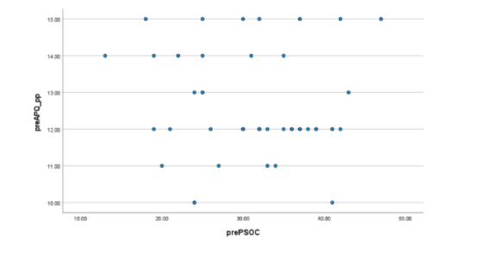
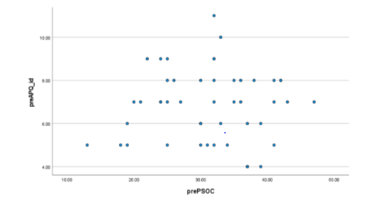
Results
Inconsistent Discipline and Self-Efficacy
We did not find a significant relationship between parental self-efficacy and effective parenting practices (p>.10).
Positive Parenting and Self-Efficacy

Slide 6
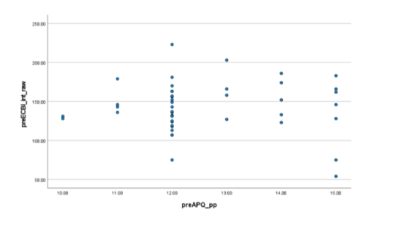
Positive parenting was not shown to be significantly associated with child behavioral concerns (P>.10).

Slide 7
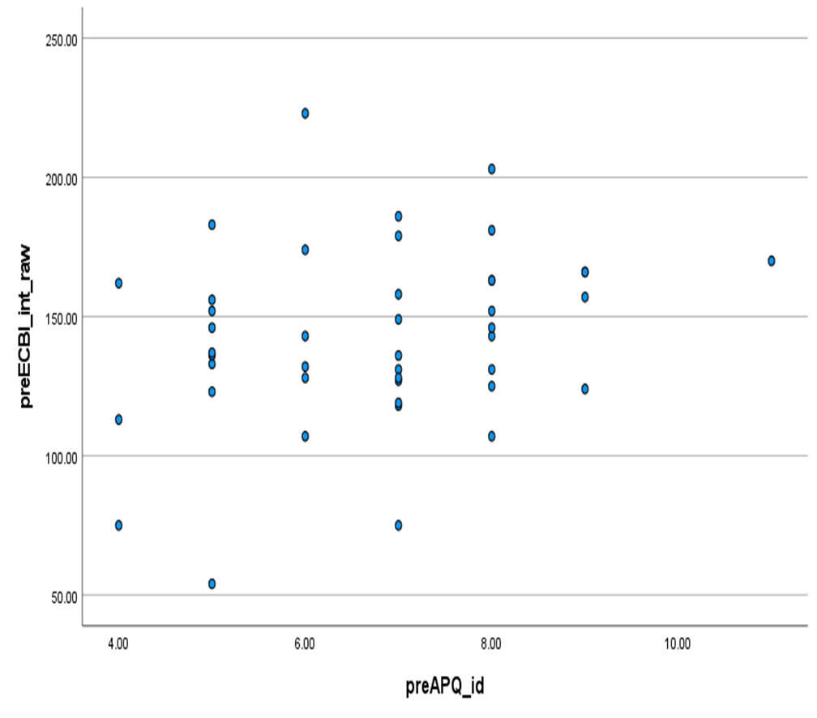
Increased inconsistent discipline was shown to be marginally positively associated with child behavioral concerns (p=.06, p=.08).

Slide 8
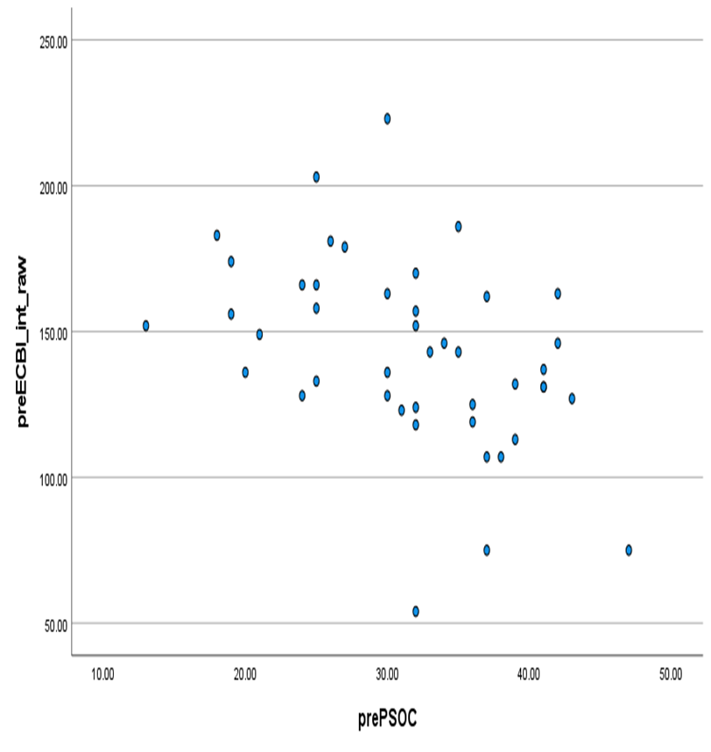
Parental self-efficacy was significantly inversely associated with child behavioral concerns (P<0.05, p<0.05).

Slide 9
Correlations
Variable | 1 | 2 | 3 | 4 | 5
1. Parenting Efficacy | 1.0 | -.068 | .031 | -.434 | -.360
2. Positive Parenting |  | 1.0 | -.165 | -.023 | -.186
3. Inconsistent Discipline |  |  | 1.0 | .268 | .285
4. Child Behavioral Concerns Frequency |  |  |  | 1.0 | .860
5. Child Behavioral Concerns Problem |  |  |  |  | 1.0

Slide 10
Discussion
There is marginal evidence that increased levels of inconsistent discipline is associated with increased child behavioral concerns. More data is needed to confirm this.
A possible explanation for why we did not see parental self-efficacy effecting parenting style could be because the sample used was a treatment-seeking population with high levels of behavioral concerns.
Since we found clear evidence that parental self-efficacy is linked to child behavioral concerns in a clinical sample, this could provide insight into what should be targeted in clinical interventions for children with behavioral concerns.

Slide 11
Limitations
One limitation of this study is that it is a nonexperimental design, meaning none of the variables were manipulated.
Another limitation of this study is that it was a small sample size.
Finally, our measurements were self-report, which is not always an accurate measure.

Slide 12
Acknowledgments
Thank you Dr. Holzman for this opportunity and for all his help throughout the process.
I would also like to thank Dr. Douglas Novins, Dr. Neill Epperson and Dr. Dominic Martinez for providing funding to this program and granting me this opportunity.
Thank you Emmaly Perkins and Lily Luo for all your help and support.

