Slide 1
How Ethnic Speech Patterns Might Influence Disorganized Communication Ratings in Psychosis Assessments
It Be Like That:
Shanna Trott
Program for Early Assessment, Care, & Study (PEACS)
& PURPLE Program 2021
Mentor: Michelle West, PhD

Slide 2
Background

Slide 3
What is Psychosis?
Trouble differentiating between what is real and not real
Positive psychotic symptoms: delusions, paranoia, grandiosity, hallucinations, disorganized communication
Negative psychotic symptom: flat affect, reduced motivation, reduced feelings of pleasure
Notes:
“The word psychosis is used to describe conditions that affect the mind, where there has been some loss of contact with reality” - NIMH

Slide 4
Clinical High Risk for Psychosis (CHR-p):
A term that describes a person with clinical characteristics that imply increased risk for psychosis, before onset of fully psychotic symptoms
Structured Interview for Psychosis Risk Syndromes (SIPS):
Interview used to assess and help diagnose psychosis disorders
SIPS P5 Scale: Measures disorganized communication on a scale of 0 – 6
Has clear & compelling power to predict the onset of schizophrenia within the near future

Slide 5
Disorganized Communication
Psychosis symptom and a collection of speech abnormalities that can make a person's verbal communication difficult to comprehend
African American Vernacular English (AAVE)
A Dialect employed by Black Americans and Canadians that has its own unique grammatical, vocabulary, and accent features
Vague, metaphorical, overelaborate speech
Difficulty directing sentences toward a goal
Irrelevant to context
Loose associations (may make speech hard to follow or unintelligible)
AAVE is spoken most consistently by working-class African Americans, particularly in urban areas
Not all Black Americans use AAVE and many AAVE users can also use Standard American English

Slide 6
African Americans are 4x more likely to be diagnosed with schizophrenia than their white counterparts. – Lawson, 2008
VS.

Slide 7
AAVE Stigma
AAVE use can trigger discrimination in the workplace, housing market, schools, and the legal system
On average Philadelphia court reporters correctly transcribed only 59.5 % of AAVE utterances
Miscommunications caused by lack of familiarity with AAVE have even gone so far as to have court witnesses dismissed for lack of credibility

Slide 8
Rachel Jeantel
Key Witness in Trayvon Martin Case
Fluent in AAVE
During testimony she was often misheard or asked to repeat herself
Jurors and attorneys found her hard to understand and called her uncredible

Slide 9
Video: Rachel Jeantel Juror

Slide 10
Research Question

Slide 11
Do clients who use African American Vernacular English (AAVE) receive different clinical assessments on disorganized communication during psychosis assessments than clients of the same race who do not use AAVE?
Hypothesis: AAVE speakers will receive higher scores on the P.5 scale (disorganized communication) than clients who are not AAVE speakers.

Slide 12
Methods
Pilot Data
Limitations
Future Study Design

Slide 13
Pilot Data

Slide 14
Pilot Data
The F ratio is low (.162) and not significant (p=.688), indicating there is
no significant difference between groups for this scale

Slide 15
Limitations of Pilot Data

Slide 16
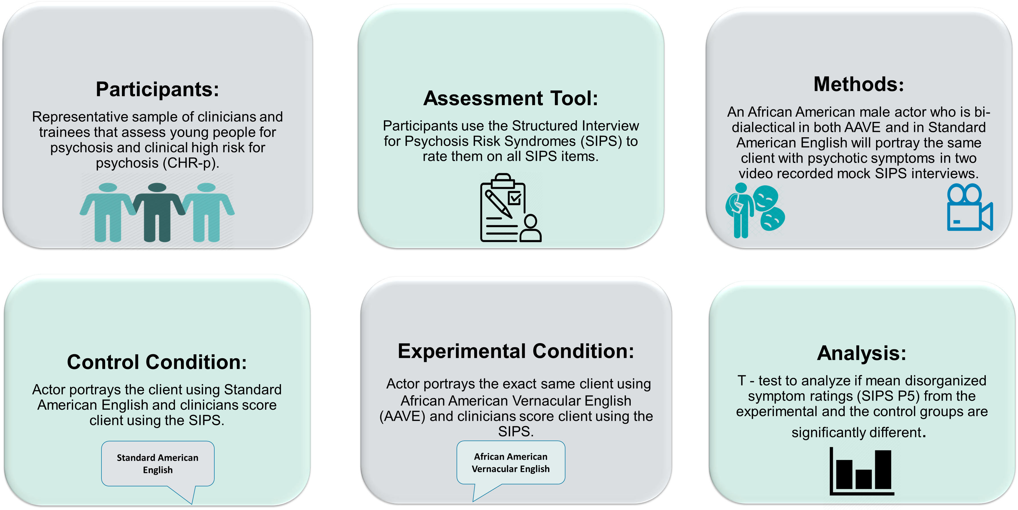
Future Study Design

Slide 17
Key Takeaways

Slide 18
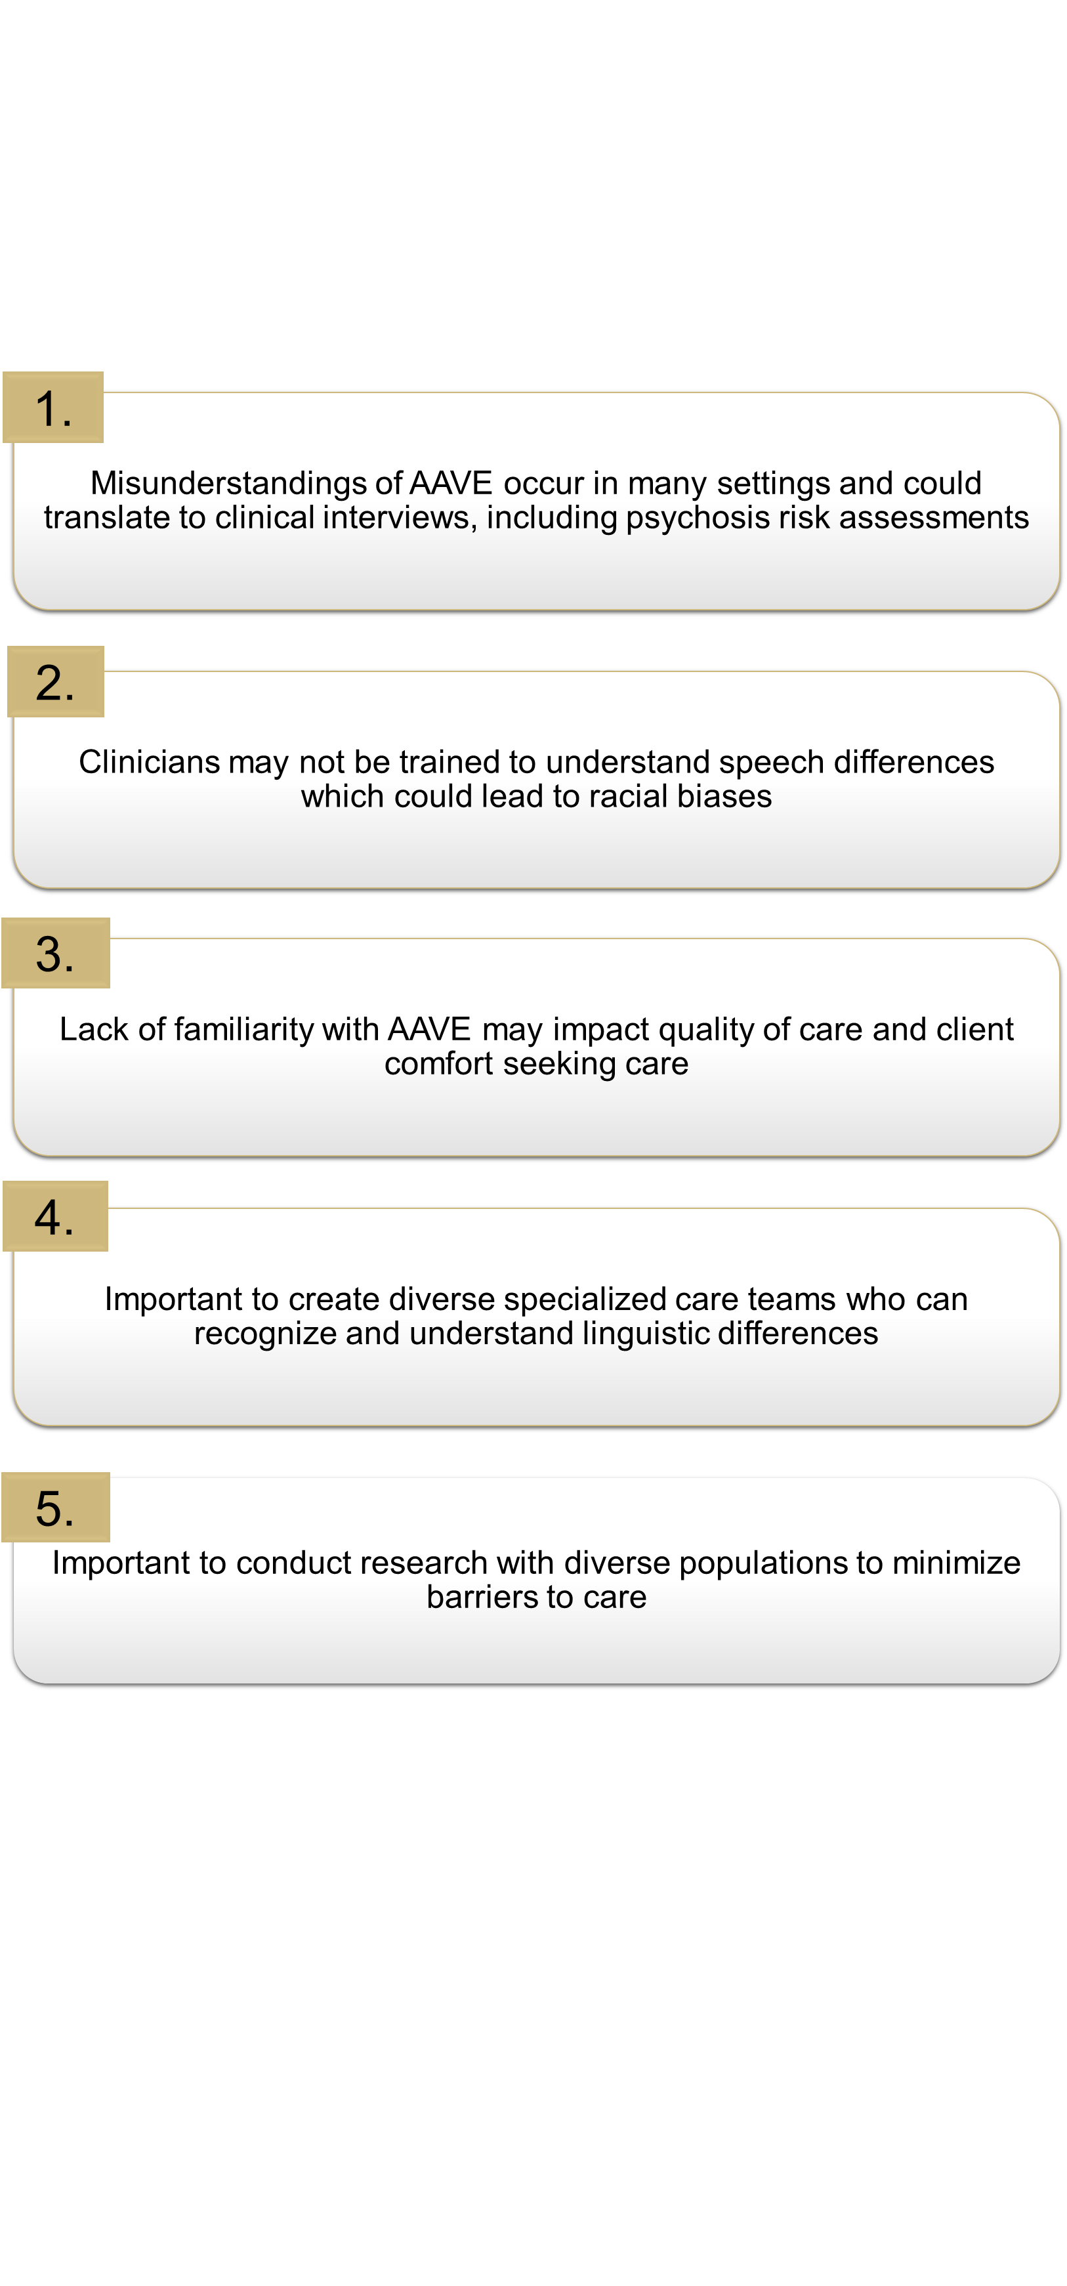
Key Takeaways

Slide 19
Acknowledgments
Dr. Michelle West, Director of PEACS Program
Dr. Douglas Novins, Chair of PMHI
Dr. Neill Epperson, Chair of Department of Psychiatry
Dr. Dominic Martinez, Dir. Office of Inclusion and Outreach, CCTSI
PEACS Team Members:
Shadi Sharif
Christine Reed
Charlie Buteyn
Dr. Melissa Batt
PURPLE Coordinators:
Lily Luo
Emmaly Perks
Dr. Merlin Ariefdjohan

Slide 20
Questions?

