Slide 1
Evaluation of Generalization When Training Stimulus Preference Assessments
Maria I. Torres Dominguez¹, Patrick W. Romani^{1,2},
Andrea L. Boorse¹, and Sophia B. Silver¹
1 Pediatric Mental Health Institute, Children’s Hospital Colorado; 2 School of Medicine, University of Colorado (Anschutz Medical Campus)
Notes:
Thank you for attending today’s presentations. My name is Maria Torres I am an undergrad student at the university of Colorado Denver , I am pleased to present this presentation titled Evaluation of generalization when training stimulus preference assessments. I would like to begin by thanking my mentor Dr. Patrick Romani, and my co- authors Andrea Boorse, and Sophie Silver.

Slide 2
Introduction
The use of positive reinforcement in the context of behavioral treatment is a common and important practice (Karsten & Carr, 2009).
To identify positive reinforcers, stimulus preference assessments are often used
MSWO (DeLeon & Iwata, 1996)
Paired Stimulus (Fisher et al., 1992)
Single Stimulus (Pace et al., 1985)
Competing Stimulus (Piazza et al., 1998)
Free Operant (Roane et al., 1998)
Notes:
Positive reinforcement is a common tool used to address behavioral excesses and deficits among children and adults with autism spectrum disorders.
To identify positive reinforcers, practitioners use stimulus preference assessments. The most common assessments used are the multiple stimulus without replacement referred as the MSWO, paired stimulus, single stimulus, competing stimulus, and free operant preference assessments.
Single: 13:50
Paired 18:12
MSWO 18:30
FO 21:30

Slide 3
Preference Assessments
Single Stimulus
Paired Stimulus
Multiple Stimulus Without Replacement (MSWO)
Free Operant
Competing Stimulus
Notes:
Single stimulus: one item is presented at a time and we are tracking the amount of time that is engaged with item selected
Paired: two items are presented and we are tracking the frequency of item selection
MSWO: All items are presented at once and we are tacking the order the items are selected
FO : All items are presented at once and we are tracking amount of time the person engages with the item
Competing stimulus: Present one item at a time and measure amount of time the person engages with the item and the behaviors that happen when the person is engaged or not engaged with the item
Single: 13:54
Paired 18:12
MSWO 18:30
FO 21:30

Slide 4
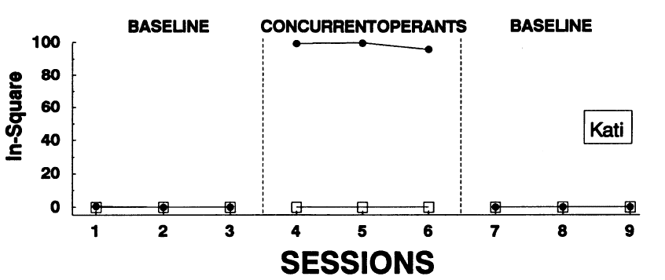
Fisher, W., Piazza, C. C., Bowman, L. G., Hagopian, L. P., Owens J. C., & Slevin, J. (1992). A comparison of two approaches for identifying reinforces for persons with severe and profound disabilities. Journal of Applied Behavior Analysis. 24, 491-498. doi: 10.1901/jaba.1992.25-491
Notes:
The results of preference assessment procedures produce data showing which stimuli are more or less preferred. Research shows that more preferred stimuli tend to function better as positive reinforcers than less preferred stimuli. These data was borrowed from Fisher and colleagues studying validating the paired stimulus preference assessment. Here we note that at baseline, this child, Kati, did not stand in a square, which was one of the target responses in this study.

Slide 5
Fisher, W., Piazza, C. C., Bowman, L. G., Hagopian, L. P., Owens J. C., & Slevin, J. (1992). A comparison of two approaches for identifying reinforces for persons with severe and profound disabilities. Journal of Applied Behavior Analysis. 24, 491-498. doi: 10.1901/jaba.1992.25-491
Notes:
When a high-preferred stimulus was available after tanding in the square, Kati was more likely to do so

Slide 6
Fisher, W., Piazza, C. C., Bowman, L. G., Hagopian, L. P., Owens J. C., & Slevin, J. (1992). A comparison of two approaches for identifying reinforces for persons with severe and profound disabilities. Journal of Applied Behavior Analysis. 24, 491-498. doi: 10.1901/jaba.1992.25-491
Notes:
compared to when the low-preferred stimulus was delivered after standing in the square, These data showed that the higher preferred stimuli in the preference assessment was a more effective reinforcer than a lesser then the lower preferred stimuli.

Slide 7
Training others
First reviewing instructions
Modeling correct implementation of the procedure
Followed by immediate feedback and rehearsal
Roscoe and Fisher (2008) taught direct-care staff to implement the paired stimulus and MSWO preference assessments.
Behavioral skills training (BST)(Parsons, Rollyson, & Reid, 2012)
We conducted a literature review to identify what preference assessments are most commonly taught to direct-care staff.
Out of 10 studies, 8 taught the MSWO, 7 taught the paired stimulus, 3 taught the free operant, and no studies taught the single stimulus or competing stimulus assessment.
Notes:
Because preference assessments are so essential to everyday behavior analytic practice, much research has been conducted in evaluating how to train others to implement these assessments. In one example, Roscoe and Fisher in 2008 taught direct care staff to implement the paired stimulus and MSWO preference assessments using behavioral skills training referred as BST. BST is a structured approach to training that involves first reviewing instructions and then modeling correct implementation of the procedure followed by immediate feedback and rehearsal. Using this approach, Roscoe and Fisher were able to successfully train these staff to implement the preference assessments.
On our end, We conducted a literature review to evaluate the efficacy of BST to train preference assessment procedures and to identify which preference assessments are most commonly taught. We found that 80% of the studies taught the MSWO, 70% taught the paired stimulus, 30% taught the free operant, and no studies taught the single stimulus or competing stimulus assessments. Of note, too, when preference assessments were trained, only one was taught at a time. This may be inefficient for settings that need staff to know more than one preference assessment procedure before working with patients or clients.

Slide 8
Study Objectives
How many preference assessments need to be trained before participant shows improvement on untrained preference assessments?
Does teaching certain preference assessments interfere with acquisition of skills for the other preference assessments?
Notes:
Our study had two objectives. First, we evaluated how many preference assessments needed to be mastered before a participant would show generalization to untrained preference assessment procedures. Second, we evaluated whether learning certain preference assessments before others interfered with acquisition of skills for the other assessments.

Slide 9
Method: Participant and Setting
Participant:
Mental health counselor
No prior experience with applied behavior analysis or implementing preference assessments
Setting:
Therapy room (6.0 m x 6.0 m) → a table and two chairs.
Notes:
Today we are presenting data from one participant enrolled in a larger study. We selected this participant because they needed to be trained on more than one assessment before generalization to untrained preference assessments occurred. The participant was a mental health counselor on a university based inpatient unit for children with intellectual or developmental disabilities engaging in problem behavior. They had had no prior experience with applied behavior analysis or preference assessments. This study took place in a therapy room measure 6 m by 6 m that contained a table and two chairs.
Shorted this slide :

Slide 10
Experimental Design
The current study took place within a multiple probe across preference assessments design (Kennedy, 2005).
Notes:
The current study took place within a multiple probe across preference assessments design.

Slide 11
Experimental Design
Notes:
Experimental control is established within a multiple probe design because we are collecting individual baselines for performance for each of the preference assessments.

Slide 12
Experimental Design
Notes:
After establishing consistent response patterns, we introduce the independent variable, which was BST for the current study, systematically to one baseline at a time.

Slide 13
Experimental Design
Notes:
We waited until a change in response pattern occurred following that training and then introduced BST to the next baseline to show the effect of BST and to evaluate when generalization occurred to untrained preference assessments.

Slide 14
Dependent Variables
Protocol integrity was defined as steps on the preference assessment protocols correctly implemented.
These data were represented as a percentage (frequency of correct implementation divided by frequency of correct plus incorrect implementation multiplied by 100).
Notes:
The dependent variable for the current study was protocol integrity. We defined protocol integrity as steps on the preference assessment protocol correctly implemented. These data is represented as a percentage.

Slide 15
Procedures : Main Study
Notes:
How did we conduct this study? Well, This study took place with three conditions Baseline, BST and Maintence, Baseline is evaluating where the participant stands in implementing the preference assessments with just reading protocol. Secondly implementing BST and noting if improvement was Maintained after BST

Slide 16
Baseline:
Participant was given preference assessment protocol
Protocol restricted from participant. Materials given to participant to implement preference assessment.
Experimenter responded to the participant’s implementation of the assessment based on a confederate protocol.
After finishing assessment, participant graphed and interpreted data.
Notes:
For Baseline , sessions began with the experimenter and participant entering the therapy room together. The experimenter gave the participant the relevant protocol for the preference assessment they were expected to conduct. After 5 min, the experimenter took the protocol away from the participant and gave them five toys to conduct the preference assessment with. As the participant conducted the assessment, the experimenter responded based on their own protocol. For example, at times during the paired stimulus preference assessment, the experimenter took two toys when they were only supposed to take one at a time. In this case, the participant was expected to interrupt the experimenter and re-present the instruction to select only one toy. After finishing the assessment, the participant graphed their data using Microsoft Excel and interpreted their data. That is, they noted which toys were high, medium, and low preferred.

Slide 17
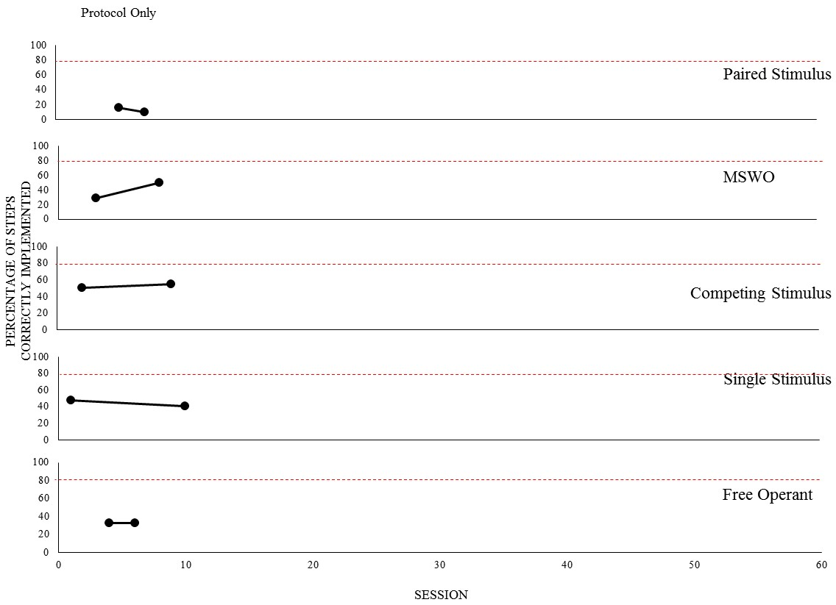
Notes:
These data here represents baseline responding for this participant. The x axis represents sessions

Slide 18
Notes:
And the y axis represents percentage of steps correctly implemented when the participant was directed to implement each preference assessment protocol
Note that on this side we break down this graph into all five preference assessments

Slide 19
Notes:
As can be seen, this participant’s integrity with implementing each preference assessment protocol procedure was exhibited at low to moderate levels.

Slide 20
Behavioral Skills Training (Parsons, Rollyson, & Reid, 2012)
Participant struggled to implement the paired stimulus the most
1
Experimenter described and provided written description of each step of protocol. Answered any questions participant had.
2
Experimenter modeled each step of the targeted preference assessment and had participant practice until they implemented steps without assistance.
3
Notes:
Due to the skill deficits recorded during the initial baseline, we implemented BST with the preference assessment the participant struggled to implement the most. In this case, it was the paired stimulus preference assessment. The experimenter and participant entered the therapy room together again . They sat across from one another at a table. The experimenter then reviewed each step of the preference assessment with the participant. Afterwards, the experimenter modeled how to conduct those steps. For example, we found this participant did not consistently allow the experimenter to have 30 seconds access to the toy that was selected. Thus, to model this step, the experimenter showed the participant how to use a timer to measure 30 seconds. After modeling each step, the experimenter allowed the participant to practice the assessment and provided immediate error correction and feedback as necessary until they implemented all steps without assistance..

Slide 21
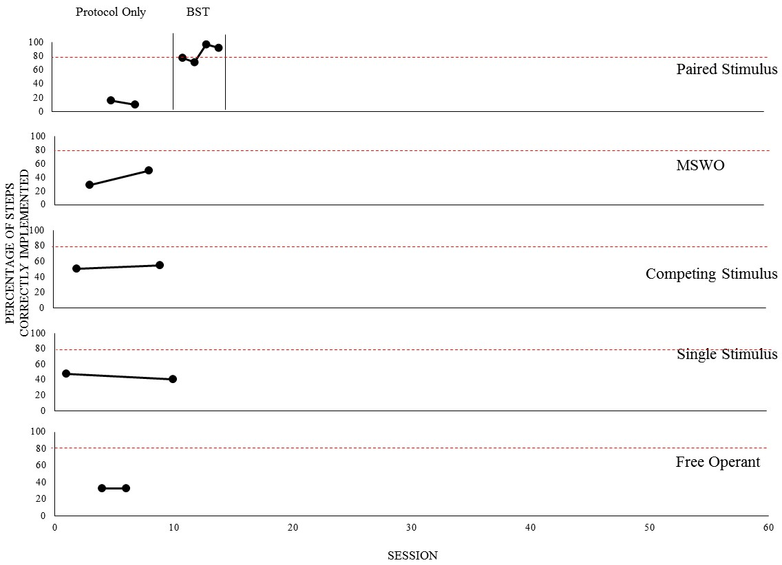
Notes:
Following BST, this participant implemented the paired stimulus preference assessment well. Their performance increased to above 80% for two consecutive sessions.

Slide 22
Maintenance
Same procedures as Baseline.
Notes:
After implementing BST and showing improvements in integrity, the participant transitioned back to baseline for all assessments. This was done to first measure the maintenance of their improvements without experimenter feedback and to monitor for generalization to other untrained preference assessments

Slide 23
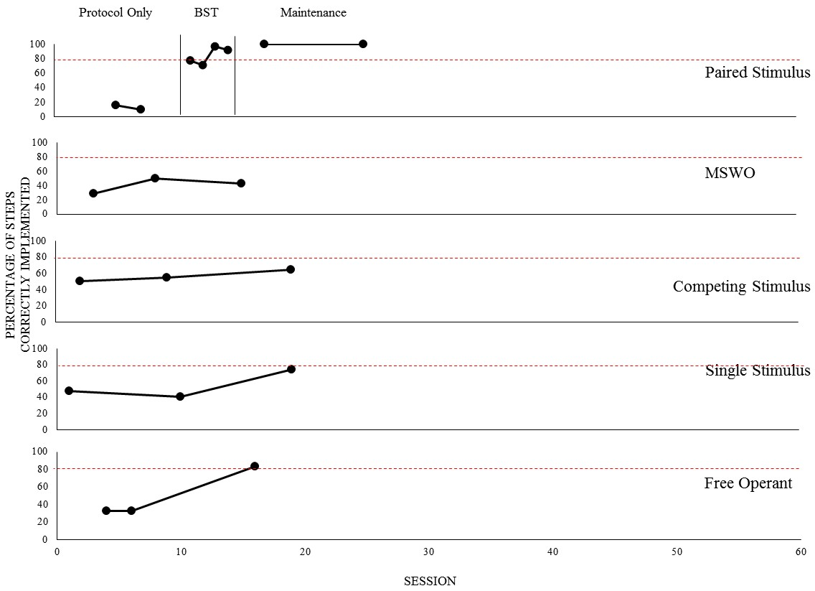
Notes:
As can be seen during the return to baseline, the participant’s improved integrity following BST for the paired stimulus assessment maintained. But They continued to demonstrate deficits in implementing the other preference assessments.

Slide 24
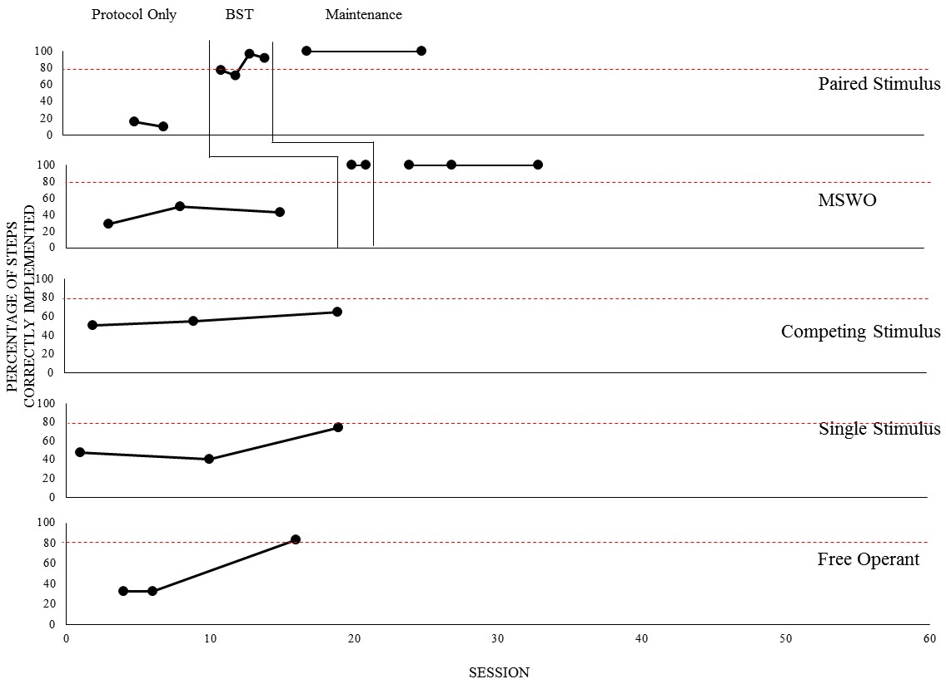
Notes:
As such, we implemented BST for the next preference assessment, the MSWO in this case. As can be seen, integrity increased following BST and was maintained during a return to baseline.

Slide 25
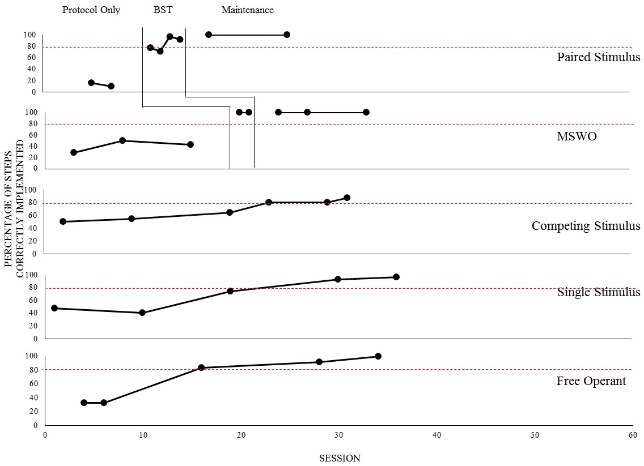
Notes:
Interestingly, integrity with implementing all other preference assessments increased following training on the MSWO preference assessment. This participant implemented sessions of each preference assessment with at least 80% integrity for all five assessments without having to implement BST or other training to the rest of the untrained preference assesments.
While overall integrity improved these data does not tell weather all skills associated with the preference assessment improved or whether if a majority did, but certain once did not
THUS

Slide 26
Procedures: Retrospective Study
Created Excel spreadsheet listing each step for each preference assessment in separate columns. Entered data on whether each step was implemented correctly or incorrectly for each session.
We divided data into conditions marked by the specific combination of assessments that had been taught and mastered by the participant.
Calculated percentage of times each step was implemented correctly to evaluate generalization of responding and potentially interfering conditions.
Notes:
THUS we investigated whether learning certain preference assessments interfered with acquisition of skills from other assessments. To do so, we created an excel spreadsheet listening each step for each preference assessment protocol in separate columns. We then entered data on whether each step was implementing correctly or incorrectly for each session. These data were then divided into conditions marked by the specific combination of assessments that had been taught and mastered by the participant. We used these data to calculate percentage of times each step was implemented correctly to evaluate generalization of responding and potentially interfering conditions.

Slide 27
Results
Notes:
These data represent percentage of accurate implementation for a subset of skills used on the competing stimulus, MSWO, and single stimulus preference assessments.

Slide 28
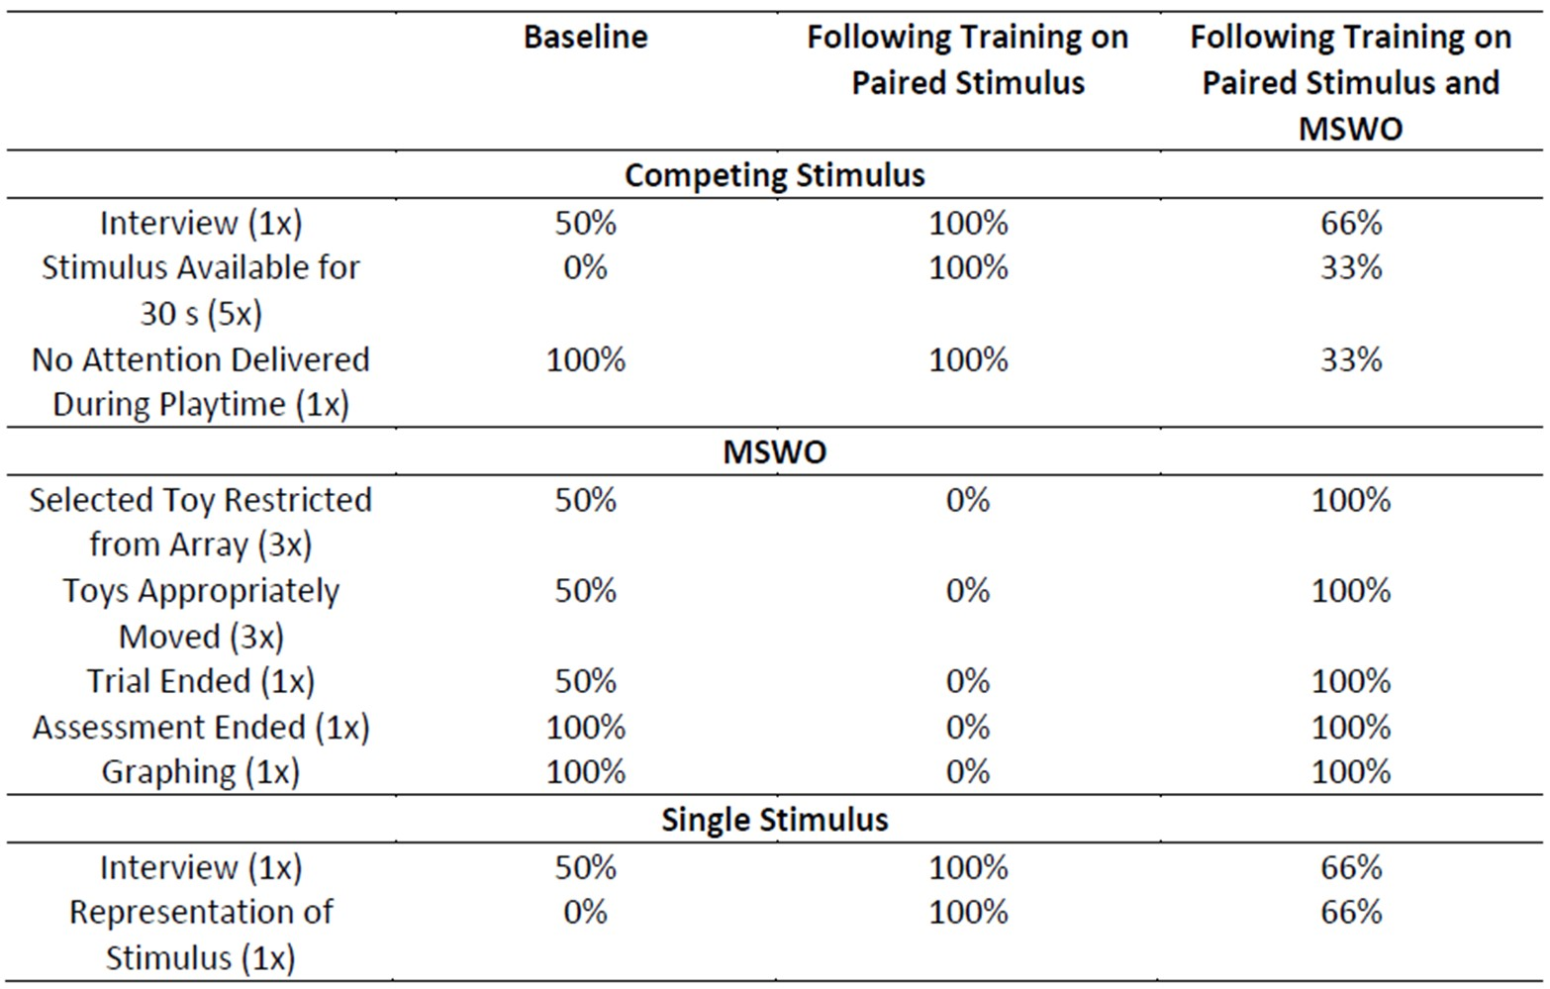
Results
Notes:
. Starting with the MSWO, for these five steps of the protocol, this participant implemented them with accuracy either 50% or 100% of the time.

Slide 29
Results
Notes:
Following training on the paired stimulus assessment, accuracy of implementation decreased for each of these steps. This participant did not implement any of them accurately.

Slide 30
Results
Notes:
After training on the MSWO assessment, accuracy of implementation increased to 100%.

Slide 31
Results
Notes:
Now let’s turn to the competing stimulus and single stimulus assessments. At baseline, this participant conducted these steps accurately either none of the time, 50% or 100% of the time during baseline.

Slide 32
Results
Notes:
Following training on the paired stimulus assessment, accuracy of implementation for each step increased to 100%.

Slide 33
Results
Notes:
But decreased once training on the MSWO preference assessment occurred.
As we can observe the paired stimulus affected in this case the MSWO and the MSWO training affected the competing stimulus and single stimulus

Slide 34
Discussion
BST effectively increased procedure integrity for the paired stimulus and MSWO preference assessments, which replicated previous research (Roscoe & Fisher, 2008).
Notes:
So what does all this mean? First , looking at this graph we note that BST effectively increased procedural integrity for the paired stimulus and MSWO preference assessments, which replicated previous research (Roscoe & Fisher, 2008).

Slide 35
Discussion
For this participant, training on two preference assessments (paired stimulus and MSWO assessments) were needed before generalization to untrained preference assessments occurred.
Notes:
As well For this participant, training on two preference assessments were needed before generalization to untrained preference assessments occurred.

Slide 36
Discussion
Following training on the paired stimulus preference assessment:
Reliable decreases in restricting the selected toy and moving the toys during the MSWO assessment occurred.
Notes:
Looking at this table ,
The most common errors that occurred on the MSWO preference assessment were restricting the selected toy, and moving the toy accurately after this participant was thaught the paired stimulus preference assessment these errors each occurred three times.

Slide 37
Discussion
Following training on paired stimulus and MSWO preference assessments:
Reliable decreases in having the toy available for 30 s occurred during the competing stimulus assessment.
Notes:
looking at the competing stimulus assessment we found consistent decreases in having the stimuli available for 30s following training on the paired stimulus and MSWO preference assessment. This error occurred 3 times.

Slide 38
Discussion
A second participant that needed to be trained on two preference assessments before generalization occurred demonstrated similar results.
Future prospective, study might evaluate a training package consisting of forced-choice preference assessments (paired stimulus and MSWO) with specific emphasis on when to restrict stimuli, move stimuli, and how long to have stimuli available for.

Slide 39
Limitation & Next Steps
A limitation of the current investigation was that we conducted this analysis for only two participants out of the five.
Future research should recruit additional participants to evaluate the current project’s research questions.

Slide 40
References
DeLeon, I. G., and Iwata, B. A. (1996). Evaluation of a multiple- stimulus presentation format for assessing reinforcer preferences. Journal of Applied Behavior Analysis. 29, 519-533. doi: 10.1901/jaba.1996.29-519
Fisher, W., Piazza, C. C., Bowman, L. G., Hagopian, L. P., Owens J. C., and Slevin, J. (1992). A comparison of two approaches for identifying reinforces for persons with severe and profound disabilities. Journal of Applied Behavior Analysis. 24, 491-498. doi: 10.1901/jaba.1992.25-491
Pace, G. M., Ivancic, M. T., Edwards, G. L., Iwata, B. A., and Page, T. J.(1985). Assessment of stimulus preference and reinforcer value with profoundly retarded individuals. Journal of Applied Behavior Analysis.18, 249 – 225. doi: 10.1901/jaba.1985.18-249
Piazza, C.C., Fisher, W. W., Hanley, G. P., LeBlanc, L. A., Worsdell, A. S., Lindauer, S. E., and Keeney, K. M.(1998).Treatment of pica thorough multiple analyses of its reinforcing functions. Journal of Applied Behavior Analysis. 31, 165-189. doi: 10.1901/jaba.1998.31-162
Roane, H. S., Vollmer, T. R., Ringdahl, J. E., and Marcus, B. A. (1998). Evaluation of a brief stimulus preference assessment. Journal of Applied Behavior Analysis. 31, 605-620. doi: 10.1901/jaba.1998.31-605

Slide 41
Acknowledgements
Mentor
Patrick W. Romani, Ph.D., BCBA-D
Directors
Merlin Ariefdjohan, PhD, MPH
Emmaly Perks, MA
Sponsors
Dr. Dominic Martinez (Office of Diversity and Inclusion, CCTSI, UCD)
Dr. Douglas Novins and Dr. Jennifer Hagman (PMHI, CHCO)
PURPLE Cohort

Slide 42
Questions?

