Slide 1
Coping and Calories:
Exploring the Relationship Between Meal Completion and Distress in Children and Adolescents with Eating Disorders
Kristen A. Torres,
Jennifer Hagman, MD & Robert Evans BS
Pediatric Undergraduate Research and Learning Experience
Children’s Hospital Colorado
University of Colorado
Anschutz Medical Campus

Slide 2
BACKGROUND
Eating Disorders have the highest mortality rate of any mental illness¹
Anxiety disorders are common in people with anorexia nervosa and bulimia nervosa²
The Ease of Eating Scale (EOES) was developed by Dr. Jennifer Hagman at Children’s Hospital Colorado’s Eating Disorder Program in 2006 to provide an objective measure of severity of food avoidance behaviors³
The EOES scale has been used daily in the program since 2006, but has not been validated and has not been studied in relationship to other measures currently being used in the program
Notes:
The EOES indicates 14 sections of FAB where the observer can circle 0 for no FAB, 1 for FAB and redirect, and 2 for FAB and unable to redirect
Examples of food avoidance behavior include cutting food into small pieces, refusal of food items, and 5 minutes to initiate intake of food
MASC- A multidimensional anxiety scale for Children ages 8-19. In the eating disorders program at CHCO, it is given as a baseline measurement. Scoring less than 40 indicates low levels of anxiety while anything above a 70 is elevated anxiety
SUDs is a self assessment score rated daily by patients in the Eating Disorders Program at CHCO to measure anxiety and stress on a scale from 0-10

Slide 3
MEAL COMPLETION MEASURES CONDUCTED IN THIS STUDY:
Rated by the person observing the patient during the meal
Ease of Eating Score: FAB + Meal Completion
FAB: 0-28
Meal Completion: 1-3
The meal time coping score: rated 3x a day for each meal
0= highly anxious, low coping, 1 = attempt of coping skills,
2 = successful coping skills
Ease of Eating Score
Meal Time Coping
Notes:
FAB: 14 FABs, 0 = not present, 1 = exhibits FAB but redirects, 2= unable to redirect
Examples of FAB: Extended time between bites, cutting food into small pieces, or refusal of food items
Meal completion: 1 is better than a 3. 1 indicates no problem completing meal

Slide 4
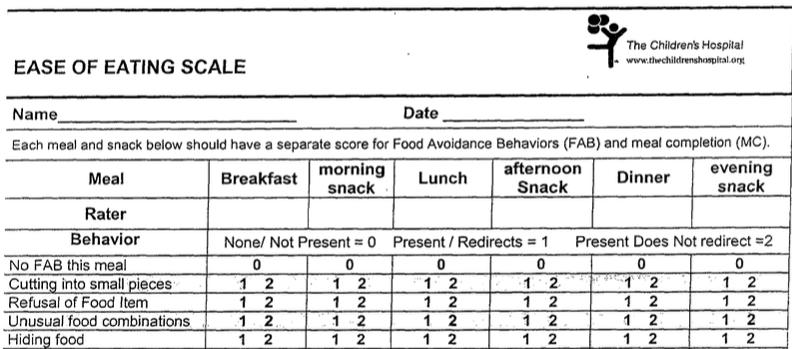
EASE OF EATING SCALE
Notes:
Provide more examples of what this looks like

Slide 5
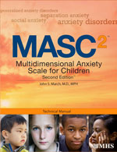
DISTRESS + ANXIETY MEASURES
Multidimensional Anxiety Scale for Children (MASC)⁴
A multi-rater assessment of anxiety in children and adolescents from ages 8-19
<40 = low anxiety
40-69 = elevated anxiety
70+ = extremely elevated anxiety
Subjective Units of Distress (SUDs)
Rated once a day, self-report measures of anxiety and distress (0-10)
0 = calm, no anxiety
10= extreme anxiety

Slide 6
RESEARCH OBJECTIVES
The primary goal of the project is to evaluate the use of the EOES in the Eating disorders program at CHCO and to explore the relationship between distress, anxiety and eating disorder behaviors
A secondary goal was to evaluate the efficiency of use of the EOES and other measures for the Eating Disorders team

Slide 7
HYPOTHESIS

Slide 8
HOW THE RESEARCH WAS CONDUCTED
Inclusion criteria:
3 meals scored a day using the EOES and for ten consecutive days (program days 2-11)
Baseline MASC score
Daily SUDS score
3 Meal time coping scores a day
Measures included in the study:
Ease of Eating Scale (EOES)
Multidimensional Anxiety Scale for Children (MASC)
Subjective Units of Distress (SUDs)
The meal time coping score
Observations and interviews were conducted with the EDU staff working with patients in the program
Pearson’s Correlation run with SPSS to evaluate the relationship between eating disordered behavior and stress and anxiety, and to evaluate change over time in each variable over the course of ten days
Notes:
An IRB approved retrospective chart review was conducted for patients treated in the Eating Disorders Program from 2015 – 2017
More on shadowing experience and more background on why Pearson’s Correlation

Slide 9
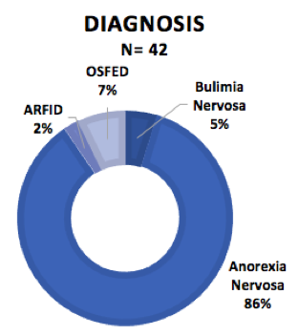
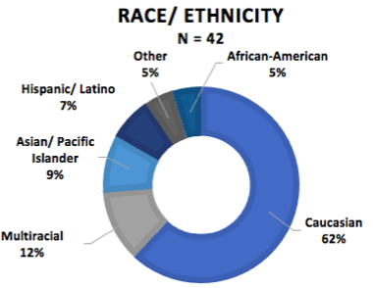
DEMOGRAPHICS AND RESULTS
100 charts were screened
42 subjects met the inclusion criteria
4 males and 38 females with average age of 15 with range of 13-19
The majority of the subjects were diagnosed with AN (86%)
Notes:
Avoidant Restrictive Food Intake Disorder

Slide 10
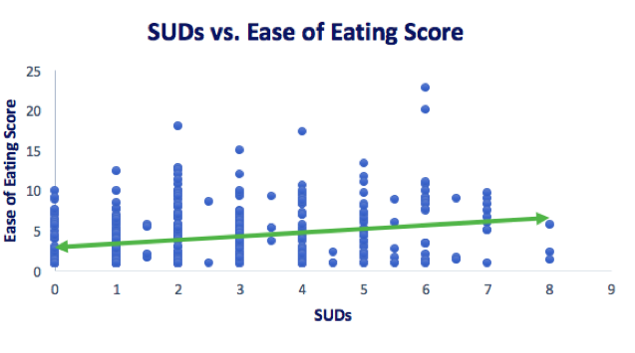
RESULTS
Correlation between SUDs and EOE = 0.263, P < 0.01
Elevated distress (SUDS) was significantly correlated with greater difficulty completing meals (higher EOES scores)
Notes:
EOE: 0-28, 28 meaning meal completion was difficult
SUDs: 0 meaning calm and 10 meaning extreme distress
Positive
Significant

Slide 11
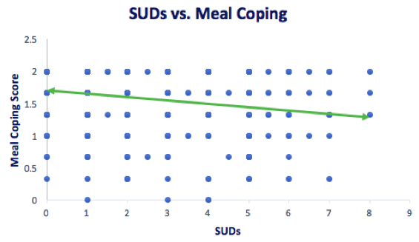
RESULTS
Correlation between SUDs and Meal Coping = -0.206, P <0.01
Better meal time coping was significantly negatively correlated with lower distress (SUDS)
Notes:
Meal coping: 0 is bad, 1 is attempted, 2 is coping well

Slide 12
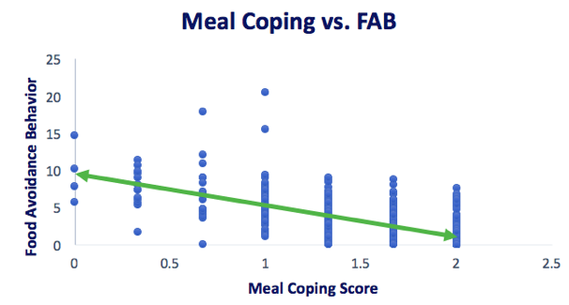
RESULTS
Correlation between Meal Coping and FAB =-0.674, P< 0.01
Higher Food avoidance behaviors were significantly negatively correlated with lower meal time coping
Notes:
X axis and Y axis
Better meal time coping was associated with fewer FAB and better meal completion

Slide 13
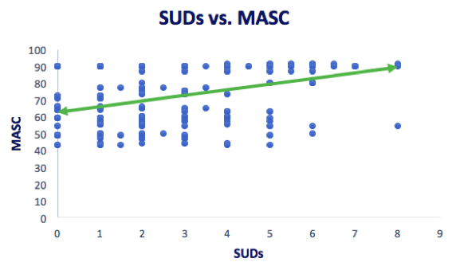
RESULTS
Correlation between SUDs and Baseline *MASC =0.40, P<0.01
Elevated Distress (SUDS) was positively correlated with
Higher Baseline Anxiety (MASC) Scores
(*average MASC = 71, SD 16.5)
Notes:
MASC, less than 40 is low anxiety, 40-69 elevated, 70+ extremely elevated

Slide 14
CHANGES OVER THE TEN DAYS IN PROGRAM
Distress (SUDS) decreased
Notes:
Add red box around table variable
Center numbers
FAB and EOE
Treatment is working

Slide 15
CHANGES OVER THE TEN DAYS IN PROGRAM
Distress (SUDS) decreased
Food Avoidance Behavior (FAB) decreased
Notes:
Add red box around table variable
Center numbers
FAB and EOE
Treatment is working

Slide 16
CHANGES OVER THE TEN DAYS IN PROGRAM
Distress (SUDS) decreased
Food Avoidance Behavior (FAB) decreased
Ease of Eating Scores (EOES) decreased
Notes:
Add red box around table variable
Center numbers
FAB and EOE
Treatment is working

Slide 17
CHANGES OVER THE TEN DAYS IN PROGRAM
Distress (SUDS) decreased
Food Avoidance Behavior (FAB) decreased
Ease of Eating Scores (EOES) decreased
Meal time coping scores increased
Notes:
Add red box around table variable
Center numbers
FAB and EOE
Treatment is working

Slide 18
WHAT DOES IT ALL MEAN?
The hypothesis was supported:
The EOES provides a useful measure of food avoidance behaviors in teens with eating disorders
The EOES score was positively correlated with measures of anxiety and distress
Notes:
as higher distress and anxiety was correlated with difficulty completing meals in the Eating Disorders Program
The average MASC score was a 71.25 indicating that children and adolescents in the Eating Disorders Program have elevated anxiety in general
Over the course of ten days in program, SUDs, EOES, and FAB has significantly decreased while meal coping has significantly increased

Slide 19
CHALLENGES
Patients under age 12 did not meet criteria for this study
Manual chart review
SUDs were not in the flowsheet
Different mental health counselors or parents score meals each day
Notes:
1. for this study because the program did not use the SUDS scale with children until 2016
2. The chart review of the 42 participants was done by hand, making human error more possible and limiting the number of subjects
3. In some cases…Causing extra chart review time to look for SUDs in the nurse’s note
4. , which could contribute to variability in scoring. There was no record of who scored each meal

Slide 20
WHAT’S NEXT?
FUTURE DIRECTIONS
This retrospective chart review study will inform the development of the planned prospective EOES validation study
Quality improvement resulting from the study:
Meal time coping scores will be added to the EOES
Automatic scoring of FAB and meal completion for EOES
Documentation of who scored the meal (specific staff / parent) will be added to the flow sheet
Notes:
3. Scoring of FAB’s was being done manually by staff which was time consuming. EPIC flowsheet to improve staff charting efficiency and ease of data retrieval
4. Calculation of FAB’s and daily EOES total scores will be done automatically by EPIC
4. This will improve awareness of how the child eats with different people and is critical for the prospective validation study. Which is critical for the validation study and interrater reliability
which is critical for the validation study and interrater reliability

Slide 21
REFERENCES
Smink, F. E., van Hoeken, D., & Hoek, H. W. (2012). Epidemiology of eating disorders: Incidence, prevalence and mortality rates. Current Psychiatry Reports,14(4), 406-414.
Kaye, W., Bulik, C., Thornton, L., Barbarich, N., & Masters, K. (Dec. 2004). Comorbidity of anxiety disorders with anorexia and bulimia nervosa. Am J Psychiatry, 12(161), 2215-2221. Retrieved July 23, 2018.
Hagman, J., MD, Gralla, J., PhD, Kelly, M., RN, & Wamboldt, M., MD. (2006). Validation of the Ease of Eating Scale for Eating Disorders. AACAP.
MASC 2™. (n.d.). Retrieved from https://www.mhs.com/MHS-Assessment?prodname=masc2

Slide 22
ACKNOWLEDGEMENTS
Thank you so much to:
Dr. Hagman
Robert Evans
Dr. Kristen Lohse
Mental Health Counselors (Bri, Kyle, Anna and Agnes)
Entire EDU Treatment Team (Kristina, Hannah S, Kristen P)
PURPLE Facilitators: Emmaly Perks, MA and Merlin Ariefdjohan PhD, MPH
PURPLE Cohort: Bri, Austin, Greer, Maria, Eve, and Claire
Thank you to our donors:
Dr. Dominic Martinez (Office of Diversity and Inclusion, CCTSI, UCD)
Dr. Douglas Novins (Director of PMHI)
Dr. Jennifer Hagman (PMHI, CHCO)

Slide 23
QUESTIONS?

