Slide 1
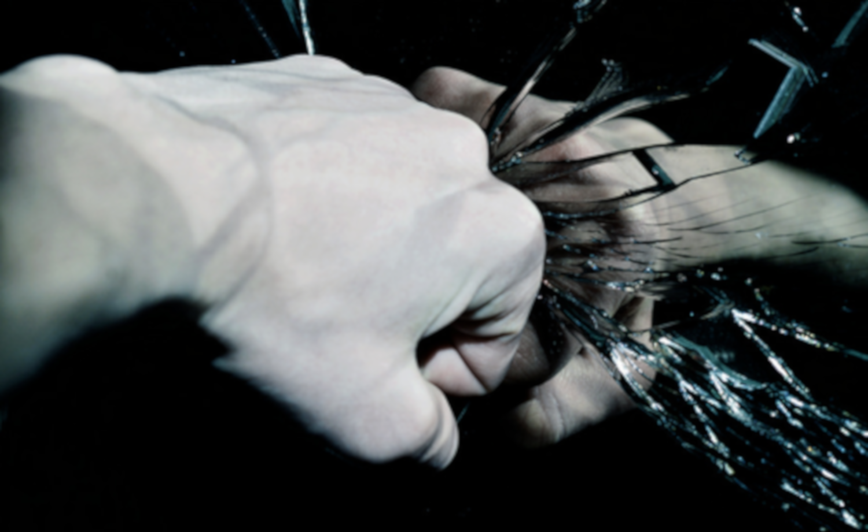
How Pathology is Related to Costly Helping
in Adolescents with Conduct Problems
Tennyson Dahlman BS, Joseph Sakai MD, Joel Stoddard MD
Department of Psychiatry, Child and Adolescent Division, University of Colorado (Anschutz); Pediatric Mental Health Institute, Children’s Hospital Colorado
Notes:
Introduction: My name is Tennyson Dahlman, and I am a recent graduate of Regis University. This summer I have been with Dr. Joel Stoddard to examine How Pathology is Related to Costly Helping
in Adolescents with Conduct Problems
And before I get going, I have a quick question for everyone. By a show of hands, how many of you have deliberated between donating money and not donating?
Well for those of you who have (as well as the others who I feel might be a little less than honest), you may already be somewhat familiar with the work I did this summer.
However, I think we need some background…[click]

Slide 2
Altruism
Prosocial Behaviors
Background
Notes:
So the main concept of my question relates to altruism [click] otherwise known as prosocial behaviors [click] (which is when one acts with the intent to benefit others), which as I’m sure you all can guess, is central to human society.
These constructs are what allow us to coexist within society, and even have society in the first place. At the same time, there is an evolutionary advantage to altruistic behaviors, as acting altruistically helps to keep our kids alive knowing that there is sacrifice on our end, and little to no personal gain for it.
However, there are instances where these behaviors break down, such as with conduct disorders, and we have research to support this.

Slide 3
Subject
Donates Money
Subject Doesn’t Get the Money
—OR—
Subject
Take Money
Charity Doesn’t Get the Money
Background
Notes:
Sakai et al. (2016) investigated altruism in a context where an individual decides to donate to a charity, which involves a cost to themselves (aka Costly Helping), or the subject decides not to donate and take the money for themselves

Slide 4
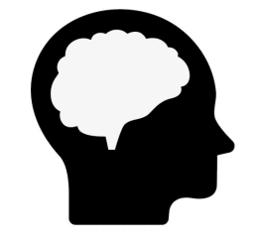
Higher Callous-Unemotional Traits
Higher Psychopathic Traits
Less Costly Helping
Background
Notes:
This study found that those with high callous-unemotional traits (a sub-classification of conduct disorders) took the most and did the least costly helping
Another study by Sakai et al. (2019) found an association between higher Psychopathic traits (callousness) and less costly helping in a community based sample
And in order to study altruism, Sakai et al. (2016) created a game to measure situational “costly helping”, but I’ll go into the specifics of that a little later. For now all you need to know is that the game presents the scenarios that were displayed on the previous slide

Slide 5
How might the amount of money that the subject gains vs. how much they lose to donating matter?
—AND—
How might pathology impact the decision to take vs. donate?
Research Questions
Notes:
So we looked at these studies, and we began to wonder…
How might the amount of money that the subject gains vs. how much they lose to donating matter?
How might pathology impact the decision to take vs. donate?

Slide 6
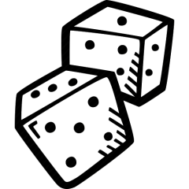
Ratio
Likelihood of Donating
Likelihood of Donating
Pathology
Modulates
Hypotheses
Notes:
And based on these questions we came up with two hypotheses:
H₁: The likelihood of donating will be a function of how much is at stake for the participant and for the Red Cross
H₂: Pathology will most modulate whether the subject donated or not

Slide 7
Subject Grouping |  | Clinical Variables M(SD)
Clinical Diagnosis | N(%) | Callous-Unemotional Traits (ICU) | Oppositional Traits (CBCL)
Subjects-LPE | 21 (32%) | 31.30 (6.11) | 6.3 (2.83)
Subjects-no LPE | 21 (32%) | 21.18 (5.36) | 3.9 (3.16)
Controls | 24 (36%) | 17.89 (6.59) | 0.4 (1.24)
Methods
Notes:
In order to actually test these hypotheses we…
Performed a secondary analysis using the data from Sakai et al. (2016)…
In which there were…
66 total subjects: 21 subjects with LPE, 21 without LPE, and 24 control subjects
And to assess for pathology we utilized the Inventory of Callous and Unemotional Traits and the Child Behavior Checklist (explain each pathology)
Also, you’re all probably wondering, what is this LPE/no LPE thing? That was a distinction that was made in the original data (though in essence it is a different term for the same construct as callous-unemotional traits. For our purposes we combined these two values to have allow pathology to be continuous.
Alright, so now we’ve finally come back to that game I mentioned earlier…

Slide 8
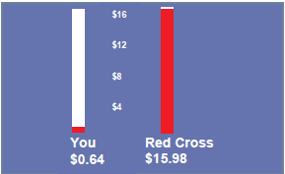
Offer (5 sec)
Decision (1 sec)
Feedback (4 sec)
Jittered
AlAn Game
Notes:
So here’s how the game works…
First, there are 3 different types of trials: active, calculation, and attention-control trials, however, for this study, we were only looking at what Sakai et al. (2016) termed “active trials”…this is what one active trial would look like:
First, you would be presented with an offer. This offer displays how much the participant would gain, and how much the Red Cross would lose
Then, the subject is given one second to decide and choose whether they would keep the money or instead donate it,
Next, the subject is given feedback on how much money they have made and how much they have donated
Finally, a fixation point is shown to separate each trial. In one AlAn game, a subject would see this block of 4 slides 72 times.
From the game we get how much money the subject would have gained and the RC would have lost by trial, and this is where our analysis begins

Slide 9
Red Cross Stake
Subject Stake
Ratio
Analysis—Computing Ratio
Notes:
We had to obtain a value for each trial of how much the Red Cross would have lost vs. how much the subject would gain.
To do this we extracted out every active trial and then divided how much was at stake for the RC by how much was at stake for each subject, and this is how we obtained our ratio.

Slide 10
Ratio
Likelihood of Donating
LmodelHT<-glmer(Donate~logRatio*cICUt+logRatio*cOPPt+(1|Subject),
+ family=binomial,data=na.omit(patho2[,c('cICUt','cOPPt','logRatio',
+ 'Donate','Subject')]),control=glmerControl('bobyqa'),nAGQ=10)
Pathology
Analysis—GLMER
Notes:
Once we had calculated our ratio, we then had to discover the how the ratio, pathology, and the interaction of thee two impacted the likelihood to donate. To do this we ran a generalized linear mixed effects regression: which looks something like this: (show R code)
But we’re not going to worry about that since it’s a bit much, instead, here‘s what this type of model allows us to do:
From this model we can learn the impact of each variable we are interested in, how each affects the likelihood of donating, as well as how they interact.
At the same time we can take into account random effects, such as the variation between each subject and random thoughts that occurred while deciding whether to donate or not.

Slide 11
Game
Subject
Subject
Subject
Anxious
Tired
Uncomfortable
Analysis—GLMER
Notes:
At the same time we can also take random effects into account such as differences between each subject, as well as the transient nature of thought and decision making such as how a subject could be focusing on the game, and then thinking about how tired they are, or how they’re anxious, or even about how the testing area may be uncomfortable for them
And so what did our model tell us?

Slide 12
Variable | Estimate | Standard Error | z | p-value
Intercept | -1.06 | 0.38 | -2.82 | 0.00**
Ratio | 1.27 | 0.03 | 40.16 | 0.00***
ICU traits | -0.09 | 0.05 | -1.80 | 0.07
OPP traits | -0.04 | 0.04 | -1.08 | 0.28
logRatio x CU traits | -0.03 | 0.00 | -8.98 | 0.00***
logRatio x OPP traits | 0.01 | 0.00 | 3.00 | 0.00**
*p≤0.05 **p≤0.01 ***p<0.001
Results
Notes:
Well our results looked a little something like this: (show table)
I know there’s a lot to look at here, but we’ll quickly move away from the table. However, before we do so I would like to display the results of the Ratio. I want to point out just how large the effect of ratio is compared to all of the other variables. This will be important to keep in mind for the next slide.

Slide 13
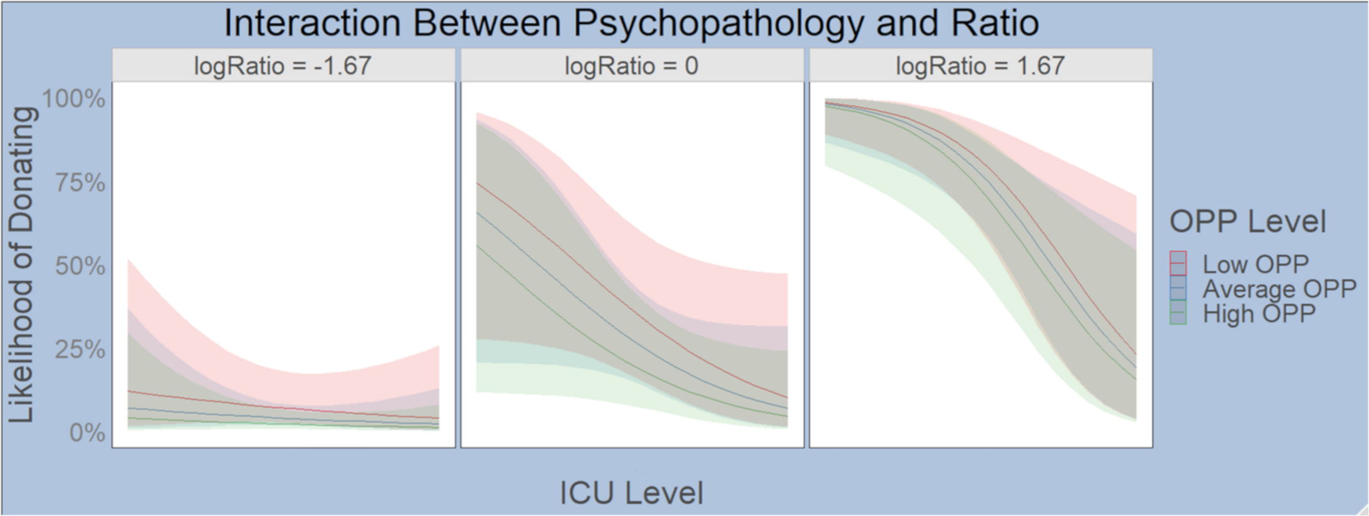
Low Average High
Low Average High
Low Average High
Results
Notes:
This graph is really what we are interested in (explain the graph, axes, ranges of likelihood [we have results spanning the entire range], and what the logRatio means). The left panel shows how when the subject gains more than the RC loses then nobody donates, so for those who were beginning to get a little worried about the decisions they’ve made in the past, know that it is completely normal to not donate when you would lose a lot when the charity would actually get very little. Magnitude is involved here, such that when the RC loses $1 the subject gains $5.50 thus, the subject gains 5.5x more than the RC loses. The right panel shows the exact opposite, and it is here where we really see the effect of pathology. Notice how steep that curve is, that is the effect of pathology (largely ICU traits, though OPP does have some effect). The same goes for the middle panel, though this one shows the likelihood of donating when the RC loses about as much as the subject gains.
So what does this mean?

Slide 14
Pathology
Altruism
Prosocial Behaviors
Conclusions
Notes:
This is the first study to examine these factors in connection with each other as opposed to separately; and what it all comes down to is that pathology greatly impacts and influences prosocial behaviors and altruistic actions
At the same time we have a better understanding of how pathology might manifest itself and we can even begin to predict how people will behave given certain information,

Slide 15
Diagnostic Tool
Neuroimaging
Future Directions
Notes:
Furthermore, this research can be used in the future to
Improve the AlAn game to make it better, and possibly make it into a useful diagnostic tool that doesn’t have some of the problems a traditional measure does.
Also, we can use to model from this research during neuroimaging to partition signals specific to CU traits during decision making to learn what network of brain structures contribute to pathology
Even broader than that, we may be one step closer to understanding the process behind deciding to act altruistically or not.
So the next time you catch yourself deliberating between donating to a charity and not, just remember what you heard here today and what the research may suggest is going on

Slide 16
Joel Stoddard, MD
Joseph Sakai, MD
Merlin Ariefdjohan, PhD, MPH
Emmaly Perks, MA
Douglas Novins MD—Chair of the Pediatric Mental Health Institute
Dominic Martinez EdD—Director of Inclusion and Outreach, CCTSI
Acknowledgements
Notes:
So before I open up the floor to questions, I would like to extend my thanks to a few very important people

Slide 17
Questions

Slide 18
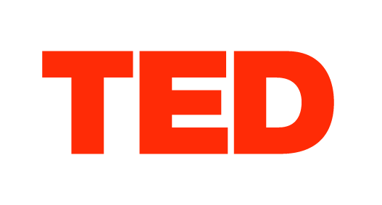
Thank You
for attending my
PURPLETalk
Notes:
So before I open up the floor to questions, I would like to extend my thanks to a few very important people

