Slide 1
Avoiding the Present Moment: How Parental Experiential Avoidance Affects a Child's Ability to Regulate Emotions
Sara Kvidahl, B.A., Jacob Holzman, Ph.D., & Jessica Malmberg Ph.D.
Pediatric Mental Health Institute (PMHI), Children's Hospital Colorado;
Dept. of Psychiatry, Child and Adolescent Division, University of Colorado

Slide 2
Introduction
Anxiety is one of the most common psychiatric problems in children and adolescents¹
May lead to poor interpersonal and academic functioning during adolescence²
Often persists into adulthood without intervention²
A transdiagnostic approach to pediatric mental health may improve our understanding and subsequent treatment of these concerns³
Focus on mechanisms vs symptoms

Slide 3
A few mechanisms of anxiety include:
Parenting practices that are aimed at suppressing or controlling a child^{1,4}
(e.g., overcontrol)
Experiential avoidance (EA)
Avoidant regulatory strategy characterized by an unwillingness to remain in contact with one’s own internal distress¹
Recent attention has been brought to parental EA and its role in the development and maintenance of child anxiety⁵
Emotion dysregulation
Children with high levels of anxiety struggle with managing emotions⁶

Slide 4
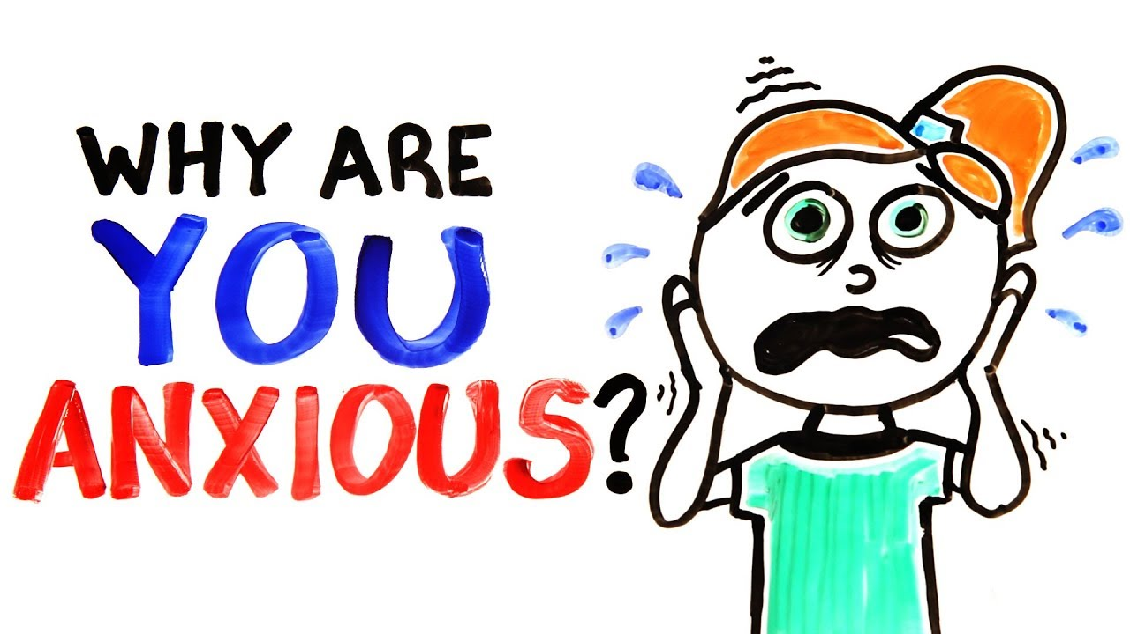
What is experiential avoidance in the context of parenting?
When a parent is unwilling to witness their child experiencing distress, as well as their own difficulties managing their reactions to their child’s affect⁷
Why might this be detrimental for children?
A fear of or adverse reaction to children’s negative emotions may play a role in overprotective and intrusive parenting practices¹
A significant link has been found between parental EA and parent reported child anxiety levels in both a clinical and community sample^{1,7}

Slide 5
Emotion regulation development
ER is a complex set of processes by which individuals modulate the experience, expression, and response to emotions⁶
Children will develop regulatory strategies that are either active or avoidant⁴
Deficits in ER have been associated with maladaptive outcomes in youth, including increased risk of developing internalizing and externalizing disorders⁸
Biologically:
e.g., Inheritance of parents’ patterns of physiological functioning⁸
Socially:
e.g., Shaping emotion regulation through parenting behaviors⁸

Slide 6
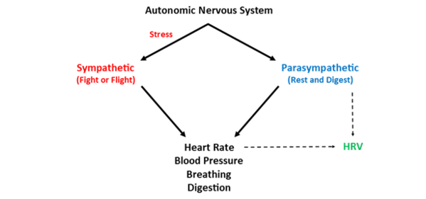
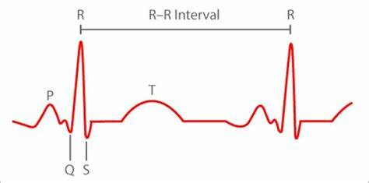
Heart rate variability (HRV)
A physiological marker of self-regulation via the parasympathetic nervous system⁸
Low resting HRV has been associated with ER difficulties, and may also be a risk factor for psychopathology⁹
Reduced variability of the heart rate has been found children and adolescence with anxiety disorders¹⁰

Slide 7
Research objectives
Explore the relationship between parental EA and child anxiety levels
Both parent and child report
Prior research has not included child reported child anxiety levels
Explore the relationship between parental EA and child ER
Physiologically (HRV)
Parent report of children’s ER capabilities
Prior work has not examined the relationship between parental EA and these underlying mechanisms of anxiety

Slide 8
Hypotheses
Parental EA
1. Positively correlated with parent report of their child’s anxiety levels
2. Positively correlated with child reported anxiety levels
3. Inversely related to child’s ER
4. Inversely related to child’s resting HRV

Slide 9
Methods
 | N (TOTAL = 101) | PERCENTAGE
SEX
Male | 62 | 61.4%
Female | 38 | 37.6%
Other | 1 | 2%
AGE
6-7 years old | 22 | 21.8%
8-12 years old | 40 | 39.6%
13-18 years old | 39 | 38.6%
PRIMARY DIAGNOSIS
Anxiety Disorder | 18 | 34%
ADHD | 14 | 26.4%
Mood/Depressive Disorder | 11 | 20.8%
Adjustment Disorder | 4 | 7.5%
Other | 6 | 11.3%
RACE
White | 73 | 72.3%
Black or African-American | 5 | 5.0%
More Than One Race | 14 | 13.9%
Asian | 1 | 1%
Unknown/Not Reported | 4 | 4.0%
American Indian or Alaska Native | 3 | 3.0%
ETHNICITY
Hispanic or Latino | 21 | 20.8%
Not Hispanic or Latino | 75 | 74.3%
Unknown or not reported | 5 | 5%
101 children and parents were administered a series of questionnaires and HRV measurements during an intake evaluation at PMHI outpatient clinic
Ran Pearson’s Correlation analysis using SPSS to evaluate relationships
HRV data was collected during a 10-minute resting baseline condition
EKG and respiratory data was collected for calculating HRV using the Biotrace+ software; artifacts were detected and removed

Slide 10
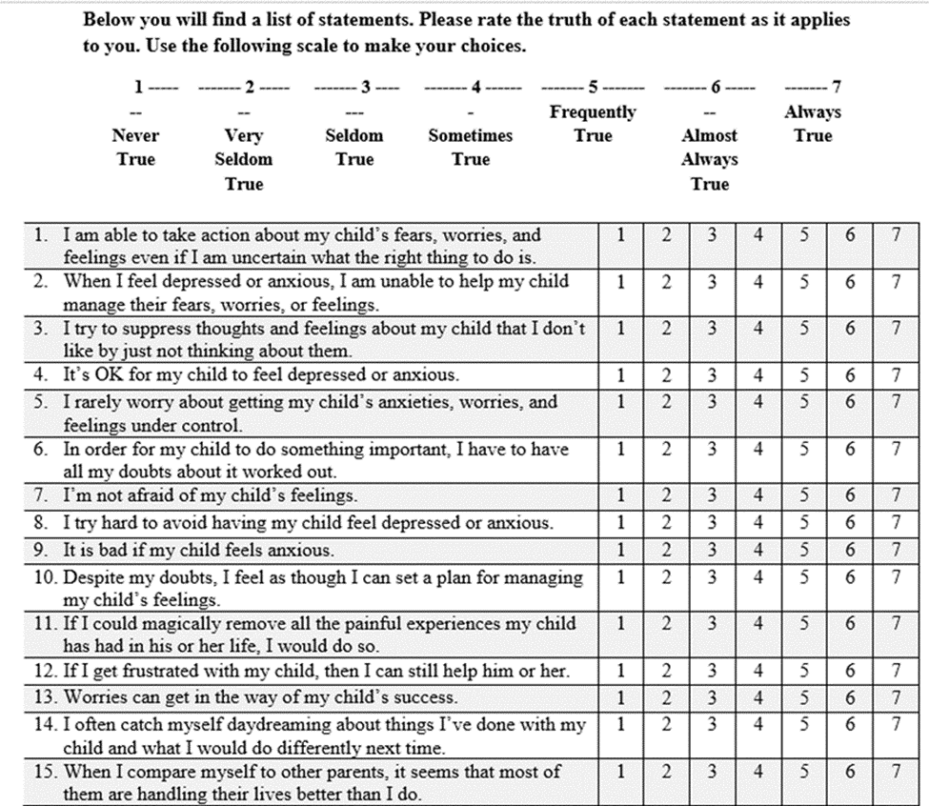
Questionnaires used:
Behavior Assessment System for Children, 3rd Edition (BASC-3)
Parent completed for 6yr+; Child also completed for 8yr+
T-scores from the child and parent report of anxiety were used
Parental Acceptance and Action Questionnaire (PAAQ)
Measures experiential avoidance in the context of parenting
15 items organized among two subscales, 7-point Likert scale ranging from 1 (Never True) to 7 (Always True)
Emotion Regulation Checklist (ERC)
Parent-report measure of their child’s self-regulation abilities
24 items, both positively and negatively weighted, rated on a 4-point Likert scale

Slide 11
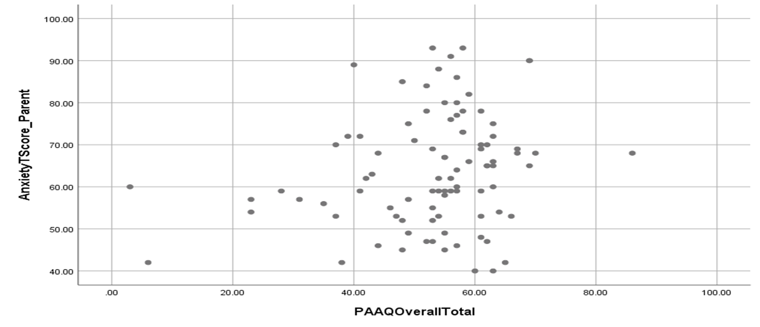
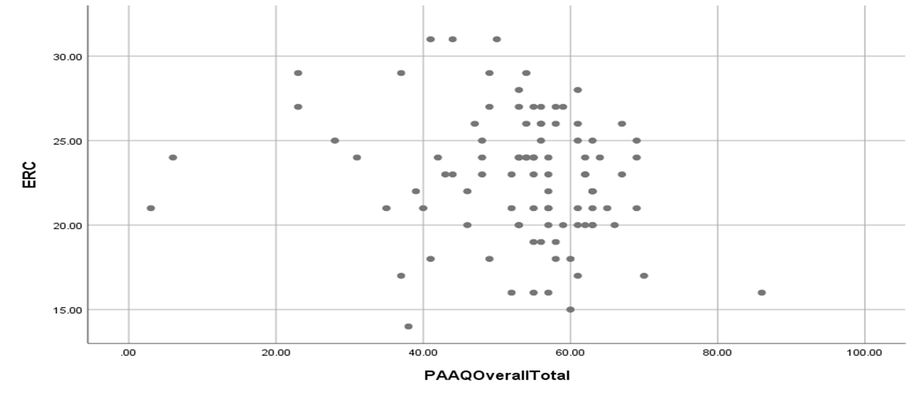
Results
Zero-order correlations | PAAQ Total
Anxiety (Parent report) | .22**
Anxiety (Child report) | .17
ERC Total | -.19*
HRV-RMSSD | .05
*p<.10, **p<.05

Slide 12
Discussion
Parental EA may influence a child’s emotion regulation by modeling a heightened threat bias and ineffective coping strategies⁴
Parents may engage in parenting practices, such as overcontrol, as a means of dealing with their own distress about their child’s emotions, thereby depriving the child of the opportunity to develop their own ER abilities¹
Parents use of avoidant strategies may also contribute to the development and maintenance of externalizing disorders¹¹
Parental EA should be addressed as an element in both the prevention and treatment of child anxiety, and other disorders as well¹

Slide 13
Limitations
Multiple participants did not complete self-report measures
Rater biases may contribute to measurement errors with the sole use of report measures
Parents reporting high in EA probably experience anxiety themselves, which also may alter their interpretation of their child’s anxiety¹
Prior work suggests that parents of anxious children usually have more negative expectations of their children’s coping strategies, which may affect their interpretations of their child’s anxiety and ER⁴

Slide 14
Limitations
Missing or malfunctioned HRV data for multiple participants
We measured statistical HRV not frequency HRV
Other bio-markers may be more applicable
Cardiac pre-ejection period
Galvanic skin conductance
Stress hormones – Cortisol

Slide 15
Future Directions
Replication of this study is important to further examine the role that parental EA has on children’s ER and psychopathology
Assess this relationship using clinician rated measurement and behavioral observation for anxiety
Replication could also measure parent’s anxiety levels to compare with their report on experiential avoidance of their child’s emotions
Include a more diverse, community sample
Examine the relationship between parental EA and externalizing disorders
Examine the relationship between parental EA and parenting practices

Slide 16
References
1.Emerson, L., Ogielda, C., Rowse, G. (2019). The Role of Experiential Avoidance and Parental Control in the Association Between Parent and Child Anxiety.
2. Ehrenreich-May, J., Rosenfield, D., Queen, A. H., Kennedy, S. M., Remmes, C. S., & Barlow, D. H. (2017). An initial waitlist-controlled trial of the unified protocol for the treatment of emotional disorders in adolescents. Journal of Anxiety Disorders, 46, 46-55.
3.Chu, B., Temkin, A., & Toffey, K. (2016). Transdiagnostic Mechanisms and Treatment for Children and Adolescents: An Emerging Field. Oxford Handbooks Online.
4. Fulton, J. J., Kiel, E. J., Tull, M. T., & Gratz, K. L. (2014). Associations between Perceived Parental Overprotection, Experiential Avoidance, and Anxiety. Journal of Experimental Psychopathology, 200–211.
5.Tiwari, S., Podell, J. C., Martin, E. D., Mychailyszyn, M. P., Furr, J. M., & Kendall, P. C. (2008). Experiential avoidance in the parenting of anxious youth: Theory, research, and future directions. Cognition and Emotion, 22(3), 480-496.
6.Brumariu, L. E., Kerns, K. A., & Seibert, A. (2012). Mother–child attachment, emotion regulation, and anxiety symptoms in middle childhood. Personal Relationships, 19(3), 569-585.
7.Cheron, D. M., Ehrenreich, J. T., & Pincus, D. B. (2009). Assessment of parental experiential avoidance in a clinical sample of children with anxiety disorders. Child Psychiatry and Human Development,40(3), 383-403.
8.Graham, R. A., Scott, B. G., & Weems, C. F. (2017). Parenting behaviors, parent heart rate variability, and their associations with adolescent heart rate variability. Journal of Youth and Adolescence, 46(5), 1089-1103.
9.Mankus, A. M., Aldao, A., Kerns, C., Wright Mayville, E., & Mennin, D. S. (2013). Mindfulness and heart rate variability in individuals with high and low generalized anxiety symptoms. Behaviour Research and Therapy, 51(7), 386-391.
10.Sharma, R. K., Balhara, Y. P. S., Sagar, R., Deepak, K. K., & Mehta, M. (2011). Heart rate variability study of childhood anxiety disorders. Journal of Cardiovascular Disease Research, 2(2), 115-122.
11.Emerson, L. M., Aktar, E., Bruin, E., Potharst, E., & Bögels, S. (2019). Mindful parenting in secondary child mental health: Key parenting predictors of treatment effects. Mindfulness

Slide 17
Acknowledgements
Thank you so much to: Dr. Jacob Holzman and Dr. Jessica Malmberg
Summer research team: Gabi, Kristen, and Megan
PURPLE Facilitators: Emmaly Perks, MA and Merlin Ariefdjohan PhD, MPH
PURPLE Cohort: Amy, Hannah, Hisham, Jada, Lily, and Tennyson
Our donors: Dr. Dominic Martinez and Dr. Douglas Novins

Slide 18
Questions?

