Slide 1
Investigating the Neural Patterns of Worry and Emotional Anticipation
Rohit Gupta
Mentor: Dr. Benjamin C. Mullin
2017 Summer Research Program for Undergraduate Students at the Pediatric Mental Health Institute (PMHI)

Slide 2
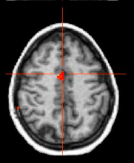
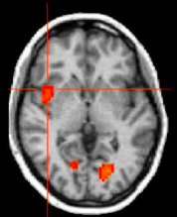
Background
Worry is a process by which people anticipate uncertain negative emotional events
Previous studies have found activation in the anterior cingulate cortex and anterior insular cortex
Anterior cingulate
Left anterior insula
Straube et al., NeuroImage. 2006

Slide 3
Problem Statement
Majority of previous worry studies have been conducted in healthy adults
However, previous imaging studies used worry inductions
Adolescent brains are far different from healthy adults
We aimed to characterize the emotional anticipation neural activation patterns in an adolescent and clinical population
Notes:
Other studies essentially asked “now worry for 30 seconds”
Our task is much more controlled

Slide 4
Research Hypotheses
Hypothesis 1: Anticipation of negative emotional stimuli will result in heightened activation of the anterior insular cortex and anterior cingulate cortex
Hypothesis 2: Adolescents with greater self-reported worry will have higher levels of activity in brain regions involved in emotional anticipation
Increased Worry
Increased activation of anterior cingulate & anterior insula

Slide 5
Methodology
n = 23, ages 13-17, mean age = 15.5
Participants first completed the Penn State Worry Questionnaire (PSWQ)
Participants completed the emotional anticipation task while blood oxygen level dependent (BOLD) fMRI images were collected (measuring whole-brain activity)
Data were processed using Statistical Parametric Mapping software (SPM12) and CONN toolbox in MATLAB version R2017a

Slide 6
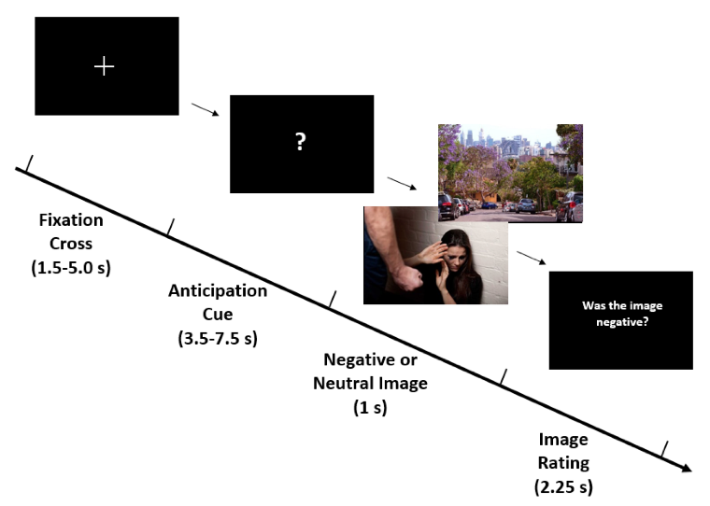
Eliciting Uncertainty: The Emotional Anticipation Task
Notes:
Total of 90 trials, 30 trials of ambiguous cue (15 negative, 15 neutral images)

Slide 7
Ambiguous Cue
Neutral Cue
fMRI whole-brain activity data collection and processing
So how did we do it?
Individual activation data
Individual activation data
Extraction of significant activity (p < 0.001, voxel threshold = 15)
Ambiguous cue brain activation pattern
Neutral cue brain activation pattern
SUBTRACT
Notes:
Independent sample t-test

Slide 8
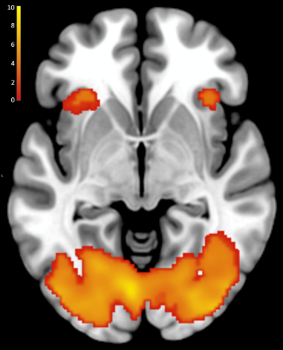
Results: Activation of the anterior insula and visual cortex are higher following ambiguous cues compared to neutral cues
Hypothesis: Activation in the anterior insula
Hypothesis: Activation in the anterior cingulate
!
!
Ambiguous cue – Neutral Cue contrast

Slide 9
Pearson correlation reveals significant positive relationship between PSWQ score and right frontal cortex activation following ambiguous cue
Average worry
Severe worry
r = 0.415, p = 0.049

Slide 10
Conclusions
Elevated activity in the right pre-frontal cortex (PFC), bilateral anterior insula, and primary visual cortex, but not the anterior cingulate characterizes emotional anticipation
Increased activation in the right PFC cluster is significantly positively correlated to severity of worry in adolescents
Widespread visual cortex activation may be due to mentally preparing for the visualization of negative images
Findings are directly applicable to clinical populations

Slide 11
Future Directions
With these findings, we can formulate better treatment options and adjust therapies for adolescents
Future studies will focus on examining whether successful treatment of worry normalizes the excessive activation of the right prefrontal cortex during anticipation of uncertain events

Slide 12
Limitations
Small sample size
Ongoing study
Unable to determine if the viewing the anticipation cue altered the processing of the images

Slide 13
Acknowledgments
Benjamin Mullin, PhD
Emmaly Owens, MA
Merlin Ariefdjohan, PhD, MPH
Marisa Deguzman
Program sponsors:
Dr. Dominique Martinez (CCTSI)
Dr. Douglas Novins and Dr. Jennifer Hagman (PMHI)

