Slide 1
The Impact of Social Support on Substance Use and Mood Across Races during COVID-19
Aneri Patel, Dr. Jarrod M. Ellingson

Slide 2
Introduction
1. Since COVID-19, there have been increases in:
2. Greater risk for People of Color (POC) than Non-White Hispanic (NWH):
Substance Use Disorders
Drug Overdoses
Depression
Isolated Drinking
59% higher depression
15% increase in overdose cardiac arrests
11% more blame for spreading COVID-19
COVID-19 treatment disparity

Slide 3
Central Research Questions
1. Did substance use and mood differ between POC and NHW participants during the study?
2. Is social support related to mood and substance use differently between the two groups?
Social Support
?
Substance Use
& Mood
Race
POC or NHW

Slide 4
Hypothesis
“Social Support is more protective in POC than NHW populations and mitigates substance use and poor mood for these participants”
Social Support
Race
POC or NHW
Substance Use
& Mood

Slide 5
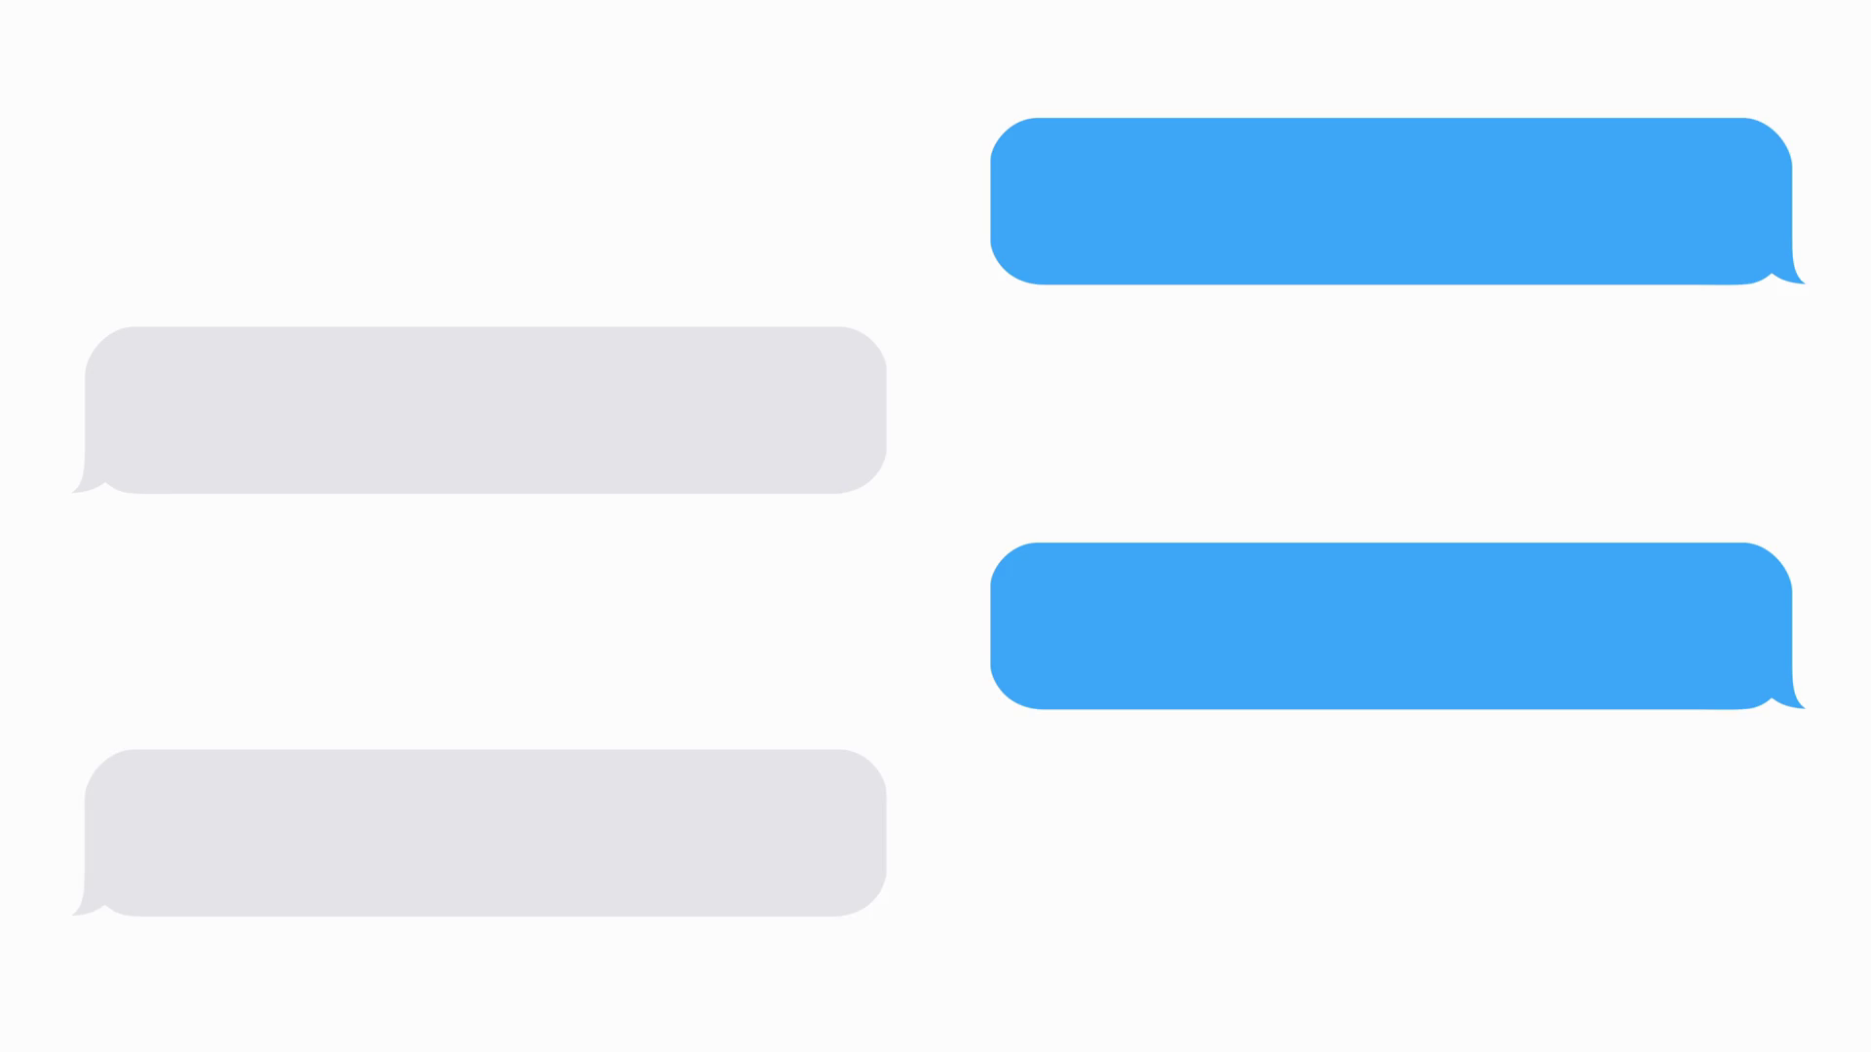
03
01
Outcomes measures
Intensive Longitudinal Mobile Health Survey
02
04
Participants
Statistical Analysis
Methods
4 outcomes for substance use
4 outcomes for mood changes
Social Support
4x per day for 60 days
Start day from July 2020-2021
Day level data analyzed
47 total
13 POC, 34 NHW
21+ with smartphone
Correlation & Linear Regression Models
JASP and R

Slide 6
Results RQ 1: Did substance use/mood differ between groups?
0.14 drinks less than POC
Note: ***p<0.001 between groups

Slide 7
Results RQ 2: Is Social Support a protective factor?
 | NHW | POC
Angry Mood | Yes | No
Anxious Mood | Yes | No
Depressive Mood | Yes | Yes
Life has Meaning | Yes | Yes
Craving for Alcohol | Yes | No
Drug Use | No | Yes
Alcohol Use | Yes | No
Legend:
Social support is more protective for POC

Slide 8
Limitations/Improvements for the study
Increase Sample Size
Linear Mixed Models
Match Baseline Social Support
Self-reporting bias

Slide 9
Future Directions
Landmark Date
News Consumption
Prospective Study
- Sociopolitical stressor differences between races
- Could play a role in social support
-Better causal inferences around stressful periods

Slide 10
References
McKnight-Eily LR, Okoro CA, Strine TW, et al. Racial and Ethnic Disparities in the Prevalence of Stress and Worry, Mental Health Conditions, and Increased Substance Use Among Adults During the COVID-19 Pandemic — United States, April and May 2020. MMWR Morb Mortal Wkly Rep 2021;70:162–166. DOI: http://dx.doi.org/10.15585/mmwr.mm7005a3external icon
Faust JS, Du C, Mayes KD, Li SX, Lin Z, Barnett ML, Krumholz HM. Mortality From Drug Overdoses, Homicides, Unintentional Injuries, Motor Vehicle Crashes, and Suicides During the Pandemic, March-August 2020. JAMA. 2021 Jul 6;326(1):84-86. doi: 10.1001/jama.2021.8012. PMID: 34019096; PMCID: PMC8140390.
Julian, K. (2021, July 1). America has a drinking problem. The Atlantic. https://www.theatlantic.com/magazine/archive/2021/07/america-drinking-alone-problem/619017/.
Friedman J, Mann NC, Hansen H, et al. Racial/Ethnic, Social, and Geographic Trends in Overdose-Associated Cardiac Arrests Observed by US Emergency Medical Services During the COVID-19 Pandemic. JAMA Psychiatry. 2021;78(8):886–895. doi:10.1001/jamapsychiatry.2021.0967
Mistler CB, Sullivan MC, Copenhaver MM, Meyer JP, Roth AM, Shenoi SV, Edelman EJ, Wickersham JA, Shrestha R. Differential impacts of COVID-19 across racial-ethnic identities in persons with opioid use disorder. J Subst Abuse Treat. 2021 Apr 8;129:108387. doi: 10.1016/j.jsat.2021.108387. Epub ahead of print. PMID: 34080555.
Torous J, Onnela JP, Keshavan M. New dimensions and new tools to realize the potential of RDoC: digital phenotyping via smartphones and connected devices. Transl Psychiatry. 2017 Mar 7;7(3):e1053. doi: 10.1038/tp.2017.25. PMID: 28267146; PMCID: PMC5416670.

Slide 11
Acknowledgements
Dr. Jarrod Ellingson, Kristin Raymond, and Missy Roark
All of the partners making PURPLE possible:
Dr. Douglas Novins, Chair of PMHI
Dr. Neill Epperson, Chair of Department of Psychiatry
Dr. Dominic Martinez, Dir. Office of Inclusion and Outreach, CCTSI
Lily Luo
Emmaly Perks
NIH for funding this study
University of Colorado
Children's Hospital Colorado
Office of Education and Training
Department of Psychiatry
Child and Adolescent Division
To all of the participants in the mHealth Study

