Slide 1
Predicting Aggressive Behavior in the
Inpatient Psychiatric Units at Children’s Hospital Colorado
Eddy Panklang
Patrick W. Romani, Ph.D., BCBA-D
Mathew Luehring, Ph.D., BCBA, NCSP
Crystal Natvig, MPH, B.S.

Slide 2
Introduction
Highly aggressive patients admitted to the inpatient psychiatric units at Children’s Hospital Colorado (CHCO) have produced an unacceptable rate of healthcare staff injuries in 2020
Injuries adversely affect team member morale (Spears & McNeely, 2019)
Expensive to the organization
Hillbrand et al. (1996) found that 2% of one hospital’s operating budget was subsumed by payments for team member injury
Notes:
From this knowledge, there is a need for an effective assessment to predict patient aggression in the inpatient psychiatric units. Ultimately, this effective assessment will ensure the safety of both the patient and the healthcare staff, which will allow the appropriate delivery of care to the admitted patients in a timely manner.

Slide 3
Investigations targeting assessment to identify patients that are of higher likelihood for producing injury before admission are needed
BRACHA
An effective screening tool shown to relate to future likelihood of aggressive behavior: Brief Rating of Aggression by Children and Adolescents (BRACHA; Barzman et al., 2011)
16-item measure about a patient’s personal history, past violence, and impulsiveness within the medical setting
Reliability of BRACHA scoring is high (Barzman et al., 2012)
Generally, higher BRACHA scores relate to increased risk for aggressive behavior

Slide 4
However,
It is unclear how well individual items on the BRACHA predict the future likelihood of aggressive behavior

Slide 5
Purpose of this Study:
Evaluate the extent to which the items from the modified BRACHA (mBRACHA) are effective in predicting patient aggression on the Inpatient Psychiatric Units at CHCO

Slide 6
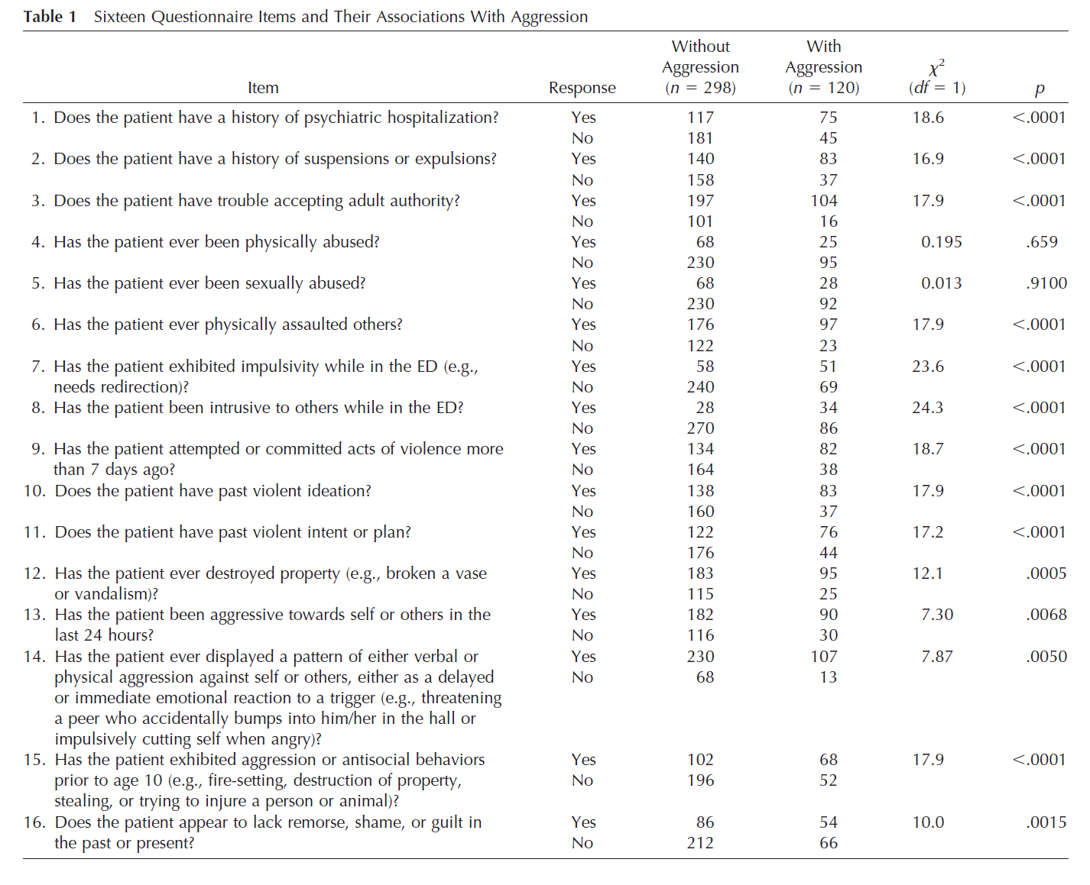
Brief Rating of Aggression by Children and Adolescents (BRACHA)
From $χ^{2}$analyses, the association between occurrence of aggression and BRACHA items was calculated
Notes:
Question 13 wasn’t included in mBRACHA, need reason.

Slide 7
Brief Rating of Aggression by Children and Adolescents (BRACHA)
From $χ^{2}$analyses, the association between occurrence of aggression and BRACHA items was calculated
The BRACHA was modified to create the mBRACHA by
Removing items 4 and 5
Notes:
Question 13 wasn’t included in mBRACHA, need reason.

Slide 8
Brief Rating of Aggression by Children and Adolescents (BRACHA)
From $χ^{2}$analyses, the association between occurrence of aggression and BRACHA items was calculated
The BRACHA was modified to create the mBRACHA by
Removing items 4 and 5
Removing items 7, 8, and 16
Notes:
Question 13 wasn’t included in mBRACHA, need reason.

Slide 9
Brief Rating of Aggression by Children and Adolescents (BRACHA)
From $χ^{2}$analyses, the association between occurrence of aggression and BRACHA items was calculated
The BRACHA was modified to create the mBRACHA by
Removing items 4 and 5
Removing items 7, 8, and 16
Removing items 10 and 11
Notes:
Question 13 wasn’t included in mBRACHA, need reason.

Slide 10
Brief Rating of Aggression by Children and Adolescents (BRACHA)
From $χ^{2}$analyses, the association between occurrence of aggression and BRACHA items was calculated
The BRACHA was modified to create the mBRACHA by
Removing items 4 and 5
Removing items 7, 8, and 16
Removing items 10 and 11
Removing item 15
Notes:
Question 13 wasn’t included in mBRACHA, need reason.

Slide 11
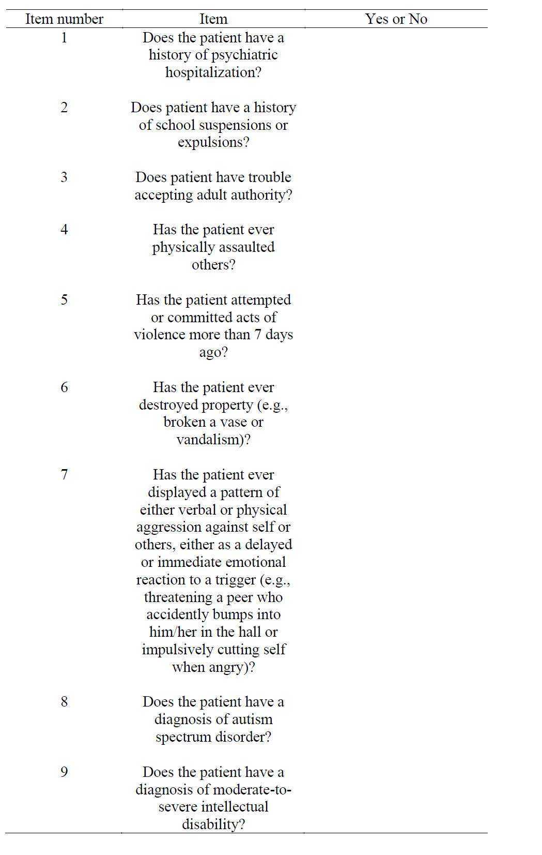
Modified Brief Rating of Aggression by Children and Adolescents (mBRACHA)
Addition of items asking about diagnoses shown to relate to aggressive behavior (Romani et al., 2020)
Items 8 and 9

Slide 12
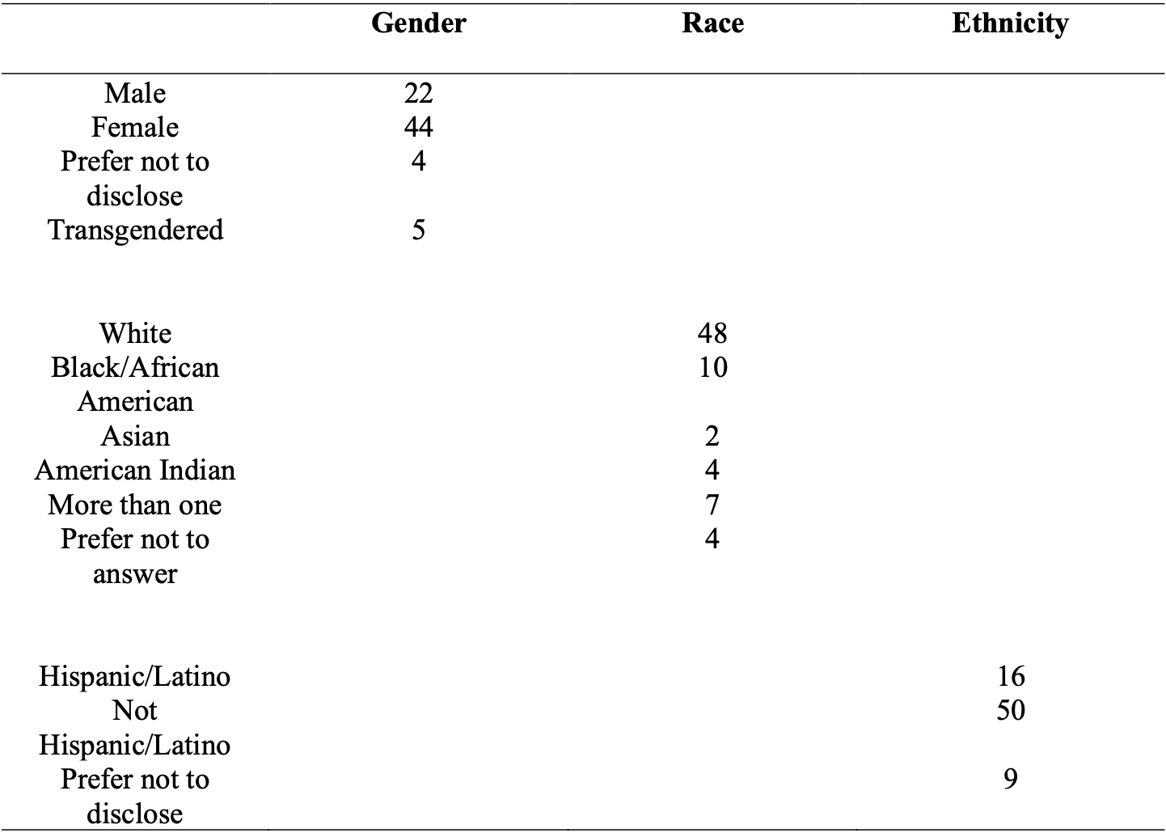
Participants
63 patients were admitted to the Intensive Psychiatric Unit (IPU)
12 patients were admitted to the Neuropsychiatric Special Care (NSC) unit
Average length of stay (IPU) = 8.3 days
Average length of stay (NSC) = 12.3 days

Slide 13
Materials
modified BRACHA (mBRACHA)
9 questions
“Yes or ”No” responses
Notes:
Include mBRACHA from slide 5

Slide 14
Procedure
Patients were presented to the emergency department at CHCO
A behavior health clinician (BHC) evaluated their crisis and completed the mBRACHA
Patients were transferred to the IPU or the NSC
The unit staff documented any behavioral concerns
The mBRACHA was completed daily for each patient

Slide 15
Statistical Analyses
Descriptive analysis
Chi-square tests

Slide 16
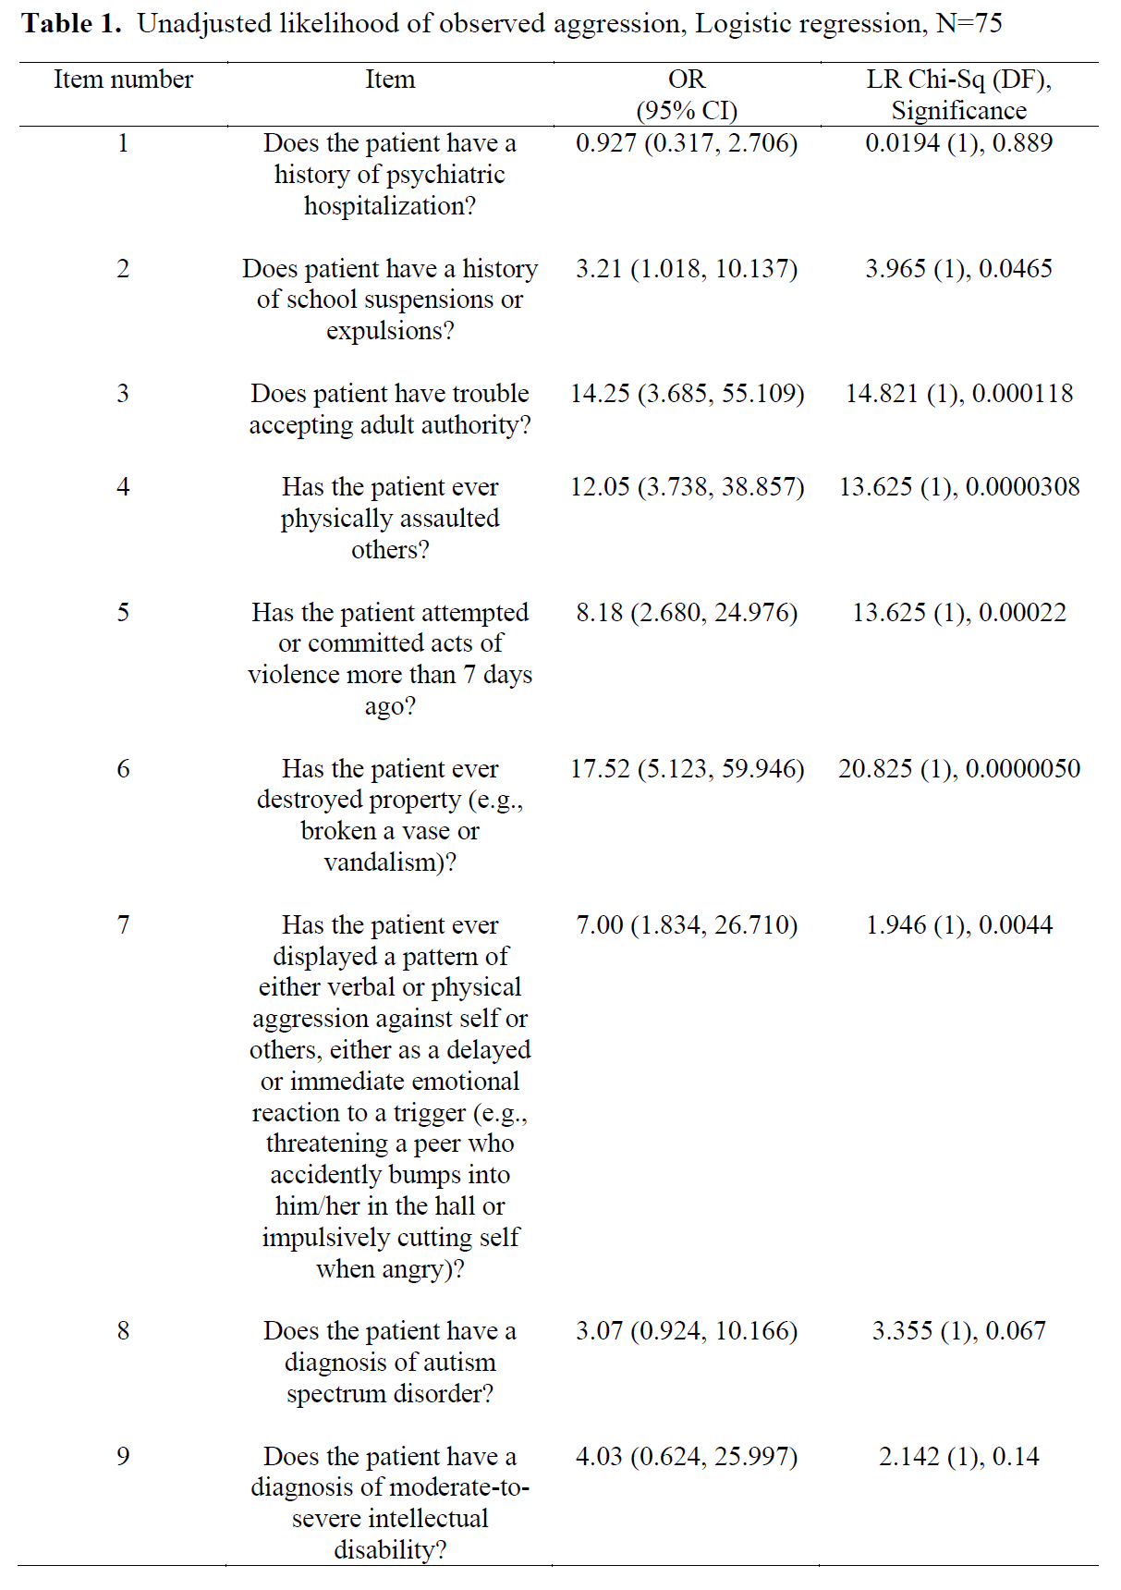
Results
Items 2 – 7 were statistically significant predictors of patient aggression

Slide 17
Results
Items 3, 4, and 6 had odds ratio (OR) values greater than 10.0
For example, patients who received a “Yes” for item 3 were 14.25 times more likely to be aggressive during their inpatient admissions compared to patients who received a “No” for this item

Slide 18
Discussion
6 of the 9 items from the mBRACHA predicted aggressive behavior
3 of the 6 items had OR values greater than 10.0
Statistically significant items can be used to control the acuity of inpatient psychiatric programs
Clinical judgement should be included in the evaluation of patient admission to inpatient programs
mBRACHA results can be used to identify potentially aggressive patients
Results can also be used to identify specific topography of aggression (Hill et al., 2009; Romani et al., 2020)

Slide 19
Limitations and Future Directions
A larger sample size, greater than 75 patients
Should the mBRACHA include only the items that were significant predictors of aggressive behavior?

Slide 20
Limitation and Directions
Endorsements of autism spectrum disorder (ASD) and intellectual disability (ID) are associated with future aggression (Romani et al., 2020)
Diagnosis of ASD is approaching significance
Diagnosis of ID was not related to aggression

Slide 21
Limitations and Future Directions
A larger sample size, greater than 75 patients
Should the mBRACHA include only the items that were significant predictors of aggressive behavior?

Slide 22
References
Barzman, D. H., Brackenbury, L., Sonnier, L., Schnell, B., Cassedy, A., Salisbury, S., Sorter, M., & Mossman, D. (2011). Brief Rating of Aggression by Children and Adolescents (BRACHA): Development of a Tool for Assessing Risk of Inpatients’ Aggressive Behavior. The Journal of American Academy of Psychiatry and the Law, 39(2), 170-179.
Hillbrand, M., Foster, H. G., & Spitz, R. T. (1996). Characteristics and Cost of Staff Injuries in a Forensic Hospital. Psychiatric Services, 47, 1123–1125.
Hill, A. K., Lind, M. A., Tucker, D., Nelly, P., & Daraiseh, N. (2015). Measurable Results: Reducing Staff Injuries on a Specialty Psychiatric Unit for Patients with Developmental Disabilities. Work (Reading, Mass.), 51(1), 99-111.
Romani, P. W., Ariefdjohan, M., Jensen Gaffey, L. L., Torres‐Dominguez, M., & Lister, J. (2020). Relations Between Patient and Staff Member Characteristics and Staff Member Injury on a Psychiatric Inpatient Unit for Children with Intellectual or Developmental Disabilities. Journal of Child and Adolescent Psychiatric Nursing, 33(3), 125-130.
Spears, S., & McNeely, H. (2019). A Systematic Process for Selection of a Crisis Prevention/De-escalation Training Program in the Hospital Setting. Journal of the American Psychiatric Nurses Association, 25(4), 298-304.

Slide 23
Acknowledgement
Douglas Novins, M.D. – Chair of Pediatric Mental Health Institute (PMHI)
Neill Epperson, M.D. – Chair of Department of Psychiatry
Dominic F. Martinez, Ed.D. – Office of Inclusion and Outreach Director, CCTSI
Patrick W. Romani, Ph.D., BCBA-D
Mathew C. Luehring, Ph.D., BCBA, NCSP
Crystal Natvig, MPH, B.S.
Emmaly Perks, M.A., CCRP – PURPLE Director
Yunliang (Lily) Luo, B.S. – PURPLE Program Coordinator

Slide 24
Thank you!
Eddy Panklang
Eddy.2.panklang@ucdenver.edu

