Slide 1
The Effects of Deep Brain Stimulation on Obsessive-Compulsive Disorder
Presentation by Hunter Orr
PURPLE Cohort 2023

Slide 2
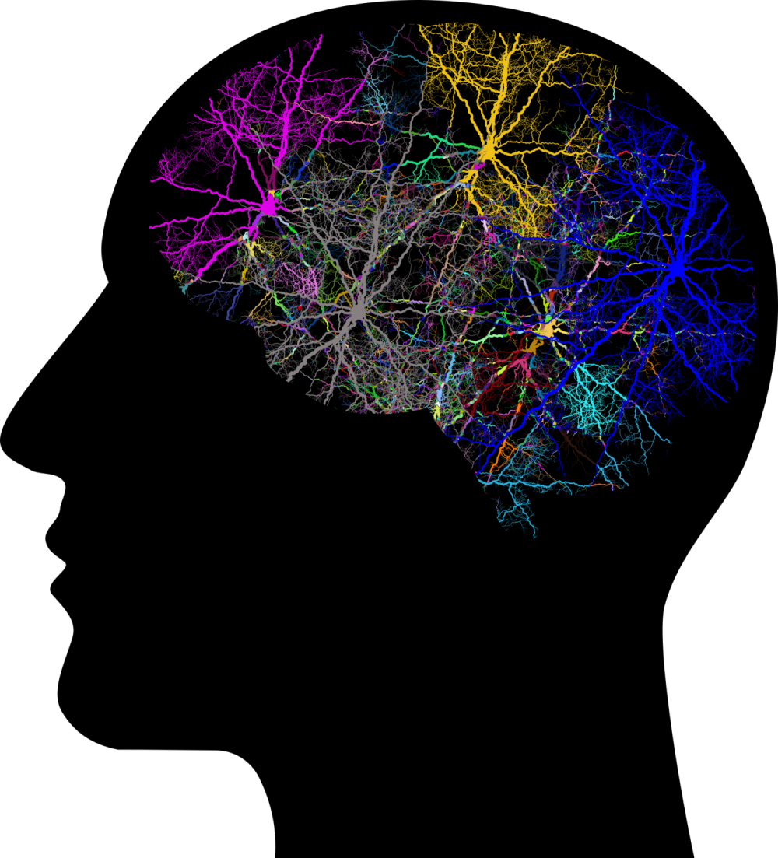
Obsessive-Compulsive Disorder: An Overview
Mental disorder that effects 2 – 3% of the United States, 1 – 2% of the world
Obsessions – The ego-dystonic “intrusive thoughts”, causes distress
Compulsions – The actions/habits that people will perform to alleviate the distress of the obsessions
Comorbidities include depression, anxiety, eating disorders, tic disorders
Even with optimal treatment, including therapy (CBT, ERP) and medications, only 35% of patients reach “remission”

Slide 3
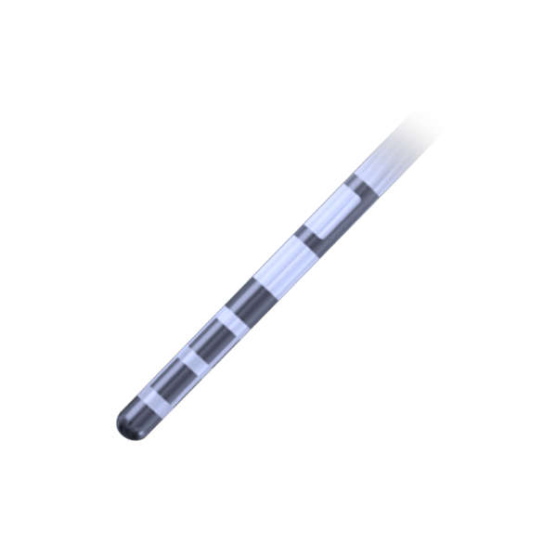
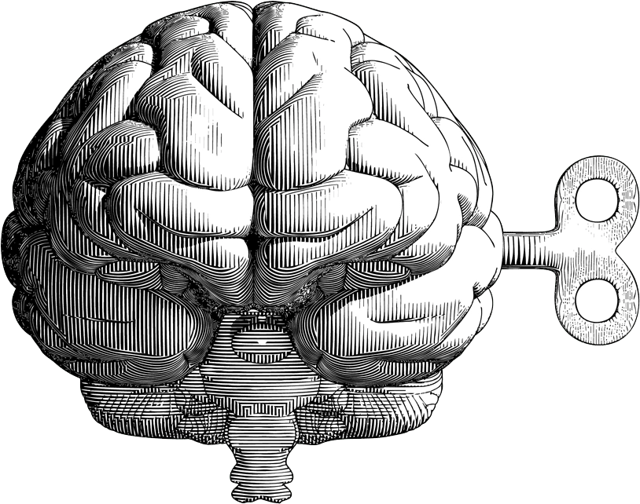
Deep Brain Stimulation
Example of lead with four electrode positions
Multiple positions allows for a large range of settings
Programming after surgery looks for ideal settings
Amplitude (V)
Pulse width (T)
Frequency
Electrode configuration
Lead
Electrodes
Invasive procedure designed in 1987 for essential tremor, used for other illnesses since such as Parkinson’s
Electric stimulation of the ventral internal capsule/ventral striatum (motivated behavior)
Granted Humanitarian Device Exemption for OCD in 2009
4
3
2
1
Extension Wire
Pulse Generator

Slide 4
INCLUSION CRITERIA
EXCLUSION CRITERIA
YBOCS score ≥ 28
20+ sessions of ERP
At least 3 trials of SSRIs, one of which being Clomipramine
At least one month using benzodiazepines
At least one month using an anti-psychotic
Any previous or current psychotic disorders
Previous or current bipolar disorders
Active substance abuse
Active eating disorders
Active and intentional suicidality
Criteria for DBS Participation

Slide 5
CU Anschutz Medical Campus has nine current patients undergoing DBS programming for their obsessive-compulsive symptoms.
Data has been kept for each patient over their time in the program.
Scores are taken for multiple scales related to OCD and its comorbidities, including...
YBOCS (OCD)
MADRS (Depression)
HAM-A (Anxiety)
YMRS (Mania)
Q-LES-Q-SF (Quality of Life)

Slide 6
This study analyzed the collected data, testing for possible significant trends in the scores of patients.
Before analysis, it was predicted that each patient would improve in their scores on each of the five scales over time.

Slide 7
Methods
Participants
Eight adults
Participation ranges from 2-7 years
One patient taken out of data analysis due to insufficient duration of programming
6 men, 2 women
Data Collection
Five rater-administered scales given to patients before their programming sessions.
Patients also underwent CBT and ERP therapies while continuing with programming
Data was taken from the following points in time:
Data Analysis
One-way ANOVA was used to measure significant effects between scores and point in time.
Time = Independent
Score = Dependent
Pairwise T-test was used to check for significant differences between each point in time
One month
Six months
Two years
Before programming
Three months
One year
Before surgery

Slide 8
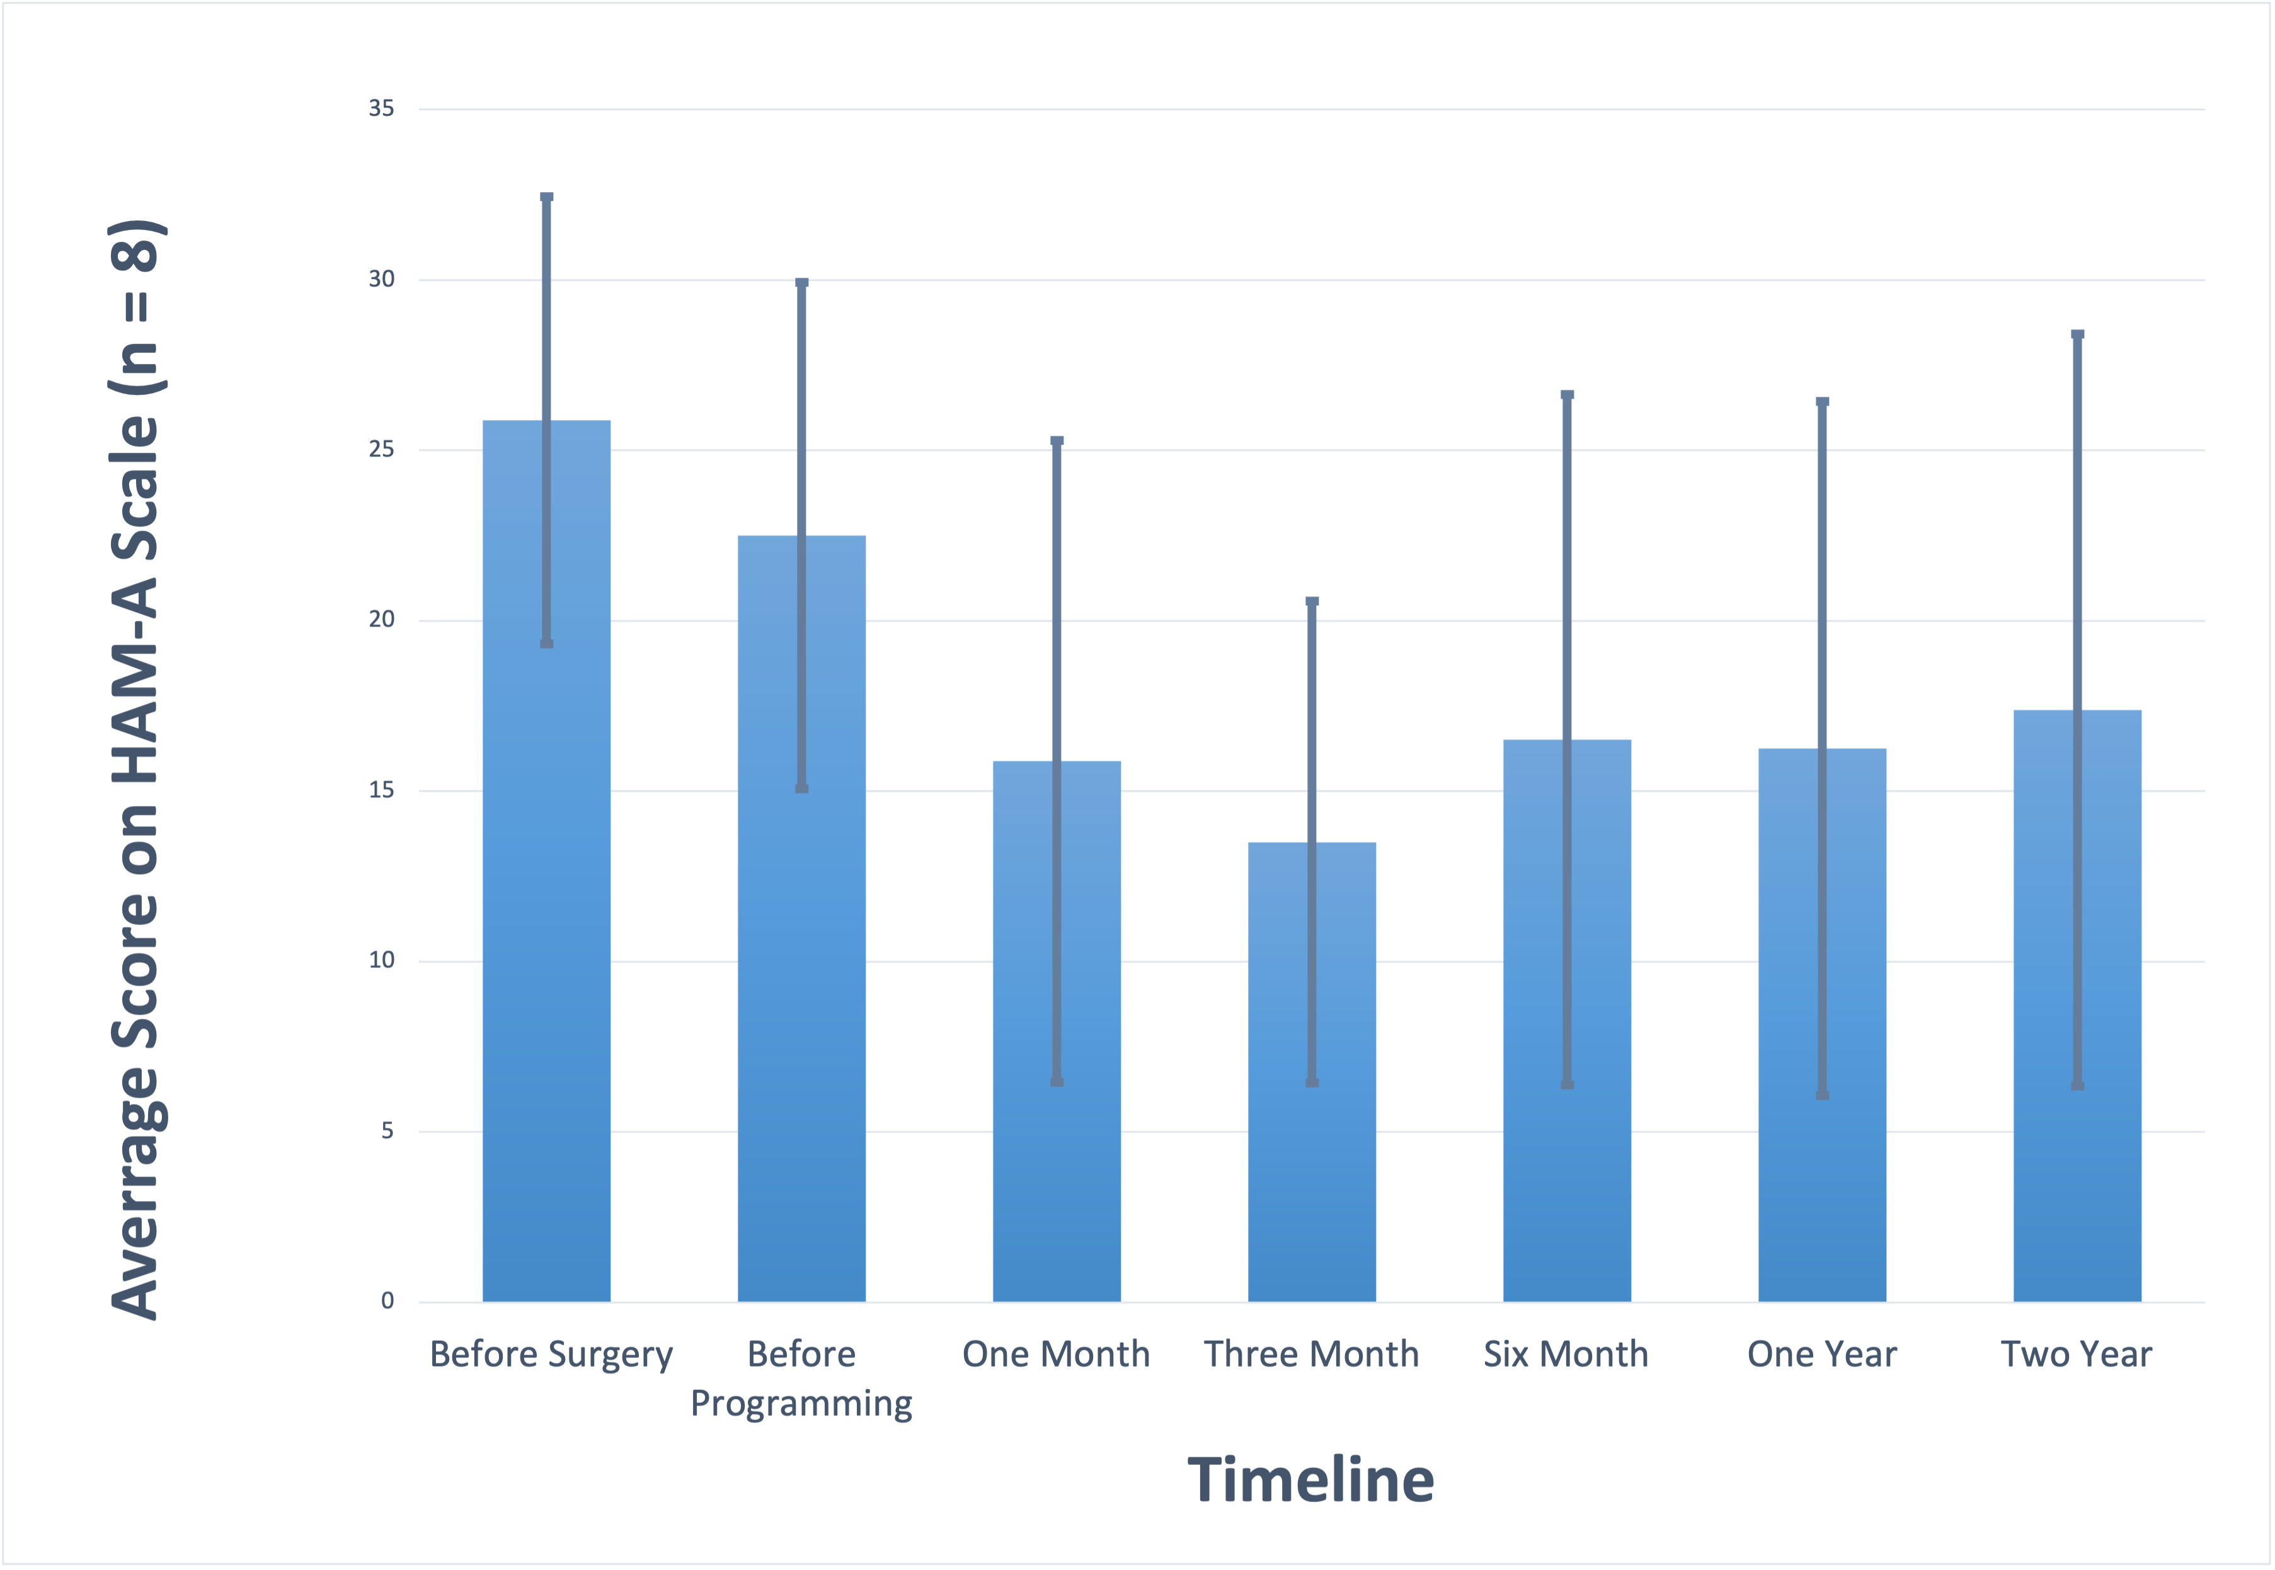
HAM-A
No post-hoc test required

Slide 9
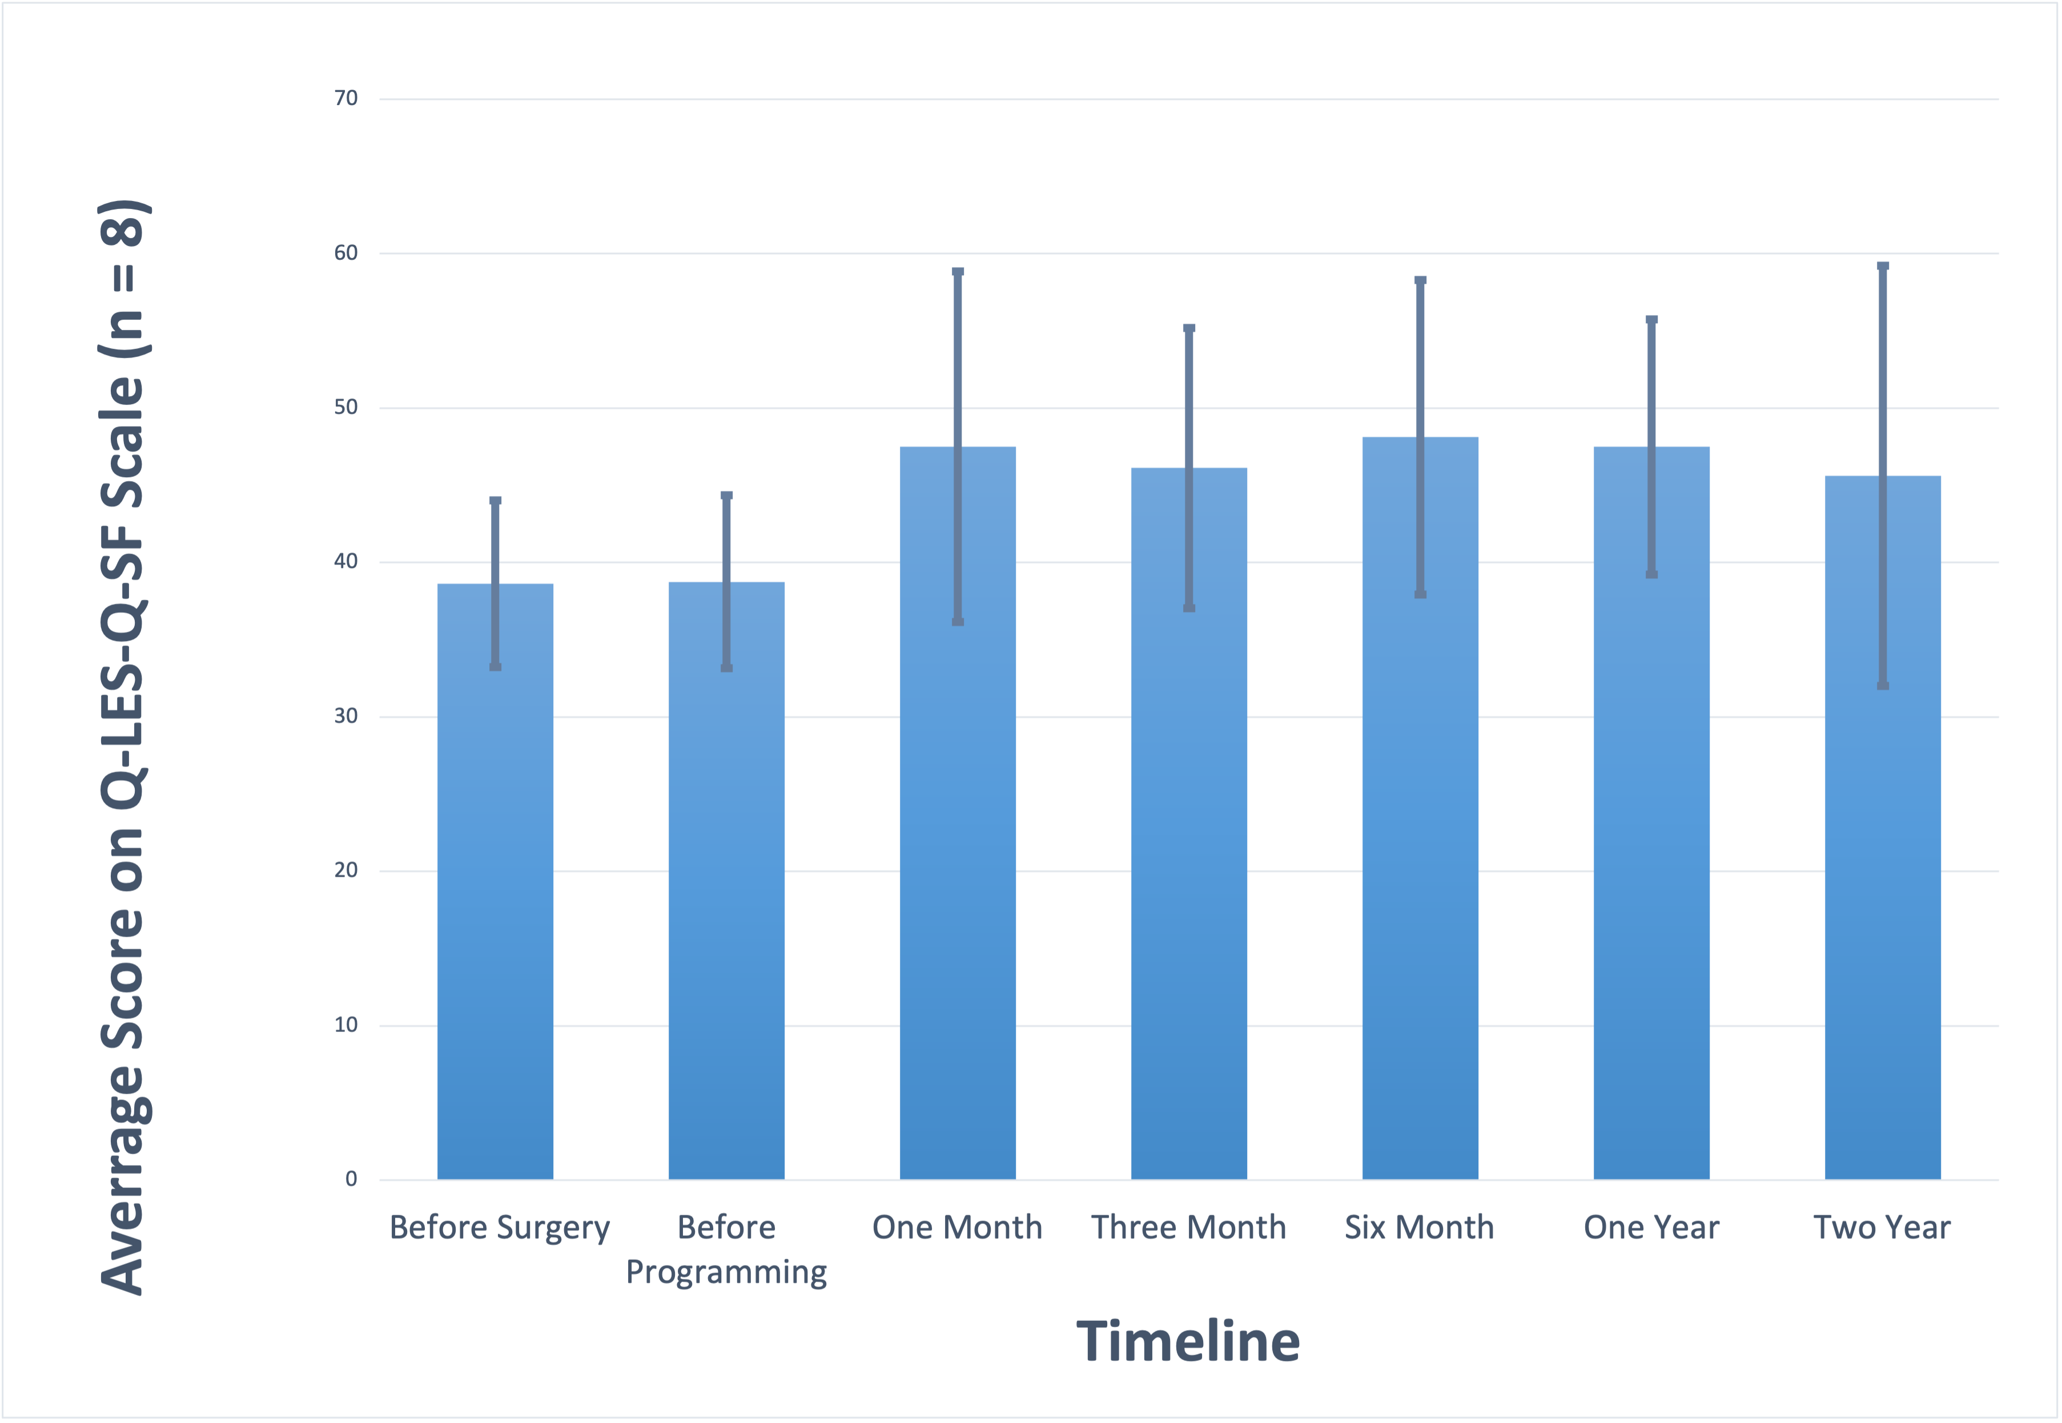
Q-LES-Q-SF
No post-hoc test required

Slide 10
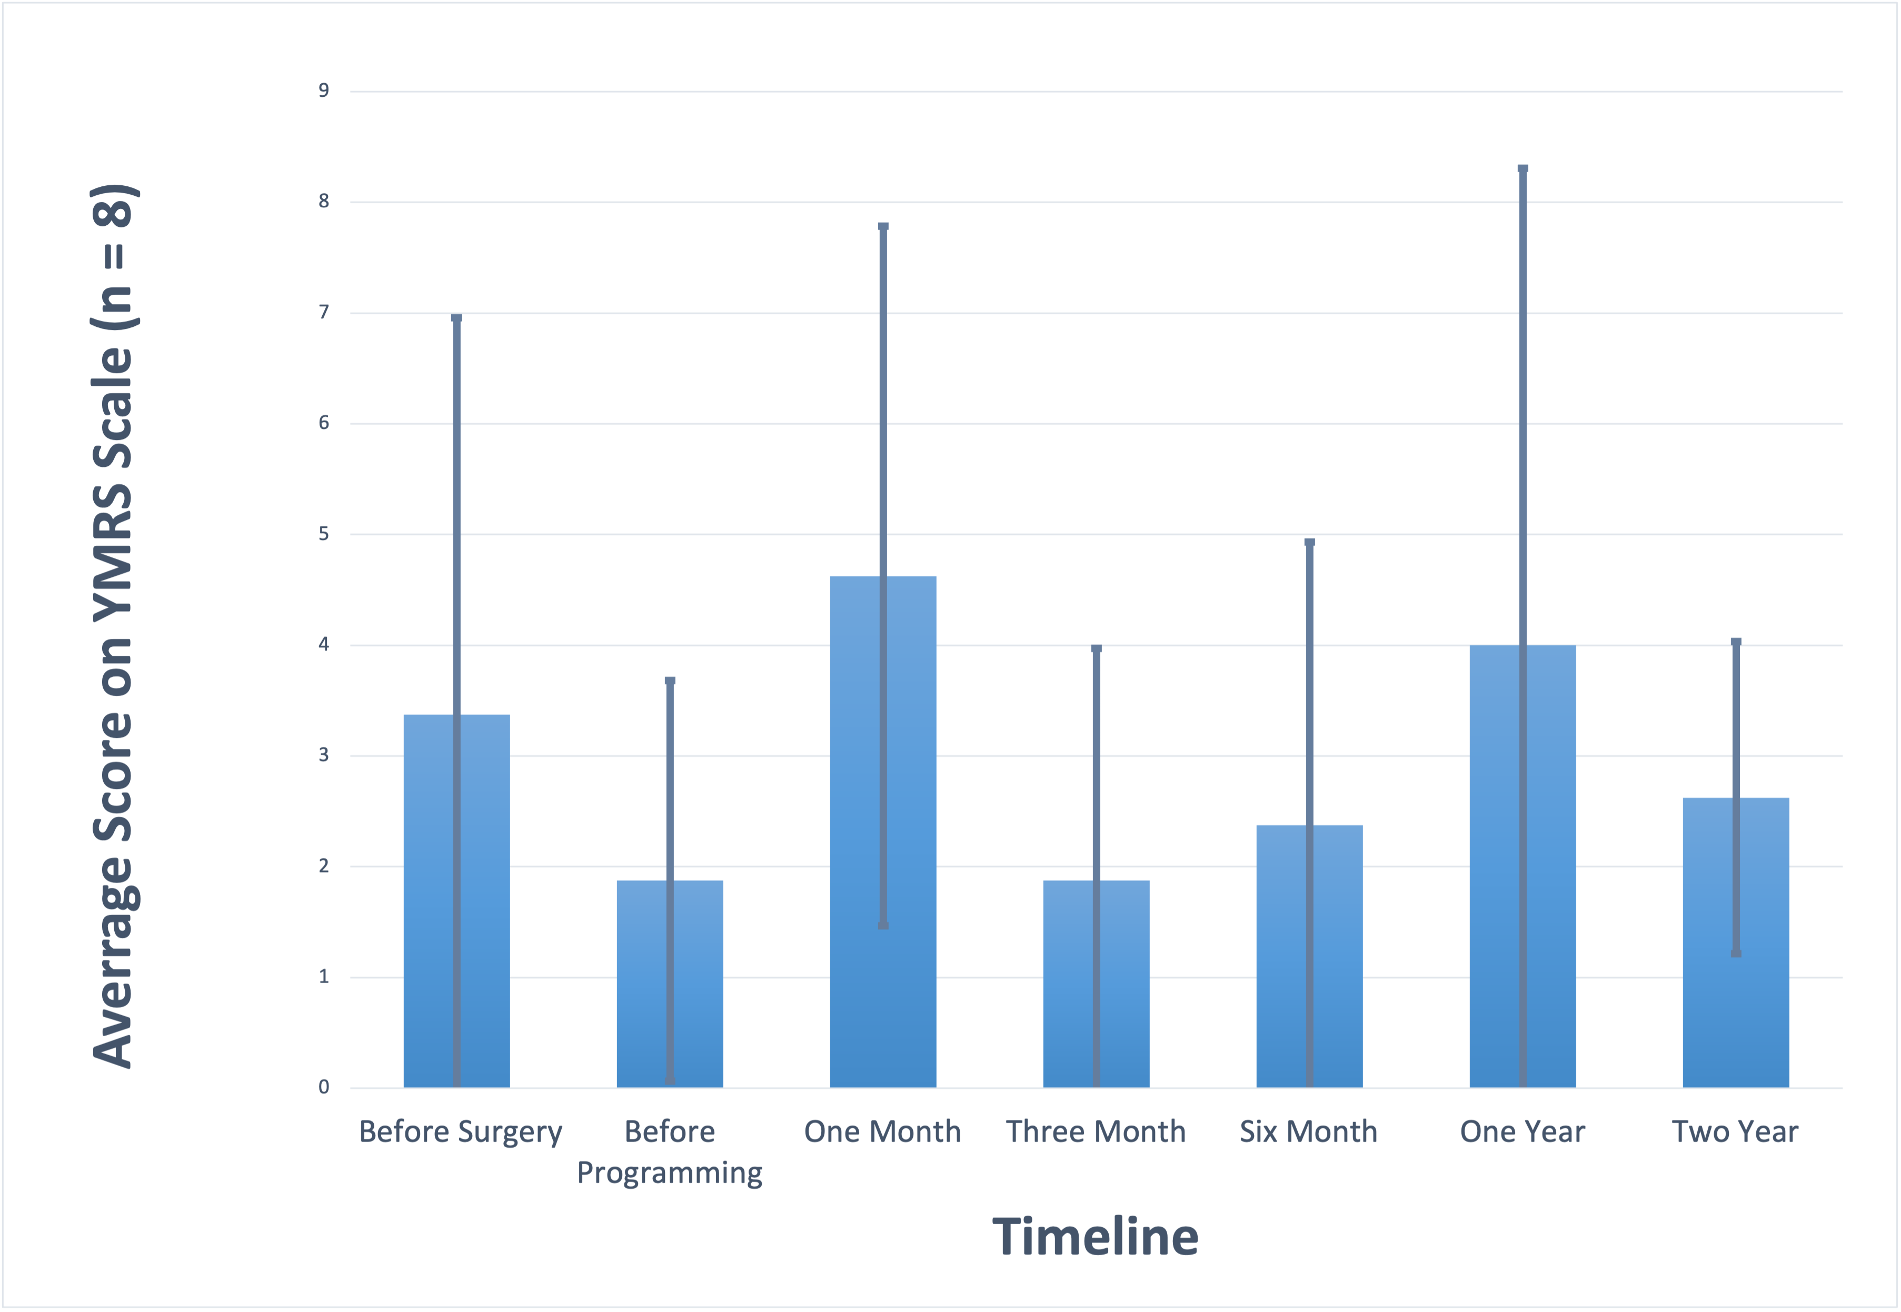
YMRS
No post-hoc test required

Slide 11
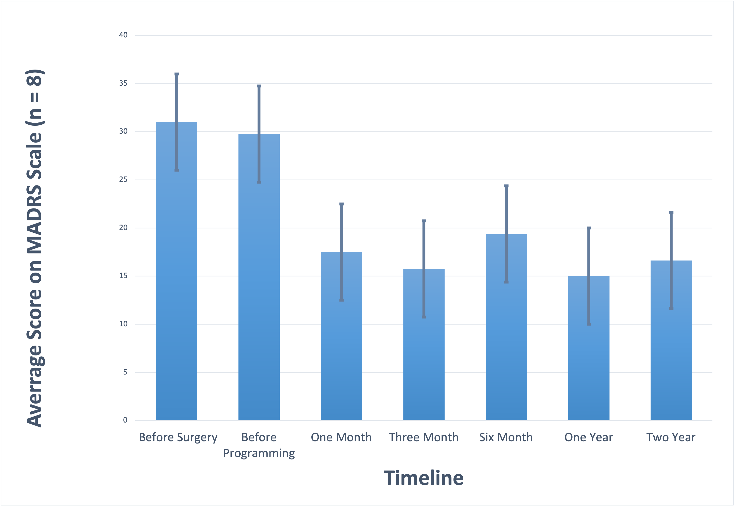
MADRS

Slide 12
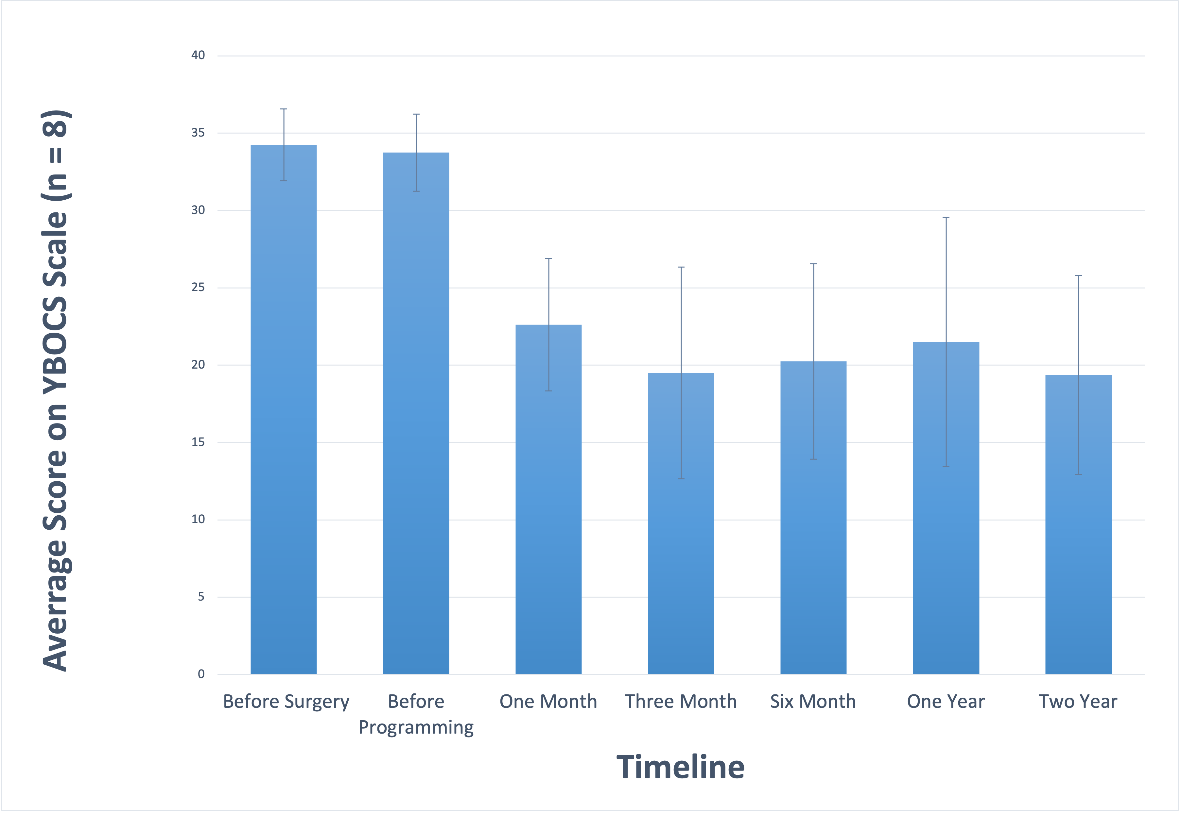
YBOCS

Slide 13
YBOCS/MADRS see significant effects
The only scales that upheld the prediction going into the study
YBOCS directly measure OCD
Depression is a prevalent comorbidity with OCD
Q-LES-Q-SF/HAM-A come up as insignificant
P-values indicate a trend towards significance
Notable stagnation in social quality of life on scales, could be holding the effect in check
This could also be seen in possible remaining social anxiety
YMRS shows least effects at p = 0.372
YMRS analysis nearly shows instances of increased mania symptoms
Could possibly provide quantitative proof as to why bipolar disorder remains an exclusion factor for DBS treatment
Discussion

Slide 14
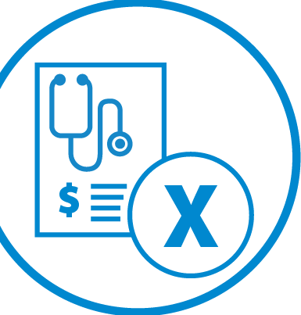
Implications
The Federal Parity Act (2008) was passed in order to equalize access to clinical care for mental illness with that of physical illness
Insurance companies continuously deny claims related to DBS for OCD, claiming it to be “investigational and not medically necessary”
Lack of available sample size doesn’t allow DBS to shed its HDE status
HDE status continues to bother insurance companies
This study suggests:
DBS is especially effective in targeting OCD
Comorbidities follow suit, which makes sense
Possible quality of life improvement
Far more research is required → insurance policies need to change to allow greater sample size

Slide 15
Future Directions
Strengths
Strong uniformity between patients in treatment
Long duration of study – 7 years for some people
Main-focus in clinically treating patients – research comes as a bonus
Further (and ongoing) exploration into quality-of-life trends among DBS patients
Weaknesses
Limited sample size
Inconsistent time intervals between patient’s visits – points in time aren’t the same for everyone
Altruism within OCD patients
Further research on DBS and obsessions vs. compulsions, types of each

Slide 16
References
https://www.ncbi.nlm.nih.gov/pmc/articles/PMC8387630/
https://www.ncbi.nlm.nih.gov/pmc/articles/PMC8631971/
https://www.hopkinsmedicine.org/health/treatment-tests-and-therapies/deep-brain-stimulation
https://www.ncbi.nlm.nih.gov/pmc/articles/PMC8044872/
https://www.ncbi.nlm.nih.gov/pmc/articles/PMC4093791/
Special thanks to Emily Hemendinger, Dr. Rachel Davis, and the entire PURPLE staff for all your help this summer

