Slide 1
Social Determinants of Health and Adolescent Depression in Pediatric Primary Care
Jenny Nguyen¹, Ayelet Talmi, PhD^{2,3}, & Jessica Kenny, PhD^{2,3}
The Psychiatry Undergraduate Research Program and Learning Experience¹, Children’s Hospital Colorado², University of Colorado School of Medicine³

Slide 2
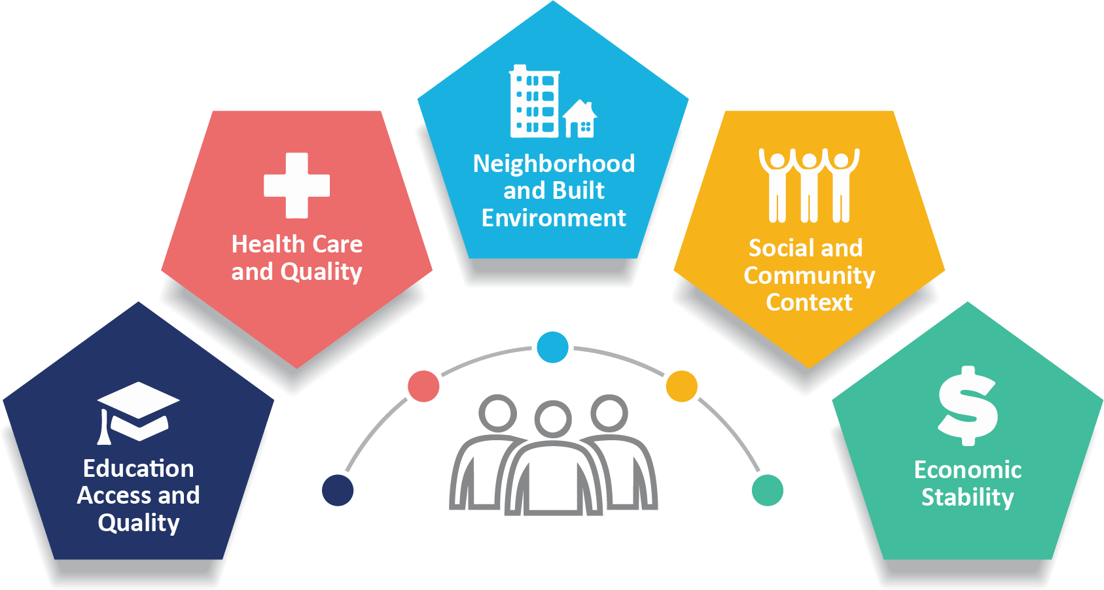
Background
Psychological problems are under-identified & under-treated in adolescents; specifically in low-income, ethnically-diverse & racially-diverse youth (Thomas et al, 2011).
Social determinants of health (SDoH) can affect access to mental health care for adolescents
Economic variables related to income may contribute to parental/caregiver mental health
Parental/caregiver mental health ↔ adolescent mental health
Notes:
Psychological problems are often undertreated in adolescents, specifically in low-income, ethnically-diverse and racially-diverse youth.
Click for this: Mental health treatment disparities that impact an individual’s ability to obtain mental health care and maintain optimal mental health (Kenny et al., 2021) may be impacted by factors of social determinants of health.
Social determinants of health are complex circumstances such as political, socioeconomic, & cultural, in which individuals are born and live in.
Some aspects of social determinants of health include access to healthcare and education, having safe and adequate housing environments, access to nutritious food and water, and other resources.
Click for this: Previous studies have shown that economical variables related to income may impact parental and caregiver mental health. Since adolescents can be affected by parental mental health, the parental distress from psychosocial concerns is related to the likelihood of adolescents developing mental health concerns as well.

Slide 3
Importance of Issue
SDoH are magnified during times of crisis, such as the COVID-19 pandemic (Islam & Matiz, 2020)
During COVID-19, minoritized communities were faced with:
reduced access to care
inadequate supplies (food, water, medications) (Islam and Matiz, 2020)
Healthcare policy reform, funding, & care delivery → ongoing mental health crisis
Notes:
Addressing social determinants of health in adolescent depression is important because of the increasing problems that minoritized communities are facing. Additionally, SDoH that disproportionately affect minoritized populations are specificially magnified during times of crisis, such as the Covid-19 pandemic (Islam & Matiz, 2020). Reduced access to care and inadequate supplies are examples of barriers that families may have faced that could’ve impacted their ability to obtain mental health care.
*Click for this*: Increased understanding of the relationship between SDoH and adolescent depression is important for healthcare policy reform, funding, and care delivery to address the ongoing mental health crisis.

Slide 4
Why I Am Interested
My own experiences with social determinants of health & mental health; directly and indirectly
Notes:
I am specifically interested in this research topic due to my own experiences throughout the years with socioeconomic and cultural barriers such as finding affordable care, economic instability, and language barriers that impacted my own family’s well-being and overall mental health.

Slide 5
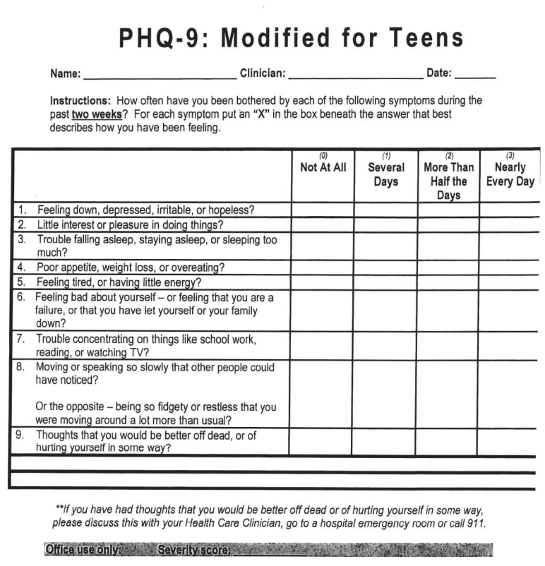
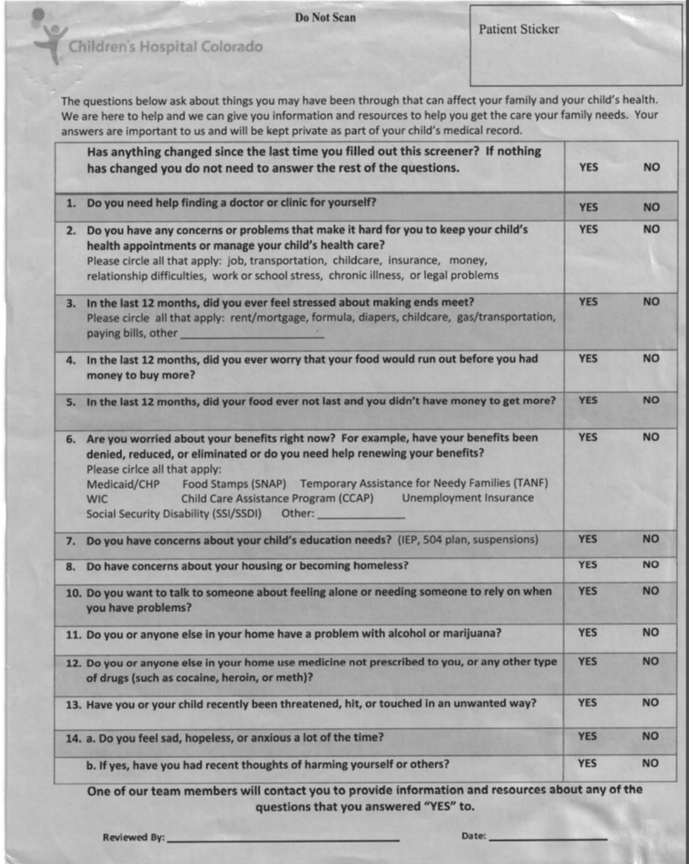
Patient Health Questionnaire for Adolescents (PHQ-9A; Johnson et al., 2002)
Psychosocial Screener (PSS) (Talmi & Poole, 2010)
Notes:
To provide some context, the two screeners used for the study are the Patient Health Questionaire for Adolescents or PHQ-9A screener shown on the left, and the psychosocial screener is pictured on the right in gray. The PHQ-9A is a validated screening tool that is widely used to assess depression symptoms for adolescents aged 11-older, particularly in medical and primary care settings.
The psychosocial screener is given to parents or caregivers and are used to assess SDoH needs related to: transportation, food, housing, education, caregiver well-being, & safety.

Slide 6
Objectives
1
Associations between items on the PHQ-9A and psychosocial screener (PSS)
2
Prevalence rates of adolescent depression symptoms
3
Prevalence rates of needs related to social determinants of health for families of adolescents
Notes:
For this research project, the primary aim and what I was most interested in looking at for the study were the associations between items on the PHQ-9A and psychosocial screener. I examined which items on the PHQ-9A and psychosocial screener were associated with one another in the context of family well-being and adolescent depression to better understand the relationship between family well-being and adolescent depression in pediatric primary care.
The supporting objectives were to examine the prevalence rates of adolescent depression symptoms seen in the clinic and the prevalence rates of psychosocial needs related to social determinants of health for families of adolescents.

Slide 7
Hypothesis
PSS items related to resource needs will be positively correlated with elevated PHQ-9A items.
Notes:
My hypothesis was that psychosocial screener items related to resource needs such as food, housing, and educational resources will be positively correlated with elevated PHQ-9A items.

Slide 8
Methods
Setting:
urban residency training pediatric primary care clinic
fully integrated behavioral health clinicians (respond to elevated PHQ-9)
community health navigators (respond to psychosocial screener needs)
Data Collection:
Adolescents aged 11 and older (except those with Autism, developmental, and intellectual disabilities) complete the PHQ-9A at every clinic visit
All families complete the PSS (Talmi & Poole, 2010) to assess SDoH needs
Electronic medical records and flowsheets yielded visit data, demographics, and PHQ-9A and PSS results from 1/1/19 - 4/30/22
Notes:
The setting of this research is in an urban residency training pediatric primary care clinic. In this clinic, there are fully integrated behavioral health clinicians that address elevated PHQ-9 scores, and community health navigators that address needs identified on the psychosocial screener.
*Click for data collection*:
For the Data Collection:
Adolescents aged 11 and older (except those with Autism, developmental, and intellectual disabilities) complete the PHQ-9A at every clinic visit.
All families complete the PSS to assess social determinants of health needs.
Data was gathered from electronic medical records that consisted of visit data, demographics, and both screener results from 2019 to 2022.

Slide 9
Statistical Methods
Chi Square Tests: demographics
Pearson’s Correlations: associations
Data from the first visit with an elevated screener (either PHQ-9A or psychosocial screener) were used (Visit 1)
Sample
Patients Screened:
PHQ-9A: N= 4,226 → 610 elevated
PSS: N= 3,565 → 821 elevated
Overall throughout 3-year study period: N= 1,340 had either an elevated PHQ-9A or PSS
Notes:
Statistical Methods:
Chi square tests were run to examine prevalence rates of elevated screener scores within different demographical variables.
Pearson’s correlations were run between individual PHQ-9A and psychosocial items based on data from the first visit where elevated scores (either for the PHQ-9A screener or the psychosocial screener) were reported.
For the Sample at Visit 1: 4,226 PHQs completed with 610 elevated; 3,565 Psychosocials completed with 821 elevated.
Then overall, throughout the 3 year study period, 1,340 had either an elevated PHQ-9A or psychosocial score

Slide 10
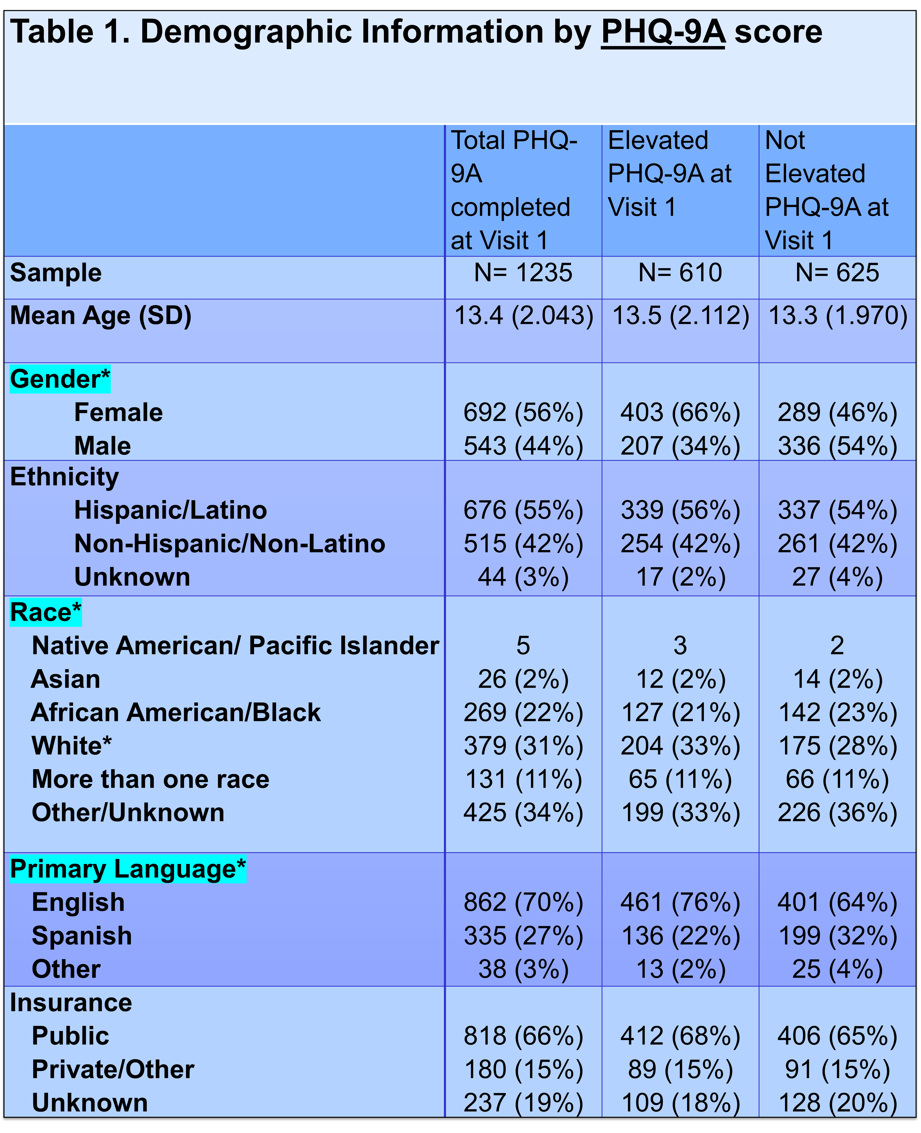
Demographic Results
Gender: More females and fewer males than statistically expected
Race: More white patients than statistically expected
Language: More English-speaking and fewer Spanish-speaking patients than statistically expected
Notes:
The demographic tables show elevated vs. non-elevated patients at Visit 1, based on variables such as age, gender, ethnicity, race, primary language spoken, and type of health insurance used.
This table, Table 1 compares demographic data for those with an elevated PHQ-9A score vs. those with non-elevated scores.
This table showed that gender, race, and language had significant results.

Slide 11
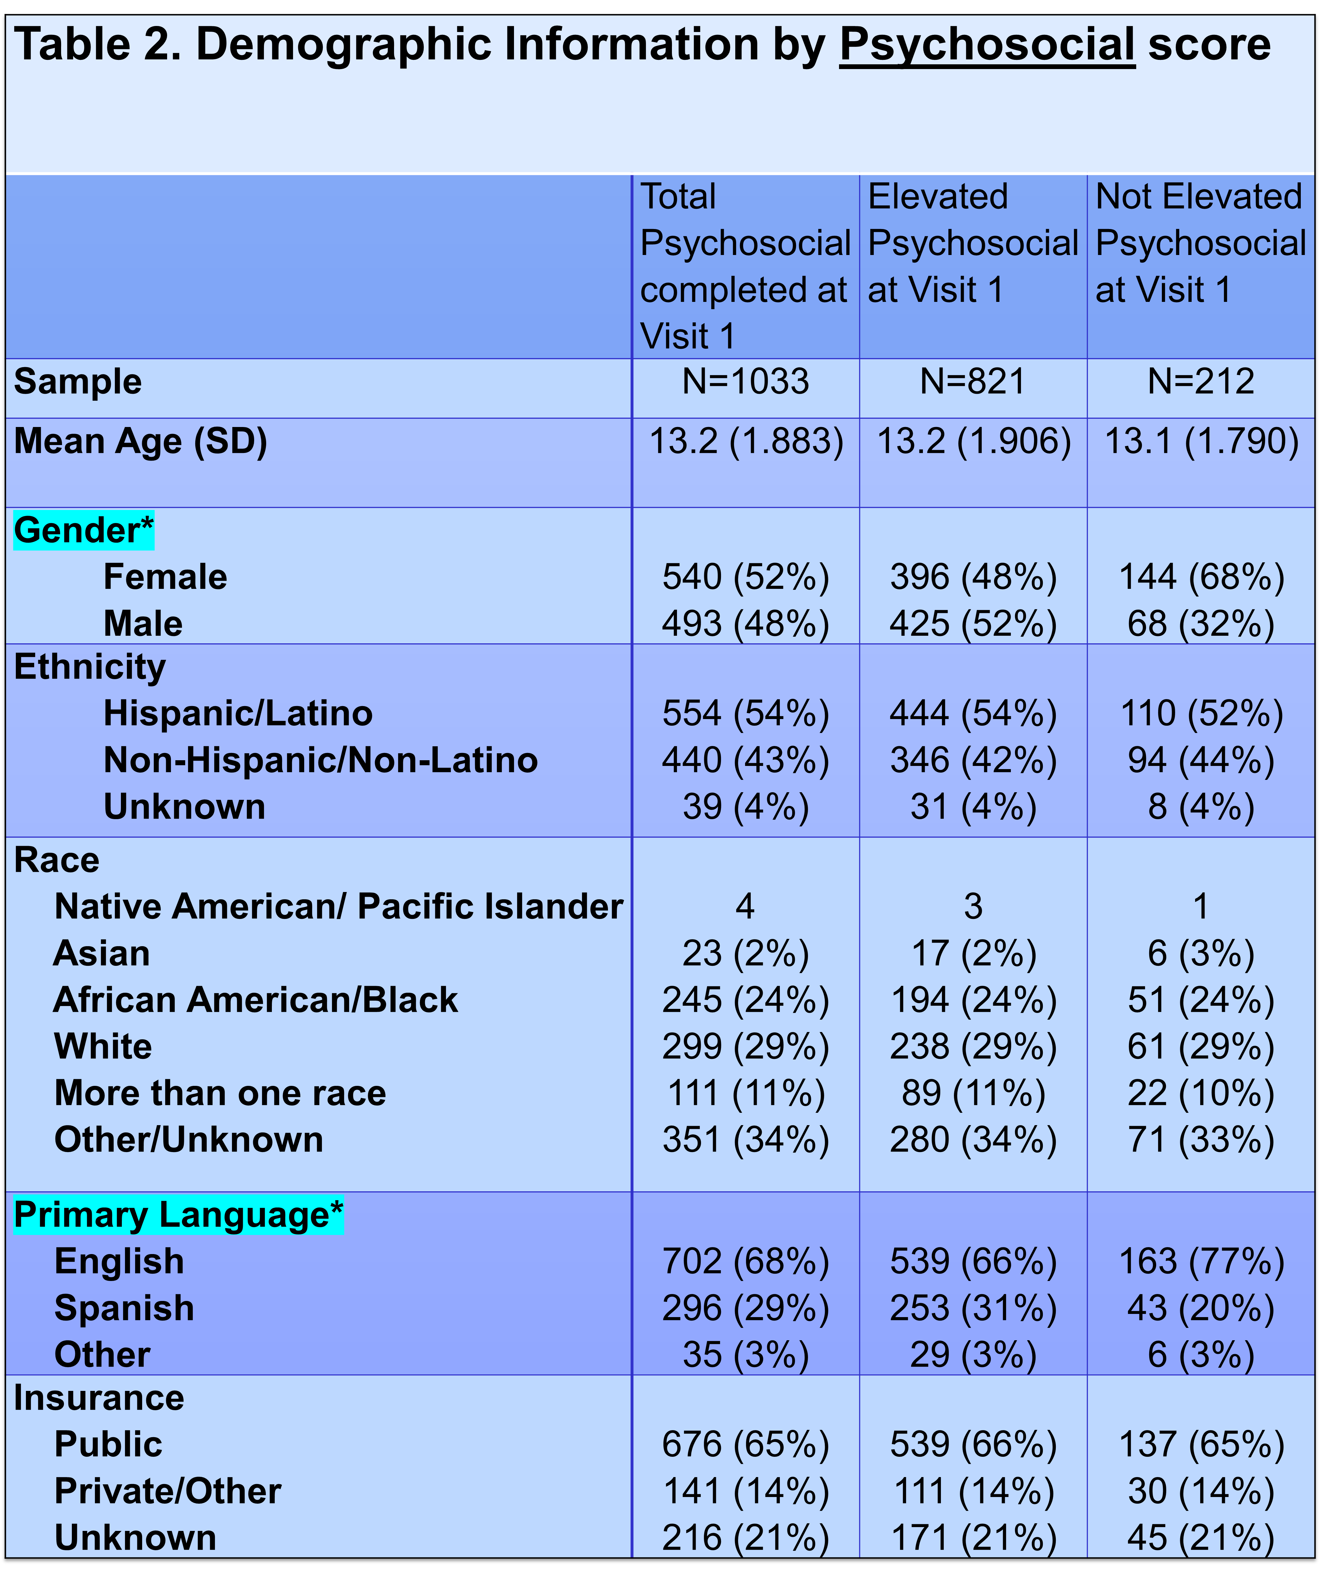
Demographic Results
Gender: Fewer females and more males than statistically expected
Language: Fewer English-speaking and more Spanish-speaking patients than statistically expected
Notes:
Table 2 compares demographic data for those with an elevated PSS score & those with non-elevated PSS score.
For the elevated psychosocial screener scores, gender and language had significant results.

Slide 12
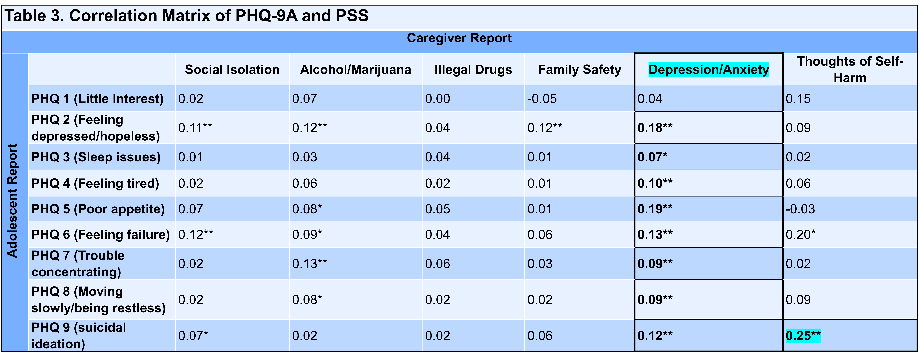
Correlation Matrix Results
Notes:
Table 3 shows the Correlation Matrix derived from the Pearson’s correlation tests between items on both screeners.
The psychosocial questions that caregivers filled out are listed across at the top, and the PHQ-9A questions that the adolescents reported to are listed on the left-hand side.
The correlation matrix shown only includes the significant relationships, which were between family well-being and adolescent PHQ-9A items.
There were no significant relationships between resource needs items on psychosocial screener and items on the PHQ-9A screener, therefore they were not shown in the correlation matrix.
Other results show that almost all PHQ-9A items were significantly correlated with caregiver psychosocial item “Depression & Anxiety”.
And the strongest relationship seen in the matrix was between PHQ-9A item 9: Adolescent Suicidal ideation and Psychosocial item: Caregiver thoughts of self-harm

Slide 13
Discussion
Resource needs items on PSS were not correlated with PHQ-9A items.
Caregiver mental health and family well-being have stronger association with adolescent depression.
Findings are consistent with previous studies on relationship between parental/caregiver mental health & adolescent mental health.
Notes:
The hypothesis was not supported by results because resource needs items on the psychosocial screener were not correlated with PHQ-9A items.
Caregiver mental health and family well-being had a stronger association with adolescent depression and overall mental health.
This may mean that resource needs may be a contributor to family well-being by causing distress and affecting family mental health, which affects adolescent mental health.
Findings are also consistent with previous studies on the relationship between parental and caregiver mental health and adolescent mental health.

Slide 14
Discussion
Addressing concerns related to caregivers’ resource needs → improve caregivers’ mental health → decrease adolescent depression symptoms.
Intervention, training, & funding/reimbursement.
Comfort level in reporting depressive symptoms may vary based on demographic differences.
Certain minoritized groups may have more psychosocial needs.
Notes:
Further discussion may be that addressing the concerns related to a caregiver’s resource needs may improve the caregiver’s mental health, which may, in turn, decrease adolescent depression symptoms.
Care coordination and behavioral health navigator involvement for resources to address caregiver mental health and well-being are especially important areas for intervention, training, and funding/reimbursement in addressing adolescent and family mental health.
It is also important to look at the demographic results. The demographic differences could suggest: Certain groups of individuals may feel more or less comfortable reporting depressive symptoms than others, and certain minoritized groups may have more psychosocial needs.

Slide 15
Limitations
Self-reports from adolescents (PHQ-9A) & caregivers (PSS)
Human error may be present when raw paper data is manually inputted into datasets
Notes:
For the limitations of this study, the data are based on self-reports from adolescents (PHQ-9A) & caregivers (PSS) on the screeners. Additionally, since the data was manually inputted into the electronic system by hand, it may contain some human error. To address this, reviewing raw screening data and conducting an integrity check will help to ensure accuracy.

Slide 16
Future Implications
Longitudinal analyses
resource needs and family-level factors
Intervention methods & focus
adolescent depression or family/parental well-being is more effective for overall family and adolescent mental health
Identify & examine contributing factors
caregivers’ psychosocial needs based on demographic differences
Notes:
Future research could focus on longitudinal analyses that examine resource needs and family-level factors that may impact adolescent depression scores.
Examining which intervention method or focus (intervening on adolescent depression or intervening on family/parental well-being) is more effective for overall family and adolescent mental health could be another future implication.
Identifying and examining factors that may contribute to caregivers’ psychosocial needs based on demographical differences may be helpful as well.

Slide 17
Thank You!
PURPLE Mentors: Dr. Jessica Kenny & Dr. Ayelet Talmi
Project CLIMB Team
Amanda Millar, MSS
Dr. Ron-Li Liaw: Chair of PMHI
PURPLE mentors, sponsors, & faculty members
Dr. Neill Epperson: Chair of Department of Psychiatry
Dr. Dominic Martinez: Director Office of Inclusion and Outreach
Emmaly Perks, Yunliang (Lily) Luo,
Shanna Trott
Notes:
Thank you Dr. Jessica Kenny and Dr. Ayelet Talmi for the opportunity to work alongside them for this research, their mentorship, and their amazing support.
Thank you to the project CLIMB team for the inclusivity and support.
Thank you Amanda Millar, MSS for helping with the data and results tables.
Thank you to all of the faculty members, sponsors, and mentors that contributed to the program.
Lastly, thank you to Emmaly, Lily, and Shanna for all their support throughout the entirety of the PURPLE program.

Slide 18
Notes:
I would like to take a few minutes at the end for questions or comments that you may have.

