Slide 1
Relationships Between Early Life Experiences and Health Risk Behaviors in Adulthood
Mentee: Luis Alan Martinez
Mentor: Christine Garver-Apgar, PhD

Slide 2
Background Information
Adverse Childhood Experiences (ACEs)
Linked to higher prevalence of a range of chronic diseases, as well as mental disorders
Benevolent Childhood Experiences (BCEs)
May act as a protective factor during development, and are associated with more favorable developmental trajectories

Slide 3
ACEs
BCEs

Slide 4
The Current Project
Hypothesis: As exposure to ACEs and other adverse experiences increases and exposure to BCEs decreases, sleep quality, healthy dietary behaviors, and physical activity will significantly decrease, additionally, the age of first reported nicotine use will also decrease.
Significance:
Gaps in the literature
BCEs and health behaviors
Expanding on broader range of adverse childhood experiences
Sex differences
Future Interventions
ACEs Healthy Behaviors
BCEs Healthy Behaviors

Slide 5
What are we asking?
Question 1: How, and to what extent, are different types of childhood experiences (both favorable and adverse) associated with adult health behaviors?
Question 2: Do the above relationships differ between men and women?

Slide 6
Methods/Measures
Procedure: Online surveys (Research Match)
Measures:
Early Life Experiences
Adverse Childhood Experiences Survey (ACE)
Childhood Unpredictability (QUIC)
Childhood SES
Childhood Violence
Benevolent Child Experiences (BCE)
Health Behaviors
Physical Activity: International Physical Activity Questionnaire (IPAQ)
Sleep: Pittsburgh Sleep Quality Index (PSQI), Sleep Related Impairment (PROMIS-SF)
Dietary Behaviors: Adapted from the Family Nutrition and Physical Activity survey (FNPA)
Tobacco: (Lifetime user Yes/No, Age of first use)

Slide 7
Participant Demographics
Number of Participants | 161
Male Female Not Listed/Not Disclosed | 44.7% 54.8% 1.8%
White/Non-Hispanic | 90.7% | 146

Slide 8
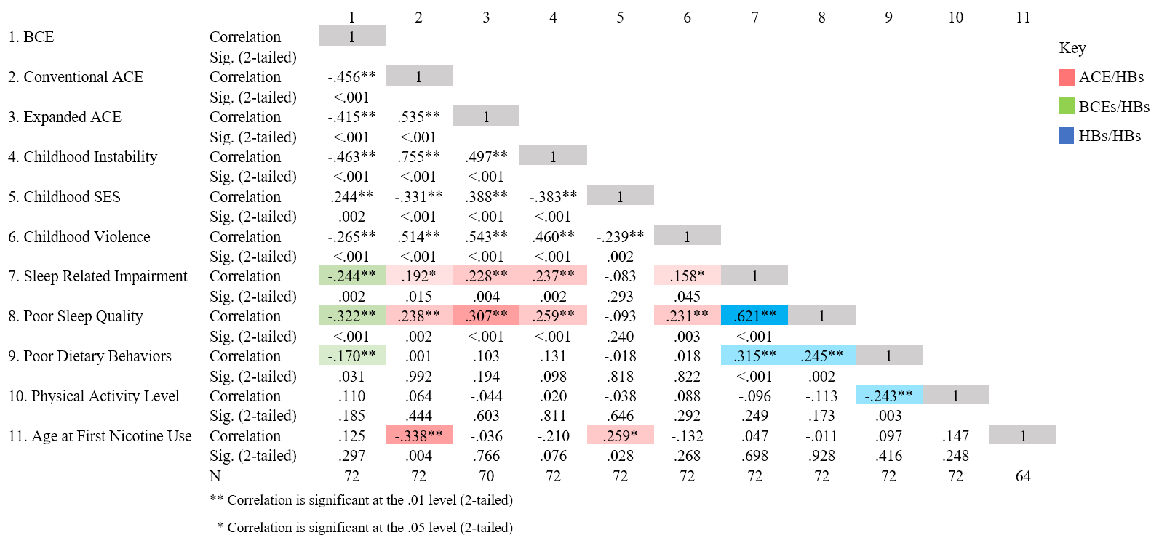
ACE/BCE Associations

Slide 9
Sex Differences
Sex differences:
Main Effects
Compared to men, women reported higher levels of unpredictability during childhood, poorer sleep quality and more sleep impairment.
Men reported marginally higher levels of nicotine use
No other statistically significant findings for childhood experiences or health behaviors
No evidence of sex differences

Slide 10
Limitations
Limitations
Limited generalizability
Small sample size (N=161)
Highly educated sample (70% held 4-year degrees)
Primarily white sample (91% White)
Self-selected and self-reported format

Slide 11
Future Directions
Future Directions
Further exploration of unique childhood experiences
Neurodevelopmental mechanisms (stress functioning, emotional regulation, cognitive adaptations)
Figuring out the WHY
Further exploration of potential sex differences

Slide 12
Acknowledgements and Affiliations
Dr. Christine Garver-Apgar
Dr. Douglas Novins, Chair of PMHI
Dr. Neill Epperson, Chair of Department of Psychiatry
Dr. Dominic Martinez, Dir. Office of Inclusion and Outreach, CCTSI
Lily Luo
Emmaly Perks
The Psychiatry Undergraduate Research Program and Learning Experience (PURPLE), Research Education Core, Psychiatry Research Innovations (PRI)
Department of Psychiatry, University of Colorado Anschutz Medical Campus

Slide 13
References
¹ Duffy, K. A., McLaughlin, K. A., & Green, P. A. (2018). Early life adversity and health-risk behaviors: Proposed psychological and neural mechanisms: Early life adversity and health-risk behaviors. Annals of the New York Academy of Sciences, 1428(1), 151-169
² McLaughlin, K.A. (2016). Future directions in childhood adversity. Journal of Clinical Child Adolescent Psychology and Youth Psychopathology. 45, 361–382.
³ Campbell, J. A., Walker, R. J., & Egede, L.E. (2016). Associations between adverse childhood experiences, high-risk behaviors, and morbidity in adulthood. American Journal of Preventive Medicine, 50(3), 344-352.
⁴ Lovallo, W.R. (2013). Early life adversity reduced stress reactivity and enhances impulsive behavior: implications for health behaviors. International Journal of Psychophysiology, 90, 8-16.
5 Del Giudice, M., Ellis, B.J., Shirtcliff, E.A. (2011). The adaptive calibration model of stress responsivity. Neuroscience Biobehavioral Rev, 35:1562-92.
6 Trickett, P.K., Gordis, E., Peckins, M.K., Susman, E.J. (2014). Stress reactivity in maltreated and comparison male and female young adolescents. Child Maltreatment, 19:27-
7 O’Leary, M.M., Loney, B.R., Eckel, L.A. (2007). Gender differences in the association between psychopathic personality traits and cortisol response to induced stress. Psychoneuroendocrinology, 32:183-191.
8 Lee, R. D., & Chen, J. (2017). Adverse childhood experiences, mental health, and excessive alcohol use: Examination of race/ethnicity and sex differences. Child Abuse & Neglect, 69, 40-48
9 Merrick, J. S., Narayan, A. J., DePasquale, C. E., & Masten, A. S. (2019). Benevolent childhood experiences (BCEs) in homeless parents: A validation and replication study. Journal of Family Psychology, 33(4), 493-498.

Slide 14
Questions?

