Slide 1

An evaluation of board-certified behavior analyst’s relationship with various functional behavior assessment and treatment procedures: The effect of time since credentialing
Krista Luttkus,
Mentor: Patrick W. Romani
University of Colorado School of Medicine
Pediatric Mental Health Institute, Children’s Hospital Colorado
Notes:
TIP: ”Save as” this template before you begin and rename it to the title of your presentation. That way you will retain a copy of this blank template for future use.

Slide 2
Introduction
Dually diagnosed clients with neurodevelopmental and mental health disorders are at an increased risk of engaging in severe problem behaviors (Gupta et al., 2018)
The severity of these problem behaviors fall outside of the competency of many practicing board-certified behavior analysts (BCBA; Colombo et al., 2020; Oliver et al., 2015)
Notes:
Dually diagnosed clients…
These problem behaviors are often treated by BCBAs. However, the severity of these problem behaviors falls outside of the competence of many practicing BCBAs. Thus, many of these children do not have access to this essential behavioral healthcare service.

Slide 3
Introduction:
What is a Functional Behavioral Assessment?
What is an FBA?
  Groups of behavioral assessment use to determine function of problem behaviors
  Used to determine what treatments will be used
Types of Functional behavior assessments (FBA)
  Indirect assessment
    Interview (ABC) – Hanley et al. (2013)
Notes:
Determine environmental variables resulting in problem behavior

Slide 4
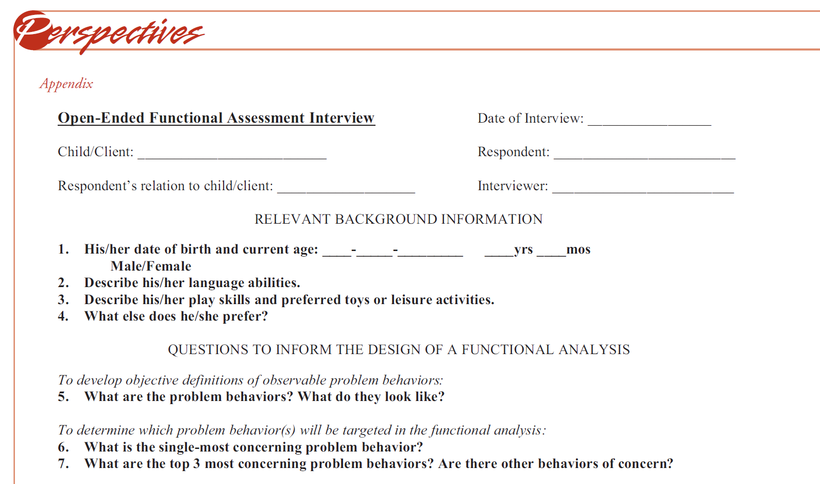
Indirect Assessment
Notes:
Determine environmental variables resulting in problem behavior

Slide 5
Introduction:
What is a Functional Behavioral Assessment?
What is an FBA?
  Groups of behavioral assessment use to determine function of problem behaviors
  Used to determine what treatments will be used
Types of Functional behavior assessments (FBA)
  Indirect assessment
    Interview (ABC) – Hanley et al. (2013)
  Descriptive Assessment
    Narrative (ABC) – Tiger et al. (2006)
Notes:
Determine environmental variables resulting in problem behavior

Slide 6
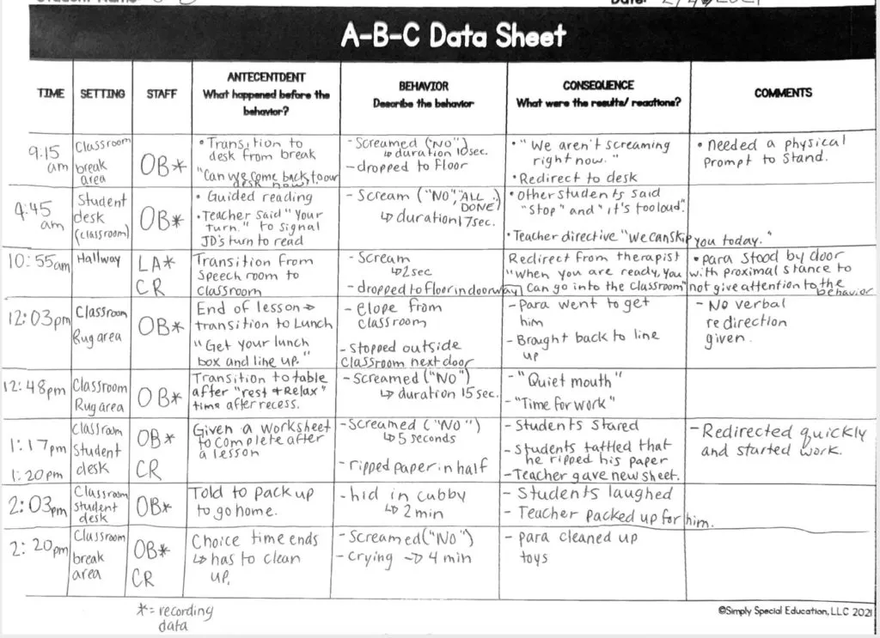
Descriptive Assessment
Notes:
Determine environmental variables resulting in problem behavior

Slide 7
Introduction:
What is a Functional Behavioral Assessment?
What is an FBA?
  Groups of behavioral assessment use to determine function of problem behaviors
  Used to determine what treatments will be used
Types of Functional behavior assessments (FBA)
  Indirect assessment
    Interview (ABC) – Hanley et al. (2013)
  Descriptive Assessment
    Narrative (ABC) – Tiger et al. (2006)
  Experimental Assessment
    Functional Analysis – Iwata et al. (1982/1994)
Notes:
Determine environmental variables resulting in problem behavior

Slide 8

Experimental Assessment
Notes:
1:31:58 1-42:34
Determine environmental variables resulting in problem behavior

Slide 9
Introduction:
Treatment Approaches
Differential reinforcement (DR)
with extinction
Teaching and reinforcing appropriate behaviors, like communication, conducted and planed ignoring
Differential reinforcement (DR) Without extinction
Reinforcing problem behaviors and also appropriate behaviors
Punishment
Individuals with highly treatment resistant problem behavior.
Notes:
Three common behavioral treatment approaches include differential reinforcement, which is a procedure for teaching and reinforcing appropriate behaviors, like communication, conducted with and without extinction.
A differential reinforcement with extinction approach involves planned ignoring and following through with expectations. Thus, the problem behaviors no longer produce reinforcement.
In contrast, differential reinforcement without extinction involves problem behavior resulting in reinforcement just like appropriate behavior.
Finally, punishment based approaches are needed for some individuals with highly treatment resistant problem behavior.

Slide 10

Differential Reinforcement with Extinction
https://www.youtube.com/watch?v=_DGl4h_Dcyg&t=2631s
Notes:
Treatments based on problem behavior
Determine environmental variables resulting in problem behavior

Slide 11
Why Year of Credentialing is Important
Best practices change over time
  For example, DR approaches have been heavily studied and refined to prevent treatment relapse (Greer et al., 2016)
Do individuals credentialed a while ago make the same decisions regarding FBA and treatment as those individuals recently credentialed?
Notes:
Important because amount of BCBAs has increased

Slide 12

Purpose
For BCBAs who have clients who engage in moderate-to-severe problem behaviors:
Use of Functional Assessment
Treatments Selections
Evaluate BCBA reported frequency and confidence using indirect, descriptive, and experimental assessment methods depending on year of credentialing
Evaluate treatment selections chosen by the BCBA after doing an FBA

Slide 13
Methods

Slide 14
Introduction
Who was included
131 credentialed behavior analysts completed the entire survey
92.0% of participants reported being White
Most participants worked in home (24%), school, (25%), clinic (24%) settings.
Years Credentialed | Precent of Respondents
14+ | 4%
12-14 | 7%
9-11 | 9%
6-8 | 28%
3-5 | 29%
0-2 | 24%

Slide 15
What We Measured
Frequency
Self reported likelihood of using different Functional Behavioral Assessments
Scale of 1 (never uses the assessment) to 10 (always uses the assessment)
Confidence
Self-reported confidence using different Functional Behavioral Assessments
Scale of 1 (never uses the assessment) to 10 (always uses the assessment)
Treatment Approaches
Self-reported likelihood of using DR procedures with and without extinction and punishment-based approaches
Score of 1 (never uses the treatment) to 100 (always uses the treatment)

Slide 16

The Needs Assessment (Survey)
Focus Group
  Evaluate current practices of BCBAs working in schools, clinics, and homes in urban, suburban, and rural areas of Colorado.
  Used to develop a Needs Assessment
Needs Assessment created in Qualtrics and sent out to BCBAs
  Sent to 1,201 BCBAs
  131 completed the entire survey (11%)

Slide 17
Results

Slide 18
Results: Frequency
Respondents reported using:
  Experimental assessment an average of 5 out of 10
  Descriptive assessment an average of 8 out of 10
  Indirect assessment an average 7 out of 10
Differences between years since credentialing
  No consistent differences
Notes:
Add a description of what problem is

Slide 19
Results: Confidence
Respondents reported feeling slightly more confident in the indirect and descriptive assessment (M = 9) than experimental assessment (M = 8).
No consistent differences between year of credentialing and confidence with various FBA procedures
Notes:
Add a description of what problem is

Slide 20
Results: Treatment Approaches
Colorado BCBAs reported using DR without extinction procedures more often than DR with extinction.
Punishment-based approaches were least likely to be used.
Slight differences between year of credential and treatment choices.
Notes:
The y axis should range from 0 – 100

Slide 21
Why Does This Matter?

Slide 22
Discussion: Main Take-Aways
Year of credentialing does not seem to affect use or confidence in using various FBA procedures.
Slight difference between year of credentialing and treatment selection
1
Despite reporting high confidence using all forms of FBA, Colorado BCBAs reported using indirect and descriptive assessment more often than experimental assessment
2
DR approaches without extinction appear to be most likely to be used with clients engaging in moderate-to-severe problem behavior.
3

Slide 23

Discussion
Choice of FBA procedures
  Relatively confident implementing all forms of FBA
    Report using indirect and descriptive modes of functional assessment more often than experimental assessment
      Similar to previous research (Colombo et al., 2020; Oliver et al., 2015)
  Implications of using less rigorous FBA
Notes:
Research shows the descriptive and indirect FBA results do not match well with the results of the experimental analysis. Thus, a BCBA may identify a false negative or false positive function of problem behavior by using these modes of FBA.
Not based on lack of confidence with FBAs (as BCBAs reported feeling confident implementing all forms of FBA)
There may be reasons, other than training, influencing choice of FBA procedure.

Slide 24
Discussion
Choice of treatment methods
  DR without extinction more often used than DR with extinction and punishment-based approaches.
    DR without extinction is often less effective than DR with extinction (Hagopian et al., 1997).
  Additionally, use of DR without extinction often led to the need for punishment approaches more often than DR with extinction.
Notes:
Research shows the descriptive and indirect FBA results do not match well with the results of the experimental analysis. Thus, a BCBA may identify a false negative or false positive function of problem behavior by using these modes of FBA.
Not based on lack of confidence with FBAs (as BCBAs reported feeling confident implementing all forms of FBA)
There may be reasons, other than training, influencing choice of FBA procedure.

Slide 25
Future Research and Limitations
Compared to Previous Research Findings
  Several studies have documented similar findings with respect to BCBA FBA and treatment choices.
  Consistent with previous research: reported using indirect and descriptive approaches more commonly, regardless of year of credentialing (Oliver et al., 2015; Colombo et al., 2020).
Future Research
  Research needs to understand how to improve decision making in clinical settings.
Limitations:
  One limitation of these data is the small sample size, particularly as it relates to some years of credentialing.
Notes:
Add a description of what problem is

Slide 26
Acknowledgements
Research Support
  My mentor: Patrick W. Romani,
  Additional Support
    Mathew C. Luehring, and Merlin Ariefdjohan
  Funding Support
    American Rescue Plan Act funds allocated to Colorado’s Healthcare Policy and Finance (HCPF)
PURPLE Program
  PURPLE Admins:
    Emmaly Perks, Shanna Trott, Yunliang (Lily) Luo
  Sponsors of the PURPLE Program:
    Dr. Ron-Li Liaw, Chair of PMHI
    Dr. Neill Epperson, Chair of Department of Psychiatry
    Dr. Dominic Martinez, Dir. Office of Inclusion and Outreach, CCTSI
Notes:
Important because amount of BCBAs has increased

Slide 27
Thank You!
Questions?

