Slide 1
Stressed and Depressed: Effects of Financial Stress and Maternal Depression on Child Development
Yunliang (Lily) Luo¹
¹University of Colorado Denver, Pediatric Mental Health institute at children’s hospital Colorado, psychiatry undergraduate research program and learning experience
AYELET Talmi, PhD², Catherine Wolcott, Phd²
²University of Colorado school of medicine, department of psychiatry, Project Climb
Notes:
Good morning, my name is Lily, and I had an amazing opportunity this summer to mentee under Dr. Ayelet Talmi and Dr. Catherine Wolcott. Both of which are psychologist at Project CLIMB.
You might be wondering “what is CLIMB?”. Well, let me ask you this; does anyone know of a mom who is stressed, depression, or even both? At project CLIMB, we try to provide resources to some moms who might feel this way.
Project CLIMB is a behavioral health program within children’s pediatrics clinic. CLIMB stands for consultation liaison in mental health and behavior.
CLIMB consists of several psychologists and social workers who work together with children’s pediatricians to provide services to moms while they attend their child’s appointments.
Some of these services include providing resources to help the mom’s mood.

Slide 2
Background-Maternal Depression
1 in 10 women in Colorado experience postpartum depression (PPD).
~75% of new mothers go untreated for postpartum depression (Maternal and Child Health Data Brief: Pregnancy Depression and Anxiety in Colorado, 2017).
Untreated depression can affect children’s cognitive and social-emotional development (Prenoveau et al., 2017; Shellinger et al., 2013; Mian, 2005).
Maternal depression
Negative effects on child development
Notes:
According to Colorado Department of Public Health and Environment, nearly 1 in 10 women reported experiencing postpartum depression, * and roughly 75% of new mothers go untreated for postpartum depression. *
It was reflected by multiple studies that maternal depression is correlated with poorer cognitive development and that maternal depression is also correlated to the quality of maternal to child interactions.
Previous work done at project CLIMB by Shellinger has demonstrated mothers who had elevated maternal depression symptoms within the first 2 months, were seen to have abnormal development screening results within the child’s first year of life.

Slide 3
Background-Financial Stress and Maternal Depression
Low social economic status (SES) is correlated with post partum depression.
Low SES is also associated with poor child development (Goyal, Gay & Lee, 2010; Beck, 2001).
Low SES ≠ financial stress (FS)
Need to understand the independent and additive effect of maternal depression and financial stress on child development.
Poverty/Low SES
Maternal depression
Negative effects on child development
Notes:
A lot of studies have considered low social economic status to contribute to postpartum depression which then in turn affects child development. *
Some hypothesize that low SES is related to child development because it can contribute to maternal depression. *
However, according to Barnett, the perception of being poor was more impactful in child development than the actual experience of being poor. *
Therefore, the component of the perception of financial stress independent of depression needs more investigation, and alongside with that, the possible additive effects of financial stress and depression.

Slide 4
Questions
Maternal depression
Negative effects on child development
Financial stress
Negative effects on child development
Financial stress
Maternal depression
Additive effects on development
Notes:
So my questions came to be, in a sample with racially and ethnically diverse low SES families: *
Does maternal depression without financial stress during early infancy relate to child development at 12-months? *
Does financial stress without depression during early infancy relate to child development at 12-months?
And finally, is there an additive effect of both depression and financial stress on development at 12-months?

Slide 5
Methods-Procedures
Patient information and screeners were abstracted from electronic medical records.
Families of children 0-4 months were screened between July to December 2017.
Child development was assessed at 12-months
Notes:
So when we go to the doctor’s, we are typically greeted and screened; do you still take your supplements, have you fallen, and finally your doctor comes in, talks to you, and writes their own notes. This process looks similar from the caregiver’s perspective as well, the patient gets screened, the social workers, doctors, and behavior health team members write notes.
For this data, patient information and screeners were abstracted from such electronic medical records.
The data of maternal financial stress and depression were gathered from mothers of children less than 4 months of age between July to December 2017.
Child development was assessed at 12-months. Quantitative data was used.

Slide 6
Methods-Measures
Psychosocial screen question 3
Edinburgh Postpartum Depression Scale
Maternal depression (≥10)
12-month Ages and Stages Questionnaire (ASQ)
Communication, gross motor, fine motor, problem solving, personal-social
Delayed vs not delayed
Notes:
Several screeners were used, the one used to measure maternal financial stress was from the psychosocial screener. This is a screener that we use to accesses family needs for resources such as food, diapers, Et cetera. *
Edinburgh postpartum depression scale was used to evaluate financial stress. Scores greater than or equal to 10 indicated positive for depressive symptoms. *
12-month ages and stages questionnaire was used to evaluate infant development. Within the questionnaire, there are a total of 5 areas being scored such as communication and gross motor skills. These 5 areas were scored as delayed or not delayed based on a numerical scale.

Slide 7
Methods-Groups
Maternal depression only
Financially stressed and depressed
Financial stress only
No risk factors
Notes:
4 groups will be analyzed.
One group of moms of infants who have no risks.
One group of moms who suffer only from maternal depression.
One group of moms who suffer only from financial stress.
And finally, the last group of moms who suffer from both maternal depression and financial stress to test for additive effects of depression and financial stress.

Slide 8
Demographics
Notes:
After weeks of data cleaning, the results were processed. The sample was racially diverse and consisted of 51% male and 49% female.

Slide 9
Insurance
Notes:
The sample was mostly publicly insured.
Public insurances include CHP+ and Medicaid while the “others” category includes international pay and self-pay.

Slide 10
Results
897 families total
77% of families with no elevation (n=694)
5% of families with post partum depression (n=47)
4% of families with both post partum depression and financial stress
14% of families reported financial stress (n=122)
Notes:
A total of 897 families were screened for financial stress and maternal depression.
The majority of families did not report experiencing depression or financial stress, 5% of families reported only maternal depression, about 15% of families endorsed financial stress.
However, only 4% of families endorsed both maternal depression and financial stress.

Slide 11
Results
482 families completed a 12-month ASQ
81% of families with no elevation (n=390)
5% of families with post partum depression (n=24)
11% of families with financial stress
3% of families with post partum depression and financial stress (n=13)
Notes:
Out of these 897 families, 482 families completed a 12-month ASQ.
Therefore, only 54% of families in the original sample completed ASQs.
Most of these families had no depression or financial stress and only 3% of the families endorsed both financial stress and maternal depression.

Slide 12
Result of 12-Month ASQs
Notes:
Chi-square analysis was used to analyze the data.
However, due to the small number of children in each group with a 12-month ASQ and elevated PPD, elevated financial stress, or both, statistical analysis could not be conducted to examine the relation between depression, financial stress, and their additive effects on development.

Slide 13
Attrition of 12-Month Child Care Visits
*
Families with no elevation were more likely to be screened (n=390 has ASQ vs. n=304 no ASQ)
Families with FS were less likely to be screened (n=67 no ASQ vs. n=55 have ASQ)
X²= 8.786, df=3, p= 0.032, N=897
Notes:
However, the data showed a very high attrition rate. About 54% of 897 families showed up for a 12-month well child visit.
Post hoc analysis examined if certain groups were less likely to be screened at 12-months.
Adjusted residuals showed that families with no risk were more likely to be screened.
Whereas families with financial stress were less likely to be screened.
As you can see on the slide, 59% of the families who had no risk had a 12-month ASQ versus the 45% or who had financial stress.

Slide 14
Discussion
Not enough amount of children within each group to perform statistical analysis, which was a surprise given the demographics of this sample.
Families with financial stress were less likely to be screened with a 12-month ASQ, which might require more intervention and outreach.
Families without financial stress or maternal depression were more likely to be screened with a 12-month ASQ.
Notes:
Although we have really interesting data, due to the small number of children in groups with a 12-month ASQ, statistical analysis could not be conducted. We were expecting more people would have endorsed both financial stress and maternal depression given that it was a population that was mostly publically insured it was quite surprising how small of a percentage of people endorsed both risks. This can possibly mean 2 things; either our families are thriving in their communities and the community is providing enough resources, or families are just not giving honest endorsements.
Families with financial stress were less likely to be screened with a 12-month ASQ which might mean these families might benefit from more outreach or intervention to ensure more on time attendance of well-child visits.
Families with no risk factors were more likely to be screened at 12-month well child visit.

Slide 15
Limitations
Appointment dates within 1 year, 30 days of children’s birthdays.
Causes of attrition were not examined.
Image from istock
Notes:
With that being said, the research contained limitations. For example, appointment dates within 1 year, 30 days of children’s birthdays were analyzed. Some children might have been screened at a slightly older age. For example, 13 months.
The cause of attrition at 12 months can be due to multiple factors, not just the negative, which were not examined. For example, it is easy for us to see the data and say that these families are not coming in most likely due to financial situations. Whether that is not having a stable housing situation, cannot afford to take off of work to go to the appointment, or transportation issues, et cetera. However, it might simply because they were on vacation, they were visiting family, or really just missed the appointment due to traffic. So it is important to look at it through both perspectives.
Incase I need better citations https://www.mycustomer.com/sites/default/files/styles/banner/public/istock_erhui1979_limitation.jpg?itok=qBfJNELYdirect

Slide 16
Future Directions
Larger sample.
Examine reasons for attrition.
Possibility of additional outreach to help attendance at well child visits.
(Overcoming Obstacles, 2019)
Notes:
Because there are flaws, some future directions include:
Using a larger sample to help determine group differences to better understand the relation between depression, financial stress, and child development.
Examining reasons for attrition to better understand what method of intervention would be the most helpful and if certain families might benefit from certain interventions more than others.
These reasons for attrition can then be used to modify our methods of engagement with the community which can possibly help with attendance at well child visits.
http://inquirylearning428.weebly.com/uploads/1/8/8/3/18830120/9931927.jpg?312

Slide 17
Thank you!
Dr. Catherine Wolcott
Dr. Ayelet Talmi
Emmaly Perks
Merlin Af
Shengh Xiong
Ryan Asherin
Dr. Douglas Novins
Dr. Dominic Martinez
Notes:
And lastly, I wanted to say a final thank you to Dr. Catherine Wolcott, Dr. Ayelet Talmi, Emmaly, and Merlin for the opportunity, mentorship, and guidance.
Thank you Shengh and Ryan for helping with the data. Thank you to the project CLIMB team for an educational and inclusive experience.
And the last but not the least, I want to thank Dr. Douglas Novins, Dr. Dominic Martinez, and CCTSI for helping to fund PURPLE so students like me can have this amazing opportunity.
I would like to take the last couple of minutes to answer any questions.

Slide 18
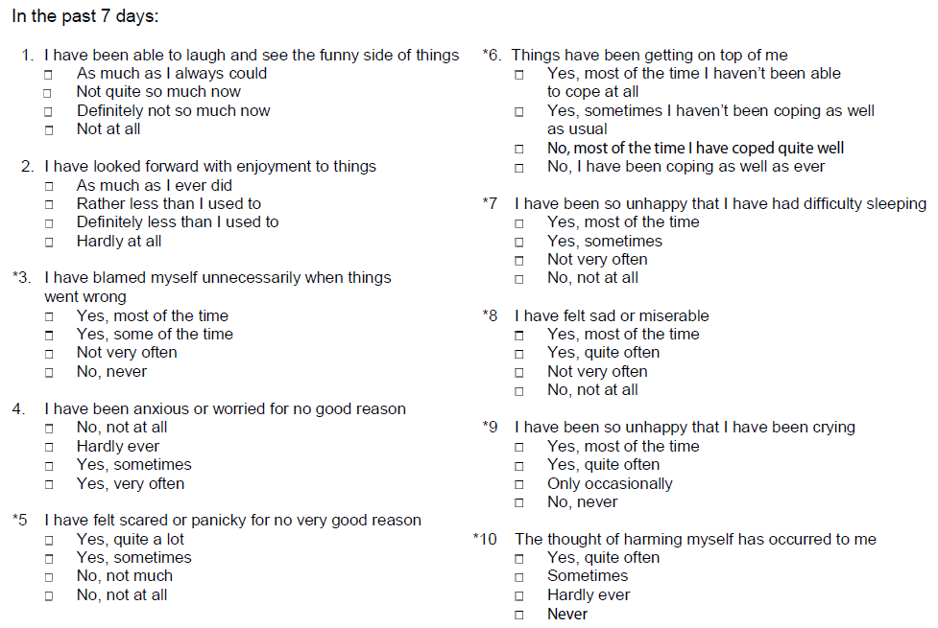
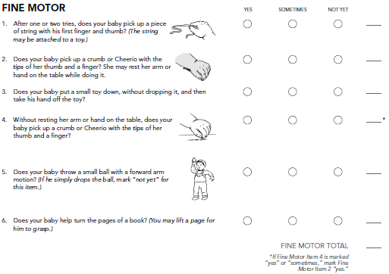
Cox, J. L., Holden, J. M., & Sagovsky, R. (1987). Detection of postnatal depression: Development of the 10-item Edinburgh Postnatal Depression Scale. The British Journal of Psychiatry, 150(6), 782-78
Bricker, D., Squires, J., Mounts, L., Potter, L., Nickel, R., Twombly, E., & Farrell, J. (1999). Ages and Stages Questionnaire. Paul H. Brookes: Baltimore.
Project CLIMB

Slide 19
