Slide 1
Variables Associated with Staff Member Injury on the Neuropsychiatric Special Care Unit
Jada Lister
Mentors: Patrick Romani, Ph.D, BCBA-D and Tara Hays, MA, BCBA
Oral Presentation for 2019 PURPLE Symposium
August 12, 2019

Slide 2
Patient Aggression and Staff Member Injury
Children and adolescents diagnosed with intellectual and developmental disabilities (IDD) are at high risk of engaging in aggressive behaviors warranting psychiatric hospitalization
Aggressive patient behavior on psychiatric inpatient units is often responsible for staff member injury
Staff member injury is a leading cause of burnout and turnover
Notes:
Aggression exhibited by patients on psychiatric inpatient units is most frequently the cause of staff member injury. Children and adolescents diagnosed with intellectual and developmental disabilities in particular are more likely than neurotypical children to engage in aggressive behaviors warranting psychiatric hospitalization.

Slide 3
Gap in the Literature
Limited research focused on variables affecting staff member injury on psychiatric inpatient units serving children and adolescents with IDD.
Results in high staff burnout and turnover rates
Can contribute to decreased quality of patient care
Has led to a lack of Intervention to decrease staff member injury in these settings.
Notes:
Up to this point, there has not been a large body of research dedicated to understanding the variables affecting staff member injury on psychiatric inpatient units serving children and adolescents with IDD. This has limited efforts to design effective interventions aimed at decreasing staff member injuries on these specialized psychiatric inpatient units. In these settings, injury on psychiatric inpatient units are a leading cause of burnout and turnover. High staff burnout and turnover rates can contribute to decreased quality of patient outcomes and care over time, making evaluation of the variables present during behavioral escalation a priority for patient and staff wellbeing.

Slide 4
The Neuropsychiatric Special Care Unit at CHCO
The Neuropsychiatric Special Care (NSC) Unit is a four-bed psychiatric inpatient unit with a 8-patient partial hospitalization program.
The NSC serves patients 4-17 with IDD who engage in severe problem behaviors and have psychiatric comorbidities.
Multidisciplinary care team consists of psychiatry, psychology, social work, nursing, occupational therapy, and mental health counselors
Notes:
Our study specifically focused on patients on the Neuropsychiatric Special Care (NSC) Unit, a four-bed psychiatric inpatient unit with a 8-patient partial hospitalization program located at Children’s Hospital Colorado. The NSC serves patients 4-17 with IDD who engage in severe problem behaviors and have psychiatric comorbidities. The multidisciplinary care team consists of psychiatry, psychology, social work, nursing, occupational therapy, and mental health counselors.

Slide 5
The Neuropsychiatric Special Care Unit at CHCO
Despite the high-quality staff on the NSC Unit, the unit has experienced a high rate of staff member injury.
Since 2013, 223 staff member injuries were caused by patients on the NSC Unit.
Interventions to improve staff member safety (e.g., adding staff members; limiting patients meeting certain weight and height criteria) have been ineffective.
Given the paucity of research identifying variables contributing to staff member injuries on specialized inpatient units like NSC, additional research is sorely needed.
Notes:
Despite the high-quality staff on the NSC Unit, the unit has experienced a high rate of staff member injuries. Since 2013 for instance, 223 staff member injuries have occurred due to patients on the NSC Unit. Efforts have been made to introduce interventions to improve staff member safety. These interventions have included adding staff members, as well as suggestions to introduce criteria limiting patient above a specific weight and height on the NSC. The interventions have been ineffective, however, further driving home the need for additional research identifying variables that contribute to staff member injuries on specialized inpatient units like NSC.

Slide 6
Purpose
To evaluate a variety of staff member and patient characteristics that served as contributing factors to staff member injury on the NSC Unit at the Children’s Hospital Colorado from 2016-2018.
Notes:
The purpose of our study therefore was to evaluate a variety of staff member and patient characteristics that served as contributing factors to staff member injury on the NSC from 2016– 2018.

Slide 7
Staff Characteristics
Staff characteristics assessed included:
Total number of staff on a shift at the time of injury
Staff response to behavioral escalations with restraint (before and after October 2017)
Staff response to behavioral escalations without restraint (before and after October 2017)
Notes:
Throughout our study, a number of variables were examined in the context of staff injuries. Staff characteristics assessed included the total number of staff working on a shift at the time of injury, staff response to behavioral escalations with restraint (before and after October 2017) and staff response to behavioral escalations without restraint (before and after October 2017). We chose to evaluate these variables before and after October 2017 because at that time the NSC Unit adopted Safety Care as its crisis management program and made significant programmatic changes.

Slide 8
Patient Characteristics
Patient characteristics assessed included:
Body mass index
Diagnosis of autism spectrum disorder
Diagnosis of intellectual disability
Notes:
In terms of patient characteristics, characteristics assessed included body mass index, as well as whether or not the patients that caused injuries had a diagnosis of autism spectrum disorder, or a diagnosis of intellectual disability.

Slide 9
Statistical analysis
To understand general demographic characteristics of NSC patients injuring staff members we calculated mean, standard deviation, minimum, and maximum values
To analyze staff member variables, we used Pearson correlation analyses
To analyze patient variables, we used chi-square tests
Notes:
For this study, several separate statistical analyses were conducted. To understand the general demographic characteristics of NSC patients injuring staff members we calculated mean, standard deviation, minimum, and maximum values. To analyze staff member variables, we used Pearson correlation analyses, while we used chi-square tests to analyze patient variables.

Slide 10
Demographic variables
Variable | Mean | Standard deviation | Minimum | Maximum
Age | 14.45 | 2.11 | 9.00 | 17.00
Height | 162.28 kg | 9.19 kg | 140.00 kg | 177.00 kg
Weight | 62.58 cm | 18.39 cm | 26.00 cm | 123.00 cm
IQ | 40.30 | 9.45 | 20.00 | 66.00
Notes:
In terms of the demographic make up of patients that caused injuries on the NSC, they ranged from ages 9-17, with the average patient being 14.45 years old. The mean patient height and weight respectively, was 62.58 cm, and 162.28 kg. Patient IQ had a mean score of 40.30, with scores ranging from 20 to 66 within our data set.

Slide 11
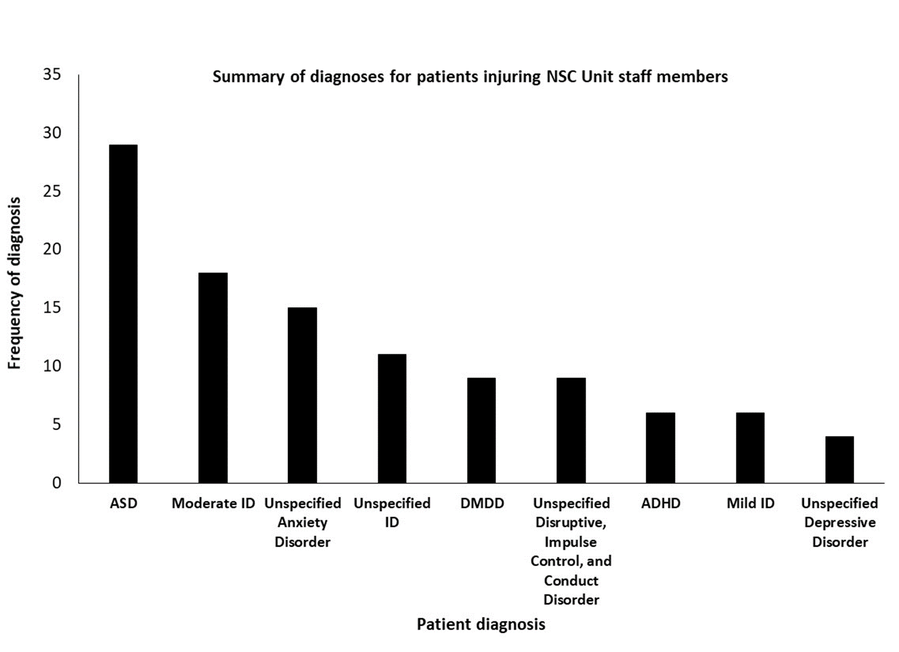
Demographic variables
Notes:
Patients admitted to the NSC have a variety of diagnoses, however among patients that caused injury to staff, the most common diagnoses were Autism Spectrum Disorder

Slide 12
Demographic variables
Notes:
Followed by Moderate Intellectual Disability

Slide 13
Demographic variables
Notes:
and Unspecified Anxiety Disorder.

Slide 14
Staff Variable | Variable Significance | Correlation
Total staff on unit | Total staff on the unit and staff member injury were not significantly correlated. | r = 0.032, p = 0.6937
Staff response to escalations with restraint (before 10/2017) | Staff response to behavioral escalations prior to October 2017 was significantly related to staff injury. | r = 0.30, p =0.0011
Staff response to escalations without restraint (before 10/2017) | Staff response to behavioral escalations prior to October 2017 was not significantly related to staff injury. | r = -0.022, p = 0.8126
Staff response to escalations with restraint (after 10/2017) | Staff response to behavioral escalations after October 2017 was significantly related to staff member injury. | r = 0.444, p = 0.0069.
Staff response to escalations without restraint (after 10/2017) | Staff response to behavioral escalations without restraint was significantly related to staff member injury after October 2017. | r = -0.40, p = 0.0160.
Notes:
I will now turn our discussion towards our analysis of staff member characteristics. We found that the total staff on shift at the time of injury and staff member injury were not significantly correlated, with an r = 0.032, and p = 0.6937.

Slide 15
Staff Variable | Variable Significance | Correlation
Total staff on unit | Total staff on the unit and staff member injury were not significantly correlated. | r = 0.032, p = 0.6937
Staff response to escalations with restraint (before 10/2017) | Staff response to behavioral escalations prior to October 2017 was significantly related to staff injury. | r = 0.30, p =0.0011
Staff response to escalations without restraint (before 10/2017) | Staff response to behavioral escalations prior to October 2017 was not significantly related to staff injury. | r = -0.022, p = 0.8126
Staff response to escalations with restraint (after 10/2017) | Staff response to behavioral escalations after October 2017 was significantly related to staff member injury. | r = 0.444, p = 0.0069.
Staff response to escalations without restraint (after 10/2017) | Staff response to behavioral escalations without restraint was significantly related to staff member injury after October 2017. | r = -0.40, p = 0.0160.
Notes:
Staff response to behavioral escalations with restraint prior to October 2017 was significantly related to staff injury, with r = 0.30 and p =0.0011, while staff response to behavioral escalations without restraint prior to October 2017 was not significantly related to staff injury, r = -0.022, p = 0.8126.

Slide 16
Staff Variable | Variable Significance | Correlation
Total staff on unit | Total staff on the unit and staff member injury were not significantly correlated. | r = 0.032, p = 0.6937
Staff response to escalations with restraint (before 10/2017) | Staff response to behavioral escalations prior to October 2017 was significantly related to staff injury. | r = 0.30, p =0.0011
Staff response to escalations without restraint (before 10/2017) | Staff response to behavioral escalations prior to October 2017 was not significantly related to staff injury. | r = -0.022, p = 0.8126
Staff response to escalations with restraint (after 10/2017) | Staff response to behavioral escalations after October 2017 was significantly related to staff member injury. | r = 0.444, p = 0.0069.
Staff response to escalations without restraint (after 10/2017) | Staff response to behavioral escalations without restraint was significantly related to staff member injury after October 2017. | r = -0.40, p = 0.0160.
Notes:
Looking at data under the new care model that began in October 2017, staff response to behavioral escalations with restraint was significantly related to staff member injury, r = 0.444, p = 0.0069, while staff response to behavioral escalations without restraint was significantly related to staff member injury after October 2017, r = -0.40, p = 0.0160. This latter variable, staff response to behavioral escalations without restraint, changed from before October 2017. That means that as NSC staff have been managing behavioral escalations with blocking techniques or verbal de-escalation, the overall total number of injuries on NSC have decreased.

Slide 17
Patient Variable | Variable Significance | Correlation/Relation
Total patients on unit | Total number of patients on the unit was not related to staff member injury. | r = 0.10, p = 0.2387.
Patient BMI | Patient BMI does not seem relate to staff member injury. | A chi-square test of independence was performed to examine the relation between patient BMI and staff member injury. The relation between these variables was not significant, X² (1, N = 36) = 0.4444, p < 0.5050.
Patient ASD diagnosis | Patients diagnosed with ASD were more likely to injury staff than those not diagnosed with ASD. | A chi-square test of independence was performed to examine the relation between patients with an ASD diagnosis and staff member injury. The relation between these variables was significant, X2 (1, N = 41) = 7.0488, p < 0.0079.
Patient IQ level | Patients diagnosed with moderate-to-severe ID were more likely to injury staff than those diagnosed with mild ID. | A chi-square test of independence was performed to examine the relation between patients with moderate-to-severe ID versus patients with mild ID and staff member injury. The relation between these variables was significant, X2 (1, N = 33) = 10.9394 p < 0.0009.
Notes:
In looking at our analysis of patient characteristics, we found that the total number of patients on unit at the time of injury and staff member injury were not significantly correlated, with an r = 0.10 and p = 0.2387.

Slide 18
Patient Variable | Variable Significance | Correlation/Relation
Total patients on unit | Total number of patients on the unit was not related to staff member injury. | r = 0.10, p = 0.2387.
Patient BMI | Patient BMI does not seem relate to staff member injury. | A chi-square test of independence was performed to examine the relation between patient BMI and staff member injury. The relation between these variables was not significant, X² (1, N = 36) = 0.4444, p < 0.5050.
Patient ASD diagnosis | Patients diagnosed with ASD were more likely to injury staff than those not diagnosed with ASD. | A chi-square test of independence was performed to examine the relation between patients with an ASD diagnosis and staff member injury. The relation between these variables was significant, X2 (1, N = 41) = 7.0488, p < 0.0079.
Patient IQ level | Patients diagnosed with moderate-to-severe ID were more likely to injury staff than those diagnosed with mild ID. | A chi-square test of independence was performed to examine the relation between patients with moderate-to-severe ID versus patients with mild ID and staff member injury. The relation between these variables was significant, X2 (1, N = 33) = 10.9394 p < 0.0009.
Notes:
Patient BMI also did not seem to relate to staff member injury. We performed a chi-square test of independence, which showed that the relationship between these variables was not significant with p <0.5050.

Slide 19
Patient Variable | Variable Significance | Correlation/Relation
Total patients on unit | Total number of patients on the unit was not related to staff member injury. | r = 0.10, p = 0.2387.
Patient BMI | Patient BMI does not seem relate to staff member injury. | A chi-square test of independence was performed to examine the relation between patient BMI and staff member injury. The relation between these variables was not significant, X² (1, N = 36) = 0.4444, p < 0.5050.
Patient ASD diagnosis | Patients diagnosed with ASD were more likely to injury staff than those not diagnosed with ASD. | A chi-square test of independence was performed to examine the relation between patients with an ASD diagnosis and staff member injury. The relation between these variables was significant, X2 (1, N = 41) = 7.0488, p < 0.0079.
Patient IQ level | Patients diagnosed with moderate-to-severe ID were more likely to injury staff than those diagnosed with mild ID. | A chi-square test of independence was performed to examine the relation between patients with moderate-to-severe ID versus patients with mild ID and staff member injury. The relation between these variables was significant, X2 (1, N = 33) = 10.9394 p < 0.0079.
Notes:
Patients diagnosed with ASD were found to be more likely than those not diagnosed with ASD, to cause injury to staff, based on a chi-square test of independence which produced a value of p< 0.0079.

Slide 20
Patient Variable | Variable Significance | Correlation/Relation
Total patients on unit | Total number of patients on the unit was not related to staff member injury. | r = 0.10, p = 0.2387.
Patient BMI | Patient BMI does not seem relate to staff member injury. | A chi-square test of independence was performed to examine the relation between patient BMI and staff member injury. The relation between these variables was not significant, X² (1, N = 36) = 0.4444, p < 0.5050.
Patient ASD diagnosis | Patients diagnosed with ASD were more likely to injury staff than those not diagnosed with ASD. | A chi-square test of independence was performed to examine the relation between patients with an ASD diagnosis and staff member injury. The relation between these variables was significant, X2 (1, N = 41) = 7.0488, p < 0.0079.
Patient IQ level | Patients diagnosed with moderate-to-severe ID were more likely to injury staff than those diagnosed with mild ID. | A chi-square test of independence was performed to examine the relation between patients with moderate-to-severe ID versus patients with mild ID and staff member injury. The relation between these variables was significant, X2 (1, N = 33) = 10.9394 p < 0.0009.
Notes:
Patient IQ was found to be significantly related to staff injury. We found that patients diagnosed with moderate-to-severe intellectual disability were more likely to injure staff than those diagnosed with mild intellectual disability, given a value of p < 0.0079.

Slide 21
Summary
Before October 2017
After October 2017
Staff experienced significantly more injuries prior to October 2017
Higher rates of restraint during patient crises
Injury to staff occurs during restraint while trying to contain aggression
Numerous staff training initiatives were introduced:
Safety Care
Therapy based on principles of applied behavior analysis
Strengthened staff response to crises
Resulted in fewer instances of restraint, which led to a decrease in staff injuries
Notes:
This slide provides a summary of the changes in injury rates among staff before and after October 2017. Staff experienced significantly more injuries prior to October 2017, likely due to higher rates of restraint during patient crises. Restraint of patients by staff while trying to contain aggression often leads to injury. In October of 2017, numerous staff training initiatives were introduced to the NSC including Safety Care, as well a therapy care model based on principles of applied behavior analysis. These new initiatives strengthened staff response to crises by encouraging staff members to apply evidence-based de-escalation strategies as well as understand how and why crisis events happen, and how they may inadvertently contribute to them. Ultimately these changes resulted in fewer instances of restraint, which led to an overall decrease in staff injuries. Efforts to replicate this analysis with other inpatient units specializing in the treatment of children with IDD and also general psychiatric inpatient units beyond the NSC are warranted based on these results.

Slide 22
Discussion
Patient variables
ASD and ID are highly comorbid with one another (Matson & Nebel-Schwam, 2017)
Individuals with ASD and/or ID are at a higher risk for engaging in aggressive behaviors yielding psychiatric hospitalization (Segel & Gabriels, 2014)
Preemptively screening patients diagnosed with ASD and/or ID who engage in aggressive behaviors
Notes:
Previous literature has shown that ASD and ID are highly comorbid with one another, as well as that individuals with ASD and/or ID are at a higher risk for engaging in aggressive behaviors yielding psychiatric hospitalization. Based on this as well as our own data indicating that patients with ASD and ID are at higher risk of injuring staff, consideration of preemptively screening patients diagnosed with ASD and/or ID who engage in aggressive behaviors upon admission to the NSC should be made. To conclude my presentation, it is recommended that preemptive patient screening should be put into practice along side the staff training initiatives mentioned on the previous slide, in order to produce the most effective outcomes related to decreasing staff injury.

Slide 23
Acknowledgements
Thank You!
Notes:
I would like to express a special thank you to my mentors Patrick Romani and Tara Hays, as well as to Dr. Douglas Novins, Chair of PMHI and Dr. Dominic Martinez, Dir. Office of Inclusion and Outreach, CCTSI, for providing funding to support the PURPLE program.

