Slide 1
Unreliable Tweets: Influence of Twitter on the Gluten Free Community
Rebecca Himberger¹, BS. Royce Kimmons², PhD., Shayna Coburn³, PhD., Monique Germone¹ Ph.D., BCBA
¹Children’s Hospital Colorado at Anschutz Medical Campus, ²Brigham Young University, ³Children’s National
Notes:
Add why I was attracted to this position in the celiac lab

Slide 2
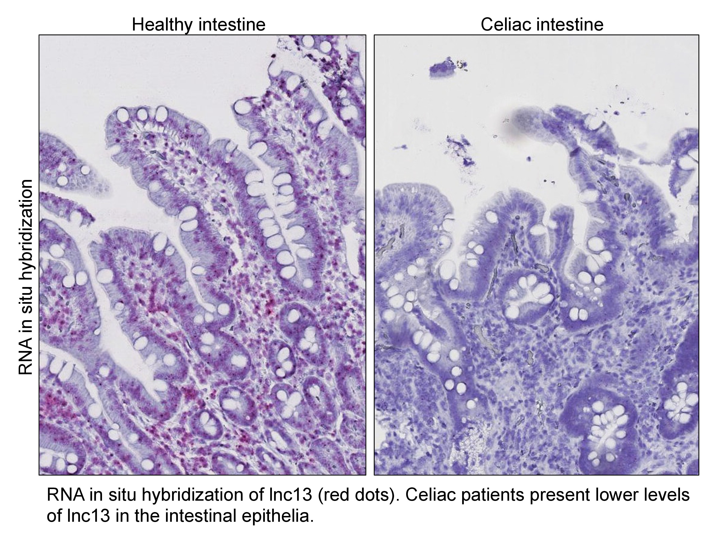
BACKGROUND
Approximately 1 in 4 Americans eat a gluten free diet¹
Celiac Disease (CD) is an autoimmune condition resulting in small intestinal damage in response to ingesting gluten²
CD affects approximately 1 in 143 individuals worldwide³
A strict gluten free diet is the only treatment for CD²
Many people turn to online sources for information and support with the gluten-free diet¹
This Photo by Unknown Author is licensed under CC BY-NC-ND
Notes:
More content was posted for #glutenfree (1,501.8 tweets per day) when compared to #celiac (69 tweets per day
source: previous study (unpublished)

Slide 3
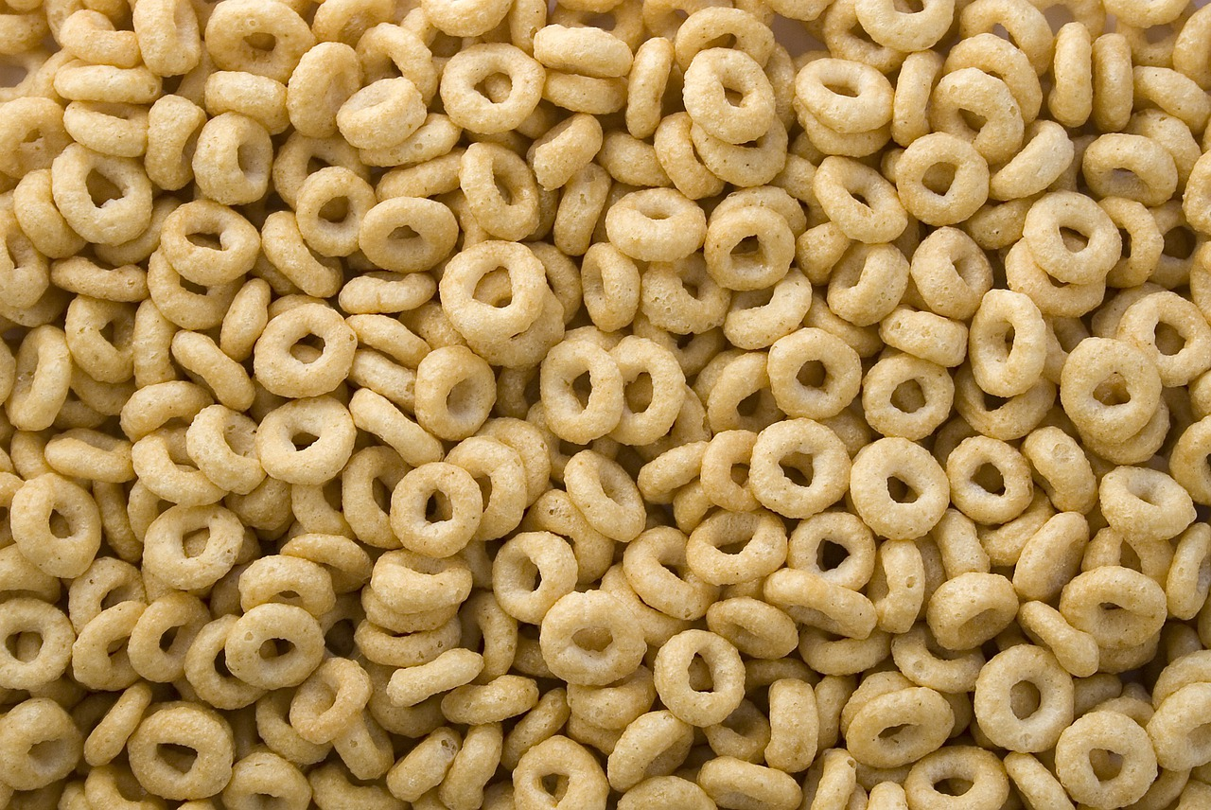

BACKGROUND
The social media platform, Twitter has been used to share information about medical conditions and treatments⁴
Cheerios is a labeled gluten-free product and its true gluten-free nature is in question following a recall in 2015⁵
Analyzing the type of information shared about Cheerios on Twitter may help to identify misinformation contributing to suspicions that Cheerios are not gluten-free, further restricting access to this product for those with CD
This Photo by Unknown Author is licensed under CC BY-SA-NC
Notes:
“when I joined Dr. Germone’s lab, their team was looking at tweets and the gluten-free community. Twitter was used because… The team was interested to see if the gluten-free status of a labeled gluten-free product, like Cheerios was being shared on Twitter”
Twitter is used by 18-29 year olds and
used by older adults (65+) has increased in recent years to 45% of older adults in 2021 use a form of social media
-source: #17 from unpublished twitter paper
Social Media has become an increasingly popular space for information to be shared, but is this information true or false?
Twitter is one of the best platform for efficient analysis. Due to the hashtags being able to be tracked and the user information accessible data to analyze the data to figure out the most common users and weather the tweets are more positive or negative in nature. Data Mining is possible via Twitter
CD – GFD stigmatism and patients with celiac needed reliable information – SCIENTIFIC LITERACY
Consumers of GFD and CD – most concerned about, because false information can be harmful
Cheerios recall in October after release of GF cereal in August 2015 and the company received major backlash for this. Since this recall they have not recalled again over the past 7 years.
Other companies' issues recall all the time and have not received as much attention as cheerios has

Slide 4

OBJECTIVE
How does false information on social media impact individuals on the gluten free diets, like those with celiac disease?
This Photo by Unknown Author is licensed under CC BY-NC

Slide 5

METHODS
43 cooccurring hashtags from 2015-2022
This cross-sectional study utilized data mining to collect tweets related to sentiment surrounding the 2015 Cheerios recall
20,000 whittled to 390 Tweets were evaluated with 43 hashtags including #cealic, #celiac, #cheerios, #glutenfree, #NoCureNoChoice.
Tweets were evaluated using descriptive statistics and qualitative review of user sources
Retweeted tweets with sources, 26, were evaluated for validity, source hunting
Thematic Analysis was done to conduct an in-depth analysis of the tweet sentiment
recall
GeneralMills
CeliacDisease
coeliac
CrossContamination
notglutenfree
HoneyNutCheerios
wheat
glutened
NoCureNoChoice
notglutenfreeCheerios
celiacs
Canada
cheeriosrecall
Iwork4genmills
oats
celiacproblems
cherrios
Allergy
foodallergies
gfree
singluten
HoneyNut
CheeriosFunFlavors
kids
foodallergy
foodsafety
LuckyCharms
FDA
GFkids
tenfree
Cheerios
celiac
glutenfreecheerios
gluten
gf
GlutenFreeCereal
sick
Recalled
celiacsafe
BE_GlutenFree
glutenfreeproblems
recalls
Notes:
Widled down to 390 for more formal analysis –
Look for Royce email chain for the carve down
The retweeted tweets with sources were analyzed for source data n = 26 – info being distributed
“we started by pulling all tweets from 2013 (before Cheerios came out with gluten-free) - 2022 that had #gluten and #cheerios. We found 20,000 tweets overall and decided to whittle them down to make sure these tweets were about topics pertinent to our study. The range of tweets was changed to 2015 – 2022 since there were no tweets prior to 2015 when Cheerios started labeling themselves GF. We evaluated the hashtags for relevance and found 43 hashtags across 390 tweets. Of the 390 tweets, we saw that only 26 tweets were retweeted with sources. This means that the information was being shared amongst twitter users and so we looked at the validity of the sources to find out what credibility the shared tweets had. We utilizes descriptive statistics and a qualitative review of tweets, including a thematic analysis, to investigate what type of information was being shared.”
Rated the most relevant hashtags to find the 43, not relevant were Giveaway, nonGMO – 202 to 43
Glutenfree
Cheerios
celiac
glutenfreecheerios
gluten
gf
GlutenFreeCereal
recall
GeneralMills
CeliacDisease
coeliac
CrossContamination
notglutenfree
HoneyNutCheerios
wheat
glutened
NoCureNoChoice
notglutenfreeCheerios
celiacs
Canada
cheeriosrecall
Iwork4genmills
oats
celiacproblems
cherrios
Allergy
foodallergies
gfree
singluten
HoneyNut
CheeriosFunFlavors
kids
foodallergy
foodsafety
LuckyCharms
FDA
GFkids
sick
Recalled
celiacsafe
BE_GlutenFree
glutenfreeproblems
recalls

Slide 6
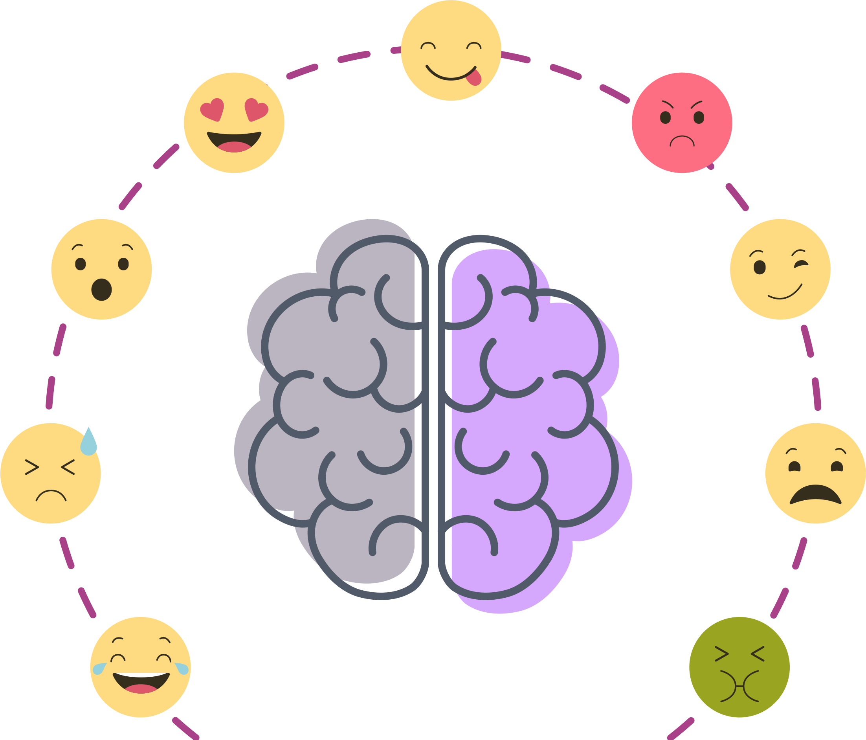
METHODS/THEMATIC ANALYSIS⁶
Braun and Clarke’s (2008) Six Step Approach
  Familiarization
  Coding
  3. Generating themes
  4. Reviewing themes
  5. Defining and naming themes
  6. Writing up
Codes
Tweets
Codes
Themes
So @Cheerios did NOT test the final product for gluten for 13 days. Nice
Cheerios is recalling 1.8 million boxes of #glutenfree Cheerios that may actually contain gluten:
FDA: Cheerios' Gluten Free labeling needs to be removed! - Sign the Petition! The problems with "gluten-free" @Cheerios still exist. How many more people need to be sickened? #notglutenfree
#Allergy alert! Gluten-free #Cheerios boxes contained wheat? What went wrong? #cheeriosrecall
@cheerios none of them are actually #glutenfree #becareful
@GGFGourmet Great news re: @cheerios blog on #gluten #CrossContamination!
Factual news/Neutral sentiment
False News
Uncertainty
Fear
Self Promotion
Distrust of General Mills/Cheerios
Sarcasm
Factual news/Neutral sentiment
False News
Uncertainty
Fear
Distrust of General Mills/Cheerios
Sarcasm
Self Promotion
Factual news/Neutral sentiment
False News
Negative Sentiment
Self Promotion
Notes:
4 themes across the top and examples
@THEgfJules TY! @CherylharrisRD shared @BuzzFeed article w/me. Hope gf folks will stop eating @cheerios! #notglutenfreeCheerios https://t.co/Y04waHkZvN

Slide 7
RESULTS
(n=390)
Contrary to continued patient concerns, the majority of tweets regarding the Cheerios recall were in 2015
Notes:
Add n=390
We did look through 2022

Slide 8
RESULTS
(n=26)
News stations and blogs were the most common sources cited in re-tweets
Notes:
n=26
Other = misc websites
Talk about how FDA and GM fits in

Slide 9

RESULTS
The sources of these re-tweets were categorized as unreliable if the source information came from personal blogs, other blogs, and news stations without source citations and reliable if the source information came from the FDA or General Mills/Cheerios company.
(n=26)
Notes:
n=26
“now, looking at the validity of the sources of these 26 tweets…”

Slide 10
RESULTS/THEMATIC ANALYSIS⁶
Negative Sentiment (203 tweets, 52%)
Factual News/Neutral Sentiment
(136 tweets, 35%)
The overall sentiment of tweets from 2015 -2022 was negative towards Cheerios
so I guess celiacs everywhere are trial and error guinea pigs, depending on the day #NoCureNoChoice
@GeneralMills Thanks for making my wife sick with your "gluten-free" cheerios. So disappointed. #cheerios #generalmills #recall
General Mills recalling 1.8 million Cheerios boxes on allergy risk
Cheerios is recalling 1.8 million boxes of #glutenfree Cheerios that may actually contain gluten:
Self Promotion (35 tweets, 9%)
Misinformation/False News
(16 tweets, 4%)
Hey @cheerios, transparency goes a long way. http://t.co/CMvgYcPOxj via @GlutenDude #NoCureNoChoice
I want to stop reading reports of #Celiac #NCGS getting sick from Cheerios. How about you? #notglutenfreeCheerios. https://t.co/7RUctYVEL8
“Update about Cheerios containing glyphosate, a know cancer causing chemical, will help people with #CeliacDisease to #walkaway! Seems the product isn’t safe for anyone now”
“Found this in my @cheerios. Yes its glass. Glad i wasnt a child! #blueglass #notglutenfree https://t.co/jhWPjBnlLy”
The top 2 contributing users to the 390 tweets were self-identified bloggers who contributed to 34.33% (n=136) of the tweets
Notes:
“then looked at the sentiment of the 390 tweets to see how people were feeling about Cheerios and gluten. Tweets fell into four categories…”
“we also looked at the types users who were tweeting to further investigate the credibility of the tweets and we found that the top 2 users were self-identified bloggers contributing to 34% of the content.”
Describe how I did the thematic analysis 1
Reformate – headers for the themes with some of the examples under the header
4 themes across the top and examples
@THEgfJules TY! @CherylharrisRD shared @BuzzFeed article w/me. Hope gf folks will stop eating @cheerios! #notglutenfreeCheerios https://t.co/Y04waHkZvN

Slide 11

IMPLICATIONS
Much of the information being spread was not reliable, which could be harmful to those on a gluten free diet
Information needs to be reliable
Future projects - gain prospective on the amount of false information being shared.
To combat this misinformation - medical professionals needs to be involved
Notes:
“so we found that most tweets were shared by bloggers, with many tweets being of XX sentiment, and sources shared were unreliable. This could be harmful to those on a gluten free diet…” You will also want to summarize your experience and what you have learned overall, tying it back to why you joined the lab. This will be that story telling part
Like how I would tell my friend what I found

Slide 12

ACKNOWLEDGMENTS
Thank you to Dr. Ron-Li, Chair of PMHI, Dr. Neill Epperson, Chair of Department of Psychiatry, Dr. Dominic Martinez, Dir. Office of Inclusion and Outreach, CCTSI for funding the PURPLE program
Special thanks to Children’s Hospital, Yunliang (Lily) Luo, Emmaly Perks, Shanna Trott, and Dr. Monique Germone for their support.
This Photo by Unknown Author is licensed under CC BY-NC-ND
Notes:
-Reflection

Slide 13

REFERENCES
1. Nebraska–Lincoln, U. (2022). Study concludes Americans self-diagnose to adopt gluten-free diets. Retrieved 27 July 2022, from https://news.unl.edu/newsrooms/today/article/study-concludes-americans-self-diagnose-to-adopt-gluten-free-diets/
2. Conditions, G. (2022). Celiac disease: MedlinePlus Genetics. Retrieved 22 July 2022, from https://medlineplus.gov/genetics/condition/celiac-disease/#:~:text=Description&text=Celiac%20disease%20is%20a%20condition,body's%20own%20tissues%20and%20organs.
3. Singh, P., Arora, A., Strand, T., Leffler, D., Catassi, C., & Green, P. et al. (2018). Global Prevalence of Celiac Disease: Systematic Review and Meta-analysis. Clinical Gastroenterology And Hepatology, 16(6), 823-836.e2. doi: 10.1016/j.cgh.2017.06.037
4. Trovato, C., Montuori, M., Oliva, S., Cucchiara, S., Cignarelli, A., & Sansone, A. (2020). Assessment of public perceptions and concerns of celiac disease: A Twitter-based sentiment analysis study. Digestive And Liver Disease, 52(4), 464-466. doi: 10.1016/j.dld.2020.02.004
5. (2022). Retrieved 22 July 2022, from https://twitter.com/cheerios/status/651118420071612416?ref_src=twsrc%5Etfw%7Ctwcamp%5Etweetembed%7Ctwterm%5E651118420071612416%7Ctwgr%5E%7Ctwcon%5Es1_&ref_url=https%3A%2F%2Fwww.washingtonpost.com%2Fnews%2Fto-your-health%2Fwp%2F2015%2F10%2F05%2Fgeneral-mills-recalls-1-8-million-boxes-of-gluten-free-cheerios-that-may-contain-wheat%2F
6. Virginia Braun & Victoria Clarke (2006) Using thematic analysis in psychology, Qualitative Research in Psychology, 3:2, 77-101, DOI: 10.1191/1478088706qp063oa
This Photo by Unknown Author is licensed under CC BY-NC

