Slide 1
Equity and medicine: Effects of patient’s language, SES, and race on access to specialized celiac disease treatment
Madison Harris, BS, BA
Monique Germone, PhD, BCBA
University of Colorado School of Medicine and Children’s Hospital Colorado

Slide 2
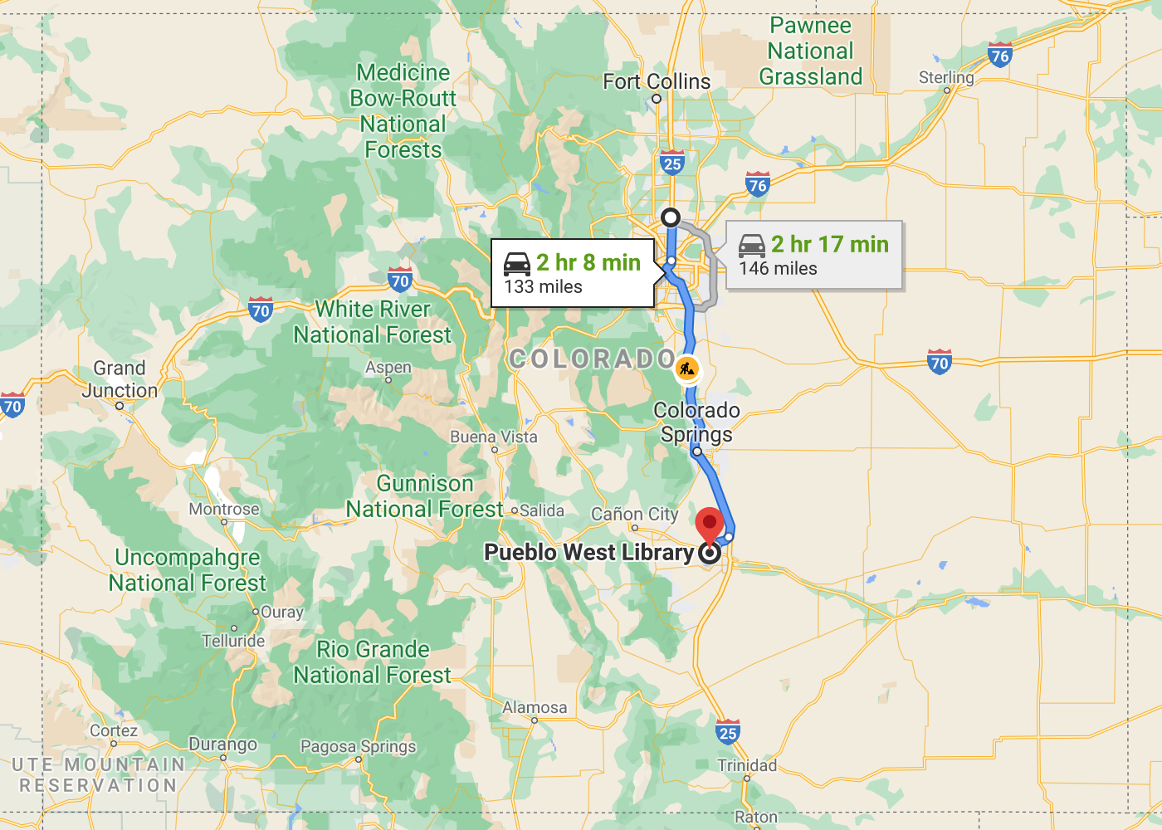
Why equity & medicine?

Slide 3
Introduction: Celiac Disease
Celiac disease is a common, autoimmune disease treated with a strict lifelong gluten-free diet

Slide 4
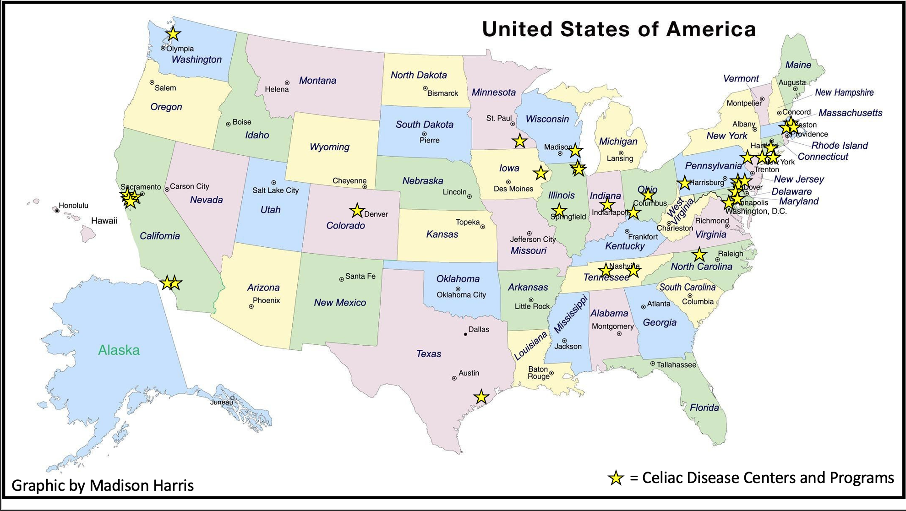

Slide 5
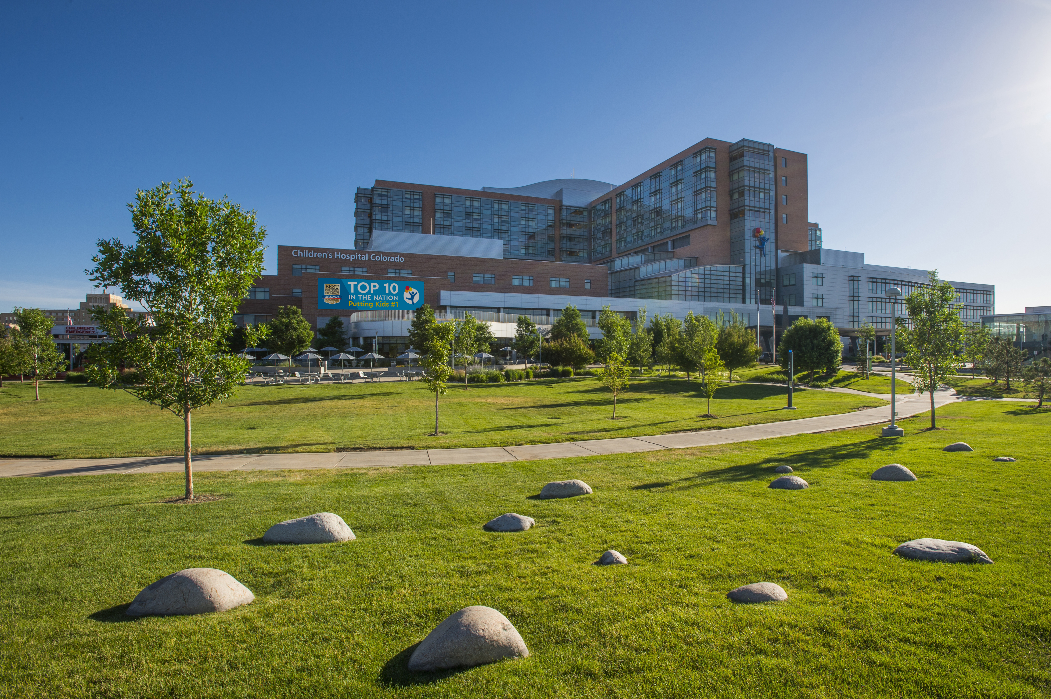
Objective
Is the Digestive Health Institute establishing equitable access to healthcare among patients with celiac disease?

Slide 6
Methods
Design: Quality Improvement (QI) project of patients seen for a medical visit in DHI
Sample: 842 patients with a CD diagnosis for visits between 4/21/20 and 7/20/21 (during COVID-19 pandemic)
Data Collection: Pre-identified criteria set as “Slices” in the EPIC SlicerDicer reporting tool
Language spoken (parent/guardian reported)
Top 10 postal codes (proxy for Socioeconomic Status)
Race (parent/guardian reported)
Analysis: Basic descriptive statistics

Slide 7
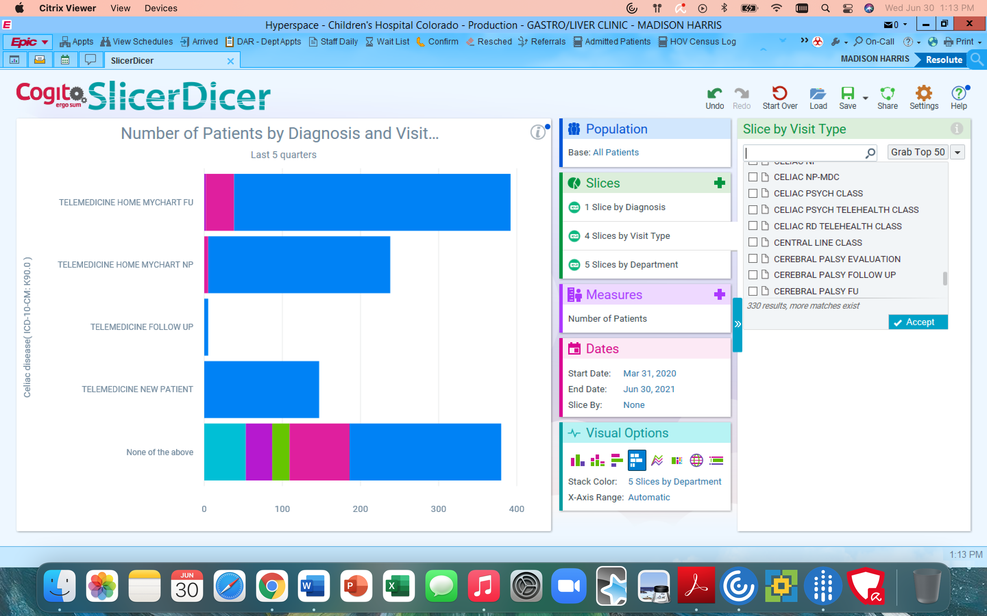
What is EPIC Slicer Dicer?
EPIC SlicerDicer is a self-service reporting tool that can filter and display large data sets from patients’ electronic medical records (EMR).

Slide 8
Hypothesizes
1
Language:
SES:
Race:
Languages Other than English
In-Person Appointments
Telehealth Appointments
2
In-Person Appointments
Below the Median Income
Telehealth Appointments
3
Underrepresented Racial Groups
In-Person Appointments
Telehealth Appointments

Slide 9
Demographics N=842
Notes:
Racial/ ethnic breakdown of the state – compared to patient population

Slide 10
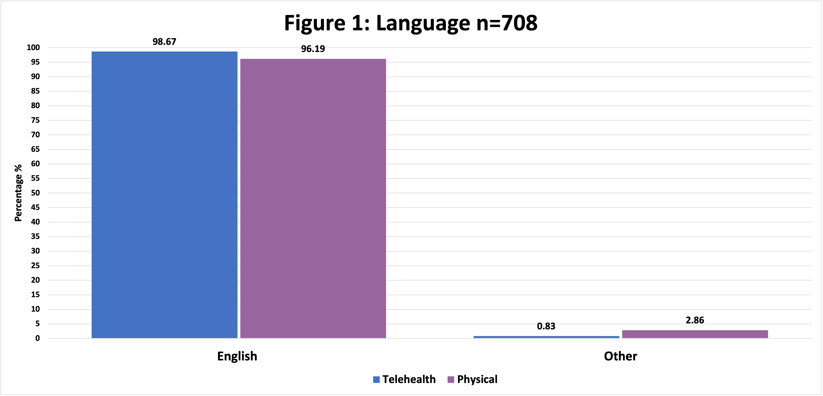
Results for Hypothesis 1:
Figure 1: Frequency of Reported Language for DHI Visits n=708

Slide 11
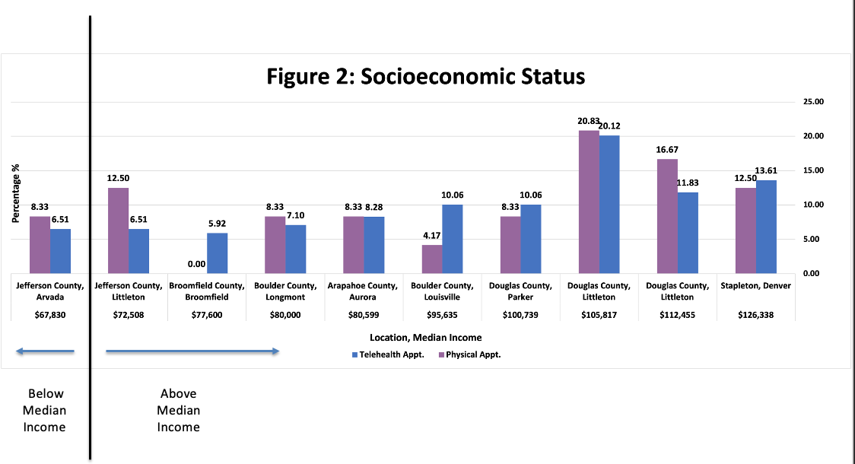
Results for Hypothesis 2:
Figure 2a: Frequency of SES for DHI Visits SES n=193

Slide 12
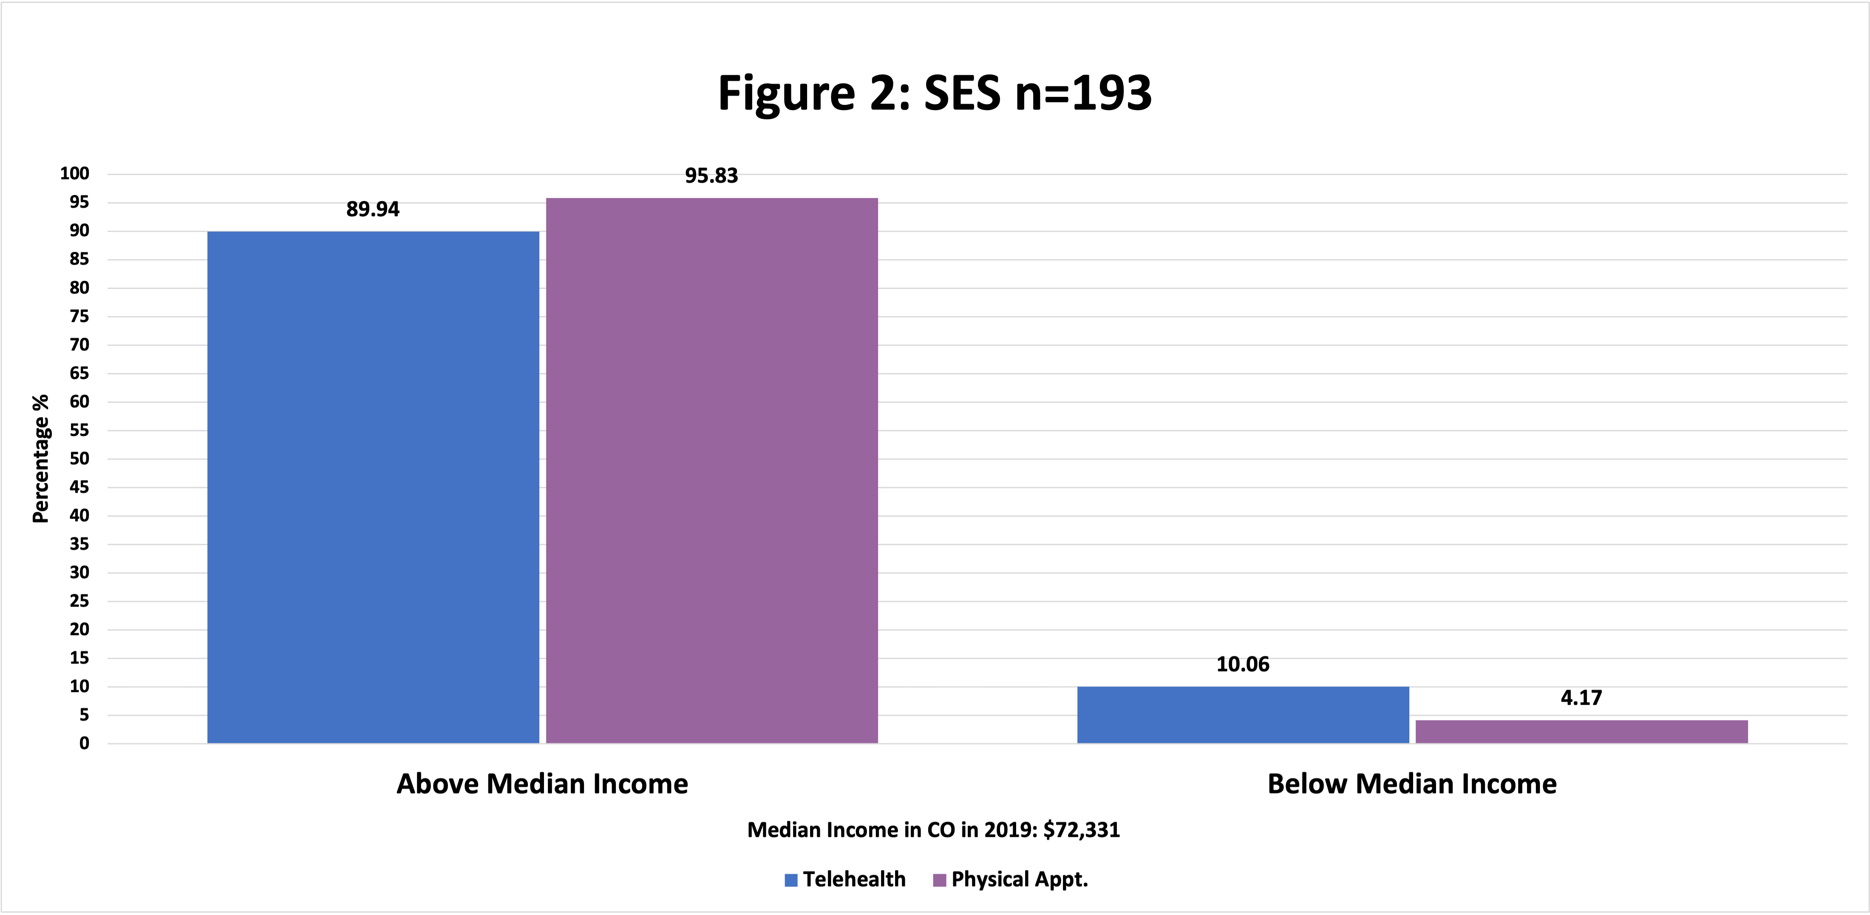
Results for Hypothesis 2:
Figure 2b: Frequency of SES for DHI Visits n=193

Slide 13
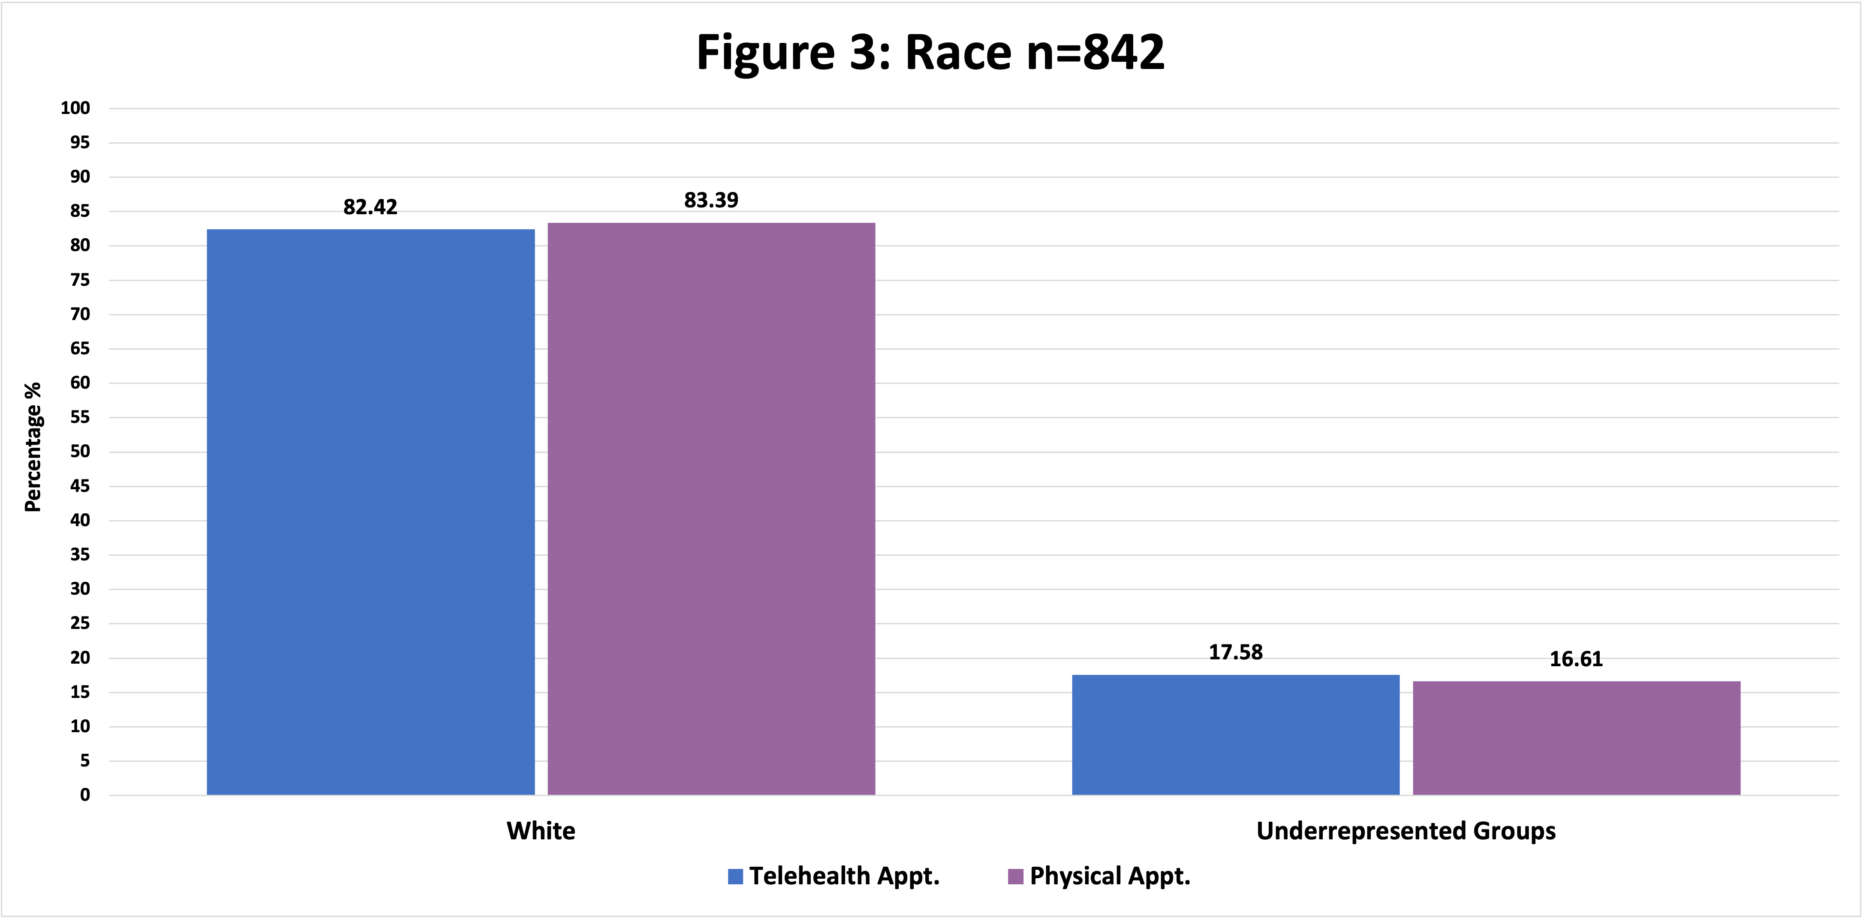
Results for Hypothesis 3:
Figure 3: Frequency of Reported Race for DHI Visits n=842

Slide 14
Conclusions
1
Language:
SES:
Race:
Languages Other than English
NC*
In-Person Appointments
NC
Telehealth Appointments
2
Below the Median Income
In-Person Appointments
Telehealth Appointments
3
Underrepresented Racial Groups
NC
In-Person Appointments
NC
Telehealth Appointments
*NC = no change

Slide 15
Limitations
Patients with known CD may have come to DHI with general GI concerns
Results may not be applicable for patients with CD who are seeking CD specific care
Results may not be applicable to broader DHI department and hospital
Self-reported data
Led to missing data
Could be missing information from the patient charts
Related to self-report, human error in entering information in the chart

Slide 16
Future Directions
Future QI projects could utilize a prospective design to engage stakeholders from underrepresented groups.
Perform a stakeholder engagement study to gain clarity of potential variables limiting access to care
A data pull from a professional analyst on variables SlicerDicer is unable to provide could build on this QI project

Slide 17
Acknowledgements
Research supported by the Bea Taplin Endowment Fund for Celiac Disease.
PURPLE program supported by: Dr. Douglas Novins, Chair of PMHI, Dr. Neill Epperson, Chair of Department of Psychiatry, and Dr. Dominic Martinez, Dir. Office of Inclusion and Outreach, CCTSI.
Special thanks to Children’s Hospital EPIC technical support, Yunliang (Lily) Luo, Emmaly Perks, Merlin Ariefdjohan, and Dr. Monique Germone for their support.

Slide 18
References & Sources
Lebwohol B, Sanders DS, Green PHR. Coeliac disease. Lancet 2018; 391: 70-81.
Hill ID, Fasano A, Guandalini S, Hoffenberg E, Levy J, Reilly N, Verma R. NASPGHAN Clinical Report on the Diagnosis and Treatment of Gluten-related Disorders. Journal of Pediatric Gastroenterology and Nutrition. 2016;63(1)156-165.
https://cchap.org/our-focus/health-disparities/
https://www.coloradohealthinstitute.org/research/racial-and-ethnic-health-disparities-lead-worse-health-outcomes-among-colorados-aging
https://connectforhealthco.com/glossary/federal-poverty-level-fpl/
https://celiac.org/celiacdiseasecentersandprograms/
https://coloradosun.com/2021/08/03/colorados-low-income-patients-cant-find-specialty-care/

Slide 19
Madison Harris Monique Germone, PhD
mharris7@uccs.edu monique.germone@childrenscolorado.org

