Slide 1
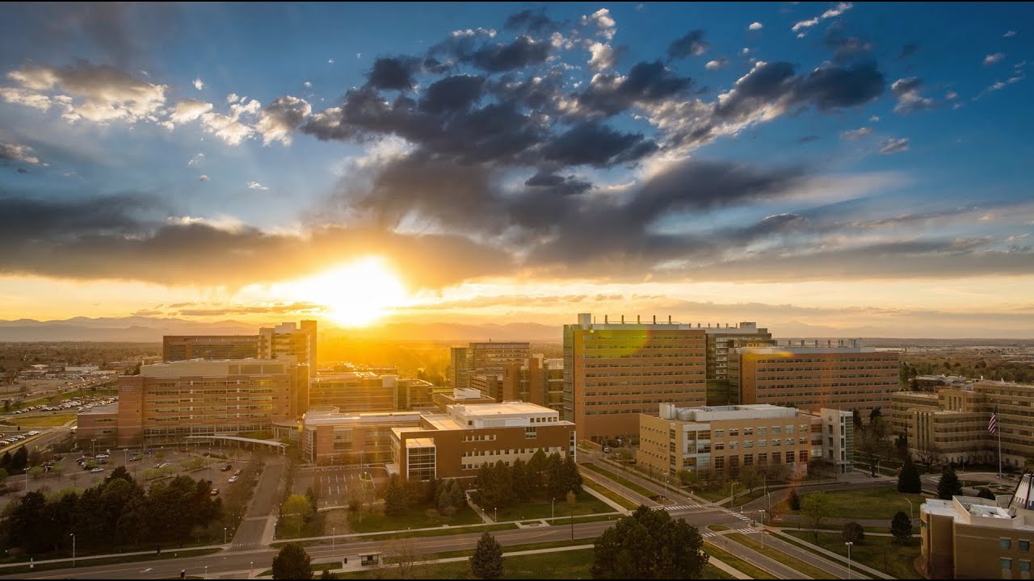
Development of a Mindfulness-Based Intervention for Adolescents with Chronic Migraine: A Semi-Structured Interview and Qualitative Analysis Approach
Michelle Harmon
Mentors: Michelle Clementi, PhD, Talia Thompson, PhD

Slide 2
Background
Migraine significantly increases in adolescence due to increased risk factors and disproportionately impacts youth from disadvantaged backgrounds
Current available treatments for migraine are expensive, not as effective as placebo, produce unwanted side effects, or are not approve for patient use
Mindfulness-based interventions (MBIs) have been shown to be effective in adults with chronic migraine, but little research has been done with adolescents

Slide 3
Phase I
Document the lived experiences of chronic migraine in adolescence from primary stakeholders (e.g., teens, parents, providers)
Phase II
Adapt an MBI based on stakeholder feedback to be pilot tested in a group of adolescents with chronic migraine
Study Aims

Slide 4
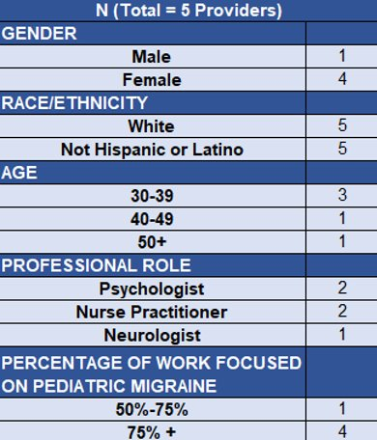
Study Sample
Table 1. Demographics of Providers in Study Sample
Adolescents with Chronic Migraine (13 – 18 years old)
Mean age = 15.6
Prefer not to say (n=1); Females (n=3); Non-Binary (n=1)
White (n=5); Black/African American (n=1); Hispanic (n=1)
Parents of Adolescents with Chronic Migraine
Mean age = 49.2
Females (n=5)
White (n=4); American Indian/Alaska Native (n=1); Hispanic (n=1)
Healthcare Providers Working with Adolescents with Migraine
See Table 1.

Slide 5
Recruited 5 families and 5 providers
Edited Transcripts for Coding
Coded Interview Transcripts in ATLAS.ti
Participated in Consensus Coding Meetings with Study Team
Completed Rapid Qualitative Analysis of Provider Interviews
Adapting the Intervention Based on Qualitative Feedback
Conducted Remote Interviews over Zoom
Qualitative Analysis of All Interviews (in progress)
Completed CCTSI ATLAS.ti Online Trainings
Edited/Finalized Coding As Needed

Slide 6
Interviews
15 one-on-one interviews with stakeholders (teens, parents, providers) were completed on Zoom
Questions pertained to experiences with chronic migraine and mindfulness and feedback about intervention delivery:
What is it like having headaches or migraine?
There are lots of different practices that are related to training people to be more mindful. Some are meditation, yoga, body scan, visualization, which means picturing something in your mind, and others. Have you ever done any of these practices?

Slide 7
Transcribing
Interview transcripts were edited/transcribed verbatim using saved audio file and generated txt file to correct transcription
Final transcripts were converted to Word files to be imported into ATLAS.ti software for coding

Slide 8
ATLAS.ti Coding
Table 2. Examples of Qualitative Deductive Codes
A preliminary deductive codebook was designed by the study team based on MBI and intervention adaptation theories
Open (inductive, representing emergent themes) codes were added during the coding process
Discrepancies in coding were discussed during team meetings and codebook was refined as needed to reflect team consensus
Code​ | Definition​ | Example​
Migraine Management (Broad)​ | How teens manage or treat theirmigraine | Medications, doctors appointments, healthylifestyle habits​
Migraine & Emotions ​ | How migraine relates to emotions​ | Feelings of stress due to migraine, missing out on social events, feelings of hopelessness related to migraine​

Slide 9
Rapid Qualitative Analysis
Five provider interview transcripts were rapidly analyzed by the study team for preliminary reporting of result
Interview summaries were consolidated into a structured matrix to identify common themes and stakeholder priorities

Slide 10
Qualitative Analysis
Qualitative analysis of all interviews currently in progress
Codes and categories from analysis will be synthesized into themes/subthemes

Slide 11
Preliminary Theme 1. Developmental Considerations for Teens
Teens Prioritize Peer-to-Peer Support
"I think just that camaraderie and not just sympathy but empathy that people can share with each other can really be helpful in that sense of community. So, I really love the group aspect of this”
Short-Term Vs. Long-Term Thinking in Adolescence
“The intervention I'm asking you to do is not gonna happen overnight….I think that's been the biggest thing is just going like, hey I know this is gonna take time."
Teen Autonomy
“I think having a good balance of like autonomy with the teen and trusting them that they're gonna do [the mindfulness practice]. Then, also having parents stepping in when they need to."

Slide 12
Preliminary Theme 2. Facilitators for Program Buy-In and Participation
Patients Desire Non-Pharmacological Options
"I think I have a lot of teens and their parents who are like, don't want to try medicine, or they're like fed up with medicine, or they want like an adjunct to it.”
Neurology Providers are a Resource for Encouraging MBI as a Treatment Option
“I will mention the benefits that we have seen from fMRI studies of the brain. So, I'll say, you know, studies have already shown that we have more activity in our frontal lobe, which, when we're using consistent meditation or mindfulness practices daily, so you can think better, you can focus better.”
MBI Must Consider Migraine-Specific Health Needs
“We're talking about teens who have chronic migraine and might be like, oh, I'm not going to turn my camera on today because it's too bright, or I don't feel well I can't participate.”

Slide 13
Conclusions & Future Implications
In addition to rapid analysis, data from all stakeholder interviews is currently being analyzed by the study team to extract themes and subthemes
We anticipate seeing themes/subthemes discussing parent migraine experiences, acceptability of the remote group program, teen personalities, etc.
Themes and subthemes deduced from qualitative analyses will be used to tailor MBI ("Learning to BREATHE"; Broderick, 2021) to the unique needs of adolescents with chronic migraine and will be pilot tested as a telehealth group format

Slide 14
Acknowledgements
This study was funded by The Children’s Hospital Research Institute
We would like to thank our study collaborators, consultants, and PURPLE and Department of Psychiatry faculty members

Slide 15
Questions? Presenter: Michelle Harmon Michelle.Harmon@ChildrensColorado.org Mentor: Michelle Clementi, PhD Michelle.Clementi@ChildrensColorado.org Qualitative Consultant: Talia Thompson, PhD Talia.Thompson@ChildrensColorado.org

