Slide 1
Does Gender Identity Impact Clinical High Risk for Psychosis?
A Call for More Research.
Elizabeth Garcia² A.A., Shadi Sharif B.A^{.1,} Michelle West Ph.D.¹
The Psychiatry Undergraduate Research Program and Learning Experience (PURPLE)², Program for Early Assessment, Care, and Study (PEACS)¹, Office of Education and Training, Department of Psychiatry, University of Colorado Anschutz Medical Campus

Slide 2
Clinical High Risk for Psychosis
Clinical high risk for psychosis
~1.7% prevalence in the USA
~15-30% transition rate to acute psychosis
Specialized clinics for identification, study, and treatments across the country

Slide 3
Gender Identity
cis-gender (CG)
gender nonconforming​ (GNC)
transgender (TG)
~1.3%​ TG prevalence in USA

Slide 4
Literature Results
Some overlap in present mental challenges: anxiety, suicidal ideations, trauma, victimization
Childhood adversities are common among (GNC) individuals
Childhood trauma/adversities may increase risk
Some differences found in psychosis symptom presentation/severity among males and females
Females-more positive symptoms/better social integration
Males-more negative symptoms/substance use
Gender nonconforming individuals might be at higher risk for psychotic disorders
Evidence for higher rates of psychotic disorder diagnoses among TG individuals
Family dynamics may be important for both gender nonconforming and those at CHR

Slide 5
Exploratory Question
Do gender non-conforming clients show more psychosis symptoms?

Slide 6
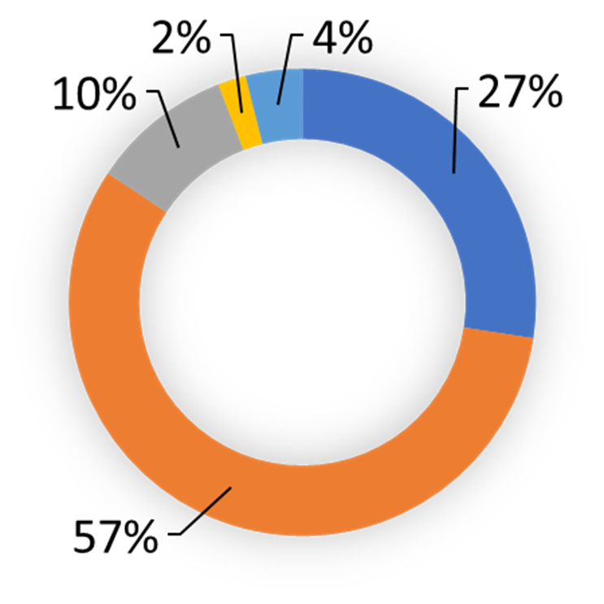
Methods
Participants
Adolescents and young adults (n= 37)
14 cis-female
15 cis-male
2 trans-male
1 trans-female
5 other/non-binary individuals
Procedures
Literature review
Demographic and clinical assessment data analysis
Measures
Demographics questionnaire
Structured interview for psychosis-risk syndrome
79% cisgender and 21% GNC and TG

Slide 7
Structured Interview for Psychosis-risk Syndromes
0-2
No psychosis
3-5
CHR
6
Psychotic
unusual thought content/delusional ideas
suspiciousness/persecutory ideas
grandiose ideas
perceptual abnormalities/hallucinations
disorganized communication
loss of emotion
social interest
ideation richness
occupational/school functioning
Positive
Negative
General
Disorganization
sleep disturbance
dysphoric mood
motor disturbance
impaired stress tolerance
odd appearance of behavior
bizarre thinking
trouble with focus
impaired hygiene.

Slide 8
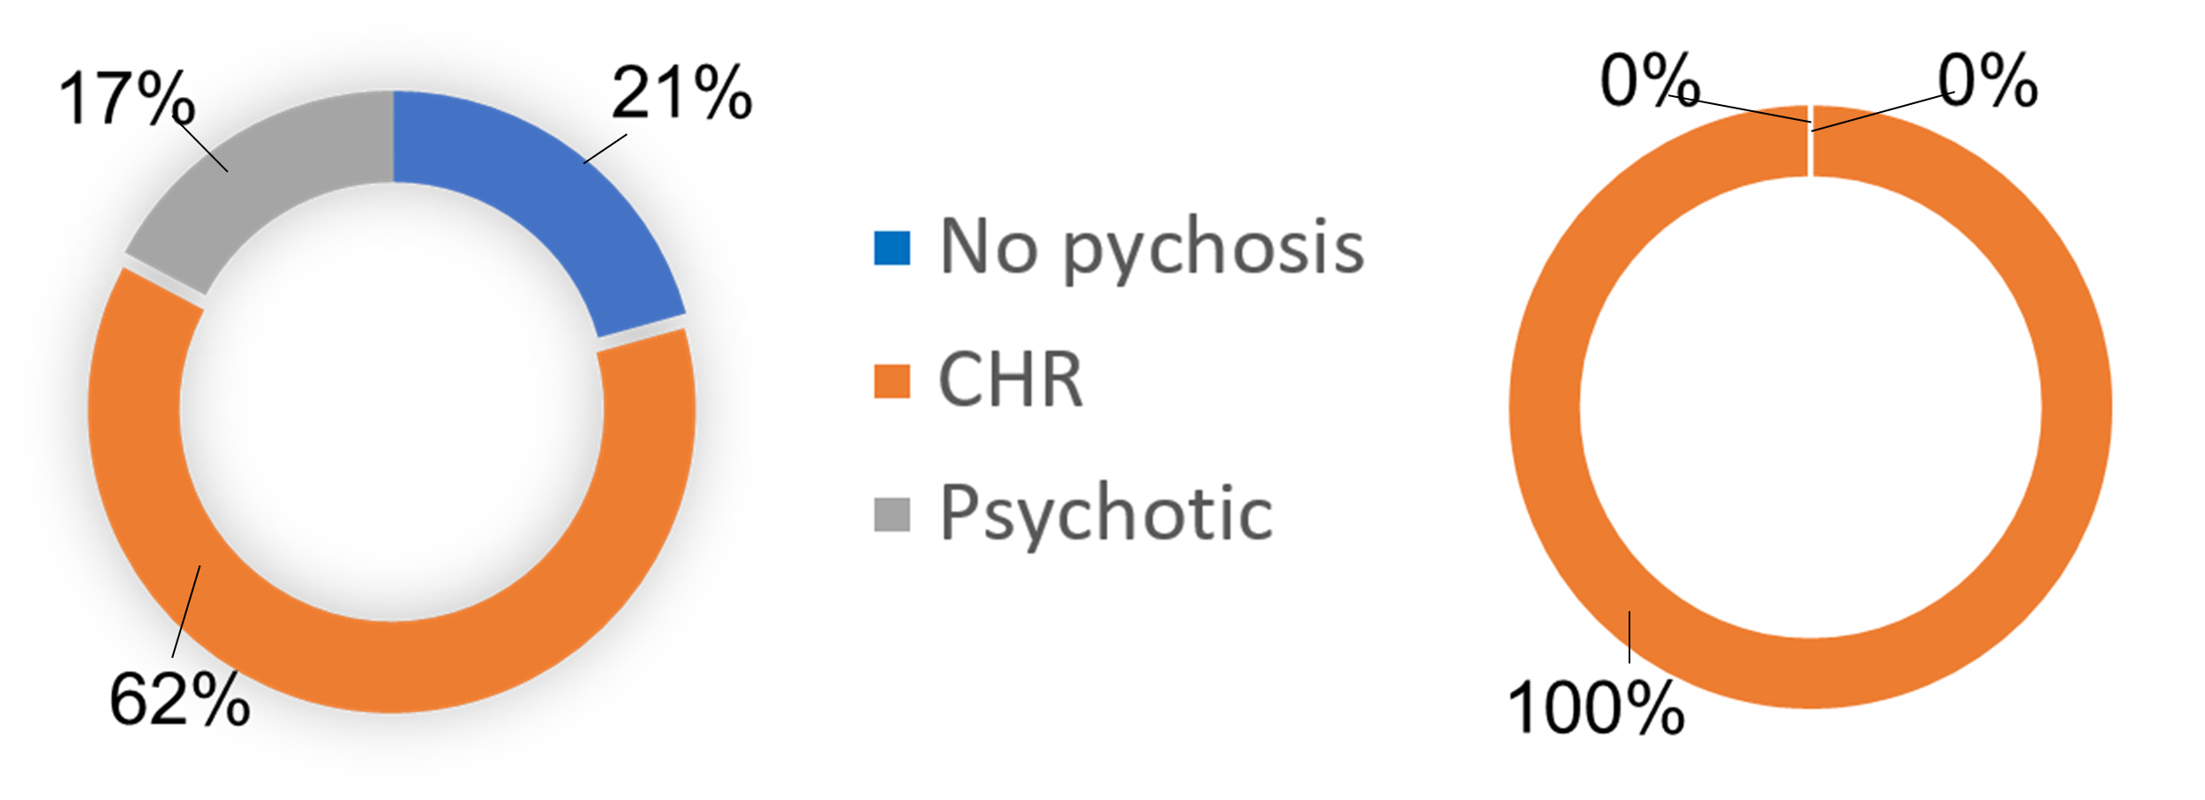
Clinical Assessment Data
~1% prevalence of TG individuals, but the clinic shows a higher population
Demographic data and clinical data suggests higher a proportion of CHR ratings for GNC and TG individuals

Slide 9
Statistical Analysis
t-test for Equality of Means |  | t-test for Equality of Means
SIPS Ratings | Equal variances not assumed | t | df | Sig. (2-tailed) | Mean Difference | Std. Error Difference | 95% Confidence Interval of the Difference
 |  |  |  |  |  |  | Lower | Upper
SIPS Ratings | Equal variances not assumed | 1.108 | 34.718 | .275 | .431 | .389 | -.359 | 1.221

Slide 10
Future Directions
More CHR rating data and gender demographic data
Understand of the unique background of GNC/TC
More research related to CHR and gender identity
Develop more informed gender-related CHR treatments
Adjusted family therapy

Slide 11
Considerations
Small sample population analyzed
Societal gender roles’ impact
Client’s referral locations
Limited research on CHR and GNC individuals
Some individuals did not provide gender

Slide 12
Acknowledgements
Special thanks to our sponsors:
Dr. Ron-Li, Chair of PMHI
Dr. Neill Epperson, Chair of Department of Psychiatry
Dr. Dominic Martinez, Dir. Office of Inclusion and Outreach, CCTSI
Additional thanks to
PURPLE mentors:
PEACS mentors:
Emmaly Perks, Director PURPLE Program
Shanna Trott, Coordinator PURPLE Program
Yunliang (Lily) Lua, Assistant Director PURPLE Rogram
Christine Reed, Coordinator/Research Services PEACS
Dr. Michelle West, Director PEACS
Shadi Sharif, Research Assistant/Coordinator PEACS
PURPLE Faculty

Slide 13
Thank you!
Any questions?

