Slide 1
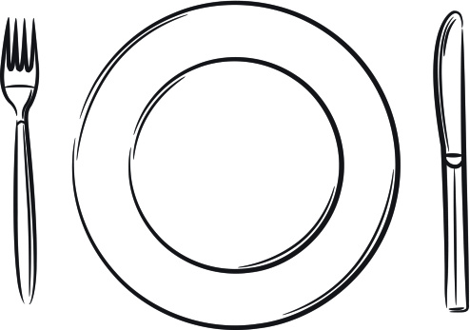


Eve M. Delao
Mentor: Dr. Jonathan R. Miller
Come and Get It!
A Case Study of
Family Member Influence on Child Eating Rate in Natural Settings
2018 PURPLE Oral Presentation
August 9, 2018
Notes:
For the PURPLE Program, I worked with Dr. Miller, who researches environmental factors that influence eating behaviors in children. For my project, I chose to explore how family members influence child eating rate using an in depth look into one family.

Slide 2


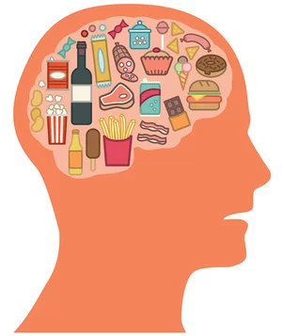
So… What’s the problem?
1 in 11
Long-term obesity increases risk of numerous diseases
  Type 2 diabetes
  Heart disease
  Cancer
Childhood obesity is very likely to persist into adulthood
Notes:
As I’m sure you all are aware, the US is currently facing an obesity epidemic. This epidemic is also being seen in children, with nearly 1 in 11 preschool children having obesity.
This is concerning, as obesity increases the risk of various diseases such as Type 2 diabetes, heart disease, and cancer.
Unfortunately, it has been shown that if one has obesity as a child, the likelihood that it will persist into adulthood is very high.
As such, understanding what contributes to child obesity can provide important information for how to prevent and treat it.

Slide 3
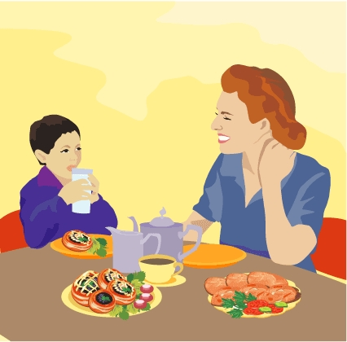
Social impacts on eating
Parents and parental figures
Influence child eating habits¹
Impact child BMI²
Modeling eating behavior
Normal and overweight adults model eating behaviors in controlled settings³
  Similar results for drinking rates⁴
Notes:
Eating habits are a critical part of the development and maintenance of obesity.
Research suggests that parents and parental figures are highly influential on the formation of child eating habits, which can impact child weight in both healthy and unhealthy ways.
For example, eating as a family has been linked to lower BMIs in children.
An important way that children learn eating behaviors is through imitating adults. But imitating others isn’t just something kids do. Highly controlled studies have shown that both normal and overweight adults tend to match the eating and drinking rates of those around them, eating faster around those who eat fast and slower around those who eat slow.

Slide 4
Child Bite Rate
Notes:
However, currently, little is known about what influences child eating rate in young children.
A previous study examined eating rates in preschool children while attempting to control the effects of modeling.
Drabman et al (1979) observed preschool children during lunch. They measured bite rates for children with overweight sitting with non-overweight peers and compared these rates to those of non-overweight children sitting with other non-overweight peers. The investigators found that children with overweight had relatively higher bite rates.
However, in controlling for the peer group without measuring peer bite rate, Drabman et al place the emphasis on the child’s weight status as the cause of differences in eating rates and ignored the potential impact of the social environment on eating rate.
Currently, little is known about how other people, particularly family members, affect child bite rate.

Slide 5
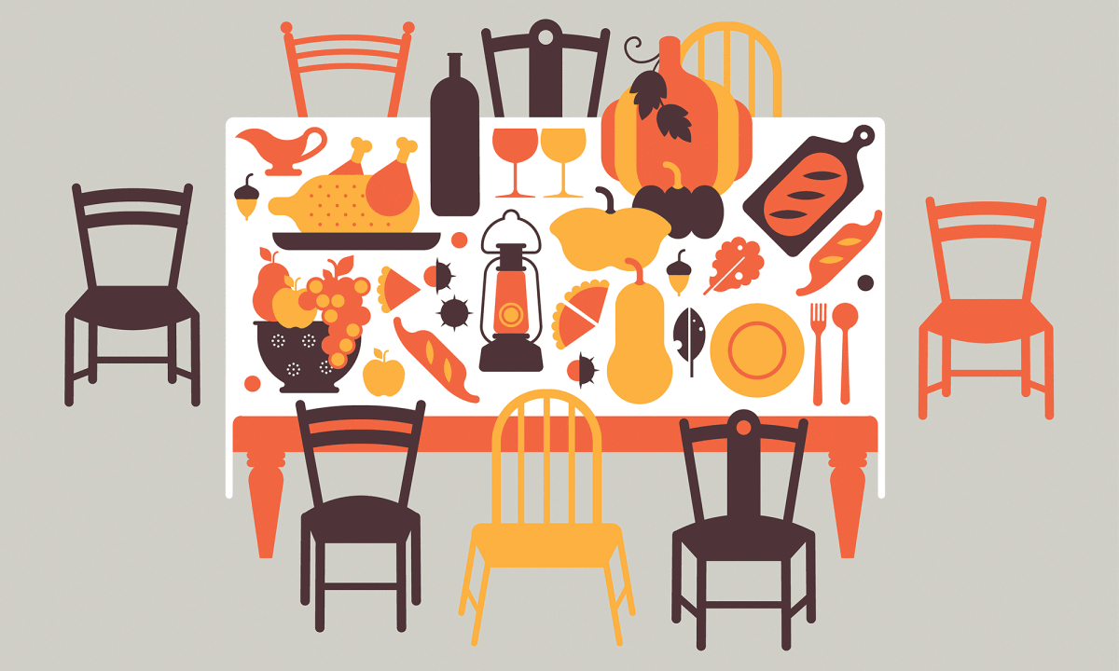
Research Objective
To investigate the influence of family members’ bite rates on child bite rate during mealtimes in a natural setting
Notes:
Therefore, in order to explore environmental effects on eating rate, this study sought to…

Slide 6
Method

Slide 7

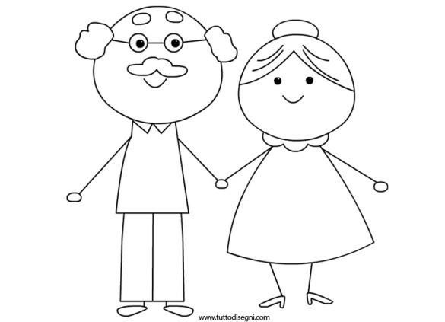
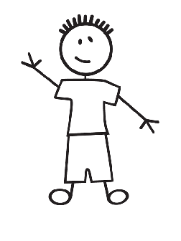
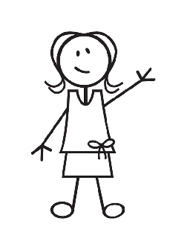
Participants
One family
Child, mother, grandfather, grandmother, great aunt, uncle
Child demographics:
  Caucasian
  5 years, 5 months
  99th percentile BMI
Notes:
The case study consisted of one family with child, mother, grandmother, grandfather, uncle and great aunt. The child was Caucasian, 5 years and 5 months and in the 99th percentile for BMI

Slide 8

Family a part of larger study
Dr. Miller’s study of family interactions around food
Recruited from LIFEstyle Medicine Clinic at CHCO
Inclusion requirements:
  2-5 yrs old
  ≥ 85th percentile BMI*
  English primary language in household
  Child living with parent full time
*Weight and height were collected for parent/child to calculate BMI
BMI = weight (kg) / height (m)²
Notes:
The family was recruited as part of Dr. Miller’s larger research study examining family interactions around food. They was recruited from the LIFEstyle Medicine Clinic at Children’s Hospital Colorado.
To be a part of the larger study, the child needed to be 2-5 years old and a BMI at or above the 85th percentile. Weight and height were collected for the parent and child in order to calculate BMI. In addition, the primary language spoken in the home needed to be English and the child needed to be living in the parent’s home full-time.

Slide 9
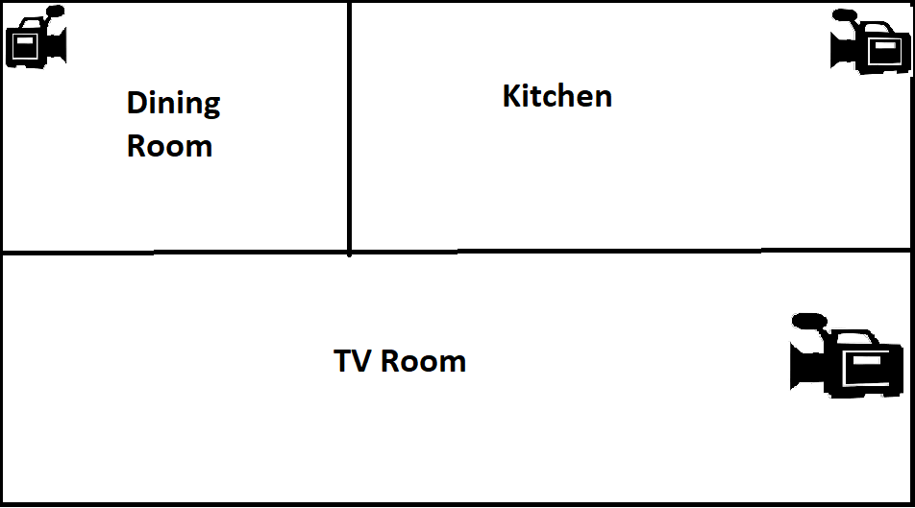
Procedures
Video recordings collected over 7 days
  TV room, dining room, kitchen
  Parent and child home and awake
    For this study: scored when child was actively eating
Food diaries recorded for parent and child
Notes:
Data for this study was collected from video recordings collected over 7 days in the family’s home. Cameras were placed in the TV room, dining room, and kitchen.
Video recordings took place at times when the parent and child were at home and awake, as identified by the family.
For this study, videos were only scored at times when the child was actively eating. In addition to the video recordings, food diaries were also recorded by the mother, which contained all foods consumed by the child and parent

Slide 10
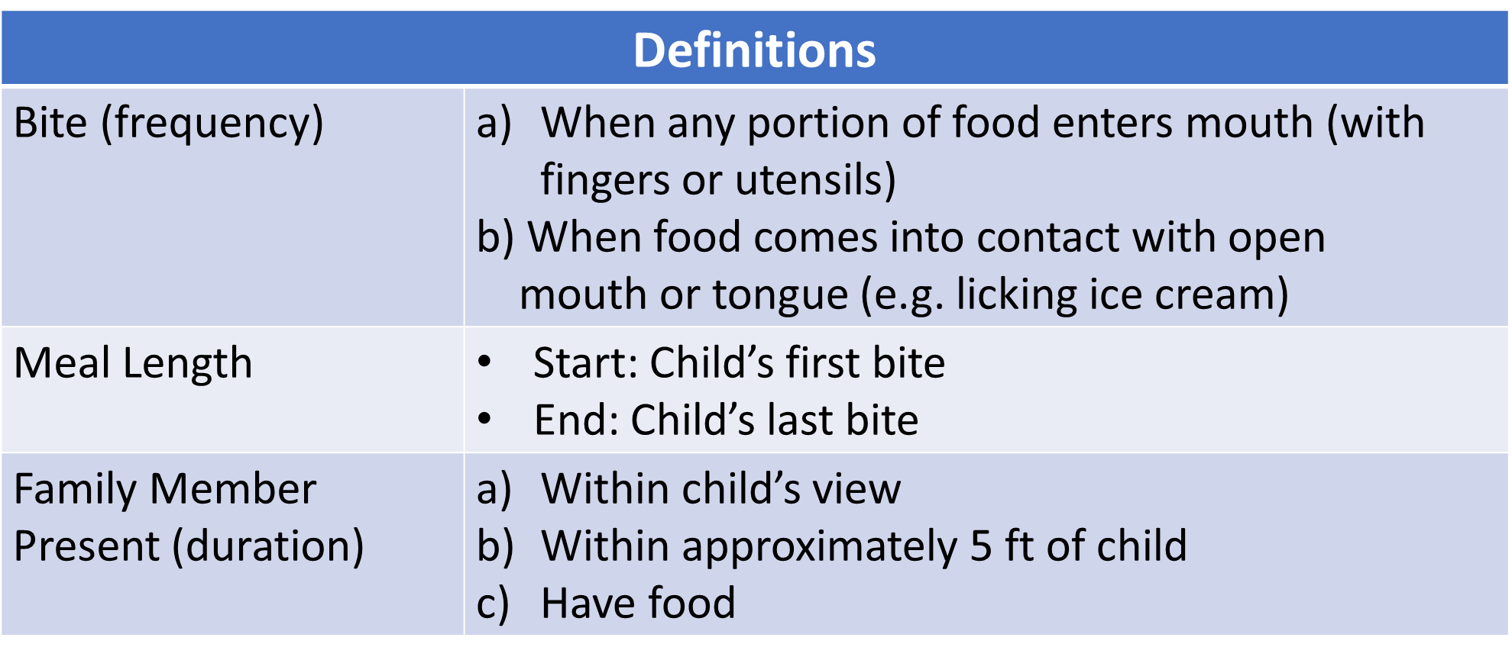
Video Scoring
All data recorded in 1-sec intervals
Family member bites averaged within intervals
Eating rate calculated as bites/min
Definitions
Bite⁴ (frequency) | When any portion of food enters mouth (with fingers or utensils) b) When food comes into contact with open mouth or tongue (e.g. licking ice cream)
Meal Length | Start: Child’s first bite End: Child’s last bite
Family Member Present (duration) | Within child’s view Within approximately 5 ft of child Have food
Notes:
“Bites” were scored on a frequency basis and happened when: 1. any portion of food entered the mouth with fingers or utensils or 2. when food came into contact with open mouth or tongue, for example, when licking ice cream.
The meal length started with the child’s first bite of food and ended with the child’s last bite.
And a family member was considered “present” when the person was within the view of the child, within approximately 5 feet of the child and had food.
All data were recorded in 1-sec intervals. Family member bites were averaged within intervals and the eating rates were calculated as bites per minute.

Slide 11
Results

Slide 12
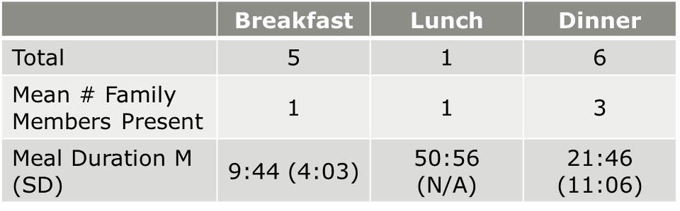
Notes:
A total of 12 meals were coded, including 5 breakfasts, 1 lunch and 6 dinners. The average number of family members present was 1 for breakfast and lunch and 3 for dinner but note there was only 1 lunch that was recorded.
Average meal duration was 9 minutes 44 seconds for breakfast, 21 minutes 46 seconds for dinner, and was 50 minutes and 56 seconds for the one lunch meal—which is very long but from video footage, the bites were widely spread a part and the child spent a lot of the time eating by himself.
The child spent 59% of meal times eating with a family member present.

Slide 13
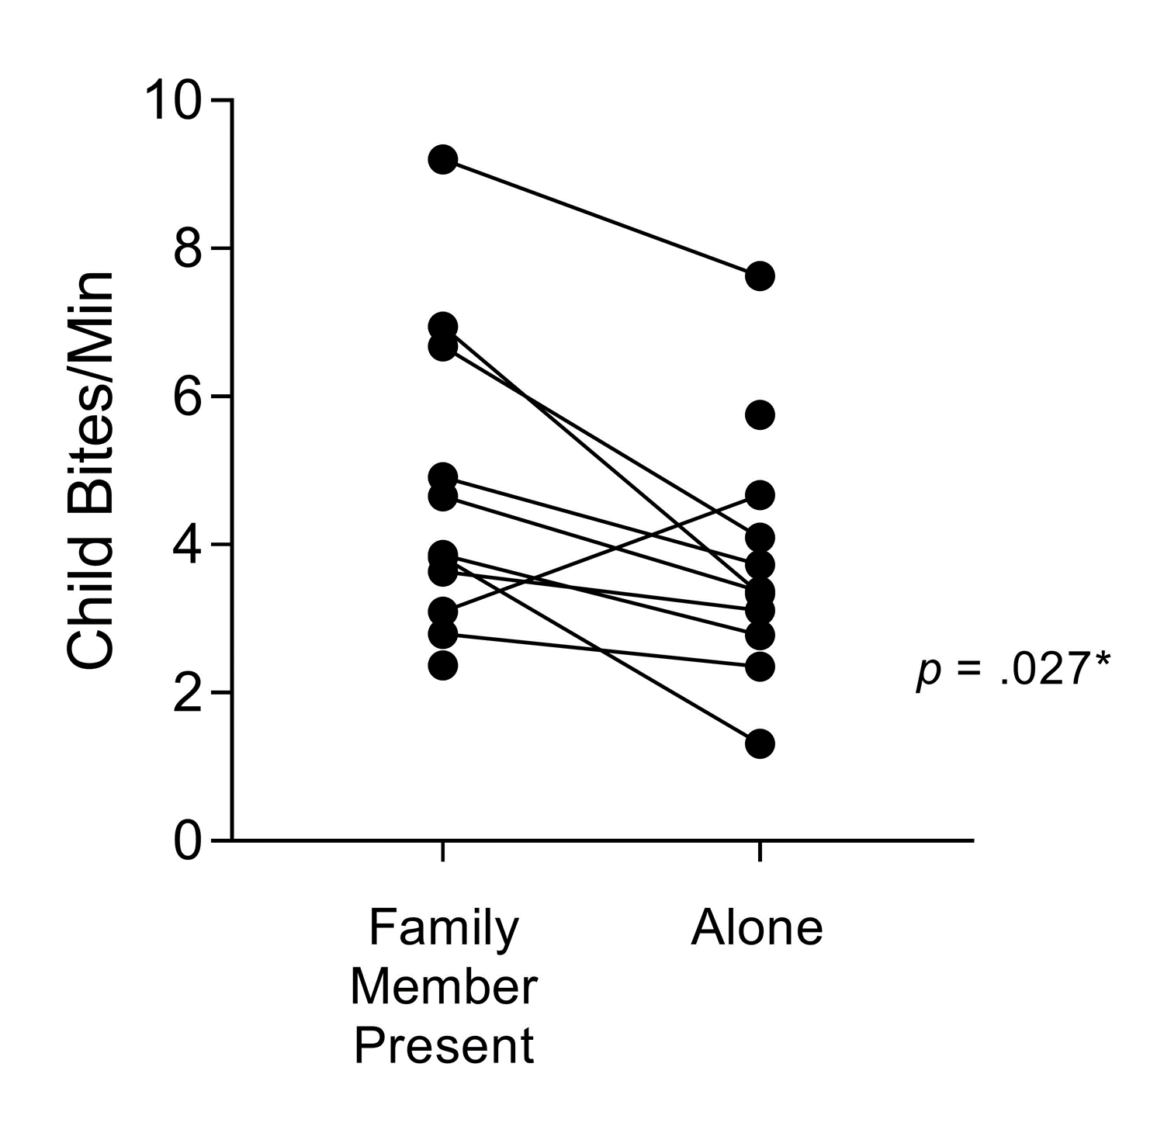
Wilcoxon matched pairs test: Comparing child bite rate within meals when family member is present vs absent
Notes:
We first analyzed the data by comparing bite rates from times when at least one family member was present to times when the child was eating alone. To do this, we conducted a Wilcoxon matched pairs test, which is the nonparametric equivalent to a paired t-test.
In the figure here, the x-axis denotes when family members were present vs. absent during the meal. The y-axis denotes child bite rate at these times.
The lines connect data points obtained from the same meal. There are two data points without connecting lines, indicating that a family member was present for the entire meal (point) or absent (point). These data were not included in the analysis, but they are on the graph to depict all data from meals.
As you can see, the majority of the meals contained both times when the child ate alone and with another family member present, and so the paired test provides more power to detect the effects of family member presence on bite rate due to assuming less variability between the paired data.
We found a significant difference in child bite rate when family members were present versus absent, with a higher bite rate when family members were present. From the graph, you can visually see this trend within meals.
This is an interesting finding, but we wanted to find out little more as to why this was the case…

Slide 14
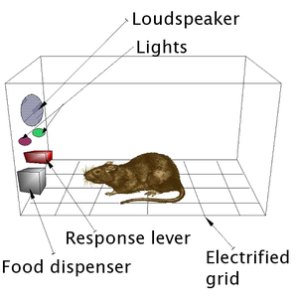
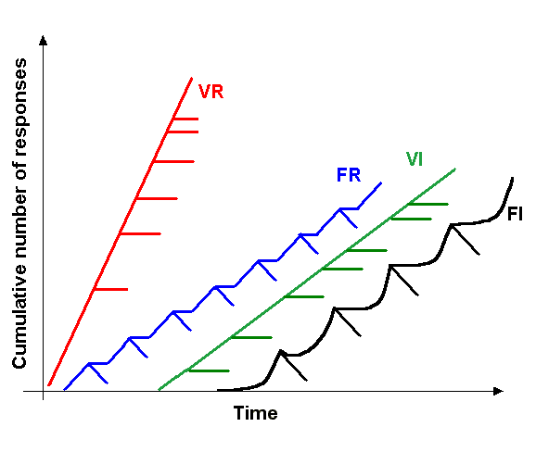
Cumulative Records
Notes:
So, we turned to cumulative records.
As you may remember from your Intro Psych classes, cumulative records were created by B. F. Skinner as a method to view and record rates of simple responses of animals like rats and pigeons being studied in operant chambers. With them, you can have a clear visual representation of the rate of a behavior in real time, and how rates changed in response to environmental events, such as reinforcement.
In this graph, you can see when behaviors are being reinforced by the marks protruding from the sloped lines and how that causes the behavior to change. For example, the red line has a higher slope which means that the reinforcement schedule resulted in a higher rate of the behavior. And the black line has a lower slope which means that schedule of reinforcement resulted in a lower rate of the behavior.

Slide 15
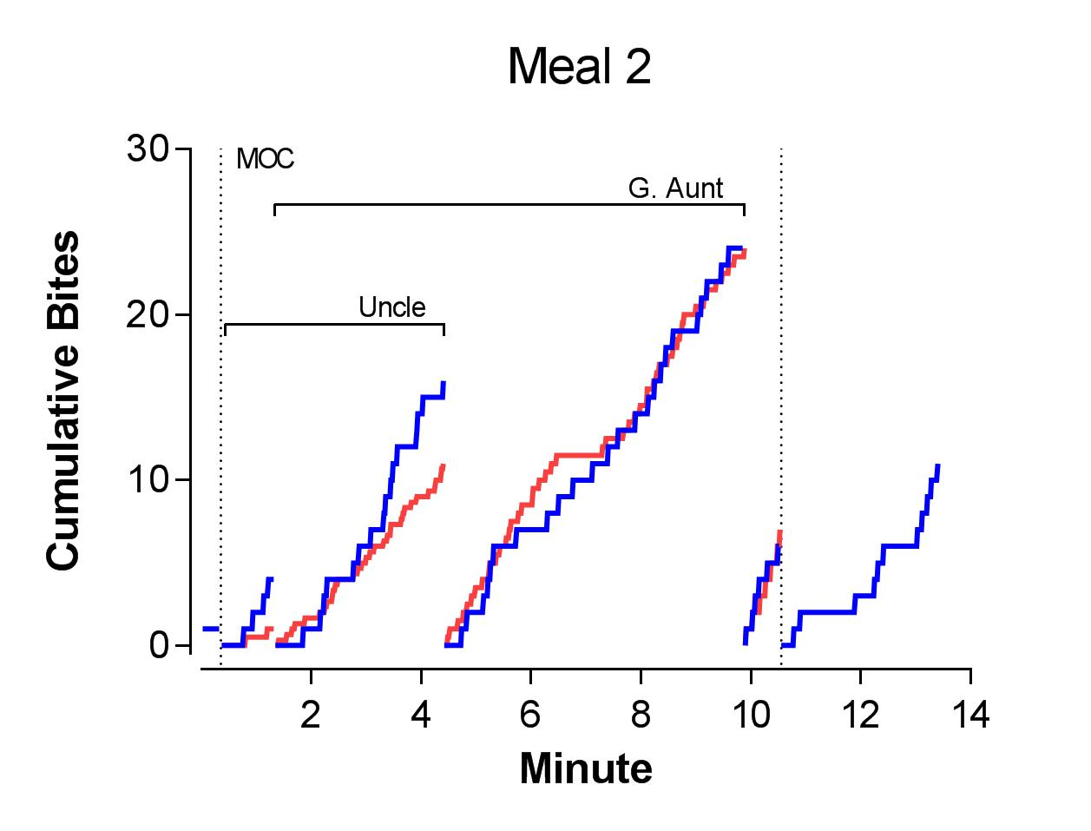
Notes:
This cumulative record depicts child and family member bites during a single meal. The x-axis represents the duration of the meal in minutes and the y-axis is the cumulative bites occurring throughout the meal.
The blue line depicts child bite rate and the red line depicts the average family member bite rate. The higher the slope of the line, the higher the bite rate and the lower the slope, the lower the bite rate.
Cumulative totals reset when the number of family members present changed. The vertical lines denote a change between at least one family member present vs. no family member.
The names on the graph show which family member was present. Family member names without a bracket signify that the member was present for the entire time and the brackets represent family members that were only there during that section of the meal.
So here we see the meal starts with the child eating alone and then the mom and uncle join the meal. Soon after the great aunt joins and so the cumulative records reset back to 0. This happens again when uncle leaves the meal and when the great aunt leaves. After about 10 minutes the mother, who was the last family member present, leaves and the child is left to finish the meal by himself.
As you can see, the slopes of the red and blue lines overlap for the majority of the meal, indicating similar bite rate between child and family members. The slope when the child is alone also appears lower than when family members were present.

Slide 16
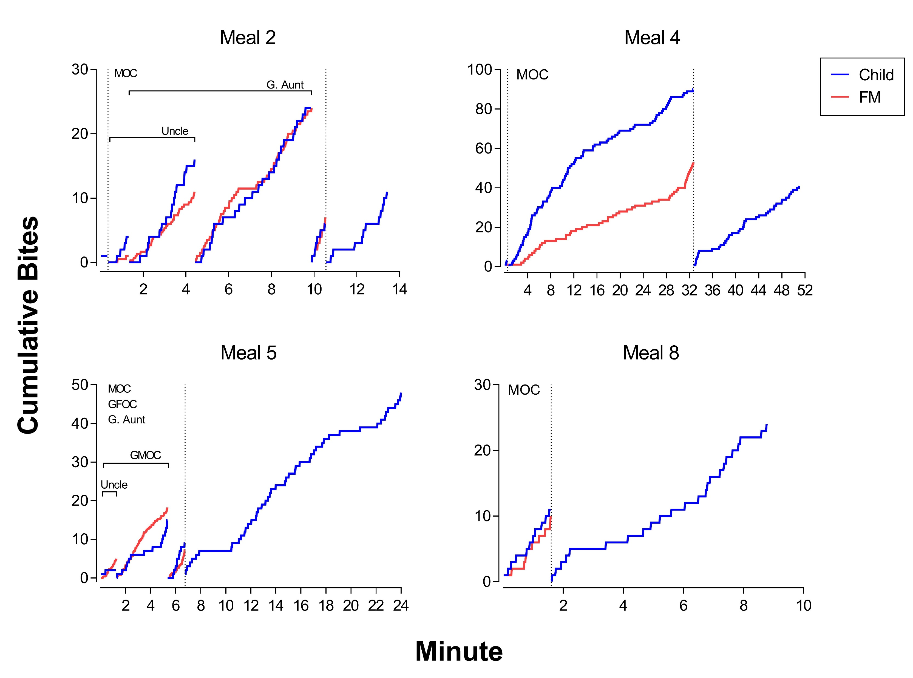
Notes:
Here are graphs for the first four meals in which the parent and child ate similar food, including the graph from the previous slide.
These cumulative records are purely observational, so we did not manipulate any variables but still found some relations between family member and child bite rate.
As you can see, the slopes overlapped much of the time.
This relation doesn’t appear to hold as well for Meal 4. However, when we looked at the data a little more closely, the slopes looked more similar towards the end of the meal.

Slide 17
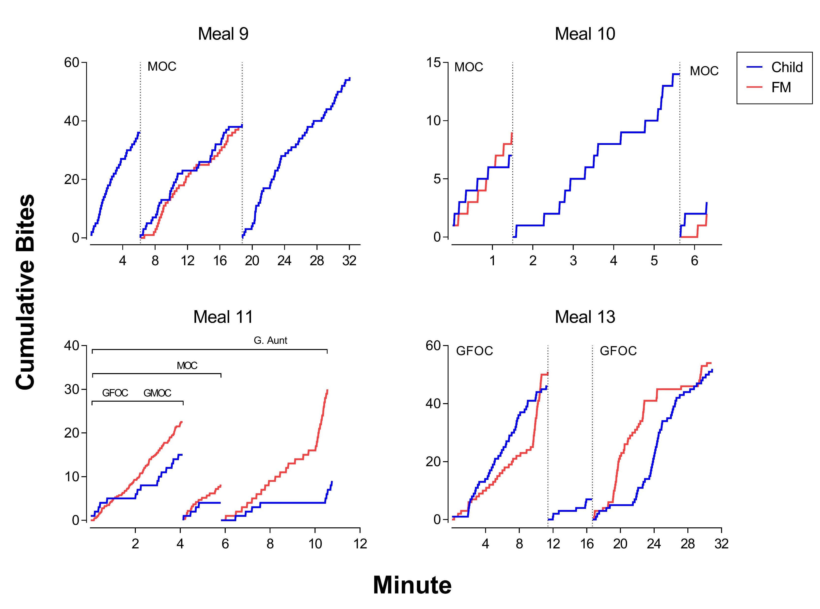
Notes:
Relatively similarly findings over these meals as well.
In meal 11, the lines do not seem to match very well but if you look past the long pauses for the child bite, the slopes seem to match relatively well in this case too.
In Meal 13, the rates don’t line up exactly, but you can clearly see the change in the child bite rate when the grandfather is present versus absent.

Slide 18
Discussion
Child bite rate matched family member bite rate
Family member presence appeared to impact child bite rate
  Higher with family, low when alone
  Research relates higher BMI with eating faster
  → 4/5 family members=overweight—may have modeled high eating rates for child
Obesity treatments?
If treatment efforts include reduction of child bite rate, family level intervention may be needed.
Notes:
From the results, it appeared that family member presence influenced child bite rate. The child generally ate faster when family members were present and slower when alone.
In addition, child bite rate appeared to frequently match family member bite rate, which is consistent with results from previous studies in adults.
We were somewhat surprised to see that child bite rate was higher when eating with family members, given previous findings of lower child BMI being associated with eating as a family. A possible explanation is that previous research has observed higher bite rates in adults with higher BMIs, and 4 of the 5 family members in the study were overweight. As such, the family members may have modeled higher rates for child eating.
These results suggest that if treatment for child obesity involves attempting to reduce bite rate, it may be important to include all family members in the intervention.

Slide 19
Limitations
Potentially confounding factors
  E.g. social cues, types of food
Small sample size=results are not generalizable
Low variability in sample
  Could not evaluate: specific family members, number of family members present
Notes:
There were a number of limitations of the study that should be noted.
Because this was a purely observational study, potentially confounding factors such as social cues (likes prompts to eat) and types of food were neither controlled nor measured. This means that other factors may have influenced the obtained results.
Due to the nature of a case study, results are not generalizable.
Specific family members and total number of family members present could not be evaluated due to low variability in sample.

Slide 20
Future Directions
More participants → assess generality
Gain more info on social influence on child bite rate
  Manipulating family member variables (e.g., parent bite rate, position in relation to child)
  Control meal variables (e.g., type of food)
Notes:
In order to determine the generality of these findings, more participants are needed for future investigations.
Gaining more information on social influences on child bite rate could be done by doing things like manipulating family member variables such as parent bite rate and position in relation to child while controlling meal variables such as type of food in the experimental preparations.

Slide 21
References
1. Bergmeier, H., Skouteris, H., & Hetherington, M. (2015). Systematic research review of observational approaches used to evaluate mother-child mealtime interactions during preschool years. American Journal of Clinical Nutrition, 101, 7-15.
2. Wansink, B., & van Kleef, E. (2014) Dinner rituals that correlate with child and adult BMI. Obesity, 22(5), E91-E96.
3. Rosenthal, B., & McSweeney, F. K. (1979). Modeling influences on eating behavior. Addictive Behaviors, 4, 205-214.
4. Garlington, W. K. and Dericco, D. A. (1977), The effect of modelling on drinking rate. Journal of Applied Behavior Analysis, 10, 207-211. doi:10.1901/jaba.1977.10-207
5. Epstein, L. H., Parker, L., McCoy, J. F., McGee, G. (1976). Descriptive analysis of eating regulation in obese and nonobese children. Journal of Applied Behavior Analysis, 9(4), 407-415.

Slide 22
Thank you!
Questions?
Notes:
I would like to say thank you to everyone a part of and who sponsored the 2018 PURPLE Program. A big thanks to Merlin, Emmaly and Robert for all the support through the 12 weeks. Thank you to the sponsors: Dr. Dominique Martinez (Office of Diversity and Inclusion) and Dr. Douglas Novins and Dr. Jennifer Hagman (PMHI). And a giant thank you to Dr. Miller for being so patient with all my questions and for his guidance throughout my project—could not have done it without you! I learned so much information throughout the course of the program in terms of Dr. Miller’s specific research and the research process in general. This program has made me even more excited to continue pursuing my career in psychology and for the research I will conduct in the future.

