Slide 1
Identifying Pregnancy Related Depression and Psychosocial Concerns in Pediatric Primary Care
Austin Chavez, Ryan Asherin, PhD, Shengh Xiong, B.S.,& Ayelet Talmi, PhD
Thursday, August 9, 2018
Denver Seminar Room| Gary Pavilion
Notes:
Introduce self
CU Denver, Junior, majoring in PBHL, pre med track
Project CLIMB under Drs. Talmi and Asherin

Slide 2
Project CLIMB
Consultation Liaison in Mental Health and Behavior
Provides comprehensive, integrated mental health services to children and families seen in an urban academic pediatric primary care clinic.
The team provides consultation, screening, and treatment as well as triage, refer, and coordinate behavioral health care with the primary care team as well as community-based resources.
Notes:
Elaborate. integrated mental health services to children and families

Slide 3
The Team
Supervising psychologists
Part time psychiatrists
Psychology trainees
Psychology fellows
Psychology interns
Psychiatry trainees
Part time Developmental Pediatrician
Notes:
Don’t spend too much time here.
Transition to what they work with…. PRD- next slide.

Slide 4
What is Pregnancy Related Depression (PRD)?
Major depressive episodes likely due to major biopsychosocial changes.
Mothers might feel unconnected to their baby, as if they are not the child’s mother, or may not love or care for the baby.
Different than the “baby blues”.
Symptoms of PRD are much more serious and are more chronic, which can last up to a year.
Lasts longer than the baby blues.
Notes:
American Pregnancy Association signs of PRD include:
-persistent sadness
-difficulty concentrating
-sleeping too much or too little
-feelings of guilt or worthlessness
-anxiety
-thoughts of death, suicide, and helplessness
-changes in eating habits

Slide 5
Why is PRD important?
With a prevalence rate of 10% - 15%, PRD is a global health problem (Rogathi et al., 2017).
PRD is the most common complication when it comes to childbearing (Robertson et al., 2004).
Nearly 14% of women in the U.S. experience PRD within the first year following the birth of their child (Chaudron et al., 2010)
The prevalence rate in the Child Health Clinic at Children’s Hospital Colorado is 11%.
Maternal mental health affects child health and development (Kerker et al., 2016).
Notes:
AS we see, this impacts a lot of women, and a population that is raising a very dependent population

Slide 6
How are Psychosocial Factors Related to PRD?
Socioeconomic status, low levels of social support, all forms of Intimate Partner Violence (IPV), fewer years of schooling, unemployment, low income, financial strain, lower social status, or experiencing a stressful life event have been associated with PRD symptomology. (Robertson et al., 2004; Rogathi et al., 2017; Mundorf et al., 2017).
Strongest predictors of PRD include stressful life events and low levels of social support (Robertson et al., 2004).
Moderate predictors include marital status of mother (closely linked to social support) and SES (Robertson et al., 2004).
Notes:
All this background and past literature led me to the questions and objectives of my research with the PURPLE program

Slide 7
Objectives
Determine if psychosocial concerns vary by pregnancy related depression status (elevated or not elevated) at two months postpartum as measured by the Edinburgh Postnatal Depression Scale (EPDS) and Psychosocial Screener.
Determine if additional screening for depression using a Psychosocial Screener increases the number of patients identified with depressive symptomology when compared with identification using only the EPDS.

Slide 8
Hypotheses
Among women with elevated EPDS scores, their responses on the psychosocial screener will be more likely to identify concerns about social support, low income, food insecurity, financial strain, intimate partner violence, and experiencing a stressful life event.
Using two depression screeners, the EPDS and the Psychosocial Screener, will capture postpartum women with depressive symptoms who may have been missed if they only completed one screener.

Slide 9
Methods
Electronic Medical Records (EMRs) from 1/17/17-12/20/17 of patients were abstracted for demographics, EPDS score, and psychosocial screener responses.
Measures:
Edinburgh Postnatal Depression Scale (EPDS): 10-item questionnaire
The psychosocial screener: 14-item questionnaire
SPSS was used to conduct Chi-Square analyses examine psychosocial concerns among mothers with elevated and non-elevated EPDS screener.
Notes:
The EPDS- used to screen mothers for symptoms of depression during the first 4 months after birth.
Psychosocial- used to screen families for psychosocial resource needs, mental health, and adverse or traumatic experiences.
The next two slide elaborate on them and I discuss them in detail.,

Slide 10
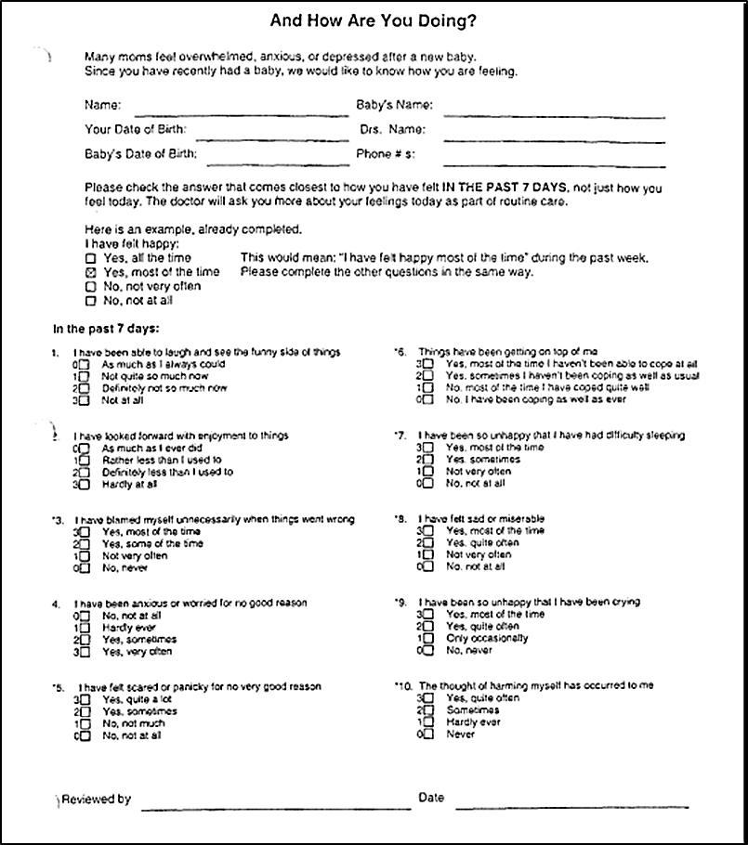
Edinburgh Postnatal Depression Scale (EPDS)
Given to caregivers of patients between ages 0-4 months
10-item questionnaire screener
Scale score of 0 (min) – 30 (max)
Elevated EPDS Score (≥10) → High Risk of PRD
Non-Elevated EPDS Score (<10) → Low Risk of PRD
Notes:
I have been anxious or worried for no good reason,
I have been so unhappy that I have been crying,
The thought of harming myself has occurred to me,
I have felt sad or miserable

Slide 11
Psychosocial Screener
Given to caregivers of patients at every well-child check
14-item questionnaire
One answer “yes” → positive psychosocial screener result
Notes:
“Have you or your child recently been threatened, hit, or touched in any unwanted way?”,
“Do you feel sad, hopeless, or anxious a lot of the time?” 14a
“In the last 12 months, did your food ever not last and you didn’t have the money to get more?”
“In the last 12 months, did you ever feel stressed about making ends meet? ”

Slide 12
Demographics
Gender | N | Percentage
Female | 245 | 46%
Male | 288 | 54%
Ethnicity
Hispanic/Latino | 195 | 37%
Not Hispanic/Latino | 322 | 60%
Not Reported | 16 | 3%
Race
White | 142 | 27%
Black/African American | 159 | 30%
Other/Not Reported | 232 | 44%
Language
English | 413 | 77%
Spanish | 48 | 9%
Other/Not Reported | 72 | 14%
Insurance
Public (Medicaid, CHP+) | 431 | 81%
Private (Contract) | 72 | 14%
Self-Pay | 26 | 5%
Tricare | 4 | 1%
Notes:
Over 50% had a race of not Hispanic/Latino.
Second reported language was Spanish at 9% and third was Burmese at 2%. Somali and Arabic were next. However this dataset included 20 different languages .
Insurance: CHC is mainly seeing families with public insurance because of the population that is seen. Ex- low income/SES patients and families
Animate arrows

Slide 13
Sample
Sample
945 patient charts from 2-month old Well-Child Check visit in 2017
801 patients charts with a completed EPDS Screener
533 patient charts with a completed EPDS Screener and Psychosocial Screener
SPSS was used to conduct Chi-Square analyses examining psychosocial concerns among elevated and non-elevated mothers according to the EPDS screener
Elevated EPDS Score
16 patients
Non-elevated EPDS Score
517 patients

Slide 14
Results
533 patients had EPDS scores, completed Psychosocial screeners, and were categorized based on elevated (n=16) or non-elevated (n=517) EPDS scores.
Compared to patients with non-elevated scores, patients with elevated EPDS scores reported more concerns about:
finding a doctor
making appointments
making ends meet
food insecurity worry
food shortage occurring
worry of benefits
needing support
and feeling sad, hopeless, and anxious a lot of the time
None of the differences were statistically significant.
Notes:
Relates to 1st objective of seeing if psychosocial concerns vary by pregnancy related depressive status

Slide 15
Results continued
N=533
yes=16
yes=3
no=13
no=517
yes=65
completed EPDS and Psychosocial Screener at 2 month WCC
Elevated EPDS score
Positive Psychosocial screener
no=452
+14a
yes=1
no=2
yes=5
no=63
The Psychosocial Screener (item 14a) identified an additional five women with depressive symptomology who did not report elevated scores on the EPDS.
14a: “Do you feel sad, hopeless, or anxious a lot of the time?”
Notes:
Relates to second objective of if adding another screener actually identifies more mothers with depressive symptomology and indeed we found that it does.

Slide 16
Discussion
Women with an elevated EPDS score did not report significantly more psychosocial concerns than women who did not have elevated EPDS scores.
However, percentage trends illustrated higher psychosocial needs being identified by those with depressive symptoms.
Using a second measure with questions about depression, an additional five mothers were identified in primary care.

Slide 17
Limitations/Future Directions
The current study used electronic medical record abstraction that relies on the correct documentation of screening results.
The sample size for mothers with an elevated EPDS and a positive psychosocial screener was small (n=3), which made finding differences between the two groups difficult.
Future research could examine a larger sample size for relationships between PRD and psychosocial concerns. Additionally, these findings could be compared to primary care settings that only use one screener.

Slide 18
References
Chaudron, L. H., Szilagyi, P. G., Tang, W., Anson, E., Talbot, N. L., Wadkins, H. I., . . . Wisner, K. L. (2010, March 01). Accuracy of Depression Screening Tools for Identifying Postpartum Depression Among Urban Mothers. Retrieved June 4, 2018, from http://pediatrics.aappublications.org/content/125/3/e609
Burnett, B. (2017) It’s Complicated! Social Determinants of Health, Patient Complexity Tiering, and Behavioral Health Integration in Pediatric Primary Care. Retrieved June 2018. Pediatric Academic Societies Annual Meeting, San Francisco, CA.
Kerker, B. D. (2016). Identifying maternal depression in Pediatric Primary Care: Changes Over a Decade. Journal of Developmental and Behavioral Pediatrics, 37(2), 113-120. Retrieved June, 2018, from https://www.ncbi.nlm.nih.gov/pmc/articles/PMC5545806/.
Mundorf, C. (2017) Reducing the risk of Postpartum Depression in Low-Income Community Through a Community Health Worker Intervention. Maternal and Child Health Journal, 22(4), 520-528. Retrieved June, 2018, from https://link.springer.com/article/10.1007/s10995-017-2419-4
Robertson, E., Grace, S., Wallington, T, & Stewart, D.E. (2004). Antenatal risk factors for postpartum depression: A synthesis of recent literature. General Hospital Psychiatry, 26(4), 289-295. Retrieved June, 2018, from https://www.sciencedirect.com/science/article/pii/S0163834304000398.
Rogathi, J. J. (2017). Postpartum depression among women who have experienced intimate partner violence. Journal of Affective Disorders, 218, 238-245. Retrieved June, 2018, from https://www.sciencedirect.com/science/article/pii/S0165032716322650.

Slide 19
Acknowledgements
PMHI Mentors
Ayelet Talmi, PhD and Ryan Asherin, PhD
Pediatric Mental Health Institute (PMHI)
Merlin Ariefdjohan, PhD, MPH
Emmaly Perks, MA
Douglas Novins, MD
Dominic Martinez, Office of Diversity and Inclusion, CCTSI, UCD
Jennifer Hagman, MD
Research Team
Amanda Millar B.A.
Shengh Xiong B.S.
PURPLE Interns
Maria Torres
Kristen Torres
Eve Delao
Greer Dellinger
Bri Barkocy
Project CLIMB Team
Melissa Buchholz, PsyD
Bridget Burnett, PsyD
Lisa Costello PhD
Kim Kelsey, MD
Tamarah Rodriguez, MD, LPC
Celeste St. John Larkin, MD
Catherine Wolcott, PhD
Sadie Hasbrouck, PhD

